Slide 1
Submm VLBI toward Shadow Image of Super Massive Black Hole
Inoue, M.¹, Blundell, R.², Brisken, W.³, Chen, M.T.¹, Doeleman, S.⁴, Fish, V.⁴, Ho, P.^{1,2}, Moran, J.², Napier, P.³,
and the Greenland Telescope (GLT) Team
(¹ASIAA; ²CfA; ³NRAO; ⁴MIT Haystack Observatory)

Slide 2
Leading-edge interferometry system to see Event Horizon of SMBH
i = 10 deg.
i = 85 deg.
a = 0
a = 0.5
a = 0.999
Image simulation for an optically thick and geometrically thin disk. (R. Takahashi)

Slide 3
SMBH Shadow size
Rshadow ≈ 5 Rsch
Name | Shadow (μas) | Mass (10⁶M_{sun}) | Dist (Mpc)
Sgr A* | 50 | 4.1±0.6 | 0.008
M87 | 21 | 3600±1000 | 17.0
M31 | 18 | 180±80 | 0.80
M60 | 12 | 2100±600 | 16.5
N5128 | 7 | 310±30 | 4.4
Gultekin+ 09

Slide 4
SMBH Shadow size
Rshadow ≈ 5 Rsch
Name | Shadow (μas) | Mass (10⁶M_{sun}) | Dist (Mpc)
Sgr A* | 50 | 4.1±0.6 | 0.008
M87 | 39 | 6600±400# | 17.0
M31 | 18 | 180±80 | 0.80
M60 | 12 | 2100±600 | 16.5
N5128 | 7 | 310±30 | 4.4
#Gebhardt+ 11

Slide 5
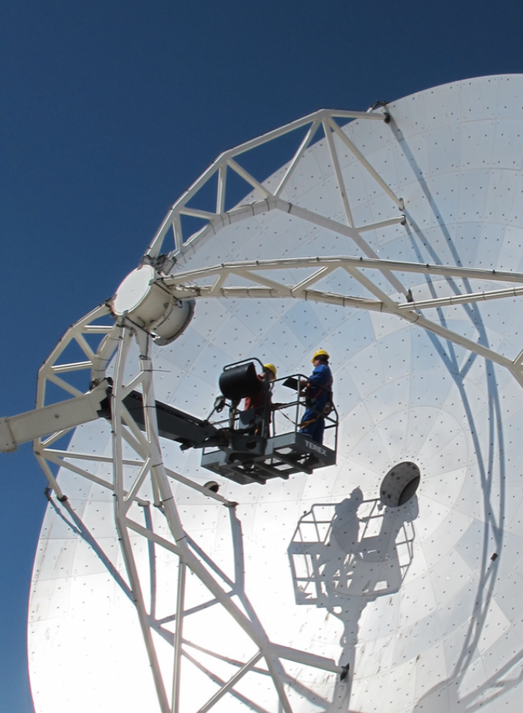
New submm Telescope Retrofitted ALMA-NA Prototype

Slide 6
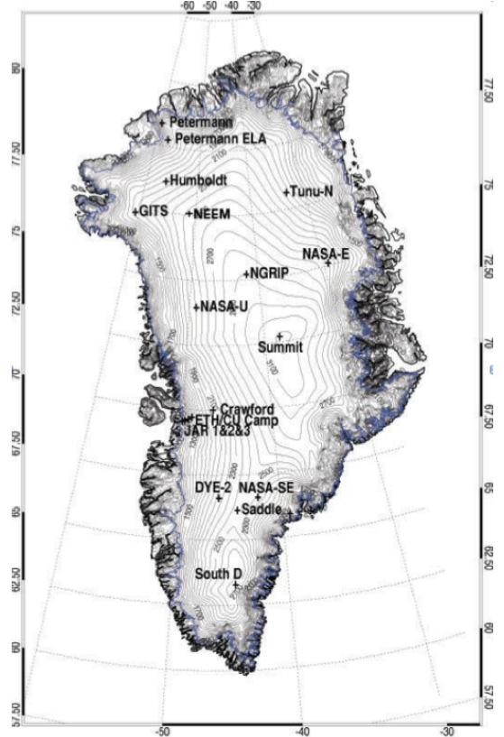
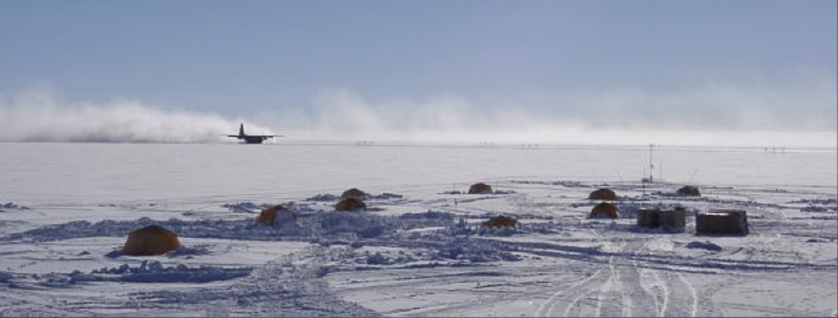
The Summit Station in Greenland
Established: 1989, height: 3,210m (72.60N, 38.42W)
NSF: Office of Polar Program, CH2M Hill, Cold Regions Res. & Eng. Lab., NOAA etc.
Population: 45 (Summer), 5 (Winter, 3 month shifts)

Slide 7
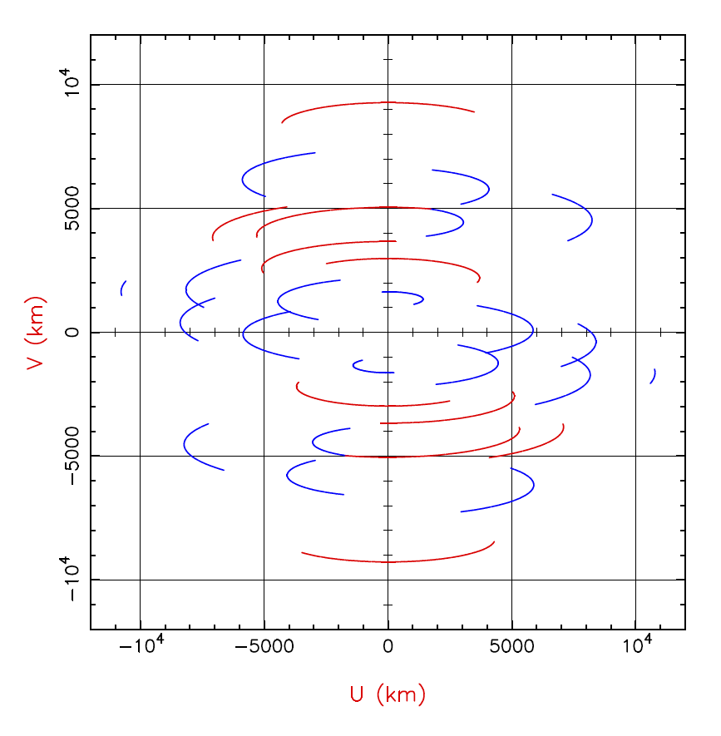
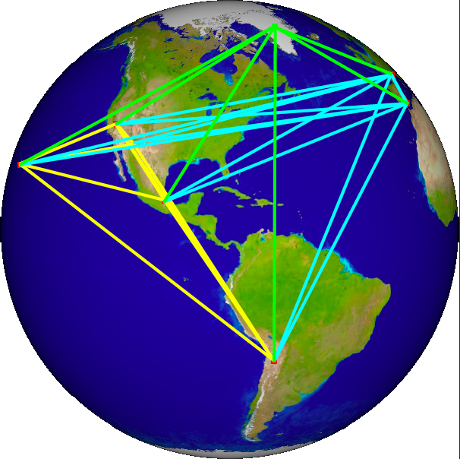
Long & multi BLs at 230 GHz
UV distribution for M87 at 230 GHz with SMA, ALMA, SMT, LMT, and IRAM 30m. Red lines are the GLT contributions.

Slide 8
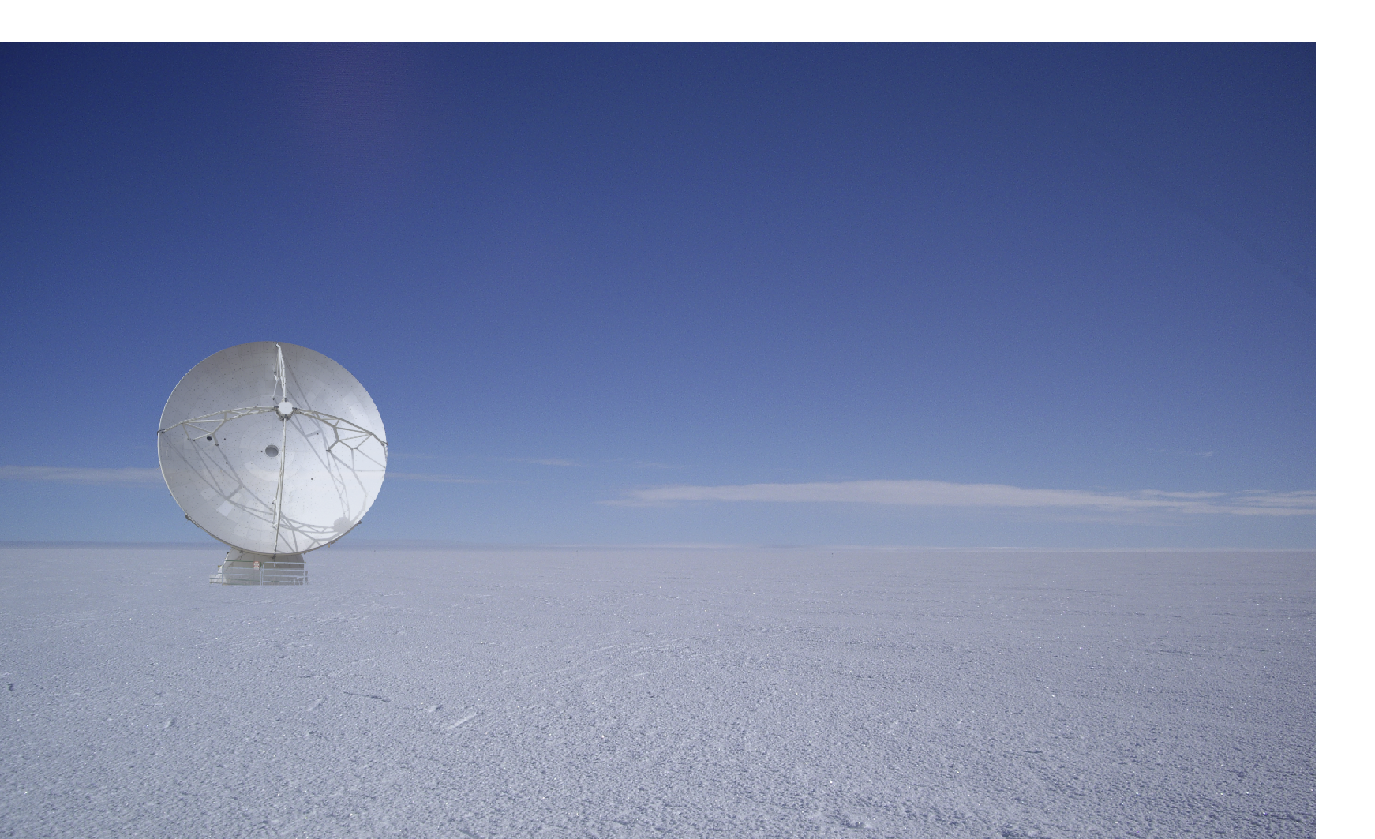
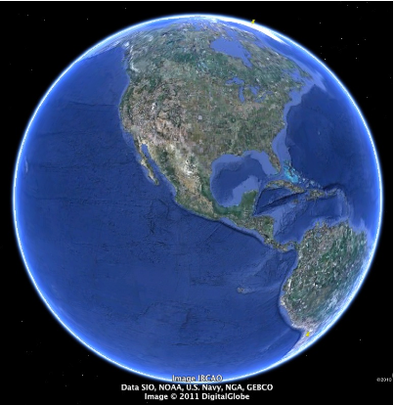
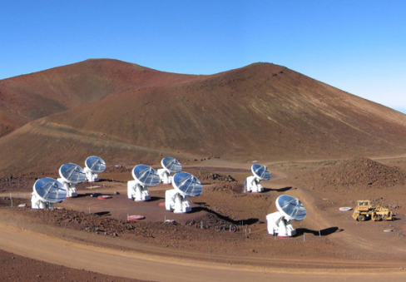
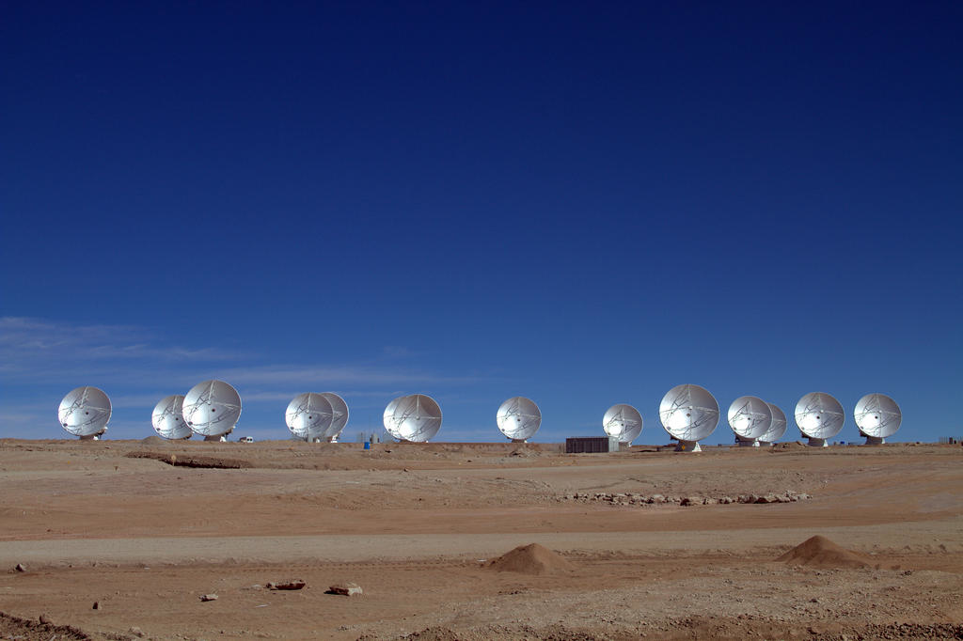
GLT Baselines at 350 GHz and higher
Greenland
GLT; artist's impression
Hawaii
Phased SMA
Chile
Phased ALMA
Baselines are 9,000 km long, and the resolution reaches 20 μas at 345 GHz.

