Slide 1
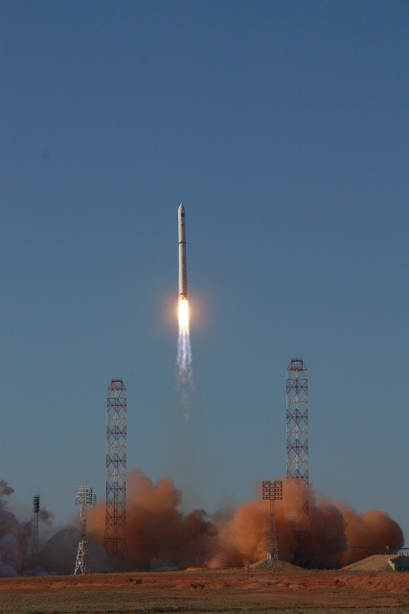


Space Radio Astronomy in the next 1000001₂ years
Leonid Gurvits
Joint Institute for VLBI in Europe, Dwingeloo, The Netherlands
Department of Astrodynamics and Space Missions, TU Delft, The Netherlands

Slide 2
In lieu of forward

Slide 3
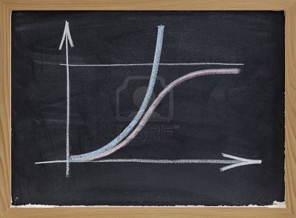
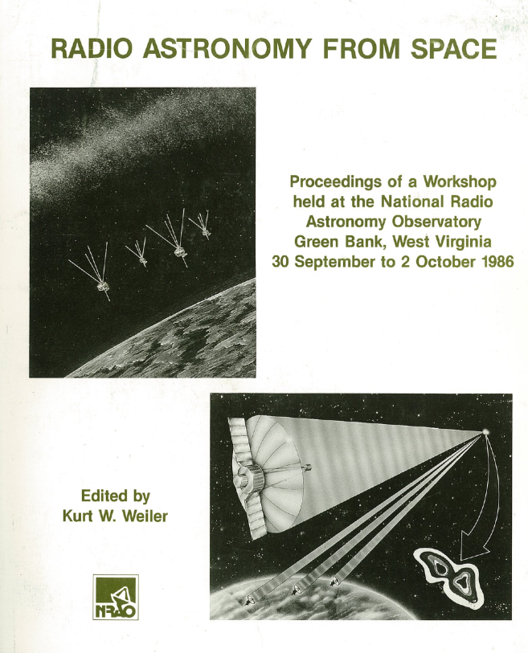
Predictions in science: to trust or …
Prediction of discoveries – a futile business
  but extrapolation of parameters is different
Growth of major instrumental parameters
  exponential (or power-law) so far (Pariiskii 2003)
  but must change to S-shaped at some point?
“Space” radio astronomy is an (almost) natural extension of Earth-based radio astronomy (unlike, e.g. high-energy astrophysics)
BUT
Only in radio, the size of Earth is a limiting factor
1965
2012
2065

Slide 4
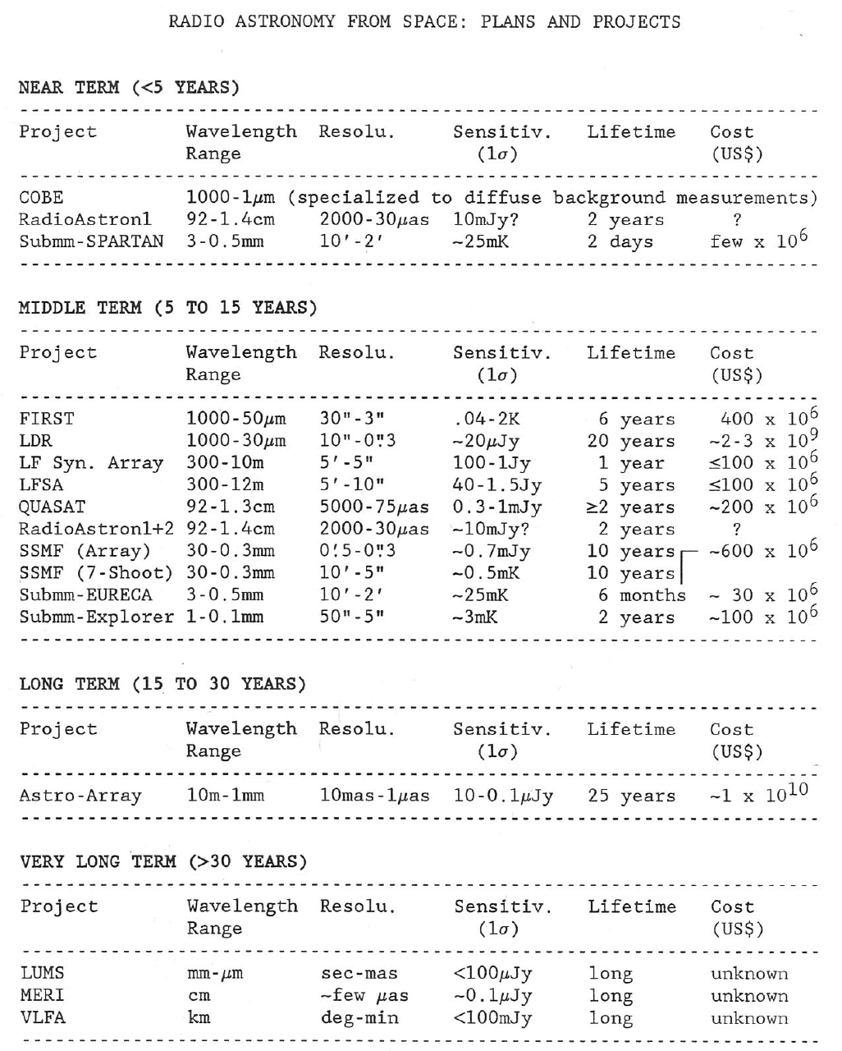
View from 1986:
On schedule!
+20 years
+10 years
But
VSOP-HALCA
WMAP
were not foreseen!

Slide 5
Benefits of being wise
End-to-end cost estimates – the Freiman (1983) Curve

Slide 6
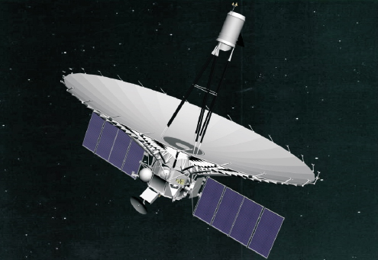
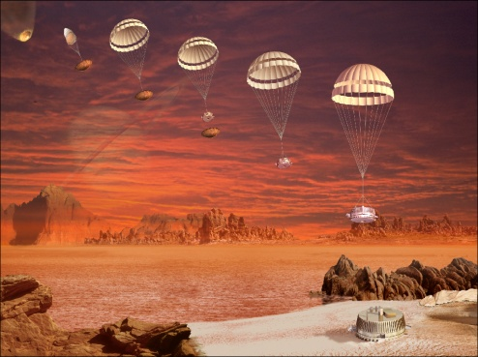
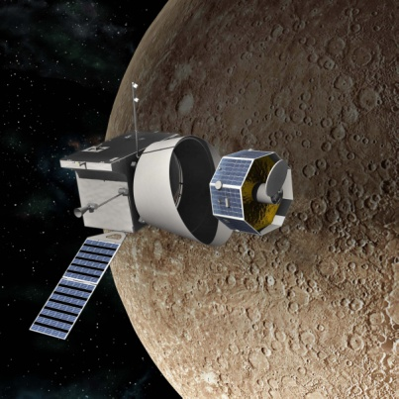
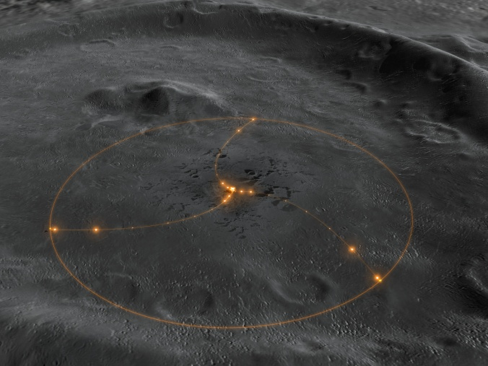
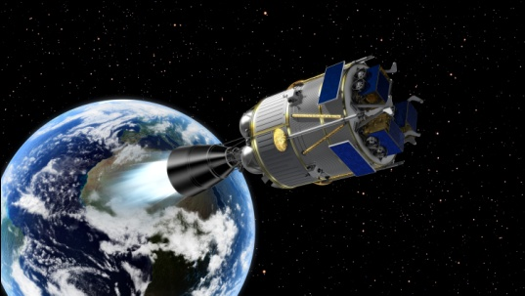
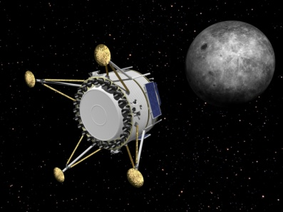
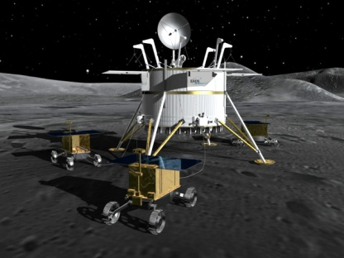
Many faces of “space” radio astronomy
Space-based CMB experiments (Relikt, COBE, WMAP, Planck)
VLBI in Space
VLBI tracking of planetary missions
Moon-based Ultra Long Wavelength
Astronomy (f<10 MHz)
NEXT

Slide 7
View from 1965
Matveenko, Kardashev, Sholomiytskii 1965, Radiophysics 8, 651

Slide 8
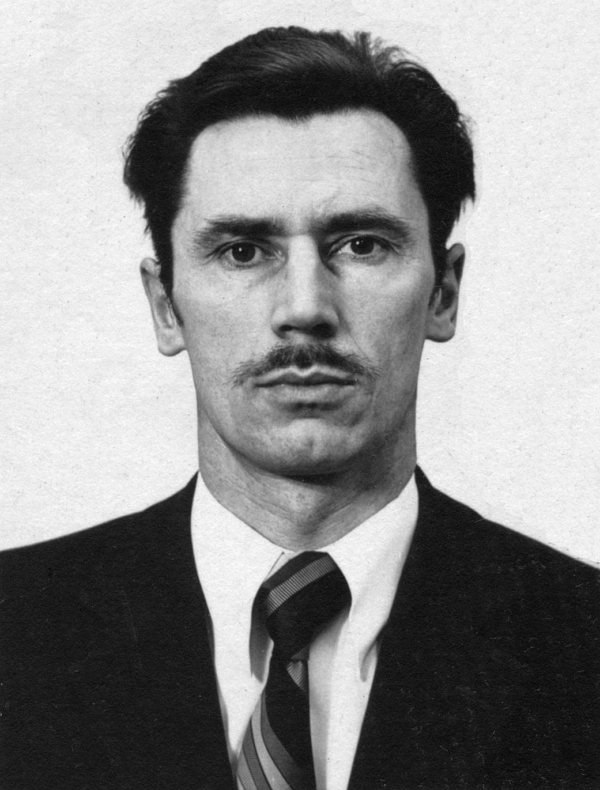
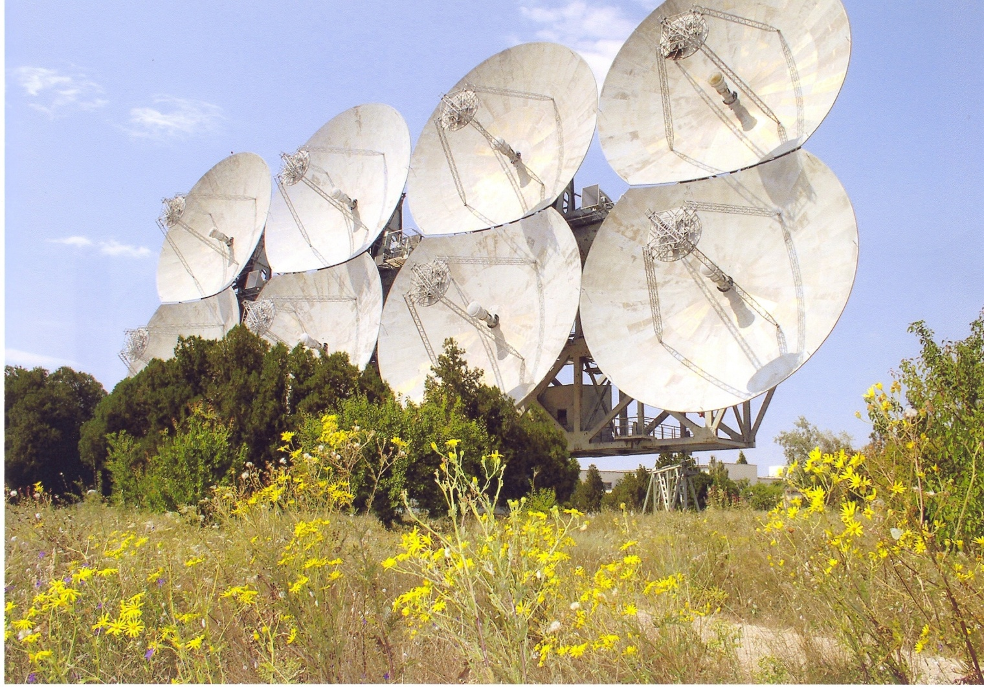
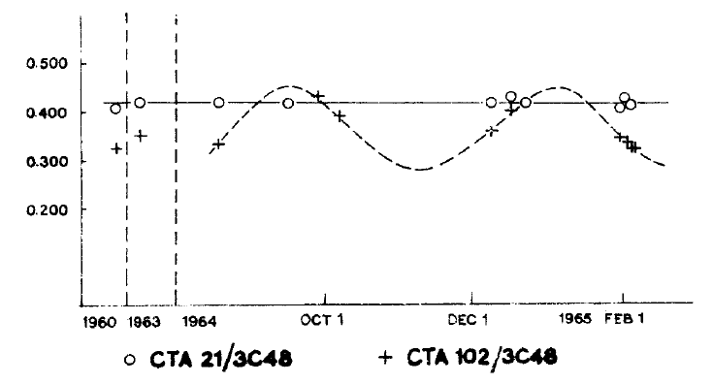
1965: precursors of VLBI (with space flavour)
Variability of CTA 102
G. Sholomitskii, 1965, IBVS 83

Slide 9
SVLBI:
the next decades

Slide 10
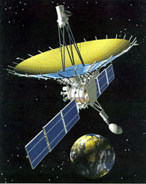
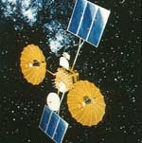
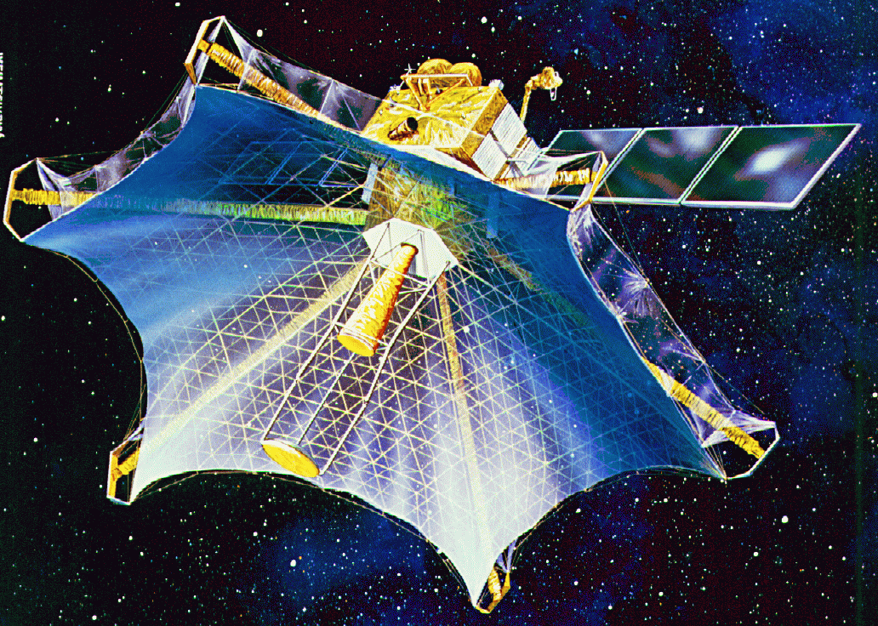
Three generations of VLBI in Space
1997-2016?
>2020
1986-88
?
Must be more sensitive!
RadioAstron, Ø 10m
TDRSS-OVLBI, Ø 5m
Broader band downlink
Is likely to be driven by industry:
10 Gbps by 2035?
Plus:
  KRT-30 (1978-82)
  QUASAT (1980s)
  IVS (1987-91)
  ALFA (1990s)
  (i)ARISE (2000s)
  VSOP-2/Astro-G
VSOP, Ø 8m

Slide 11
Science sociology of SVLBI
3 SVLBI telescopes in operation (from ~25 proposed)
Evolving science case
  Drive for extremely high resolution remains topical
Demography of (Space) VLBI:
    ~1500 professional radio astronomers in the world
    ~400 of them did/do VLBI
    ~200 of the latter ready to deal with SVLBI
    Need to appeal to broad scientific community!
Arguably, SVLBI is the most difficult space science activity...

Slide 12
Space VLBI ~2030: what to expect?
Today’s Space VLBI:
  Angular resolution – at the expense of sensitivity
    Both VSOP-HALCA and RadioAstron ~10 m antennas
Resolving the sensitivity bottlenecks:
  Larger apertures (at least 25 m)
  Broader band
    currently 128 Mbps, but must increase at least 30-fold
What is realistic?
Astrometric tasks (need for ultra-precise OD)

Slide 13
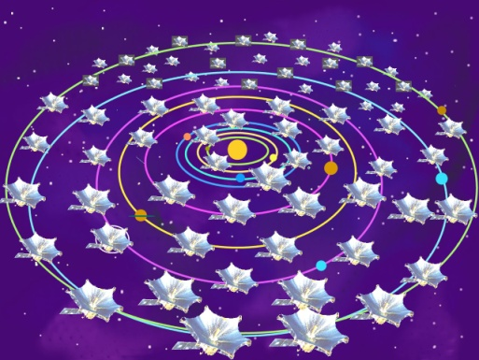
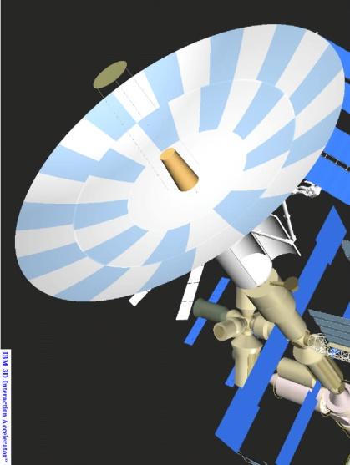
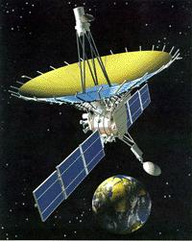

Global radio astronomy in XXI century
HH-SVLBI-20??
SVLBI_2-20??
SKA era
2025
RA-2011
2020
ALMA►
2015
SKA pathfinders
2010

Slide 14
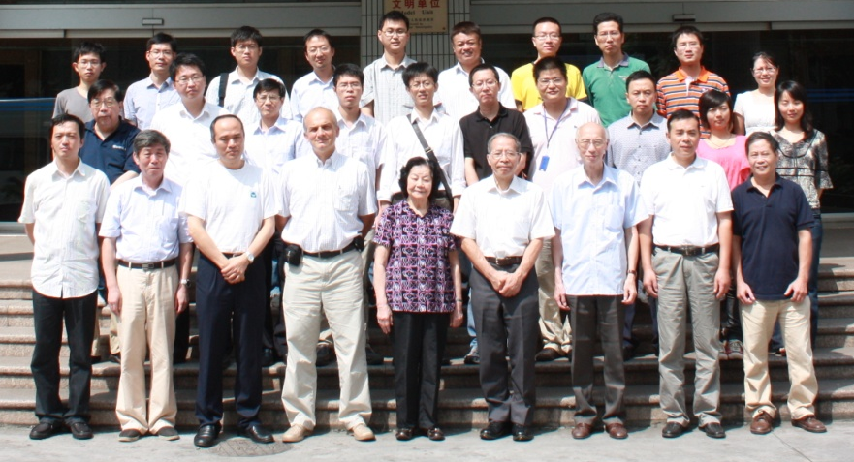
Second generation SVLBI: ideas 2012
Smaller high-frequency antenna
On-board recording (buffering) of data
Data to Earth through the same antenna (a-la Cassini)
or
Large lower frequency antenna assembled in low orbit
Low-thrust placement onto the operational orbit
Chinese SVLBI mission under
consideration
Ad-hoc brain-storming meeting during IAU GA 2012
Shanghai, 2011.09.13

Slide 15
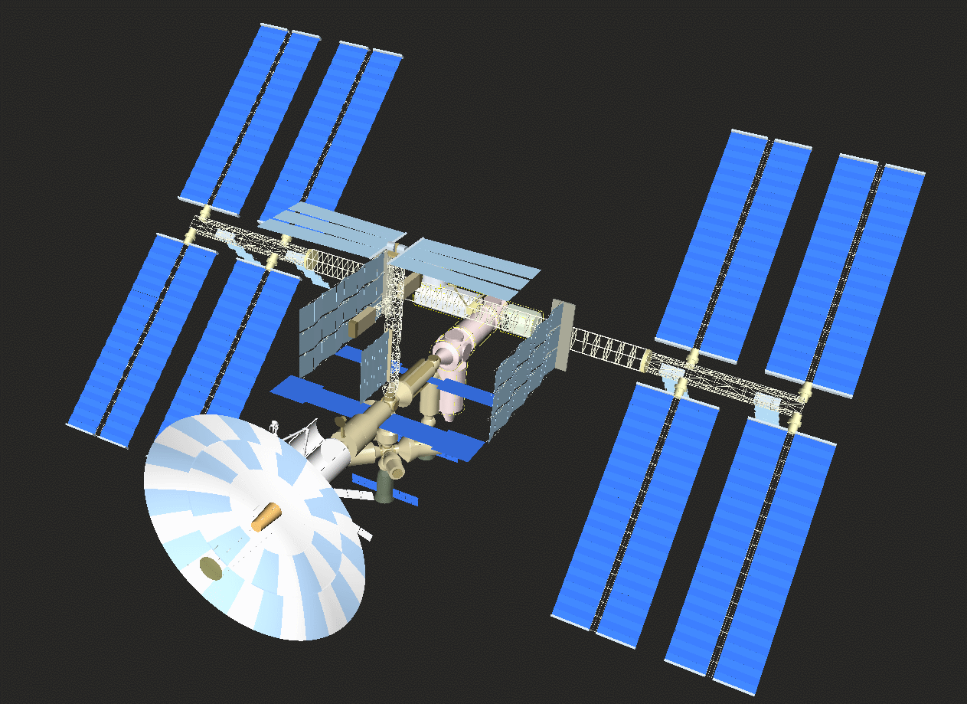
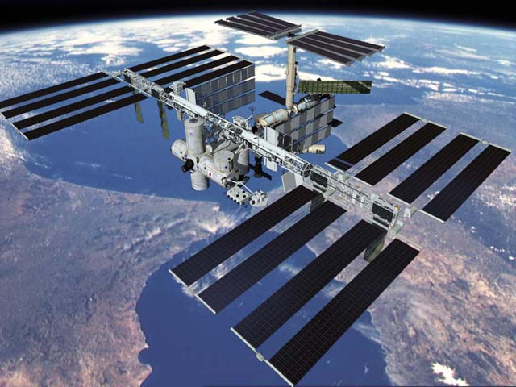
~60 SKA in orbit ($$$-wise…)

Slide 16
ISS as an assembly base
Mission scenario
Assembly at ISS
VLBI tests at docked position
De-docking
Low-thrust transfer to
operational orbit
EADS study 1998-2000

Slide 17

Traffic jam of space radio telescopes
Courtesy H. Hirabayashi
See also Yu. Pariiskii, “Fresnel Telescope”, Space VLBI technology, Sagamihara, 1989

Slide 18
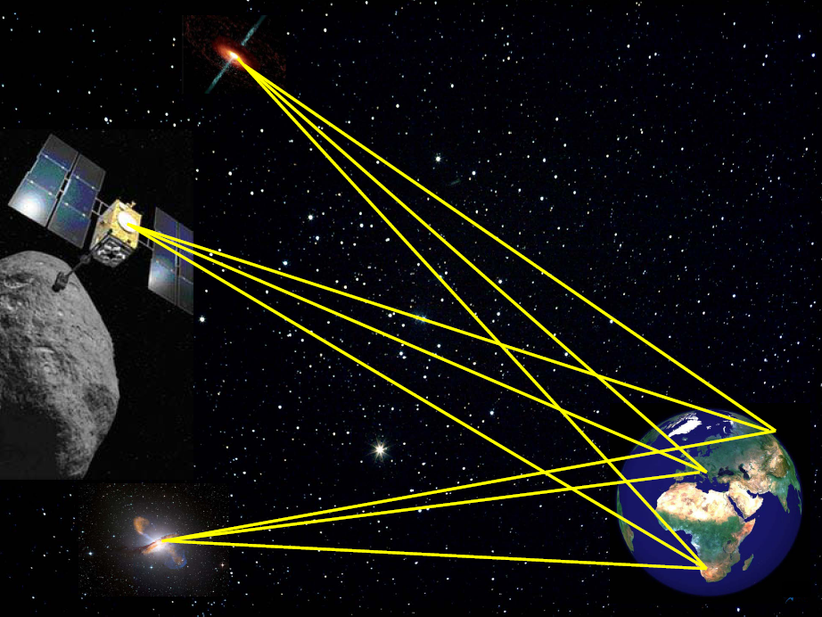
Near field VLBI
R ≈ B²/λ
Planetary
Radio
Interferometry &
Doppler
Experiment
3D astrometry of high T_{B} objects
T_{B} > 10¹⁸ K?
See also Pariiskii 1990, 2005
GPS accuracy anywhere in Solar System
Baseline | 100 km | 1000 km | 10⁴ km | 10⁵ km | 10⁶ km | 10⁷ km | 10⁸ km
Facility | MERLIN | EVN WE | EVN | R-Astron | L2 | - | ~1 AU
λ = 3 cm | 2 AU | 200 AU | 0.1 pc | 10 pc | 1 kpc | 100 kpc | 10 Mpc
λ= 30 cm | 3x10⁷km | 20 AU | 2x10³AU | 1 pc | 100 pc | 10 kpc | 1 Mpc
Astrometry of extragalactic pulsars?

Slide 19
SKA in space?
Not as crazy as it sounds…
Some engineering considerations:
Buyakas et al. 1979, An infinitely expandable space radio telescope,
Acta Astronautica 6, 175
Aperture array is expandable (by definition)
Advantages:
  Lighter structures in lower (or zero) gravity
  RFI shielding (e.g. Moon Far side)

Slide 20
Back to the Moon

Slide 21
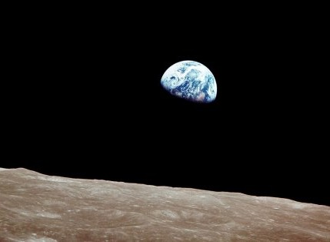
Moon – the next step for making a remote site accessible for astronomy and astrophysics?
Moon – the next step for making a remote site accessible for astronomy and astrophysics?
Stable ground: ideal for large interferometers
Almost free space: no disturbing atmosphere (ionosphere)
Radio quietness: A huge body to shield radio interference
Solid body in free space = `beam dump’ for particles
Moon is ideally suited for low-frequency radio astronomy
Stable ground: ideal for large interferometers
Almost free space: no disturbing atmosphere (ionosphere)
Radio quietness: A huge body to shield radio interference
Solid body in free space = `beam dump’ for particles
Moon is ideally suited for low-frequency radio astronomy
See:
  Jester & Falcke 2008, New Astronomy Reviews
  Mimoun et al 2011, Exp. Astronomy

Slide 22
