Slide 1
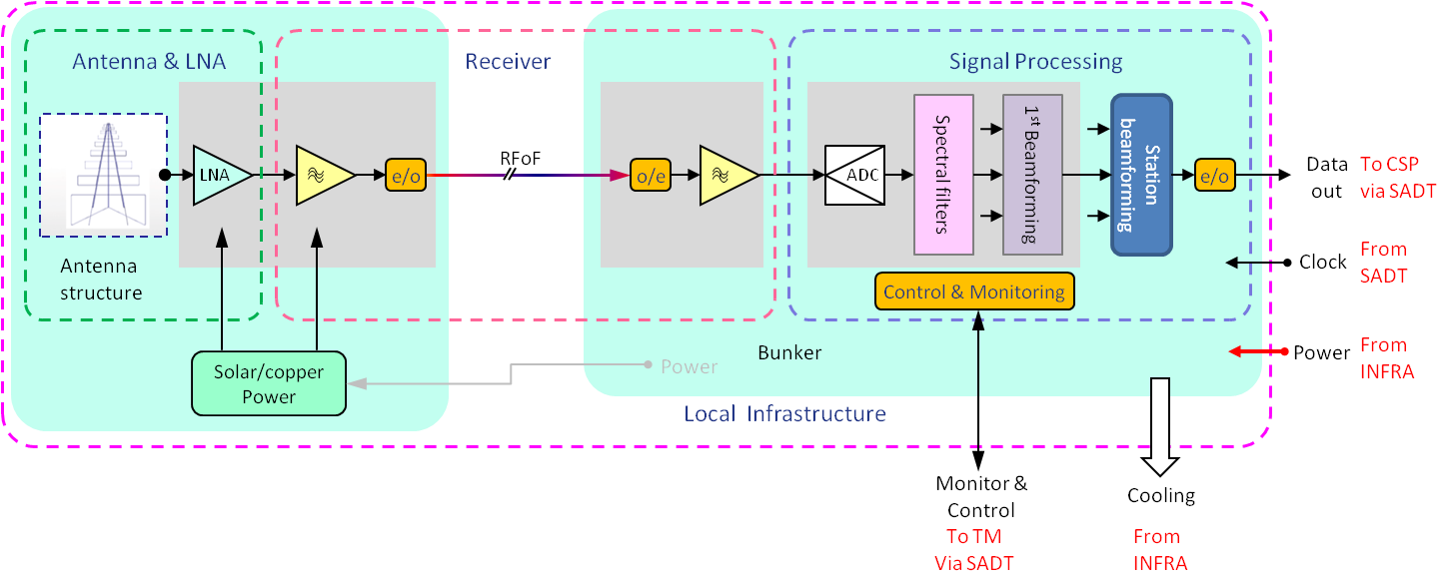
Infrastructure Interface – Power, cooling & building
Description
Building specification: # of racks,
Power: total and rack level reticulation
Cooling
No data connection.
Work on solar power @ antenna
T0: Outline requirements description, initial ICD
T0+12: Detailed ICD assuming architecture
PDR: Confirmed architecture, so firm ICD
.
Leadership: LFAA element
Other party: INFRA element
LFAA WP: SKA.TEL.LFAA.LINFR.PWR
Type: Direct
Classes: Electrical, Mechanical, Building
desc. physical i/face
Thermal
Safety aspects: yes
I/face specs by class: International standards and National (Australian) standards

Slide 2
CSP – Data transfer
Description
Data transfer of beams to Correlator
Time stamping and modes
Protocol through switches
T0: Baseline req’ts description, initial ICD
T0+12: Detailed ICD , with further options assuming architecture
PDR: Confirmed interface w/architecture, so firm ICD
.
Leadership: LFAA element
Other party: CSPelement
LFAA WP: SKA.TEL.LFAA.SP.ARC
Type: Indirect
Classes: Data exchange specifications
Safety aspects: no
I/face specs by class: International standards

