Slide 1
SKA Interface Workshop: Dishes External Interfaces
Thomas Kusel & Mark Bowen
For Dishes consortium
Manchester
June 2013

Slide 2
Overview of this presentation
Approach
SKA_MID Dishes external interfaces
SKA_SURVEY Dishes external interfaces

Slide 3
SKA Interface Workshop: 1) Approach

Slide 4
Foundation of interface definitions
Interface = boundary between “items”
“items” are defined in the Product Breakdown Structure (PBS)
Thus: the PBS is the foundation for all interface definitions. Without an agreed PBS, interface definitions are unstable.

Slide 5
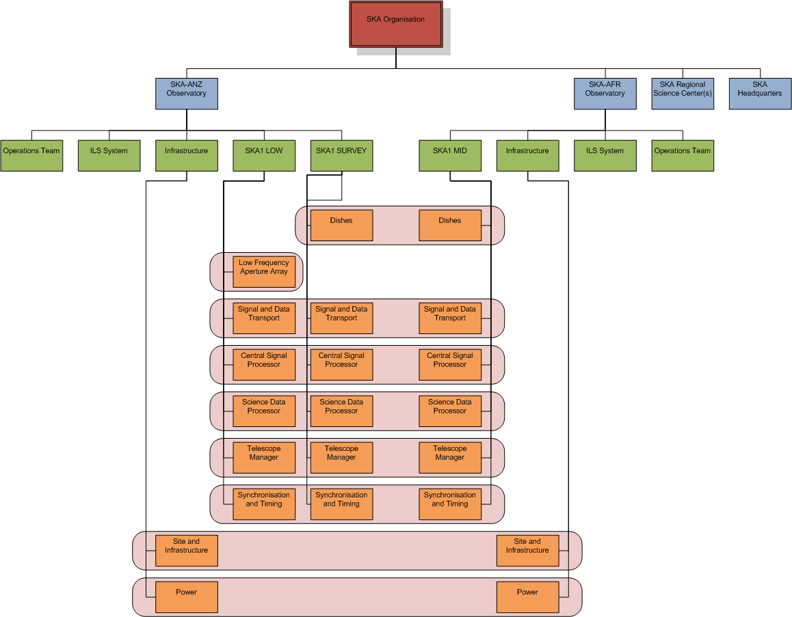
Assumed SKA1 PBS

Slide 6
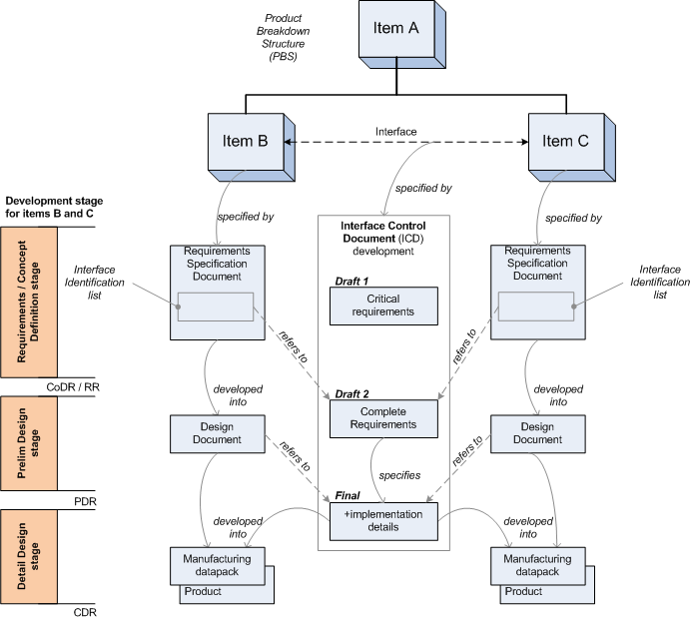
Developing ICDs
Iterative approach, following the product development stages.
(adopted by a number of consortia)

Slide 7
Developing ICDs
Concept stage:
Agree the critical requirements and implementation details first:
Architecture drivers.
Cost, performance & schedule drivers.
Notes:
It strikes me we haven’t done this stage properly yet. However it should have been done before the CoDR? I guess we haven’t done the requirements review yet! I guess the point is it appears that we have a bit of catching up to do.
Yes, you will see in the SEMP we have included a CoDR milestone to cover this catching up work.

Slide 8
Developing ICDs
Requirements / Prelim design stage:
Next agree all the requirements + implementation details that are available. Typically, at this stage not all implementation details are available yet.

Slide 9
Developing ICDs
Detail Design stage:
Finally, make sure that all implementation details are agreed before finalising the detailed design.

Slide 10
Interface Types
Physical
Mechanical
Power & Earthing
Signal and Data Transport
Functional
Signal
Control & Monitoring
Timing & Synchronisation
Human / Machine Interfaces

Slide 11
SKA Interface Workshop: 2) SKA_MID Dishes External Interfaces

Slide 12
SKA_MID Dishes External Interfaces - overview
SPFs
RXs
For each dish:
Foundation (mechanical)
Power & Earthing
Signal data (functional & fibre)
CAM (functional & fibre)
Time & freq reference (functional & fibre)
Maintainer/Operator (human/machine)

Slide 13
SKA1_MID Dishes External Interfaces
SKA_MID Dish
Infrastructure
Foundation:
Structural: Forces, stiffness, etc.
Ring bolts: configuration, tolerances, etc.
Cable conduit entries
Earthing
NOTE: This interface will require close cooperation between the two teams during the design of the dish structure.

Slide 14
SKA1_MID Dishes External Interfaces
SKA_MID Dish
Power
Power supply:
Power consumption & power factor
Power quality (voltage, frequency, THD)
Power reliability
Earthing requirements (Ω to ground)
Earthing connections
Lightning surge protection: boundaries of responsibility
NOTE: a lightning protection design is required on a system level for the power supply.
Assumptions:
Goal is for SKA_MID Dish to fit into a power budget (nominally 12kVA), based on existing infrastructure constraints.
Power reticulation on the Dish forms part of the Dishes Element.
Power will be interruptible, thus we need to make provision for UPS (for stow & network connectivity).
Notes:
At some point I thought that load shedding was discussed as a possible means of providing sufficient power for emergency stowing in the event of a partial power outage. If some sort of dynamic load shedding is to be implemented it will need to be considered from the outset. Trying to implement it later on will only cause problems and increase the cost of doing so.
Does a reference to it need to be in here or is that too low level?
If load shedding or other power management is required, I think this should be managed within the Dishes element, and is therefore not an external interface. But for SKA_MID it seems we can fit into our 12kVA budget without intelligent power management. I could clarify this as an assumption in the slide.
Another assumption that could be added to this slide is that we will need an internal UPS capability to stow in the case of power failure & network connectivity.

Slide 15
SKA1_MID Dishes External Interfaces
SKA_MID Dish
Telescope Manager
Control and Monitoring: of the following components:
Dish Structure (pointing)
Feed packages (SPF Band 1, 2, 3/4/5) + cryo system + helium system
Receivers
Dish Infrastructure (power, safety, etc.)
NOTES:
Agree on a protocol for CAM early.
Agree on maximum # monitoring points (if this is an issue for TM).
Fault reporting based on FMECA analysis.
Antenna based LMC hardware and software required.
CAM implementation must meet EMI/RFI requirements.
Notes:
Agree on minimum requirements, number of points/antenna, critical/non-critical, update rates, etc. There will need to be some finite monitoring overhead agreed upon that is achievable, not too light on and not so onerous it dominates the system. Is this part of the protocol or not?
Yes, so I propose that we add max data rate, in case it is an issue for TM.
Monitoring based on FMECA.
Local M&C integrated or direct to individual components.
Discussion with CASS member of LMC – LMC may expect to interface to the dish as an entity. If this is the case then there will be a reasonable amount of LMC hardware and software considered to be part of the dish array.
Would this then require some sort of Antenna Control Computer (ACC) in each antenna?
One alternative is direct access to individual devices this would probably mean 10GB ethernet running all over the antenna – not a good idea!
Another alternative is data transported around antenna using an EMI/RFI friendly means.

Slide 16
SKA1_MID Dishes External Interfaces
SKA_MID Dish
Central Signal Processor
Digitized data: (functional interface)
Data format, protocol & type. (7-layer ISO model)
Details for the functional interface for each of the Receivers will be captured in ICDs.
NOTES:
This is a functional interface.
Data transport is facilitated by the SaDT.
Notes:
Data format , protocol and type? Yes
Do you mean constant data rate, as per the baseline design? Max network data rate – this is an interface with the SaDT who will transport the data.
Is the interface with CSP or with SaDT given they are responsible for the network over which the data flows? Good question. There are interfaces to both. This depends on where you draw the boundary for SaDT. Perhaps for now we should add SaDT to this slide?
I don’t know how you want to represent this, but there are significant issues around where we define the interface.
In the case of observational data and who is responsible for the terminal equipment at each end of the fibre SaDT or Dish Array? Good question – this is an interface with SaDT.
Do we draw the line at the fibre patch panel on the antenna where the buried cable comes in and the antenna cable is spliced to it, do we draw the line at the focus? Good question. My preference is to keep interfaces as simple as possible. Keep the interface at the fibre patch panel. This is an interface with SaDT, not CSP.
Also integration. It is likely that we would want the terminal equipment in the same box as the digitiser. We are not going to want to pipe 10GB/s data around the antenna. So we may have equipment on the antenna or even in an enclosure that we are responsible for but that belongs to someone else or is designed by someone else.
Bottom line: Keep the interfaces as simple as possible. Keep the integrated Dishes element as autonomous as possible for independent integration and verification.
I don’t know whether I am getting into the detail too much or not.

Slide 17
SKA1_MID Dishes External Interfaces
SKA_MID Dish
Signal & Data transport
Requirements:
Synchronisation mechanisms (e.g. noise diode control)
Performance requirements for synchronisation & timing links
Data transport requirements for CAM and Observation data links
NOTES:
Clarify boundary of responsibility at the Dish for terminal equipment & on-Dish fibres:
Observation data.
CAM data.
Synch & Timing signals.
EMI/RFI compliance.

Slide 18
SKA1_MID Dishes External Interfaces
SKA_MID Dish
Synchronisation & timing
Synchronisation & timing:
Network absolute time (e.g. PTP) for pointing.
High resolution absolute time reference (1pps + PTP) for data time stamping.
Receiver down-conversion LO reference.
Sampling clock.
NOTES:
See notes on SaDT – boundaries of responsibility need clarification.
Notes:
Do we need absolute time (BAT)? Yes, for data time stamping. For MeerKAT we derive absolute time from the network time + 1pps. Will this work differently for SKA1?
Calibration and/or Built in Test waveforms - timing? Yes. For MeerKAT, the receiver sends the control waveform to the noise diode in the feed package. Thus it is an internal interface. Will this work differently for SKA1?
Where do we define the interface to be? What is included and what is not?
Particularly in the area of reference/LO and clocks:
It is unlikely that we will be routing these signals around the antenna. So my expectation is that the hardware is likely to be in the same enclosure as the receiver.
The assumption in our RfP response is that SaDT provide ALL of the necessary signals in their final form i.e. An LO at the right frequency and the correct power level.
Do SaDT de the design to our requirement/specification? How do we work this through?
These are good questions – we need to discuss. The RfP response also included a Local Infrastructure (power and data distribution): “Data distribution includes the provision of a local data network, including network switch, network cabling and fibre network to all Dish sub-elements (Feeds, Receivers, Antenna Controller, etc.). ”

Slide 19
SKA Interface Workshop: 2) SKA_SURVEY Dishes External Interfaces

Slide 20
SKA_Survey Dishes External Interfaces - overview
PAFs
dish
enclosure
Digitisers & beam formers
RF over fibre
Digital data
Foundation (mechanical)
Power & Earthing
RF over Fibre (functional & fibre)
Dishes CAM (functional & fibre)
Dishes time & freq reference (functional & fibre)
Maintainer/Operator (human/machine)
Foundation
Power & Earthing
Cooling
Signal Data (functional & fibre)
Receivers CAM (functional & fibre)
Receivers Time & freq reference (functional & fibre)
Notes:
This lot came out of my discussion with John Bunton and Russell Gough today.
The structure with the enclosure being separate is good.
The enclosure for the digitisers and beamformer will probably need the following:
Cooling (environmental control). Boundary of responsibility with infrastructure?
A foundation (if it is a dedicated bunker not part of an antenna). Yes – add this.
The following suggestions/questions were raised:
The beamformer enclosure should be part of dish array not SaDT? I would propose the Dish Array if it houses mainly dish array equipment, though we probably have not budgeted for this - lets discuss.
Should the RFoF section of the network be defined as Dish Array or SaDT? The link is analogue and the performance of the RFoF section is very dependant upon terminal equipment and signals going into it so the feeling was it should be dealt with by one group. Good question – lets discuss.
The structure of the interfaces need to be capable of working with a digitisation “bunker” that is either remote from the antenna or located on or about 1 in every ~10 antennas. As I understand it there is no clear answer at this stage and there will not be until perhaps the end of stage 1 or even some way into stage 2. This is also a programmatic issue but this is not really relevant in this context. Understood. Lets define the interfaces as if there are bunkers – this is the worst case scenario.

Slide 21
SKA1_SURVEY Dishes External Interfaces
SKA_SURVEY Dish
Infrastructure
SKA_SURVEY Dish Receiver enclosure
Dish foundation: same as for SKA_MID.
Receiver enclosure :
Foundation & earthing
Notes:
Digitisation “bunkers”. Should there be a mention in here?
Yes, I could clarify this in the slide. [done]

Slide 22
SKA1_SURVEY Dishes External Interfaces
SKA_SURVEY Dish
Power
SKA_SURVEY Dish Receiver enclosure
Power supply to Dish: similar to SKA_MID dish
Power supply to Receivers Enclosure:
Power consumption & power factor
Power supply configuration
Power quality (voltage, frequency, THD)
Power reliability
Earthing requirements (Ω to ground)
Earthing connections
Lightning surge protection: boundaries of responsibility
Some level of UPS is required.
Notes:
Change to indicate bunker as separate interface
Power reticulation on antennas – where does it fit? Again I think that this is an issue of where we define the interface to be This is particularly relevant if you intend to use load shedding (turning off and restarting the cryo compressors).
Is there are requirement for UPS? Where does this fit? How does it fit in with LMC?
Power reticulation on the antennas is the responsibility of the “Local Infrastructure” part of the Dishes element. The boundary is at the power cable coming into the foundation. This is the only boundary we need to specify now. – see SKA_MID Dish / Power interface slide.
Power supplies on the antennas – AC to DC conversion each package enclosure done separately or one common power supply in the pedestal. Who does it belong to? How does it fit in with LMC?
These are all internal interfaces.

Slide 23
SKA1_SURVEY Dishes External Interfaces
SKA_SURVEY Dish
Telescope Manager
SKA_SURVEY Dish Receiver enclosure
Control and Monitoring: of the following components at the Dish:
Dish Structure (pointing)
Feed packages (PAF Band 1, 2, 3) + PAF cooling system
Dish Infrastructure (power, safety, etc.)
Control and Monitoring: of the following components at the Receivers Enclosure:
Receivers & Beam Formers
Array Covariance Matrix (ACM) and beamformer weight generation .
Enclosure infrastructure (cooling, power, safety, etc.)

Slide 24
SKA1_SURVEY Dishes External Interfaces
SKA_SURVEY Dish Receiver enclosure
Central Signal Processor
Digitized data:
Data format, protocol & type (7-layer ISO model).
Details for the functional interface for each of the Receivers will be captured in ICDs.
NOTES:
This is a functional interface.
Data transport is facilitated by the SaDT.
Notes:
This is similar to SKA1_Mid
Data format , protocol and type?
Do you mean constant data rate, as per the baseline design?
Is the interface with CSP or with SaDT given they are responsible for the network over which the data flows?
I don’t know how you want to represent this, but there are significant issues around where we define the interface.
The “digitisation bunker may need to be represented in here somehow. This may depend upon whether it is in or out of dish array. Yes, slide has been modified.
The RFoF portion of the network, how does this fit in? See slide on SaDT
In the case of digital data and who is responsible for the terminal equipment at each end of the fibre SaDT or Dish Array? See slide on SaDT
Do we draw the line at the fibre patch panel in the bunker?
Yes, all good questions – lets discuss.

Slide 25
SKA1_SURVEY Dishes External Interfaces
SKA_SURVEY Dish
Signal & Data transport
SKA_SURVEY Dish Receiver enclosure
Requirements:
Performance requirements for RF over fibre links (Dish to Enclosure)
Performance requirements for synchronisation & timing links (Dish/Enclosure to S&T)
Data transport requirements for digital observation data (Enclosure to CSP)
Data transport requirements for CAM data links (Dish/ Enclosure to TM)
NOTES:
Clarify boundary of responsibility at the Dish and at the Receivers Enclosure,
for terminal equipment & on-Dish fibres:
RF over Fibre.
CAM data.
Synch & Timing signals.
EMI/RFI compliance.

Slide 26
SKA1_SURVEY Dishes External Interfaces
SKA_SURVEY Dish
Synchronisation & timing
SKA_SURVEY Dish Receiver enclosure
Synchronisation & timing:
Dishes:
Network absolute time (e.g. PTP) for pointing.
Calibration source timing.
Receiver Enclosure:
Sampling clock
High resolution absolute time reference (1pps + PTP) for data time stamping.
NOTES:
See notes on SaDT – boundaries of responsibility need clarification.
SKA_Mid and SKA_Survey boundaries may be different.
Notes:
We are probably likely to need absolute time (BAT). This may also be the case for SKA_mid.
As per SKA_MID notes.
The ideal boundary with SaDT may be different for SKA1_Mid and SKA1_Survey.

Slide 27
Conclusion
Boundaries of responsibility need some clarification.
Otherwise, no serious concept driving interface issues.
Will assume a power consumption limit for SKA_MID.

