Slide 1
SKA Interface Workshop: AIV interfaces
AIV consortium
Manchester
June 2013

Slide 2
AIV consortium responsibility
For the purpose of this meeting:
Identify constraints (interfaces) between:
SKA1 elements and existing infrastructure
SKA1 elements and pre-cursors

Slide 3
Overview of this presentation
Approach
SKA_MID interfaces to:
Existing South African infrastructure
MeerKAT
SKA_SURVEY interfaces to:
Existing Australian infrastructure
ASKAP
SKA_LOW interfaces to:
Existing Australian infrastructure

Slide 4
SKA Interface Workshop: 1) Approach
T Kusel
Manchester
June 2013

Slide 5
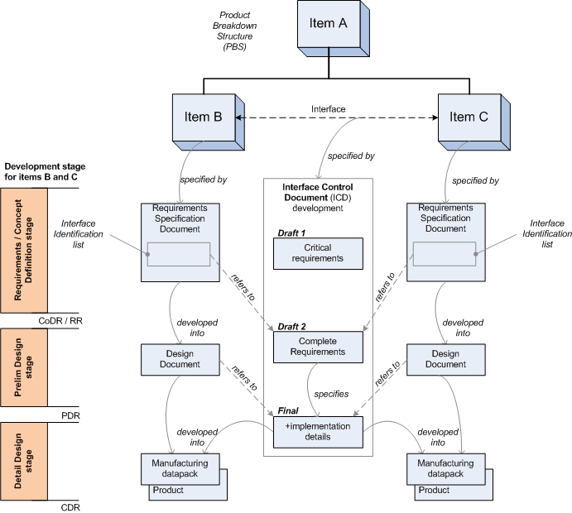
Developing ICDs
Iterative approach, following the product development stages.
(adopted by a number of consortia)

Slide 6
Interface Identification
MeerKAT Product Structure
SKA1_MID Product Structure

Slide 7
Interface Types
Physical
Mechanical
Power & Earthing
Signal and Data Transport
Functional
Signal
Control & Monitoring
Timing & Synchronisation
Human / Machine Interfaces

Slide 8
SKA Interface Workshop: 2) a. SKA1_MID ← → SA Infrastructure
T Kusel and R Lord
Manchester
June 2013

Slide 9
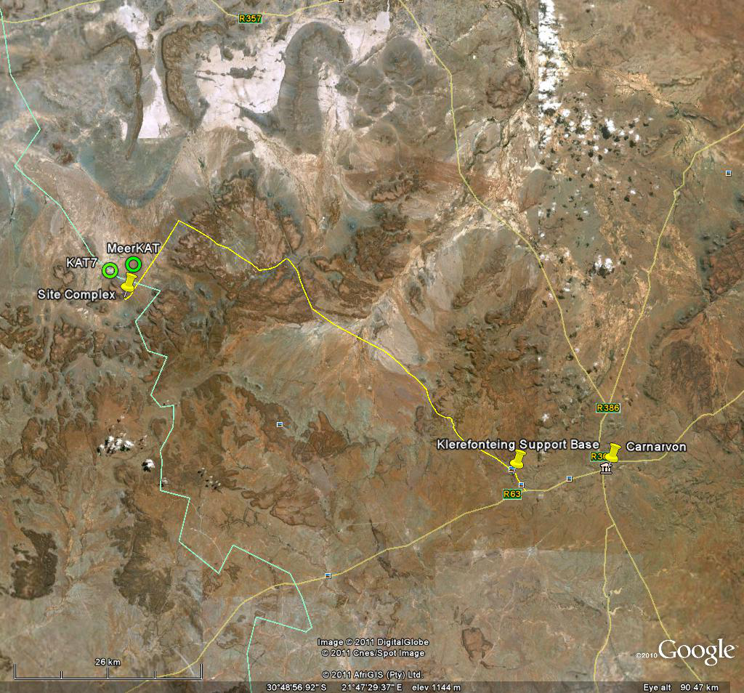
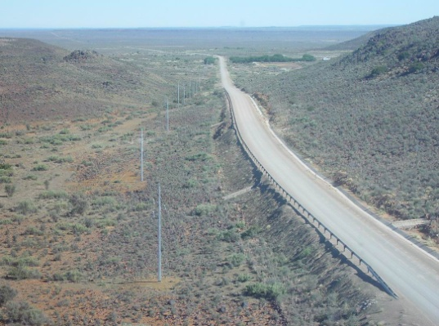
Context: SA Site Infrastructure
Site Facilities:
Manufacturing facilities for dishes and antenna assembly
Storage space for spares
Limited accommodation
Small workshop / lab
Operations room
Landing strip
Temporary construction camps
80km gravel road
Klerefontein Facilities:
Workshops (Electronic & mechanical)
Stores
Accommodation
Operations room
Population ~6000
Landing strip
Tarred road

Slide 10
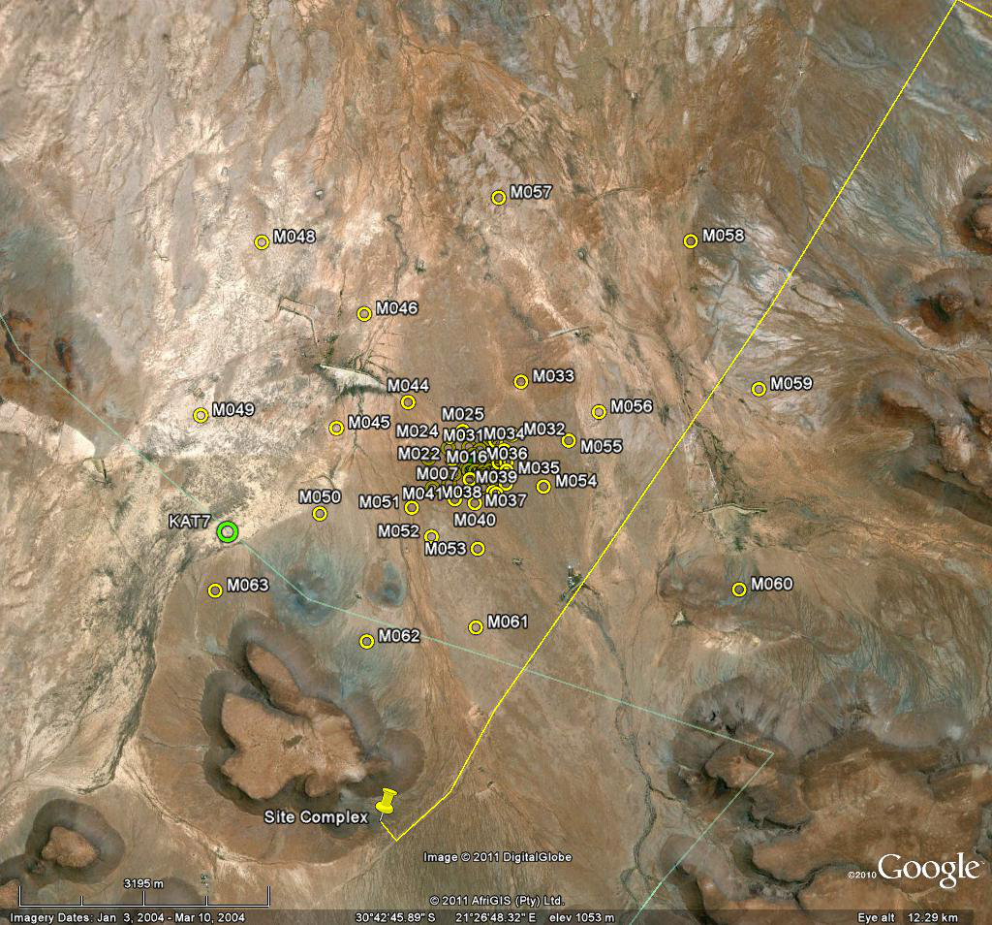
Context: SA Site Infrastructure
MeerKAT array configuration

Slide 11
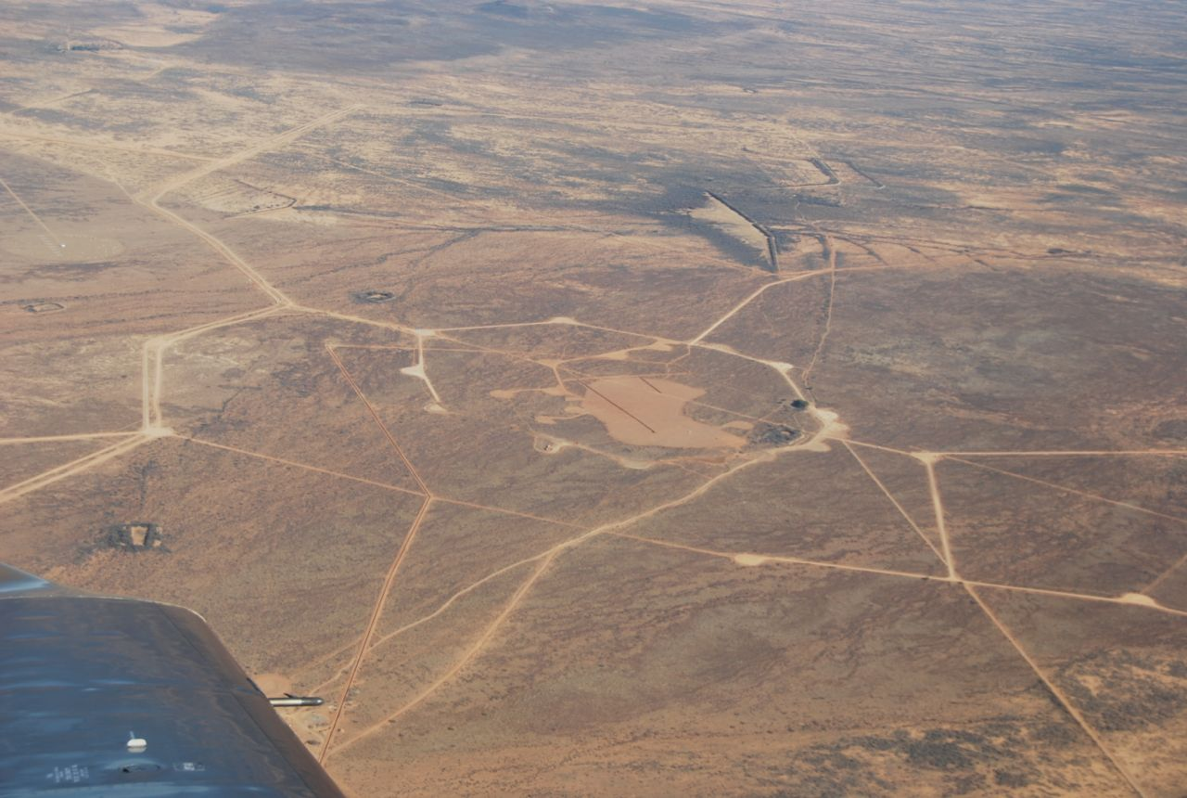
Context: SA Site Infrastructure (Land & Roads)
MeerKAT array: roads

Slide 12
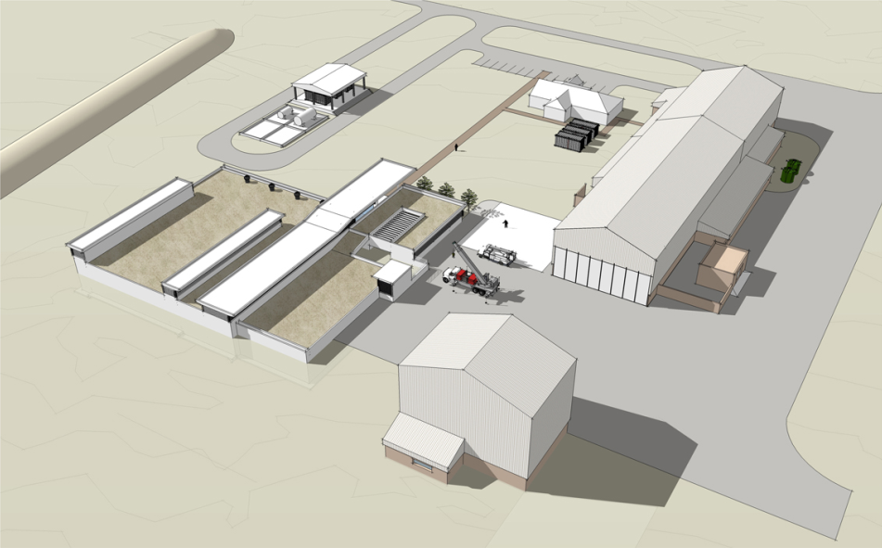
Context: SA Site Infrastructure (Land & Roads)
Backup power plant with rotary UPS
Dish manufacture shed
HVAC
Pedestal integration shed
Karoo
Array Processor Building
(KAPB)

Slide 13
Interface Identification Matrix
 |  | SA site Infrastructure
 |  | Land & Roads | Buildings | Electrical System | Data & Comms | Vehicles
SKA1_MID | Dishes
 | Telescope Manager (TM)
 | Science Data Processor (SDP)
 | Central Signal Processor (CSP)
 | Signal and Data Transport (SDT)
 | Timing and Synchronisation (T&S)
 | Infrastructure
 | Power

Slide 14
Interface Identification
Constraints:
MeerKAT array layout, roads & reticulation place constrains on:
SKA1_MID Array layout
SKA1_MID Reticulation (trenches)
SKA1_MID Roads
 |  | SA site Infrastructure
 |  | Land & Roads | Buildings | Electrical System | Data & Comms | Vehicles
SKA1_MID | Dish (including phased array feeds)
 | Telescope Manager (TM)
 | Science Data Processor (SDP)
 | Central Signal Processor (CSP)
 | Signal and Data Transport (SDT)
 | Timing and Synchronisation (T&S)
 | Infrastructure
 | Power

Slide 15
Interface Identification
Assumption: SDP & CSP & TM are housed in KAPB.
Constraints:
KAPB rack space: ~75 racks
KAPB power & cooling: ~6kW per rack
 |  | SA site Infrastructure
 |  | Land & Roads | Buildings | Electrical System | Data & Comms | Vehicles
SKA1_MID | Dishes
 | Telescope Manager (TM)
 | Science Data Processor (SDP)
 | Central Signal Processor (CSP)
 | Signal and Data Transport (SDT)
 | Timing and Synchronisation (T&S)
 | Infrastructure
 | Power

Slide 16
Interface Identification
Constraint:
Existing infrastructure can supply up to 12kVA to each Dish. More than this will require expensive upgrade to site infrastructure.
Constraint:
Existing infrastructure can supply up to 12kVA to each Dish. More than this will require expensive upgrade to site infrastructure.
 |  | SA site Infrastructure
 |  | Land & Roads | Buildings | Electrical System | Data & Comms | Vehicles
SKA1_MID | Dishes
 | Telescope Manager (TM)
 | Science Data Processor (SDP)
 | Central Signal Processor (CSP)
 | Signal and Data Transport (SDT)
 | Timing and Synchronisation (T&S)
 | Infrastructure
 | Power

Slide 17
Interface Identification
Interface: Monitoring of existing infrastructure components by TM (from MeerKAT Building Management System)
 |  | SA site Infrastructure
 |  | Land & Roads | Buildings | Electrical System | Data & Comms | Vehicles
SKA1_MID | Dishes
 | Telescope Manager (TM)
 | Science Data Processor (SDP)
 | Central Signal Processor (CSP)
 | Signal and Data Transport (SDT)
 | Timing and Synchronisation (T&S)
 | Infrastructure
 | Power

Slide 18
Interface Identification
Existing on site vehicles that could be used for SKA1_MID construction & maintenance.
 |  | SA site Infrastructure
 |  | Land & Roads | Buildings | Electrical System | Data & Comms | Vehicles
SKA1_MID | Dishes
 | Telescope Manager (TM)
 | Science Data Processor (SDP)
 | Central Signal Processor (CSP)
 | Signal and Data Transport (SDT)
 | Timing and Synchronisation (T&S)
 | Infrastructure
 | Power

Slide 19
SKA Interface Workshop: 2) b. SKA1_MID ← → MeerKAT
T Kusel and R Lord
Manchester
June 2013

Slide 20
High-Level Assumptions
MeerKAT Dishes are incorporated into SKA1_MID.
What level of retro-fitting is required (feed packages & receivers)?
SKA1 | replaces | MeerKAT
Central Signal Processor |  | Correlator Beamformer
Telescope Manager |  | Control & Monitoring
Science Data Processor |  | Science Processor
Timing & Synchronisation |  | Time & Frequency Reference

Slide 21
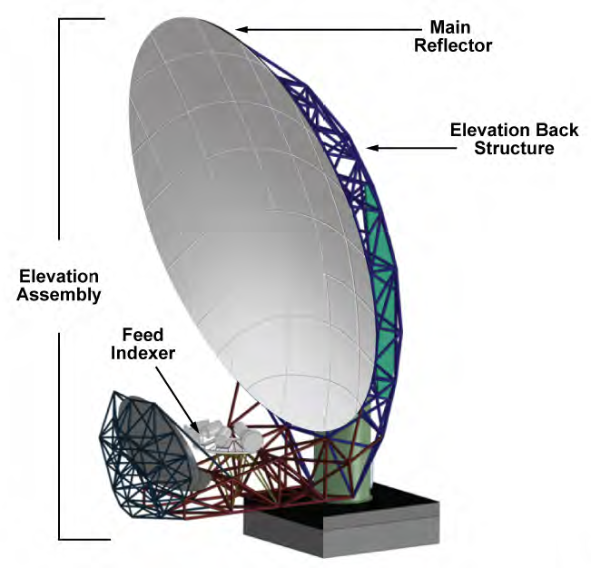
Context: MeerKAT Receptor
Digitiser
Helium compressor for cryogenic cooling
Pedestal with antenna controller
Multiple octave band receivers with vacuum pump

Slide 22
Interface Identification Matrix
 |  | MeerKAT
 |  | Receptor | Weather Stations | Array Fibre Network
SKA1_MID | Dishes
 | Telescope Manager (TM)
 | Science Data Processor (SDP)
 | Central Signal Processor (CSP)
 | Signal and Data Transport (SDT)
 | Timing and Synchronisation (T&S)
 | Infrastructure
 | Power

Slide 23
Interface Identification
Q: Will MeerKAT be retro-fitted with SKA1 SPFs and Receivers?
Frequency bands don’t overlap completely;
Interfaces: EM (e.g. feed illumination); volume; weight; power; cooling; fibres; etc.
This may be a significant engineering effort.
 |  | MeerKAT
 |  | Receptor | Weather Stations | Array Fibre Network
SKA1_MID | Dishes
 | Telescope Manager (TM)
 | Science Data Processor (SDP)
 | Central Signal Processor (CSP)
 | Signal and Data Transport (SDT)
 | Timing and Synchronisation (T&S)
 | Infrastructure
 | Power

Slide 24
Interface Identification
Assumption:
SKA1 TM will control MK Receptor directly
Functional interface: (if not retro-fit)
Between TM and all MK Receptor components (Motion Controller, SPFs, Digitisers, etc) using KATCP protocol
 |  | MeerKAT
 |  | Receptor | Weather Stations | Array Fibre Network
SKA1_MID | Dishes
 | Telescope Manager (TM)
 | Science Data Processor (SDP)
 | Central Signal Processor (CSP)
 | Signal and Data Transport (SDT)
 | Timing and Synchronisation (T&S)
 | Infrastructure
 | Power

Slide 25
Interface Identification
Assumption:
SKA1 T&S will replace MK TFR
Functional interface: (if not retro-fit)
Frequency reference
High accuracy time reference (1pps)
Network time reference
 |  | MeerKAT
 |  | Receptor | Weather Stations | Array Fibre Network
SKA1_MID | Dishes
 | Telescope Manager (TM)
 | Science Data Processor (SDP)
 | Central Signal Processor (CSP)
 | Signal and Data Transport (SDT)
 | Timing and Synchronisation (T&S)
 | Infrastructure
 | Power

Slide 26
Interface Identification
Functional interface:
Simple access to weather data via LAN. Agree on protocols.
 |  | MeerKAT
 |  | Receptor | Weather Stations | Array Fibre Network
SKA1_MID | Dishes
 | Telescope Manager (TM)
 | Science Data Processor (SDP)
 | Central Signal Processor (CSP)
 | Signal and Data Transport (SDT)
 | Timing and Synchronisation (T&S)
 | Infrastructure
 | Power

Slide 27
Interface Identification
Constraints:
Type of fibre and length of fibre need to be compatible. Terminal equipment compatibility.
 |  | MeerKAT
 |  | Receptor | Weather Stations | Array Fibre Network
SKA1_MID | Dishes
 | Telescope Manager (TM)
 | Science Data Processor (SDP)
 | Central Signal Processor (CSP)
 | Signal and Data Transport (SDT)
 | Timing and Synchronisation (T&S)
 | Infrastructure
 | Power

Slide 28
Interface Identification
Constraints:
Underground fibre places routing constraints for trenches
 |  | MeerKAT
 |  | Receptor | Weather Stations | Array Fibre Network
SKA1_MID | Dishes
 | Telescope Manager (TM)
 | Science Data Processor (SDP)
 | Central Signal Processor (CSP)
 | Signal and Data Transport (SDT)
 | Timing and Synchronisation (T&S)
 | Infrastructure
 | Power

Slide 29
SKA Interface Workshop: 3) a. SKA1_SURVEY ← → Aus Infrastructure
A Macleod
Manchester
June 2013

Slide 30
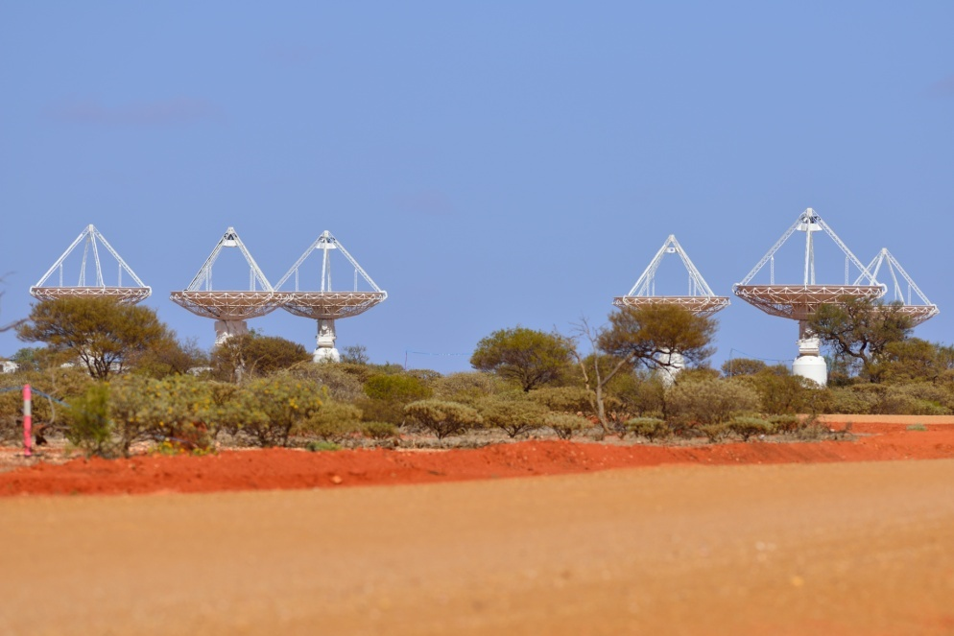
SKA 1 Survey – MRO Assembly, Integration & Verification
MRO Overview
MRO Constraints
MRO Interfaces

Slide 31
MRO Overview
Murchison Radio Observatory
Land and Environment
Fibre link to Geraldton and Repeater Huts
Roads and Airstrip
Control Building
Power Station
Weather Station and Lightening Detection
RFI Monitoring
(Boolardy Station and the MSF)
Notes:
Incomplete:
- Power plant
- Weather station
- Lightening detection
- RFI monitoring system
RFI Monitoring System – No specifications, probably not DF
For the sake of AIV, we should consider Boolardy and the MSF as part of the MRO.

Slide 32
MRO Constraints
These constraints include (but are not limited to):
Constraints derived from hosting agreements
Constraints imposed on SKA elements by existing infrastructure
Constraints imposed by local regulations
Notes:
Constraints derived from hosting agreements
For example, it is believed that the hosting agreement will determine at what time a precursor may be integrated into the corresponding SKA1 instrument.
The hosting agreement might also put constraints on SKA1 construction, so that precursor operations are not unduly hindered (e.g. due to construction-related RFI).
Constraints imposed on SKA elements by existing infrastructure
Specifically infrastructure that will not change as part of SKA1 construction, and that will be used by SKA1 Elements.
Constraints imposed by local regulations
These include working within radio quiet zones, guidelines on how to access the sites, etc.

Slide 33
MRO Constraints
These constraints include (but are not limited to):
General rules and guidelines for access to Boolardy Station and the MRO.
Constraints arising from existing science programs.
Suitable visas for international visitors working on SKA in Australia (not AIV)
Notes:
General rules and guidelines for access to Boolardy Station and the MRO.
This will include safety inductions, accommodation arrangements and compliance with the Indigenous Land Use Agreement (ILUA).
Constraints arising from existing science programs.
Working around scheduled observing periods for ASKAP, the MWA and other MRO-based telescopes.

Slide 34
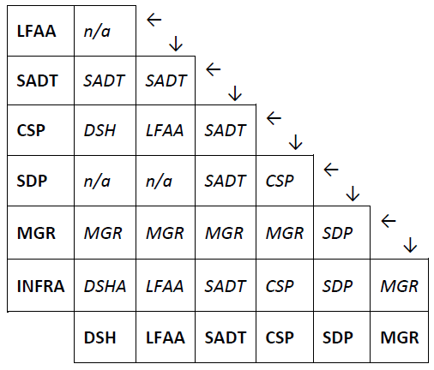
MRO Interfaces
SKA Interface Management Plan, Rev 1
- N² interface diagram does not show AIV
- Has this document been updated?

Slide 35
MRO Interfaces
 | AIV
LFAA | AIV
SADT | AIV
CSP | AIV
SDP | AIV
MGR | AIV
DSH | AIV
INFRA | AIV
N² interface diagram with AIV
AIV Provides MRO ICDs to Internal Customers
i.e. AIV is the Leader.
Notes:
Exact location of the interface (i.e. Where the interface is) is TBC in many instances....given the gaps in the baseline design.
Resolve that (2 way)....so that AIV can produce the ICDs.

Slide 36
MRO Interfaces
MRO ICDs to be provided by AIV
 | AIV
LFAA | AIV
SADT | AIV
CSP | AIV
SDP | AIV
MGR | AIV
DSH | AIV
INFRA | AIV
Land, Roads, Airstrip | Control Building & BMS | Power Plant Including C&M | G’ton Fibre Link & Repeaters | Weather Data | On Site Fibre, Data & Comms | RFI Monitoring
X | X | X |  |  | X | X
X | X | X | X |  | X | X
 | X | X | X |  | X | X
 |  |  | X |  |  | X
 |  |  | X | X
X | X | X |  |  | X | X
X | X | X |  |  | X | X
Notes:
Column with multiple Xs => One or more ICDs.

Slide 37
MRO Interfaces
MRO Assembly, Integration and Verification activities to be facilitated by AIV
(no ICD)
Site Access | Site Test Facilities | Site Machinery | Airstrip | MSF & Boolardy | MRO/ASKAP Design Documents
X | X | X | X | X | X
X | X | X | X | X | X
X | X | X | X | X | X
X | X | X | X | X | X
X | X | X | X | X | X
X | X | X | X | X | X
X | X | X | X | X | X
 | AIV
LFAA | AIV
SADT | AIV
CSP | AIV
SDP | AIV
MGR | AIV
DSH | AIV
INFRA | AIV
Notes:
May be documented, but not as an ICD.
Site access = Inductions, training, accommodation, co-ordination of visits etc.
Site test facilities = hot load, test equipment, electronics lab, etc.

Slide 38
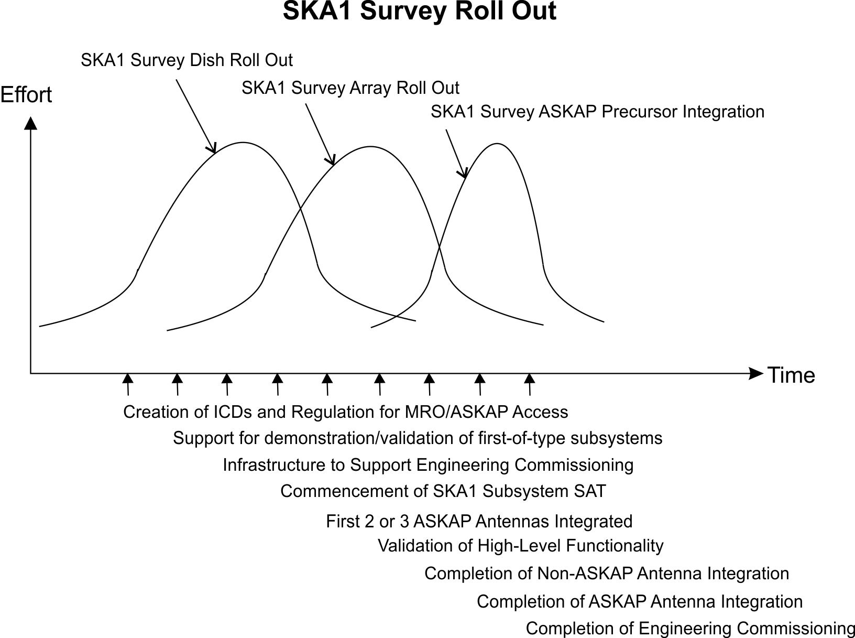
Expected SKA1 MRO Delivery Milestones
Notes:
Based on information within the SKA 1 Baseline Design document.
Strategy to facilitate SKA 1 assembly, integration and verification mitigating the impact on ASKAP operation.
Important for planning AIV activities....provision of ICDs and other support....
Mitigation of technical risks, and development of low-changeability interfaces first!

Slide 39
General Information: SKA1 MRO Integration
AIV Support for SKA1 SURVEY Dish Roll-Out will comprise two major activities:
Providing access to existing infrastructure and supporting the construction of new infrastructure. That is, regulating site access and supporting logistics for site activities. Providing access to the MRO and existing infrastructure will require site access agreements, site inductions and propagation of knowledge around the local rules and regulations. Support for the construction of new infrastructure will include the development of high-level interfaces with low changeability. AIV will provide input into the development of proposed infrastructure designs through interface documentation and consultation with all stakeholders. This may is likely to include site surveys for antenna configuration, installation of underground cabling for fibre and power, supporting the creation of roads, development of repeater huts, control buildings and power systems.
The second major activity will be supporting the prototyping and demonstration of new SKA1 systems at the MRO site. This may include validation or development testing of first-of-type receiver, dish and infrastructure systems. The work may involve the creation (or support for the creation) of particular test facilities. It may also involve coordination of access to existing facilities including power systems, the control building, weather station, lightning detection and RFI monitoring systems.
Notes:
From the AIV Technical Description
Regulating site access
Logistics for site activities
Dialogue with stakeholders & creation of relevant ICDs

Slide 40
General Information: SKA1 MRO Integration
AIV Support for SKA1_SURVEY Array Roll-Out
The SKA1_SURVEY Array Roll-Out will overlap with the SKA1_SURVEY Dish Roll-Out. The work will support the assembly, installation and verification of the receiver electronics and other (non-infrastructure) sub-systems into the SKA1 system. This work will include deployment of Receiver Electronics, Back-End pre-processing and Network Communication Systems, Timing, and Control and Monitoring Systems. It will include site acceptance testing of production items. It will also include higher-level integration and demonstration/validation of higher-level end-to-end SKA1 functionality.
Retro-fitting and regression testing of non-compliant systems will be supported as required.
Verification of physical and functional interfaces with the ASKAP antennas will start during this phase. Initially this may include the use of a small number of ASKAP antennas (probably 2 or 3) that have been taken off-line. Verification should include a demonstration of scalability in preparation for full ASKAP integration.
Agreements regarding the ongoing access to MRO and ASKAP facilities may need to be revisited and re-negotiated at this stage, prior to the completion of SKA1-ASKAP integration.

Slide 41
SKA Interface Workshop: 3) b. SKA1_SURVEY ← → ASKAP
A Macleod
Manchester
June 2013

Slide 42
SKA 1 Survey – ASKAP Assembly, Integration & Verification
ASKAP Overview
ASKAP Constraints
ASKAP Integration

Slide 43
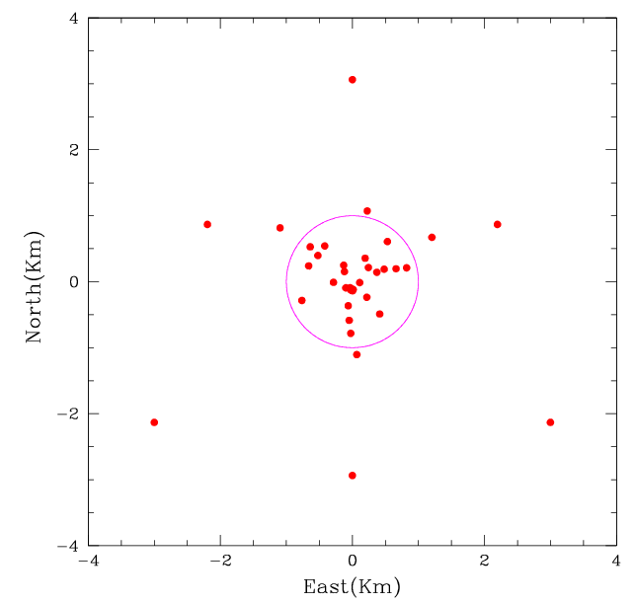
ASKAP Overview
A sensitive wide field-of-view telescope
Number of dishes 36
Dish diameter 12 m
Max baseline 6km
Resolution 10” (6km array), 30” (2km core)
Sensitivity 70 m²/K
Field of View 30 deg²
Speed 1.5x10⁵ m⁴/K^{2.}deg²
Observing frequency 700 – 1800 MHz
Processed Bandwidth 300 MHz
Channels 16k
Focal Plane Phased Array 188 elements (94 dual pol)
Phased Array Feed
RF Signal Transport
7km
Coarse
Filter Bank
Fine
Filter Bank
Gain
Gain
ADC
Beam Former
Correlator
Control, Monitoring and Timing

Slide 44
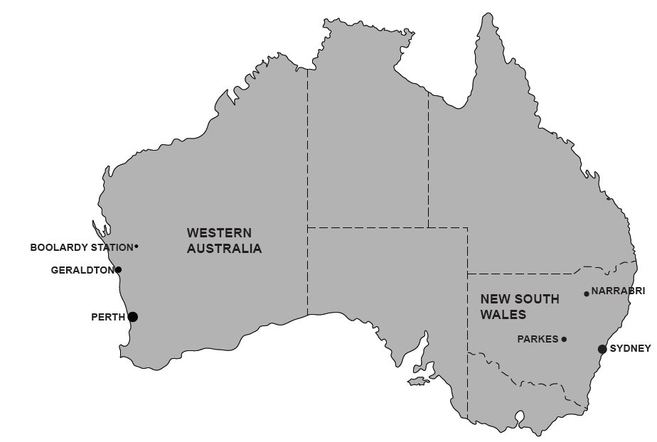
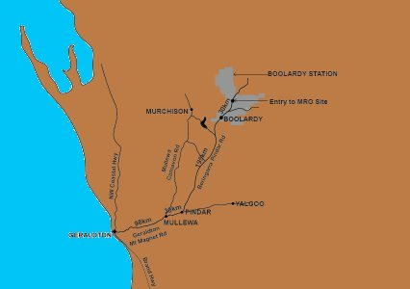
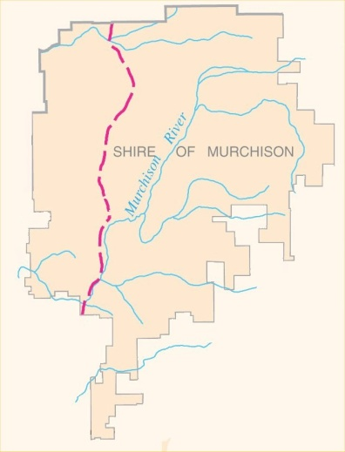
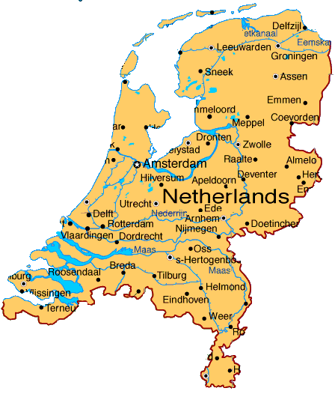
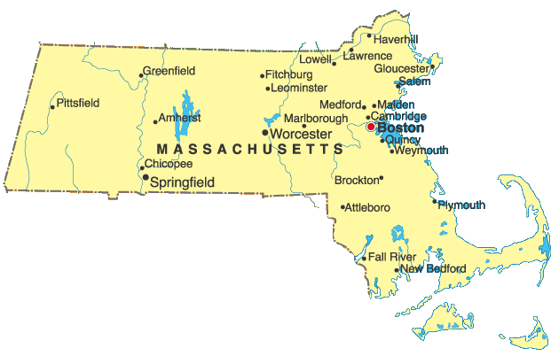
ASKAP Overview
Taiwan:
35,801 sq km
23 million
gazetted towns: 0
population: “up to 120”
Area 41,200 sq km

Slide 45
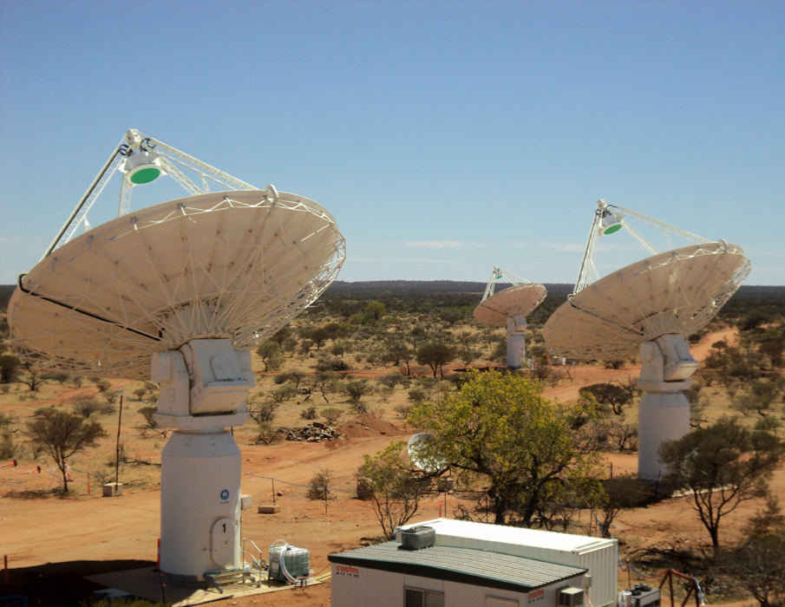

Slide 46
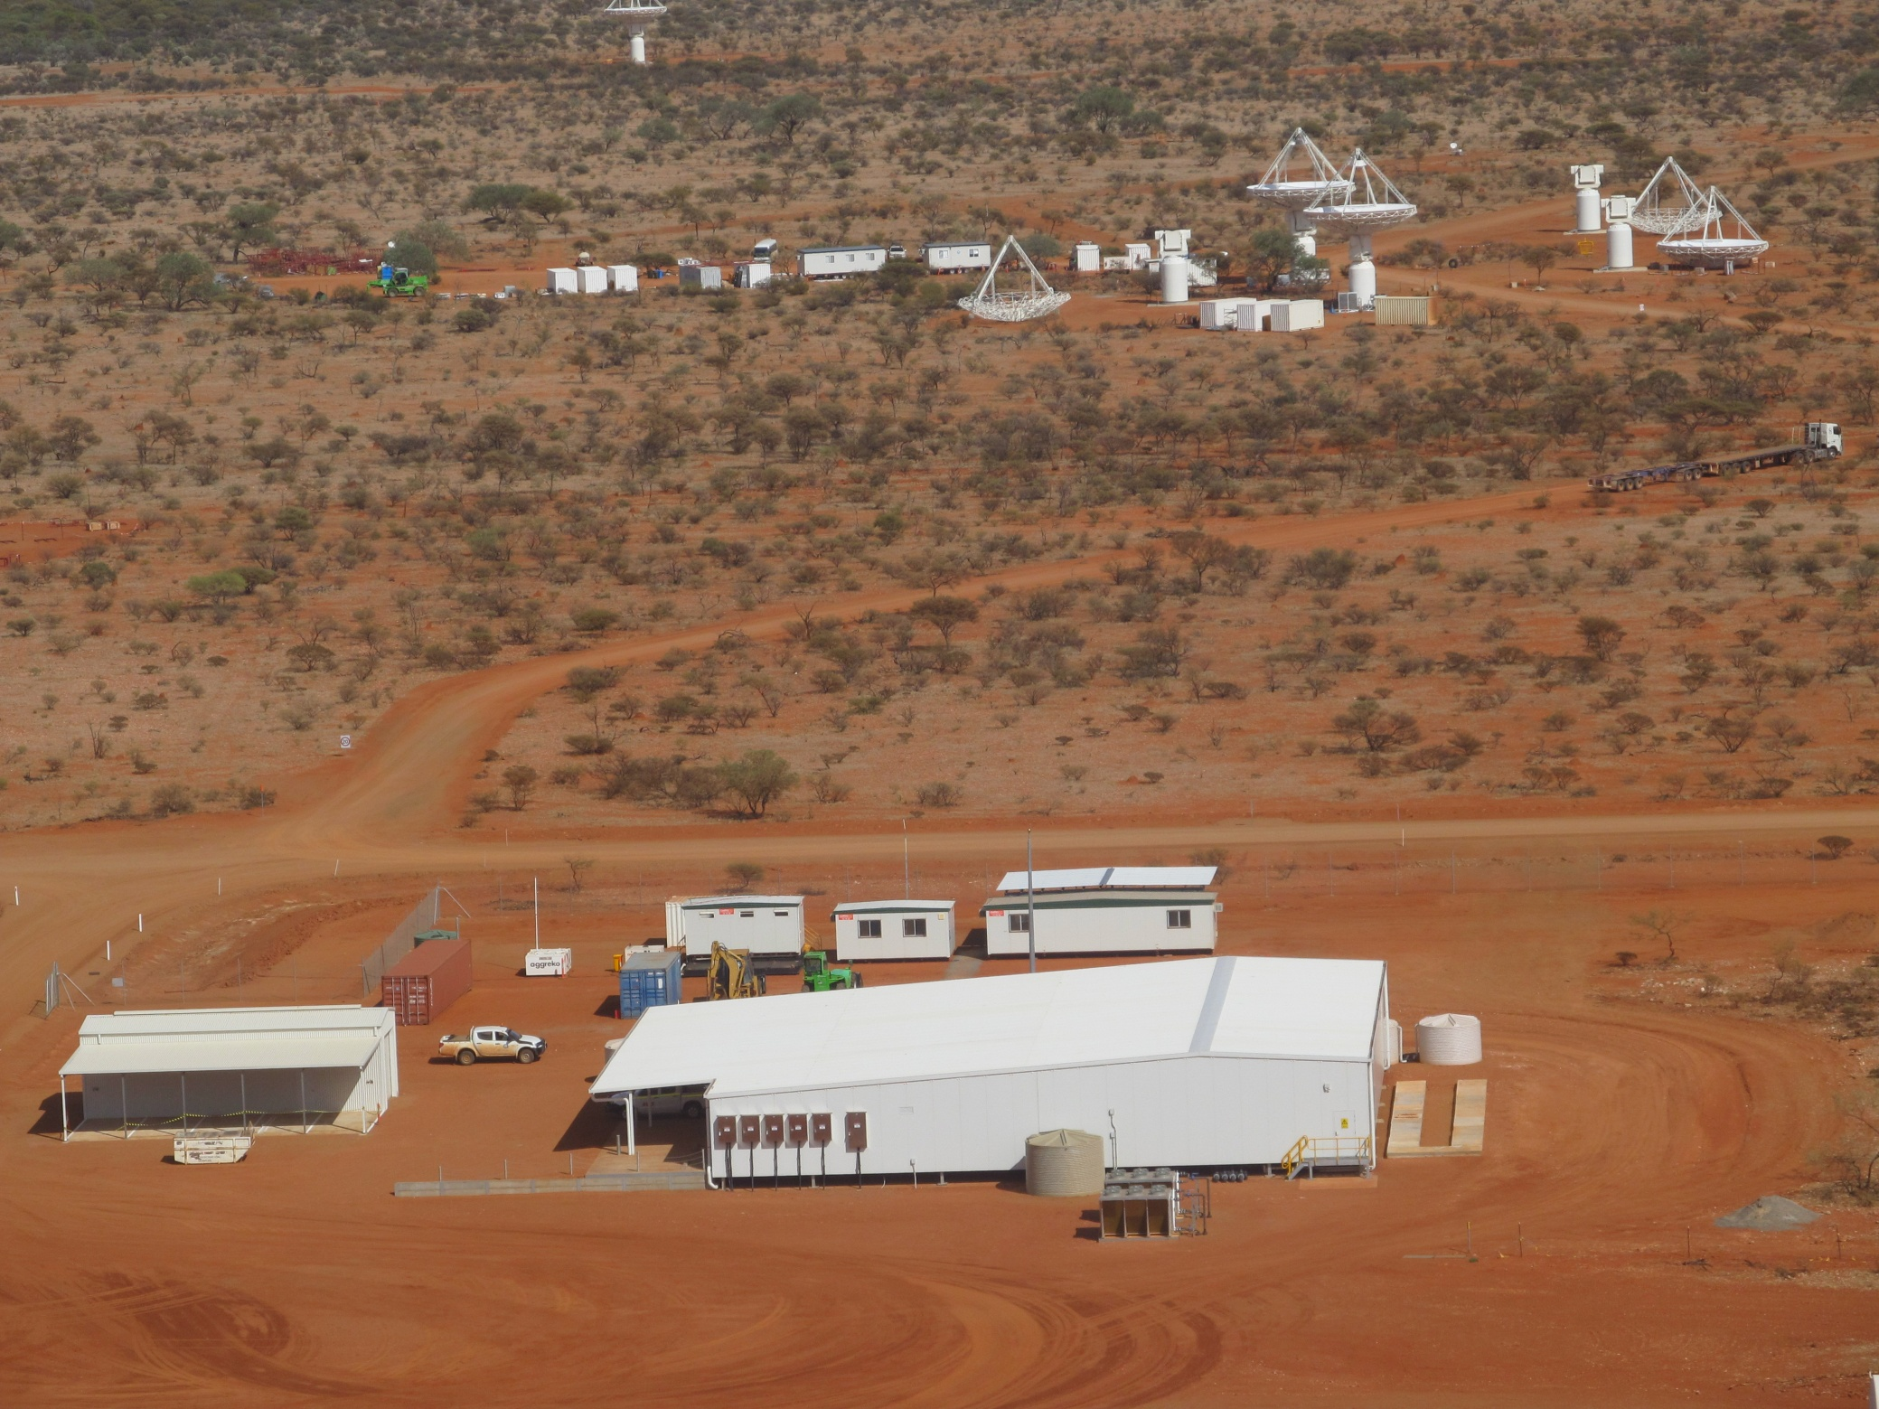

Slide 47
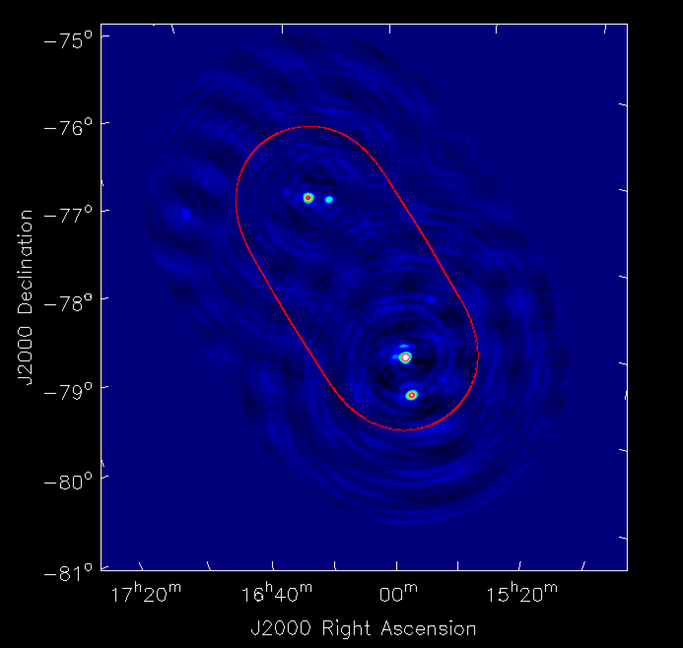

Slide 48
ASKAP Constraints
Constraints arising from the requirements to integrate with precursors:
Coordinating access to the ASKAP system or subsystems for the purpose of design validation, acceptance testing, and ASKAP integration.
Physical and functional limitations of the ASKAP system and subsystems.
Constraints relating to organisational aspects.
Notes:
Coordinating access to the ASKAP system or subsystems for the purpose of design validation, acceptance testing, and ASKAP integration. This may include:
The ASKAP dishes and PAF receiver systems,
Fibre or power cabling,
Back-end DSP electronics in the control building,
Timing, control and monitoring systems in the control building,
The power station.
Physical and functional limitations of the ASKAP system and subsystems.
Data and signal specifications from the receive chain
Message types and signal specifications for control and monitoring
ASKAP Performance specifications
Location of the interfaces
Limitations of the existing interfaces
(Changeability of the existing interfaces)
Constraints relating to organisational aspects, for example:
Negotiated agreements regarding the long-term design, maintenance and operation of the precursors as they are integrated into SKA1.

Slide 49
ASKAP Interfaces
 | AIV
LFAA | NA
SADT | AIV
CSP | AIV
SDP | NA
MGR | AIV
DSH | AIV
INFRA | AIV
AIV Provides ASKAP ICDs to Internal Customers
i.e. AIV is the Leader.
Notes:
Exact location of the interface (i.e. Where the interface is) is TBC in many instances....given the gaps in the baseline design.
Resolve that (2 way)....so that AIV can produce the ICDs.

Slide 50
ASKAP Interfaces
ASKAP ICDs to be provided by AIV
 | AIV
LFAA | AIV
SADT | AIV
CSP | AIV
SDP | AIV
MGR | AIV
DSH | AIV
INFRA | AIV
Receiver Perf, Data | Receiver Data SSL | C&M Data | C&M SSL | Dish C&M + SSL | Antenna Driver (Power, Modes, BIT <-> FMEA) | Antenna Config.
 |  |  |  |  |  | X
 | X |  | X |  | X
X
X |  |  |  |  |  | X
 |  | X |  | X | X
X |  |  |  |  | X
 | X |  | X | X | X | X
Notes:
Exact location of the interface (i.e. Where the interface is) is TBC in many instances....given the gaps in the baseline design.
Resolve that (2 way)....so that AIV can produce the ICDs.
Data and signal specifications from the receive chain
Message types and signal specifications for control and monitoring
ASKAP Performance specifications
Location of the interfaces

Slide 51
Expected SKA1 ASKAP Delivery Milestones
Notes:
Based on information within the SKA 1 Baseline Design document.
Strategy to facilitate SKA 1 assembly, integration and verification mitigating the impact on ASKAP operation.
Important for planning AIV activities....provision of ICDs and other support....
Mitigation of technical risks, and development of low-changeability interfaces first!

Slide 52
General Information: SKA1 ASKAP Integration
SKA1 SURVEY – ASKAP Precursor Integration
SKA1 SURVEY – ASKAP Precursor Integration will involve the complete integration of all 36 ASKAP Antennas, plus required ASKAP back-end computing and communications equipment, into SKA1.
There will be some overlap with SKA1 SURVEY Array Roll-Out. However, the SKA1 design should support scalability, allowing precursor integration to be performed over a relatively short period.
The completion of the full system integration will allow the completion of SKA1 SURVEY Engineering Commissioning and the commencement of Science Commissioning.

Slide 53
SKA Interface Workshop: 4) SKA1_LOW ← → Aus Infrastructure
A Macleod, JG bd Vaate
Manchester
June 2013

Slide 54
Overview
SKA1 LOW- MRO
as for SKA1 Survey - MRO
AIV is the leader for relevant ICDs
Dialogue => where, AIV => what
One ICD provided may be used for multiple SKA subsystems
Reviewed by internal customers for completeness and correctness, but low changeability means MRO (& infrastructure) probably won’t be changed.
Interfaces of low changeability to be identified first.

