Slide 1
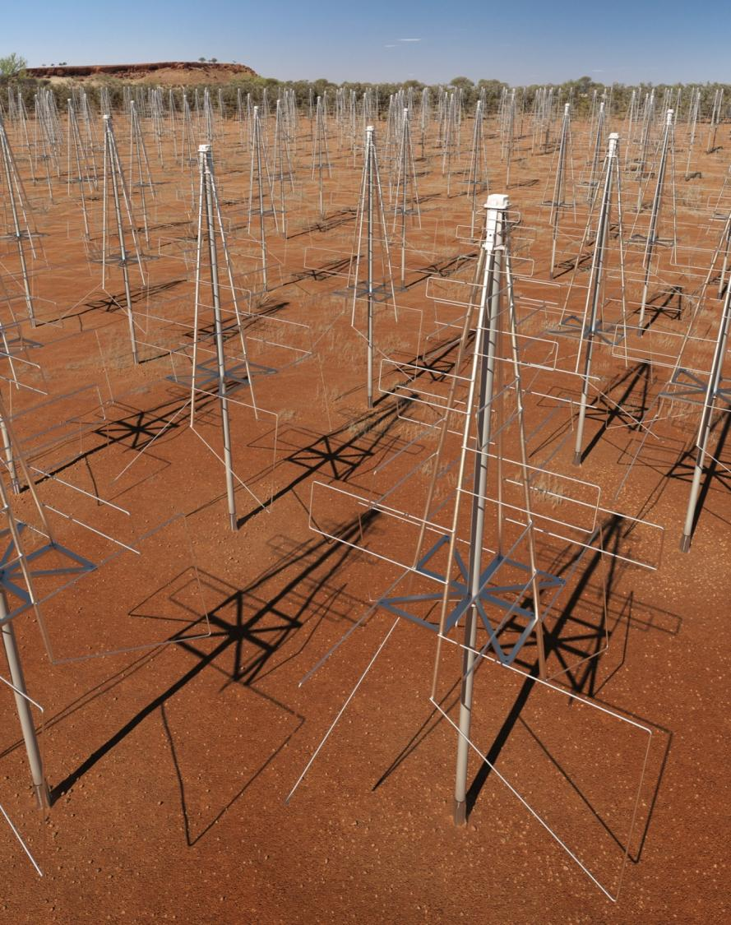
Low Frequency Aperture Array Interfaces

Slide 2
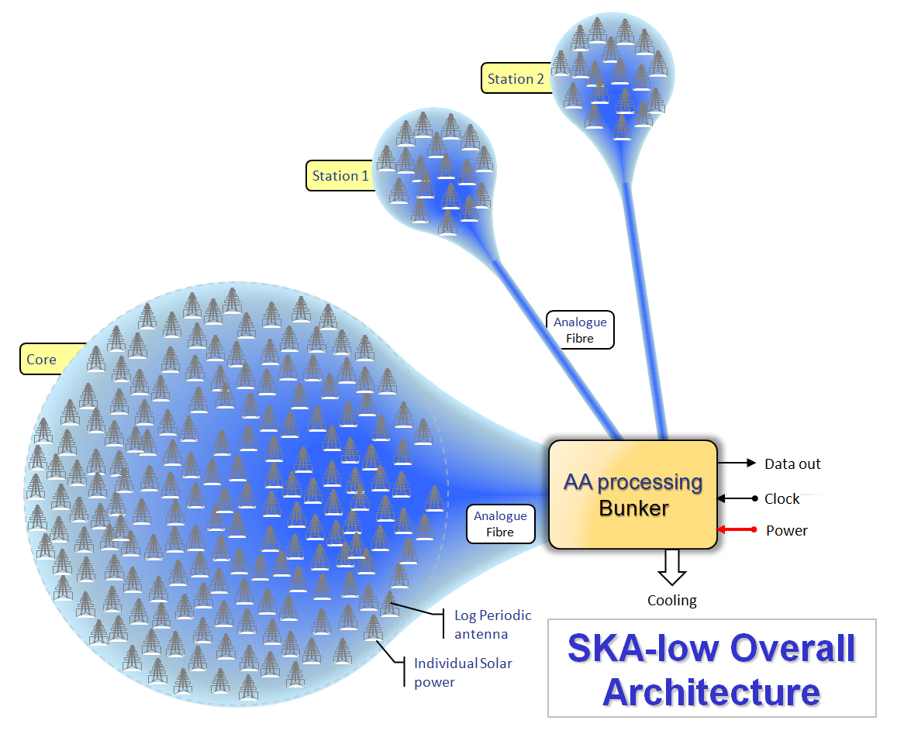

Slide 3
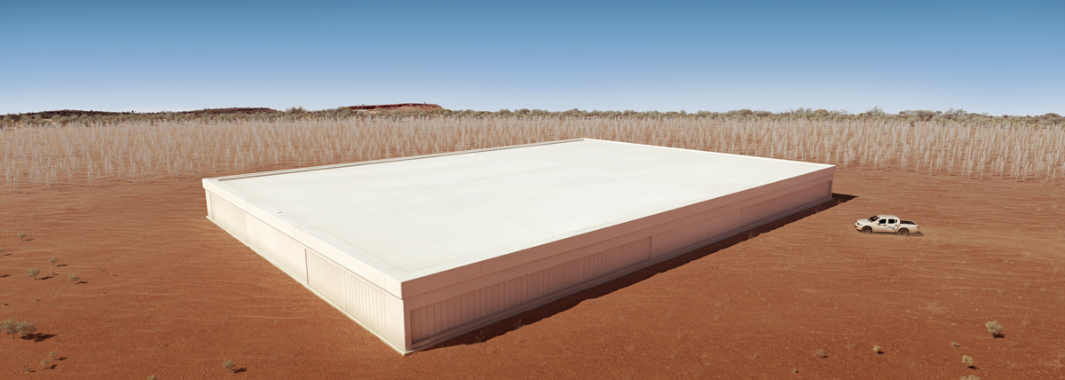
Possible physical implementation

Slide 4
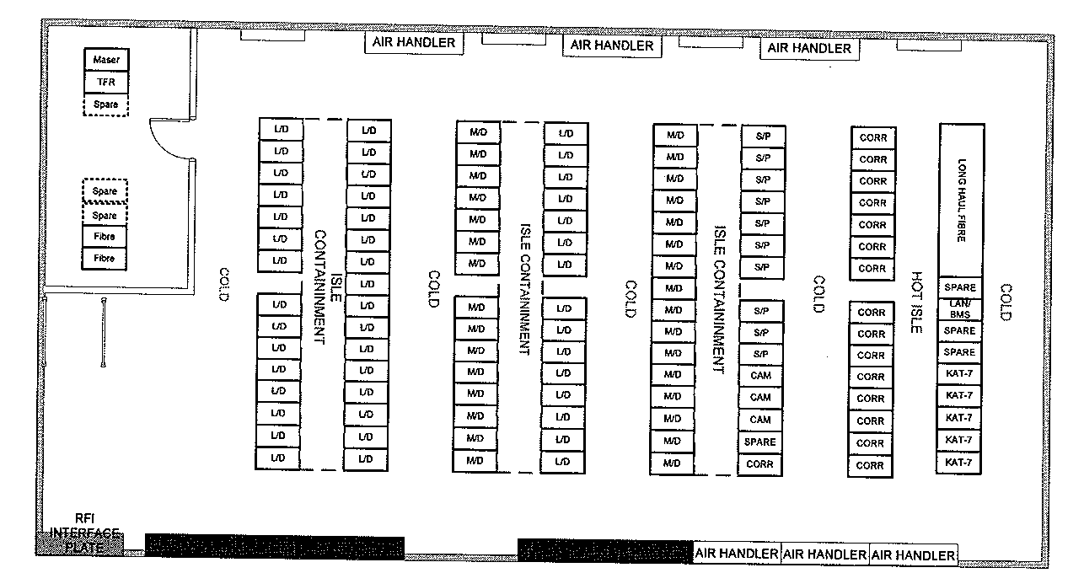
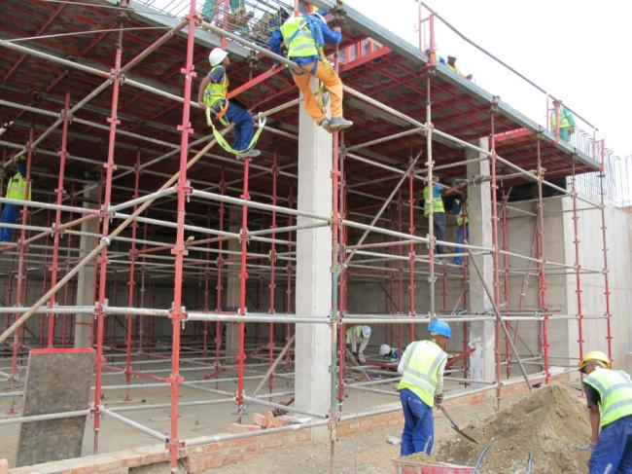
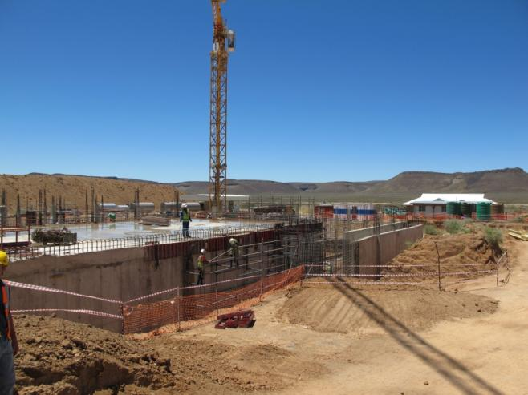
Example bunker…

Slide 5
SKA-low: end-to-end
Maser
Signal & Data
Transport
Low frequency
Aperture Array
Central Signal
processor
Science Data
processor
Scientists!
HPC
HPC
HPC
Switch
Buffer store
Switch
Buffer store
Bulk
Store
HPC
Beamforming
…
Correlator
Beamformer
UV
Processor
M&C
Telescope Manager
Power
Cooling
Infrastructure

Slide 6
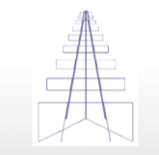
Work flow and external interfaces
Antenna & LNA
Receiver
Signal Processing
Spectral filters
1st Beamforming
Station beamforming
LNA
e/o
RFoF
o/e
ADC
e/o
Data
out
To CSP
via SADT
Antenna
structure
Clock
From
SADT
Control & Monitoring
Power
Bunker
Power
From
INFRA
Solar/copper
Power
Local Infrastructure
Monitor & Control
Cooling
To TM
Via SADT
From
INFRA

Slide 7
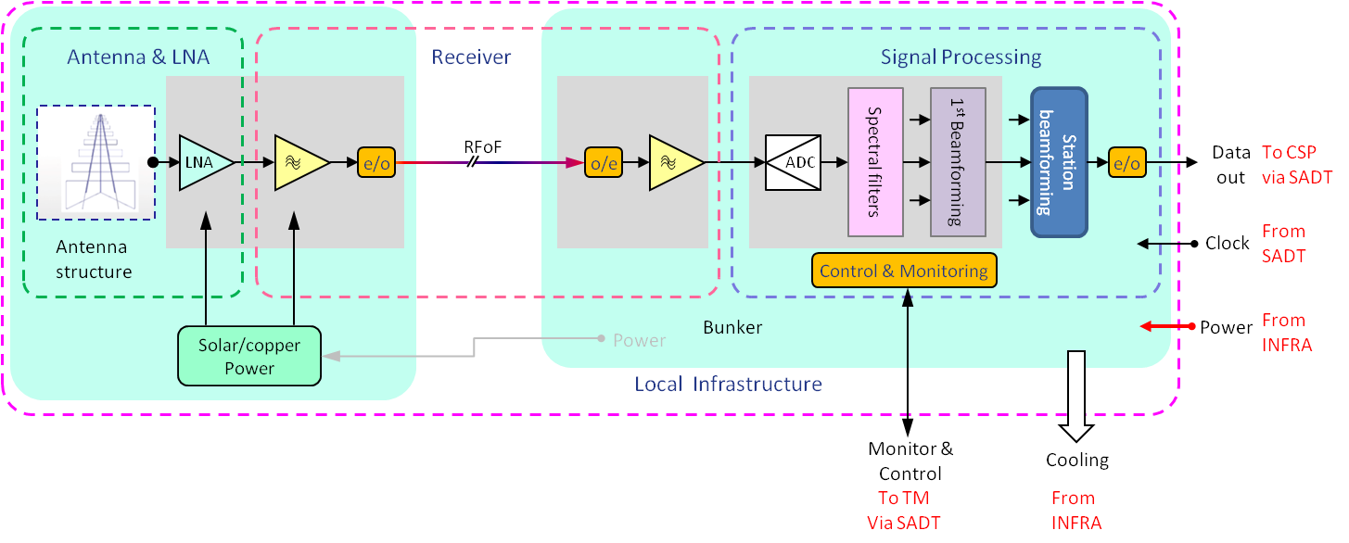
Link to Signal and Data Transport for SKA-low correlator
Description
Connection from the LFAA to the SADT element to carry the beamformed signal data from the LFAA to the SKA-low correlator. This may be over a wide area network or inter-rack communications dependent upon the relative location of the LFAA processing and the SKA-low correlator. The location will depend on the overall SKA-low architecture.
Data rate*: ~10Gb/s from 911 stations. 10Tb/s total.
*Baseline design, may increase with other implementations
Leadership: SADT element
Other party: LFAA element
LFAA WP: SKA.TEL.LFAA.LINFRA.SDT
Type: Direct
I/face scope: TBD
Standards: TBD
Classes: Electro-optical data link
Data exchange protocols
Mechanical
Safety aspects: None foreseen.
I/face specs by class: International standards

Slide 8
Data transfer to the LFAA correlator
Description
The data processed by the LFAA beamforming system is transferred to the LFAA correlator for processing as a whole low frequency system. This is the interface to transfer the data logically from the LFAA to the correlator. This will specify where the metadata will be added and the protocols used.
Data rate*: ~10Gb/s from 911 stations. 10Tb/s total.
*Baseline design, may increase with other implementations
Leadership: LFAA element
Other party: CSP element
LFAA WP: SKA.TEL.LFAA.SP.ARC
Type: Indirect
I/face scope: TBD
Standards: TBD
Classes: Data exchange specifications
Safety aspects: None foreseen.
I/face specs by class: International standards

Slide 9
Link to Signal and Data Transport for Telescope Manager
Description
This is a connection from the LFAA onto the Signal and Data Transport element to carry the control and monitoring signals from the LFAA to the Telescope management system. This may be over a wide area network or inter-rack communications dependent upon the relative location of the LFAA processing and the SKA-low correlator.
Data rate: Unknown but reasonably low.
Leadership: SADT element
Other party: LFAA element
LFAA WP: SKA.TEL.LFAA.LINFRA.SDT
Type: Direct
I/face scope: TBD
Standards: TBD
Classes: Electro-optical data link Data exchange protocols
Mechanical, desc. physical i/face
Safety aspects: None foreseen.
I/face specs by class: International standards

Slide 10
Control & Monitoring data to and from Telescope Manager
Passes all control & monitoring information, including information that relates to safety e.g. power status etc. Safety monitoring will be designed to be “fail-safe”. Further details TBD.
Description
The LFAA operation is controlled by the Telescope Manager, which is also controlling the other SKA-low systems. The control information is communicated with the LFAA station control systems, which then control the parameters of the beamforming and station configurations.
Also, LFAA monitoring information is gathered by the LFAA monitoring systems and is communicated to the Telescope Manager.
Data rate: Unknown but reasonably low.
Leadership: TM element
Other party: LFAA element
LFAA WP: SKA.TEL.LFAA.MAC
Type: Indirect
I/face scope: TBD
Standards: TBD
Classes: Data exchange specifications
Safety aspects: Some potentially….
I/face specs by class: International standards

Slide 11
Clock and timing information
Description
The LFAA needs to be synchronised in time with the rest of SKA-low. The clock and timing information is delivered by the SADT. This interface is only to provide information to the LFAA.
The specification of this signal is currently undefined in terms of precision, but must be adequate for the highest frequency of the LFAA – 350MHz in the Baseline Design or 650MHz in the Proposed Design to maintain accurate coherence. This is fraction of a wavelength jitter and stability or of order 10ps.
Leadership: SADT element
Other party: LFAA element
LFAA WP: SKA.TEL.LFAA.SE.CLK
Type: Direct
I/face scope: TBD
Standards: TBD
Classes: Electro-optical data link
Data exchange protocols
Mechanical
Safety aspects: None foreseen.
I/face specs by class: International standards

Slide 12
Power from Infrastructure
There are significant safety aspects involved with this interface. There is considerable power available which could cause personal injury or death through high voltages. Also, there is a risk of a fault causing a fire within a sealed processing facility.
Description
This is a multi-faceted interface in that the main processing systems require significant levels of power in one or a few locations. Also, there will need to be either power reticulation to each of the stations and subsequently antennas via either signal cables or dedicated power cables. Alternatively, there will be solar power provided for individual or small groups of antennas.
The power requirements are to be fully defined, but expected to be 1W per antenna (250kW for all antennas) and approximately 2-3MW for the processing in one or more bunkers.
.
Leadership: LFAA element
Other party: INFRA element
LFAA WP: SKA.TEL.LFAA.LINFR.PWR
Type: Direct
Standards: TBD
Classes: Electrical
Mechanical, desc. physical i/face
Thermal
Safety aspects: Some...
I/face specs by class: International standards and National (Australian) standards

Slide 13
Cooling by Infrastructure
Description
Cooling will be provided in the processing bunker(s) as part of the Infrastructure building provision. This will need to remove 2-3MW for the full LFAA maintaining an operation temperature of ~20C.
.
Leadership: LFAA element
Other party: INFRA element
LFAA WP: SKA.TEL.LFAA.LINFR.PWR
Type: Direct
Standards: TBD
Classes: Electrical
Mechanical, desc. physical i/face
Thermal
Safety aspects: Some...
I/face specs by class: International standards and National (Australian) standards
The cooling systems has potential hazards with high voltages and large moving parts.

Slide 14
Final points
The buildings are provided by INFRA?
The antennas have integral solar power LFAA design the power units.
The development of the fibre link from the antennas to the bunker is part of LFAA.
Contact: Andrew Faulkner

