Slide 1
SKA Element Interface Management Workshop CSP Element
SKA Project Office,
25-27 June 2013

Slide 2
N² Diagram
LFAA | n/a
SADT | SADT | SADT
CSP | DSH | LFAA | SADT
SDP | n/a | n/a | SADT | CSP
MGR | MGR | MGR | MGR | MGR | SDP
INFRA | DSHA | LFAA | SADT | CSP | SDP | MGR
 | DSH | LFAA | SADT | CSP | SDP | MGR
N² diagram showing Leading Party for each interface
(from SKA Interface Management Plan)

Slide 3
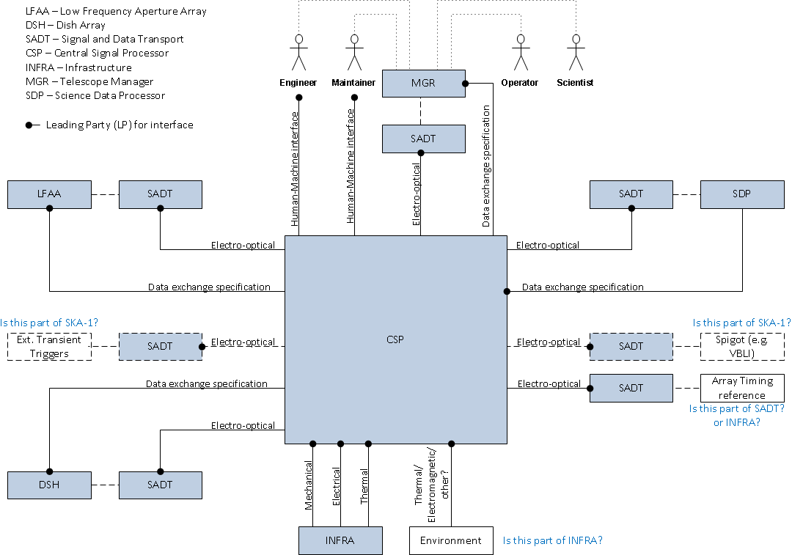
Element Level Interfaces

Slide 4
List of CSP Interfaces (1)
Interface with | Leading Party | Interface Type | Description
SADT | SADT | Electro-optical | Data from/to: LFAA DSH SDP MGR Array Timing Ref Ext. Trans. Trg. Spigot
LFAA | LFAA | Data Exchange Specification | LFAA data format
DSH | DSH | Data Exchange Specification | DSH data format
SDP | CSP | Data Exchange Specification | SDP data format

Slide 5
List of CSP Interfaces (2)
Interface with | Leading Party | Interface Type | Description
MGR | MGR | Data Exchange Specification | MGR control/status
 |  | Human-Machine Interface | Engineer/Maintainer control/status GUIs
INFRA | CSP | Mechanical | Rack mounting, space envelope etc
 |  | Electrical | Power to racks
 |  | Thermal | Rack cooling
Environment (part of INFRA?) | CSP | Thermal | Room thermal characteristics
 |  | Electromagnetic | RFI environment

Slide 6
Interface details
Now over to Brent for more details…

