Slide 1
SKAO Power Update
2015 Engineering Meeting: Penticton
Adriaan Schutte
2015-11-11

Slide 2
Overview
Power Restrictions on Sites
Consumption Management
  General budgeting procedure
  Power budgeting
  Power Maturity Levels (PMLs) & milestones
  Power allocations
Power Quality Standard

Slide 3
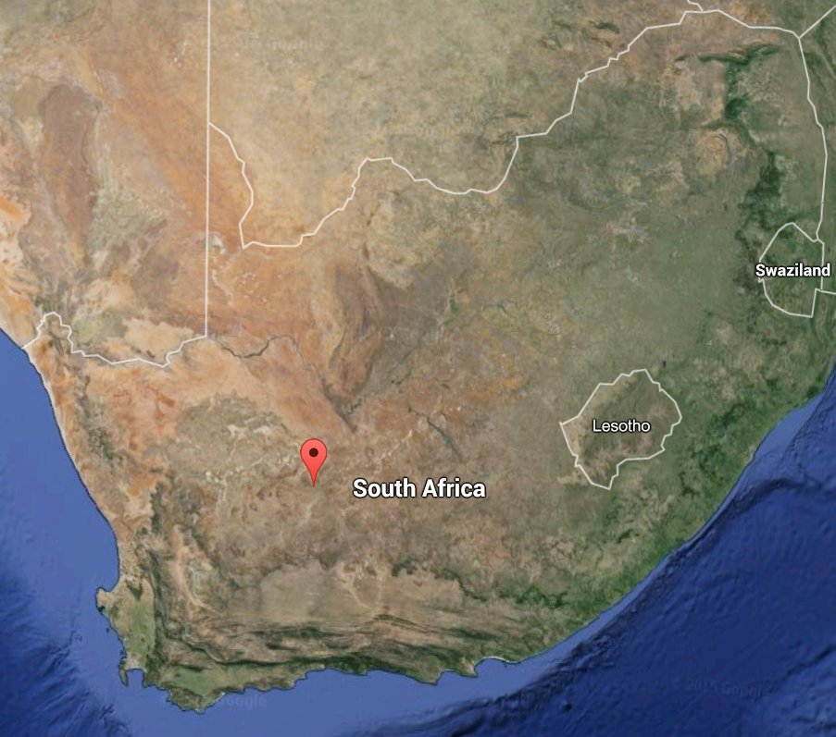
Power Restrictions
SA: 4MW available (transient effects)

Slide 4
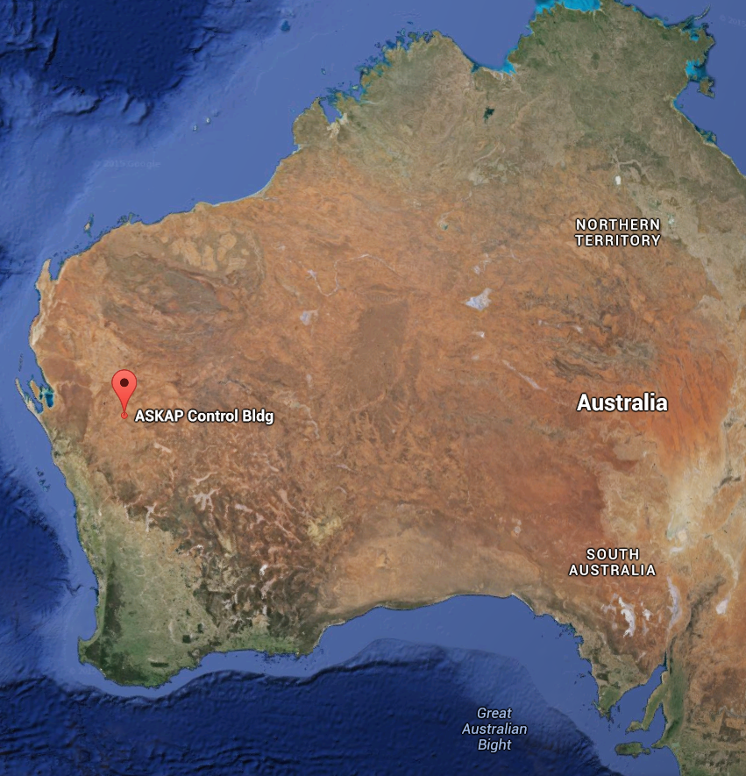
Power Restrictions
Aus: Primarily diesel-based, high cost

Slide 5
Consumption Management
General Budgeting Process:

Slide 6
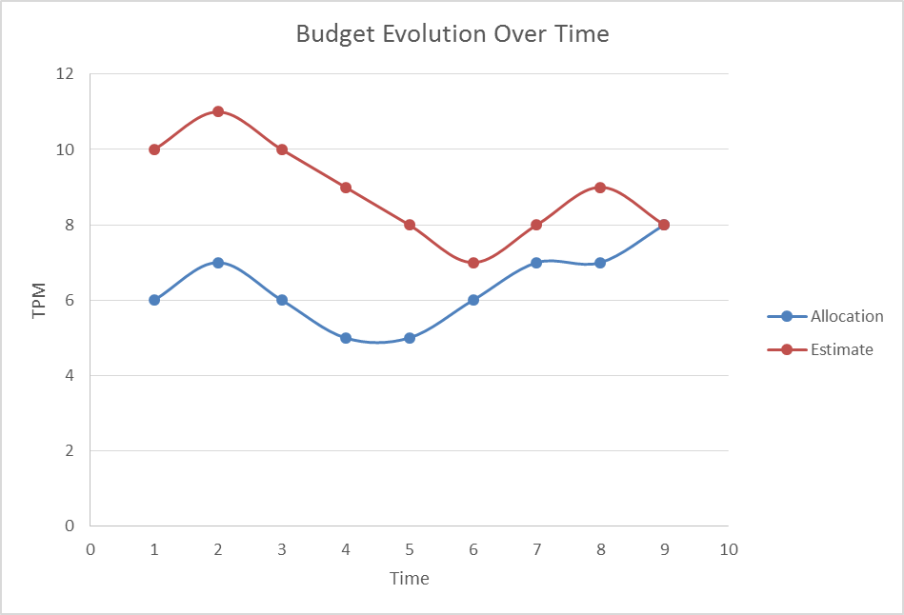
Consumption Management
General Budgeting Process:

Slide 7
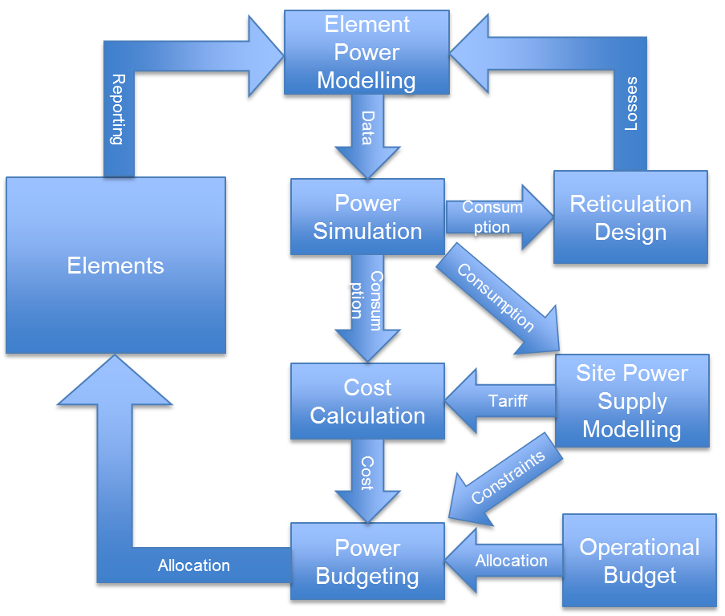
Consumption Management
Tailored to power management
Include:
  Reticulation as loads
  Supply cost
  Operational budget

Slide 8
Consumption Management
Power Maturity Levels (PMLs)
  Based on Technology Readiness Levels (TRLs)
  Evidence required (same data as for simulation)
PML Required | PML Evidence Required | Milestone
1 | Power estimates based on first order calculations
2 | Estimates based on engineering analysis and simulation | Preliminary Design Review (PDR)
3 | Measurements in laboratory environment on test setups | PDR +9 Months
4 | Measurements in laboratory environment on breadboards | CDR -6 Months
5 | Measurements in a representative environment + PQ | Critical Design Review (CDR)
6 | Short term measurements + PQ on prototype for all operating scenarios | Production Readiness Review
7 | Medium term measurements +PQ on prototype for all operating scenarios | Before Site Testing is Allowed
8 | Medium term measurements on at least one production unit at site | Before Site Operation is Allowed
9 | Long term measurement on multiple production units | Completion of Commissioning

Slide 9
Consumption Management
Reporting in detail design phase:
  Revised power reporting document issued
  Implement PMLs
    “Engineering estimates” no longer OK
    Require simulations and then measurements
  Implement time-domain simulation
    Require power models from Consortia
    Consumption per science use case (Day in the Life)
    Identify other effects:
      Modes
      Temperature (e.g. cooling systems)
      Wind (e.g. dishes)
      Etc.

Slide 10
Consumption Management
Recap: baseline v2 allocations SKA1 Low:
When running on diesel: 12,000 litres / day
Element | Average & Peak Power Consumption (kW)
LFAA | 1,064
CSP Low Imaging | 30
CSP Low Non-Imaging | 144
TM Low | 20
SADT Low | 50
INFRA-AUS (LFAA) | 15
Cooling & Site Dist. Losses (INFRA) | 741
SKA1 LOW TOTAL | 2,062

Slide 11
Consumption Management
Recap: baseline v2 allocations SKA1 Mid:
When running on diesel: 30,000 litres / day
Element | Average Power Consumption (kW) | Peak Power Consumption (kW)
Karoo Site Complex (incl. DRUPS, sheds, etc) | 380 | 530
Existing Equipment (KAT-7, etc). | 45 | 56
MeerKAT Dishes (64) | 864 | 1024
SKA1 Mid Dishes (133) | 1,130 | 1,530
CSP Mid Imaging | 170 | 170
CSP Mid Non-imaging | 420 | 420
TM Mid | 20 | 20
SADT Mid | 110 | 110
Cooling & Site Distribution Losses (INFRA-SA) | 867 | 1005
SKA1 MID SITE TOTAL | 4,007 | 4,865
33kV Line Losses | 450 | 690
Klerefontein Support Base | 25 | 45
Carnarvon POP Station | 5 | 10
SKA1 MID KAROO TOTAL | 4,487 | 5,610

Slide 12
Power Budget
Operational cost (approx.):
  SKA1 Mid: Eur 7.5 mil / year (grid only)
  SKA1 Low: Eur 8 mil / year
Power cost is about 25% of annual budget
  Assuming ops budget is 10% of Eur 650 mil
  Assumptions on SDP consumption

Slide 13
Power Quality
SKA PQ standard developed by INFRAs
Replace PQ sections in all ICDs
Based on international standards
Checked against ALMA and E-ELT standards
Status:
  In final review
  To be issued very shortly

Slide 14
Thank You
Questions?

