Slide 1
Head of Project Update
Alistair McPherson
November 2015

Slide 2
Past Year included….
Re-Baselining
Preliminary Design Reviews
Consortia Progress
Telescope Teams

Slide 3
Re-Baselining Principles
The revised baseline should deliver:
  Transformational Science
  Design optimised with high priority science
  Deviation from Baseline Design & Technologies must be justified with risk assessment & TRL
  Designs/Technologies incorporated take into account cost & risk
  Must sit within cost cap (€650M)
  Traceability to previous agreements & decisions

Slide 4
Process














(44)

Slide 5
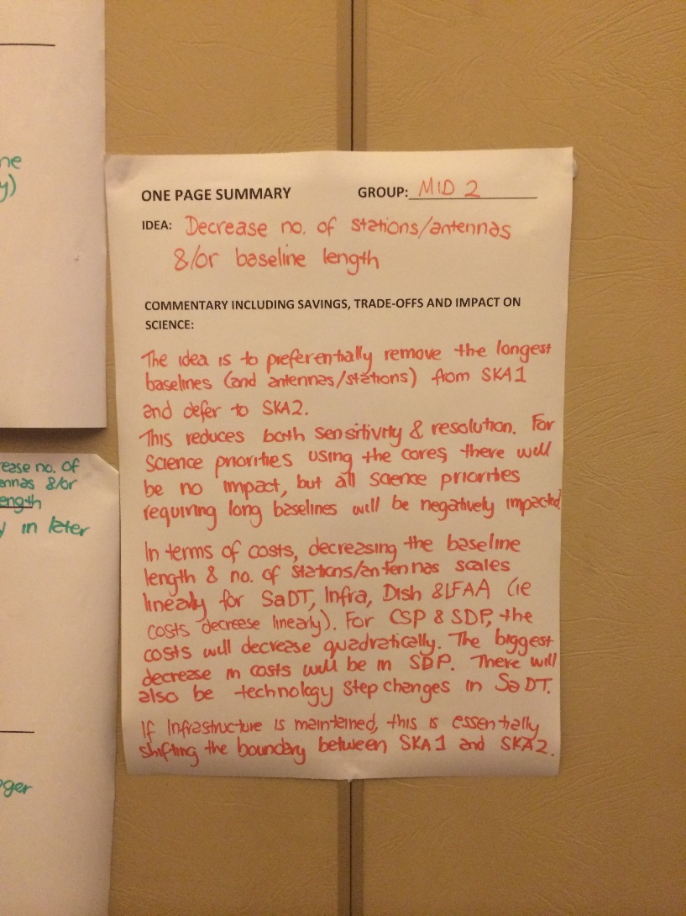
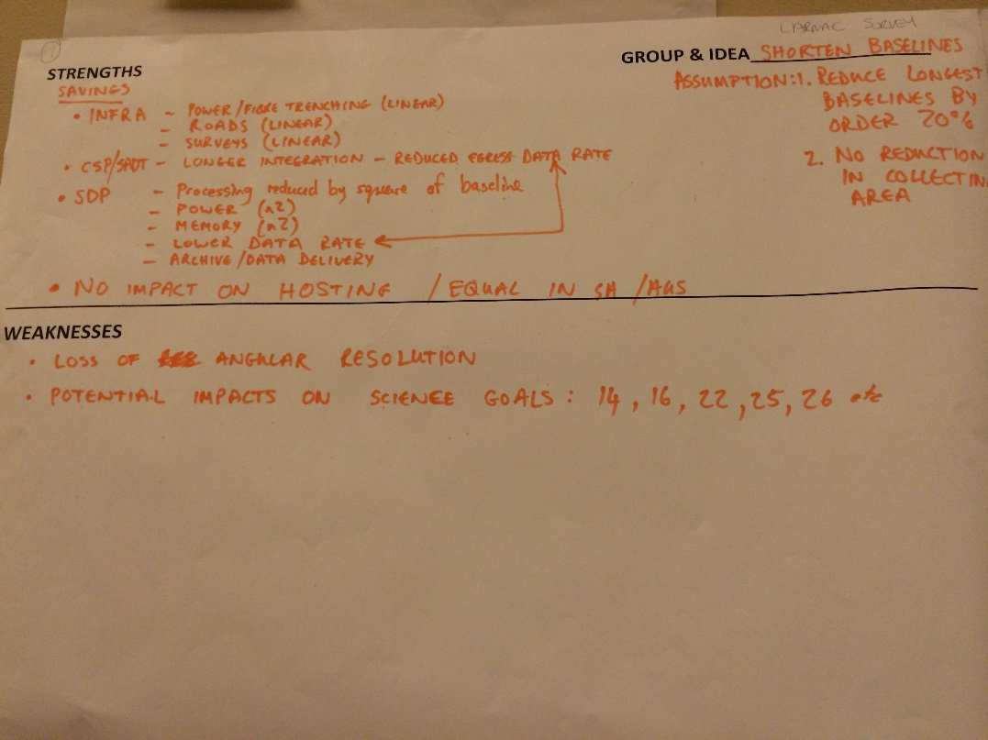
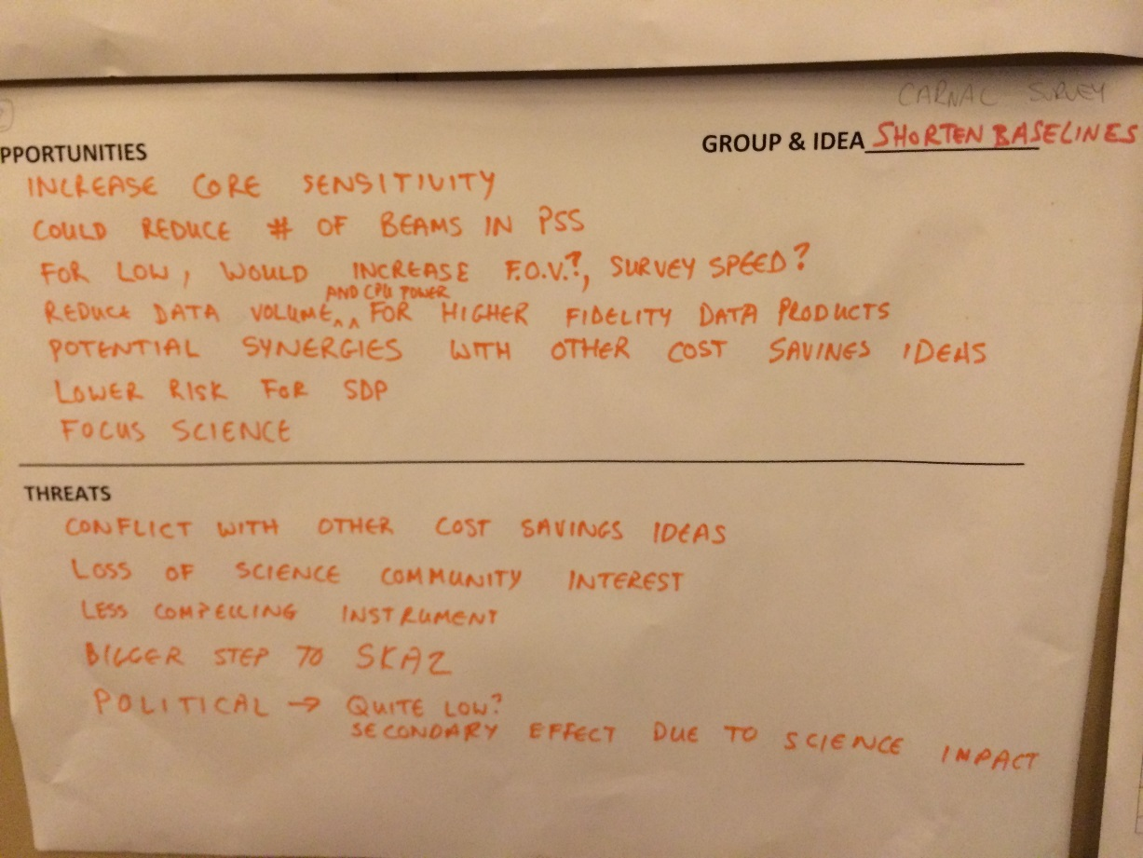
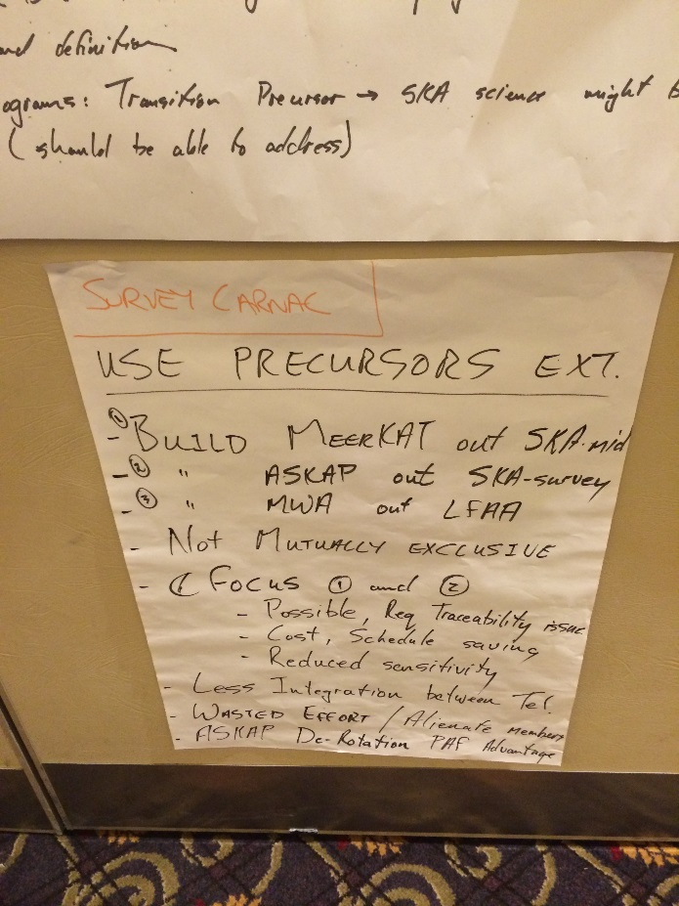
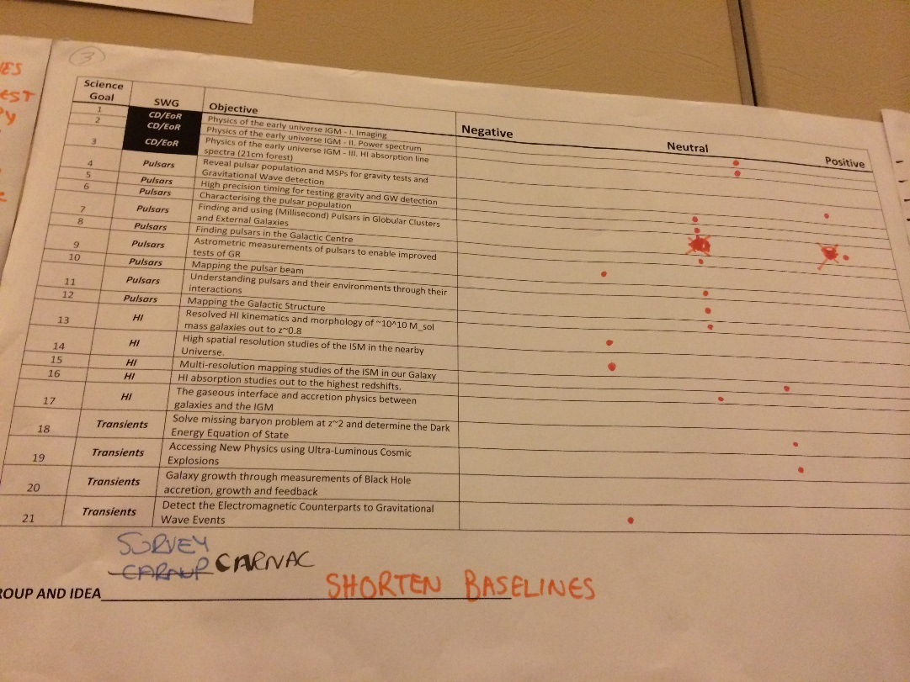

Slide 6
Phases in Assessment
Phase | 0 | 1 | 2 | 3
Goal | Remove inappropriate options | Reduction of large number of options to manageable number | Application of Element cost information to reduced set of options | Science and cost scoring of combined options
Filtering | Out of Scope, Part of Process, Duplicate, Assumed to be Complete, Too General | Estimated Resource savings, Science impact, Technical and Schedule Risk | Detailed analysis of cost savings, and science impact | Total Budget with € 10M of cost cap
References | Board Statements, RBS Process Definition | Options Group | RBS submissions, Options Group | Exhaustive
Output | Table of options with ID and provenance | Table of options with ID, provenance, primary Element, scores | Table of options with ID, provenance, primary Element, scores | Table of selected option combinations with budgets, science scores
Options | 204 in, 79 out | 29 out | 35 out | 35 in, ~ 720,000 considered, 1 out

Slide 7
Phase 2 Output with SRP Impact
Cost Saving Option | JIRA | ID | SKAO Science Capability Score | SRP Science Impact
Low 30% fewer stations | RA-38 | 267 | -4 | Minor
Low 50% fewer stations | RA-39 | 86 | -8 | Severe
Low 75% fewer stations | RA-39 | 272 | -10 | Unacceptable
Low cancelled | RA-31 | 249 | -10 | Unacceptable
Mid 30% fewer dishes | RA-20 | 265 | -8 | Severe
Mid 50% fewer dishes | RA-17 | 259 | -22 | Unacceptable
Mid 75% fewer dishes | RA-77 | 259 | -28 | Unacceptable
Mid Do not integrate MeerKAT | RA-13 | 232 | -5 | Severe
Mid shorter baselines 120km | RA-72 | 273 | -6 | Moderate
Mid shorter baselines 90km |  |  | -8 | Unacceptable
Mid shorter baselines 60km |  |  | -8 | Unacceptable
Mid shorter baselines 30km |  |  | -8 | Unacceptable
Mid 50% pulsar search beams | RA-24 | 205 | -6 | Severe
Mid Eliminate pulsar modes (redefine array conf) | RA-25 | 240 | -4 | Unacceptable
Mid Eliminate pulsar modes (same array conf) | RA-26 | 239 | -15 | Unacceptable
Mid Remove band 1 | RA-14 | 245 | -4 | Severe
Survey 30% fewer dishes | RA-19 | 266 | -6 | Minor
Survey 50% fewer dishes | RA-18 | 260 | -18 | Moderate
Survey 75% fewer dishes | RA-78 | 260 | -28 | Moderate
Survey cancelled | RA-28 | 250 | -28 | Moderate
Survey Do not integrate ASKAP | RA-1 | 233 | -6 | Minor
Survey shorter baselines 40km | RA-73 | 273 | -1 | No Impact
Survey shorter baselines 30km |  |  | -4 | Moderate
Survey shorter baselines 20km |  |  | -12 | Moderate
Survey shorter baselines 10km |  |  | -19 | Moderate
Survey fewer PAF beams | RA-21 | 128 | -18 | Minor
Survey/Low share SDP | RA-8 | 252 | -22 | Moderate

Slide 8
Baseline Options for Consideration
Prioritisation of traditional SKA-1 drivers
( Packages 1,2 & 3)
  EoR & Pulsars
Balanced Reductions
(Package 4)
  Something of everything
Acknowledged Technical Risks
( Packages 5, 6 & 7)
  LFAA Risk
  Survey Risk

Slide 9
Baseline Options for Consideration
ID | Title | Components LOW:MID:SUR % LOW:MID:SUR B_{Max} | SKAO Science Capability Score (-65 min) | State-of-Art Factor
 |  |  |  | LOW xLOFAR A/Tsys SSFoM Resolution | MID xVLA A/Tsys SSFoM Resolution | SUR xVLA A/Tsys SSFoM Resolution
1 | EoR & Pulsars | 70:70:00 % 65:30:00 km | -43 | x12 x190 x1 | x4.7 x60 x1 | -
2 | (EoR &) Pulsars Plus | 50:70:00 % 65:150:00 km | -45 | x8 x135 x1 | x4.7 x60 x4 | -
3 | EoR (& Pulsars Plus) | 70:50:00 % 65:150:00 km | -53 | x12 x190 x1 | x3.7 x37 x4 | -
4 | Some of everything | 25:50:50 % 65:60:40 km | -49 | x4 x70 x1 | x3.7 x37 x1.6 | x0.9 x100 x1.1
5 | LFAA to AIP v1 | 00:70:100 % 00:150:40 km | -18 | - | x4.7 x60 x4 | x1.5 x250 x1.1
6 | LFAA to AIP v2 | 00:80:70 % 00:150:40 km | -21 | - | x5.4 x80 x4 | x1.2 x150 x1.1
7 | PAF moves to AIP | 25:100:00 % 65:150:00 km | -36 | x4 x70 x1 | x6.2 x100 x4 | -

Slide 10
Science Key Objectives

Slide 11
Phase 3 Advice

Slide 13
SRP Advice
Building 2 facilities with transformational science is better than 3 facilities with incremental gains
Endorse ECP for pulsar search on SKA-LOW and an AIP programme for PAF development
Cutting SKA-LOW below 50% will make it largely uninteresting to community

Slide 14
Advice
SRP
  Option 2 with PAF AIP
  Second phase time analysis of time allocation
    Trimmed HPSOs
    Commensal Observing
SEAC
  Process Effective
  Unlikely for options to be overlooked
  SRP advice supported

Slide 15
SEAC Charge
Has the re-baselining process been effective?
  The process has been effective
Has the SKA Office overlooked any options?
  It appears unlikely
SEAC should provide advice on the direction of re-baselining
  Package 2 is the best option

Slide 16
Preliminary Design Reviews
Entry Conditions (Readiness)
Review Data Pack Contents
Participants
Constitution of Review Panel
Roles & Responsibilities during process

Slide 17
Programme
Element | Review Readiness Notice (RRN) due | Actual PDR Meeting | PDR Decision | Final delta-PDR Meeting
CSP | 18 September 2014 | 17-18 Dec 2014 | Do Not Accept: delta PDR required | March 2016 (TBD)
TM | 18 September 2014 | 7-8 Jan 2015 | Do Not Accept: delta PDR required | Monday, 12 October 2015
SaDT | 18 September 2014 | 14-15 Jan 2015 | Do Not Accept: delta PDR required | Wednesday, 14 October 2015
LFAA | 17 September 2014 | 26-27 Jan 2015 | Do Not Accept: actions incomplete | N/A (action completion expected Dec 15)
DSH | 23 October 2014 | 9-10 Feb 2015 | Do Not Accept: full PDR required | 15 - 16 Dec 2015
INFRA SA | 15 October 2014 | 16-17 Feb 2015 | Accept without reservation | N/A
INFRA AUS | 15 October 2014 | 18-19 Feb 2015 | Accept without reservation | N/A
AIV | 15 October 2014 | 23-24 Feb 2015 | Accept with reservation | N/A
SDP | 09 December 2014 | 18-19 Mar 2015 | Do Not Accept: full PDR required | Q1 2016

Slide 18
Review
Time to respond to questions short
Process appeared ‘mechanistic’ at times
Tools could be improved
Only documents submitted reviewed I didn’t cover missing documents
Dealt with detail in documents, not always global issues
Expectation of level of detail was not always consistent
Brain-storming following review was useful
Remote participation did not always work well
Restricting number of consortia members was not always helpful

Slide 19
Review Continued…
Not all consortia were clear on the scope of PDR
Guidance required on the completeness of documentation
Preparation and quality control of documentation was lacking
Declarations of Readiness were not always accurate
Issues over applicability of documents – some beyond PDR
SE approach inconsistent
Creation of Baselines

Slide 20
Development of Baseline
Baseline Design #1
ECPs
PDR
Re-baselining
Baseline Design #2

Slide 21
CDR
Readiness
List of Documents
Process
  CDR in parts
  System CDR
Panels
Schedule
CONSTRUCTION PROPOSAL

Slide 22
Schedule Issues
PDRs Completed later than planned
Resources not always available within Consortia
SKA Office output
Experience of teams
Development levels

Slide 23
High-level Pre-Construction Schedule
KEY: blue = SKA1 science & engineering, orange = policy; triangles: red = review meeting; black = released doc; green = Board of Directors meeting
Element system inputs
Delta Architecture Review
System level inputs
Delta element PDRs
Operations Concept Review
NEW: Post RBS element submission
System Review
Element Stage 2 deliverables:
AIV to CDR submission
CSP to CDR meeting
DSH to structure CDR mtg
DSH to Band 1,2 CDR mtg
DSH to Band 5 CDR meeting
INAU to CDR submission
INSA to CDR submission
LFAA to CDR meeting
SaDT to CDR submission
SDP to CDR submission
TM to CDR submission
System CDR inputs
System CDR
Construction Proposal
Construction approval
IGO negotiation & signature
IGO ratification of agreements
IGO in operation
(TM, SaDT, CSP-Low, DSH, SDP)
12-18 months?
Q3 ‘15
Q4 ‘15
Q1 ‘16
Q2 ‘16
Q3 ‘16
Q4 ‘16
Q1 ‘17
Q2 ‘17
Q3 ‘17
Q4 ‘17
Q1 ‘18
Q2 ‘18
Andrea Casson, SKAO, Oct 2015
Notes:
High level schedule for the next 3 years – the timescale is quarters – taking us through key engineering activities upto construction approval and showing how the policy timeframe is aligned.
Top left is the work required through to System Review, including the inputs due September from the consortia (updated costs, compliance, risks, EMI control plans, RAM report, Logistic report, ICDs, power estimates), the delta AR, delta PDRs for 5 consortia, the Ops Concept Review and system-level inputs, the latter being the consolidated output documents per telescope from the analysis work currently ongoing on products, functions, requirements and interfaces; the system budget/requirements allocation work; and other policies and standards. New “Post RBS element submission” milestone - some elements already have this covered via delta PDRs but others don’t, so this will be agreed on a case by case basis.
The middle grey-shaded area shows the 9 SKA1 consortia activities through to their CDR submissions or meetings, depending on how their milestones are currently defined – this will be updated in line with the consortia Stage 2 ECPs when they come through.
Underneath the consortia activities is the System CDR and Construction Proposal, the approval process for which could take 6 months. The orange tasks represent the development of the SKA as an Intergovernmental organisation (IGO), and shows that the IGO should be in place just in time to receive the construction proposal.

Slide 24
High-level SKA Schedule
KEY: Blue = SKA1 science & engineering; orange = policy; green = SKA2
Detailed design
Pre-construction Stage 2
Critical Design Reviews (elements then system)
SKA1 construction proposal & approval
Procurement
SKA1 construction
SKA1 early science
SKA1 operations
Key Doc Set & Prospectus
IGO agreements negotiated and complete
Formal negotiations
Ratification of Agreements
IGO operational and able to centrally contract
Advanced Instrumentation Prog.
PDR (MFAA and WBSPF)
SKA2 detailed design
SKA2 procurement
SKA2 construction starts
2015
2016
2017
2018
2019
2020
2021
2022
2023
2024
Andrea Casson, August 2015

Slide 25
Integration Centres
Development
Construction
  Providing proof of verification
  Integration of subcomponents
  Preparation for overall integration

Slide 26
Locations
Member Countries
  Early integration
  Verification and alignment
Hosting Countries
  Pre-integration centres

Slide 27
Regional Data Centres
SDP Data Centres
  Australia
  South Africa
Connection to Users
Availability of Data on Regional Basis

Slide 28
Communications
Trust
Openness
Same Page/same plan

Slide 29
Communication methods
Monthly discussions
Face to Face meetings
Visits
Working at JBO
Monthly Newsletter
Personal contacts

Slide 30
Methods
Meetings
  Monthly Progress Meetings
  Monthly Consortium Leaders’ Meeting
  Science Meetings
  Telescope Teams
  Consortia F2F
  PM/SE updates

Slide 31
Communication Tools
Email
Video Conferencing
Telephone
Confluence/Jira
eB
Consortia tools

Slide 32

Attitudes
Time for coffee?

Slide 33
Responsibility Matrix
Responsibility | Definition
Approve | Has final say
Recommend | After weighing proposals, recommend action
Propose | Unilateral proposal
Advise | Provides input when consulted

Slide 34
Communication
Don’t be afraid to make suggestions
  Remember Science priorities
  Some preparatory discussion is useful
Take part in Change Review Boards
Accept decisions in good faith

Slide 35
Consortia Progress
Nearly through PDRs
Plenty of Phase 2 work started
Some necessary re-alignment
Decisions being made (down-selects)

Slide 36
Telescope Teams
Work organised by Elements
Two Telescope Teams:
  TT-Mid
  TT-Low
Resolution Teams
Further development

Slide 37
Office News
Staff Changes
New Project Engineer - Luca Stringhetti
Two vacancies as domain specialists
Computing Lead – interviews November
Systems Engineer vacancies
New Safety Manager – John Kerr

Slide 38
2016 brings
Progress towards CDR
Systems Review (Q1/2016)
Operations Planning
Telescope Model
Configurations

Slide 39
Engineering Meeting
Busy Programme
Many People
Use opportunities…….
Enjoy

