Slide 1
INFRA SA Consortium
Engineering Meeting, Penticton, Canada
Tracy Cheetham
10 November 2015

Slide 2
Overview of presentation
Stage 1 Deliverables, Milestones and PDR closure
Overview of some of the infrastructure & power sub-element design solutions and issues, trade-offs and ECPs to be addressed for Stage 2
Stage 2 Deliverables, milestones & schedule
Risks / Challenges
Concluding Remarks

Slide 3
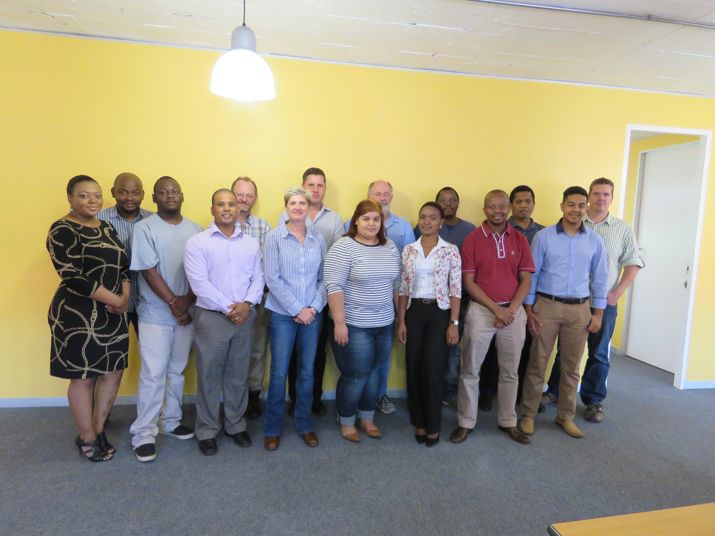
INFRA SA Consortium

Slide 4
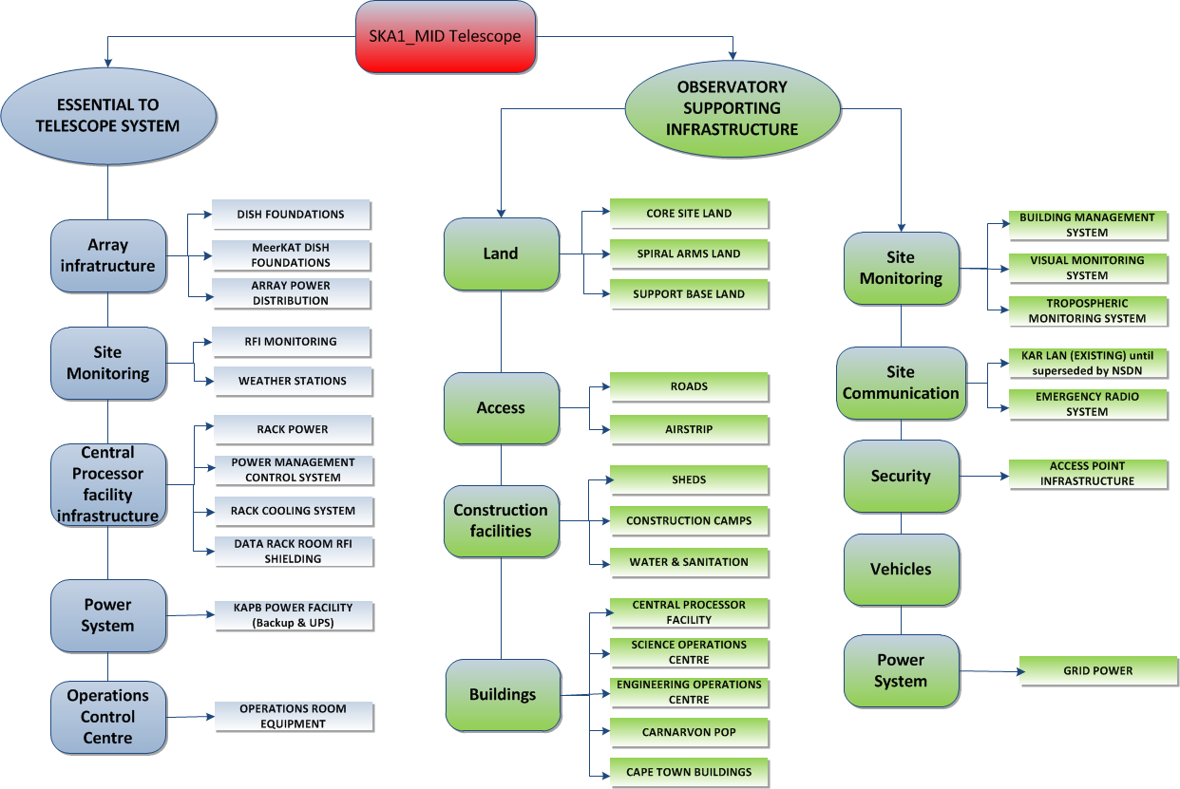
SKA1_MID INFRA & Power PBS

Slide 5
Deliverables & Milestones
STAGE 1
ITEM | DELIVERABLE | DUE DATE | PROGRESS
1 | T0 Kick-off | 4 Nov 2013
2 | T0 + 12 weeks – Level 1 Requirements | 20 Feb 2014
3 | Power Analysis Report | 24 April 2014
4 | SDP Siting Trade-off Study | 29 May 2014
5 | Antenna Foundation Design Report (Concept Design) | 17 Sept 2014
6 | Infrastructure & Power construction deployment strategy | 27 July 2014
7 | Inputs into SKAO re-baselining | 25 Sept 2014
8 | PDR submission | 28 Nov 2014 (T0 + 52 wks)
9 | PDR Closure & baselined | 15 April 2015 (T0 + 68 wks)

Slide 6
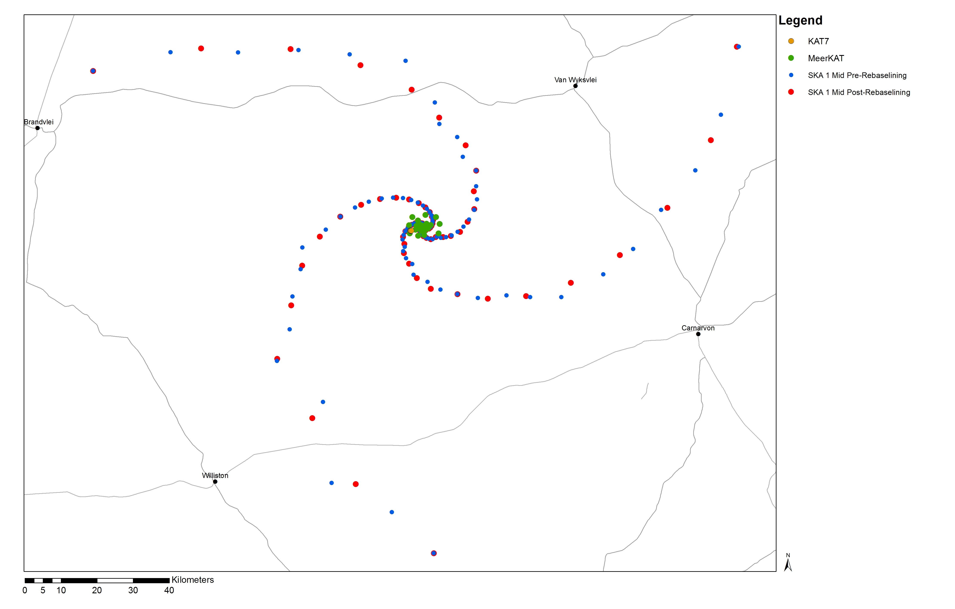
SKA1_MID Physical Configuration

Slide 7
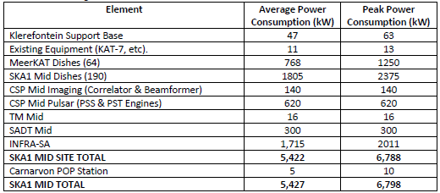
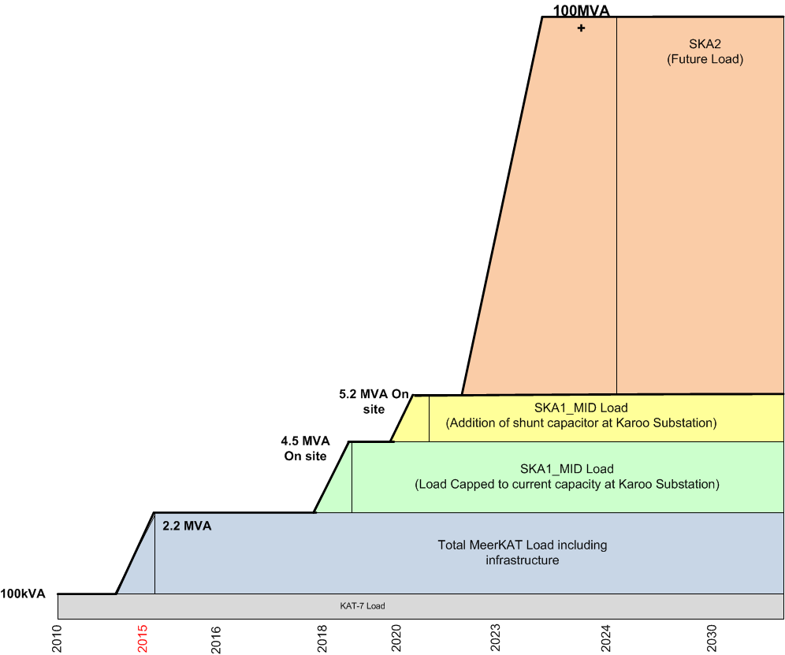
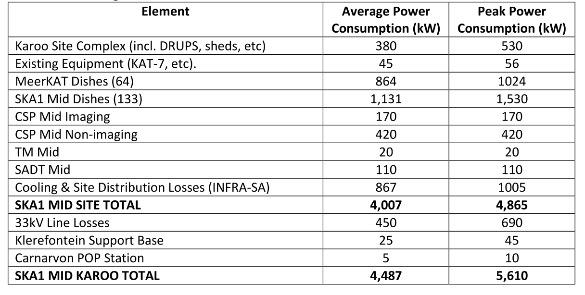
Grid Power
Baseline
€ LOTS
Post RBS
Notes:
Load growth – when 6.5MVA-load less on line is exceeded – trigger construction of new 132kV power line
Existing grid connection to site is limited in terms of the power it can deliver.
5.2MVA max available on site with introduction of shunt capacitors. We are doing modelling to limit over-voltage on site to within 10% and introduce voltage support capacitors on site so that average power is limited to below 4MW, while peak power consumption (due to dishes slewing) is allowed to be higher than 4MW.
Introduce load curtailment measures when power requirement exceeds power available on site.

Slide 8
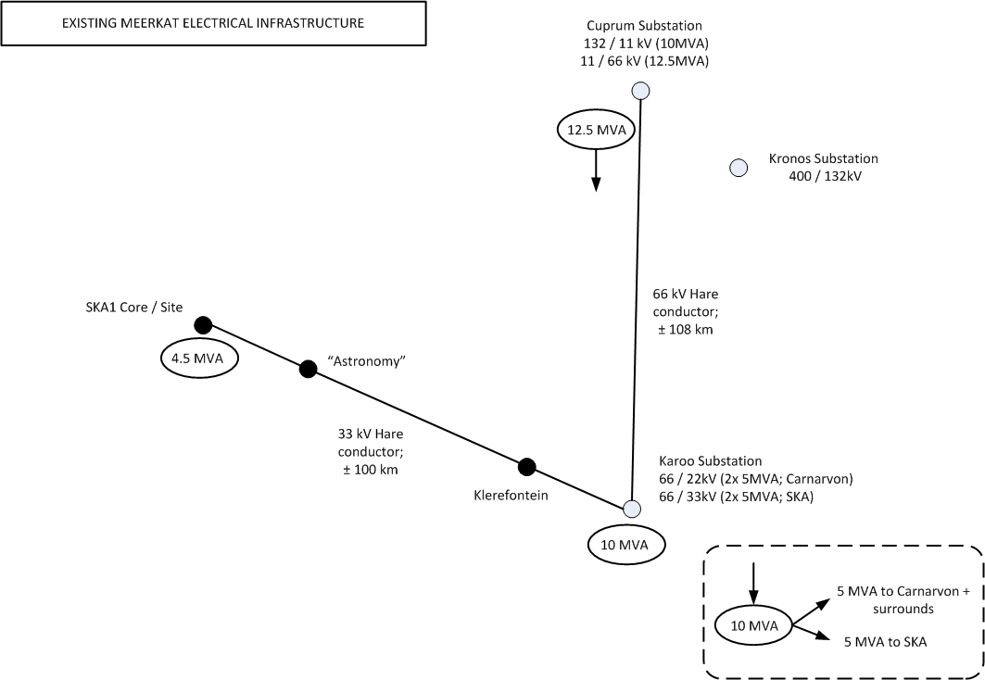
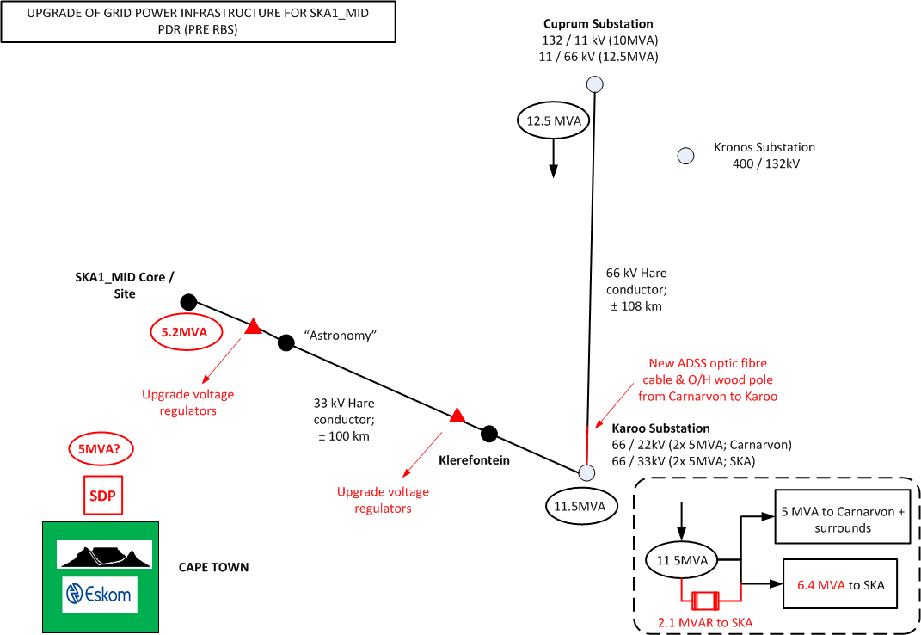
Grid Power
Notes:
The 66kV line feeding the Karoo substation is shared by the SKA and the town of Carnarvon. 5MVA capacity currently being reserved for Carnarvon.
Install a 2.1MVAR Shunt Capacitor Bank on the 33kV busbar at Karoo Substation. This will make 6.4MVA available at Karoo Substation for SKA
On-site with load losses: 5.2MVA
Given the reduction in the load based on new SKA Power budget, voltage drop reduced and might eliminate need to upgrade existing 100A Voltage Regulators to 200A units
SDP in CT – Eskom
Cost come down from 26million Euro to 24 million Euro

Slide 9
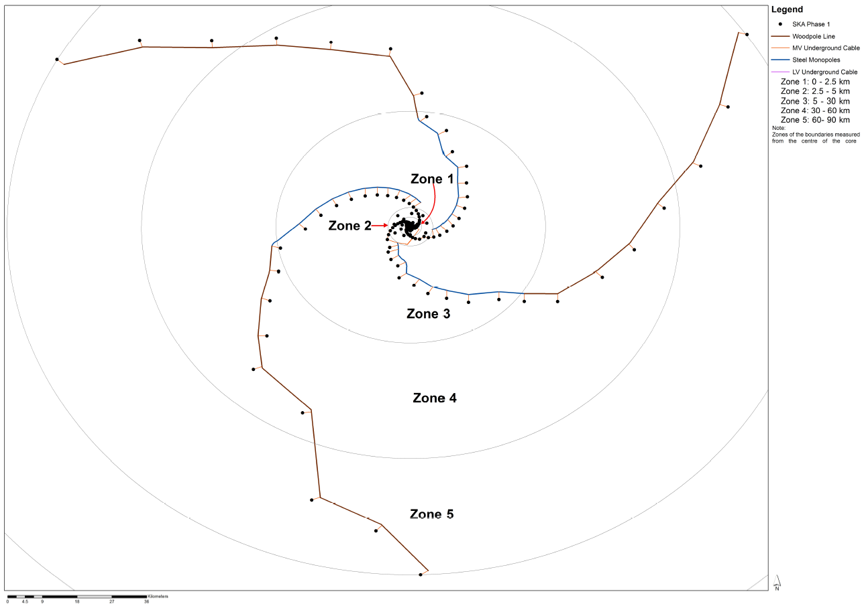
Power to Spiral Arms
2km separation
distance
22kV steel o/h line
500m?
22kV wood o/h line
Notes:
First 5km – underground trenched power cabling
5-30km – Steel overhead power line to get better earthing, bonding and lightning protection
Transition from 30km out on spiral arms to wooden pole structure to reduce costs
PDR – 2km separation distance between antennas and o/h power lines
RFI measurement campaigns during course of 2015 against SARAS standards – looks like this can be relaxed to 500m separation distance which will reduce costs
Decision on final separation distance NB for servitudes for land acquisition programme
Real Time spectrum Analyser as used with calibrated antenna, LNA and cables
Measurements were done at a acquisition Bandwidth of 5 MHz for 10 second periods over a duration of more than a hour
Post processing was done for a Resolution Bandwidth (RBW) of 1 Hz as well as 255 Hz (SKAO spec)

Slide 10
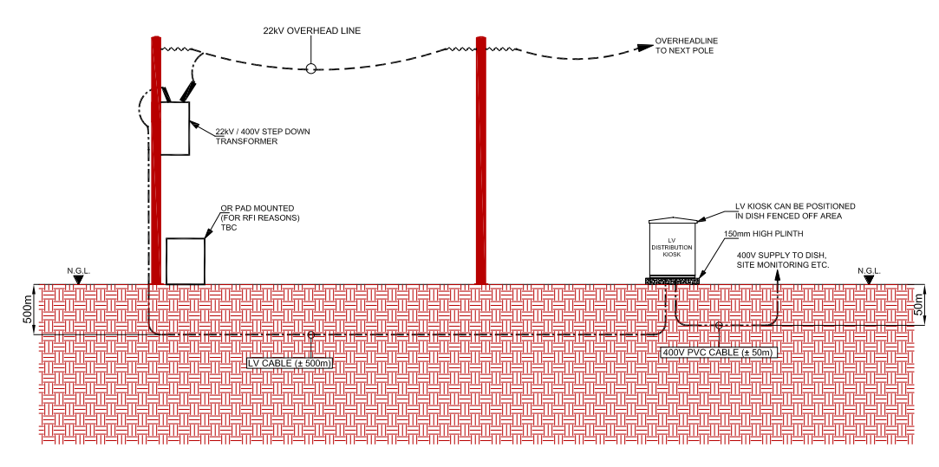
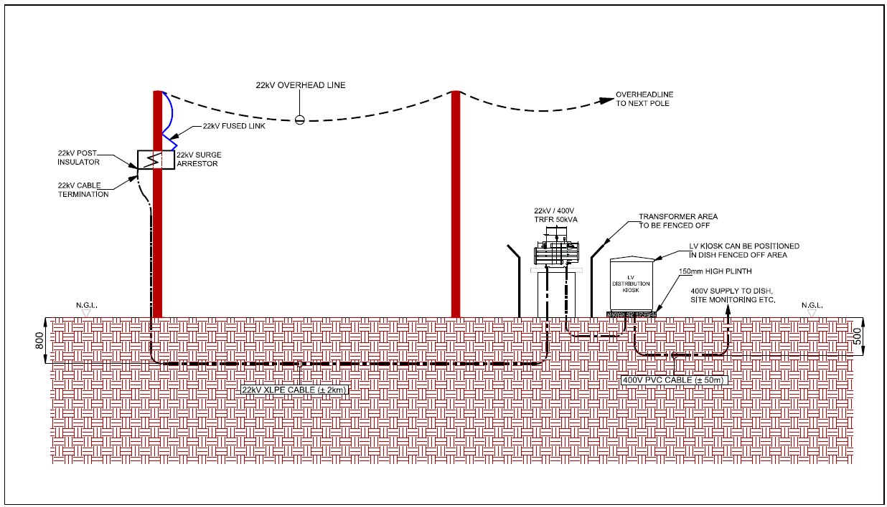
Power to Spiral Arms
500m separation distance
2km separation distance
22kV/400V step-down transformer
22kV/400V step-down transformer
400V LV cable
22kV cable

Slide 11
Power issues post-PDR / RBS
Need a power commissioning / ramp up plan for SKA1_MID (early deployment of power in relation to the deployment of dishes & computing & how test and verification takes place)
AIV rollout plan to address power ramp-up
Power simulations post RBS still to be done which includes harmonics, voltage regulation per dish, transient studies, over-voltage issues, load-flow & Power Factor Correction
Power Quality Standard to be issued shortly. Largely based on international standards (IEC). South Africa & Australia have provided input to ensure alignment with local QoS standards as far as possible. This standard will replace the QoS related requirements in ICDs

Slide 12
Power issues post-PDR / RBS
Concern around over-voltage on 33kV line when site draws full load and 33kV incoming breaker trips. Existing voltage regulators won’t be able to tap down quick enough to bring voltage within allowable limits which means over-voltage will remain on the line – voltage correction capacitors are being investigated
SaDT on-site tests on overhead optic fibre cable – await final recommendation but it looks like the fibre can be strung on the overhead power lines in spiral arms to reduce costs. Joint ECP being raised to investigate cost savings. Decision required as this influences number of servitudes required as part of land acquisition programme
Repeater stations required on spiral arms – joint ECP with SaDT to be raised to implement this

Slide 13
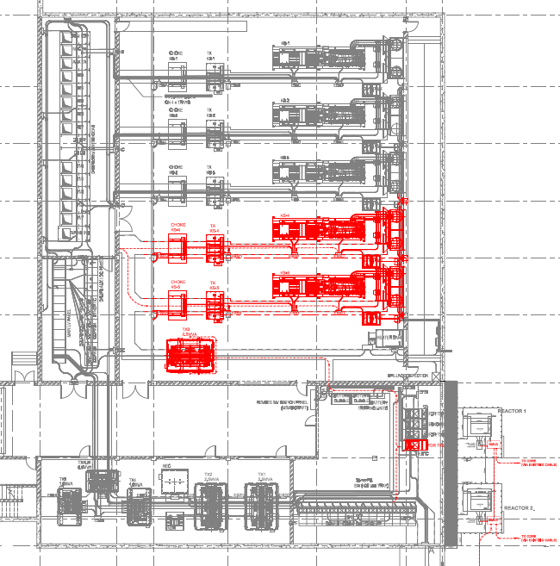
Back-up & UPS Power
2 x new DRUPS units to existing 3 units = 6.25MVA back-up/UPS power available (No N+1 redundancy)
Add additional 2.5MVA, 33/22kV Transformer
Install additional 33kV breaker for new transformer
Notes:
For MeerKAT, 3 x 1.25MVA Rotary UPS system are fitted in a N+1 configuration
Assumption that 5MVA units will fit into KAPB (1.25MVA @ 0.8PFC) – for SKA1 there will be no redundancy in terms of back-up/UPS

Slide 14
Buildings
Assumption that existing MeerKAT on-site dish assembly facilities will be re-used for SKA1_MID
Three construction camps will be established for SKA1_MID which accommodate 740 people during the peak period of construction. This number is based on the estimated 540 people for the Infrastructure and Power element and an additional 200 people for the other telescope elements

Slide 15
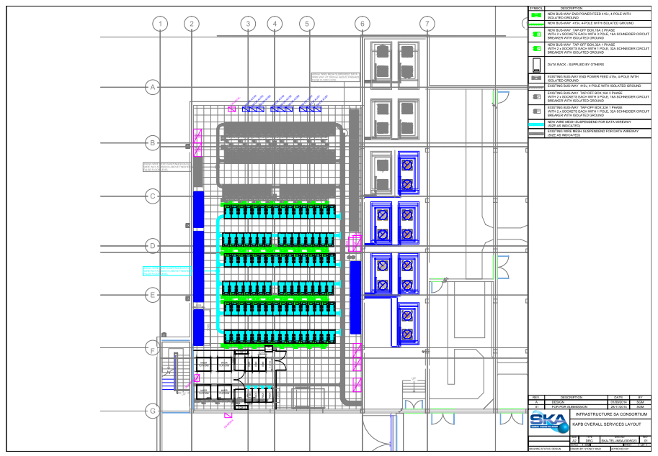
Buildings
Notes:
PDR – 143 racks can be housed in the KAPB data rack room –
CSP rack driving req (110 racks) - of that 62 racks could fit into the KAPB
An additional 48 CSP racks had to be accommodated in a new CSP facility adjacent to the KAPB

Slide 16
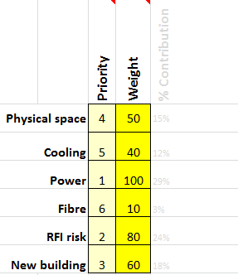
Decision Model for ECP
CSP raised ECP to investigate 32 options for CBF & PSS racks, cooling, power
Decision model used: Robert Halligan of Project Performance International
.
Options are evaluated against various factors.
Each factor is given a relative weight
Each of the 32 options were then populated with the parameters for each of the factors
Each factor is scored, for each option
The weights are used to compute a summary
Notes:
.

Slide 17
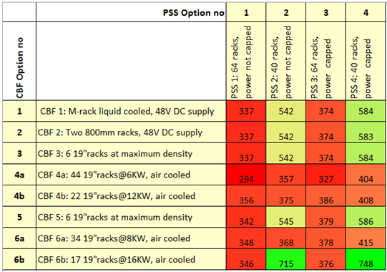
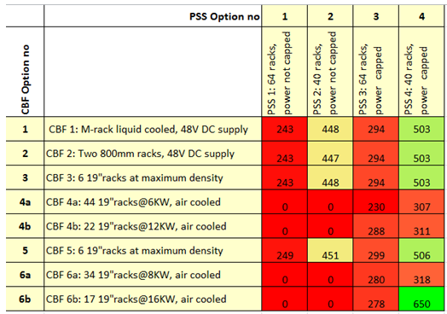
Decision Model
If power is not capped, the recommended solution is:
CBF Option 6b with PSS Option 4 = 17 19“ racks@16KW, air cooled with PSS 4: 40 racks, power capped
If power is capped, the recommended solution is:
CBF Option 6b with PSS Option 4 = CBF 6b: 17 19"racks @16KW, air cooled with PSS 4: 40 racks, power capped, but by a huge margin
Notes:
.

Slide 18
ICD requirements from CSP
 | INFRA SA PDR | Design (Nov 2015)
CSP number of Racks (CBF, PST and PSS) | 110 racks | 60 racks for CSP 40 for PSS 18 for CBF 2 for PST (ECP 150014 and 150015)
Fit into KAPB | No New CSP Building | Yes
Cooling | Air cooled and water cooled mix | Air cooled
Fit into Power Budget from SKAO | No | No SKAO Budget: Average: 590kW & peak 760kW CSP Power Estimate: 900kW

Slide 19
CSP Power
The INFRA SA recommendation is fairly intuitive.
The KAPB is an air cooled facility
The best solution from INFRA SA’s point of view is an air cooled solution which fits into the existing building
CSP to consider INFRA SA recommendations
CSP has to fit into the SKAO Power Budget
It understood that the SKAO has raised an ECP to investigate the option of shifting CSP to Klerefontein (need to investigate data costs; power implications, building costs)
Notes:
.

Slide 20
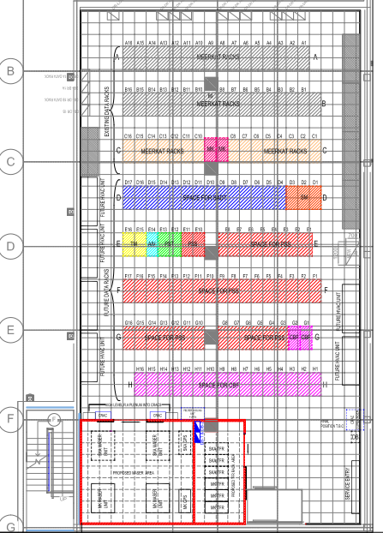
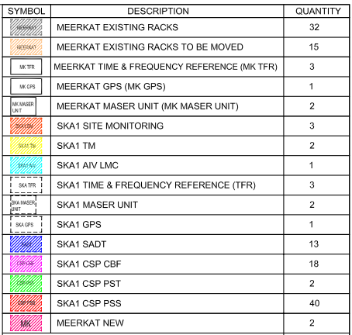
Notes:
.

Slide 21
Buildings outside scope
SKAO Engineering Operations Centre (Annex 4 Hosting Agreement)
– Assumption that Klerefontein Support Base will be re-used – however decision reliant on SKAO Operations and Support Concept
SKAO Science Operations Centre in Cape Town (Annex 4 Hosting Agreement)
- SKA SA lease in Cape Town expires in March 2017. User requirements for office space signed off
- Current SKAO requirement is office space for 50 people (TBC). Space subject to commercial terms and conditions
- SKAO requirements included in SKA SA user requirements specification for now. The SKA SA is proceeding with a tender to see how these requirements can be met

Slide 22
Buildings outside scope
Science Data Processing Centre (Annex 4 of Hosting Agreement)
- Western Cape Government is busy undertaking a feasibility study
to construct the Western Cape High Performance Computing Facility in Cape Town
- Aim is to secure anchor tenants of which SKAO can be one
- SDP requirements to be included in ICD (external to INFRA SA)
as an input to this process.
- Subject to commercial terms and conditions

Slide 23
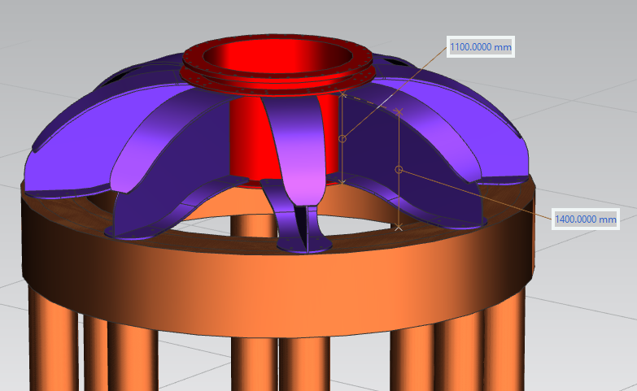
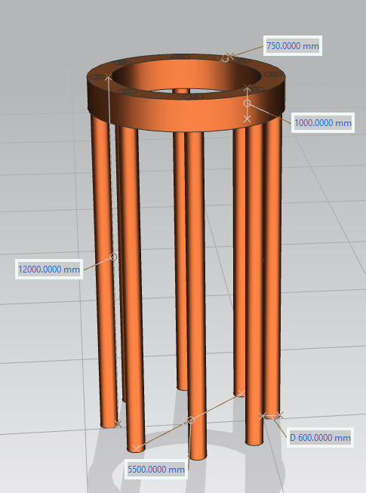
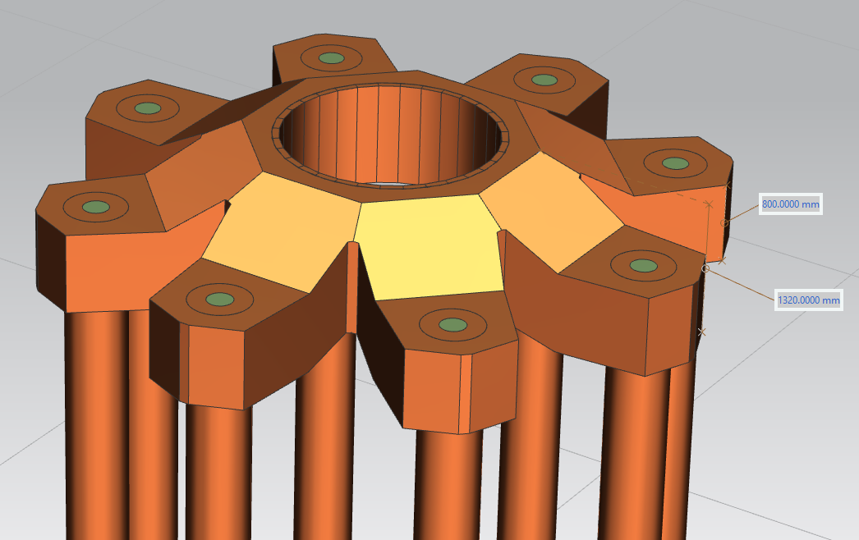
Antenna Foundations
1000.000mm
Steel-top concept
D750.000mm
Spider concept
Pre-cast concrete top
Notes:
Geotechnical investigation done for MeerKAT – geotech for SKA1 not undertaken yet
Yellow represents hillwash; orange is mudstone and pink is dolerite outcrops where founding conditions for foundations will be shallower
Anticipated Length of Piles and Corresponding Number of Foundations – purely assumption at this stage – until geotech study undertaken, assumed 12m depth worst case

Slide 24
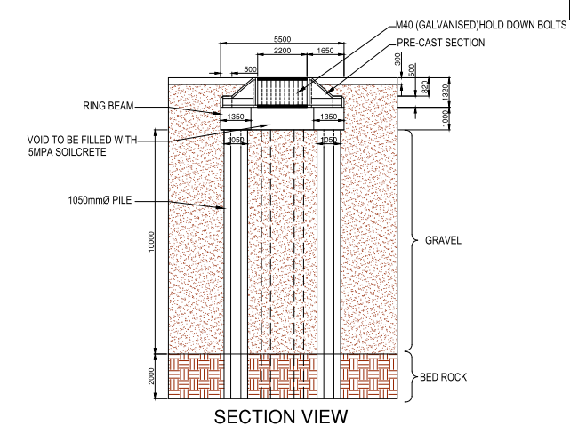
Antenna Foundations
8x1050mm piles which augered into the ground up to bedrock
Above the piles, a 1m wide, 1m high and 5.5m diameter ring beam is cast in-situ into the piles
The top structure includes 4 pre-cast sections that will be placed on top of the ring beam.
The sections will be bolted down with 4xM40 bolts to the ring beam directly above each pile. They will be bolted together in the centre with 8 steel sections and 32xM40 bolts for alignment and strengthening purposes. The bolts will be cast with the ring beam and tied to the top of the top structure. The gap between the precast sections will be filled with epoxy.
Pre-cast concrete top
Notes:
Steel reinforced piles – 30MPA concrete
Soilcrete inside centre – 5MPA
Precast section – 50MPA concrete
Pre-cast option reduces costs (reinforced); ring beam reinforced
Starter bars tie pile and ring beam together.
Epoxy between precast sections – M30 bolts tie top and bottom
Finite Element Analysis was undertaken by creating models for the soil, piles and concrete
The soil model was used for all 3 concepts. The model was a 12m diameter cylinder which addresses 12m, 7.5m and 5m deep piles. Lowest section of model was at least 2.5m bedrock
Displacement results in terms of deflection and rotation are shown in Figure to the right

Slide 25
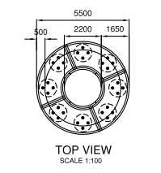
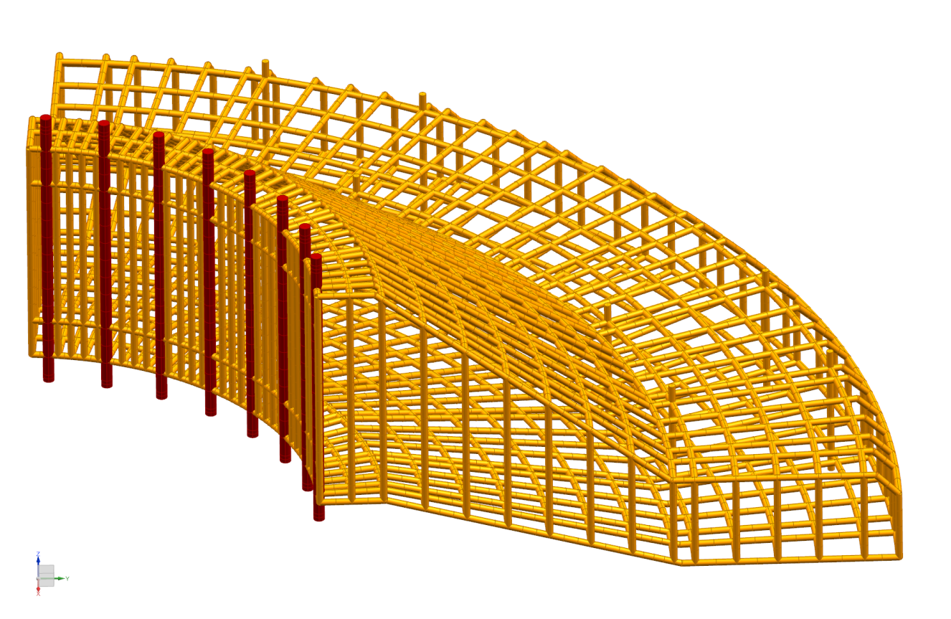
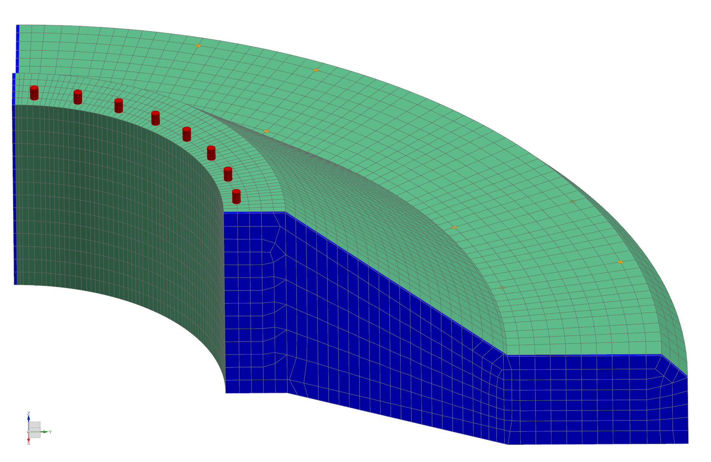
Antenna Foundations
Notes:
Steel reinforced piles – 30MPA concrete
Soilcrete inside centre – 5MPA
Precast section – 50MPA concrete
Pre-cast option reduces costs (reinforced); ring beam reinforced
Starter bars tie pile and ring beam together.
Epoxy between precast sections – M30 bolts tie top and bottom
Finite Element Analysis was undertaken by creating models for the soil, piles and concrete
The soil model was used for all 3 concepts. The model was a 12m diameter cylinder which addresses 12m, 7.5m and 5m deep piles. Lowest section of model was at least 2.5m bedrock
Displacement results in terms of deflection and rotation are shown in Figure to the right

Slide 26
Antenna Foundations – post PDR
Await dish down-selection to inform design further
DISH loading / wind requirements changed as per new ICD
DISH to do more modelling with regards to dish transporting as the existing and future O/H power line clearance must be taken into account & terrain needs to be carefully understood
Tender awarded for SKA1_MID geotechnical investigation – work to commence in due course
Tender advertised last Friday for the detailed design of the antenna foundations and the construction of a prototype (which includes pull tests in site to verify design)

Slide 27
Draft Detail Design Phase
Inputs
MeerKAT record information (investigation reports, designs, test results, etc.)
SKA1_MID record information (investigation reports, designs, etc.)
Interfaces with SKA Representatives
Design Process
Review and Analysis of all inputs
Determine the optimal antenna
foundation solutions for all 133 positions
Outputs
133 Antenna foundation solutions and supporting documentation
Antenna foundation prototype
construction documentation
Prototype Construction Phase
Antenna Foundation Prototype Construction Process
Site Establishment
Construction of the prototype
Testing and verification of the prototype
Pile load testing on existing MeerKAT trial piles
Draft Design Detail Review
Outputs
Tested and verified antenna foundation Prototype
As-built Information
Decision To Proceed (or not) with Prototype Construction
Final Design Review
Approval of the final deliverables for procurement and construction
Final Design Phase
Design Process
Review and analysis of all as-built information
Assessment of lessons learnt
Determine the optimal antenna foundation solutions for all 133 positions
Outputs
Final designs for all 133 antenna foundations
Final design report and all supporting documentation
20 weeks
10 weeks
6 Weeks
34 Weeks

Slide 28
Access
Approximately 560km of road works required for SKA1_MID
Of the 560km, 150km will be new roads in the spiral arms; 12km will be new roads in the core and 398km in the spiral arms will be existing farm & district roads which will be rehabilitated to improve access
Roads will follow independent routing of power line & have separate servitudes

Slide 29
Geotechnical Investigation
Access (Roads)
Identify borrow pit sites (and alternatives) suitable for sourcing of road construction materials and antenna platforms;
Investigate how much more material can be sourced from the four (4) existing MeerKAT borrow pits
Confirm the quality of the material by sampling and off-site specialist laboratory testing; and
Use the ground information compiled during the investigation as input to the mineral permits applications.

Slide 30
Geotechnical Investigation
Scope
Rotary core drilling will be undertaken at 3 locations within the core and 5 per spiral arm (Total of 18 locations)
Further drilling will be undertaken at 12 stone quarry locations at an assumed average distance of 15km from the core drilling position for the foundations
Percussion drilling at all the 18 rotary core sites, and 72 other locations (Total of 90 (35 in the core and 55 in the spiral arms)
TLB excavations at 15 antenna positions in the core and along the spiral arms up to a depth not exceeding 4m for further profiling and plate load testing at all 15 positions
Laboratory testing
Borrow pits investigations to confirm sources material within a distance not exceeding 20km from a road section. A total of 14 borrow pits have been estimated, three of which were used for the MeerKAT project

Slide 31
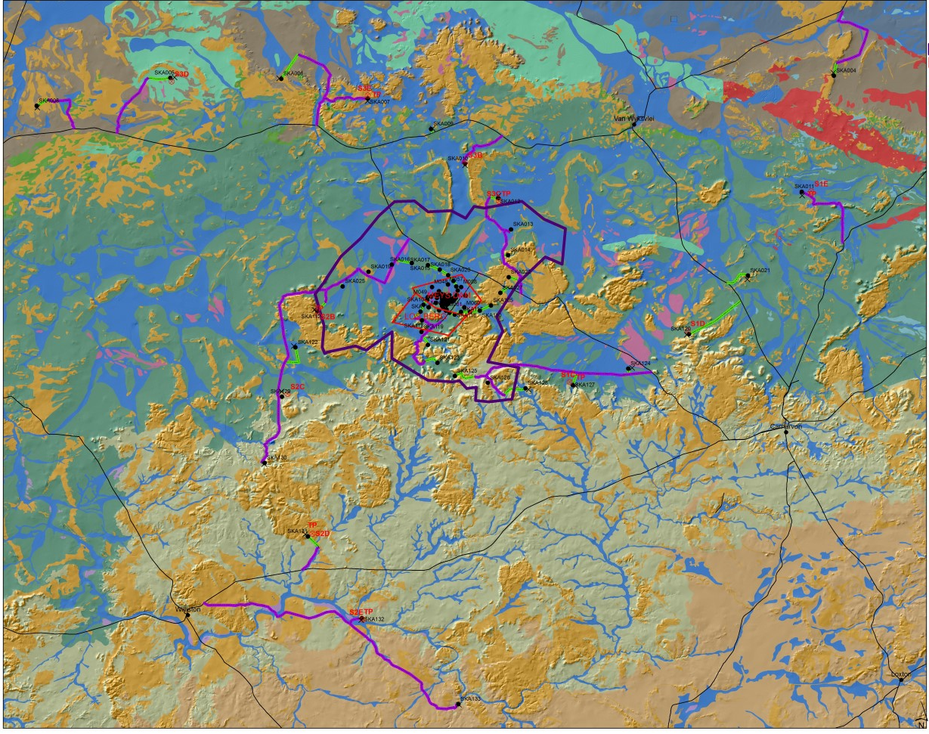
Geotechnical Investigation

Slide 32
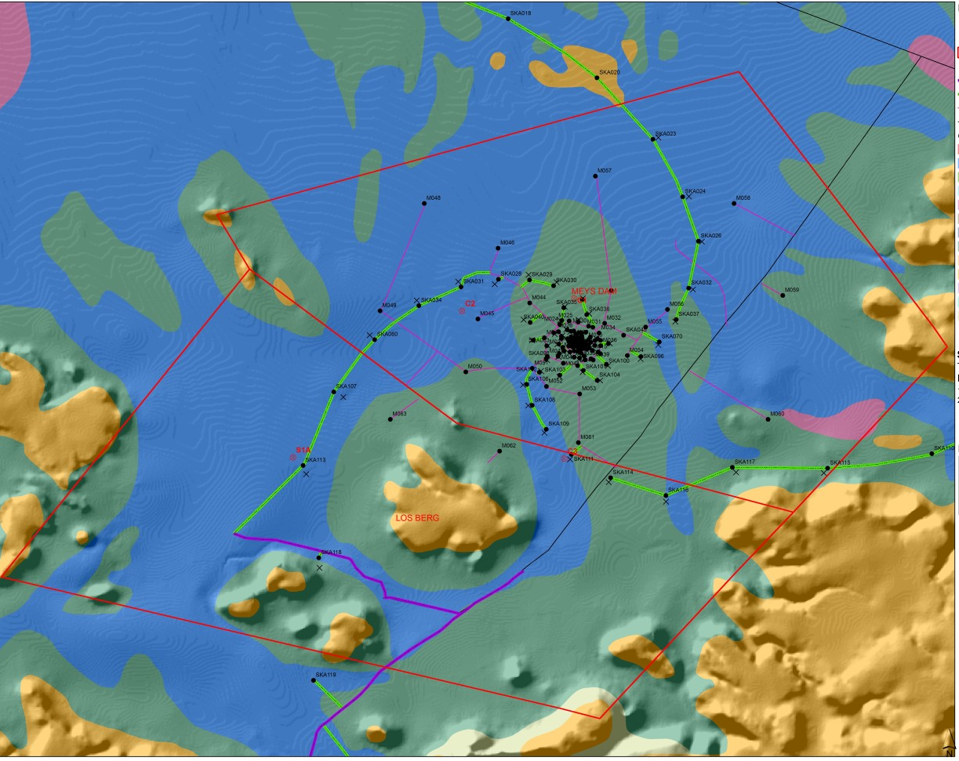
Geotechnical Investigation
Notes:
Red is percussion drilling
Yellow is rotary core drilling

Slide 33
LIDAR Survey of SKA1_MID
Total survey area of approximately 390,000 hectares. The survey will enable the following:
- Determination of optimal routes for overhead powerlines, fibre trenches and access(roads)
- Design the geometry of the roads
- Confirmation that dishes are not located in harsh terrain
- Definition of catchment areas for stormwater design around the infrastructure and the dishes
- Definition of catchment areas for floodline analysis
- Input to the geohydrological study
Flying started yesterday – will take approx. 1 week

Slide 34
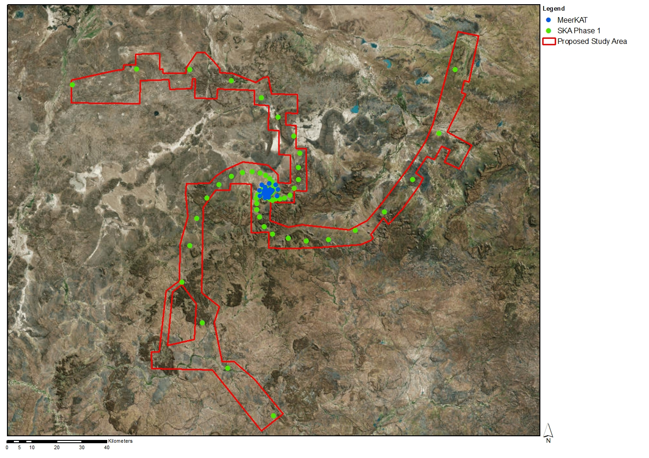
LIDAR Survey of SKA1_MID
Vertical points shall be within a 300mm accuracy
Horizontal points shall be within a 1000mm accuracy
The point density shall be a minimum of 1 point per square meter
The image pixel resolution will be 30cm
Contour interval shall be 0.5m, 1m and 2m

Slide 35
Geohydrological Study & Floodline
Study covers full extent of the SKA1_MID construction area
The purpose of the study is to:
- Assess the groundwater capacity & content
- Assess the impact of abstraction on the resources
- Determine the floodlines for various rainfall return intervals and associated risks; and
- Use the groundwater information compiled as input for the water use & waste management license applications
There are a total of twenty four (24) boreholes for the MeerKAT project, with a total estimated yield of 574kl/day. For SKA1_MID, the total estimated demand for construction and portable water use is 700kl/day

Slide 36
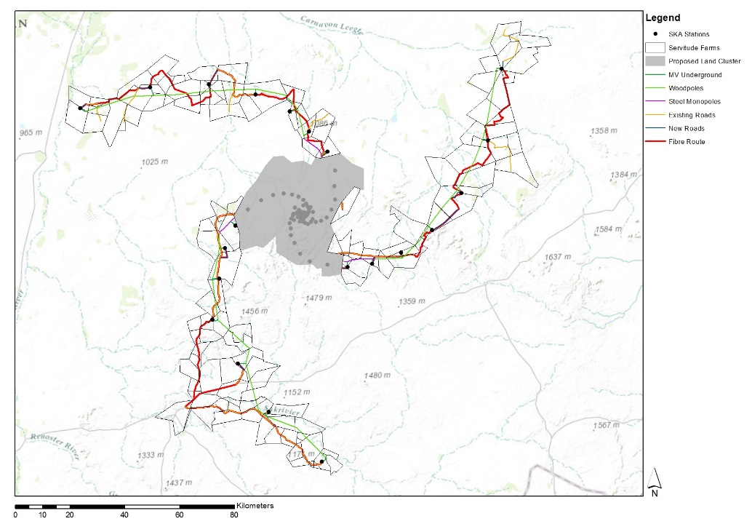
Land & servitudes
Notes:
“Core” (117,993 ha) and servitudes to be
ervitudes will be required for the 3 spiral arms – this amounts to 216 farm portions totaling 1700 hectares
Land to be procured for full SKA (core) and servitudes secured for SKA1_MID

Slide 37
Other hosting issues
Strategic Environmental Assessment
SKA / MeerKAT is Strategic Integrated Project (SIP 16) as part of the Infrastructure Development Act which is overseen by the Presidential Infrastructure Coordinating Commission (PICC)
National Department of Environmental Affairs has appointed the CSIR to undertake SEA .
SEA will include socio-economic impact study of SKA1_MID as well as specialist studies (flora, fauna, heritage, archeological etc.)
Integrated Management Plan to be submitted to South African Cabinet for approval by mid 2016. This IMP will be implemented during construction and operations (IMP = environmental authorization)
Land Management Plan to be included in IMP
DEA looking at declaring “Core” area as Conservation area
Public participation process is commencing this week in the area
Notes:
37

Slide 38
Main Risks / Uncertainties
SKA EMC/EMI Standards
The impact on INFRA of the new Protection and Threshold levels includes:
PDR Design assumptions need to be re-assessed (based on SARAS standards)
INFRA SA will need to assess impact on designs of some of the sub-elements e.g. Power to Spiral Arms, MV switching equipment in KAPB.
Infrastructure delivered for MeerKAT will remain in accordance with SARAS standard – otherwise everything has to be requalified

Slide 39
Main Risks / Uncertainties
INTEGRATED SCHEDULE
Inter-dependencies between land acquisition programme, site studies, design work, Strategic Environmental Assessment & specialist studies, construction licenses etc. Being managed by SKA SA
Potential delays in accessing privately owned land to undertake specialist studies (geotech, geohydrological study)
INTERFACE CONTROL DOCUMENTS
Still number of TBCs and TBDs in ICDs – good progress being made but INFRA SA runs the risk of not meeting its milestones if ICDs remain “immature”
ENGINEERING CHANGE PROPOSALS
Number of ECPs in process and trade-off studies underway which influence the design. Decisions by SKAO on ECPs must be given priority

Slide 40
Stage 2 Deliverables & Milestones
STAGE 2
ITEM | DELIVERABLE | DUE DATE | PROGRESS
1 | Stage 2 Kick-off | 15 April 2015 | 100%
2 | Cost Plan Update | 11 Sept 2015 | 100%
3 | Topographical survey report | 18 Jan 2016 | 8%
4 | Geotechnical and geo-hydrological report | 15 Mar 2016 | 0%
5 | Draft power distribution layout & workshop with SaDT | 14 April 2016 | 0%
6 | Draft Cost Plan and draft EMI/EMC Control Plans | 24 June 2016 | 0%
7 | ILS and RAM Reports | 30 June 2016 | 0%
8 | Updated Power Analysis report | 24 August 2016 | 0%
9 | Antenna foundation prototype | 10 October 2016 | 0%

Slide 41
Stage 2 Deliverables & Milestones
STAGE 2
ITEM | DELIVERABLE | DUE DATE | PROGRESS
9 | Detailed design reports and drawings of all infrastructure & power sub-elements & EMC Control Plans | 3 Feb 2017 | 0%
10 | INFRA SA Management Plans for CDR | 3 Feb 2017 | 0%
11 | CDR Submission | 28 Feb 2017 | 0%
12 | CDR Closure | 7 April 2017 | 0%
Terms & Conditions apply to meeting
these deliverables & milestones

Slide 42
Concluding Remarks
For the Consortium to adhere to the Stage 2 deliverables & milestones, there is a heavy reliance on external factors (ECPs, ICDs, outcome of System Review, approval of separation distances between antennas and overhead power lines in the spiral arms, hosting issues influence studies being undertaken etc.) The schedule will continue to be under pressure
Good Ideas Group (GIG) with Australia has been hugely beneficial (sharing lessons learnt, best practice, defining common standards where possible etc.)
Gratitude to INFRA SA team for ongoing enthusiasm and commitment & to SKA EPM for dealing with our problems in pragmatic approach

Slide 43
Thank You

