Slide 1
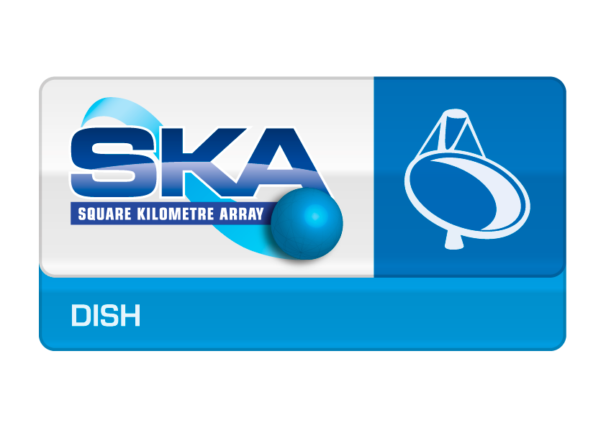
Dish Consortium Status in SKA1 Preconstruction
SKA Engineering Meeting,
Nov 9 – 12 2015
Roger Franzen
Lead, SKA Dish Consortium
CSIRO

Slide 2
Outline
Introduction to New Dish Consortium Leader
Dish Consortium Overview
Major Activities
Key Progress in Work Elements –various
Schedule - Earned Value
Summary

Slide 3
Consortium Leadership
Leadership
Mark McKinnon returned to NRAO – April 2015
Mark Bowen Appointed as Interim Lead
Roger Franzen commenced as lead – 07 Sep 2015
Mark Bowen very relieved – 08 Sep 2015
This new boy is still on a learning curve with Mark’s help.
THANK YOU MARK

Slide 4
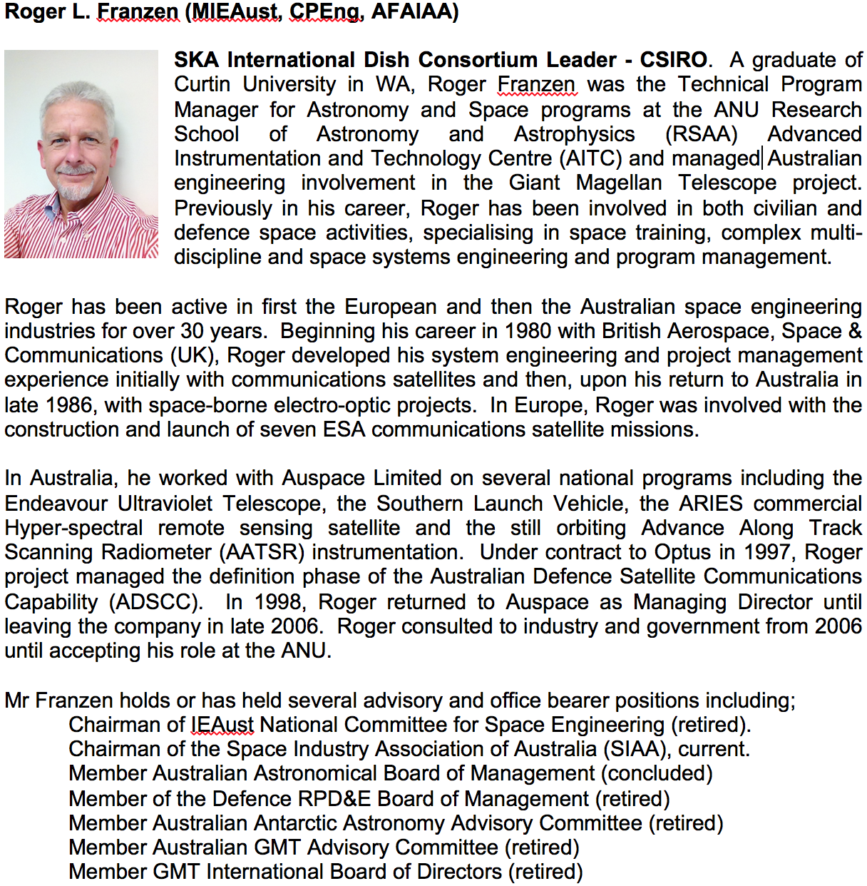
Bio for Roger Franzen

Slide 5
Consortium Members
Dish Consortium: 17 institutions, 8 countries (largely intact post re-baseling)
Chalmers (Sweden)
Commonwealth Scientific and Industrial Research Organization (Australia)
Electromagnetic Software and Systems (South Africa)
European Industrial Engineering (Italy)
IAF Fraunhofer (Germany)
National Institute for Astrophysics (Italy)
Instituto Geografico Nacional (Spain)
Joint Laboratory for Radio Astronomy Technology (China)
Max Planck Institute for Radio Astronomy (Germany)
National Research Council of Canada (Canada)
Omnisys Instruments AB (Sweden)
RPC Technologies (Australia)
SKA South Africa (South Africa)
Societa’ Aerospaziale Mediterranea S.c.r.l. (Italy)
Universidad de Cantabria (Spain)
Universidad Publica de Navarra (Spain)
Vertex Antennentechnik GmbH (Germany) – (up to July 2015-may re-engage)

Slide 6
New Memberships
4 New Members are about to be considered for acceptance by the Dish Consortium Board:
Oxford University – Cryocooler efficiency, band - 3, 4, 5 cryostat
Dr Angela Taylor
Stratosat Datacom – Dish RFI/EMI analysis and design
Alan Geldenhuys
Engage SKA (Portugal) – Band - 3, 4, 5 cryostat integration
Assistant Professor Domingos Barbosa
MTM (Germany) – Dish structure
Lutz Stenvers
The new members are already engaged with Oxford leading the acceleration of activity on elevated Band 5 priorities and MT Mechatronics working with JLRAT to promote the panelised dish structure concept.
New memberships are most effective when aligned with SKA developmental needs.

Slide 7
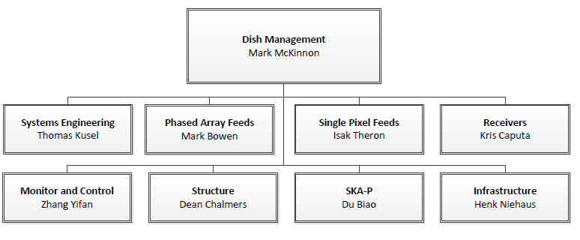
Consortium Organization
Roger Franzen
CSIRO
SKA-SA
CSIRO
EMSS
NRC
JLRAT
NRC
JLRAT
SKA-SA
Special thanks to Mark Bowen for
BRILLIANTLY holding the fort and helping me in transition

Slide 8
Dish Consortium Scope of Work
Many changes since last Engineering Meeting in 2014.
Dish Consortium was/is responsible for the design and verification of dish structure, optics, feed suites, receivers, all supporting systems and infrastructure for SKA1-Mid.
Consortium members have also been designing and building two pre-cursor antennas to inform the design of SKA-P
DVA-1 by NRC and
DVA-C by JLRAT
This status is true for pre - Dish PDR February 9-10, 2015.
After Re-Baselining, no PAF, no SKA Survey, tighter budgets and timelines.

Slide 9
RE-BASELINING
Re-Baselining took place in early March, 2015.
It has affected all consortia to varying degrees.
SKA MID deferred Survey and
PAF activities moved to possible AIP
Impacts include;
A reduction in some development activities.
Re-alignment of reviews and design baselines.
A delay to program as realignment has occurred.
Increased emphasis on delivery to schedule, cost and performance.
Additional scope not in previous plan – Band 3, 4, 5.

Slide 10
Major Activities
Since last Engineering Meeting, Major Activities were:
Stage 1 PDR February 9-10, 2015: Did not pass
Re-Baselining March 2015
delta PDR Step 1 – COAR closeout July 2015
delta PDR Step 2 – Remaining PDR Documents reviewed
delta PDR Step 3 – Dish Structure Down Select 3 Nov 2015
Proposed to hold Delta PDR December 15-16, 2015.

Slide 11
Dish Structure
Design for the structure element of the SKA1-Mid antenna
Feed down – Feeds at secondary focus
Common optical design – Compatible with SPF and PAF
Common pedestal design
Common feed indexer design
Since Feb, 2 Main reflector concepts –
Single piece composite reflector (NRC)
Metal panel reflector (JLRAT)
Down selection process for reflector concept is underway on the basis of preliminary design

Slide 12
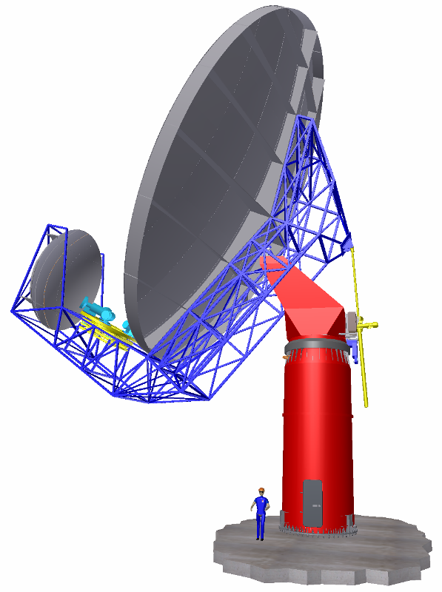
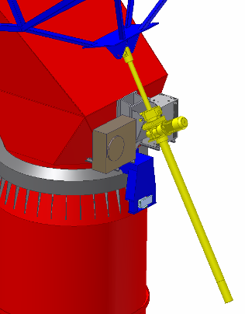
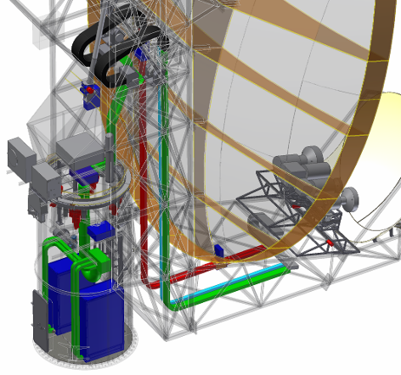
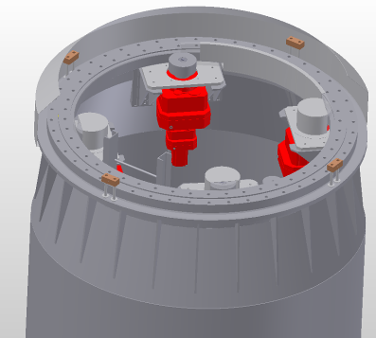
Dish Structure - Antenna Concept
CoDR design selection: feed arm down; feeds at secondary focus
Elevation Actuator
Feed indexer
Main reflector
Backup Structure
Sub reflector
Turning Head
Feed and Sub-reflector Support Structure
Plant installation: electrical, thermal and general plants.
Pedestal
Azimuth actuator
Azimuth bearing
Notes:
12

Slide 13
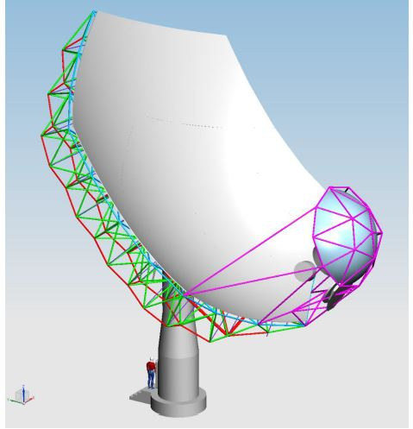
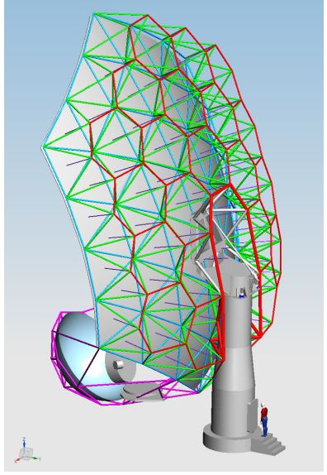
Design – Panel Reflector

Slide 14
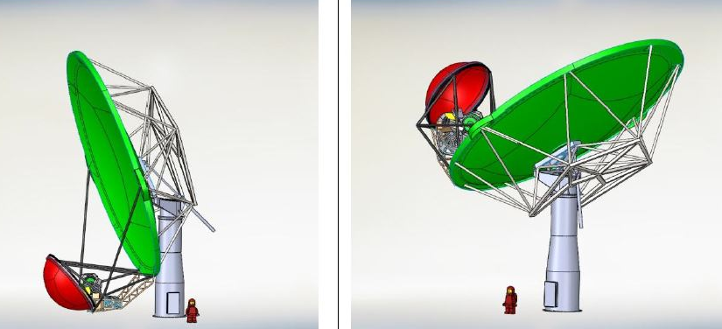
Design – Single Piece Composite

Slide 15
Dish Optics
Optical Configuration
Optical model now fully defined and available in consortium repository
15m Offset Gregorian
5m sub-reflector
Shaped reflector with 58°openning angle
Flat rim
Configuration supports SPF and PAF

Slide 16
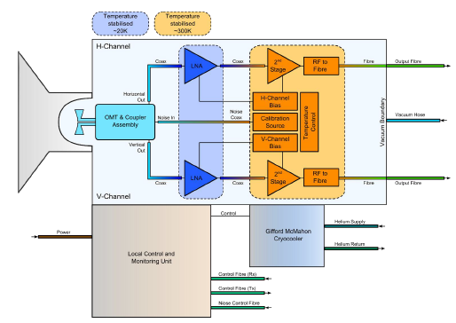
SPFs - Bands
SPF Bands
1: 350 -1050 MHz
2: 950 -1760 MHz
3: 1.65 -3.05 GHz
4: 2.8 -5.2 GHz
5: 4.6 -13.8 GHz
Block diagram for SPF Band 2
High priority bands for SKA-1 construction
Band 5 priority increased after re-baseline

Slide 17
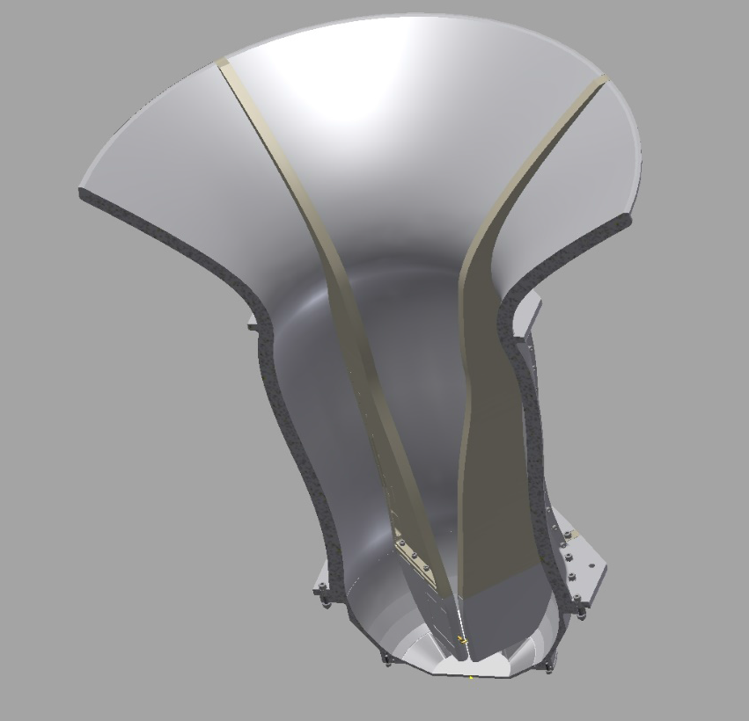
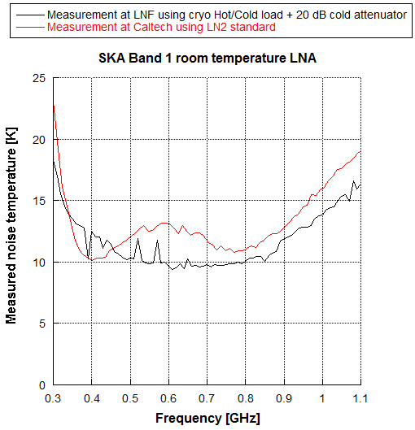
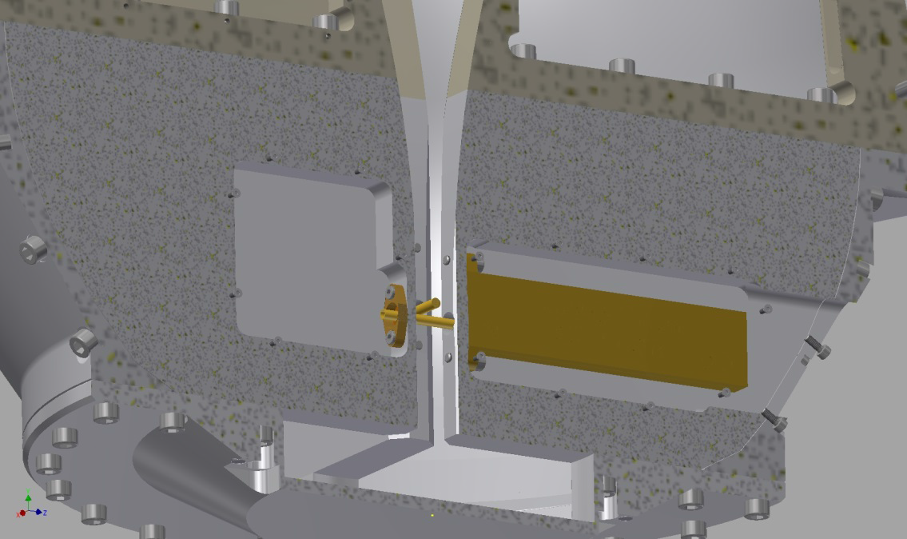
SPF – Band 1
Room Temperature (Uncooled) Feed Horn and LNA

Slide 18
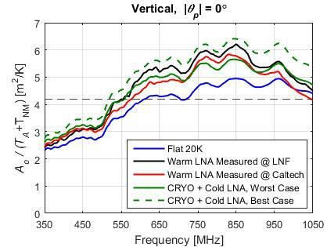
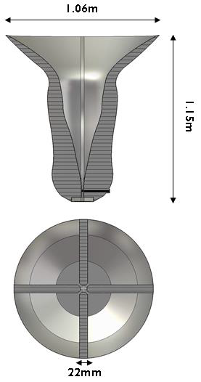
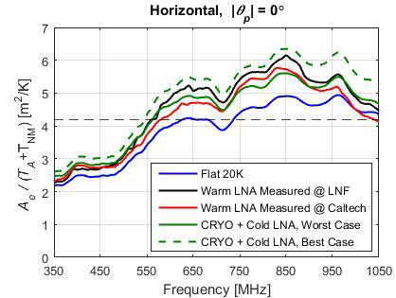
SPF – Band 1
Comparison - Cooled vs. Uncooled Feed Horn and LNA

Slide 19
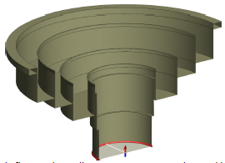
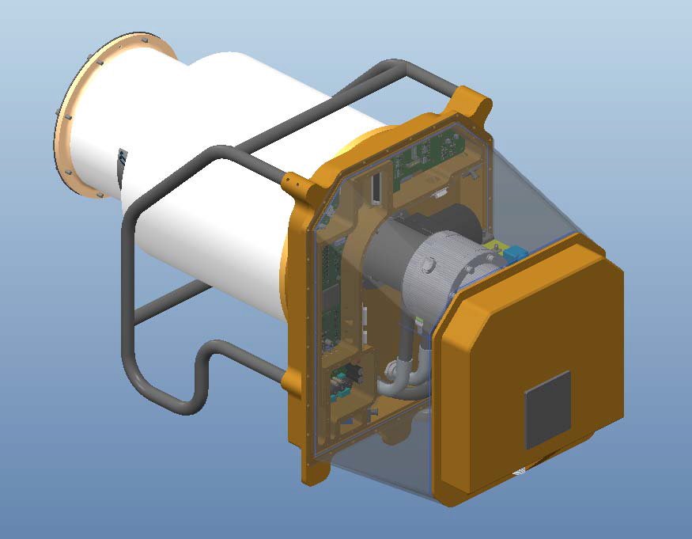
SPF – Band 2
PDR completed
Cryostat detailed design underway
Feed horn optimised to SKA Optical Configuration
Band 2 horn (EMSS)
Feed Package Detailed Design, Band 2, (EMSS)

Slide 20
SPF – Bands 3, 4 & 5
Delivery in-scope for SKA1 after SKA re-baselining
Band 5 elevated in priority
Common cryostat → Band 5 only delivered for SKA1
New partners engaged to perform additional work
Oxford University (UK)
ENGAGE SKA (Portugal)
Detailed Design Review (DDR) scheduled for June 2016
Notes:
Bands 1 and 2 are high priority

Slide 21
SPF Receivers
Receiver design for Bands 1 and 2 well developed
Receiver architecture defined
Digitiser location selected – Feed indexer
Optical Digital Link (ODL) architecture defined
Prototype sub-system components under test
Band 5 receiver now in-scope for SKA1 after re-baselining
Possible collaboration with U. Bordeaux → Receiver for Wide Band Single Pixel Feed (WBSPF), Band 2.
Detailed Design Review scheduled for June 2016
Notes:
Bands 1 and 2 are high priority

Slide 22
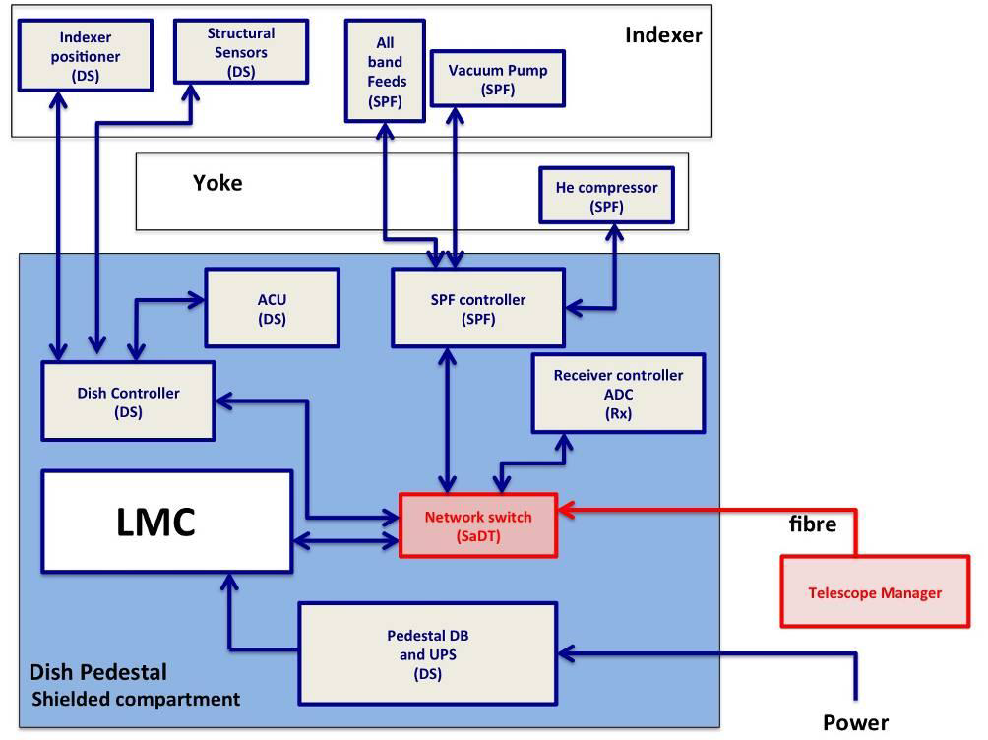
LMC Interfaces
LMC Interfaces: SKA-Mid

Slide 23
Phased Array Feeds (PAFs)
SKA Re-baselined
SKA Board rebaselining decision announced March 2015
SKA Survey delayed and a PAF Advanced Instrumentation Program (AIP) proposed.
SKA_Mid antenna design should support future installation of PAF systems – Optics and Structure.
SKA Dish Consortium – PAF Group
PAF related work associated with SKA Stage 1 of preconstruction completed (delta-PDR closure).
PAF development moved into PAF AIP (construction).
Discussions underway to establish PAF AIP for Stage 2 of preconstruction

Slide 24
Local Monitor and Control (LMC)
TANGO selected as the SKA M&C common framework
Architecture of the LMC system defined
includes interfaces with DISH work elements and TM
Detailed design of the LMC software underway
includes TM interface, operational databases, scheduler, pointing program, operator displays, and alarm, logging, and monitoring services
Development of prototype software and hardware for the LMC system
Physical envelope to be reviewed post Dish Structure down select

Slide 25
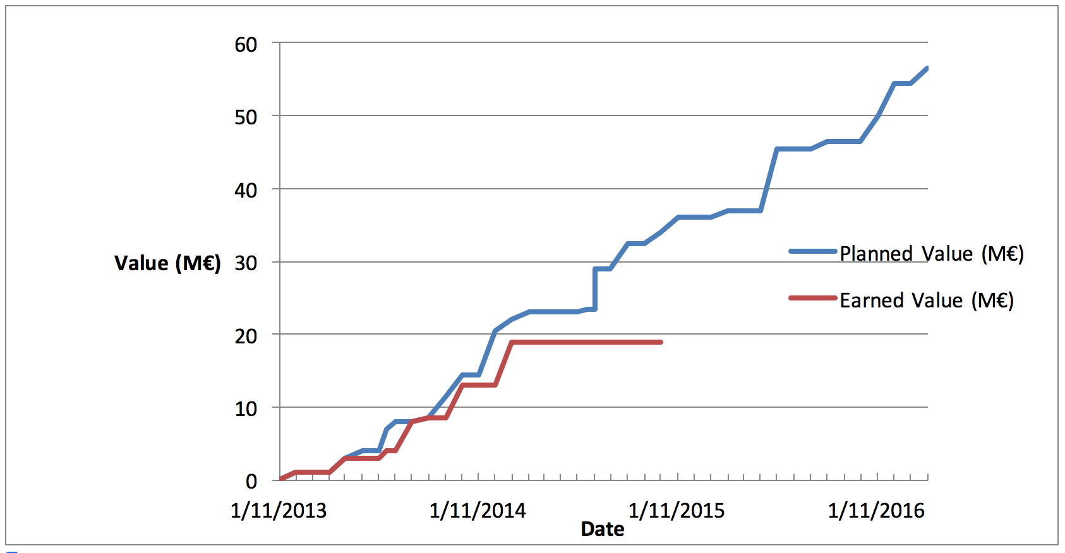
Schedule - Earned Value
Total Planned Value = 56.5M€
(Stage 1 EV = 22.0M€; Stage 2 EV = 34.5M€)
as of 30 September 2015
Flat line EV due to effects of re-baseling and leader search.

Slide 26
Summary
Consortium set to move to Stage 2 post Dec dPDR.
Next 90 days
Dish Engineering Review Nov 13-14 – consolidate.
Complete dPDR Dec 15-16 based on single structure design.
Confirm new design baseline.
Recast Schedule and DDR planning post dPDR.
Close out remaining COAR’s if any by Jan 2016.
Recast Costing by ~ February 2016
Commence with detailed design.

Slide 27
Notes:
Last slide of the presentation

