Slide 1
AADC: Aperture Array Design & Construction Consortium
LFAA: Low Frequency Aperture Array

Slide 2
AADC Consortium Members
ASTRON NL
ICRAR Australia
INAF Italy
KLAASA (CETC38) China
STFC UK new!
University of Cambridge UK
University of Oxford UK
New associate: Nice Observatory (Observatoire Cote d’Azur)

Slide 3
Credit: MWA Project, Curtin University

Slide 4
SKA1-LOW
Station 2
Station x
Station 1
Digital
Fibre
Core
Digital
Fibre
Notes:
Core is a sea of elements -> opportunities
Sophisticated antenna: much better broadband performance than dipoles

Slide 5
Status
Successful PDR
‘just’ outstanding COARs
Commenced on stage 2 work
Detailed Design Review AAVS1 completed (Aperture Array Verification System1)

Slide 6
Costing after re-baseling
€89M
21% Antenna & LNA
17% Receiver
20% Signal Processing
31% LINFRA
On av. 20% contingency included
‘Sanders’ method used

Slide 7
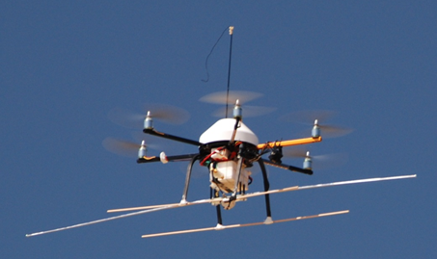
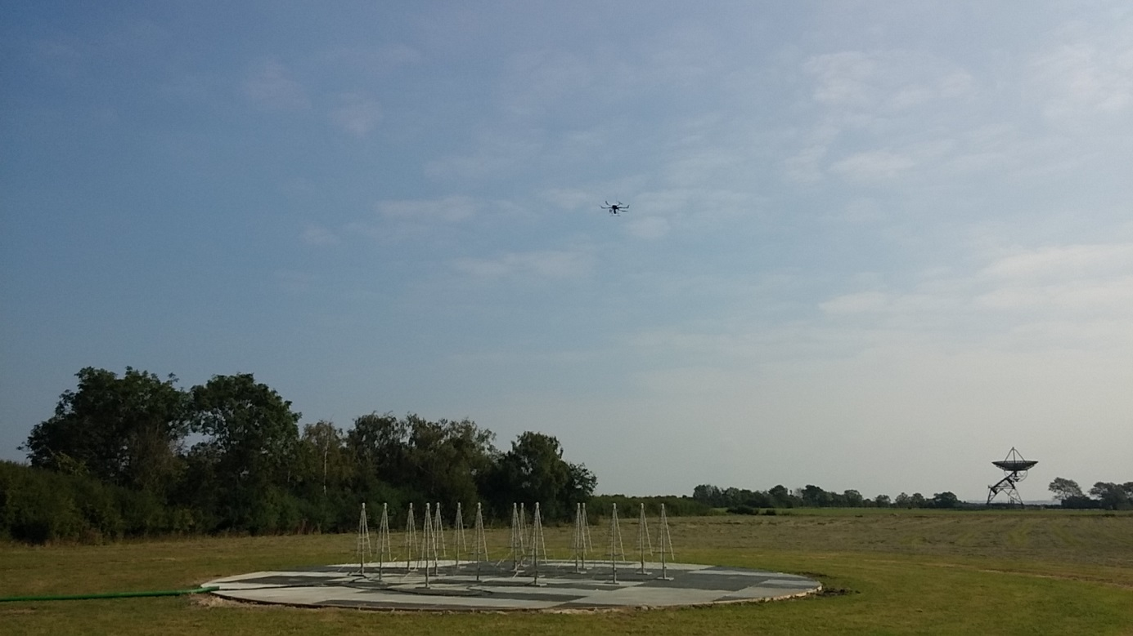
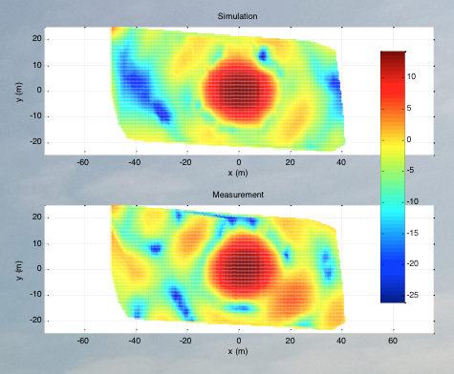
AAVS0
Located at Lord’s Bridge
Hexacopter beam test

Slide 8
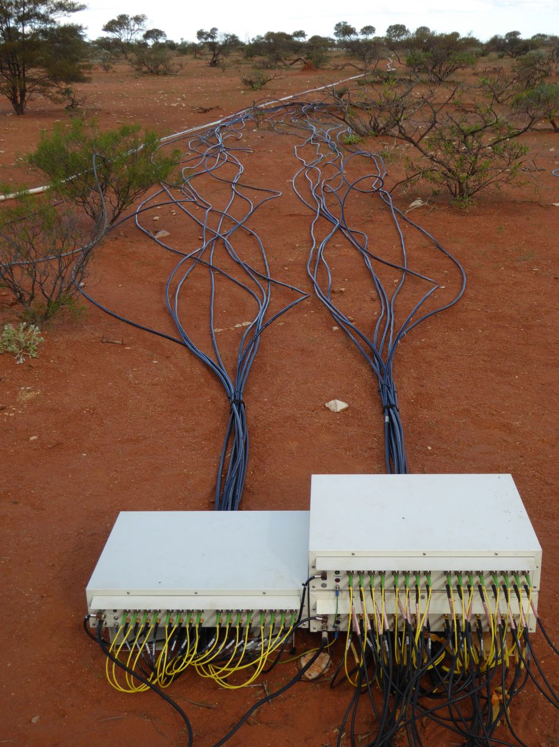
AAVS0.5 upgrades: Radio over Fibre

Slide 9
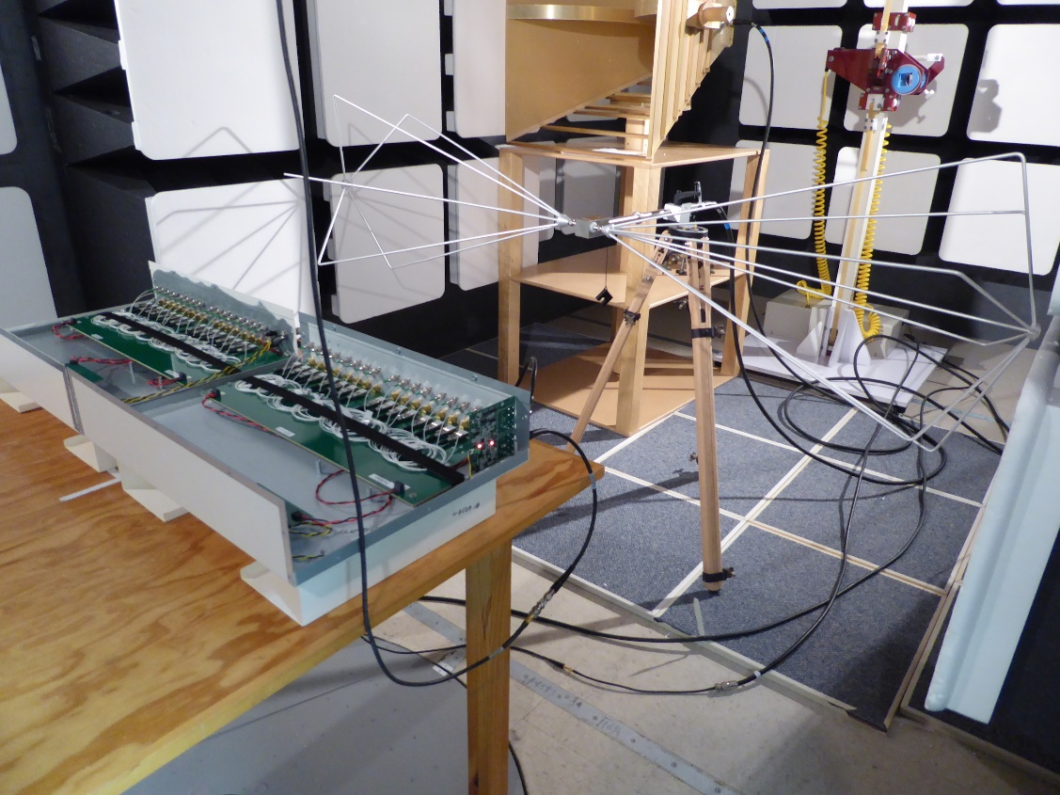
EMC testing RFoF module

Slide 10
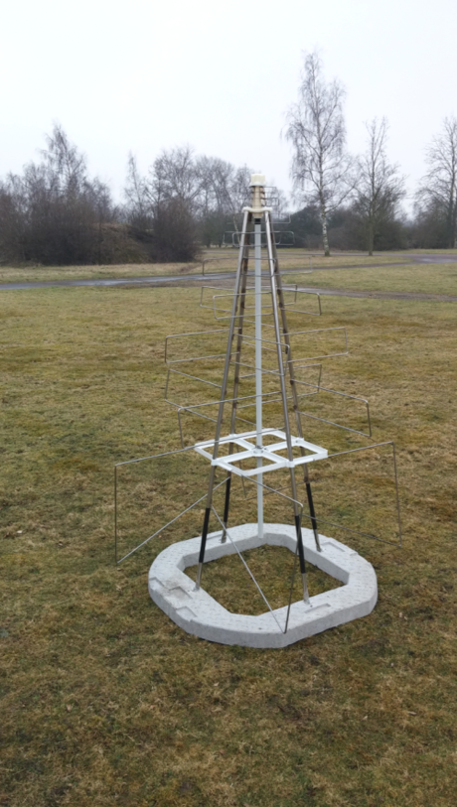
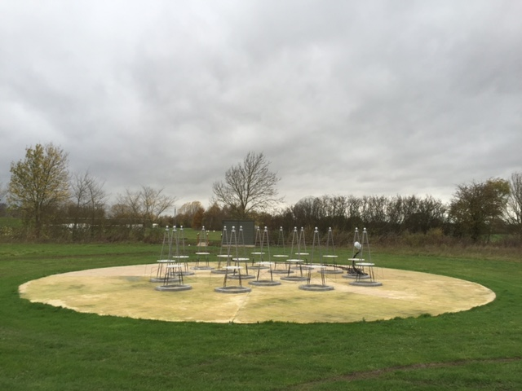
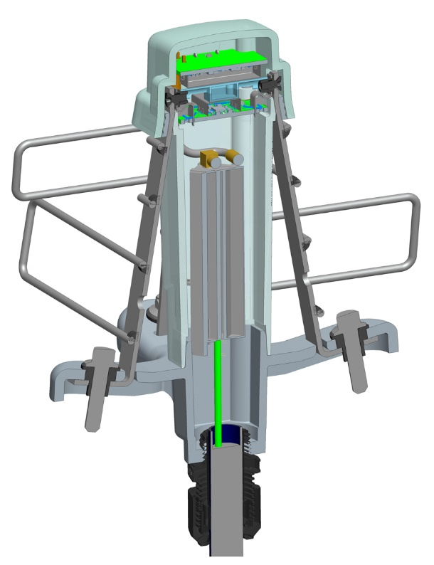
Status
Improved antenna base structure

Slide 11
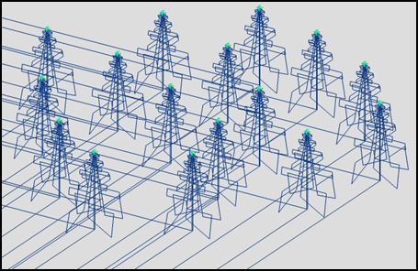
Standalone SKALA2
Single SKALA connected to BIGHORNS spectrometer system
Multicore FEKO (MoM

Slide 12
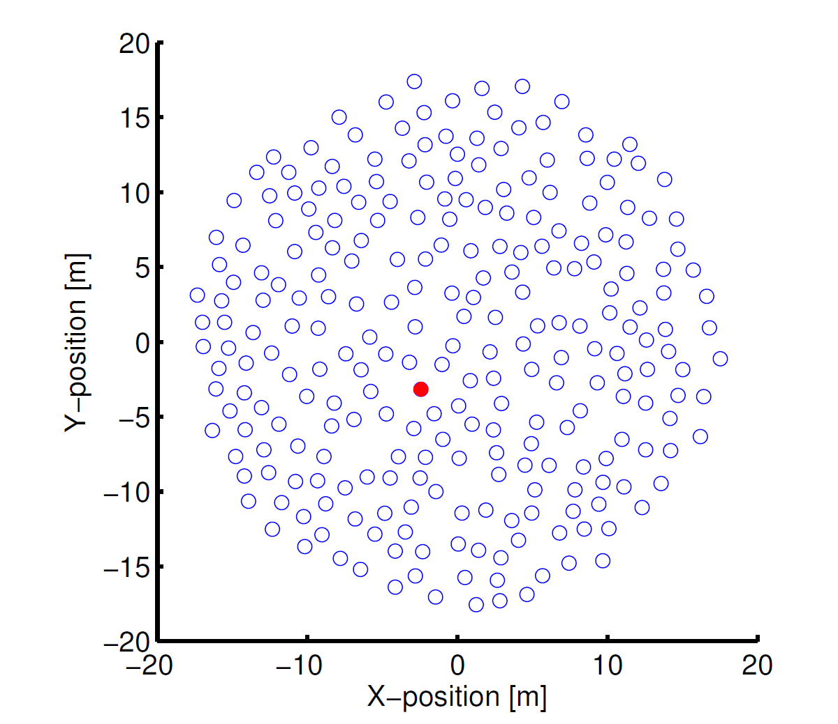
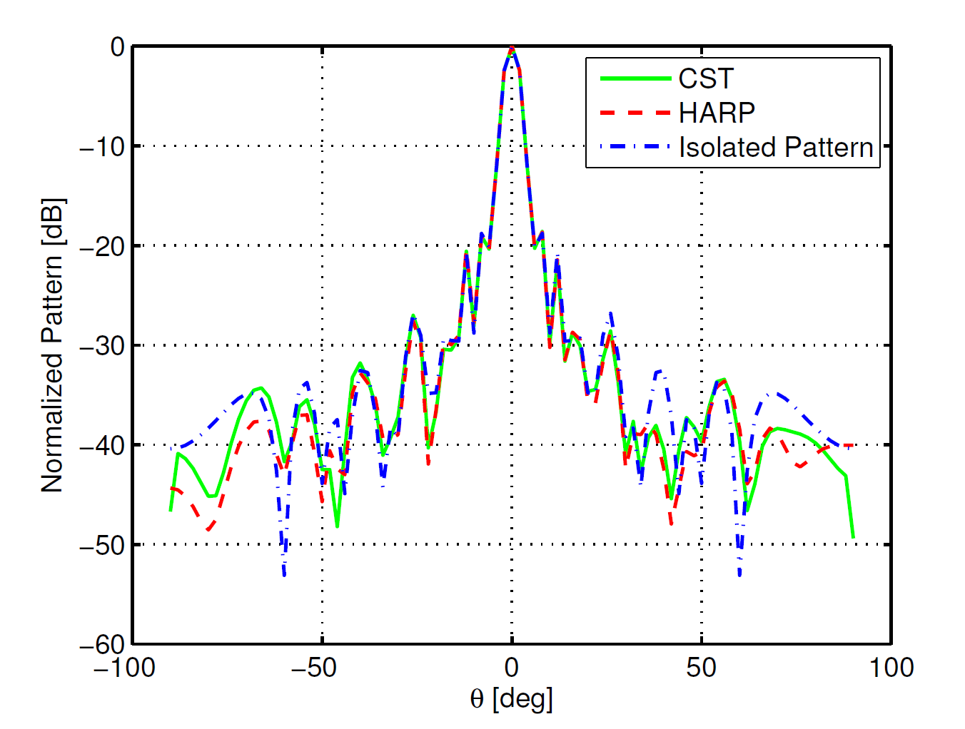
Full station EM simulation
Multicore FEKO (MoM

Slide 13
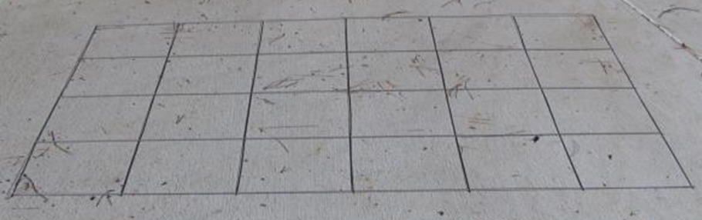
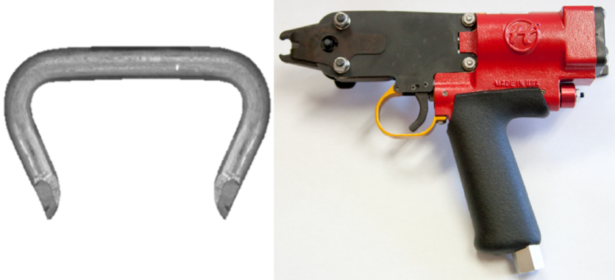
Ground plane
Adjacent panels ‘clipped’ together

Slide 14
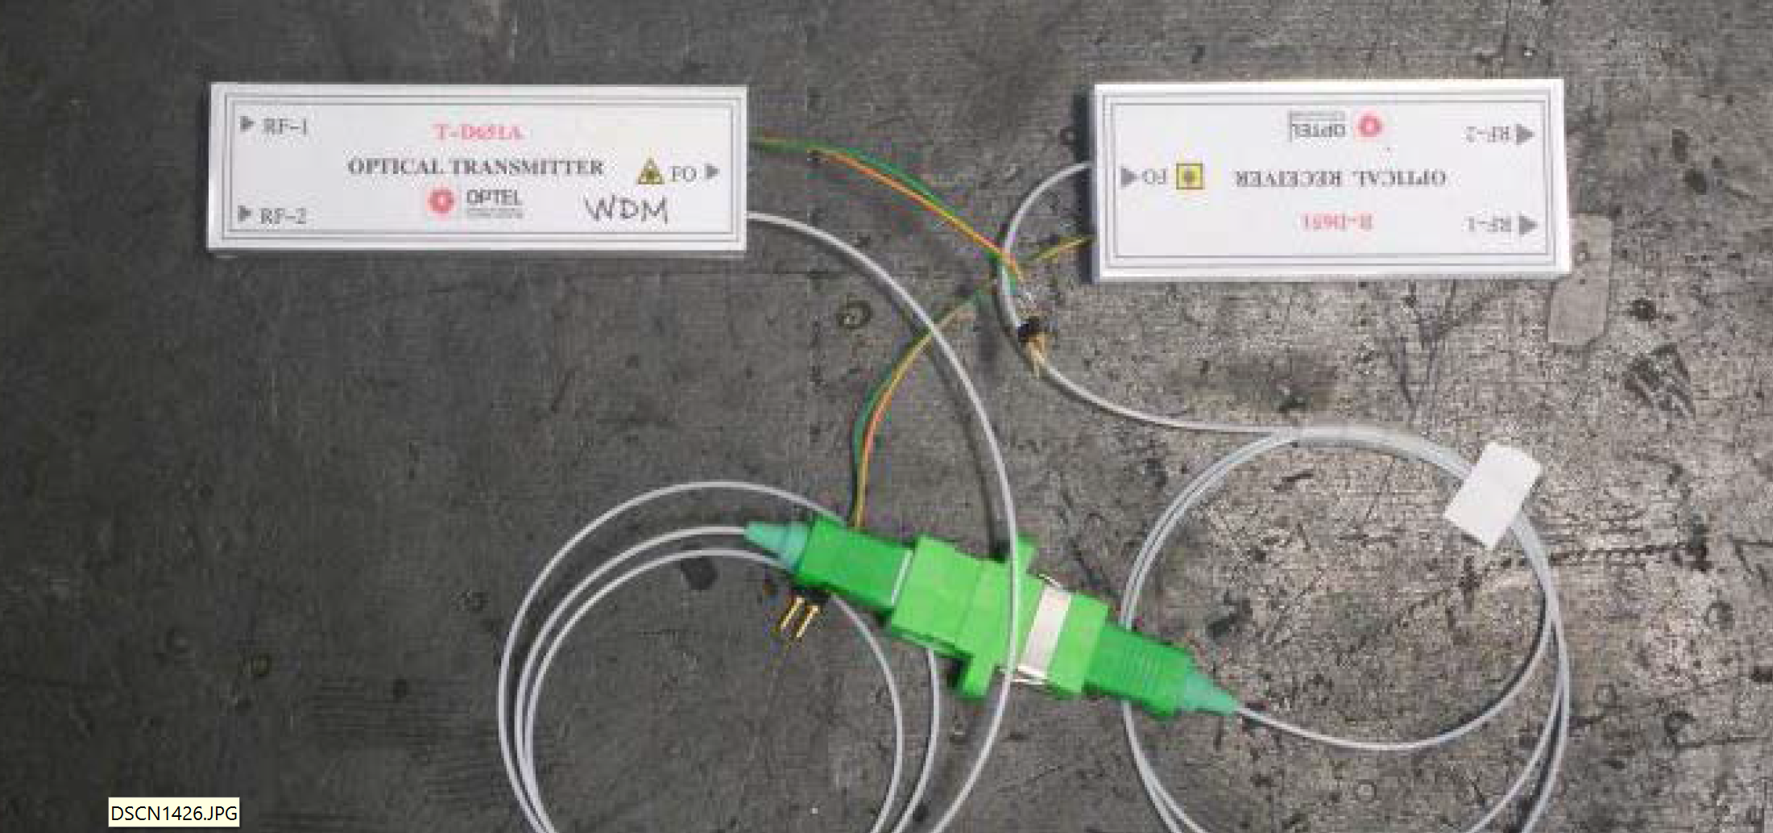
RFoF

Slide 15
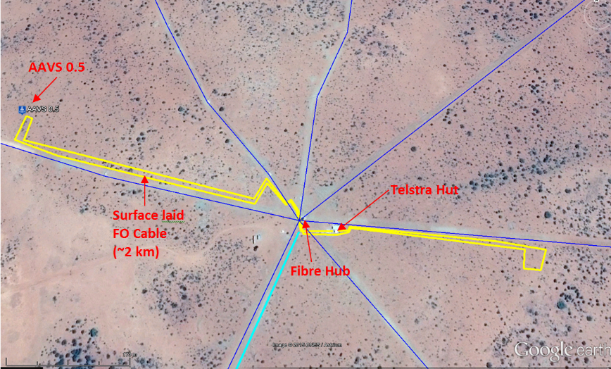
Fibre phase drift on 2km surface laid cable

Slide 16
Fibre phase drift on 2km surface laid cable
Worst-case 600-sec window:
Max = 0.72° (phase)
Requirement@ 160 MHz = 1.2°
Surface laid is OK for 2 km, but not for more than a few kms. Buried fiber cables are needed for very long runs

Slide 17
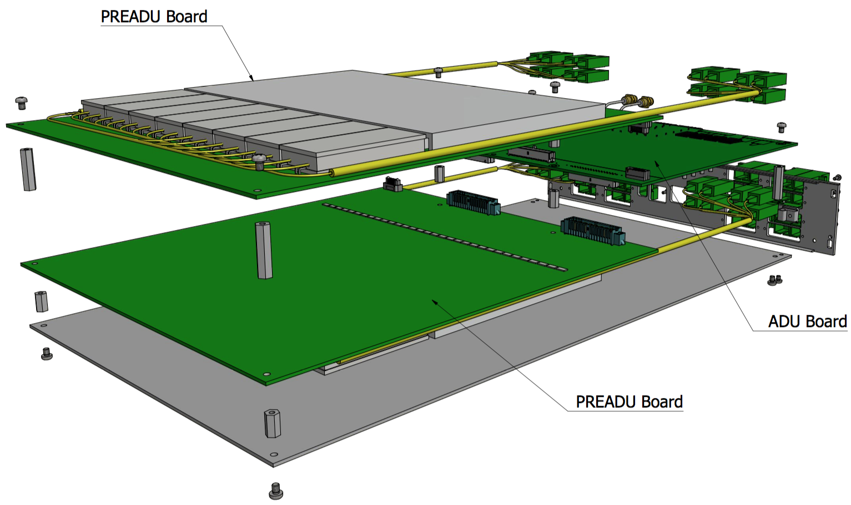
PREADU+ADU -> TPM

Slide 18
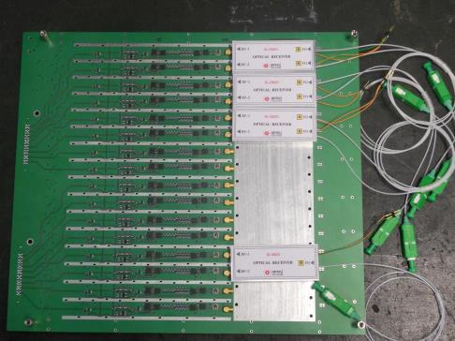
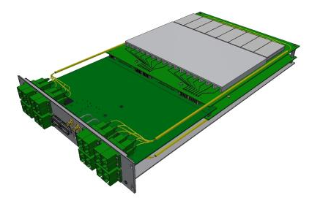
PREADU
Material | Tickness (mm)
Cu | 0.043
FR4 | 0.23
Cu | 0.035
FR4 CORE | 0.984
Cu | 0.035
FR4 | 0.23
Cu | 0.043
OVERALL | 1.6

Slide 19
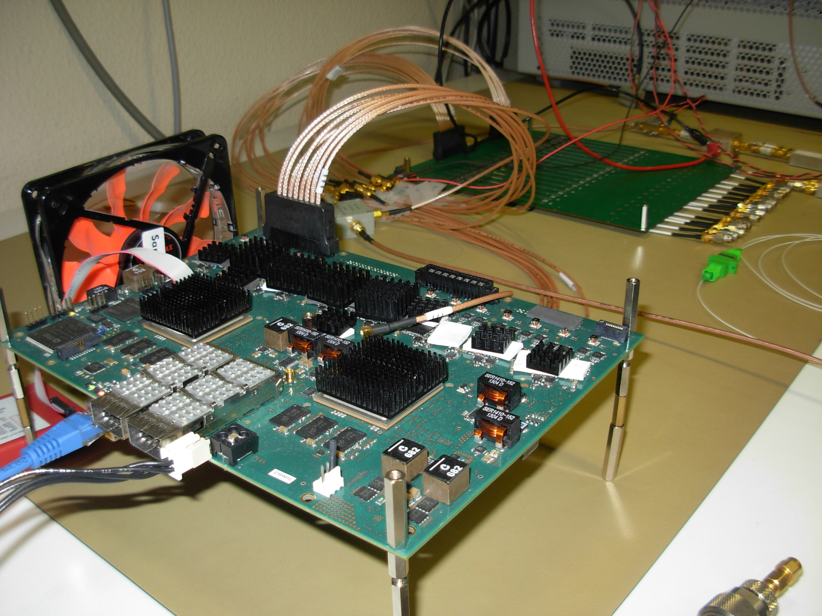
TPM
Tile Processor Module

Slide 20
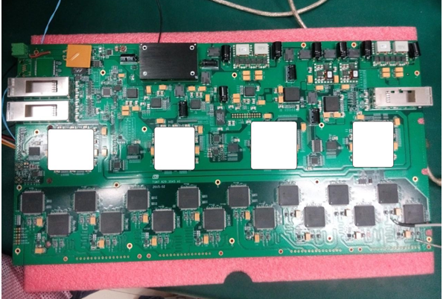
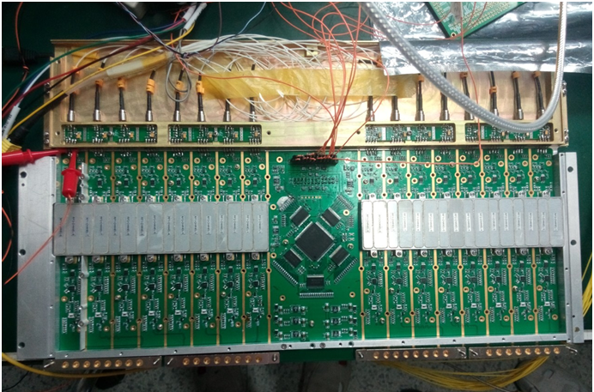
TPM
KLAASA realization

Slide 21
The rack design
PSU
POWER DIST.
FANS
TPM
CLOCK DIST.
PIPES DIST.
FANS
TPM
1Gb SWITCH
40Gb SWITCH
FANS
TPM
CLOCK DIST.
PIPES DIST.
FANS
TPM
PSU
1Gb SWITCH
CABLE TRAY
OPTICAL FIBRE DIST.
TPM
CABLE TRAY
CLOCK DIST.
40Gb SWITCH
1Gb SWITCH
CABLE TRAY
OPTICAL FIBRE DIST.
TPM
CABLE TRAY
CLOCK DIST.

Slide 22
AAVS1
Substantial Verification system
Design verification: station performance, key components
Test bed for (limited) design options
Verification of production techniques
Verification of deployment aspects
Verification against requirements, e.g. station calibration

Slide 23
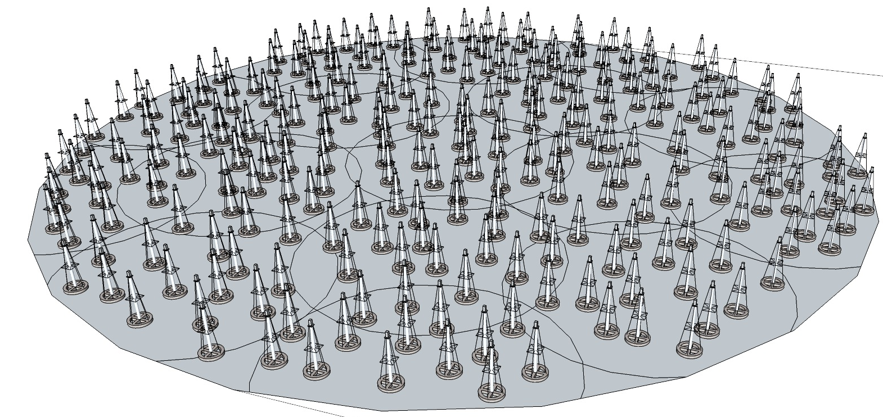
AAVS1 system layout (single network)
MRO Main Building
Internet I/F
Station
box
TPMs
“TM”
Controller
MWA
Control
System
Power
4
1
Splice
Box
Data Switch
MCCS
Servers
MCCS
Servers
3
Fibre cables
576-core
Fibre
splicing
3
Beams to
MWA
Correlator
….
Data Switch
2
Power
Signal data
Recorder
(server)
Patch
cables
1
Internet
I/F
25
….
Signal data recorder
(server)
Power
Clock Dist
Clocks from
MWA/Maser

Slide 24
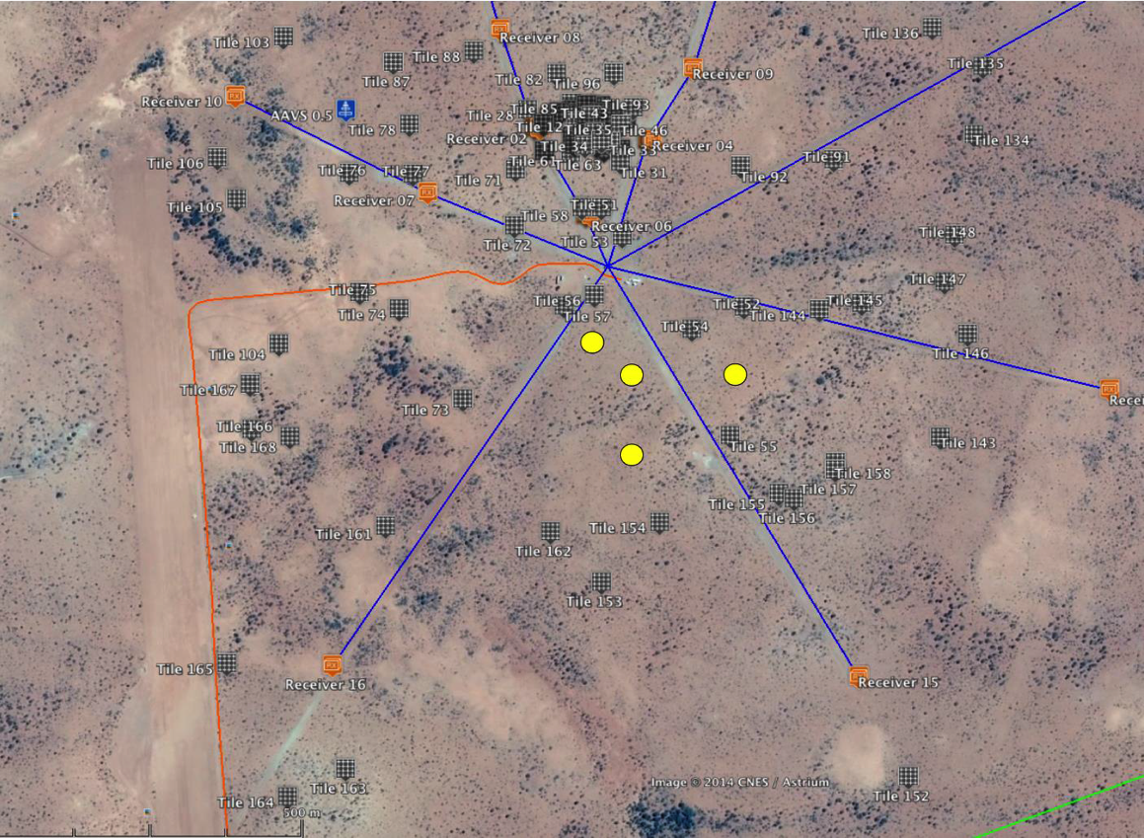
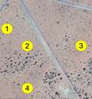
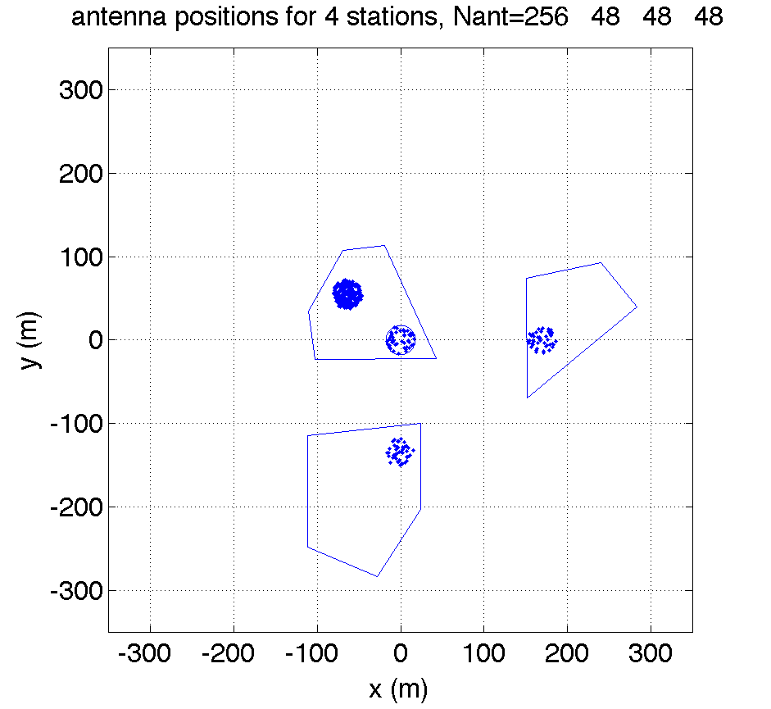
Station Location
At the MRO
Hosted by MWA
MWA correlator
1: 256 antennas
2-4: 48 antennas

Slide 25
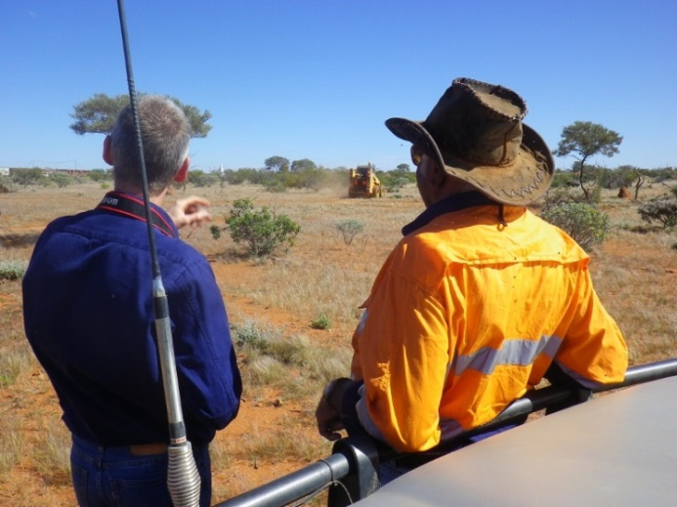
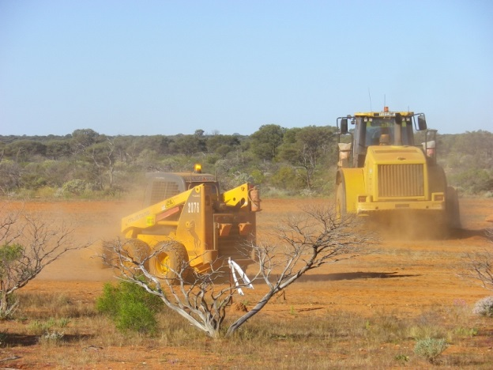
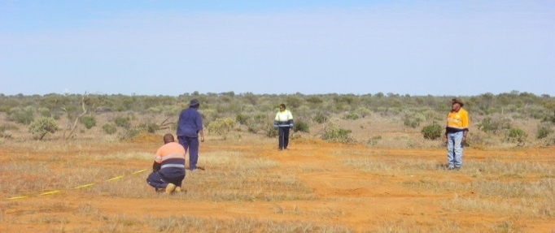
Ground Preparation
Antenna sites cleared
Trees & shrubs removed
Surface rock removed
No levelling
Cleared sites post-surveyed
Max slope across any location is 0.9%
Notes:
1.1 ns 8.4cm; 1.1 ew 18.6; 1.2 ns 19.9; 1.2 ew 15.3; 1.3 ns 32.4; 1.3 ew 6.6; 1.4 ns 34.5; 1.4 ew 28.3

Slide 26
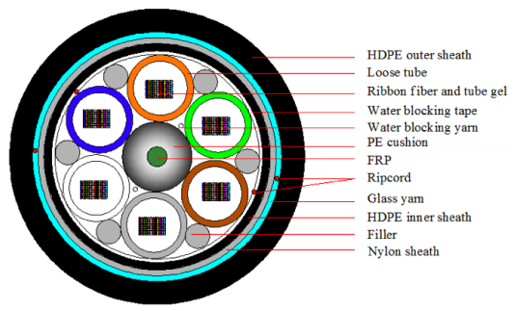
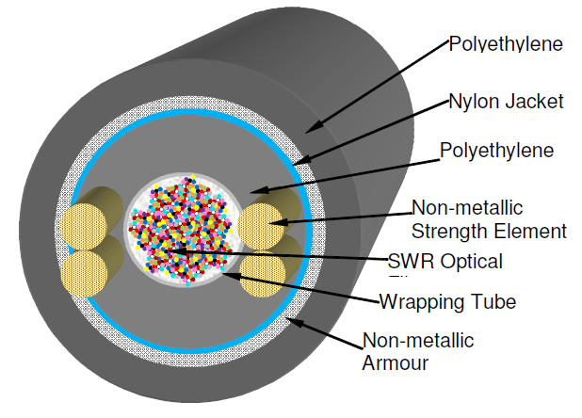
Fibre Distribution

Slide 27
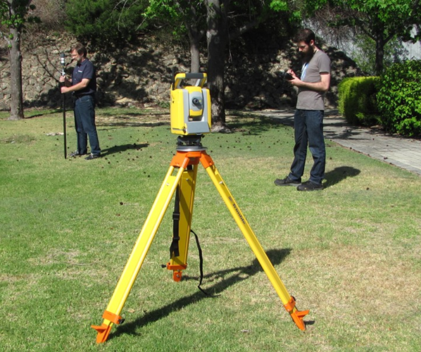
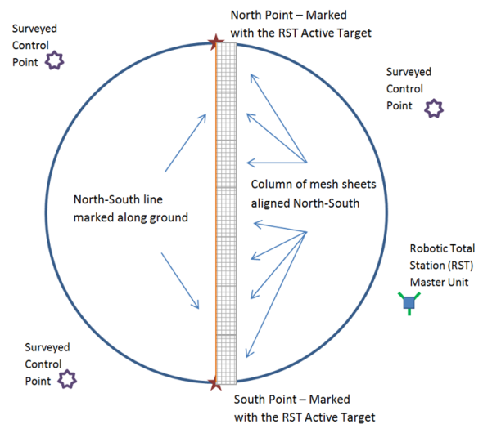
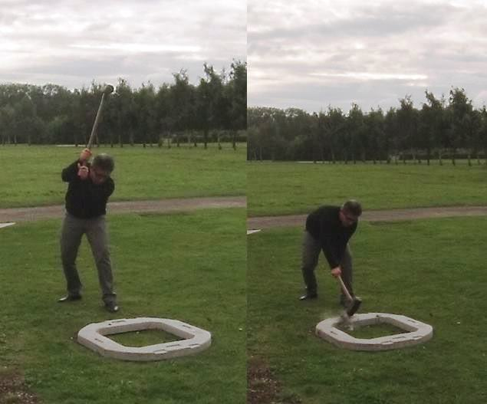
Deployment and Installation
Antenna sites surveyed
Reference points established
‘Robotic Total Station’ system procured

Slide 28
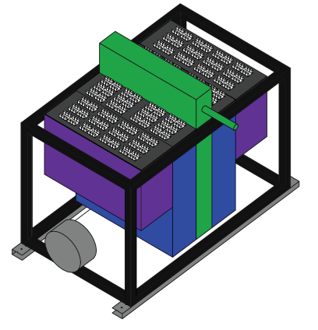
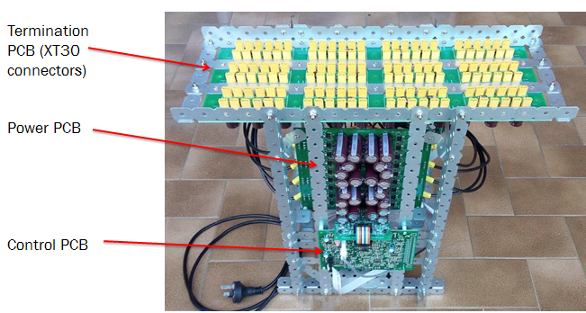
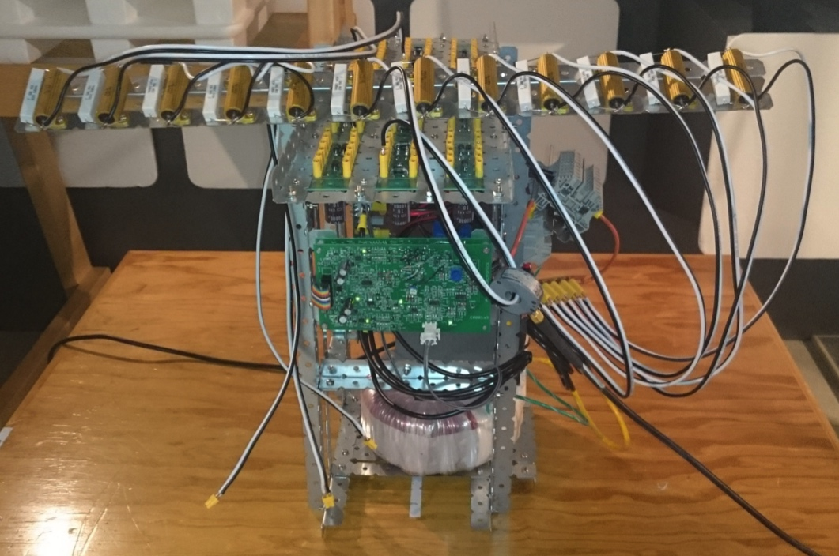
Antenna Power Interface Unit

Slide 29
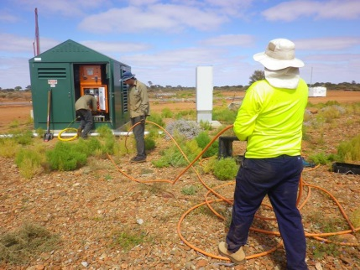
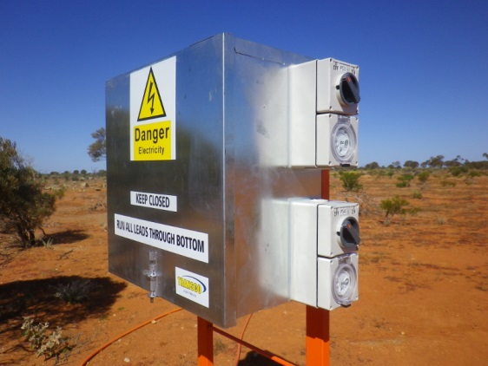
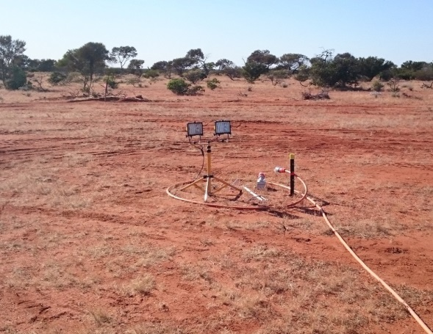
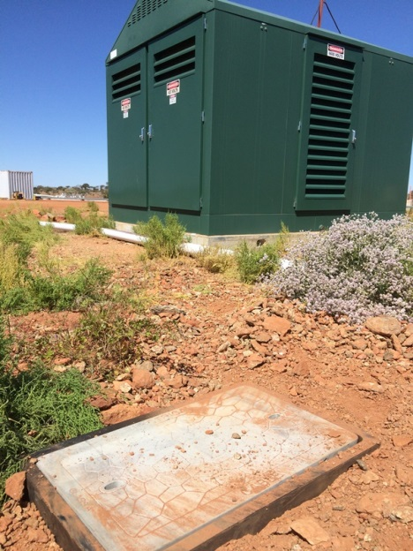
Power

Slide 30
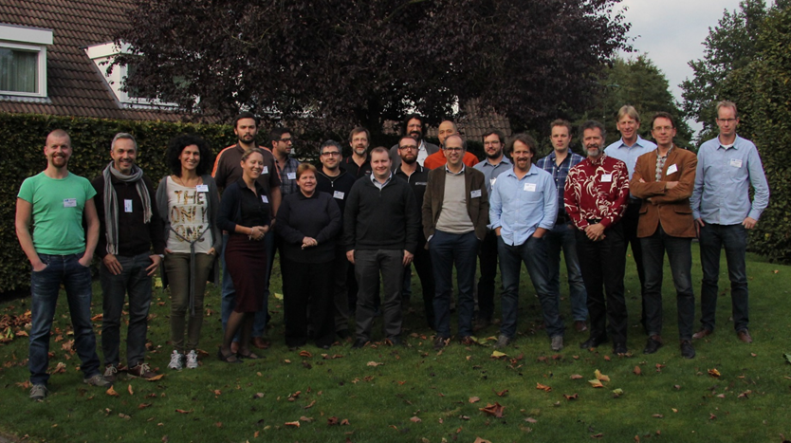
AAVS1 Detailed Design Review
Requirements review 2nd July
CDR Oct 2015

Slide 31
LFAA System Design, Risks
RFoF Good results reported, 3 options
Signal processing 3 alternatives explored FPGA based, Altera& Xilinx DSP based , KLAASA
Architecture Configuration?
Antenna New design, gain smoothness?
Calibration Flexible switched based digital back-end. MWA connection
Schedule AAVS1

Slide 32
Join us?

