Slide 1
SKA Configuration Management
Engineering Meeting
Susan Nel
2015-11-10

Slide 2
Outline
What does this mean?
CM Challenge
CM Strategic Framework
CM Methodology
Q&A

Slide 3
CM Definition
Configuration
Configuration is the functional and physical characteristics of existing or planned hardware, firmware, software or a combination thereof as set forth in technical documentation and ultimately achieved in a product.
Configuration Management (CM)
Configuration Management is a management activity that applies technical and administrative direction over the life cycle of a product, its configuration items, and related product configuration information. (ISO 10007:2003) It manifests as coordinated activities to direct and control configuration.

Slide 4
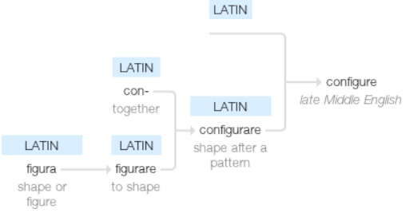
What does it mean?
‘Configuration’ meaning (1550s)
‘To fashion after a pattern’
SHAPE TOGETHER

Slide 5
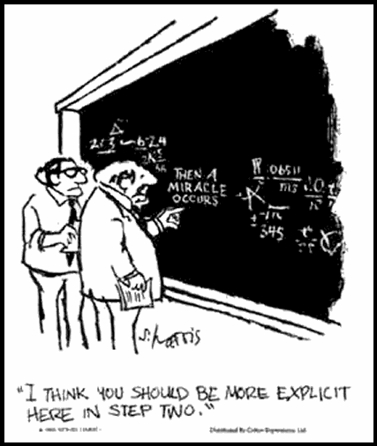
What does it mean?
Then a miracle occurs….
Making things explicit
Clear
Concise
Valid
Notes:
Making things explicit, inevitably has the effect of showing up gaps and shortcomings. It also presents the opportunity to address shortcomings and facilitate improvement.

Slide 6

What does it mean?
Making things explicit
Clear, Concise and Valid requirements
Common set of approved information

Slide 7
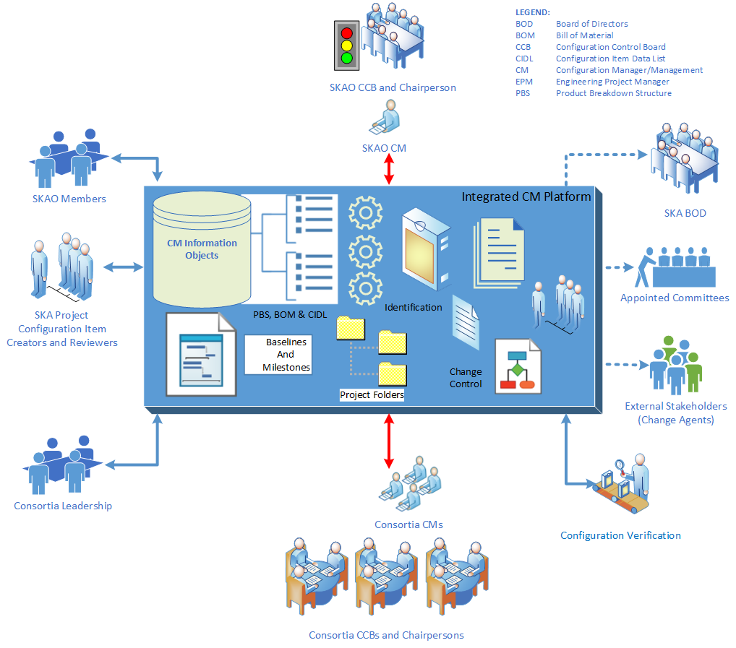

Slide 8
What does it mean?
Systematically increasing the level of control (rigor)
Assess change impact across boundaries
Accommodate change
Keep a long term focus

Slide 9





CM Challenge – Long Term
Design Requirements
“As Designed”
Asset & Process
Information
DESIGN
Must Conform
Must Conform
Design
Information
Physical Configuration
Operational
Configuration
Information
Operating
Maintenance
Training
&
Procurement
Information
Must Conform
“As Maintained”
“As Built”
OPERATIONS
PRODUCTION
From: Bentley SA

Slide 10












What is the issue?
Standards Committee
Regulatory Agency
People
Purchase Order
System Architect
Compliance Org
Design Report
Owner
MID TELESCOPE
Specification
Element A
Standard
Assembly #A1
Industry Regulations
Assembly #A2
Assembly #A2
Compliance Codes
Assembly #A3
Sub-Assy #A3.1
Sub Contractor
Element N
Sub Assy #A3.2
Statements of Work
Sub Contractor
REQUIREMENTS
Ref. Docs
Sub Contractor
Req. 1
Req. 1.1
Sub Contractor
Req.1.2
Sub Contractor
Req. 1.2
Req. 1.3
Test Procedure
Req. N
Req. 1.3.1
KNOWLEDGE ITEM
Req. 1.3.2
TELESCOPE DESIGN
Test Results
System A
W B S
PROJECT BUDGET
Component A1
Stage 1
Stage 1
Comp A2
Comp A2
Milestone 1.1
Milestone 1.1
Comp A3
Milestone 1.1
Milestone 1.1
System Architect
Comp A3.1
Milestone 1.2
Milestone 1.2
System N
Comp A3.2
Milestone 1.3
Milestone 1.3
System N
Consortium
Stage N
Stage N
P&IDs
From: Bentley SA

Slide 11
Standards Committee
Regulatory Agency
People
Purchase Order
System Architect
Compliance Org
Design Report
Owner
MID TELESCOPE
Specification
Element A
Assembly #A1
Standard
Assembly #A2
Industry Regulations
Assembly #A2
Compliance Codes
Assembly #A3
Sub-Assy #A3.1
Sub Contractor
Element N
Sub Assy #A3.2
Statements of Work
Sub Contractor
REQUIREMENTS
Ref. Docs
Req. 1
Sub Contractor
Impact of Change
Sub Contractor
Req. 1.1
Req.1.2
Sub Contractor
Req. 1.2
Req. 1.3
Test Procedure
Req. N
Req. 1.3.1
KNOWLEDGE ITEM
Req. 1.3.2
TELESCOPE DESIGN
Test Results
System A
W B S
PROJECT BUDGET
Component A1
Stage 1
Stage 1
Comp A2
Comp A2
Milestone 1.1
Milestone 1.1
Comp A3
Milestone 1.1
Milestone 1.1
System Architect
Comp A3.1
Milestone 1.2
Milestone 1.2
System N
Comp A3.2
Milestone 1.3
Milestone 1.3
System N
Stage N
Stage N
P&IDs
Consortium
From: Bentley SA

Slide 12







Strategic Framework
Tools
Procedures and Standards
Culture and People
Metrics

Slide 13

Tools: eB Pilot
Designated CMs for every Consortium
eB specified, setup and tested
Trained 35 users
Conducted a CM workshop (Evaluation)
Migrated 2276 documents
Identified 729 physical items
Applied eB improvements
Thanks for your support!
Notes:
Thanks to every Consortium for contributing a CM.
Thanks to Alistair and Phil for approving the funding.
Thanks to SKA SA for extra time and support during testing.

Slide 14
Tools: eB Commissioning
Commissioning Phase from 01 October to 31 January 2016
Roll eB out to each Consortium
    This includes registration of new users and defining training provision
Finalise hosting arrangements with Bentley
Optimise eB functionality
Conclude the data migration activities
Align CM Plan and Procedures

Slide 15
Tools: eB Implementation
Licensing open ended for commissioning phase
From Feb 2016 licencing budget allows for ~30 users and ~280 viewers
Paid by SKA Office
Bentley Agreement to be finalised for eB Production System
Current viewers list: eB User List (72)

Slide 16

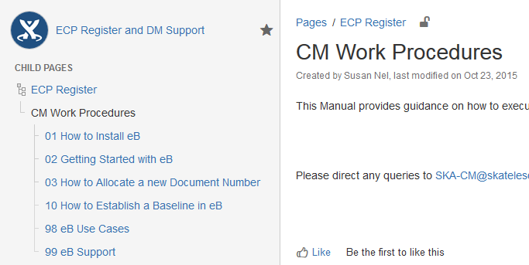
Procedures and Standards
Next priority:
Align CM Processes and Standards
CM Plan
DM Procedure
Change Procedure
CM Working Procedures (How to)

Slide 17
Culture and People
Teamwork - con-figure
Integration (minimising islands of information)
Sharing
Compliance with CM principles
Notes:
Work together
Use CM tool
Keep to the rules of the game

Slide 18





CM Methodology
CM Lifecycle
Physical Hierarchy
Administrative Hierarchy
Accommodating Change
Verification and Audits

Slide 19
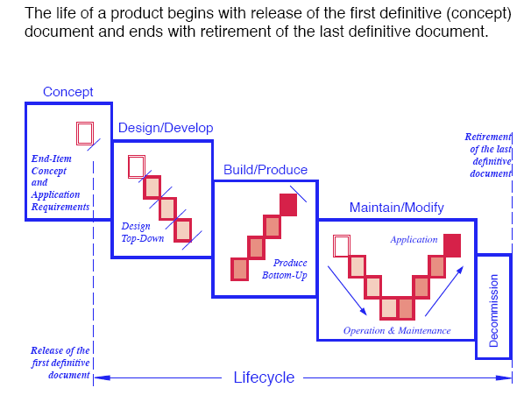
CM Lifecycle

Slide 20
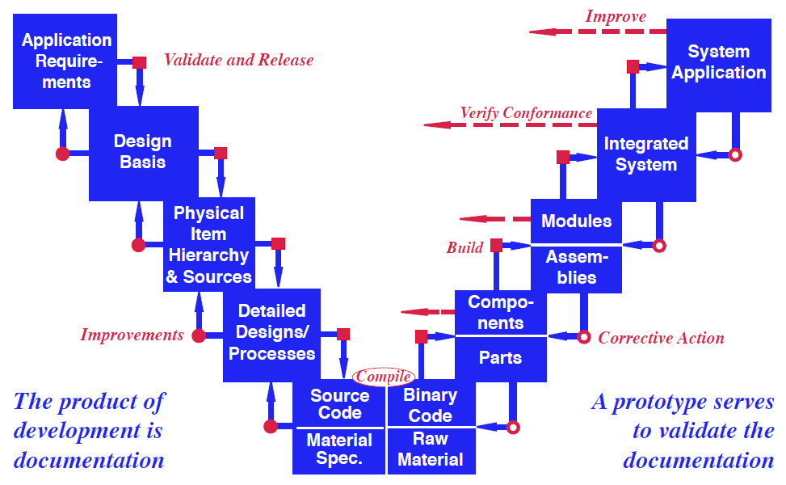
CMII Lifecycle
PDR
Procurement
CDR

Slide 21
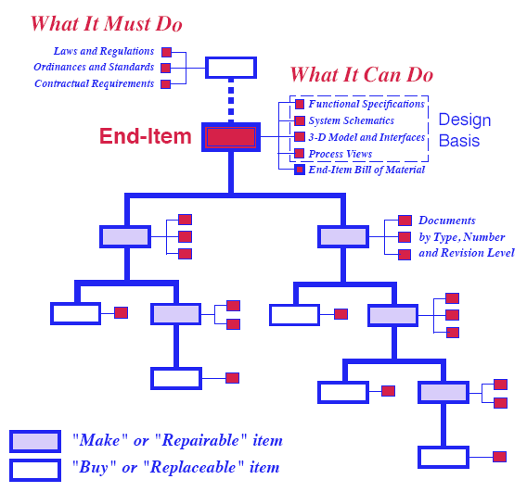
Physical (Structure) Hierarchy

Slide 22
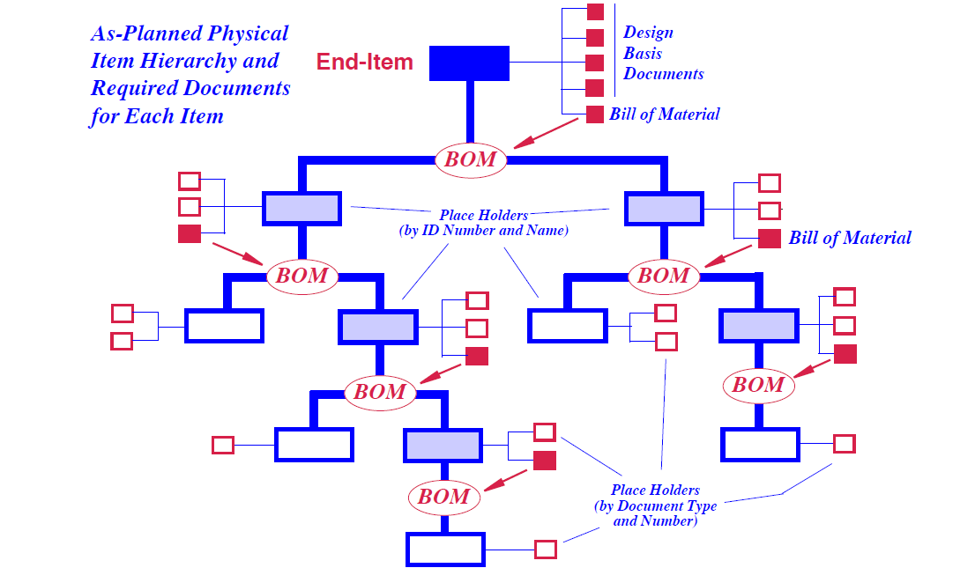

PDR PBS Submissions – Level of Control
Observatory
Location
Telescope
Element
Product
Notes:
You need to define your design basis in eB as Planned documents. This will allow everyone to see what is planned for CDR and allow for the illumination of gaps.

Slide 23
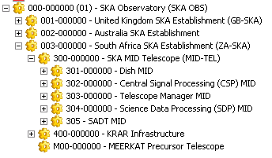

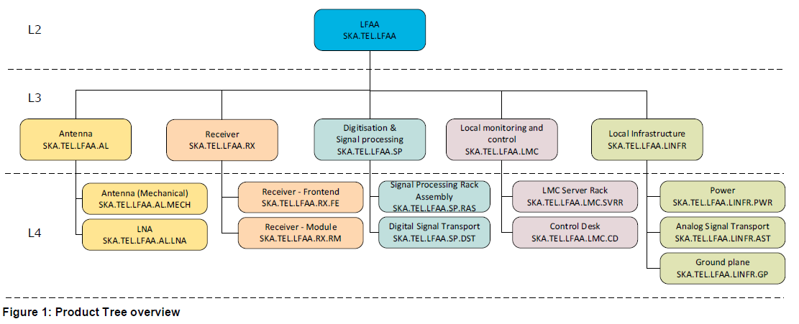
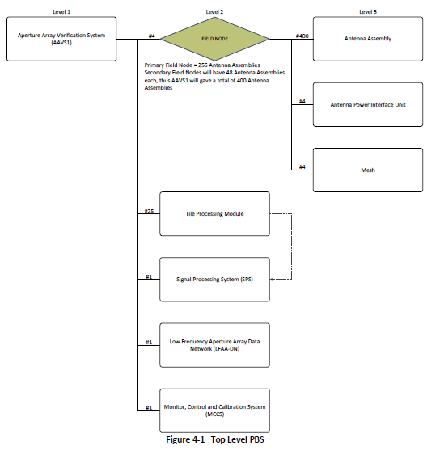
PBS under Configuration Management
SKA Telescope PBS
PDR PBS Submissions
To reflect the updated PBS the Consortia are working on

Slide 24
PBS under CM Control
Observatory
Location
Telescope
Element
Sub Element

Slide 25
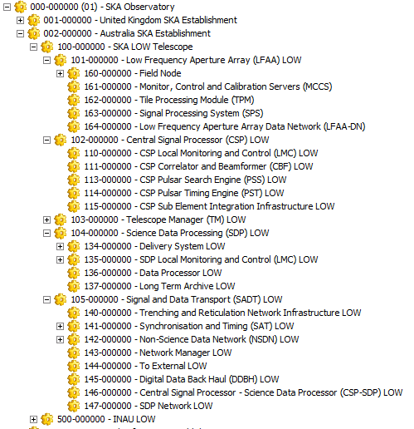
PBS Example
PBS designed to:
a) progress integration,
b) align with the Functional Analysis,
c) facilitate requirements flow-down,
d) facilitate document mapping to items, e) incorporate work done by Consortia subsequent to PDR.
Andrea Cremonini is facilitated the changes to MID
Maria-Grazia Labate is facilitated the changes to LOW
Change Notes to be finalised

Slide 26
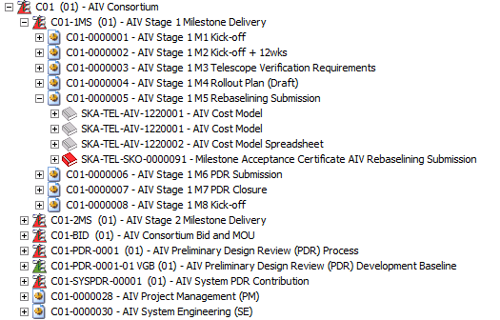
Administrative Hierarchy
Allow for different views
Grouping of non-physical items
Accommodate WBS views
Notes:
We need to review the organisation and use of Admin Hierarchies. It was mainly used to organise migrated data.

Slide 27
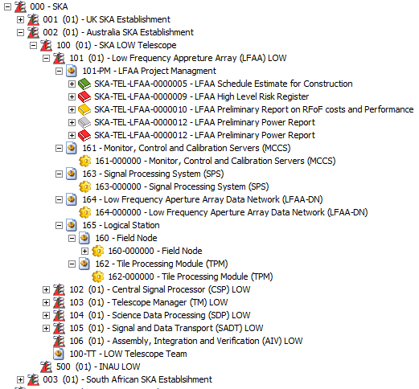

Slide 28
Accommodating Change
Levels of change:
  Revision Changes
  Change Notes
  Engineering Change Proposals
Change Impacts Assessment
All Changes to be managed in eB
Segmentation of responsibility regarding ECPs

Slide 29
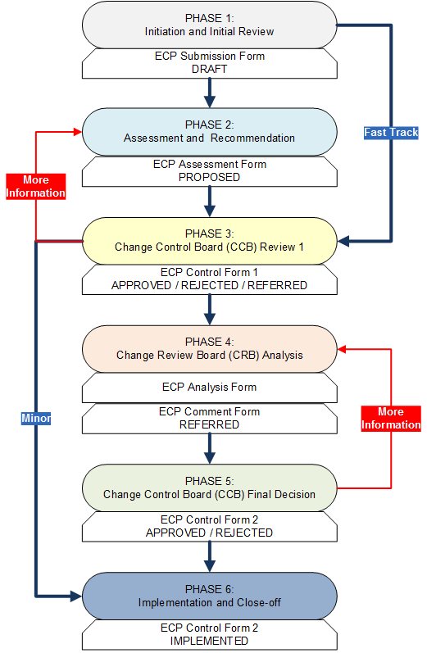

Slide 30
Segmentation of Responsibility
LFAA
System Level ECP
(Class 1)
Intra-Consortia ECP
(Class 2)
Telescope
Infrastructure
Inter-Consortia ECP
(Class 1)
CSP

Slide 31
CM Baselines - Definition
Traditional CM: Configuration Baseline
An approved set of functional and physical characteristics describing a product and as documented in a data pack at a specified point in time. A Configuration Baseline consolidates the results from a preceding phase that has been formally reviewed and agreed on, and which forms the point of departure for the succeeding phase. A Configuration Baseline can be changed only through formal change control procedures.
CMII: As-Planned As Approved Baselines
An approved set of functional and physical characteristics describing a product and as documented in a data pack at a specified point in time. This is a rolling baseline (As-Planned / As-Designed) as changes are approved and implemented.

Slide 32
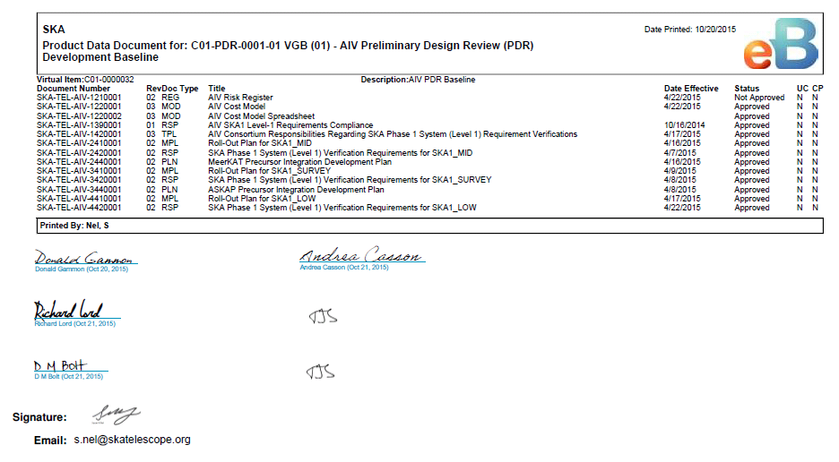
What does this PDR Development Baseline look like?

Slide 33
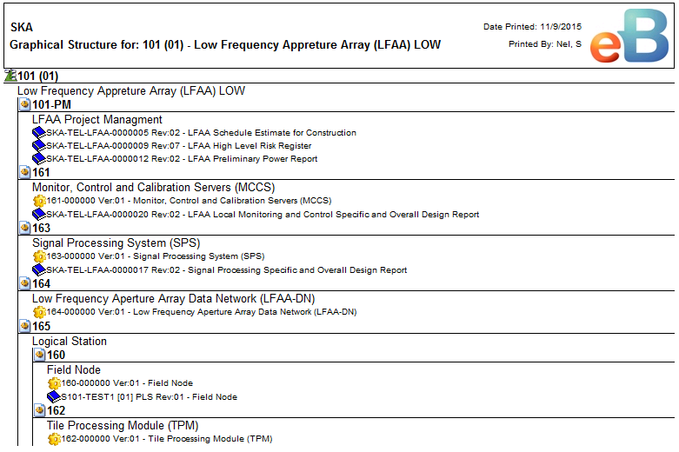
Alternative view for a Baseline Report

Slide 34
Verification and Audits
Data Quality Verification
Completeness of Information
Functional Configuration Audits
Physical Configuration Audits

Slide 35

What next? Longer Term
Align and improve Procedures and CM Plan
Roll out to Consortia
Training
CM process Implementation
Please come tomorrow to confirm eB access

Slide 36

Questions?
CM Q&A Wednesday 14h00 to 17h00 CM Q&A (Salon C)
Configuration Management is a key part of the project puzzle

