Slide 1
SKA Science Update: KSPs, L0s, SKA1-Low
Robert Braun, Science Director
10 November 2015

Slide 2
SKA Science
SKA: will be one of the great physics machines of 21st Century and, when complete, one of the world’s engineering marvels.
Science goals:
  Fundamental physics: Gravity, Dark Energy, Cosmic Magnetism
  Astrophysics: Cosmic Dawn, First galaxies, galaxy assembly and evolution; proto-planetary discs, biomolecules, SETI + much more
  The unknown: transients; +…????

Slide 3

SKA Science Book:
Science Director’s Report, BD-12-17

Slide 4
SKA Science Book:
Meeting Program based on advanced Chapter drafts
135 self-contained chapters with 1200 contributors
Published electronically in PoS May 2015
Printed Book ~2000 pages, in 2 volumes now out
  Weighs in at 8.8 kg!

Slide 5

SKA Science Book 2015

Slide 6
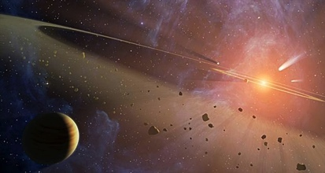

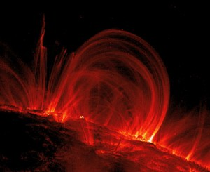
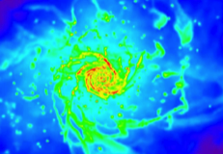
Headline Science with SKA1 and SKA2

Slide 7
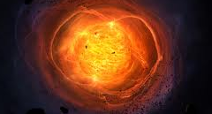
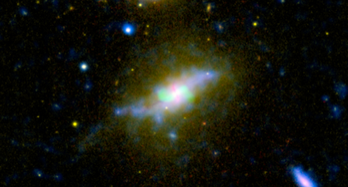
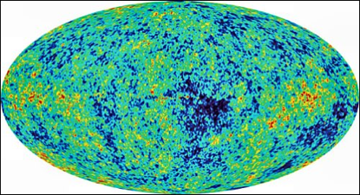

Headline Science with SKA1 and SKA2

Slide 8
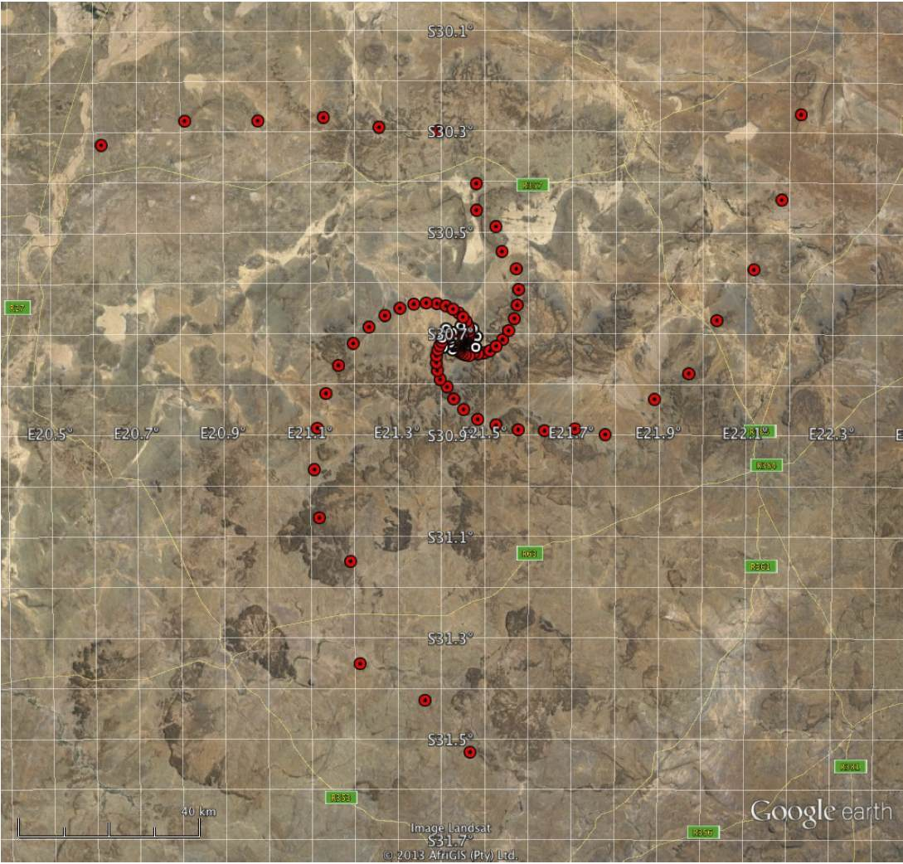
SKA1 Configurations
SKA1–MID, –LOW: B_{Max} = 156, 65 km

Slide 9
Sensitivity Comparison

Slide 10
Survey Speed Comparison

Slide 11
Resolution Comparison

Slide 12
Image Quality Comparison
Single SKA1 track equivalent to VLA A+B+C+D + E+A⁺
“Structural” dynamic range of ~1000:1 rather than ~3:1 per track
Beam quality ~100 times better than VLA

Slide 13
Key Science Projects:
Notional package of Key Science Projects in Q1 2015 based on the highest priority science objectives that have been recommended by our science community that will be:
  Consistent with capabilities of the SKA1 design
  Consistent with a realistic observing schedule filled at 50 – 75% for the first 5 years of scientific operations
Adopt KSP policy
  Only scientists from SKA member countries may lead a KSP
  KSP Leadership is guaranteed to be distributed amongst SKA members in proportion to their financial contribution
  KSP participation (at the non-Leader level) is guaranteed to be distributed amongst SKA members in proportion to their financial contribution
  KSP participation (at the non-Leader level) of SKA non-members is capped at the value defined in the Access Policy

Slide 14
A Package of Notional SKA1 Key Science Projects
Outcome of well-documented SKA1 science prioritisation process
  All objectives originate with the science community
  Review and strong endorsement by advisory bodies (SRP, SEAC)
Should be viewed as representative package of high-impact science deliverables for the first five years of science operations

Slide 15
A Package of Notional SKA1 Key Science Projects
HPSOs distilled from much broader package of survey ideas and goals

Slide 16
KSPs: 2015 Stockholm Workshop Aims
Further develop KSP concepts
  A notional KSP list has emerged from the SKA1 Science prioritization process, but this is only a representative placeholder, and will be continually reviewed.
    This workshop aims to provide a forum for open discussion of KSP concepts, reviewing the notional list and identifying missing concepts.
Support development of potential KSP collaborations
  There will ultimately be a competitive process of KSP proposal submission, evaluation and allocation, implying that all discussions at this stage are informal and come with no guarantees.
    This workshop aims to provide a forum for the key areas of interest of particular communities to be presented, leadership aspirations to begin to be identified and resourcing strategies to begin development.
Maximizing commensality
  It is likely that the same data stream will serve multiple KSP or PI-led groups, each with limited data rights to address specific scientific objectives.
    This workshop aims to provide a forum for early discussion of support for such commensal programs, including the development of efficient survey strategies intending to maximise the scientific return of the KSP package.

Slide 17
KSPs: 2015 Stockholm Workshop Outcomes
Further develop KSP concepts
  Good progress as documented in the Working Group summaries (posted on web).
Support development of potential KSP collaborations
  Feedback has been positive.
Maximizing commensality
  Exploring definition of handful of “generic” surveys.
Documenting science match to frequency bands
  Document now posted on web.

Slide 18
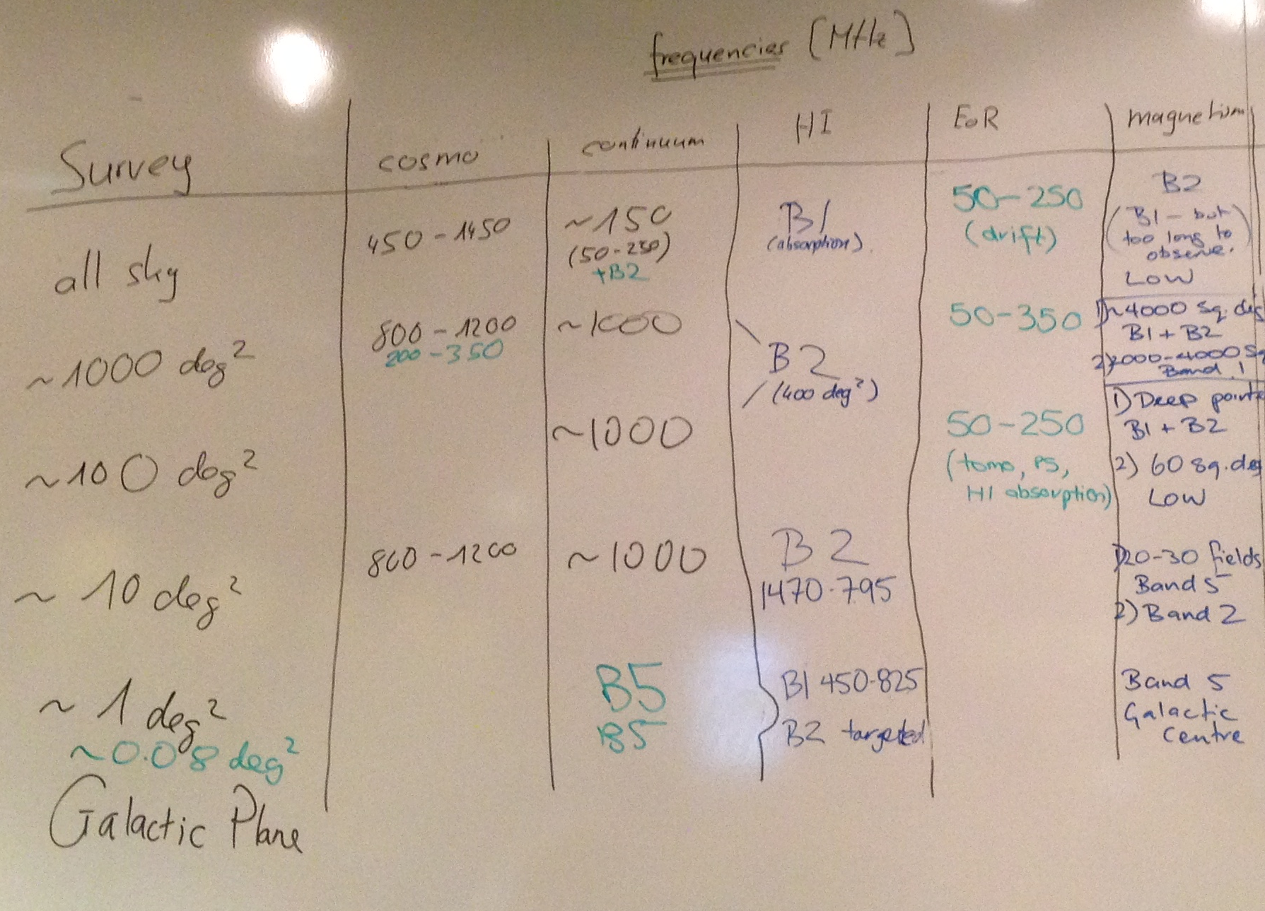
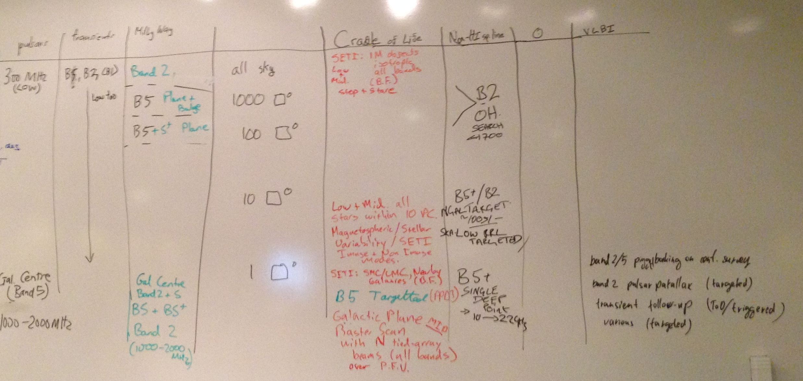
KSPs: 2015 Stockholm Workshop
Maximizing commensality
  Exploring definition of handful of “generic” surveys.

Slide 19
KSPs: 2015 Stockholm Workshop
First “generic” surveys ideas, utilising about 50% of KSP time

Slide 20
KSPs: 2015 Stockholm Workshop
Survey A, “All-sky” 8000h

Slide 21
KSPs: 2015 Stockholm Workshop
Survey B, 500 deg² 2000h

Slide 22
KSPs: 2015 Stockholm Workshop
Survey C, 20 deg² 2000h

Slide 23
KSPs: 2015 Stockholm Workshop
Survey D, 1 deg² Galactic Centre, 2000h

Slide 24
Level 0 Science Requirements
“The Level 0 requirements convey the scientific goals of the facility, while the Level 1 requirements convey the technical specifications that the project proposes to deliver to address those goals. Neither is formally “applicable to”, although both are “informed by”, the other. All of the engineering design work is tied to meeting the L1 System requirements.”

Slide 25
Level 0 Science Requirements
Relationships between the Level 0 requirements and other key documents

Slide 26
Level 0 Science Requirements
Linkages between L0 and L1 requirements documented in L1 Release 6C Appendix A (pp 155 – 223)
  Each L1 is linked back to one or more L0
L1 Requirements under change control
  ECPs assessed against Science, Operations, System and budgetary implications
L1s always represent current best balance over all constraints
L1s are the “one-stop-shop” for all design specifications
If L1s are missing/incomplete in some areas, then they will be filled/supplemented via the ECP process

Slide 27
SKA1-Low Configuration
Scientific Constraints:
The highest possible filling factor of both individual stations and the core configuration over the key frequency interval of 100 – 200 MHz.
Instantaneous field-of-view that exceeds about 4 deg² for EoR imaging and 16 deg² for EoR power spectra (both apply to the frequency range 50 – 200 MHz).
Ability to provide excellent quality of ionospheric calibration: enough high sensitivity pierce points.
Ability to provide excellent quality of direction dependent gain calibration: extremely low far sidelobes of station beam.
High sensitivity and good visibility sampling to angular scales of about 10 to 1000 arcsec.
Practical constraints:
Site-specific and maintenance constraints.
Infrastructure Cost.

Slide 28
SKA1-Low Configuration
Recommended solution:
Highest possible filling factor of antennas in station tied to a nominal frequency (the λ/2 antenna spacing) of no lower than about 100 MHz.
Tightest practical packing of stations within core consistent with maintenance requirements.
Logarithmic decline of collecting area beyond core: radii of about 350m to 35km.
Smallest total number of extra-core sites plus minimum spanning tree with adequate aperture sampling and instantaneous visibility coverage.
Hierarchical station definition allowing choice of 10m, 30m or 90m beam-forming scales.
Identical station definition both inside and outside core.

Slide 29
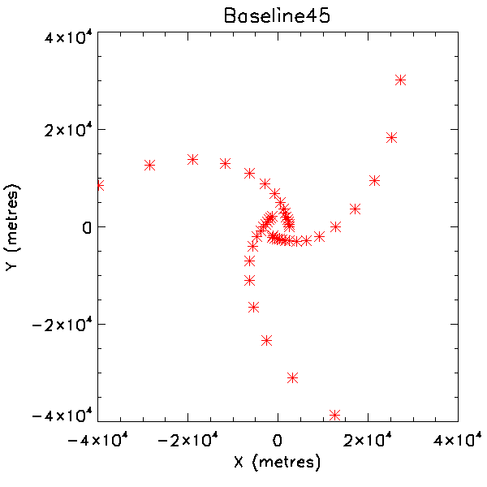
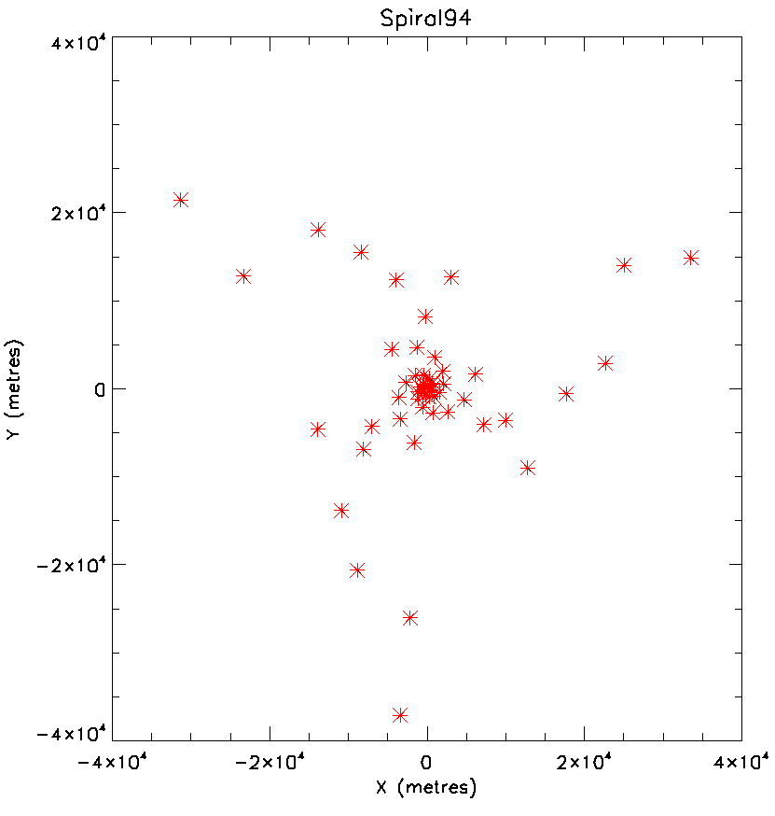
SKA1-Low Configuration
Comparison of ionospheric calibration performance (Cath Trott memo)
Options 1- 6 have only “single” remote stations, option 7 has “compound” remote stations

Slide 30
SKA1-Low Configuration
Comparison of ionospheric calibration performance (Cath Trott memo)
Options 1- 6 have only “single” remote stations, option 7 has “compound” remote stations

Slide 31
SKA1-Low Configuration
Comparison of ionospheric calibration performance (Cath Trott memo)
Options 1- 6 have only “single” remote stations, option 7 has “compound” remote stations
Best ionospheric calibration performance provided by “Spiral94”; also with Minimum Spanning Tree smaller by factor of about two

Slide 32
SKA1-Low Configuration

Slide 33
SKA1-Low Configuration

Slide 34
SKA1-Low Configuration

Slide 35
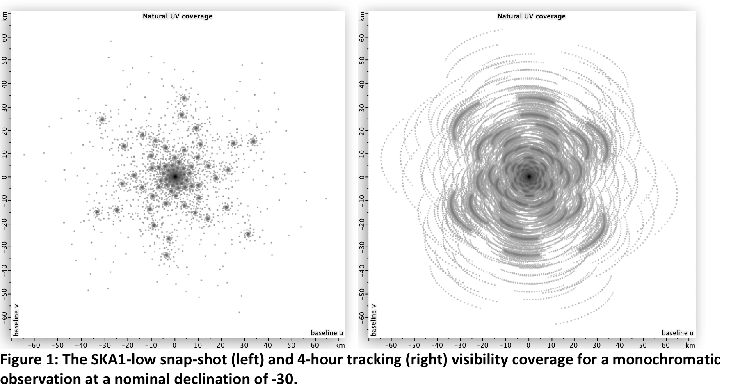
SKA1-Low Configuration

Slide 36
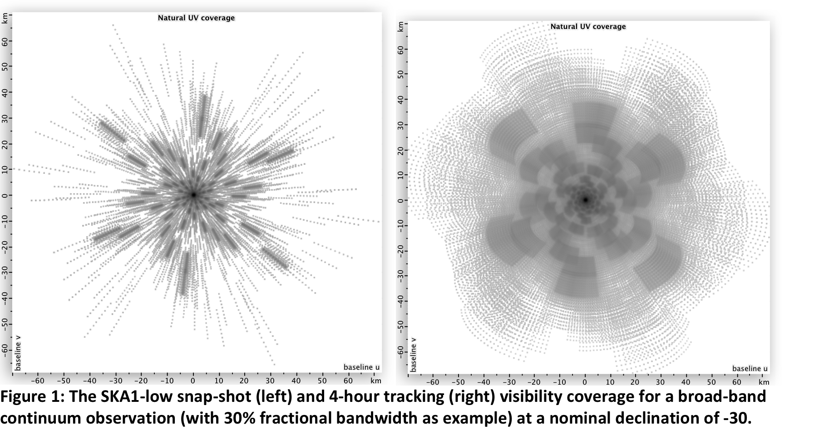
SKA1-Low Configuration

Slide 37
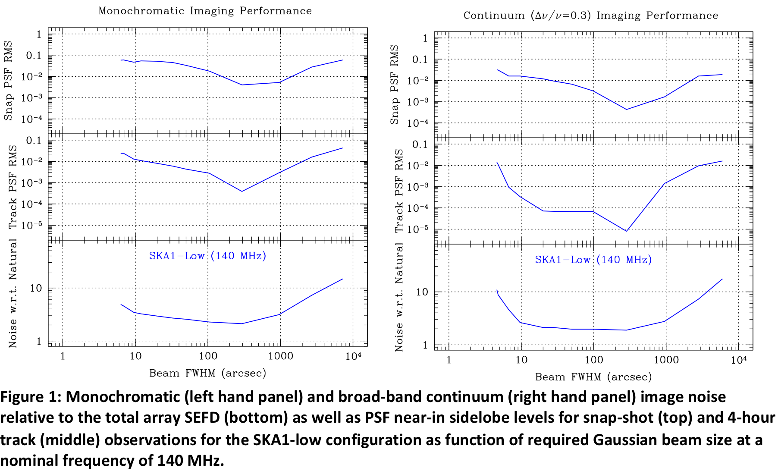
SKA1-Low Configuration

Slide 38
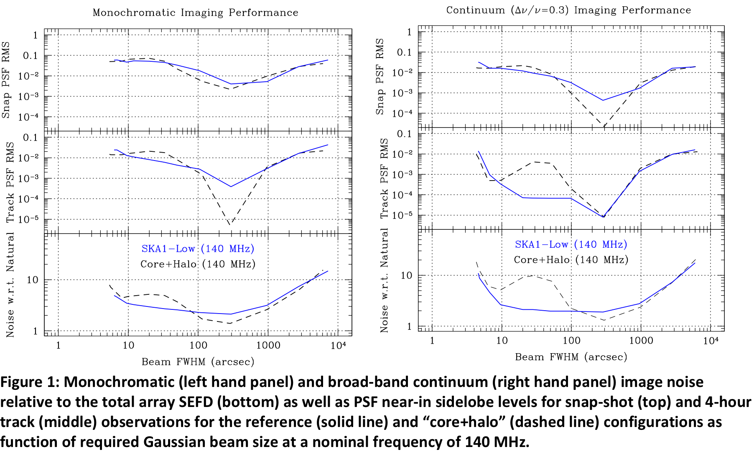
SKA1-Low Configuration

Slide 39
SKA1-Low Configuration

Slide 40
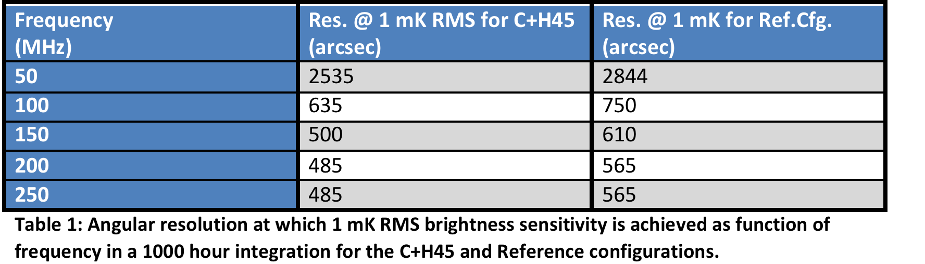
SKA1-Low Configuration
Logarithmic decline of sensitivity beyond core is vital for imaging performance that is needed for EoR foreground subtraction
Concentration into “compound” stations provides excellent/superior ionospheric calibration performance
“Penalty” of non-core stations is modest loss of angular resolution for the highest brightness sensitivities (mK)
Solution also has much smaller Minimum Spanning Tree (~half)

Slide 41
SKA1-Low Station Definition
Search for suitable “tiling” element from which to construct a three level beam-forming hierarchy
Solution could be regular pentagon

Slide 42
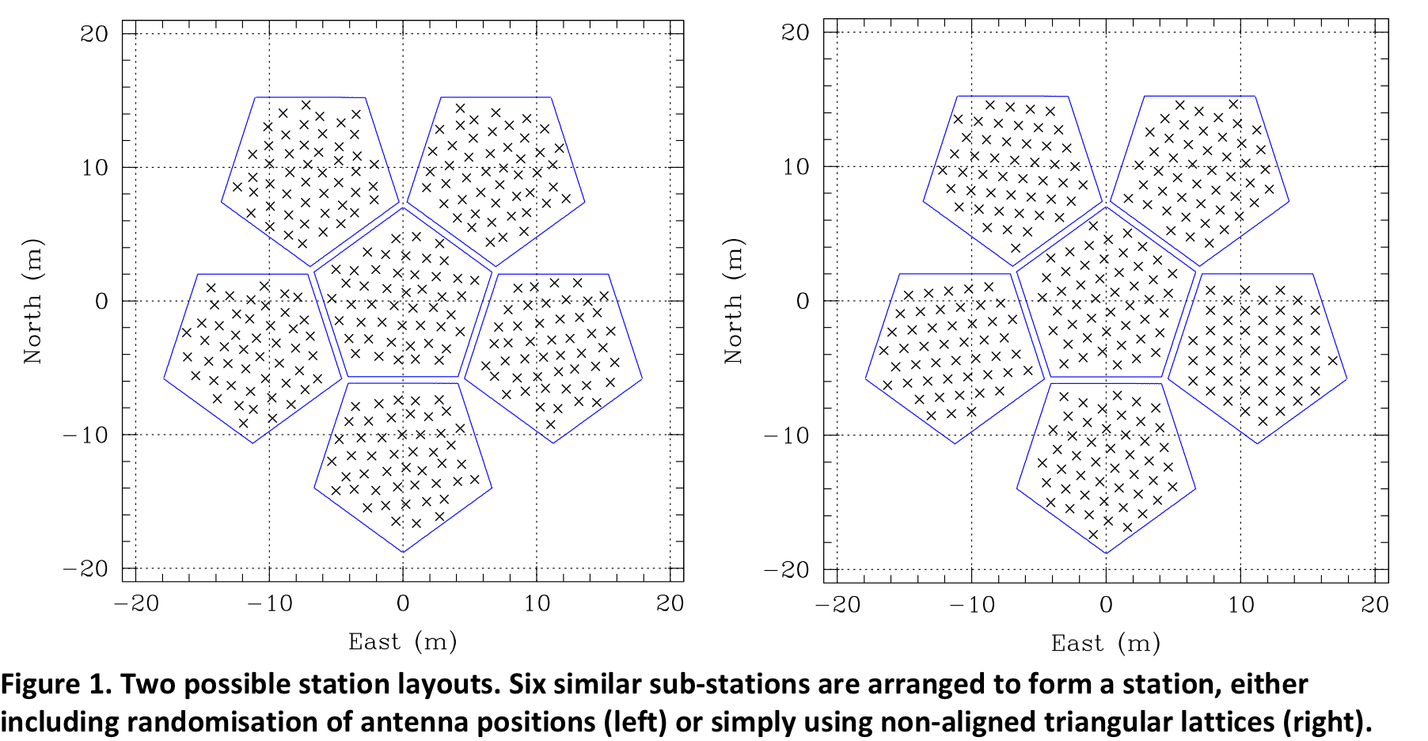
SKA1-Low Station Definition

Slide 43
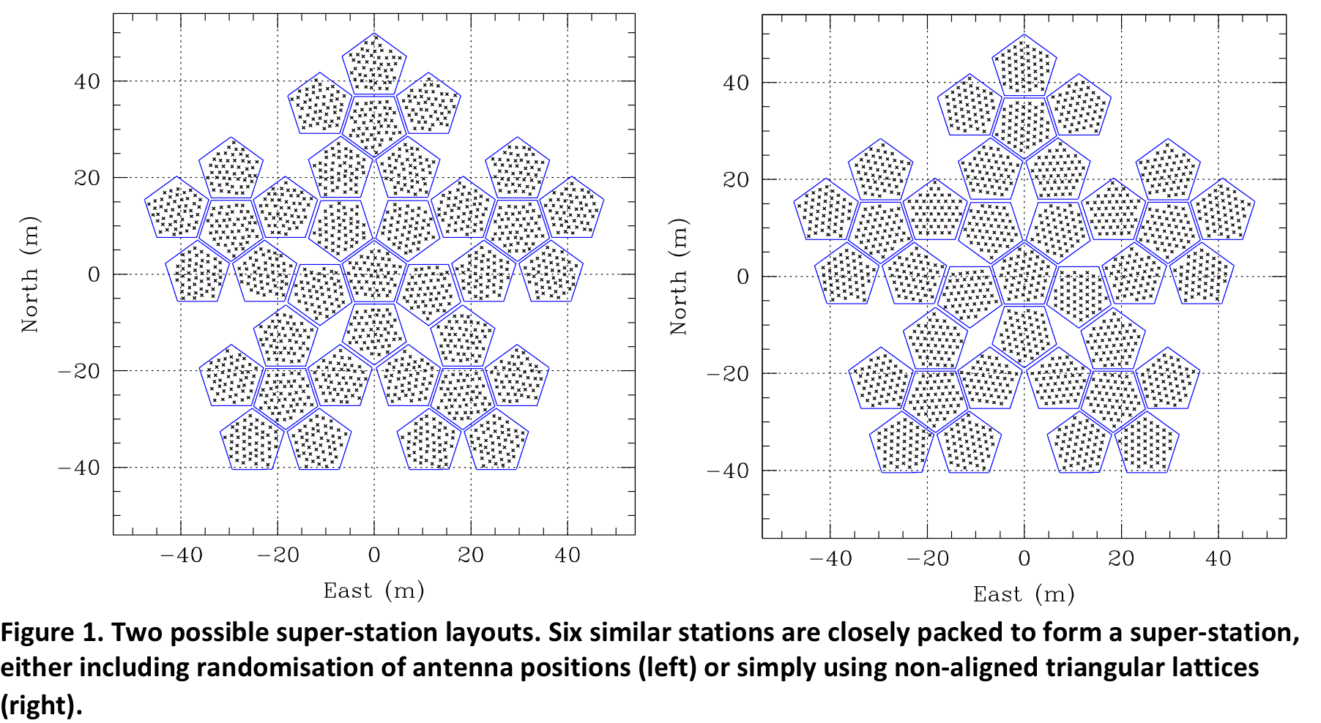
SKA1-Low Station Definition

Slide 44
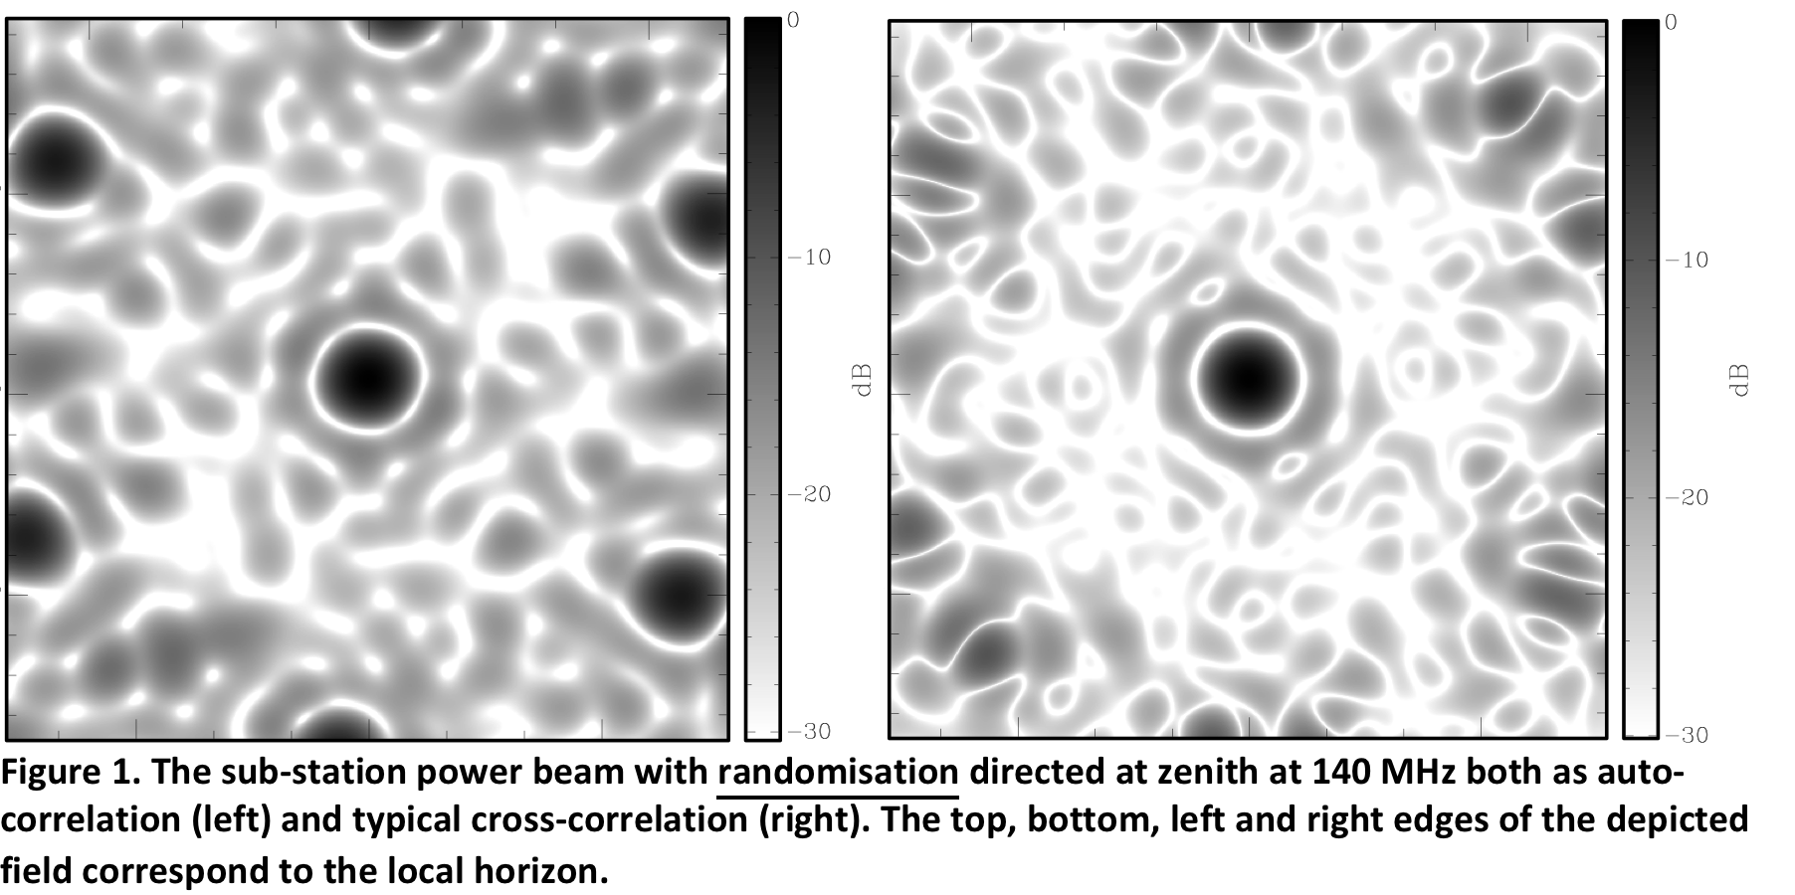
SKA1-Low Station Definition

Slide 45
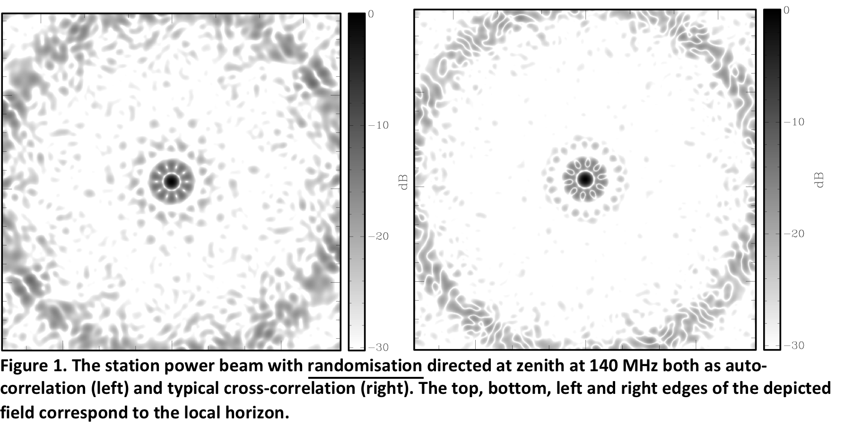
SKA1-Low Station Definition

Slide 46
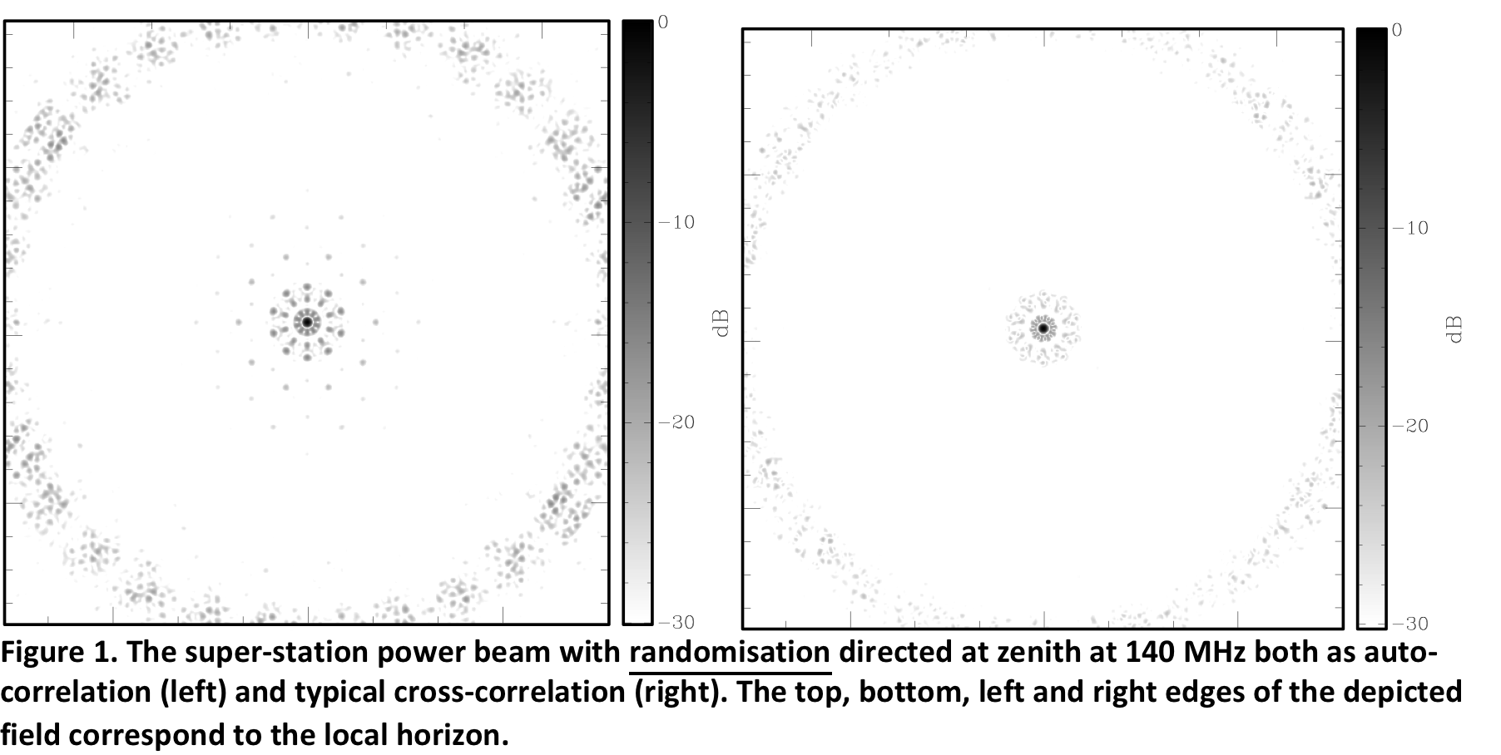
SKA1-Low Station Definition

Slide 47
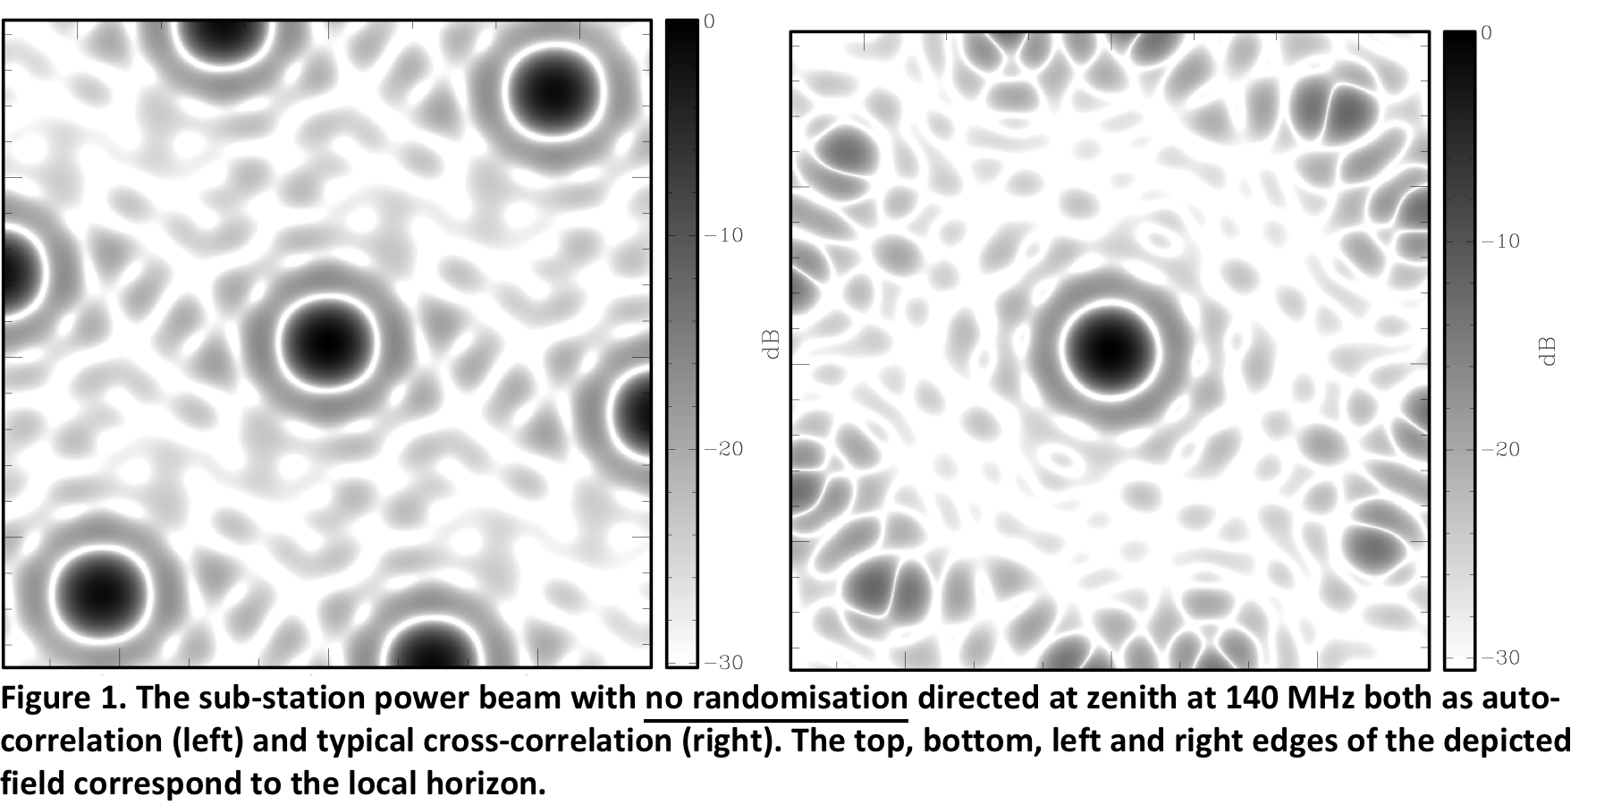
SKA1-Low Station Definition

Slide 48
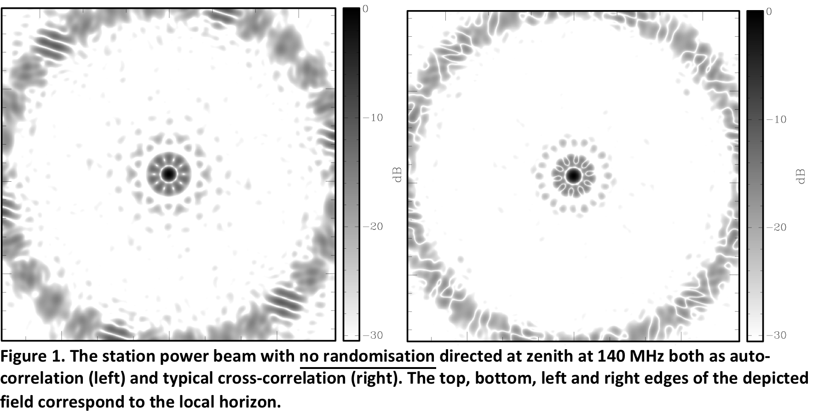
SKA1-Low Station Definition

Slide 49

SKA1-Low Station Definition

Slide 50
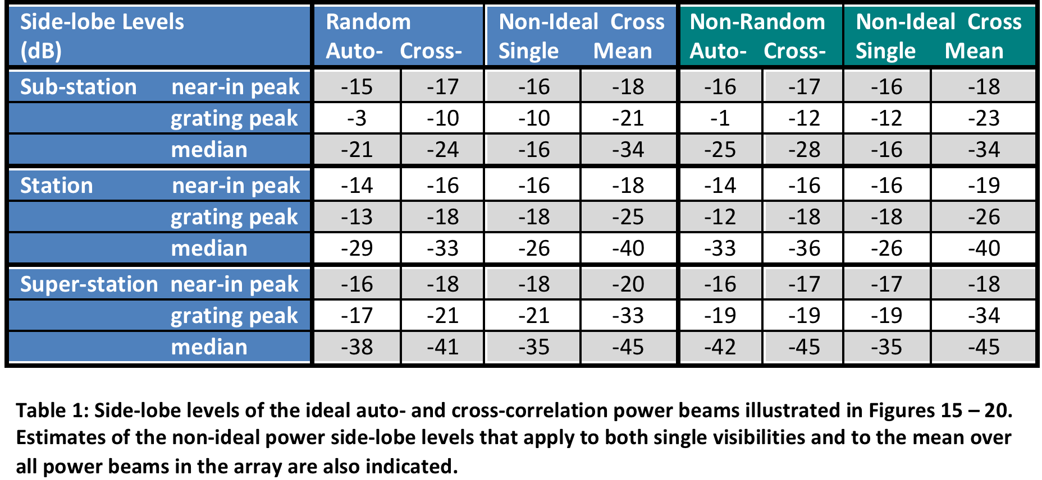
SKA1-Low Station Definition
Only the mean over all “super-stations” far sidelobe level approaches what’s needed (about -47 dB) for viable Direct Dependent calibration

