Slide 2
“Free” publicity
Aired in many countries around the world
10s millions of viewers (taxpayers, students, policy-makers, future customers, etc.)
Huge visibility for project and individual partners

Slide 3
PR challenges of communicating on the SKA (years ahead of operations)
and why we need you and you need us!
William Garnier, Comms Director
9 November 2015

Slide 4
Why communicate?
Let taxpayers know where their money go
Build trust with funding agencies -hence secure (future) funding- and with your community
Promote your organisation
Promote your science
Promote your engineering activities
Engage with a variety of stakeholders
Enthuse, inspire, raise awareness, educate
Get kids and students into science and astronomy
Etc.
“The 1-2% spent on comms/outreach is what will give the 98% to build the telescope”
Prof. Gerry Gilmore (Cambridge University), 2008

Slide 5
To whom?
National governments (includes non-members) and local governments
Industry
Science/engineering community
Local stakeholders
General public
Educational community
(media)

Slide 6
SKA Communications Strategy
“To grow financial, political, and public support for the SKA project by communicating its value to stakeholders and the general public”
Support SKA top managers to attract new member nations to the Organisation and enroll non-traditional funding sources
Ensure that stakeholders and the public understand the SKA to be a single coherent project
Increase communications activity in non-host countries
Ensure that all stakeholders are engaged with the project at the national and international level
Communicate the value of the SKA project to all its stakeholders, including the public

Slide 7
A global endeavour
SKAO Comms & Outreach team
leads and coordinates global comms strategy
William Garnier (Director)
Mathieu Isidro (Deputy Manager)
Joe Diamond (Outreach and Events Assistant)
Comms Steering Committee (12 people)
Chaired by SKA Comms Director
One representative per Member country
Coordinate strategy, promote collaboration, implement good practices, optimise resources, etc.
SKACON (25 people)
Chaired by SKA Comms Director
Large network of comms partners
Promote project in SKA countries
Own SKA mini-sites
Have access to SKA social media accounts
Implement local initiatives
Act as liaisons with SKAO

Slide 8
SKA Comms challenges
Very complex project
Still a long road…
No science results yet
Many audiences
“Competitive” landscape
And many other punctual ones

Slide 9
Challenges are opportunities !
Complex project
That what makes it exciting, intriguing!
Our role is to make it accessible, appealing, understandable…

Slide 11
Challenges are opportunities !
Still a long road…

Slide 12
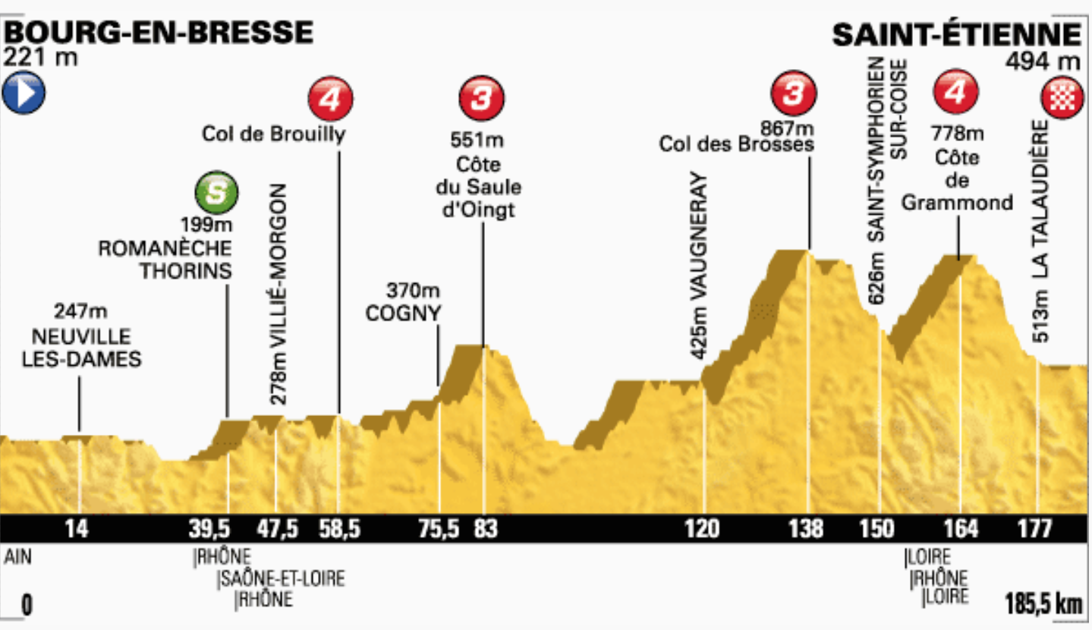

Slide 13
We are here!
Start of Project
SKA1 completion
Design work
Re-baselining
Set up of SKAO
Funding secured SKA1 constr. approved
Short listing of suitable sites
Governance/ Funding
Site selection
PDR/CDR
Tender/Constr
SKA1 cost ceiling
Early Science
Concept
Early 1990’s
2024

Slide 14
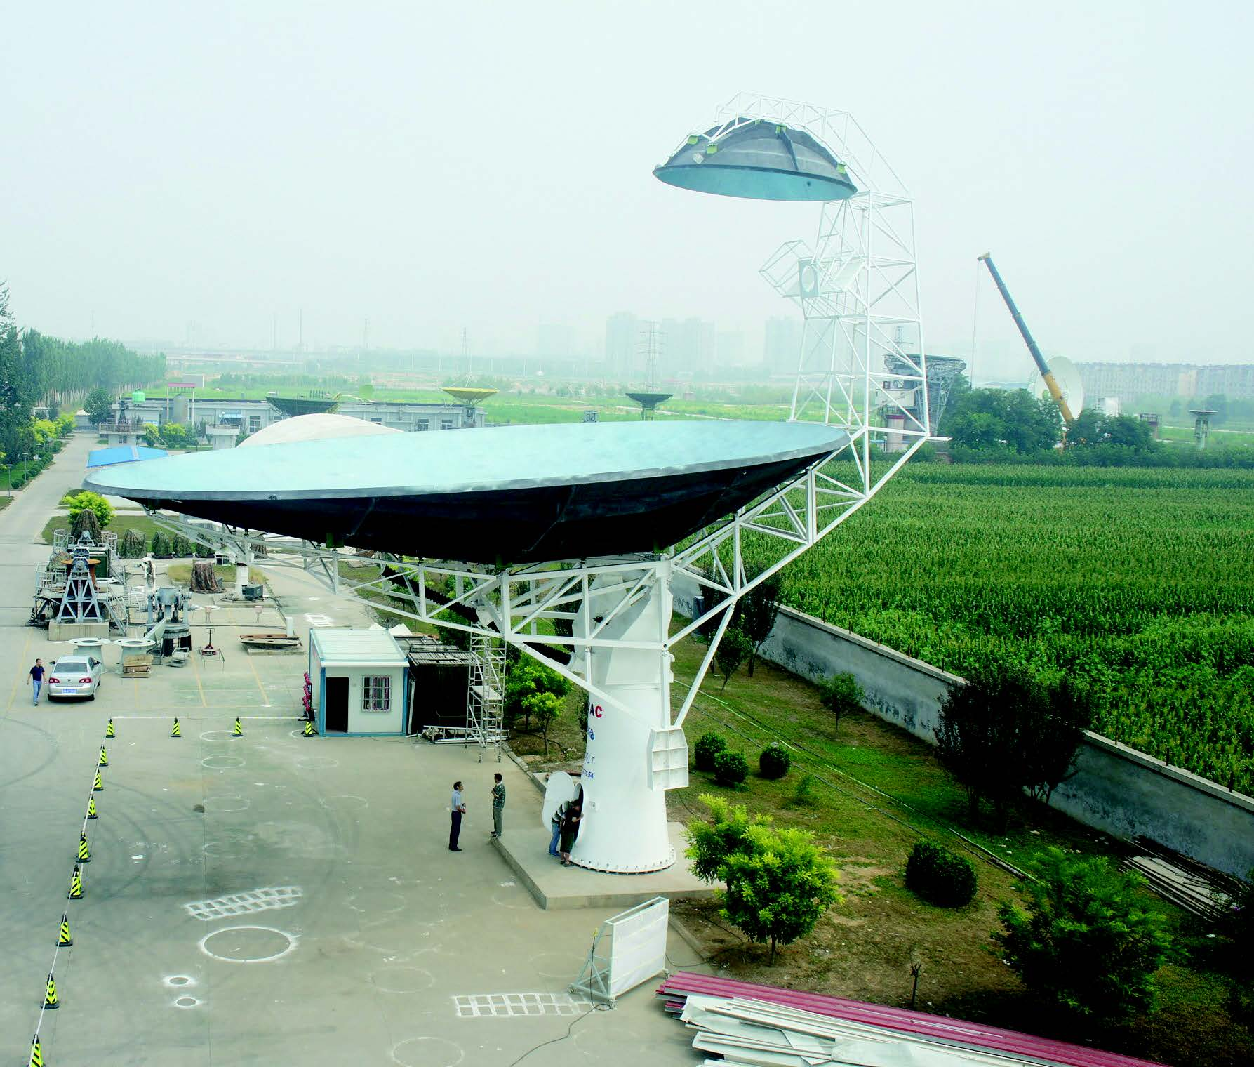
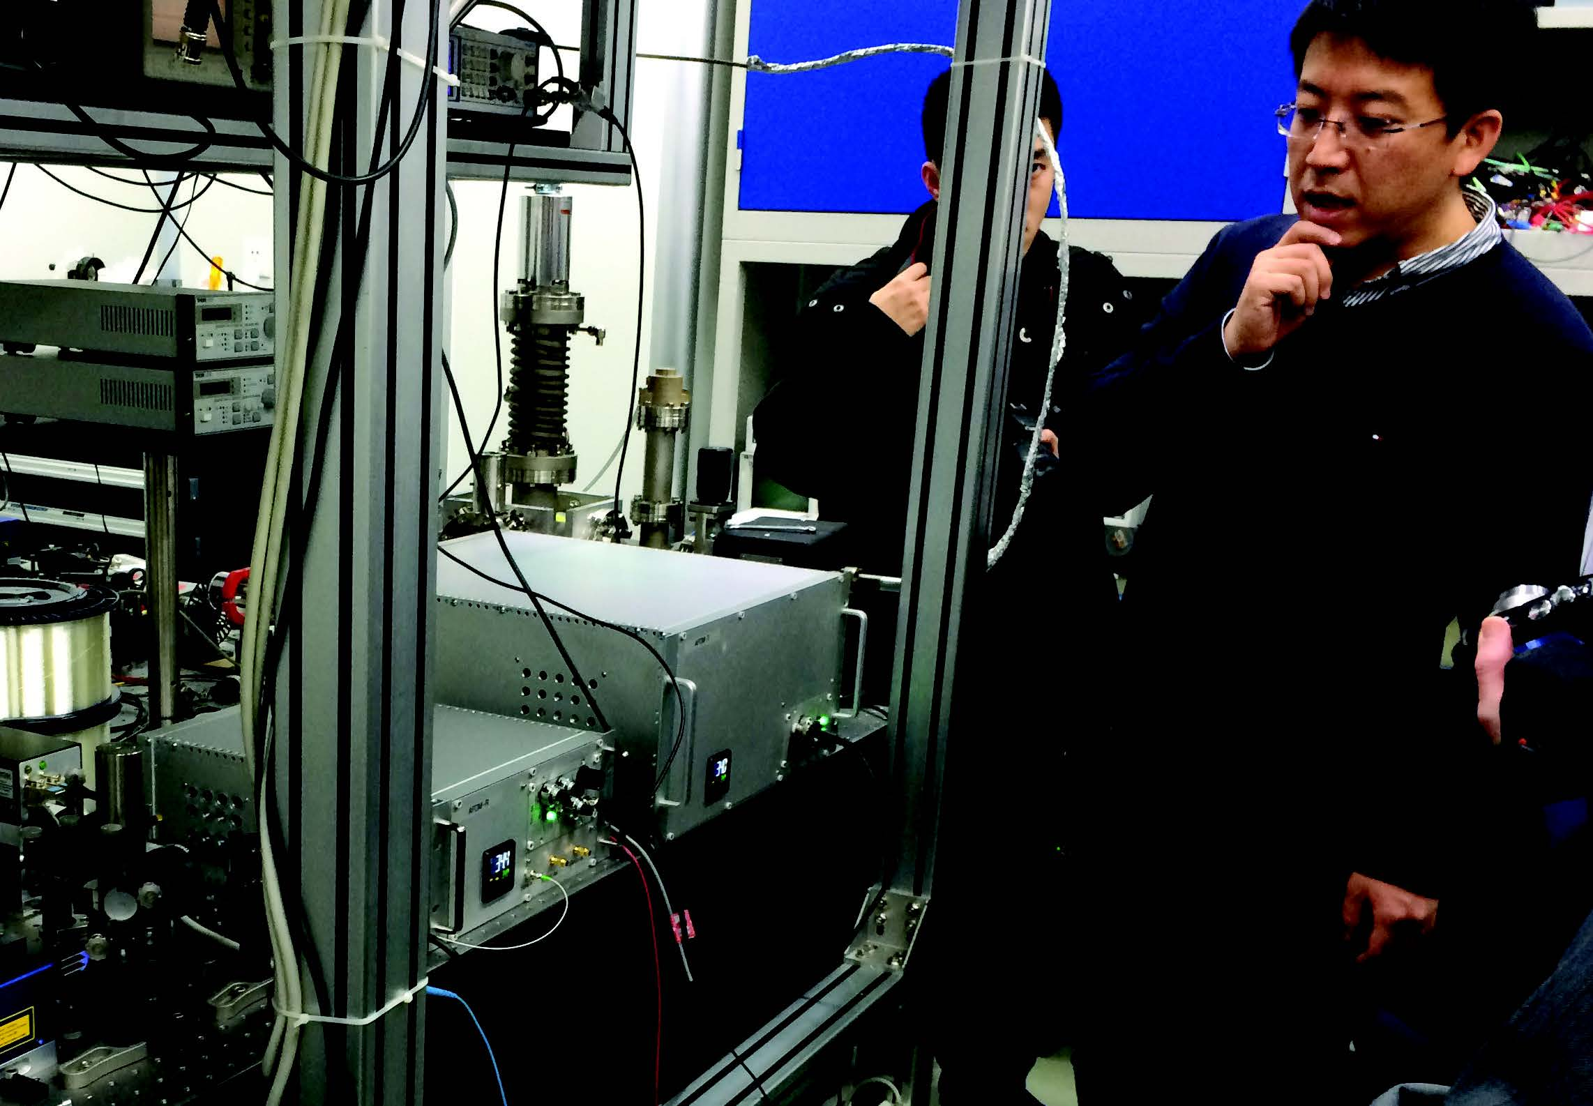
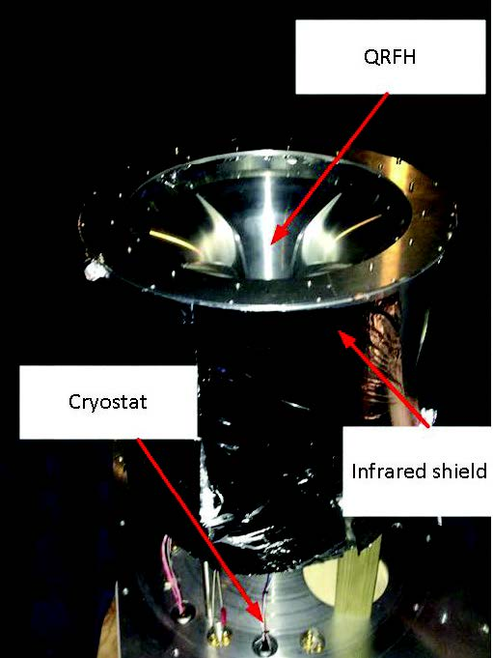
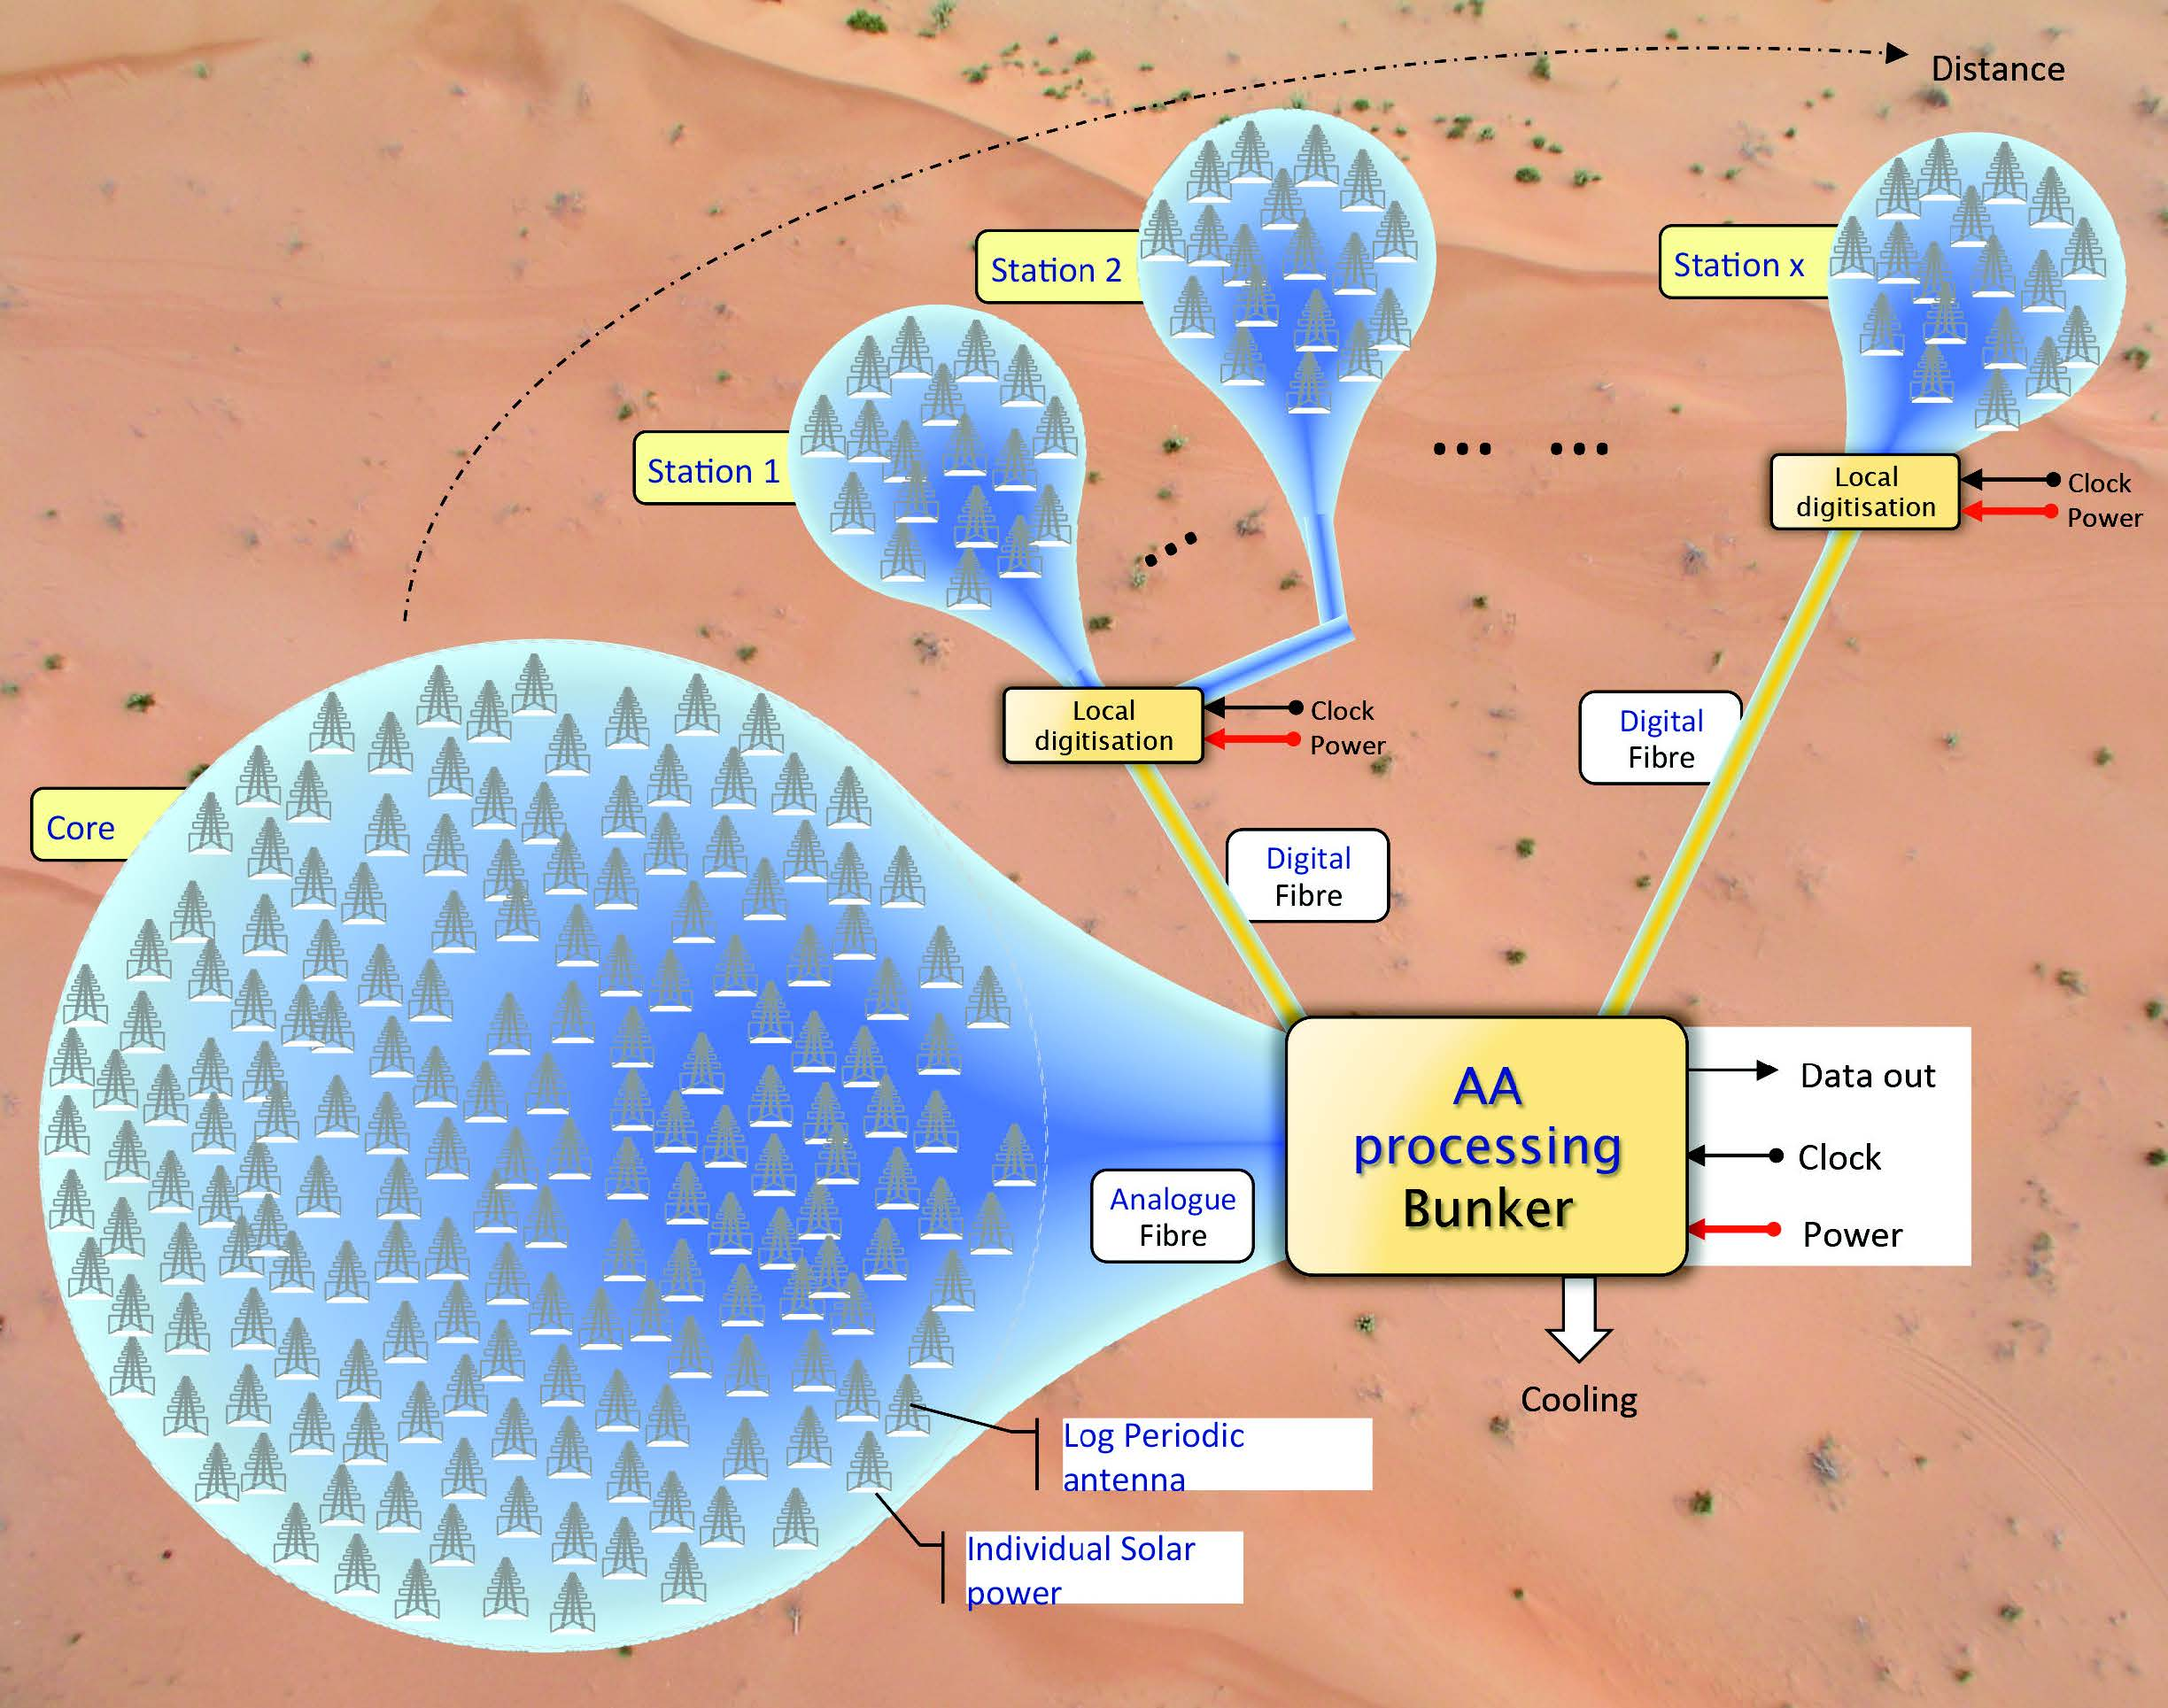
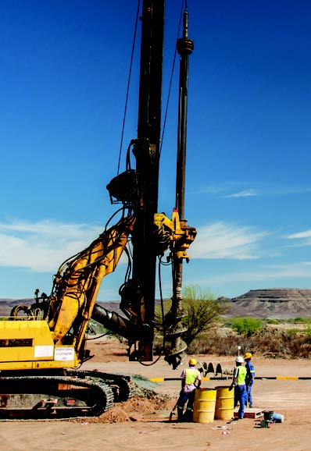
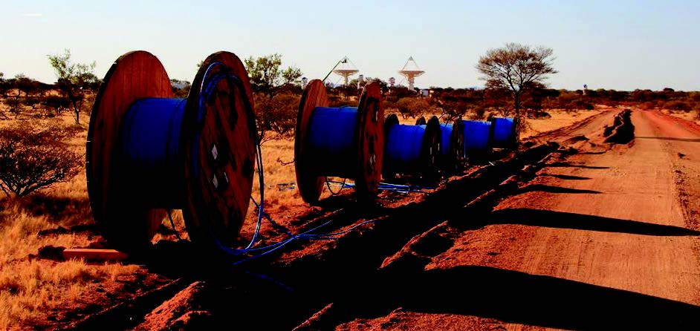
Challenges are opportunities !
Still a long road…
But many things happening already !

Slide 15
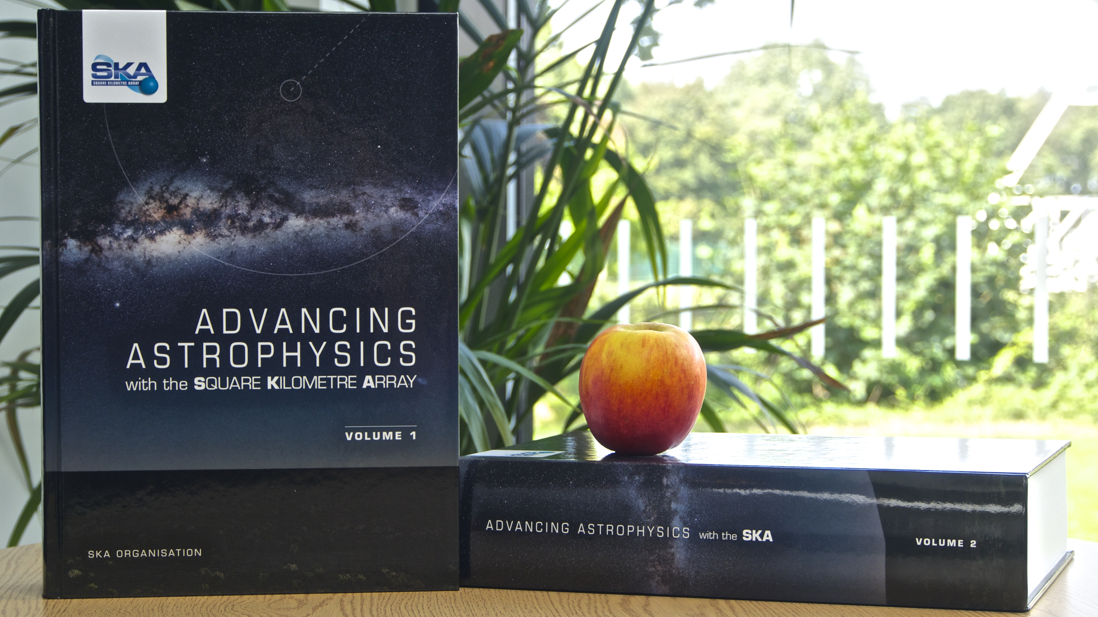
Challenges are opportunities !
No science results yet?
Right but…it’s all about raising (while at the same time managing) expectation!
SKA science already exciting curiosity

Slide 16
Challenges are opportunities !
No science results yet?
Well, with SKA, right but…
SKA precursors and pathfinders already delivering great science!

Slide 17
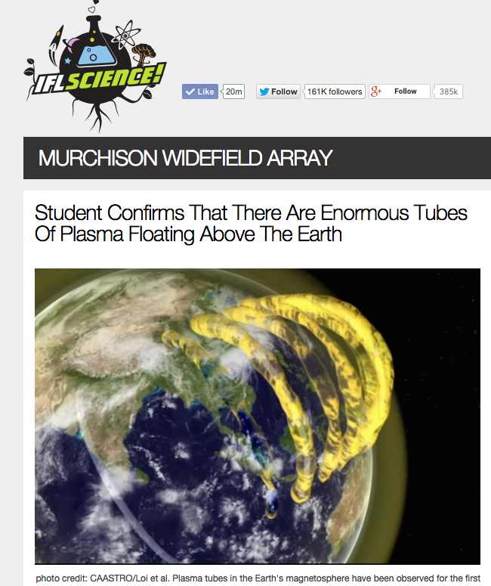

Slide 18
Challenges are opportunities !
Many audiences
Speak everybody’s language
Set the right tone
Develop a narrative which will resonate with your audiences
Tailor your material to your audiences
SKACON is key in that !

Slide 19
Challenges are opportunities !
“Competitive” landscape
Several funding partners also involved in other big science/astro projects…
Competition?
Complementarity and synergy are nicer words…

Slide 20
All goes down to…
Growing interest/support
Keeping momentum
Building trust
Managing expectations

Slide 21
How can you help and why?

Slide 22
Commitments
MoU:
Article 6.1.c:
“The Consortium Members will use reasonable endeavours to provide the SKA Communications and Outreach Working Group (“SKACOWG”) with any marketing materials and other public-facing materials produced by them or on their behalf which relate to their contribution to the SKA Project.”
Article 6.1.k/l/m:
“The Consortium Members will not issue any public communication or make any public disclosure regarding their involvement in the SKA Project unless:
(i) SKA Organisation has already issued a public communication which discloses the nature of their involvement; and
(ii) their proposed communication or disclosure falls within the scope of the disclosure made by SKA Organisation in its public communication.
They will notify SKA Organisation of their intent to issue a press release (but not posts on or via social media, blogs and websites) as far in advance as possible and will use reasonable endeavours to provide SKA Organisation with a copy of the proposed press release not less than 3 days (where possible) prior to it being issued. All such communication to be in writing to skacowg@skatelescope.org or by such other means as SKA Organisation may reasonably notify to them from time to time.
They will use reasonable endeavours to co-ordinate press release content and timing with SKACOWG communications to maximise the coverage and reach of communications relating to the SKA Project.”

Slide 23
A global endeavour
SKAO Comms & Outreach team
Comms Steering Committee
SKACON
Coordination is critical !
Consortia / Consortia partners
- Document activities (videos, photos)
- Report on activities (corporate publications, SKA publications, press releases, social media, etc.)

Slide 24
The ‘Monster Moves’ example

Slide 25
The ‘Monster Moves’ example: what does it tell us?
Documenting is key !
Progress on site
Activities around the world
High-quality material will definitely be used by media!
JOINT ENDEAVOUR

Slide 26
The ‘Monster Moves’ example: what does it tell us?
When it’s too late, it’s too late !
Let’s not miss opportunities !

Slide 28
The ‘Monster Moves’ example: what does it tell us?
Reporting, collaborating and coordinating is critical!
Identify upcoming visually appealing activities, let’s video/photo record them, let’s promote them !

Slide 29
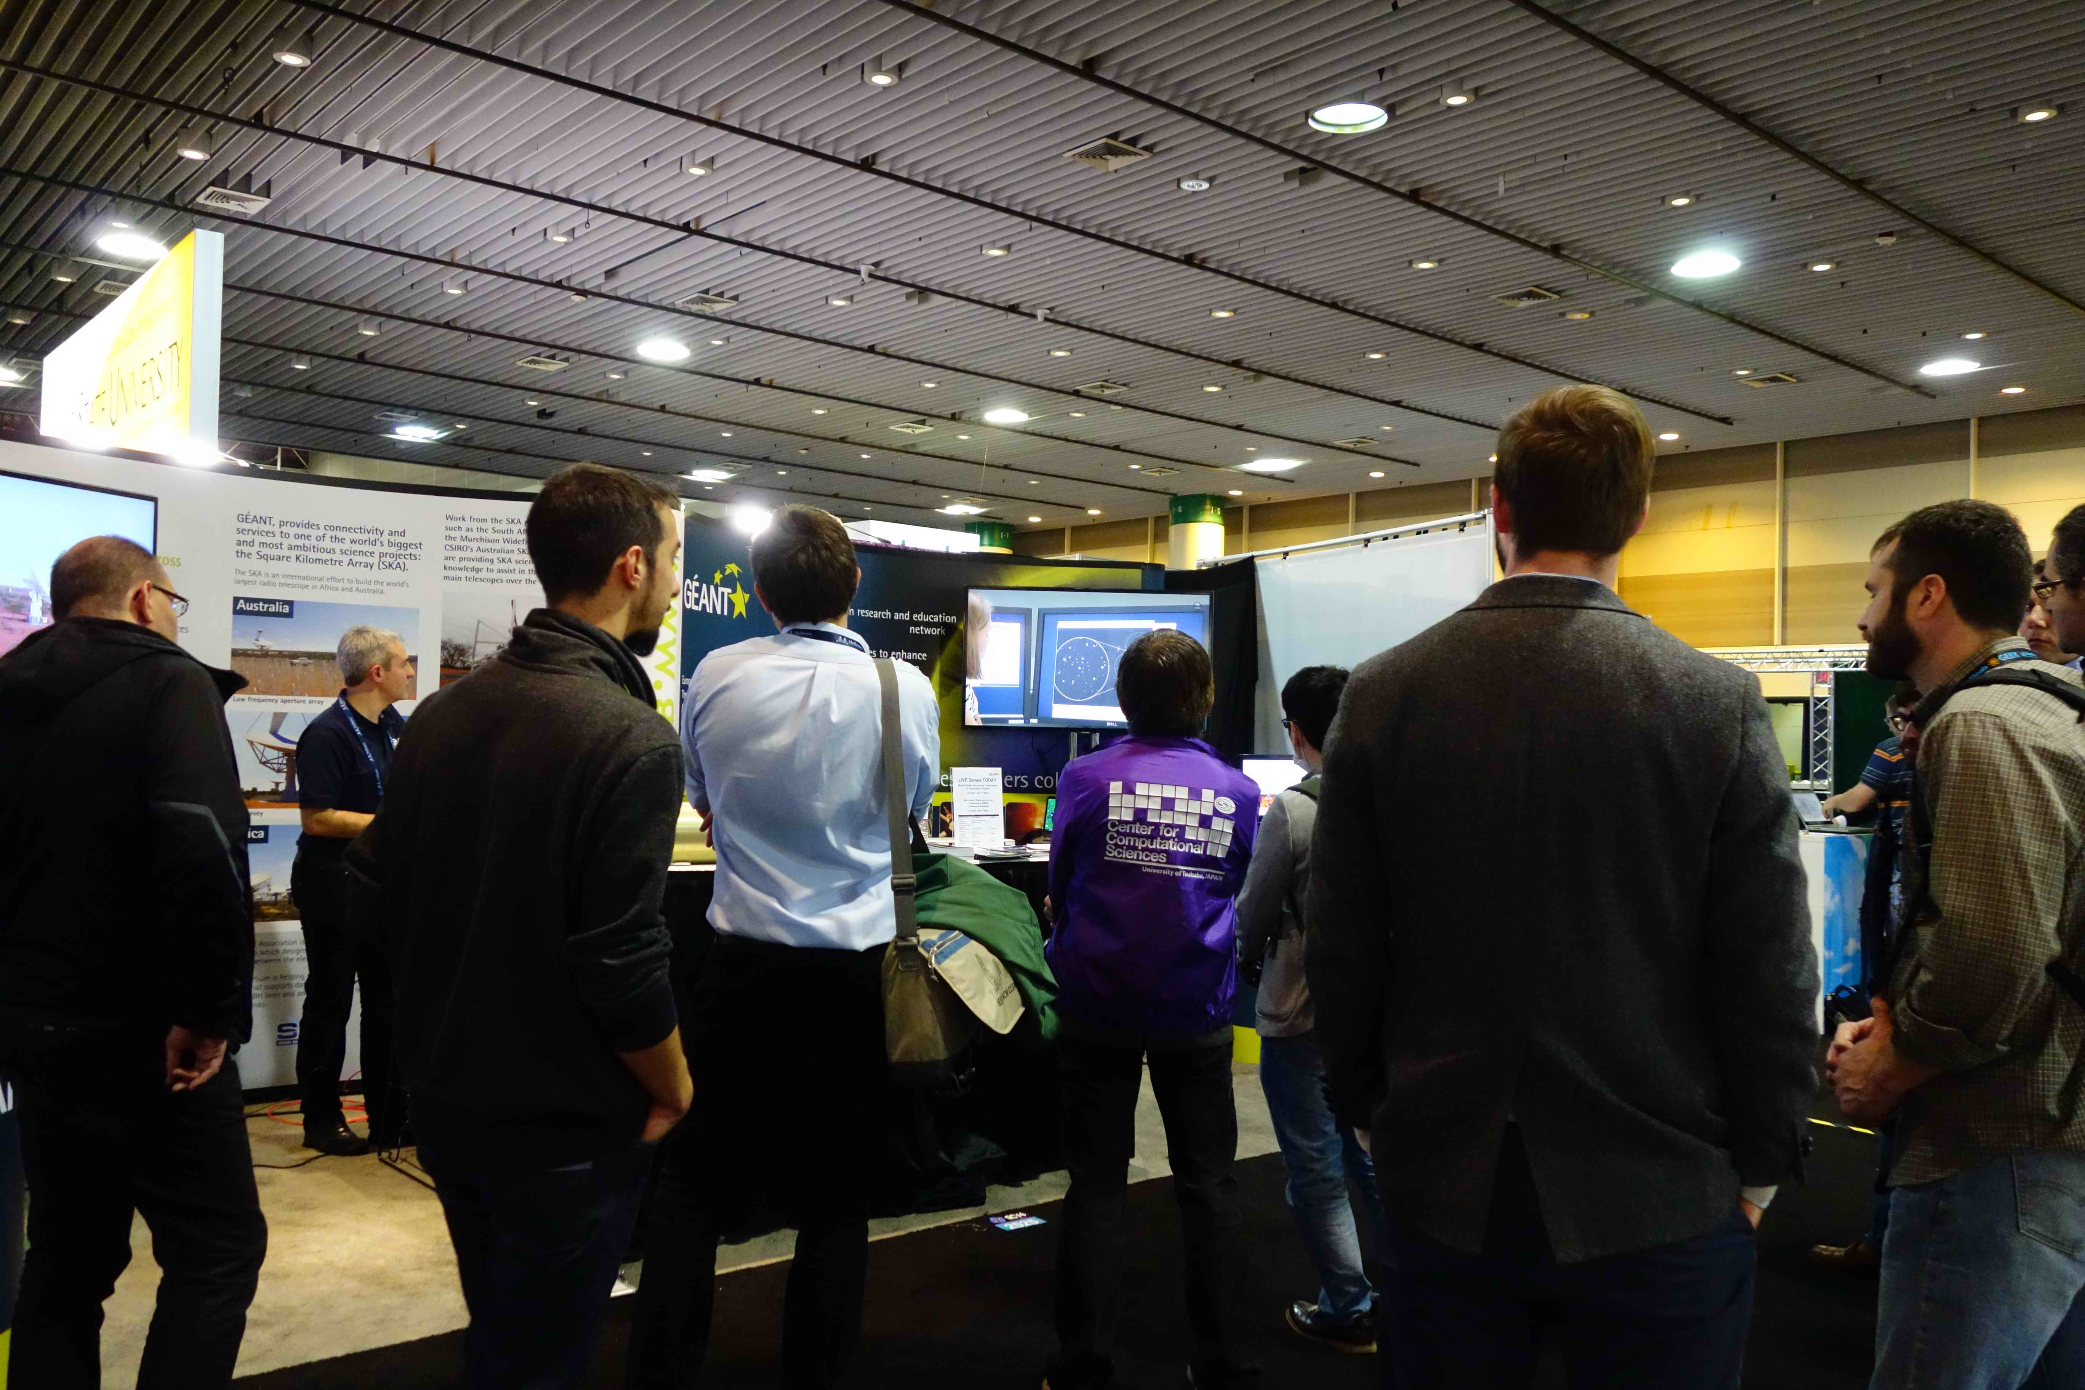
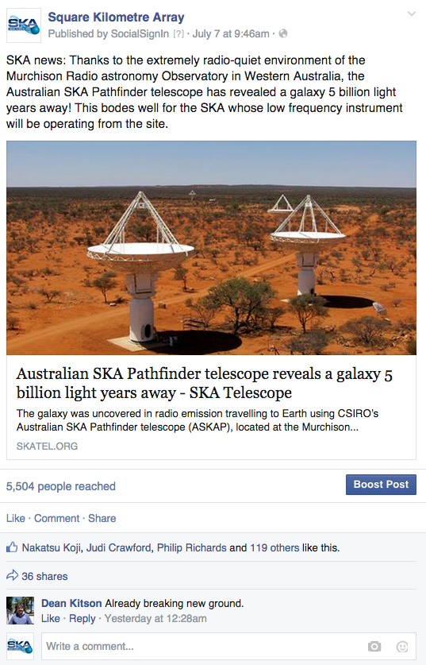
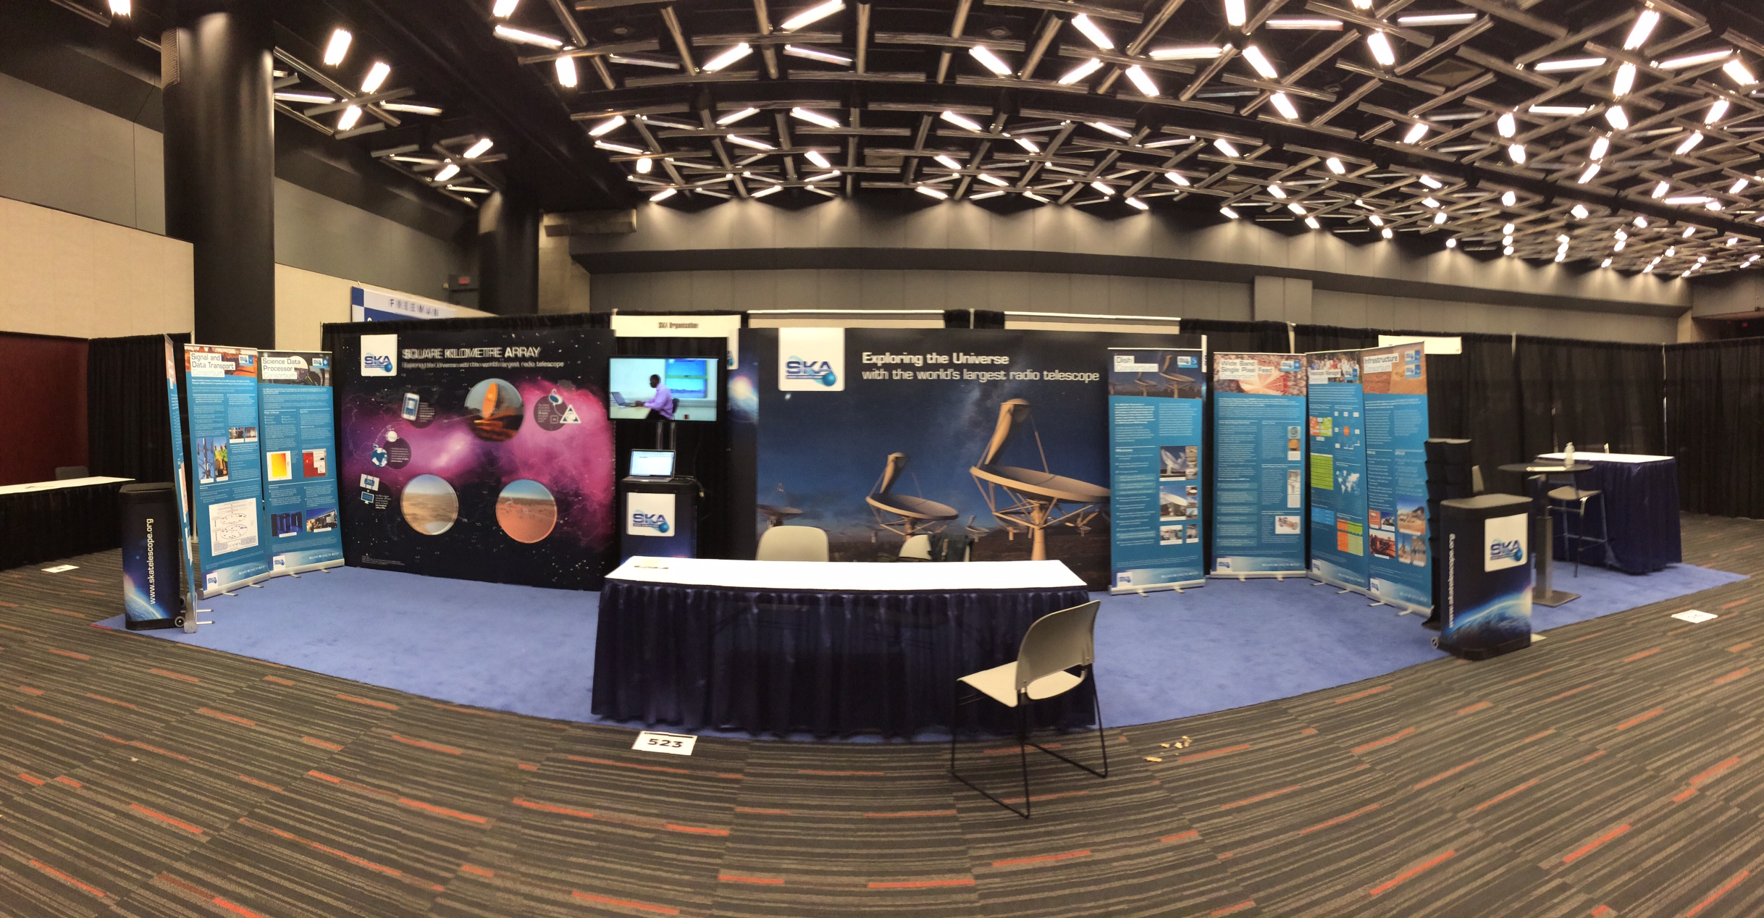
Let us help you!

Slide 30
Let us help you!
Training:
Ex: Ingenious Programme (funded by Royal Academy of Engineering)
Joint project: SKAO-UK Jodrell Bank Discovery Centre
Session on Tuesday afternoon!
Please come along…

Slide 31
Thank you !
Questions?
(and don’t forget to support our
Movember group)

