Slide 1
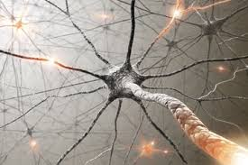
TANGO a Possible Nervous System for SKA
R. Smareglia A. Gotz, L. Pivetta, C. Knapic,
R. Brederode, Y. Gupta, S. Vrcic, …
SKA Eng. Meeting 2015 (Penticton,BC)

Slide 2
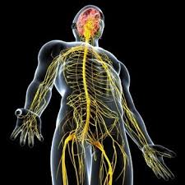
What is a nervous system
The Nervous System is:
the master controlling and communicating system of the body
The Nervous System CONTROLS and
COORDINATES ALL ESSENTIAL FUNCRIONS of the Human Body

Slide 3
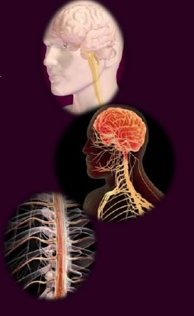
Structural Classification of the Nervous System:
Central Nervous System (CNS):
Consists of the brain and the spinal cord, which act as the integrating and command centers of the nervous system
They interpret incoming sensory information and issue instructions based on past experience and current conditions
Peripheral Nervous System (PNS):
It is the part of the nervous system outside the CNS
They link all parts of the body by carrying impulses from the sensors receptors to the CNS and from the CNS to the appropriate glands or muscles
It consists mainly of the nerves that extend from the brain and spinal cord
Cranial Nerves carry impulses to and from the brain
Spinal Nerves carry impulses to and from the spinal cords.

Slide 4
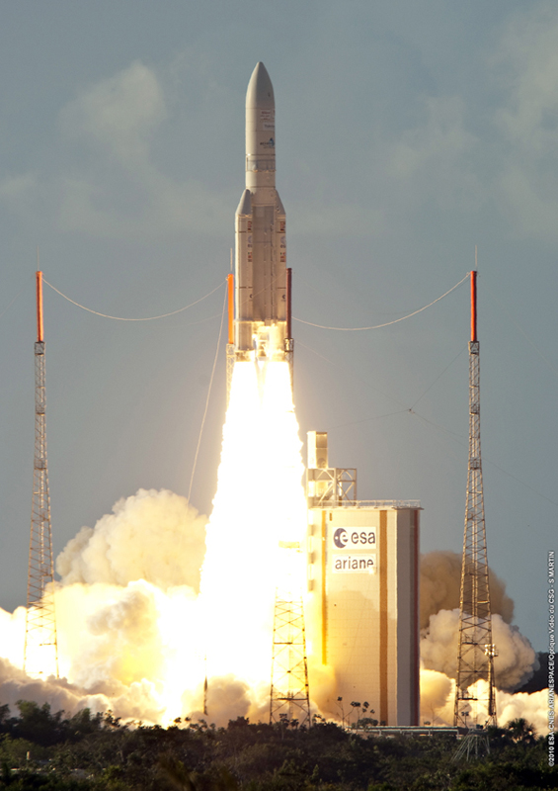
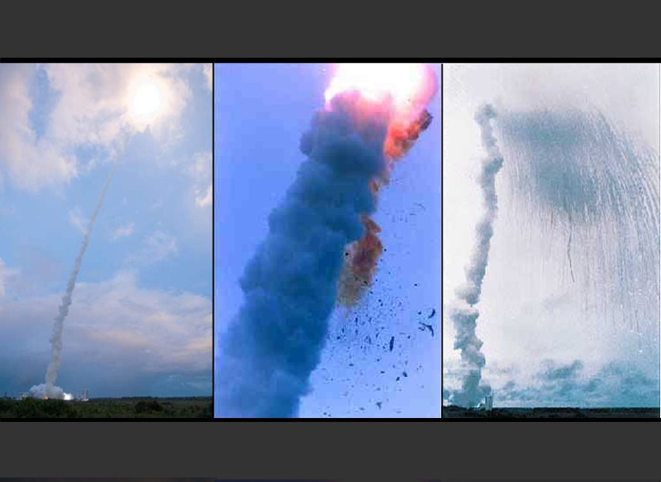
Break or bad connection on N.S.
Arianne V: first launch => A Bug .. A Crash
Key world.. Is not interoperability but unique and efficient communication bus ➔ Communalities

Slide 5
Trieste meeting
From 25 to 27 of March 2015 representatives from 8 SKA Consortia met at Trieste (Italy) with the goal to explore some open source Monitor & Control Frameworks, share their requirements and expertise and define a procedure to choose the best common framework for the SKA.
To support this effort some experts from EPICS, TANGO and ACS were invited to the meeting.
Before and during the meeting some draft documents had been exchanged in a shared Google drive directory.
During the discussions and following the Consortia presentations, it became clear that there are two main candidates: TANGO and EPICS.
At the end of the three days meeting, after very useful discussions TANGO was chosen as the SKA M&C Common Framework.
https://www.ict.inaf.it/indico/event/74/

Slide 6
TANGO a Possible Nervous System for SKA
R. Smareglia A. Gotz, L. Pivetta, C. Knapic,
R. Brederode, Y. Gupta, S. Vrcic, …
SKA Eng. Meeting 2015 (Penticton,BC)

Slide 7
What is TANGO ?
High performance framework for distributed control systems
Multi-Language - C++, Java, Python, JavaScript
Multi-Platform - Windows, Linux, Macintosh etc.
Integration into many 3rd-party systems (Matlab, LabVIEW, IGOR Pro etc.)
Unified interface to hardware devices and equipment

Slide 8
What is Tango?
Connecting things together
Scientific workspaces
Industrial SCADA
Native client applications
In short:
Control system framework
TANGO C++
Java Python
Clients (CLI/GUI)
Based on CORBA and ZMQ
TANGO
Archiving System
Centralized config. database
TANGO
binding
TANGO
binding
TANGO
binding
TANGO
binding
Software bus for distributed objects
TANGO software bus
Provides unified interface to all equipments hiding how they are connected/managed
Device Server
Device Server
Device Server
Device Server
Device Server
Device Server
Device Server
HV ps + serial
Pylon LIMA
OPC UA
Modbus
Data socket
Motion Control
TANGO 2 EPICS
SNMP
OS/drv.
OS/drv.
OS/drv.
OS/drv.
OS/drv.
OS/drv.
OS/drv.
RS232
GigE
TCP/IP
Modbus
RS232/Eth
EtherCAT
PLC
NI cRIO

Slide 9
How easy is TANGO
Basic TANGO is not difficult – students write their first device server within hours
TANGO is a very rich toolkit – 15 years of development have seen it adapted to many use cases
Distributed programming - learning how to design, program and debug a distributed system is the challenging part

Slide 10
Device
Connecting things together
Everything which needs to be controlled is modeled as a Device The Device is the core concept of TANGO
A Device can represent:
an equipment (e.g. a power supply)
a set of equipment (e.g. a set of 3 motors, x-y-z axes, driven by the same controller)
a set of software functions
a group of equipment constituting a subsystem
The modeling of the equipment, either hardware or software, is the first fundamental step when writing a TANGO device
a TANGO device must be self-consistent
must enable the access to all the features of the modeled device
the limit of its responsibilities, meaning the separation of concerns, is clearly defined: 1 device = 1 service = 1 element of the system
the analogy with object-oriented programming is straightforward

Slide 11
TANGO Concepts
Three major building blocks
TANGO device
TANGO device server
TANGO database
TANGO Client API
Database server
discover
register
Device_{Device} Device server
TANGO
client
Client requests Server events
Device

Slide 12
Device Server
Connecting things together
Startup sequence Device server
the TANGO device server contacts the TANGO database to know which devices it has to create and manage based on the instance specified
the TANGO device server registers device(s) IOR
Client
1 - the client asks the TANGO database for device IOR 2 - the client connects to the device server peer-2-peer
The TANGO database is involved, and necessary, only during the connection phase (*)
(*) memorized attributes
peer-2-peer

Slide 13
Corba and ZeroMQ
CORBA – http://www.omg.org
Common Object Request Broker Architecture specification
Defines the ORB and the services available for all objects
Uses an Interface Definition Language (IDL) and defines bindings between IDL and programming languages
An Inter-operable Object Reference (IOR) identifies each object
TANGO adopts omniORB for C++ and JacORB for Java http://www.omniorb.sourceforge.net http://www.jacorg.org
Used only for synchronous communication since TANGO≥ 8
ZeroMQ, ZMQ, 0MQ – http://zeromq.org
An embeddable networking library that acts like a concurrency framework
Sockets that carry whole messages across various transports like in-process, inter-process, TCP and multicast
Used for event-based communication in TANGO ≥ 8
Corba will be replaced completely in the next major release of TANGO V10 (planned for 2017)

Slide 14
TANGO Device
Fundamental element of interaction
Interface to existing hardware or logical devices
Identified by a three field name
“domain/family/member”
Every device belongs to a TANGO class
Configured by device properties
Exposes attributes and commands

Slide 15
TANGO database
Database server is a TANGO server with a device itself
MySQL-backend for storing configuration
Register device servers and devices
Remember device properties
Memorize device attributes (optional)
Communication device end points (IOR) for p2p-communication
Notes:
1 DB x ogni dominio, puoi aggiungeer quanti domini vuoi e ciuscun devaice di ogni dominio puo’ comunicare con ogni altro device di ogni altro dominio ( se conosce il full qualified domain name)

Slide 16
TANGO Device Server
Runnable piece of software containing TANGO devices
Device classes are defined in the code
Device instances are defined in the TANGO database
Server instances are registered at the TANGO database
Identified by executable name + instance name
Creates devices specified in database on startup
Can be written in C++, Java or Python

Slide 17
Typical Device Server
MultiAxis MotorController
AxisClass
Axis
id1/axis/x
ControllerClass
Controller Library
Controller
id1/controller/1
Axis
id1/axis/y
Axis
id1/axis/z
Controller hardware

Slide 18
Device Server
The Device Server is the process where the TANGO class(es) run
Device Server configuration is stored into the TANGO database (MySQL)
Device number and names for a TANGO class are defined within the database,
not in the code
Which TANGO class(es) are part of a DS process is defined in the database
but also in the code
The Device Server can host several TANGO classes, each class can be instantiated several times ...but be careful with code or DLLs not thread safe

Slide 19
Device Interface
Connecting things together
Everything which needs to be controlled is modeled as a Device Each Device is identified by the Fully Qualified Domain Name (FQDN)
tango://host:port/domain/family/member
Each Device belongs to a TANGO class that inherits from the same root class Device_XImpl
Every Device exposes the same interface:
Command(s): act on devices (e.g. power on)
Attribute(s): set/get physical values (e.g. set/get motor position)
Can be memorized
Attribute properties: per-attribute configuration parameters (*)
State/Status: TANGO Device finite state machine value (also available as Commands) (*)
- Properties: config. Parameters Attribute level
Device level
Class level Free/Global
(*) more on these to come

Slide 20
REAL World Device
One device
One device
One device

Slide 21
a Closer look at TANGO Devices
Commands: perform an action on a device
Attributes: represent physical values
Properties: configuration used at initialisation
e.g. IP adress, default shutter time
State and Status: indicators for device state

Slide 22
Commands
Have one input parameter and a return value
Only limited set of data types (approximately 15)
But also arrays
e.g. PowerOn(), Stop(axisNumber), StopAll()

Slide 23
Attributes
Self-describing data via attribute propertius
e.g Description, Unit, data_type, min/max, alarm values
May be read-only, write-only or read-write
All typical primitive data types like boolean, integer, double, string etc.
Three data formats :
Scalar (one value)
Spectrum (one-dimensional array)
Image (two-dimensional array)

Slide 24
Properties
Properties are stored in the TANGO database
Manage using the tool Jive
Can be defined at class, device and attribute level
Basic data types as scalar or array values

Slide 25
State + State Machine
State management is essential for control systems
14 defined states are available
e.g ON, OPEN, MOVING, FAULT, ALARM etc.
Explanatory message available as Status attribute/command
Support through „state machine“ and „allowed states“

Slide 26
Tango Client
Can be written in C++, Java, Python
Implementations for many tools exist
e.g. Matlab, LabView, IgorPro, concert
Different communication mechanisms
Synchronous calls
Asynchronous calls
Events
Group Calls

Slide 27
Synchronous Calls
Network transparency etc. using DeviceProxy
Easy to use calls like command_inout(), read_attribute(), write_attribute()
Result objects can contain data and metadata
Exceptions are of type DevFailed
Request (blocking)
Client
Device
Response

Slide 28
Asynchronous Calls
Non-blocking request to a device
Device notifies clients via callback
No changes on the server side required
Supported for
command_inout
read_attribute(s)
write_attribute(s)

Slide 29
Events
Different communication paradigm
No polling from the clients
Devices notify clients about „interesting“ changes
Only available for attributes
Clients need to subscribe to events and are notified using callbacks
Different types like Periodic, Change, Data ready, Archive etc.

Slide 30
TANGO Tools
Jive
Database management
POGO
Device server code generator
Astor
Device server control
AtkPanel
Generic device gui
Jdraw
Synoptic editor

Slide 31
APIs and Frameworks
JTango for Java
PyTango for Python
GUI-Toolkits
ATK for: Java/Swing
Taurus for: Python/Qt4
Qtango for: C++/Qt4
mTango for RESTful http
Sardana for beamlines
Jddd for supervision

Slide 32
TANGO @ SKA
Many elements are working on TANGO:
Many SKA.TM, SKA.SA and SKA.* had followed the training at ICALEPCS
Existing pathfinder projects have used different control systems - KAT CP and EPICS. Both of them will need to talk to TANGO. For KAT CP this should be easy to map as they are based on the same concepts. For EPICS there is a bridge.
SKA.TM will benefit from the experience of developing a Tango based M&C system for the GMRT -- (a SKA pathfinder instrument )
SKA.TM is working on designing its architecture with TANGO.
There is a long list the tasks to do e.g.
design the architecture,
define the naming convention.
define interfaces for the different parts of the system e.g. infrastructre, telescope, correlator, etc.
SKA.LFAA team in Cambridge working on the low frequency array in Australia have used TANGO
SKA.DISH team use TANGO
….
Which languages SKA will use for TANGO - all three or will Python be the main language?

Slide 33
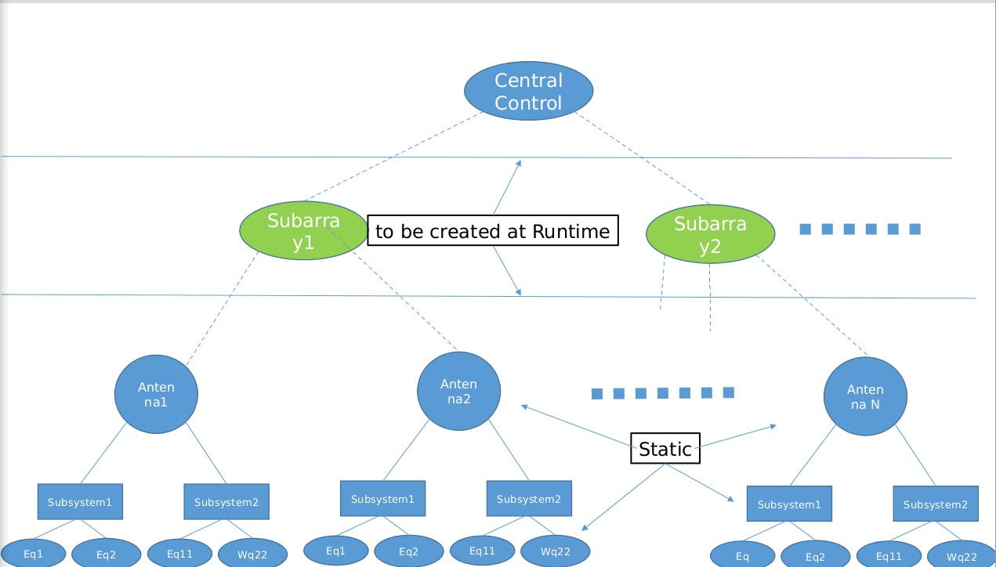
TANGO @ SKA.TM
TANGO are going to be applied at GMRT (a SKA pathfinder instrument)
TANGO concept are going to applied to SKA.TM

Slide 34
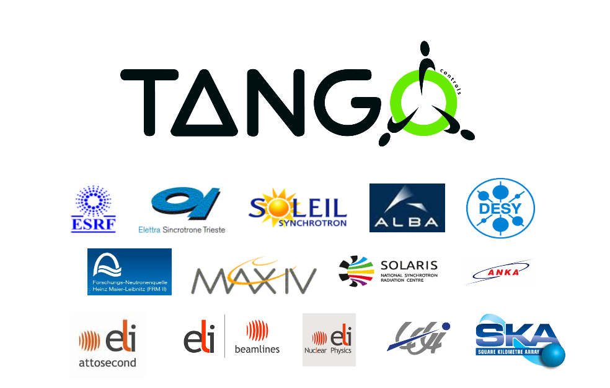
TANGO Collaboration

Slide 35
TANGO Continuous Improvement
Keep the concept of a distributed object simple
Integrate new features and applications into the core
Multiple languages as 1st class citizens (C++, Python + Java)
Documentation + Installation

Slide 36
TANGO 9 New Features
Pipes (aka Streams)
Dynamic commands
Forwarded attributes
Enumerated attributes
Polling thread optimisation
New base class – Device_5Impl (API is backwards compatible)

Slide 37
Java Device Servers & Client
A new version of the Java implementations for device server
JTango has been developed using annotations. It makes writing Java device servers MUCH easier!
A new API for Java clients has been developed called ezTangORB. It makes writing Java device clients MUCH easier!
Tango Collaboration in 2015 – 21 October ICALEPCS 2015

Slide 38
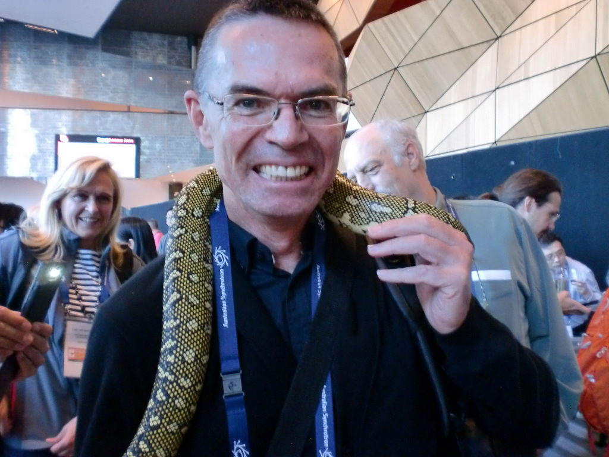
Tango .. And Python Lover
ALBA developed the first Python TANGO control system for controlling accelerator and beamlines
Some sites that love Python :
LMJ
DESY
Max IV
ELI-ALPS
SKA SA ...

Slide 39
Archiving
A new event based archiving system (HDB++) has been implemented with :
higher data rates,
us time resolution,
precise timing
multiple TANGO control systems
The architecture allows multiple database backends to be plugged into the archiving system. So far MySQL and Cassandra are implemented.

Slide 40
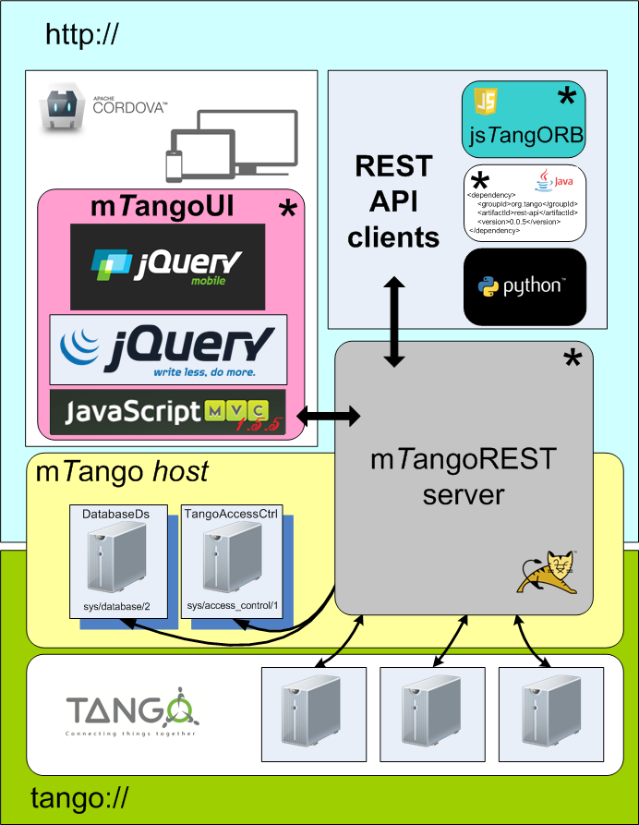
mTANGO – Mobile Tango
http://localhost:8080/mtango/rest/device/sys/tg_test/1
A RESTful http based API called mtango (m for mobile) has been developed for TANGO.
Uses TANGO Access Control and tomcat for security
Can be used from any client implementing http
API implemented for JavaScript
See website for API

Slide 41
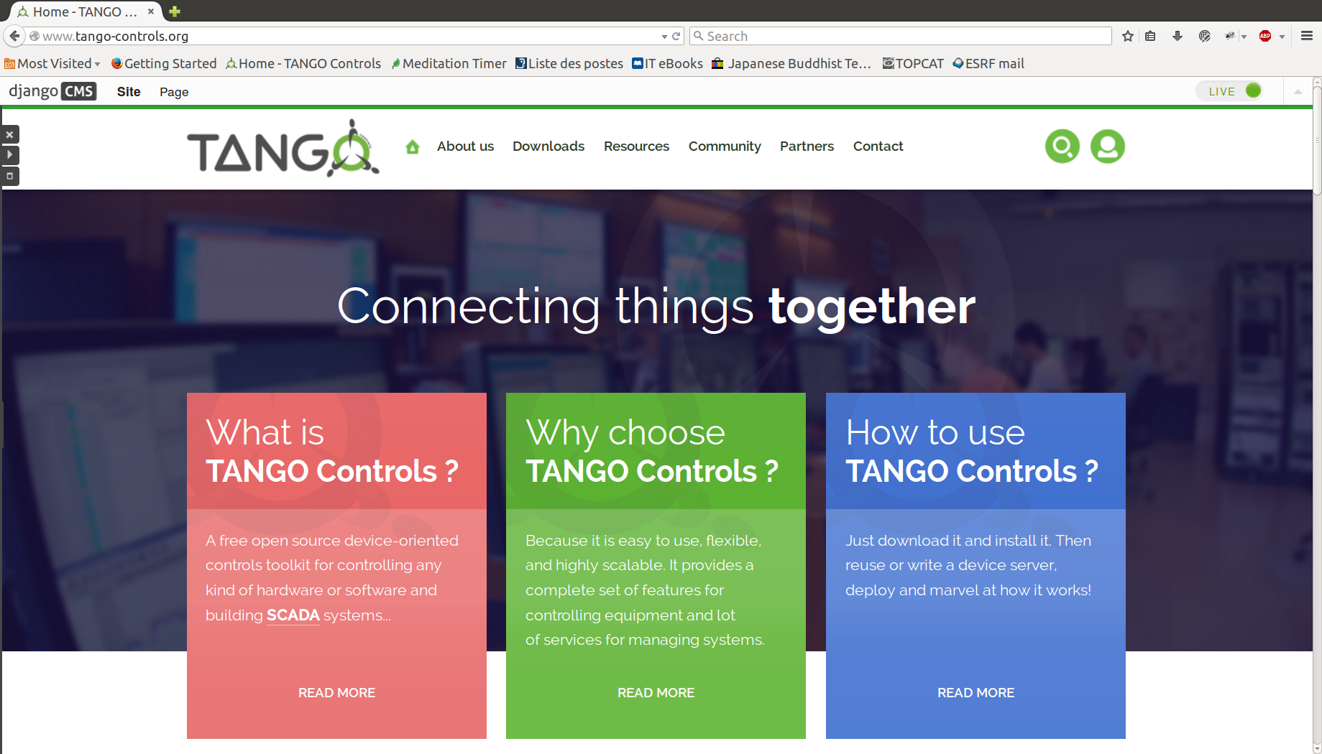
TANGO Website
http://www.tango-controls.org

Slide 42
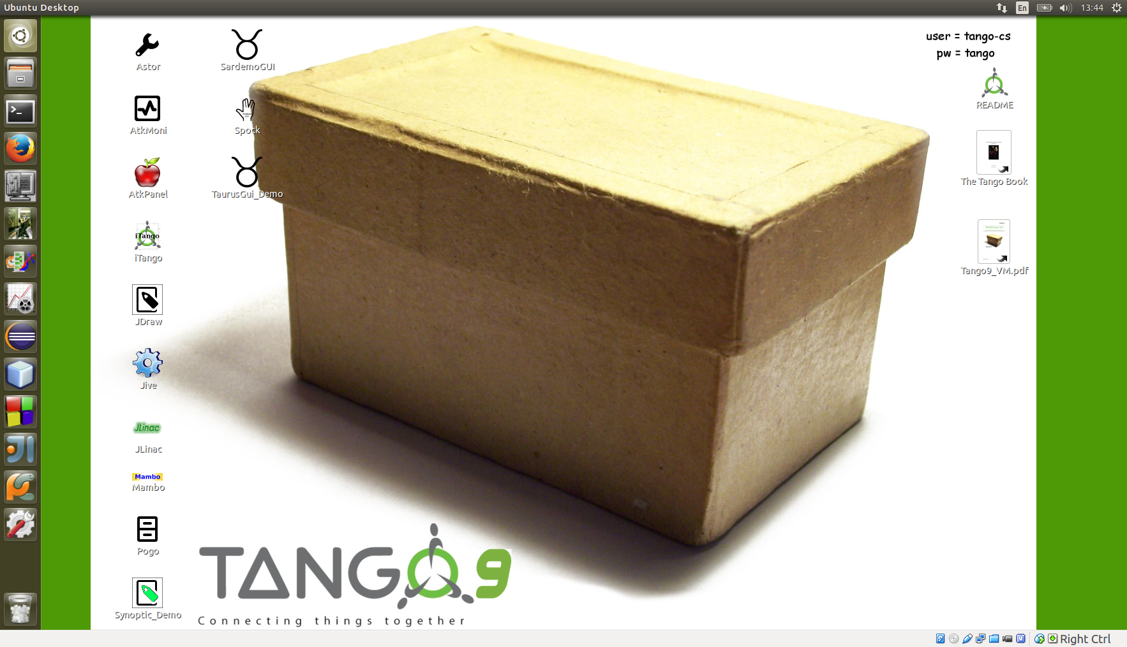
TANGO Virtual Machine
http://ftp.esrf.fr/pub/cs/tango/tango9-vm.zip

Slide 43
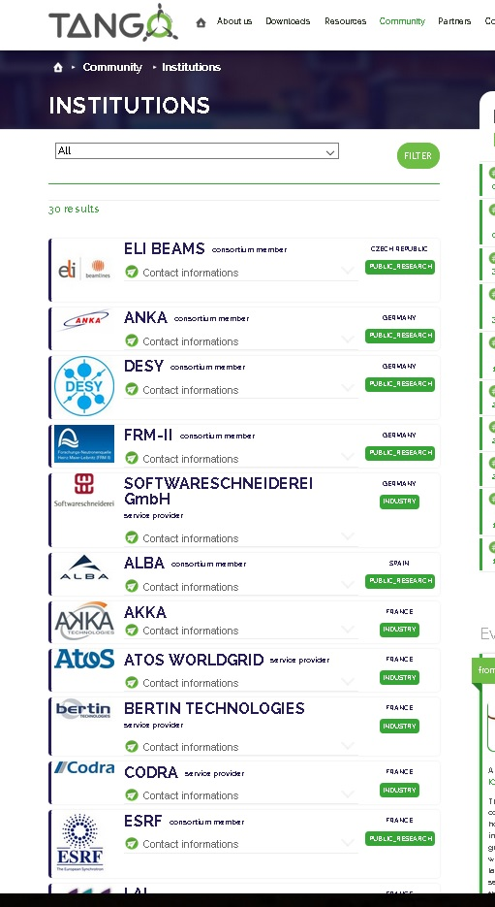
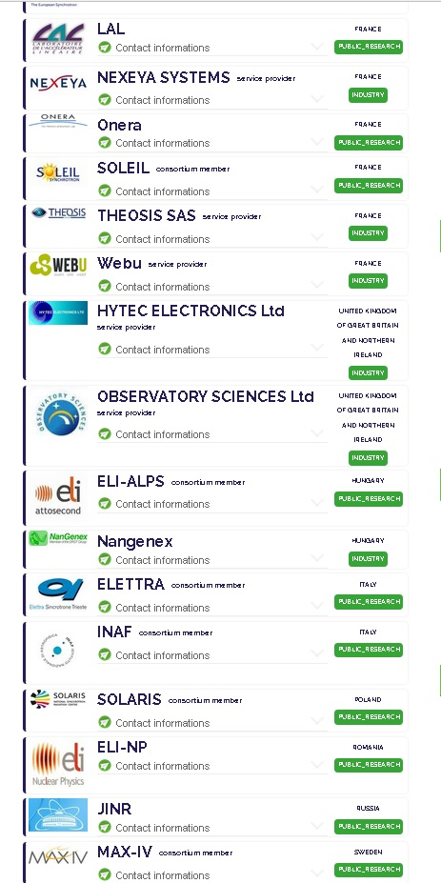
TANGO Community is Growing
There are Big and Small Project that need 24/7 service
➔ high degree of reliability is part of the requirements
➔ Long life
This is essential for a project the size of SKA and which is only at the beginning of its lifetime.
Other installations starting up now like
ESRF-EBS,
MAX-IV,
VIRGO,
FERMI@ELettra,
SHARK @ LBT
…

Slide 44
TANGO Roadmap
Git
Marketplace
Documentation
Replace CORBA
completely
Database Schema
LTS
Community Solutions
Replace Boost
Virtual Box
SysML tools
Encryption
Fast Archiver
Web browser
REST api
Packaging
V9
V10
V11
2015
2016
2017
2018
2019
2020
Evolution
The colour code is: - green means being implemented or already implemented, - red with circle means high priority to be done, - red without circle means still to be done but not high priority.

Slide 45
The TANGO Collaboration
Connecting things together
TANGO collaboration history
started in 1999 at the ESRF
in 2000 SOLEIL joins ESRF to develop TANGO
end 2003 ELETTRA joins the club
2004 ALBA also joins
2006 ANKA
2007 – 2012 Desy, MaxLab, FRM II, SOLARIS
2013 – 2014 ELI-Beamlines, ELI-ALPS, University of Szeged, INAF
TANGO MoU signed by institute directors
Yearly basis collaboration meetings (last 20-22 May, Krakov, Poland) Committer member: commit source code to TANGO Controls core Collaborator member: write and share TANGO device servers
Nevertheless, TANGO is free for anyone to use
Mailing list, forum, web site...
http://www.tango-controls.org

Slide 46
How TANGO Collaboration work
One collaboration meeting / year
TANGO coordinator per site
A mailing list (tango@esrf.fr)
Project Web Site http://www.tango-controls.org
Documentation, Forum, Howto, Events, News
Open Source Software (OSS) hosted on SourceForge
Change requests
Patches
Bug reports
Virtual machine
Packages (Debian, Windows)

Slide 47
Collaboration Contract
We have prepared a contract with partners who are willing to finance TANGO infrastructure developments. Contract is for 5 years.
Two types of partners : Core + Contributors
Potentially 10 partners have expressed their interested. This would finance at least one FTE / year. Fee 10KEuro/year
Collaboration contract will start in 2016
TANGO stays free and Open Source and Sustainable!

Slide 48
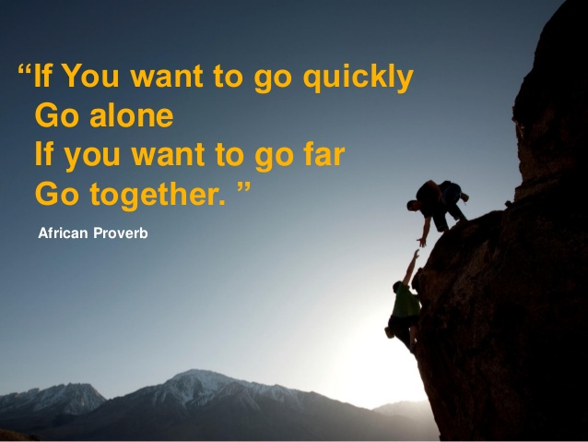
Conclusions
TANGO IS CONSTANTLY IMPROVING TANGO COMMUNITY IS GROWING
TANGO IS SUSTAINABLE

Slide 49
Corba and ZeroMQ

