Slide 1



SADT update
SKA Engineering Meeting, Penticton
11th November 2015
Keith Grainge, SADT Lead
University of Manchester

Slide 2
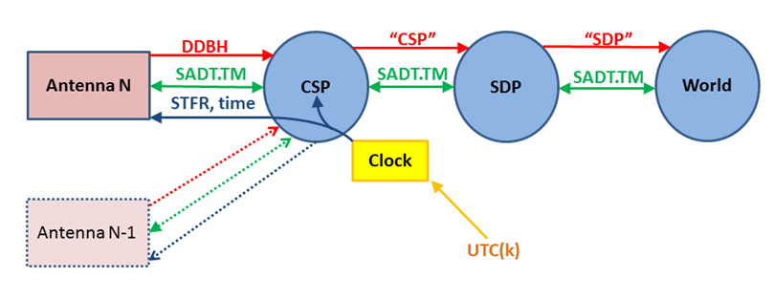
SADT summary
Science Data
DDBH
CSP-SDP
SDP to world
Sync & Timing
Clock ensemble
Freq. & Phase
UTC time
Non-Science Data
Control & Monitor
Alarms
Internet, VoIP
“Spanning” Tasks: Network Architecture; Network Manager;
Local Infrastructure
CSP-SDP
NSDN
NSDN
NSDN

Slide 3
Staff / Resource
Now have recruited a SE team
  Missing in run up to PDR
ASTRON have left the Consortium
UWA have joined the Consortium
JIVE and Geant have increased their level of contribution
Samantha Lloyd: Network Security Engineer
Paul Boven: SAT Architect

Slide 4
PDR
PDR 15th January 2015
  Constructive meeting
  Thorough evaluation by team of experts
  Deficiencies in SE identified up front
    Plan agreed on how to rectify this
Delta-PDR 14th October 2015
  Permission to proceed to Stage 2 once OARs closed
NSDN PDR December 2015
  Responsibility for NSDN assigned to SADT Sept 2014

Slide 5
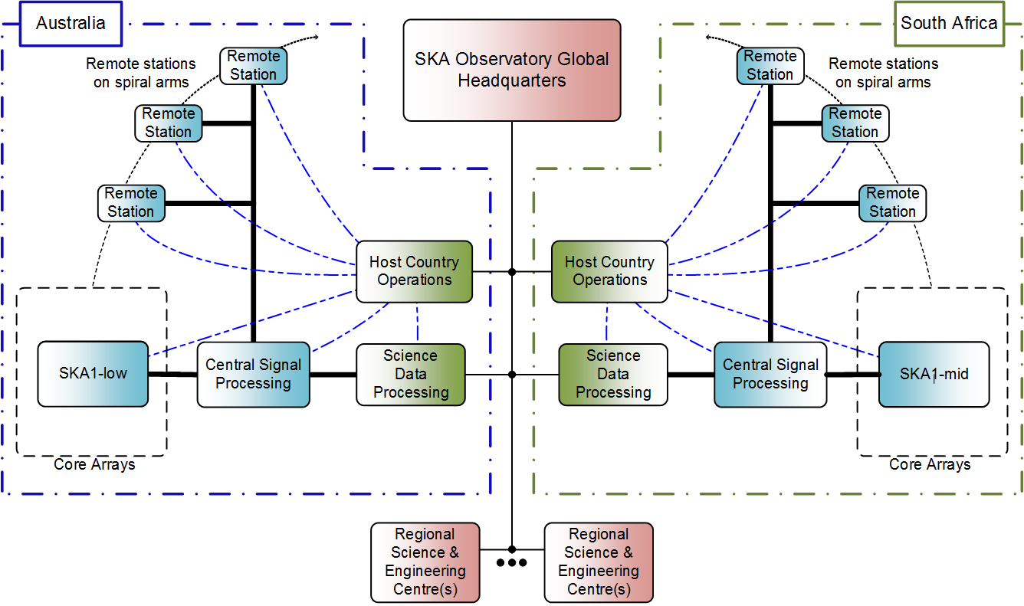
Effect of RBS
0.68 Tb/s
5.1→4.5 Tbps
13.9→8.8 Tbps
100Gb/s
100Gb/s
(15→7.2Tbps)
59→3.1Tbps
27→4.9Tbps
SKA1_Low
SKA1_Mid
()* – if digitised
Notes:
Continuous data flows through the instrument:
Remote stations up to 150 km away – but the fibre paths are longer.
Core ~ 2-5 km
CSP-SDP ~ 900 km
Telescope – world baseline: 100 Gb/s for transporting the data products to the Regional Science Centres around the world.
Science rates – no meta-data: SKA1_Low = 3.7 SKA1_Mid = 4.1
Main effects od RBS are due to:
Deferring SKA1_Survey
Reducing the number of stations and dishes
Reducing the number of frequency bands
CSP-SDP required metadata now included in Re-Baselining
Pulsar beams in SKA1_Low and SKA1_Mid

Slide 6

DDBH network overview
Interface boundary
Interface boundary
Low
/Mid
CSP
COTS network nodes
COTS Line cable & equipment
COTS network nodes
Receptors/
stations
Standard transparent Ethernet network
with standardised management services
Short reach Ethernet
transceivers & interconnect
Short Reach
Ethernet
transceivers & interconnect
Fully managed COTS solution – vendor agnostic design
SKA-Mid; 133 dish antennas, 1x100GE transport lanes
  Passive spans with LR4/ER4 grey optics or amplified/regen spans with DD/Coherent DWDM
SKA-Low; 45 remote beam formed stations, 2 x 20GE transport lanes
  Passive spans with LR/ER/ZR grey optics

Slide 7
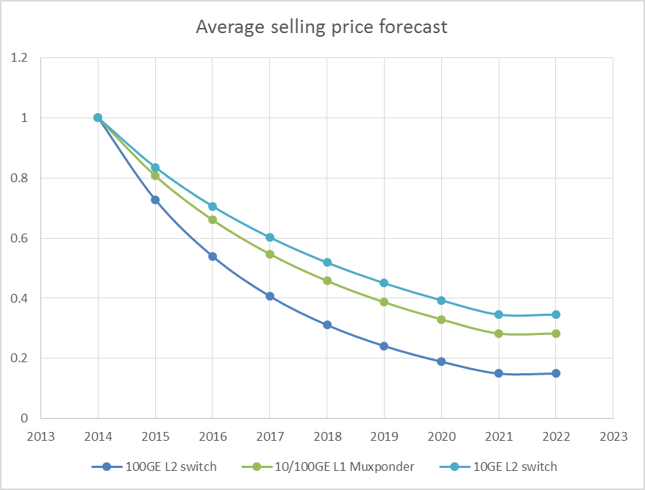
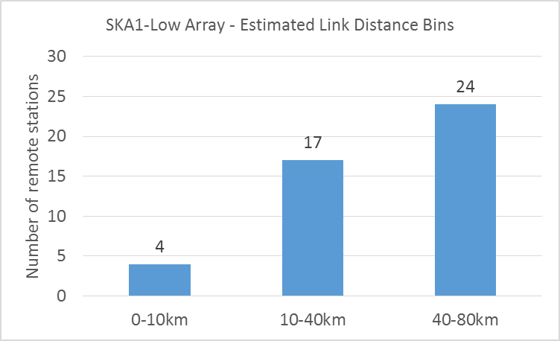
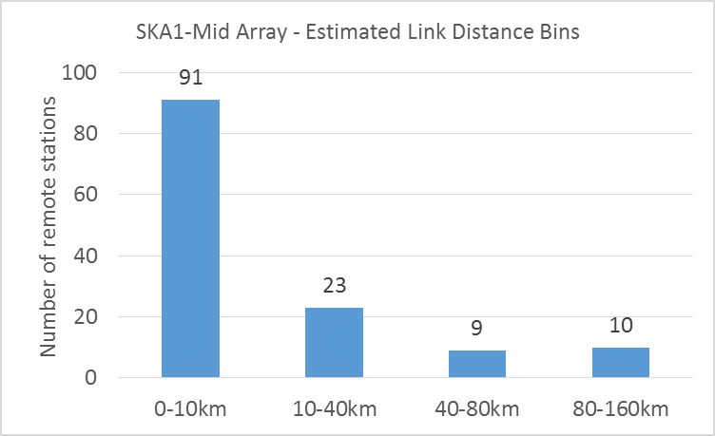
DDBH COTS Cost estimation
Fractional selling price drop per annum
Estimates cable routed distance bins BDv2
Cost / power function of :
  Year deployed (roll-out)
  Data capacity
  Cable distance

Slide 8
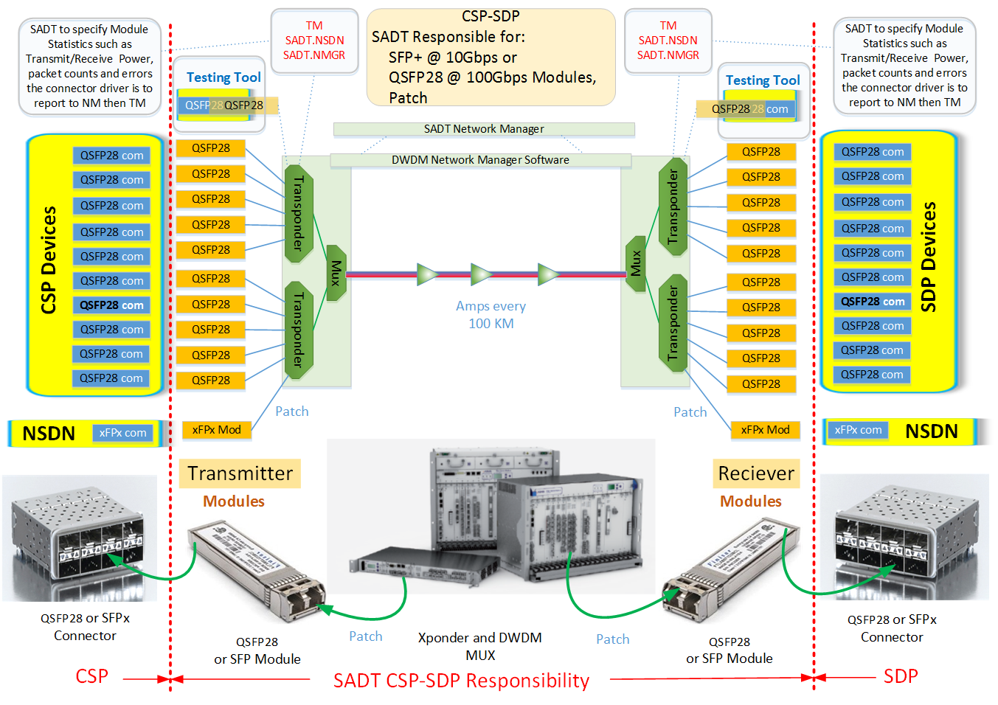
CSP-SDP Network Design
CSP-SDP concept & design remain valid after RBS and Level1 v6B
Carries the following on 10/100 Gigabit Ethernet channels from CPF to SPF:
  Visibility
  Pulsar
  VLBI
  NSDN

Slide 9
CSP-SDP operations concept
Operation: AARNet
Core
MRO
Geraldton
Perth
SDP
SKA1_Low
ASKAP
EOC
CSIRO dark fibre
Fibre: AARNet / Gov
ASKAP & CSIRO ask AARNET to manage the core-HPC network
MeerKAT have a similar approach with SANReN
Operation: SANReN
Core
Karoo
Carnarvon
Cape Town
SDP
Klerefontein
SKA1_Mid
MeerKAT
EOC
SKA SA dark fibre
Fibre: various providers

Slide 10
CSP Egress: Visibility Data

Slide 11
SDP Ingress: Visibility Data

Slide 12
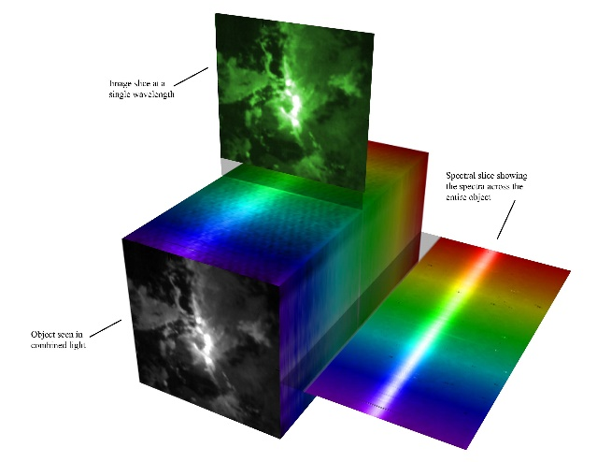
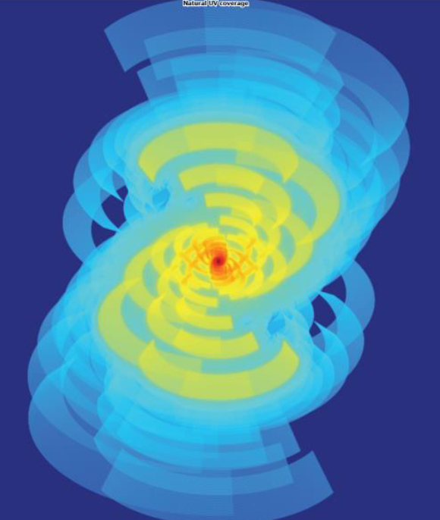
SDP to world – rates
Image cubes of sky maps 18PB n*/year ~30Gbit/s
  SDP Fourier transform of CSP time series
  Moderate external compute and model fitting
Epoch of Re-ionisation 1.6PB/ 6 Hr ~600 Gbit/s
  Uses calibrated aperture plane
  Enormous compute of power spectra
Weak gravitational lensing 70PB/2500Hr 60Gbit/s
  Uses further processed aperture plane data
  Considerable compute of galaxy ellipticity
Pulsars 4-5 PBytes/y ≤10Gbits
  Discovery and in depth study; timing 10 ns in 10 years
  Large physics compute
VLBI we do 4 Gbit/s now !
  Data direct from the beamformer ~ 10 Gbit/s UDP
Bottom Line: Lots of data, work in progress to constrain it – what about 100 Gbit/s
Notes:
Lots of interest from NRENs and Academic network providers like GEANT around the world.
SaDT.SDP-Deliv in discussion with SDP concerning the SKA data products
Stress the good collaboration here
Estimates of data growth based on science use cases but transfer rates even more uncertain.
SKA Data Flow Advisory Panel will advise on this area
The word used (by Rosie) was terrifying!

Slide 13
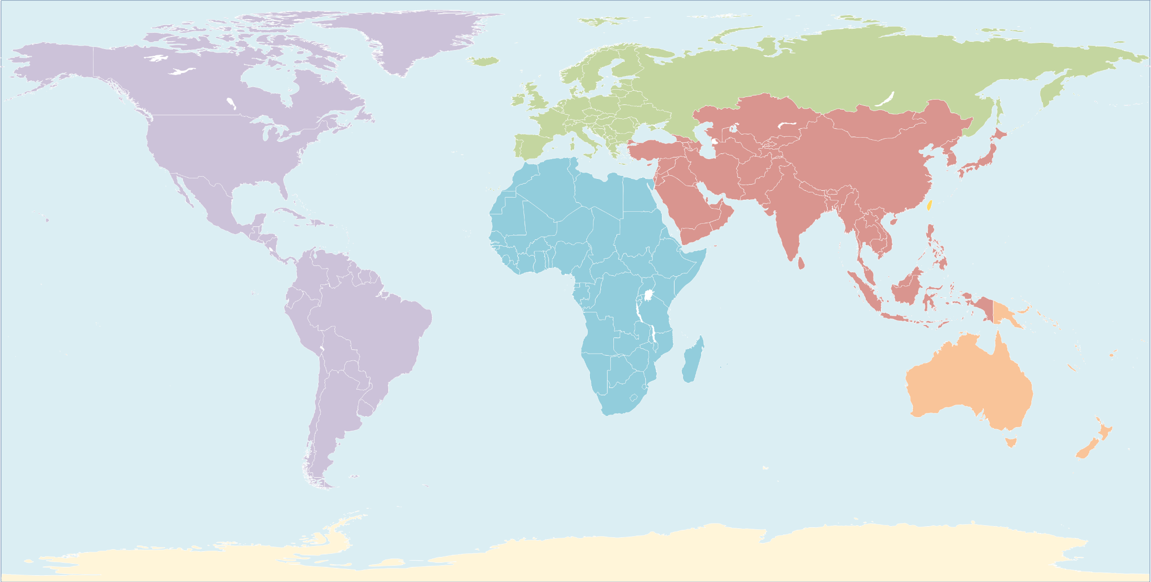


Estimated SDP to world costs
10 year IRU per 100Gbit circuit 2020-2030
Guesstimate of Regional Centres locations
US$.1M/Year
US$.1M/Year
US$.5-2M/Year
US$1-3M/Year
US$.2-.5M/Year
US$1-2M/Year
US$.5-2M/Year
US$1-3M/Year
US$1-3M/Year
Guesstimate of
Regional Centres
Notes:
Centre locations are guesses – no SKA board decisions
Network costs have input from current 100 Gigabit and 10 Gigabit contracts with reasonable projections

Slide 14
Non Science Data Network

Slide 15
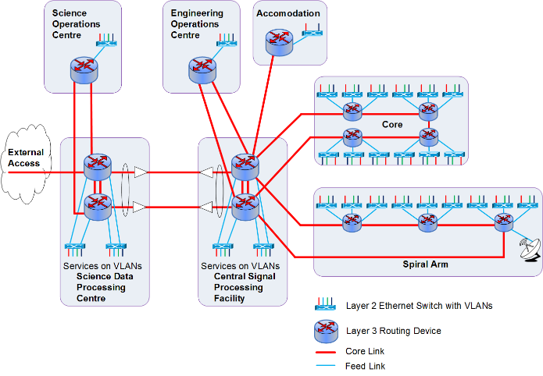
Non Science Data Network
A network infrastructure with resilience – given the topology.
The set of services include:
  Control & Monitor
  Internet access
  IP phones
  Security
Notes:
Similar to a large campus – need for containment of any problem and provision of security

Slide 16
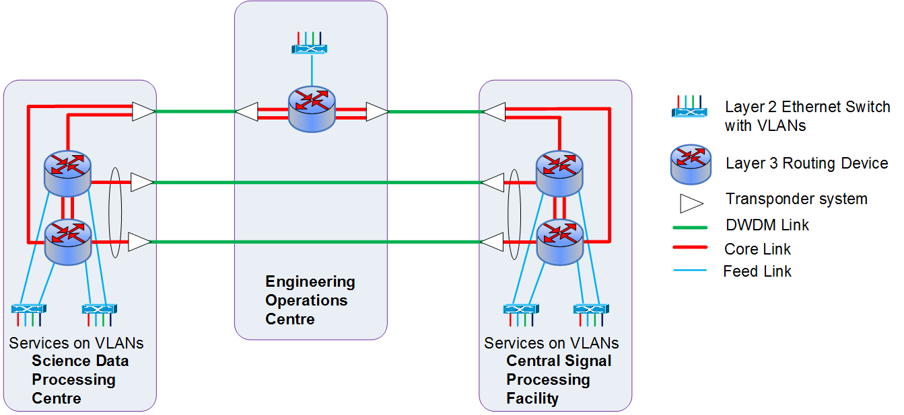
CSP-SDP Carrying NSDN
Same approach for Australia and South Africa
3 separate transponders to give resilience – given the topology.
  2 λ with a 10GE on each direct from core to SDP location
  1 fibre from core to EOC then EOC to SDP location with 2 10 GE
Perth
Cape Town
Geraldton
Klerefontein
Notes:
Might be useful
Similar to a large campus – need for containment of any problem and provision of security

Slide 17
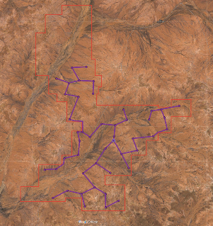
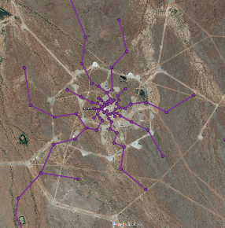
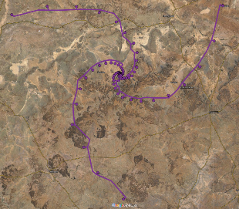
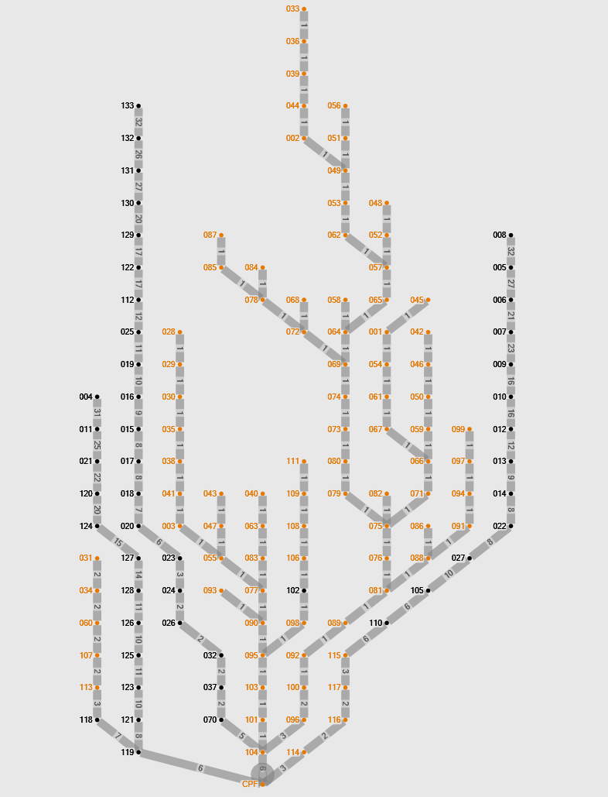
LINFRA - cable routing to CPF
Cable route distance optimised examples
Australia
SKA1-Low Outer array
South Africa
SKA1-Mid Inner Array
South Africa
SKA1-Mid Outer Array

Slide 18
SKA1 MID Spiral Remote Station Fibre Options
Overhead Fibre on Powerline
Total Fibre Length – 453 km
Average length/spiral – 151 km
SADT trench req. - 0 km
Shared INFRA trench - ± 214 km
Could save around €10 Million (full powerline implementation costs to be assessed)
Pros / Cons:
Fibre exposed to temperature changes / weather conditions
Lower fibre losses - require 2 repeater shelters per line
On same servitude as powerline – no additional legal wayleave costs
Easier maintenance access – same as per current Long Haul fibre access to site
Buried Duct Fibre
Total fibre length – 732 km
Average length/spiral – 244 km
SADT trench req. – 680 km
Shared INFRA trench - ± 52 km
More costly option
Pros / Cons:
High fibre stability / not exposed to daily temperature and wind/vibration effects
Lower risk of physical damage?
Fibre loss require 3 repeater shelters per spiral
Minimal fibre effect on SAT / STFR Timing systems

Slide 19
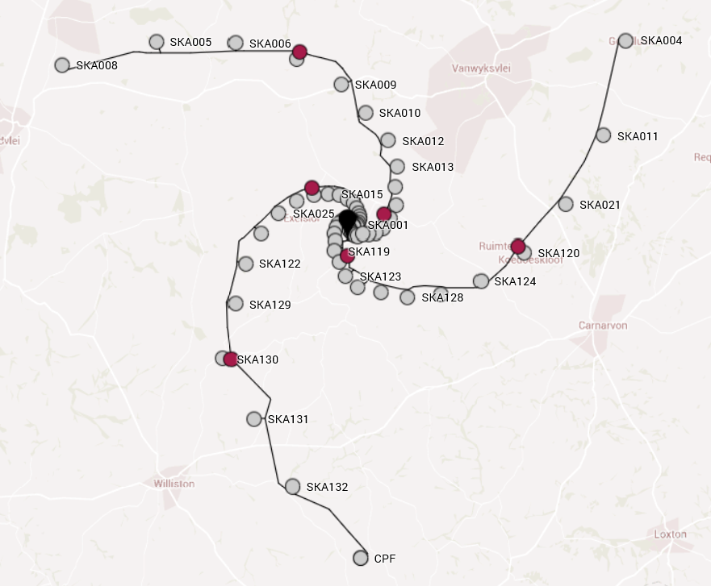
Network Architecture
Reach of optics ~ 80km
Amplify or regenerate DDBH, NSDN, STFR, WR
Dedicated shelters along spiral arms

Slide 20
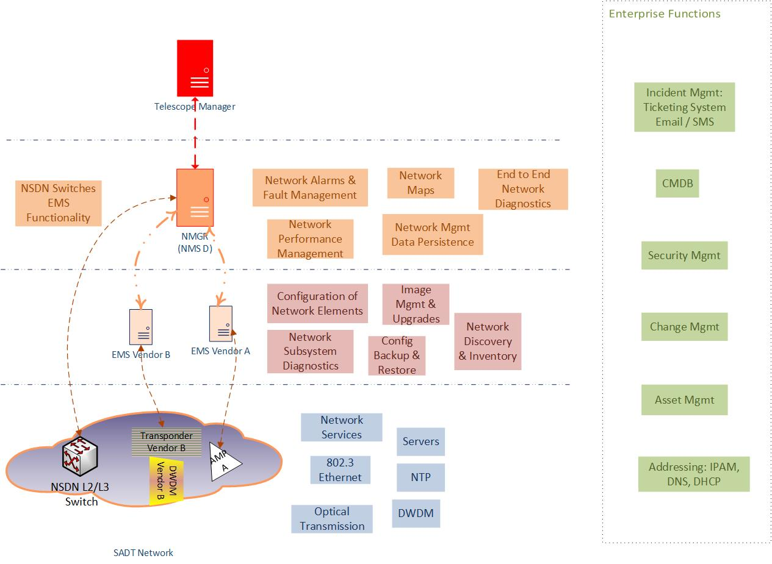
NMGR Functional Architecture
Notes:
NMGR interfaces with NSDN network devices directly
For optical transmission equipment in DDBH network, NMGR interfaces with vendor EMS.
Considering doing configuration management for optical transmission equipment directly from vendor EMS interfaces (cost savings).
CSP-SDP network to be managed by NREN. NMGR interfaces with NREN EMS

Slide 21
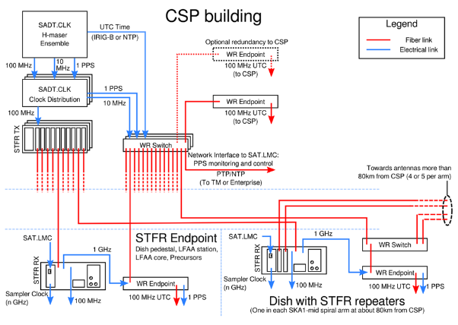
SAT Overview

Slide 22
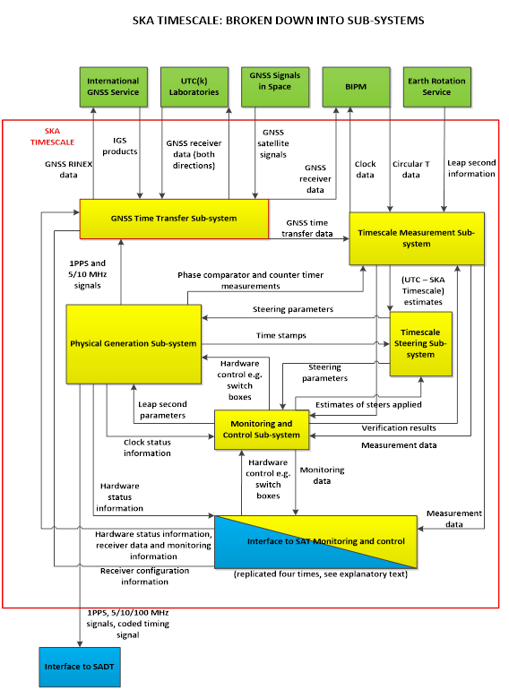
SKA Timescale block diagram

Slide 23
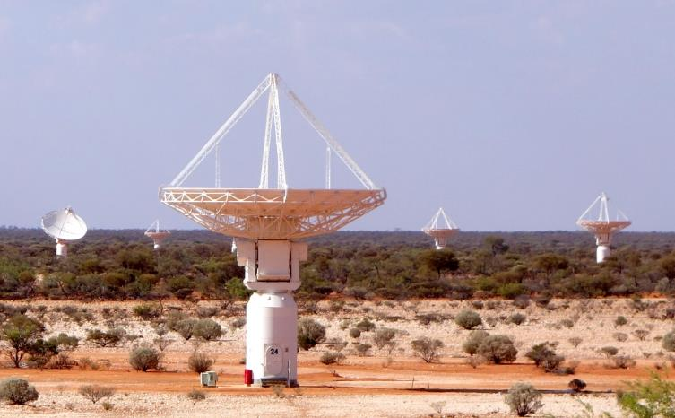
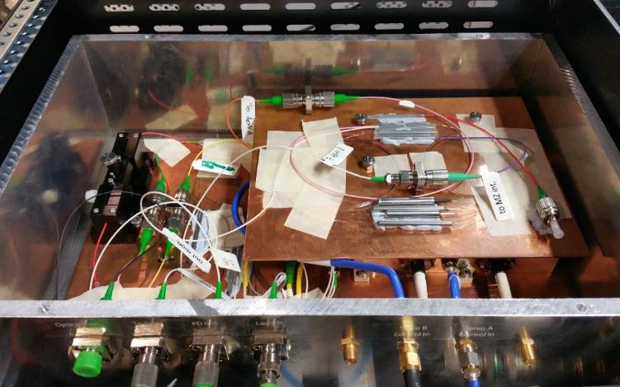
STFR – ASKAP field tests
Thanks to CSIRO
UWA Group tests
Prototype SKA Phase Synchronization System

Slide 24
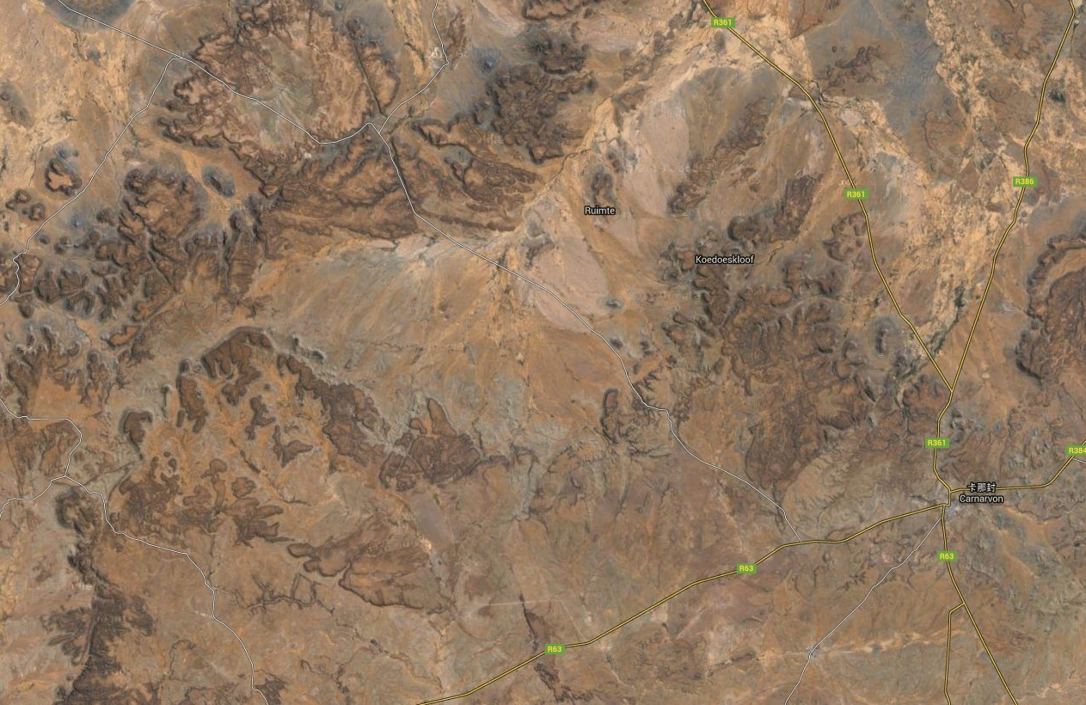
Overhead fibre tests
SKA Site
(Losberg)
76.8km
(2 cores)
16.3km
(4 cores)
Klerefontein
Carnarvon
Thanks to SKA-SA

Slide 25
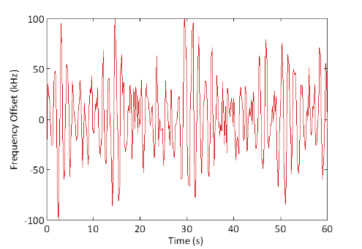
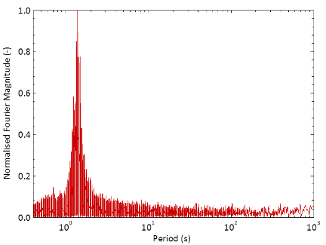
Overhead Fibre Characterisation
Measured frequency offset induced on overhead fibre in South Africa
~3000 times noise increase at 1.4s period

Slide 26
STFR on overhead fibre
Tsinghua team testing
64 km overhead fibre
  8E-14@1s
  3E-14@10s
  3E-14@100s
  3E-15@1000s
  4E-16@10000s
No problem at ~ 1s
Bump at ~30s being investigated
  Harmonics at mixer?
The relative phase stability of the 100 MHz signal.

Slide 27
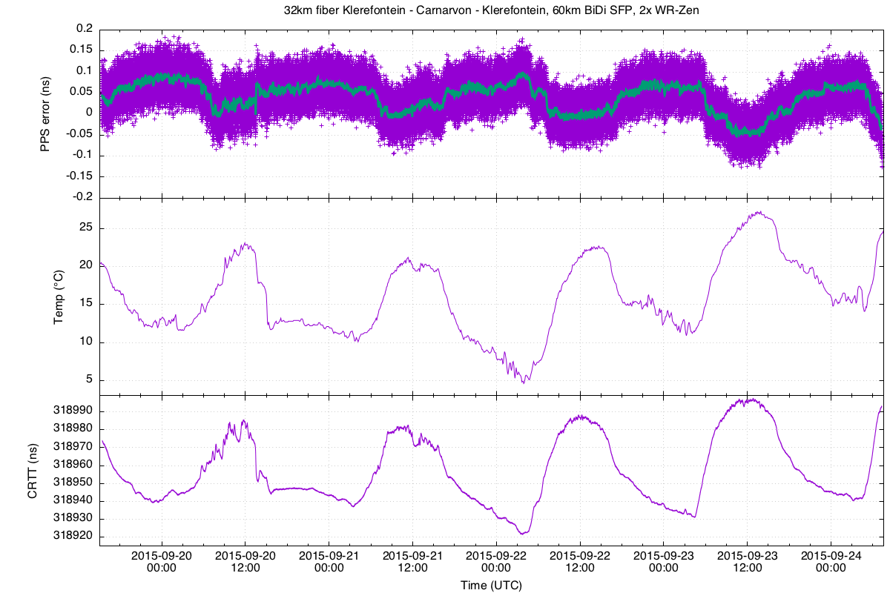
White Rabbit tests
White Rabbit delivers absolute time

Slide 28
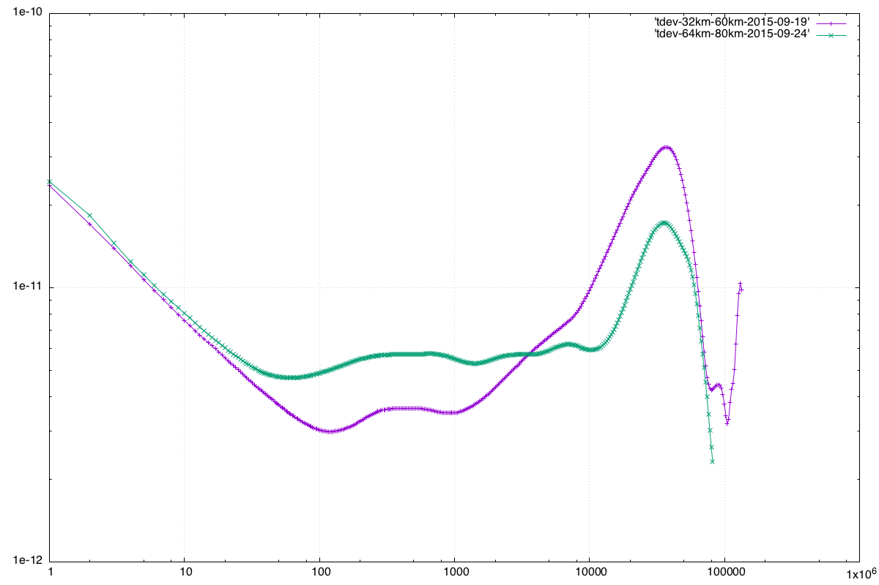
WR Tdev results

Slide 29
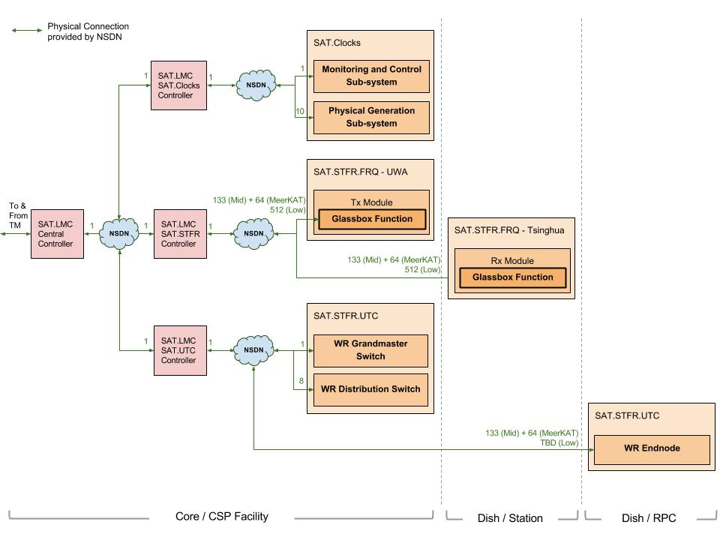
SAT.LMC – Overview
Industry standard PC104 controllers used
Software a major component
Connects to SAT through NSDN
Use Case document created
Prototype in Progress

Slide 30
SAT.LMC – Update
Internal Interface documents created with SAT sub-systems
SAT Operational Model worked out through negotiations with SAT teams on LSR/LIG documents and IICDs
Contributed in down selecting TANGO controls framework at Trieste, Italy. Submitted a technology report.
Cost Model, Power Budget, INFRA requirements updated post PDR Review
Use Case document created
Protoype in Progress

Slide 31
Issues
SADT short term priorities
  Close out PDR
  Issue EICDs
Work with SKAO on timing requirements
LOW configuration is critical
CSP location ECPs
  Need to assess impact on DDBH
  If passed will require amendment of design
Engage with NMISA on UTC(k)
Engage with INFRA on joint reticulation

