Slide 1
CSP Consortium Report
David Loop, NRC Herzberg
CSP Consortium Lead
11 Nov 2015
SKA Engineering Meeting, Penticton

Slide 2
CSP Work Package
Carry Central Signal Processing Design to CDR
A horizontal slice across both Telescopes – SKA-Low, SKA-Mid
Strengths
  “combined view” to explore domain commonalities/synergies
  Building from prior experiences on EVLA, MWA, LOFAR, ASKAP, MeerKAT, Pulsar Search
Weaknesses
  Requirements dealt with in isolation, long list of assumptions
  Relies on strong external interface definitions
  Relies on Telescope Architecture Teams

Slide 3
CSP Consortium Participants
Canada
NRC (Lead)
MDA
CITA
Australia
CSIRO
Swinburne
ICRAR
NVIDIA
CISCO
New Zealand
AUT
Compucon
Open Parallel
U of Auckland
Massey U
Nyriad
JPL (US)
IBM (Switzerland)
Netherlands
ASTRON
JIVE
NLeSC
UK
Manchester
STFC
U of Oxford
Italy
INAF
Selex ES
India
NCRA
NVIDIA
Germany
Max Planck IfR
Spain
UPMadrid
14 signatories
9 countries
20.7 M€
130 FTE-yrs

Slide 4
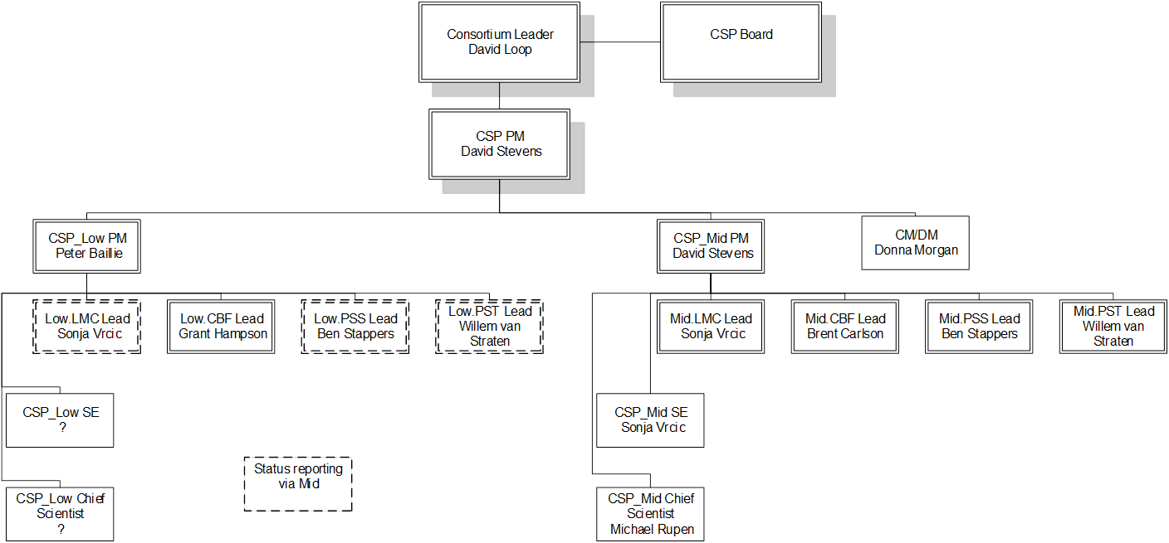
CSP Organization Structure

Slide 5
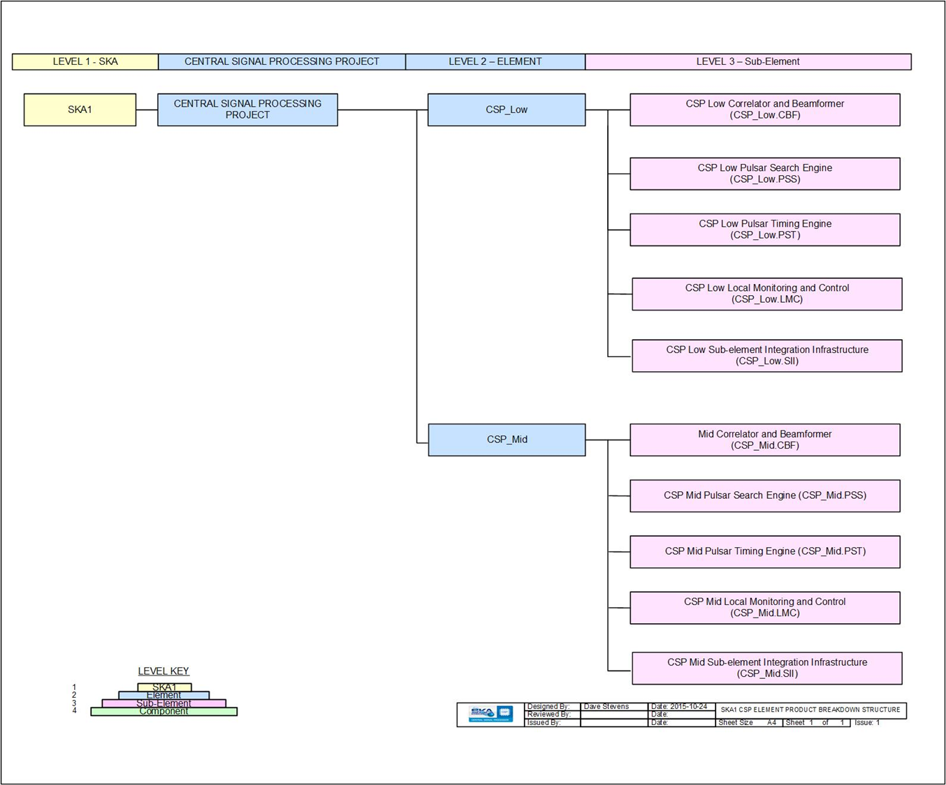
CSP Product Breakdown Structure

Slide 6
CSP Architecture to Level 3
    Low.CBF (Correlator Beamformer)
      Grant Hampson, CSIRO - FPGA
        Peter Hall, ICRAR – Software COTS CPU/GPU/Infiniband
    Mid.CBF (Correlator Beamformer)
      Brent Carlson, NRC Herzberg – FPGA PowerMX
    PSS-Low/Mid (Pulsar Search Engine)
      Ben Stappers, Manchester – COTS CPU w/GPU and/or FPGA accelerators
    PST-Low/Mid (Pulsar Timing Engine)
      Willem van Straten, Swinburne – Software COTS GPU/CPU/switch
    LMC-Low/Mid (Local Monitoring and Control)
      Sonja Vrcic, NRC Herzberg – COTS CPU

Slide 7

Low CBF Progress
LOW Rebaselining
Before rebaselining large but simple correlator
Rebaselining has reduced the number of
stations from 1024 to 512, but added
      Multiple Zoom modes
      Pulsar Search beams
      Pulsar Timing beams
      Different in every subarray
Major system redesign required
CSP Reorganisation
Loss of Survey correlator completely changed
the allocation of work packages
New Low.CBF collaboration was formed
– made great progress after 5-months

Slide 8
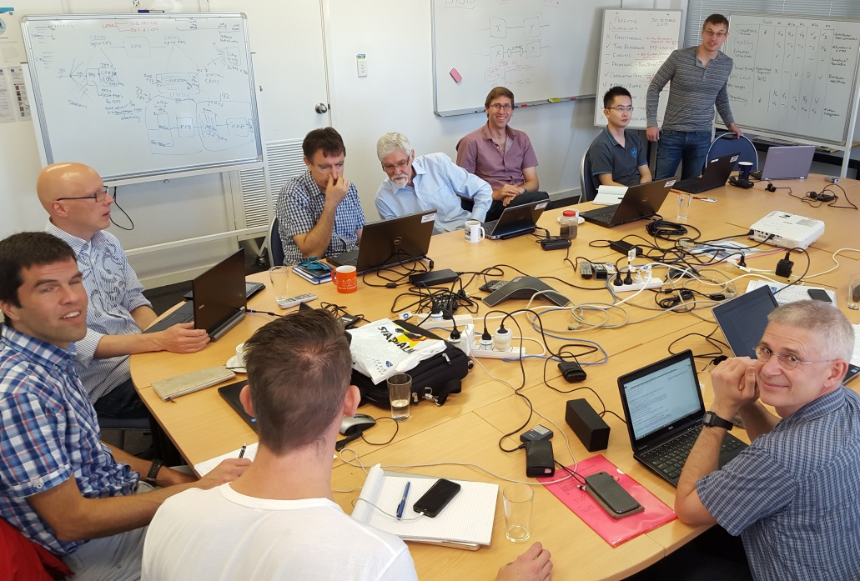

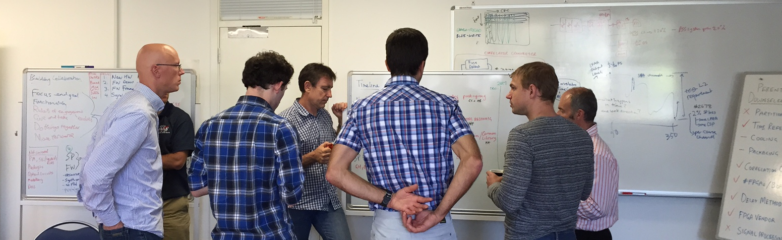
LOW CBF
Collaboration
Formed
ASTRON,
Curtin
CSIRO
NZA
Strong and united team!
Notes:
Strong united team and we know how we are going to get there

Slide 9
LOW CBF Approach
The collaboration is approaching the design in a genuine, open-minded and consultative manner
Everyone gets the opportunity to be heard
Three significant meetings:
July 2015: Edinburgh – Planning
  Collaboration meets for the first time, understanding approaches
Sep 2015: San Francisco – Kickoff / Icebreaker
  Engineers meet and options tabled
Nov 2015: Sydney – Downselect
  All major design decisions made – foundations set
  Commenced writing documentation for
  Delta-PDR submisssion for end-Jan’16

Slide 10
LOW.CBF System
Signal Processing Algorithms
RFI excision, delays using phase shifts, beamformers,
correlator zooms using fine channel accumulation
Matlab/Simulink modelling progressing
Hardware solution
Liquid cooled “pizza” box – standard LRU
One FPGA per board – rapid development and path to production
All optical interconnect – fully flexible system configuration/size
Firmware solution
Technology independent design flow for all firmware except processing functions are optimized to the FPGA
Focus on Xilinx FPGAs towards CDR
Monitor and Control FW/SW solution
Management and System Engineering
Resources and objectives for CDR are achievable

Slide 11
Low SW Verification Correlator
ICRAR/Curtin led effort to support early verification of the LFAA
NVIDIA in-kind contribution ~0.5 FTE.
AUS pre-construction funding ~0.5 FTE.
Cisco are supplying extensive benchmarking hardware.
Investigating CSP processing in Perth
  Curtin awarded a Shared University Research Grant for IBM to support SKA and MWA Software Correlator Development

Slide 12





Mid.CBF Contributors
NRC (HW,FW,SW)
MDA (PM,PE,SE,FW)
NZ Alliance (FW,models)
Selex (HW)
UPM (FW)
INAF/Italian Industry (HW,FW)

Slide 13
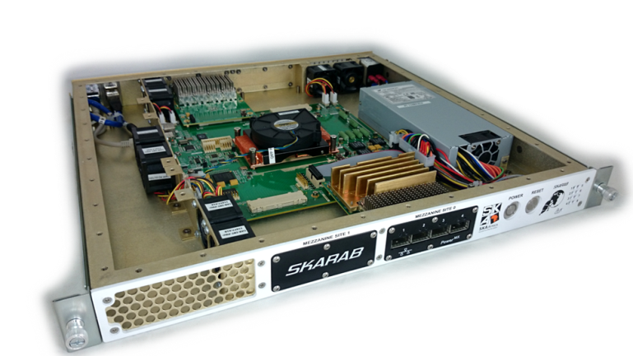
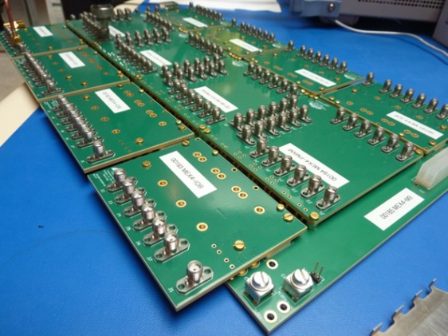
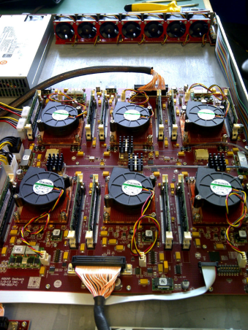
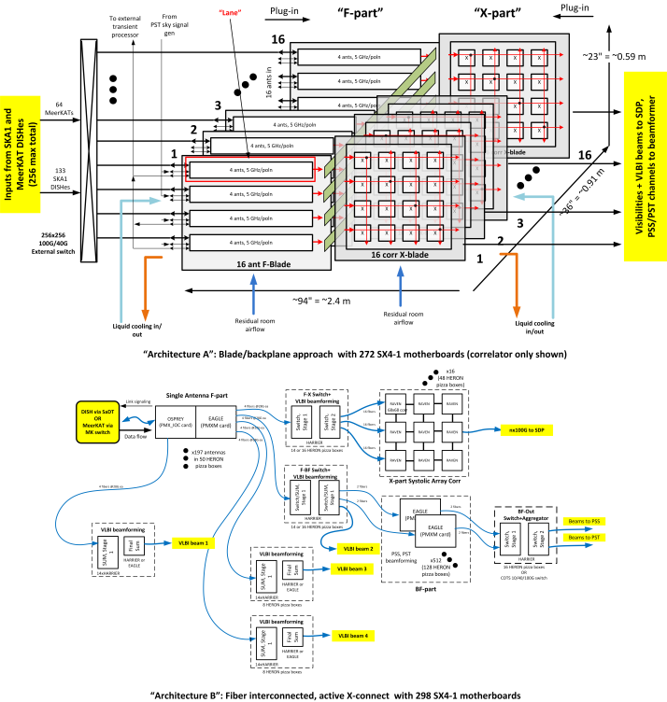
Mid.CBF Downselections in 2015
SKARAB
PowerMX
Redback
Arch A
Blade/
Backplane
Baseline: Arch B
PowerMX in Pizza Box
with optical interconnect
Air-cooled (tbc)
vs
Arch B
PizzaBox

Slide 14
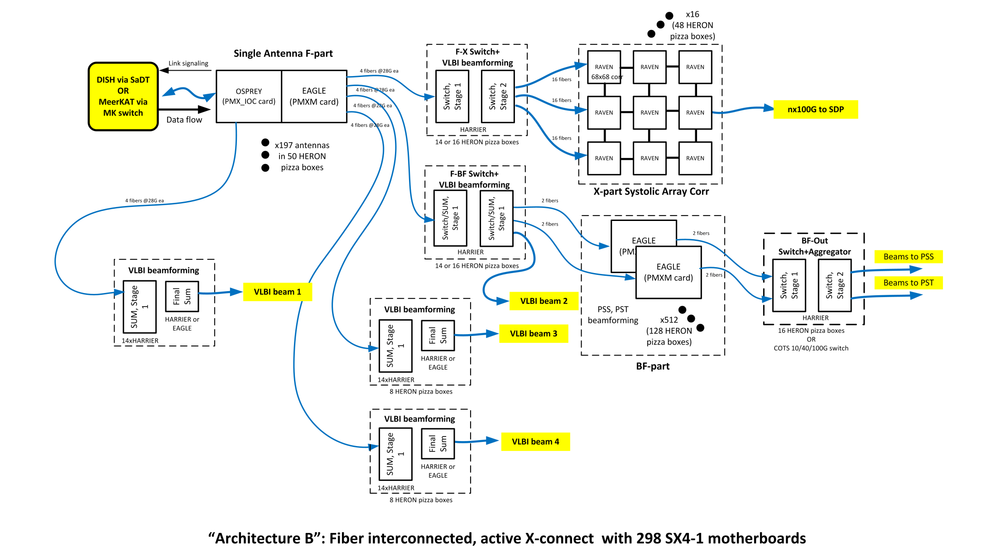
Mid.CBF Signal Flow

Slide 15
Mid.CBF Prototyping Plans
Develop PowerMX SX4-1 motherboard
Develop PowerMX mezzanine cards
  First mezzanine card with available Arria 10 FPGA
  Later mezzanine cards with Stratix 10 FPGAs
Verify critical design functionality/performance
  Motherboard/mezzanine communication and control (Arria 10)
  HMC memory access and performance (Arria 10)
  SERDES communication at 25/28G (Stratix 10)
  Develop test firmware and software to support above activities
Develop DSP Firmware to ensure processing will fit within selected FPGA devices
Develop thermal mockups to test cooling solutions

Slide 16
Pulsar Search: PSS-Low/Mid – Personnel
Manchester, Oxford, MPIfR, STFC, ASTRON, INAF, NZA, Swinburne
Progress
Acceleration Search: Near complete GPU based implementation, ~50% complete FPGA implementation
Single Pulse Search: Near complete GPU and FPGA based implementations
Pipeline: Majority of aspects of framework in place – connection with individual modules on accelerators underway.
Hardware: New FPGA and GPU hardware in the New Year, also 5% prototype (see later).
Industry: Strong Hardware links established and extended, recently begun working with specialist FPGA developers.
SKA1-LOW: Progressing ICDs – PSS design predominantly unchanged

Slide 17
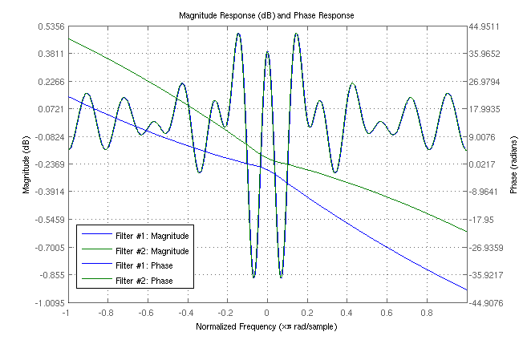
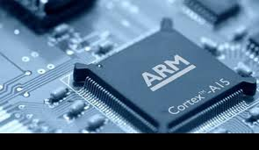
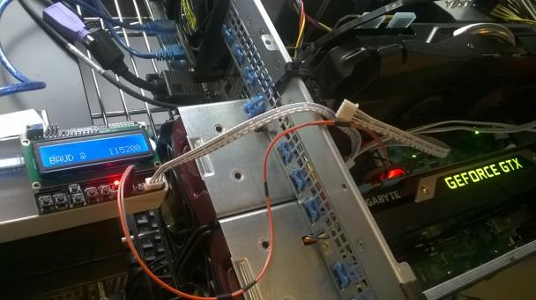
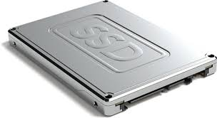
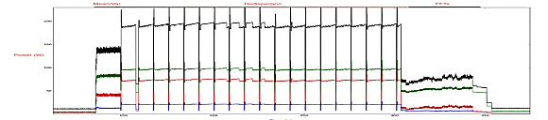
PSS-Low/Mid – Addressing Power
Need to achieve a Gflops/Watt 5 times better than current greenest computer.
Three pronged approach:
Algorithms
Hardware
Testing
Pursue innovative approaches
to cut processing times
In situ while running
using custom sensor hardware
Not only looking at accelerators but hosts and storage.
Notes:
Left plot shows how we determined that the convolution filter responses are complex conjugates of each other, allowing for less compute resources to be used when doing the acceleration searches. Middle panel shows that we are looking at possibly using ARM chips for our hosts for each node and less power hungry SSD disks in place of RAM for some aspects. Final panel shows the test RIG that we have set up that allows to measure directly for each accelerator when running different parts of the pipeline.

Slide 18
PSS-Low/Mid – Prototyping Plans
Emphasis on power!
Vertical prototyping:
  Advance processing modules to TRL6 and TRL7
Horizontal prototyping:
  Advance pipelines (receptors + host-to-device interfaces to TRL6 and TRL7
Target technologies:
  Undergoing down-selection process
  FPGA, GPU + host CPU remain strongest candidates
New development: ProtoNIP
Fully funded (UK) PSS prototype to be installed on the SKA-SA site.
~20 PSS nodes and switches based on the PSS PIP architecture
Designed to test density, power consumption, heat dissipation in the real PSS environment.
Test reliability and maintainability of potential PSS cluster components.
Test data persistence, movement and management in PSS software.
Test logistical assumptions for PSS, further mitigate cost uncertainties.
ProtoNIP will be installed on-site by 2016 Q3, and used to inform PSS CDR.

Slide 19
Pulsar Timing: PST-Low/Mid
Designed at Swinburne University of Technology
Expanded to SKA1-Low
Performs phase-coherent dispersion removal
Notes:
phase-coherent dispersion removal (RED)
recovers high-precision timing information
post-detection removal (BLUE) smears
signal & loses precision

Slide 20
PST-Low/Mid Baseline Solution
16 phased array beams on Low and Mid
  16 servers, each with 4 GPUs
  Space: 2 racks; power: 18 kW
Compliant for Mid, not for Low
  maximum dispersion measure currently too high
  revisions under consideration by Pulsar SWG
Prototyping plans
  testing prototype at SKA-SA in Nov 2015
  Commissioning at MeerKAT in Q1 2016

Slide 21
PST

Slide 22



CSP LMC - Local Monitor and Control
Contributing Organizations
NRC, Canada
NCRA, India
INAF, Italy
University of Swinburne, Australia

Slide 23
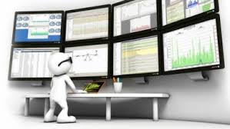
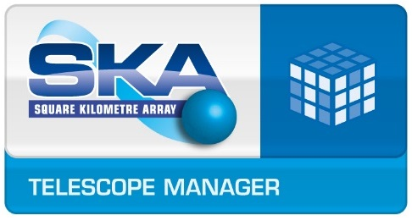
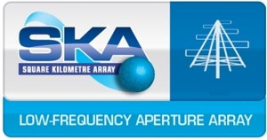

CSP.LMC - Overview
Reports on behalf of CSP
Co-ordinates Pulsar Search and Pulsar Timing observations
CSP_Low.LMC
CSP_Low.CBF
CSP_Low.PSS
Pulsar Search
CSP_Low.PST
Pulsar Timing

Slide 24
CSP LMC – Technical Solution
Software running on COTS computer.
Uses TANGO CS for communication with TM and other CSP sub-elements (CBF, PSS and PST).
INAF is working on TANGO based prototype.
The same technology used in CSP_Low and CSP_Mid.

Slide 25
Schedule
11 | Delta PDR | Jan-16
11a | System PDR Inputs | Dec-15
12 | Technical Interchange Meeting #5 | Mar-15
12a | Pre-CDR | 30-Sep-16
13 | Sub-element CDRs & Prototype Test Reports
13a | Pulsar Timing Sub-element (Formal Review) | 30-Sep-16
13b | Pulsar Search Sub-element | 28-Nov-16
13c | Mid CBF & LMC Sub-elements | 5-Dec-16
13d | Low CBF Sub-element | 12-Dec-16
14 | Submission of Stage 2 (CDR) Data Package | 23-Jan-17
15 | Review of Stage 2 Data Package (CDR) | 20-Mar-17
16 | Closure of Stage 2 | 28-Apr-17
17 | Submission of the final documentation package for supply of the Element. | 28-Apr-17

Slide 26
Progress Against Plan
PDR – a few remaining OARs and Low.CBF “update” due to team/solution change
TIM#4 – certificate in process
Delta PDR – some remaining documents considering RBS and latest downselections
System PDR inputs – most in signature cycle

Slide 27
Current State of CSP Design
Level 1 (Parent) req’ts for CSP: 6B
  Still tracking large number of issues/assumptions
Level 2 CSP Req’ts: Rev 1
  Proceeding making documented assumptions
Level 2 CSP Architecture: 100%
External ICDs: 90%
  Getting attention, must close asap

Slide 28
Current State of CSP Design cont’d
Internal ICDs for CSP (between sub-elements): 80%
  Keeping pace with design work
Level 3 Req’ts (sub-elements): 50%
  Being upgraded to RBS
Level 3 Architecture: ~ 70%
Level 3 Physical Solutions: good progress

Slide 29
Challenges and Issues
Costing increases
Re-baselining has added significant complexity
Open tender procurement model
2018 technology freeze date
Power budgets
Challenging targets to meet with increased complexity

Slide 30
Challenges and Issues
Technical issues
RFI (environment; number of bits)
Calibration issues (tied-array beam placement; fidelity issues; approaches; update rates)
Transient buffer & response
Clock offset scheme

Slide 31
Summary
Messy down select process behind us
Good progress by all the teams
Big push now to get to CDR
Remaining system issues need to be resolved
Requirements assumptions starting to harden
Construction costs are challenging
Power budgets are challenging

