Slide 1



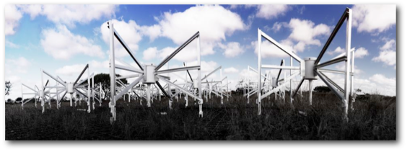















Precursor Update – Murchison Widefield Array
Credit: Natasha Hurley-Walker
Tom Booler
MWA Program Manager, ICRAR – Curtin University
On behalf of the international MWA consortium

Slide 2

Update scope
What are we?
What have we done?
What are we doing?
What are we going to do?
What do we enable and support?
An insightful and poignant finish!

Slide 3
What are we?
The MWA is a low-frequency radio telescope operating between 80 and 300 MHz. It is located at the Murchison Radio-astronomy Observatory (MRO) in Western Australia, the planned site of the future SKA_LOW telescope, and is one of three telescopes designated as a Precursor for the SKA
Tingay et al. 2013, PASA, 30, 7
MWA system description paper
Bowman et a. 2013, PASA, 30, 31
MWA science description paper
Notes:
Boring way to describe the MWA

Slide 4
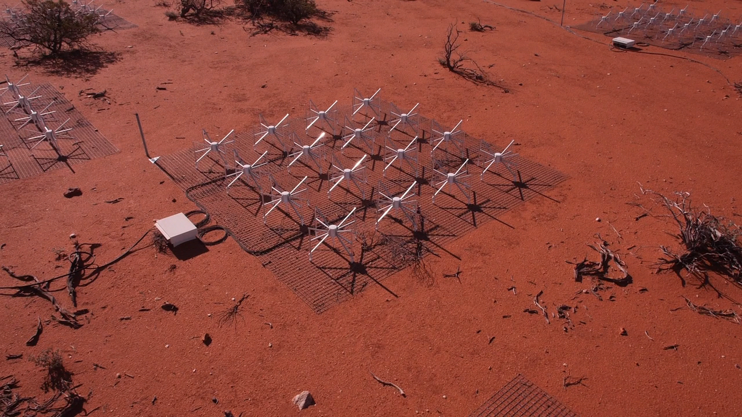
What are we?
Notes:
Better way to describe the MWA

Slide 5
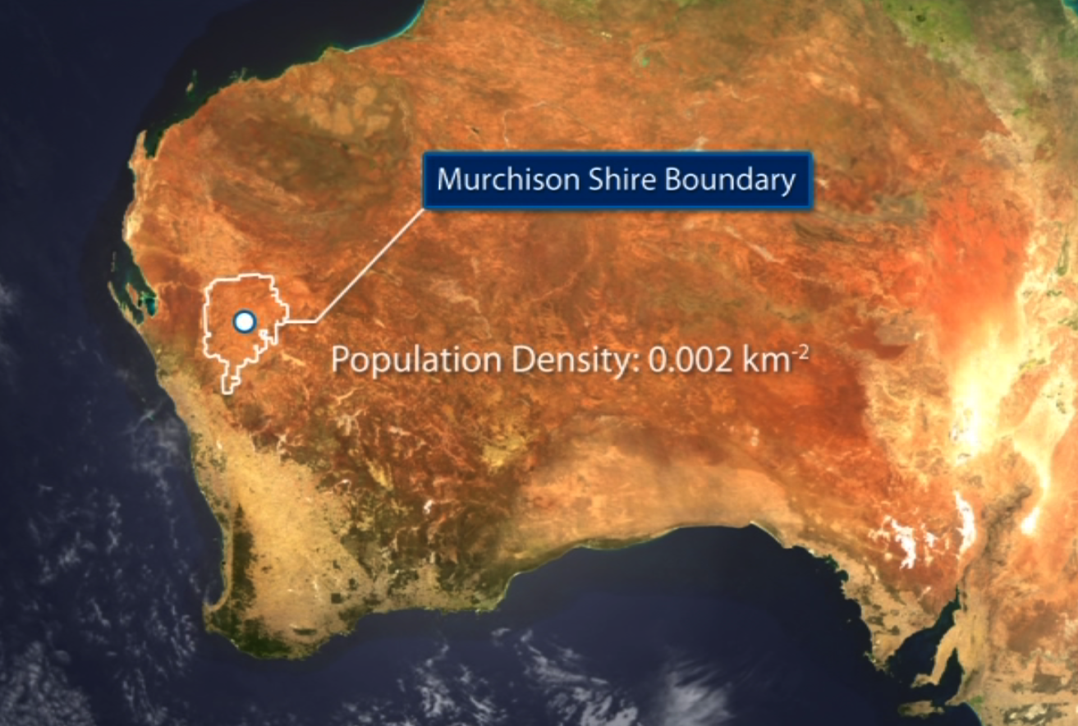
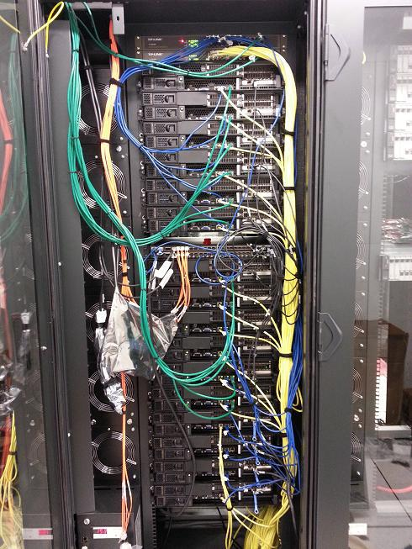
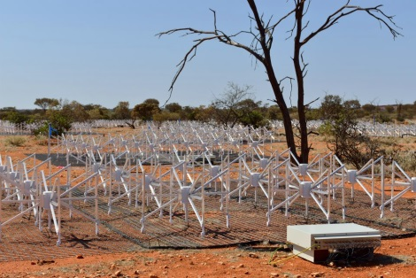
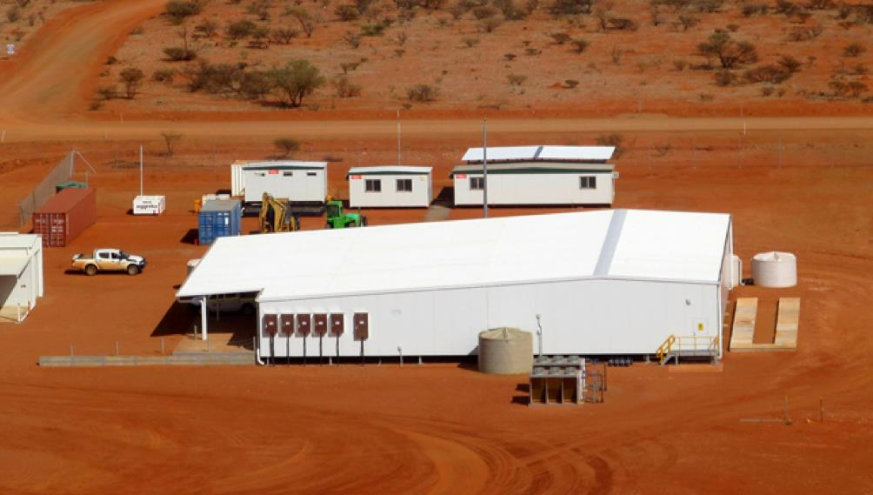
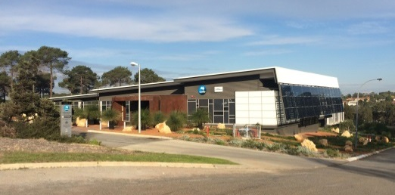
MRO (operated by CSIRO)
On site: data rate into central building ~60 Gbps
41,000 sq. km = The Netherlands
Population density = 0.002 people/sq. km
Geraldton
Off site: data rate into science archive ~3 Gbps
~200 km
Perth
Pawsey Centre 9 PB storage for MWA
5
Notes:
Best way to describe the MWA (including next 6 slides)
Refer to DG’s comments on the observatory boundary. Quality controlled, standardised and curated data products. Value-added ‘science’ software and tools are the responsibility of the science teams.
MWA Project = Take, store and serve data.
MWA Collaboration = science outputs.

Slide 6

Antenna tiles
Notes:
16 dual polarisation antennas arranged in a regular 4 x 4 grid, supported by an analogue Beamformer that uses physical delay lines to ‘steer’ the tile-beam. Two polarisations of analogue beam-formed RF signal are transmitted over copper coaxial cable to in-field receiver electronics. There are 128 tiles deployed and operating in MWA’s current configuration.

Slide 7
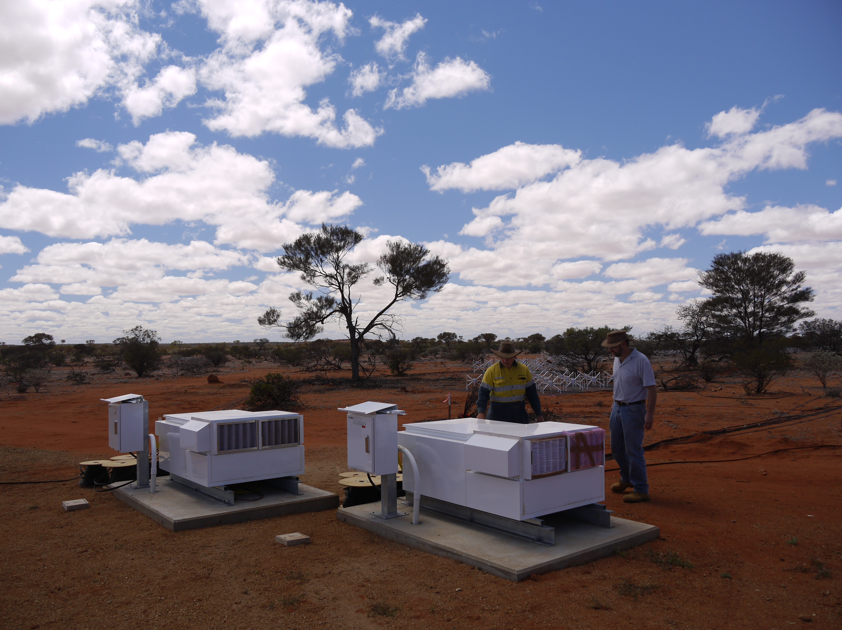
Receivers
Notes:
The dual-polarisation analogue RF tile-beam signals from eight tiles are routed to each ‘receiver’ node in the field. The Receiver first digitises all 16 signals, 8x and 8y, then digitally filters each digital signal into 256 coarse frequency bins—each bin representing 1.28MHz of bandwidth. 24 coarse frequency channels, constituting a total instantaneous bandwidth of 30.72MHz, are then sent via optical-fibre to the MRO Central Building for further processing.

Slide 8
Central Signal Processing
Notes:
The MRO central building houses the MWA correlator which is a hybrid FPGA/GPU FX-system. Each 1.28MHz coarse channel from the receivers is further divided into 128 10kHz fine frequency channels. Each 10kHz fine channel from each of the 128-tiles is then cross-multiplied with the same 10 kHz channel from every other tile to give 8128 independent ‘visibilities’. These visibility sets are transmitted off site for archiving and science processing.

Slide 9
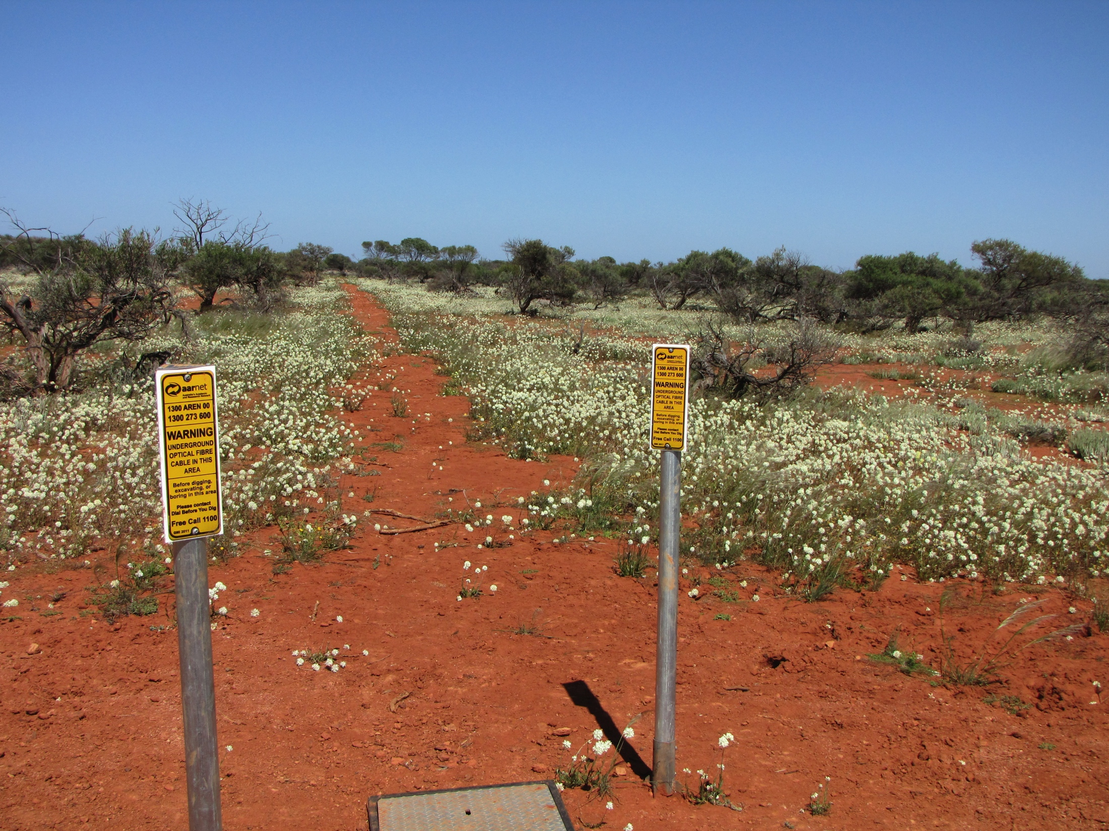
800 km of optical fibre
Notes:
MWA currently has utilises a dedicated 10gigabit ps link from the MRO to the Pawsey Centre leveraging infrastructure provided by CSIRO and AARNET. Working with industry and community partners we hope soon to have a 100Gb link established to support development and eventually a transition to, an offsite correlator.

Slide 10

Pawsey Supercomputing Centre
www.pawsey.org.au
Notes:
The Pawsey Centre currently houses the MWA data archive and operates a number of supercomputers that the MWA Science teams utilise for processing their data.
What does all that translate to in terms of the MWA’s science utility. By far, the MWA’s uniquely defining characteristic is…

Slide 11



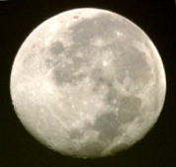
Field of view!
~15 - 50 deg. (200 - 2500 sq. deg.)
ASKAP
Hubble
Space
Telescope
MWA
SkyMapper
From: Prof. Bryan Gaensler
11
Notes:
FOV.
Where, for reference, the moon is approximately half a degree across.
Having covered what we are I’ll move along to what we have done.

Slide 12
What have we done?
We will complete our fifth 6-month operational observing campaign at the end of CY15
~8000 hours of observing have been conducted in support of >36 different projects (@20151104)
>7.5 PB of data are archived at the Pawsey Centre (@20151104)
Completed a design study and implementation plan for an MWA node of the All-Sky Virtual Observatory (www.asvo.org.au)
First public release of MWA data (www.mwatelescope.org)
Learned a lot about building, commissioning and operating a low-frequency aperture array at the MRO
Science
Notes:
On one slide.
Next are science slides. I will not speak to these in detail, as I wouldn’t do them justice. I will dwell on each slide just long enough for those who are inclined to read them.

Slide 13
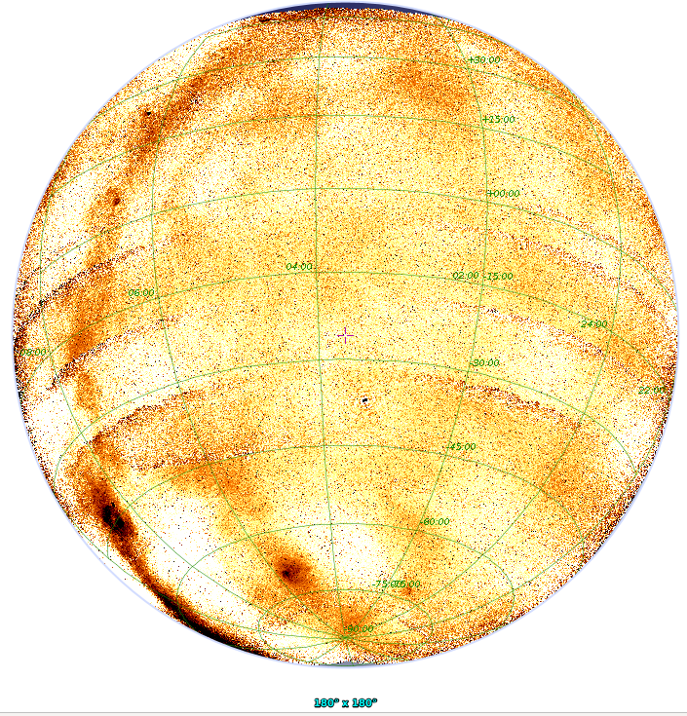
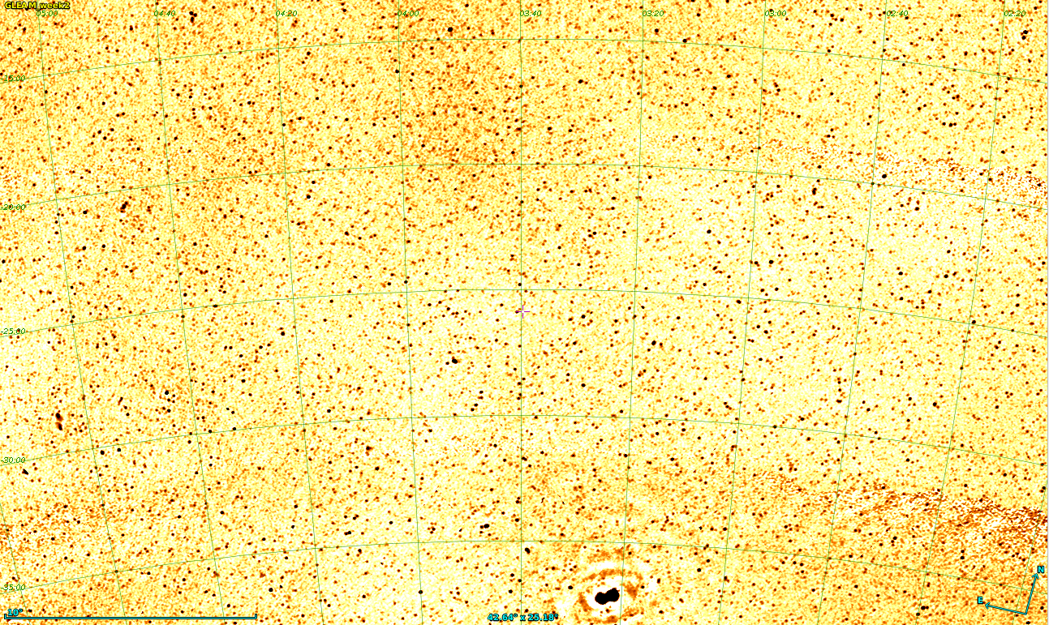

Hurley-Walker et al. 2015, in preparation
Wayth et al. 2015, PASA
300,000+ sources
19 freq sub-bands
δ<+25
|b| > 10
Notes:
The first release of this survey, which is in preparation uses data taken in the first year of MWA operations.

Slide 14
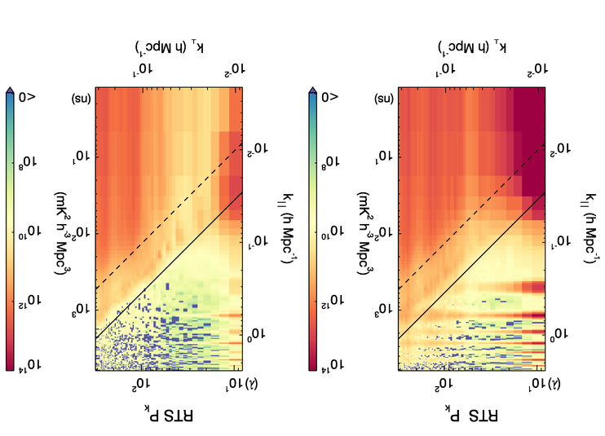
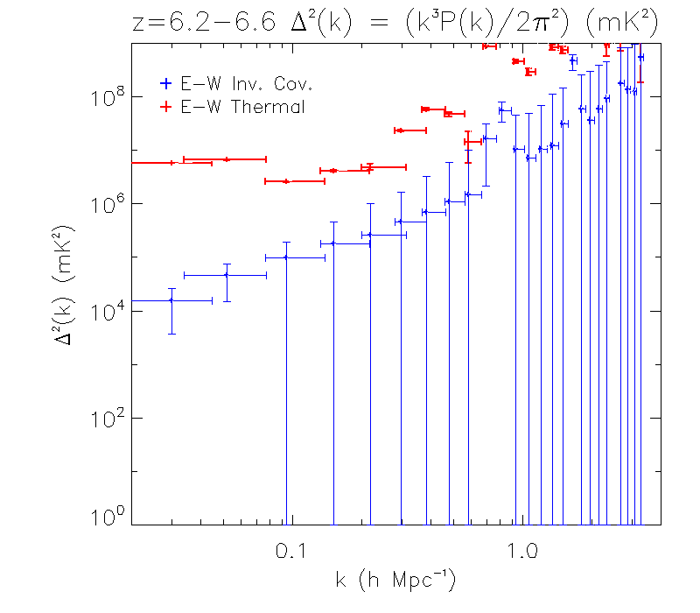
Epoch of Reionisation
Trott+ (2015)
- Two calibration pipelines + two power spectrum pipelines
- 1000 hours of data observed on three fields
2D power spectra from 3 hours of data
1D power spectra from 3 hours of data
Foreground and instrument cleaned power
Upper limit on EoR power at k=0.05 Mpc⁻¹: (275 mK)²
Consistent with expectations
Native power

Slide 15
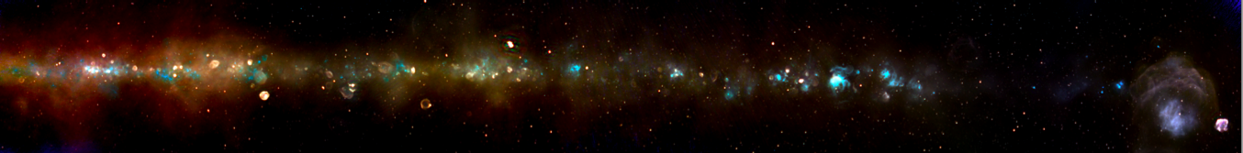
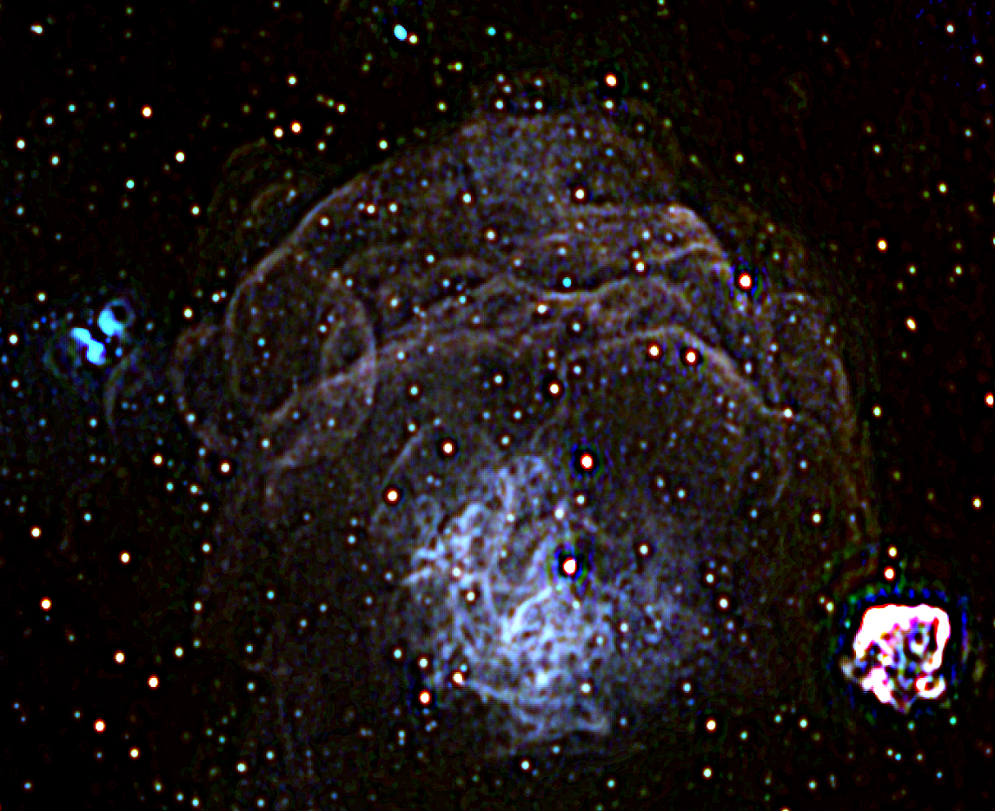
Multi-frequency imaging of the Galactic plane
Vela/Puppis
~100 degrees
Galactic Centre
  Images: Luke Hindson et al.
“Three-colour” image: ~120 – 200 MHz
Unsharp mask (Melanie Johnston-Hollitt)

Slide 16
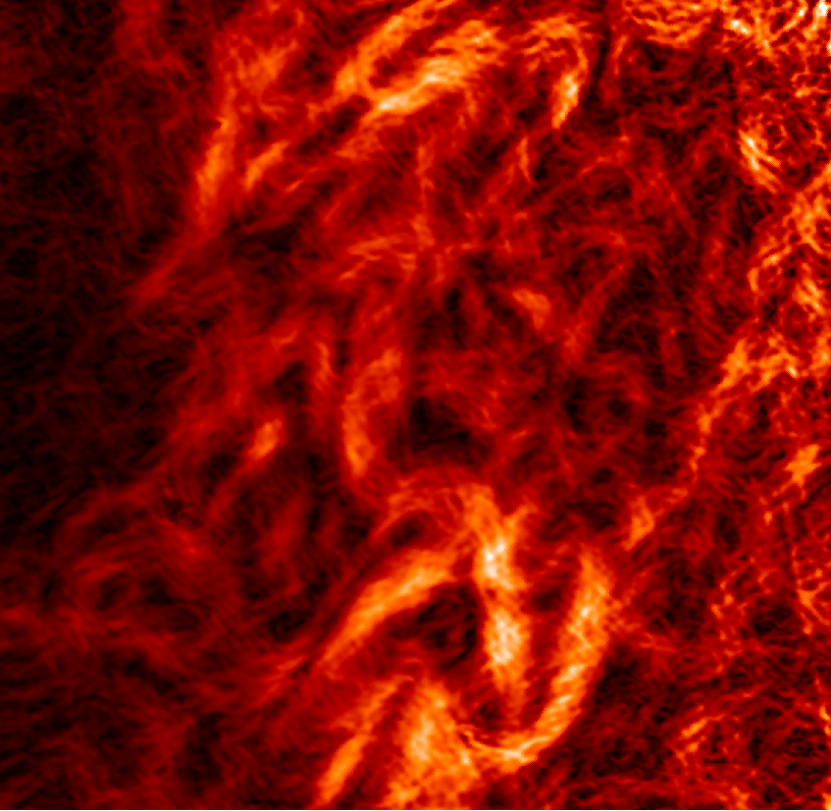
Snakes out of the plane
Linear polarisation gradient maps from 200-230 MHz (20 x 20 degs)
The maps highlight turbulence in the local ISM and are the first to be made in these frequency bands
Large angular scale structures -> very important foreground to account for in EoR experiment
20 degrees
Emil Lenc et al. 2015, in preparation

Slide 17
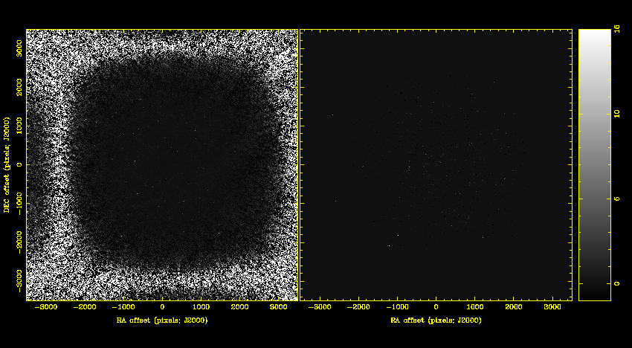
Interplanetary scintillation
(Kaplan et al. 2015 ApJ 809)
~40 deg @ 150 MHz
(~1600 sq. deg!)
2 second images over ~2 min
~50 mJy/beam sensitivity
100% modulation of
PKSB 2322-275 flux density

Slide 18
Coherently dedispersed polarimetric tied array beam on 0437-4715 (Ord et al.)

Slide 19
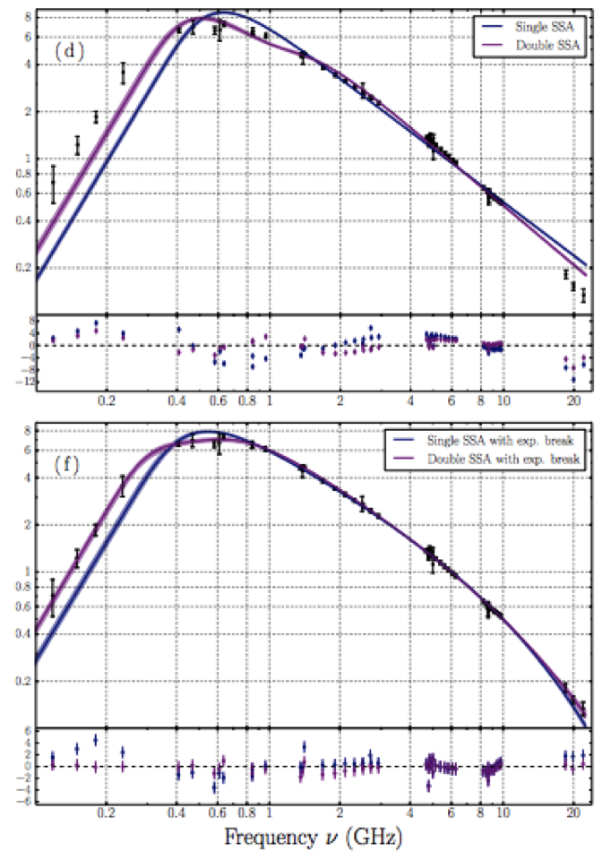
THE EXTREME GIGAHERTZ-PEAKED SPECTRUM
RADIO SOURCE PKS B0008-421: Callingham et al.
2015 ApJ 809 168C
Halo and relic radio emission from
Abell 3376: George et al. 2015

Slide 20
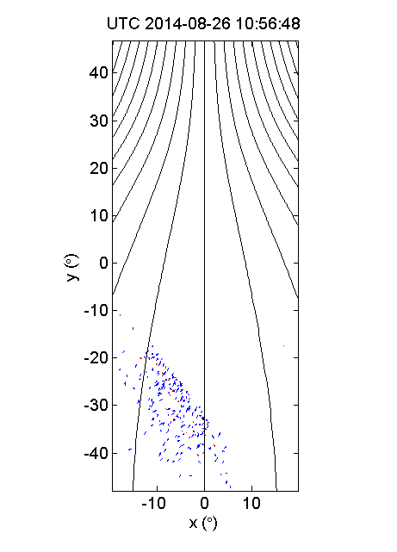
MWA confirms existence of ionsopheric plasma ducts
Loi et al 2015.
Movie shows formation of ducts aligned with B fields (lines) after passage of travelling ionospheric disturbance.
Notes:
What does all of this translate to for the guy who reports to the funding agencies?

Slide 21
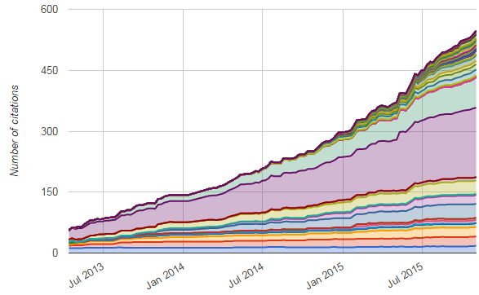
MWA papers/citations
Nov 2015 | July 2015 | July 2014 | July 2013 | July 2012 | Stage
39 (7) | 33 (7) | 16 (7) | 11 (3) | 2 (1) | Accepted/published by journals (conferences)
8 | 7 | 7 | 2 | 2 | Submitted to journals
9 | 3 | 3 | 3 | 6 | Drafts posted for collaboration review
28 | 23 | 18 | 5 | 3 | Proposals posted for collaboration review
84 (7) | 66 (7) | 44 (7) | 21 (3) | 13 (1) | TOTAL (@20151104)
Notes:
Publication statistics.

Slide 22
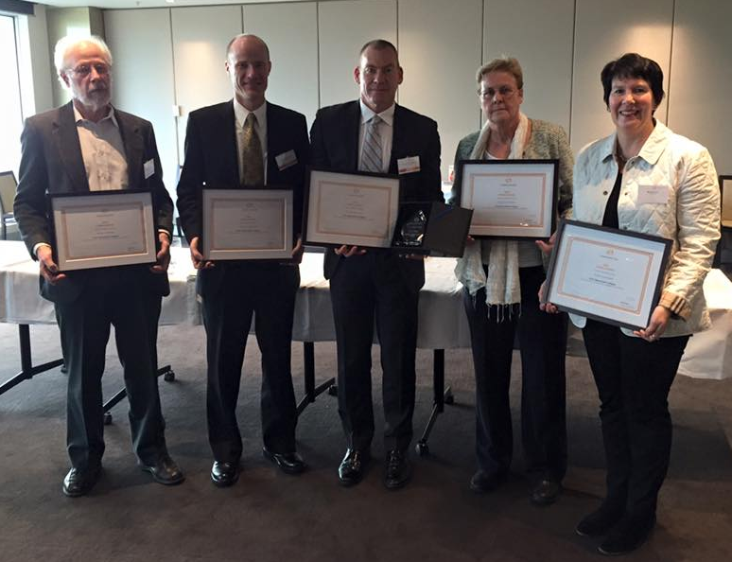
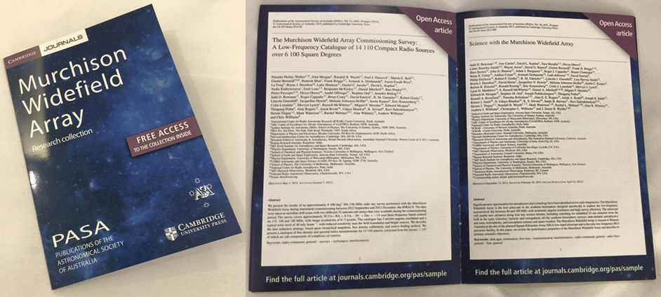
Scientific productivity
Professor Frank Briggs,
Dr Randall Wayth,
Professor Steven Tingay,
Professor Rachel Webster,
and Ms Kate Gunn
Notes:
MWA’s productivity, in terms of science output in the form of publications, has accelerated significantly through the reporting period, as evidenced by the recognition of eight MWA researchers at the 2015 Thompson Reuters Citation and Innovation awards.
In further recognition of the growing body of work produced by MWA researchers, the journal Publications of the Astronomical Society of Australia (PASA), produced a special library and glossy digest of MWA papers they have published.

Slide 23
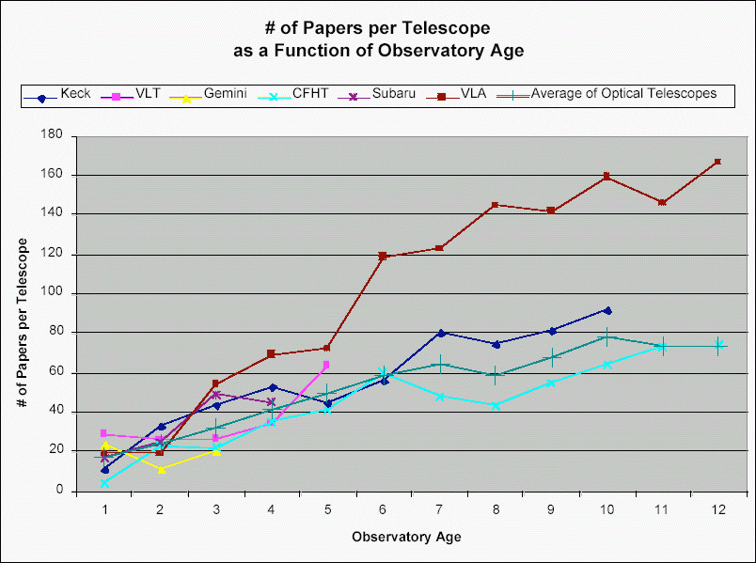
Scientific productivity
From Prof. Ron Ekers, based on analysis in “The scientific productivity of the Gemini Telescopes”, Jean-René Roy, Phil Puxley & Dennis Crabtree GSC/AOC-G Meetings, 12-14 Oct. 2004 -- Waikoloa, Hawaii
Notes:
Having established what we have done, I have one slide to show you what we are doing right now.

Slide 24




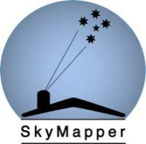



What are we doing?
TAC currently reviewing 13 observing proposals for our 16A observing campaign
Collaborating
Notes:
Having matured to the point of being a relatively stable and robust facility, we have been able to execute our core science programs very well to date. In parallel, the observing and operational systems of the MWA have been improved and augmented over time, allowing new areas of science to open up.
The primary direction of this new research is in multi-wavelength and multi-messenger transient science, utilising the unique and defining characteristic of the MWA that I referred to a little earlier, its extreme field of view. These new capabilities allow the MWA to co-observe with other EM and non-EM facilities around the world and for MWA observations to be triggered for rapid response by both ground and space-based instruments.
The MWA has an MoU with the LIGO collaboration to follow up on LIGO gravity wave triggers, using the MWA field of view to efficiently cover the very large LIGO error regions. The MWA is performing follow up of the first LIGO trigger event and is co-observing during the first LIGO science run.
The MWA is also pursuing joint operations with neutrino observatories IceCube (Southern Hemisphere) and ANTARES (Northern Hemipshere) and is completing follow up analysis of the ANTARES trigger list, leading to a first publication. MoUs for ongoing joint operations with ANTARES and IceCube are in development. The MWA field of view capability is critical to these efforts.
The MWA has triggered off SWIFT gamma-ray events, resulting in a submitted publication on GRB 150424A.
The MWA is undertaking joint observations with the Kepler K2 mission, SkyMapper and the Palomar Transient Factory (PTF), obtaining simultaneous radio/optical images on a range of fields.
Finally, an all-sky optical transient monitor camera has been installed at Wooleen Station, 80 km from the MWA, for full-time dedicated optical monitoring of the fields the MWA observes.
These commensal, co-observational, and triggered MWA programs are clearly pathfinder activity for the SKA in Australia. The multi-wavelength and multi-messenger approach to astrophysics is becoming increasingly important in the era of wide field telescopes, new international astro-particle facilities, and the maturity of gravitational wave astronomy. A number of these facilities will come into existence at the same time as the SKA and the MWA is leading the way in terms of interfacing to these diverse and different communities now.

Slide 25
What are we going to do?
Phase 1: 2013-2016
  128 antennas, 2.5 km max baseline
Phase 2: 2016-2018
  Expand with additional 128 antennas, comprised of
    72 closely spaced in 2x hexagonal grids approx 100m size
    56 new long baseline antennas to double max baseline to 5km
  Only 128 antennas used at any time: reconfigure for
    ‘EoR array’ (existing core tiles plus new hexes)
    ‘Long baseline array’ (existing non-core tiles + new long baseline tiles)
  Same correlator, receivers: reconfigure by manual re-plugging of tiles into receivers
Phase 3: 2018+(?)
  All 256 tiles correlated
  Increased frequency range and instantaneous bandwidth
  Requires replacement of post-beamformer analogue and digital hardware

Slide 26
MWA Phase 2
Project costed at $2.8m
  ARC LIEF scheme proposal for $1.2m, $1.6m from proposal partners
  ARC awarded $1.0m on 30 October 2015
128 new tiles
  72 in two compact hexagons in core for an enhanced EoR capability
  56 on baselines up to 6 km for enhanced survey imaging capability
128 of 256 tiles correlated: reconfigure for
  ‘EoR array’ (existing core tiles plus new hexes)
  ‘Long baseline array’ (existing non-core tiles + new long baseline tiles)
  Same correlator, receivers: reconfigure by manual re-plugging of tiles into receivers
Phase 2 will see new partners join the MWA Collaboration
  University of Toronto, Canada
  University of Western Sydney, Australia

Slide 27
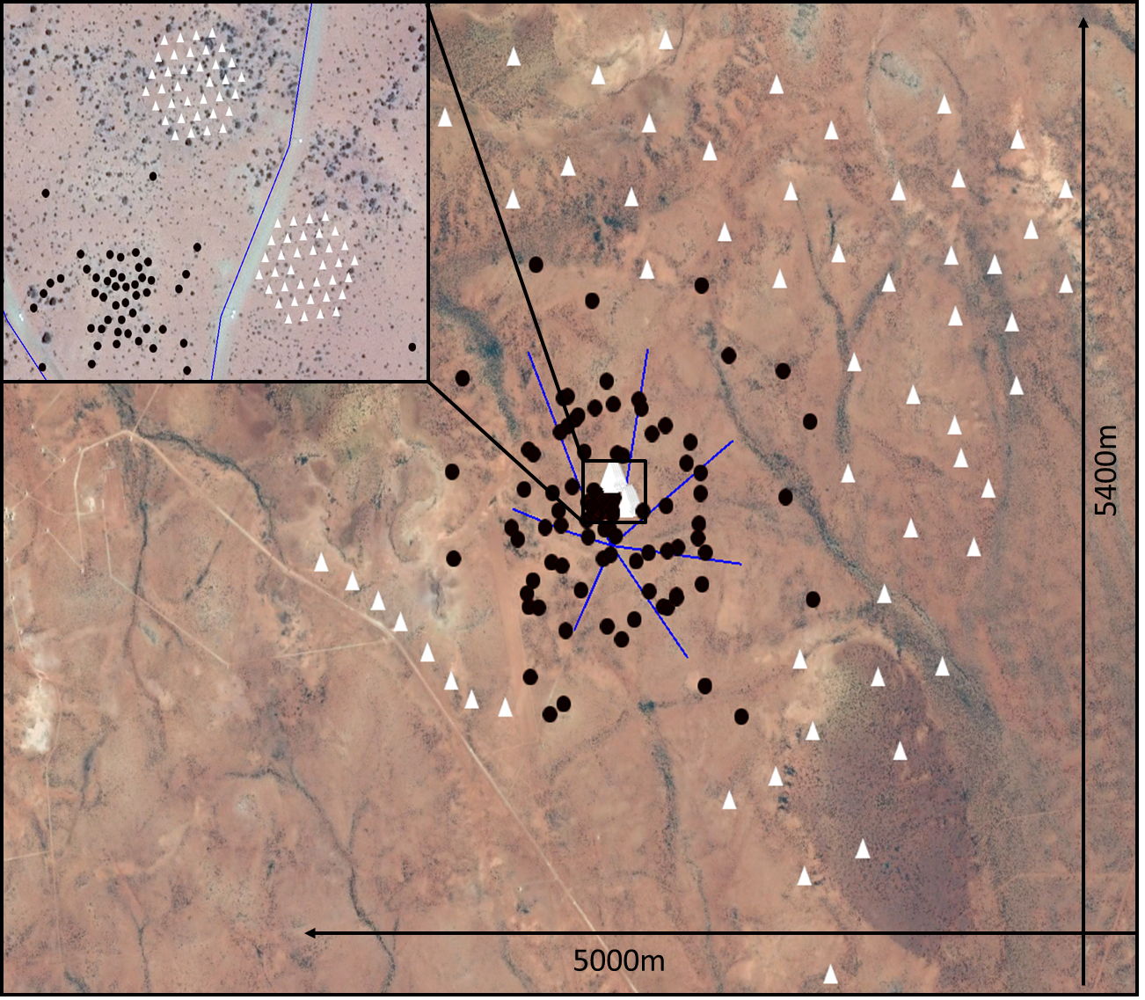
128 new tiles
  72 in two compact hexagons in core for an enhanced EoR capability
  56 on baselines up to 6 km enhanced survey imaging capability

Slide 28
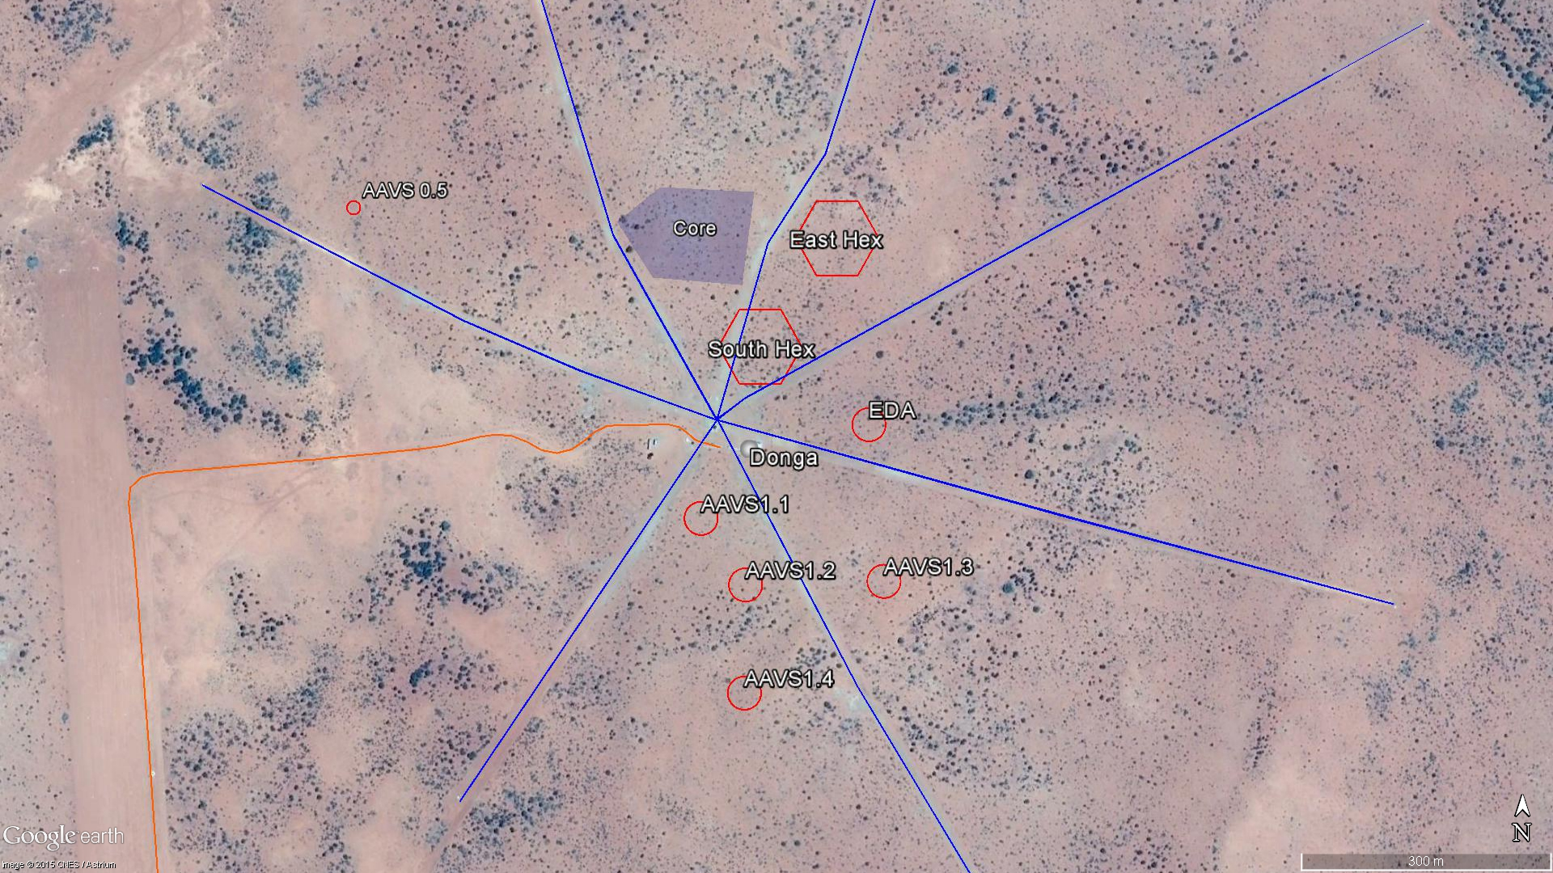
What do we enable and support?

Slide 29
Engineering Development Array
(EDA)
Purpose:
  Prototype and test technology required for expanded MWA phases 2 and 3
    Remote (long baseline tiles with RFoF)
    Network/comms to remote tiles
    Provide signal and control path for potential MWA phase 3 without current MWA receivers
  Enable testing of MWA correlator expansion project
    External data into MWA correlator → full cross correlation with entire MWA (mutually beneficial)
    Hybrid array calibration schemes
  AAVS1 reference/comparison system
    Aids AAVS1 characterization, regardless of any comparison role
    Beamforming and beam metrology on same sized station
    Comparison of station performance over SKA_Low frequency range
  Provide ICRAR/Curtin University with a “sandpit” for array radio science and engineering developments

Slide 30
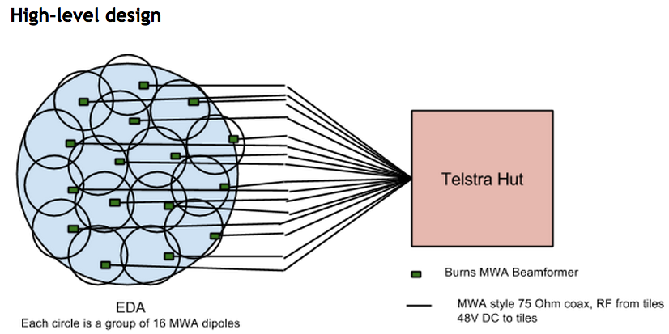
EDA - Initial implementation
Made from off-the-shelf or existing MWA components
  MWA active antenna dipoles with expanded low freq range LNA (50-330 MHz)
  RF/data over 200m coax
Analogue beam-formed sub-arrays
256 dipoles total
2nd stage beamforming (analogue or digital) in Hut
Full baseband signal sampling in Hut

Slide 31
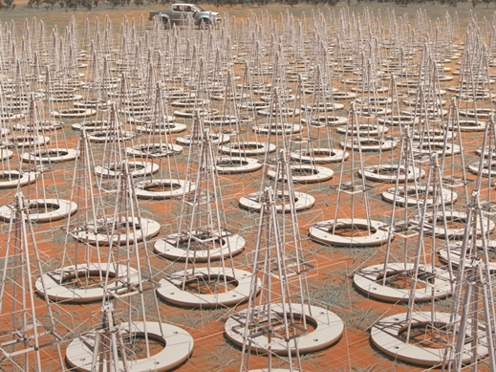
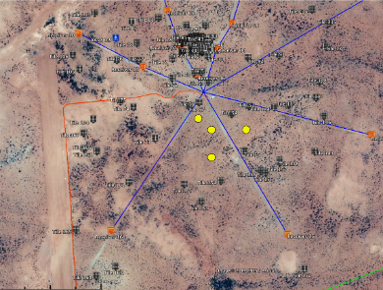
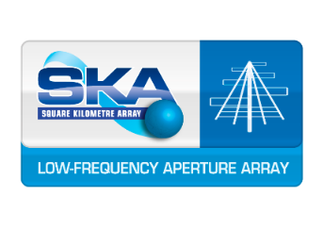
Aperture Array Verification System 1 (AAVS1)
Field test and demonstration of technology proposed for LFAA = ↑system TRL
Owned by 6 international research partners, led in Australia by ICRAR
(not an SKAO instrument)
  Low Frequency Aperture Array development consortium
Operated stand-alone, and in conjunction with MWA
Will trial economical, low-impact construction techniques which might be used for SKA-Low
About 400 antennas, grouped in four 35m diameter ‘stations’
  One full “SKA1-Low” station
Aim to build in 2015-16 and operate in 2016-17
Mainly an engineering development instrument, but will do science alongside MWA
Site civil work largely complete; thanks to regional and indigenous contractors
AAVS1 stations
(approximately to scale)
Notes:
Aperture Array Verification System 1 will be built by the AADC Consortium as the principal test and verification platform for the LFAA. The system will allow the consortium to critically evaluate designs and procedures at the SKA1_LOW site. It will enable the group to advance the TRL of key technologies and components; and to test, refine and support the system specifications in the lead up to CDR.
AAVS will be constructed under an MRO site license held by Curtin University and will be hosted by the MWA. The system will rely heavily on MWA infrastructure, facilities and procedures and as such it had to be formally endorsed by the MWA Consortium Board.
Design review completed in ASTRON in early October.
Progress on site in anticipation of an antenna deployment from QTR2 2016.

Slide 32

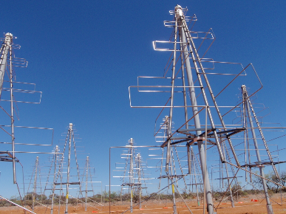
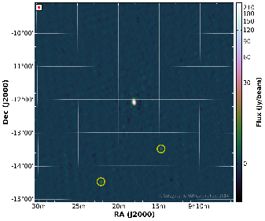
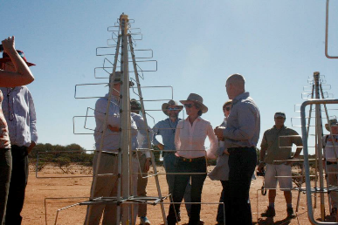
AAVS 0.5 – a taste of things to come
AAVS 0.5 (16 antennas)
  External instrument of MWA (returns to MWA, SKA)
  Main job done, observations complete
  New antenna/array metrology in “difficult” frequency range
  Continued use as environment and technology test platform for AAVS1
Electromagnetic engineering + astronomy = verification of SKA1 design tools
Notes:
The AAVS0.5 system was deployed and commissioned by the AADC Consortium under the MWA ‘external instruments policy’ late in CY2012.
AAVS0.5 is a 16-element array employing an early version of the log-periodic SKA_LOW antenna developed by Cambridge University. The installation is a The intent of the system was to inform the development of AAVS1 and the early identification of critical system design issues.
Utilising the MWA signal path, AAVS0.5 can be operated in a stand-alone mode or correlated with the MWA. Co-location and integration with the MWA has facilitated a regime of metrology and astronomical testing and verification that would not be possible if the AAVS0.5 were not located with a large, well characterised radio interferometer.
AAVS0.5 has been very successful in terms of its objectives and continues to provide valuable data on component and system performance in the MRO environment in the lead up to the deployment of AAVS1.

Slide 33
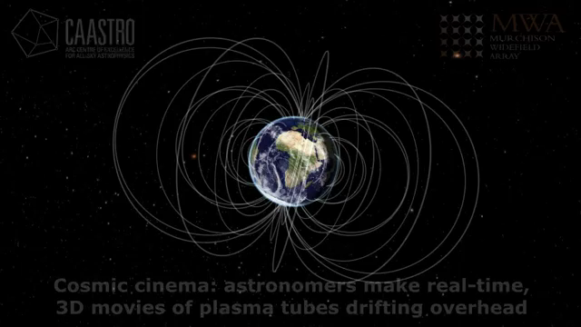
Plasma tubes in the ionosphere (Loi et al.): >1,000,000 hits on YouTube
An insightful and poignant finish
Notes:
Earlier in the week, as part of his ALMA lessons learned, Robert Laing reminded us that often the science objective that informs the design of an instrument does not turn out to be its defining capability.
This has also proven true through the early-science phase of MWA operations. While our two biggest science programs, EoR and GLEAM wrestle with the myriad challenges of processing the vast quantities of data our most impactful result to date was produced by a University of Sydney undergraduate student, Cleo Loi. In the process of trying to better understand the effects of the ionosphere on an experiment led by her supervisor, Cleo was able detect and image ‘plasma tubes’ in the magnetosphere surrounding the Earth confirming the existence of the structures it had been theorized ‘must exist’ for more than 60-years.
Rather than utilizing the MWA’s 128-tiles all together Cleo split them into two halves, east and west, and used the two-halves—like a pair of human eyes—to allow the MWA ‘see’ in 3D. This technique allowed Cleo to view the ionosphere above the MWA with unprecedented precision, and to directly image structures within it for the first time.
Cleo’s result is an example of how radio-astronomy can have real-world benefits. Structures in the ionosphere create unwanted signal distortions that affect a variety of terrestrial and spaced based technologies. Cleo’s work is a definitive example of how radio-astronomy can contribute to our understanding and management of these issues.
The worldwide attention gleaned Cleo’s result underscores the scientific potential of the MWA and instruments like it in the hands of innovative researchers. The continuous development of novel data analysis techniques like those employed by Cleo will ensure that the MWA data archive continues to support, and remain relevant to the low-frequency radio-astronomy community until SKA_LOW is realised.

Slide 34
For updates:
  www.facebook.com/murchison.widefield.array
For info:
  www.mwatelescope.org
For contact:
  MWA-Director@curtin.edu.au

Slide 35



THANKS!!!
Wadjarri Yamatji Traditional Owners
people of the MRO site
CSIRO Operates the MRO
Astronomy Australia Administers
Limited Federal funding
Australian Provides
Government Federal funding
Western Australian Provides
Government State funding
CAASTRO Major science partner

