Slide 1
SKA Engineering Meeting:
Close
Philip Diamond, Director-General
Penticton: 12th November 2015

Slide 2
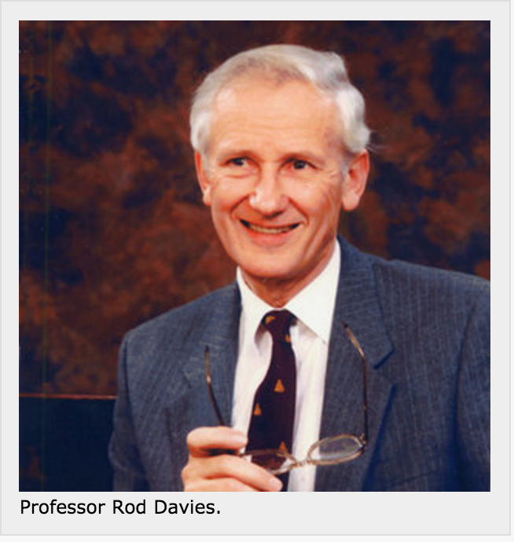
Prof Rod Davies CBE FRS
1930 - 2015
Physics U of Adelaide
Radiophysics Sydney 1951 – 1953
Moved to Jodrell Bank in 1953
Director Jodrell Bank 1988 – 1997
President Royal Astronomical Society 1987 – 1989
Elected Fellow of the Royal Society 1992
CBE 1995
Solar radio astronomy
HI : mapped the Galaxy
Zeeman studies
CMB: 1980s onwards
Key player in Planck satellite

Slide 3
Welcome to Penticton
3rd SKA All-hands
Engineering Meeting
Overview of SKA design and
other activities.
Opportunities for
inter-consortium interactions
Workshops on specific issues
#SKAengcon15

Slide 4
Impressions I
Extremely pleased at the level of progress
Can see an observatory taking shape before our eyes
PDR and associated down-selects have been a tough, but necessary process. We see the fruits of all that hard work.
Extensive lessons learned from PDRs which must be built on as we prepare for CDR.

Slide 5
Impressions II
Robert Laing’s talk on lessons learned from ALMA – highly instructive, and worthy of close study
Lori Wingate on the complexities of international project management provided impressive insight – we are learning from others.
Excellent progress on precursors and pathfinders – again, providing lessons for SKA.

Slide 6
Impressions III
We have a complex project:
Designing two telescopes
Designing an observatory
Designing a governance structure
Only possible through open, transparent structures and through broadband bi-directional communication.
All-hands engineering meeting essential to achieve this.

Slide 7
Statistics
5 days:
11 rooms
34 plenary talks
92 booked meetings
6 video conferences
14 audio conferences
742 litres of alcohol.

Slide 9
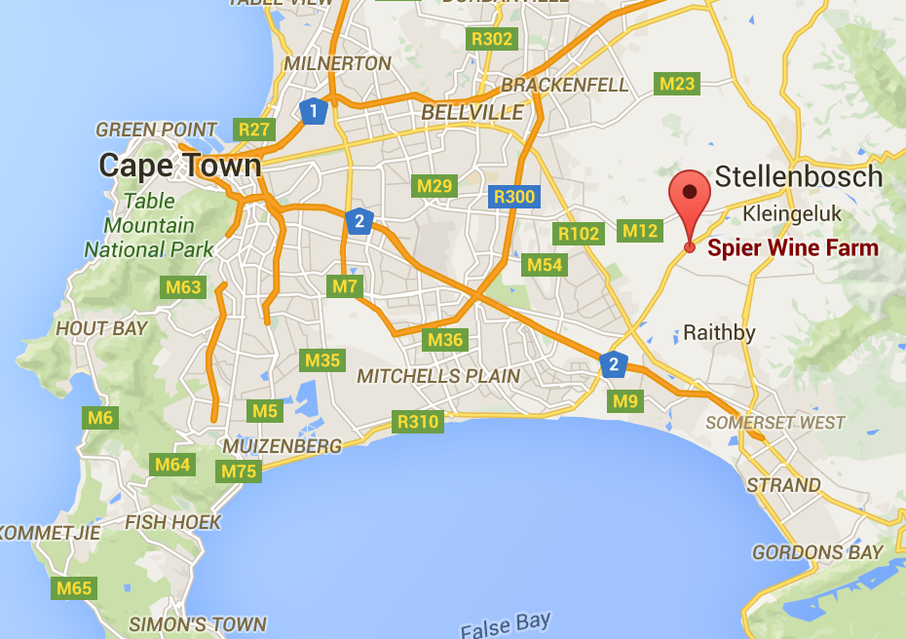
Next year’s meeting
2nd – 6th October, 2016
Spier: www.spier.co.za
Large auditorium
12 breakout rooms
10 minutes from Stellenbosch
15 minutes from Cape Town airport

Slide 11
Summary
[Message from Paul Furness (IT): please upload talks if not done so.]
Momentum in SKA is excellent
SKA science well-defined, prioritisation and re-baselining for design complete
Detailed design proceeding well; normal project issues but no show-stoppers
Formal negotiations to establish a treaty organisation for SKA have begun.

Slide 12
Thank you to all
www.skatelescope.org

