Slide 1
SKA: Update on SKA Governance
Simon Berry, Director Policy Development
9th November 2015

Slide 2
News since last time
Focus in last September report:
Key Document Set development
  Observatory Agreement (now Convention)
  Financial aspects
  Procurement, access, IPR
  Plus the associated engineering documentation
StratCom leading on the various policy areas
  Led to March Board meeting and agreement to move into ‘formal negotiation’ phase

Slide 3
Overall picture

Slide 4
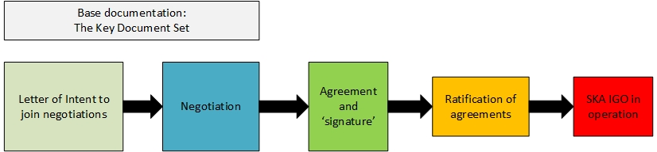
Governance/organisational structure
Evolution planned to an SKA IGO: a structure like ESO/ESA/ITER/EMBL
Rationale:
  Government commitment: Long-term political stability, funding stability
  Availability of ‘supporting processes’ through Privileges and Immunities from members
  ‘Freedom to operate’, specifically through procurement process, employment rules and so on

Slide 5
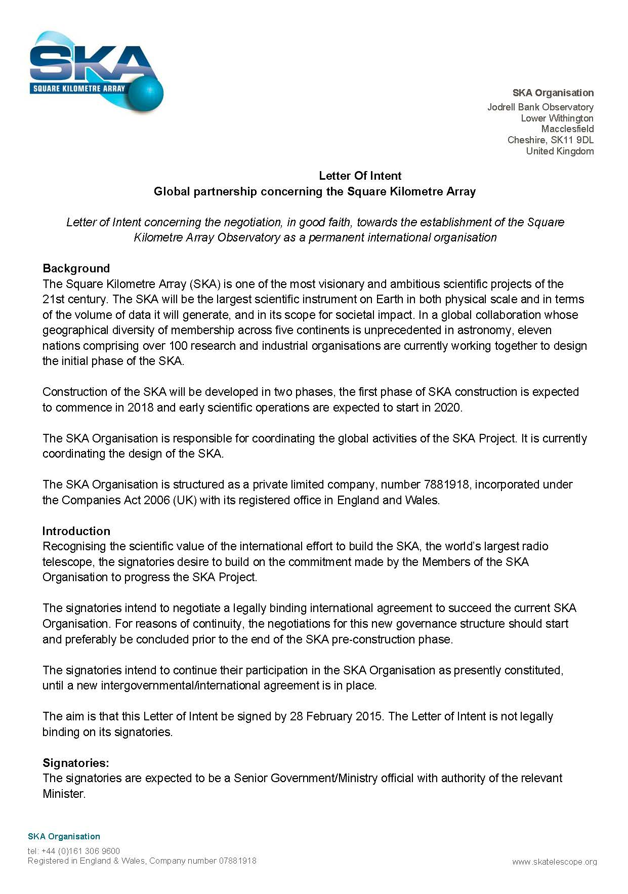
Progress during 2015…..
Letter of Intent signed by:
  AUS, RSA, UK, CN, NL, NZ, IT
  India new status, good progress in SE
Negotiation process initiated in mid 2015
Preparatory meeting, Brussels June 2015
  LOI signatories and observers present
  Preparatory discussions
Board agreed OK to proceed: March 2015
Several signed LOIs

Slide 6
IGO discussions
Presidency: Italy (Ministry level, with INAF support) to chair and coordinate negotiation process, advised by international law expert
3 plenary meetings:
  14-16 October 2015
  Jan 2016, then April 2016
Participation from all current SKAO members:
  Majority as ‘negotiating parties’ – triggered by mandate being provided by a Member’s government
  ‘Observer’ status for those without that mandate
Aim of discussions: prepare the governance for the SKA, prepare the supporting structures and understanding:
  Negotiation of core texts of agreements
  Negotiation on supporting concepts that input to agreements or supporting policies
Process continues until agreement reached on texts: ‘signing event’ at end before process moves to ratification

Slide 7
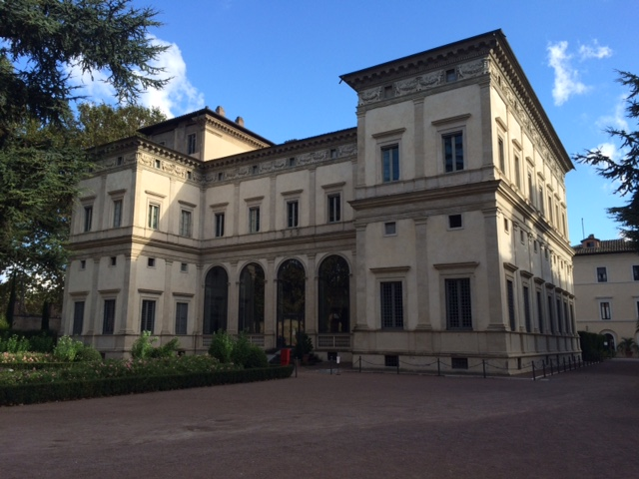

Slide 8
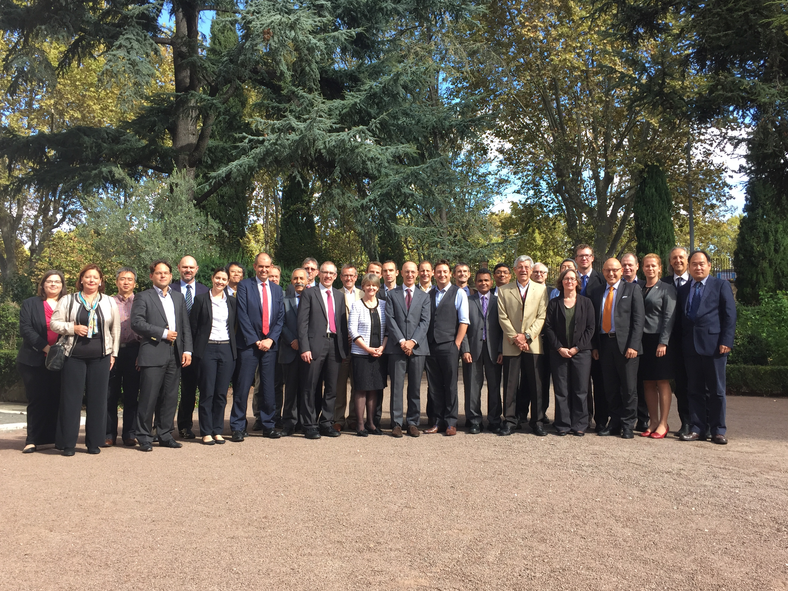

Slide 9














Slide 10
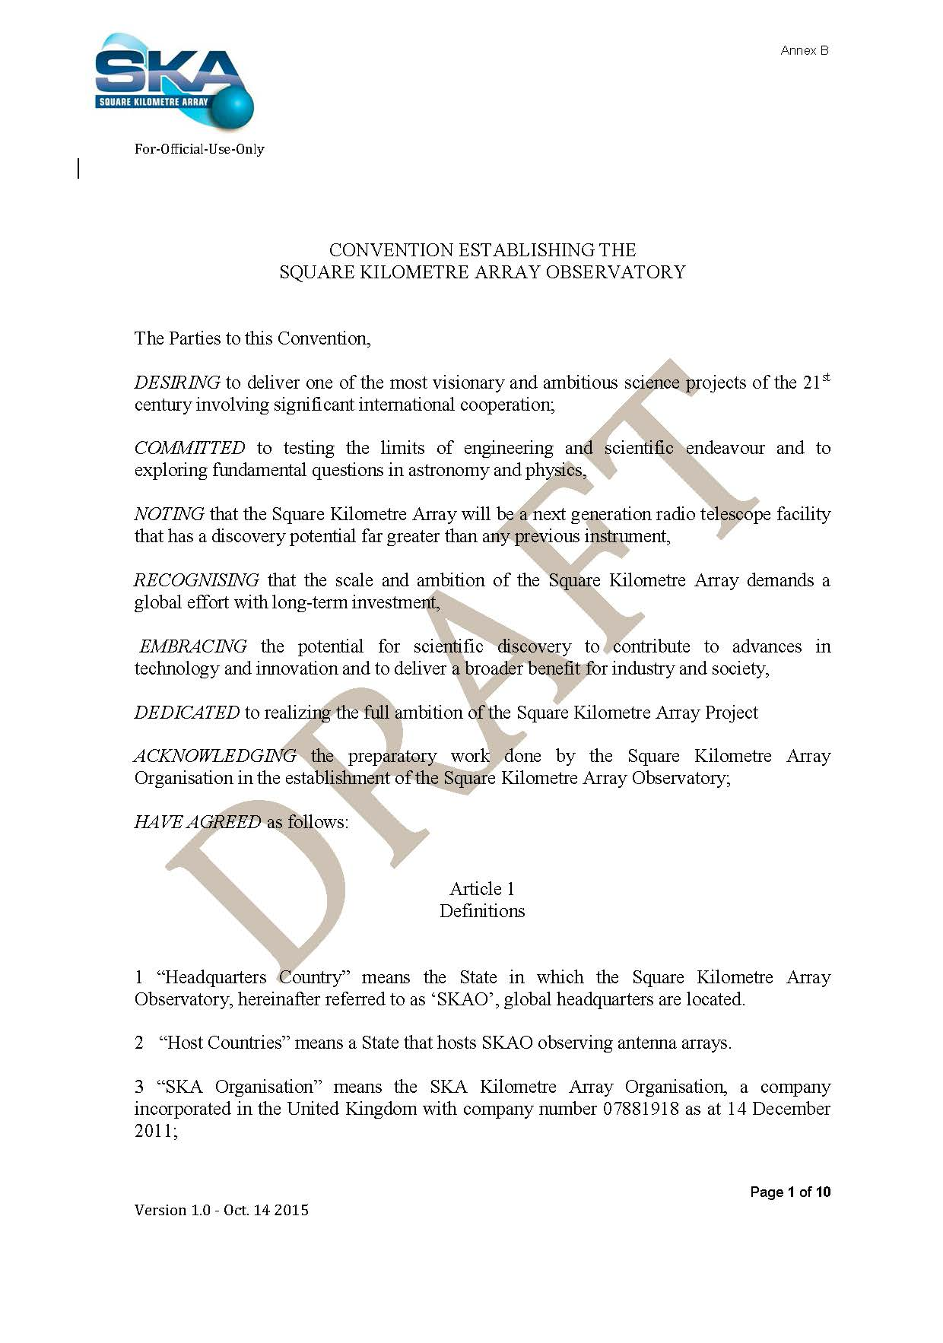
SKA Observatory Convention
Issues and key points include:
Getting the top-level structure right:
  Difference between the IGO coming into operation and ‘approving the project’
  Process for ‘coming into force’
Membership:
  Who can join or work with the future Observatory organisation
Treatment of Privileges and Immunities
  What P&I and how far are they applied at Treaty level?
Top-level financial rules:
  Voting rights, other Council procedures
  Types of contributions, rules for late joiners
Withdrawal rules, winding up process

Slide 12
Working groups to support negotiations
Much work to be undertaken between plenary sessions in working groups:
Working group memberships taken from the plenary groups – active now
Financial Protocol working group (Lead: Tiplady, RSA)
  Goal: develop core Treaty financial documents, funding schedule negotiation process, high level procedures
Privileges and Immunities working group (Lead: Baker, UK)
  Goal: understand P&I requirements for project and present as draft for negotiation
Procurement and IPR working group (Lead: Jing, CN)
  Goal: develop Board/StratCom work into a sufficiently detailed description of process to support core IGO negotiation → policy document
Operations and access working group (Lead: Pearce, AUS)
  Goal: develop Board/StratCom work into a sufficiently detailed description of process to support core IGO negotiation → policy documents at end
All starting from existing work, principles and and draft documents at some level

Slide 13
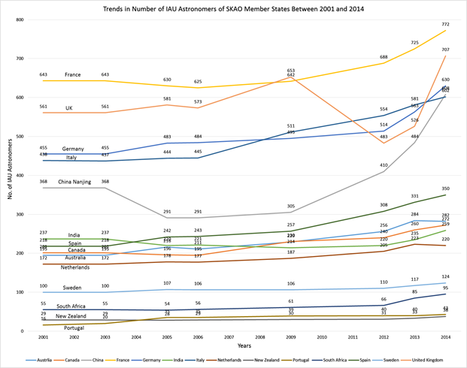
Financial protocol
Funding model
  Designed by
  Funding assumptions based on ‘ability to use’
  Return on investment embedded in the project as base concept
Principles designed in 2013 by Funding Task Force Protocol documents set out expectations for funding ‘rules’ Starting point for negotiations on contributions related to ‘capacity to use’ Sets relative levels for Members and Hosting countries (at 14%) Return on investment embedded in the project as base concept Financial protocol describes financial rules, % table, decision-making processes, processes around budget-changes etc

Slide 14
Other work in progress
Hosting agreements
  Now ×3: 2 telescope sites plus HQ agreement
  Alignment required as far as possible
  Challenges: P&I and organisation operation issues, also overall structure of project and infrastructure scope
IPR
  Will be picked up in Procurement-IPR working group
  Challenge here: evolving current pre-construction IPR policy for the construction phase → legal/policy and industrial testing process
Internal organisation operation and transition planning
  Moving from current company structure to new legal basis
  Numerous practical issues wrt HR, financial planning
  Internal policies need to be developed, with advice, ready for implementation

Slide 15
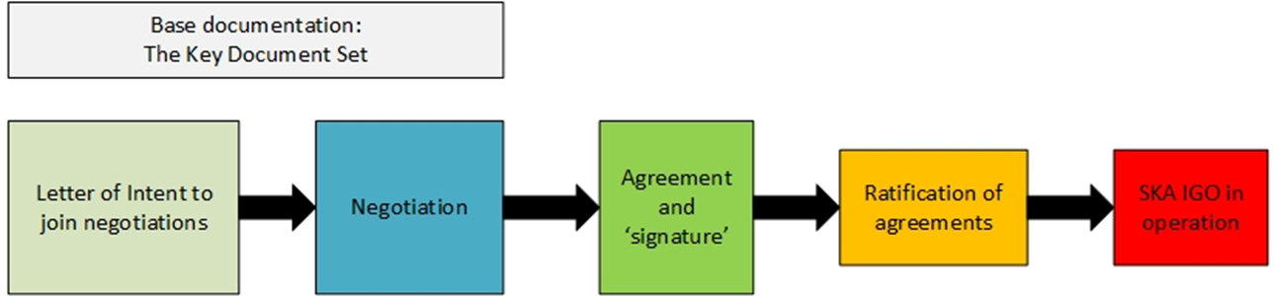

A note on timing
Start intention is that IGO negotiations are complete by mid 2016: then move to ratification
Real timing clearer after negotiation working groups start
~Q2/3 2016
12-18 months?
>Q2 2017
~Q4 2017+?

Slide 16
(Some of) the questions…
What’s the real chance of the IGO being operational on this timescale?
  Two areas of risk: Negotiation time and ratification time
  Believe in the timeline for now
What level of detail do IGO negotiators need to support the negotiation?
  Not clear yet….
  Financial aspects of IGO must imply being content with overall cost position and planning
  How much does return on investment (and specifically procurement situation) impact on IGO implementation
What does it mean for when and how the procurement process starts?
  Discussion with consortia on Wednesday: need to understand positions and possible issues

Slide 17
What happens at the transition point?
Internal processes for the new organisation being developed
Numerous detailed issues on the table
  Resourcing transition – personnel and structures in the Office
  Transition into whatever overall structure in place for construction (relationship to national entities etc) needs study
  What about a situation where some have completed the ‘ratification’ process and some not? What’s the legal position?
  Mechanics and detailed timing of the transition from pre-construction into construction? See discussion on Wednesday….

Slide 18
Governance summary
This is now moving…. Quickly. Being driven hard by Italian negotiation leaders
  Level of engagement from the governments is impressive
Most challenging work to be developed in the various working groups
  Very compressed timeline to fit around plenary negotiations
  Will have a better idea of how difficult it will be in coming weeks
  Work with your national structures to help support the discussions

Slide 19
Procurement

Slide 20
Developing a procurement policy
Work so far developed by StratCom (reporting to Board)
Gradual evolution of work to fit with growing understanding of member positions
Last September
  Focus on accommodating cash and in-kind
  Struggling with process and timing
Since then:
  Board input and discussion
  Procurement workshop and StratCom group
  Board March 2015: Focus on principles
  Alignment with IGO process – need ‘policy’

Slide 22
Long-lived policy to support Convention and drive day-to-day procurement rules
Shorter-term thinking and process for SKA1 planning, before enacting procurement for construction

Slide 23
Contributing to SKA: principles
Contributions to SKA in the construction phase are likely to be a mix of cash and in-kind offers from Members: demonstrable ‘return’ has to be there
There will be some minimum cash contribution necessary, at a level to be determined by the SKAO;
  required to enable the continued operation of the central SKAO activities
  also to deliver various work package areas that are most appropriately centrally procured;
A Member can provide remaining share:
  As cash to central fund or
  As in-kind contributions managed and resourced by the Members (within framework of central oversight)
Responsibility for risk apportionment and management of contingency will be an important consideration;
Some form of pre-qualification and supply chain quality assessment will be necessary as part of the process,

Slide 24
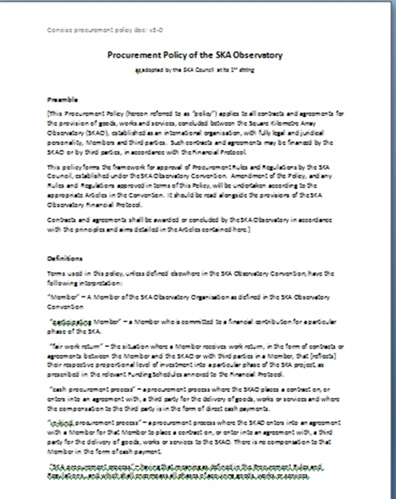
Developing a ‘policy’
Based on Board-principles, StratCom group has worked on a policy statement
  Discussion at Board next week, and work developed by WG
Assigns responsibility for specification setting and who has responsibility for procurement
  Central contracting from SKAO
  In-kind from the responsible body
Describes difference between cash and in-kind approaches
Introduces the concept of a Procurement Plan how it is arrived at
Introduces the principle that eventual procurement can take various forms:
  Open procurement through to
  Directed/restricted advertisement of opportunities

Slide 25
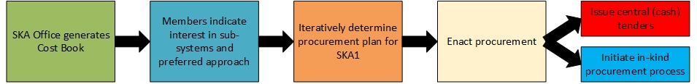
Near term planning steps
Discussion ongoing about short-term process to support IGO negotiation process
Work towards first vision Cost Book underway at present
Cost Book principles
  Developed ‘intelligently’ with appropriate granularity
  Needs to have appropriate value attached to activities
  Pre-defines preferred approach
EoI step not a tender process, but critical in matching aspiration and capability by a member with requirements of project
If used, such a process a first step in developing a final SKA1 procurement plan for implementation – timing issue present
More discussion on details in procurement session Wednesday afternoon

Slide 26
Summary
IGO negotiation process now underway – successful first meeting mid October
  Core Convention negotiation now started – good progress already
Working groups
  Several (Member government) working groups established to progress discussions and draft documents
Of particular interest (and concern?)
  Ability to complete Convention discussions in timely manner
  Complexity of financial/funding discussions
  Completion and expert/community testing of procurement policy
  Detailed discussions on procurement with consortia on Wednesday
Critical few months ahead to make progress to match engineering timeline
Procurement work continuing – handover from StratCom to IGO working group to lead discussions
  Moving to develop principles into practical implementation – testing more with community

