Slide 1
Central Signal Processor
Local Monitor and Control
TANGO Use Case: Hierarchical Approach
Sonja Vrcic, NRC-Herzberg
SKA LMC Harmonization Workshop
16-18 February, 2016
Trieste, Italy

Slide 2
Introduction
Each of the SKA Elements is a complex, functionality rich sub-system, and each has been sub-divided in sub-elements which themselves are complex systems and consist of many components.
Each Element is responsible for monitoring and control of its components.
This use case uses CSP as an example of a hierarchical architecture.

Slide 3
CSP Sub-elements
Signal processing sub-elements (CBF, PSS and PST) receive configuration and commands from LMC.
In most cases originator of configuration and commands is TM, but data is received via LMC.
CBF, PSS and PST each have a single point of communication with LMC.
From the point of view of monitor and control, CSP sub-elements CBF, PSS and PST are ‘loosely coupled’; they exchange very little information.

Slide 4
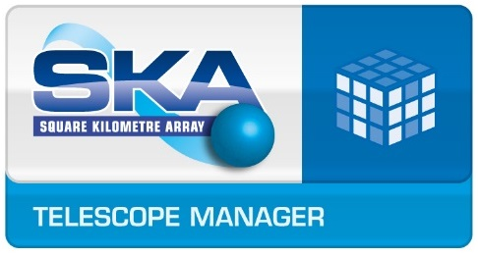
Each CSP sub-element:
implements a single interface with CSP_Mid.LMC.
is responsible for internal monitor, control and co-ordination of its components.
Each CSP sub-element must be able to:
Translate commands received from LMC into commands for its components.
Co-ordinate operation of components.
Report overall sub-element status.
And much more…
Hierarchical approach to monitor and control.
Entity that reports on behalf of a sub-system or on its own behalf:
Is responsible for internal monitoring, control and co-ordination of its components.
Maintains its own status and is able to report it.
Reports self-description to an entity higher up in the hierarchy.
CSP_Mid.LMC
CSP_Mid.CBF Master
CSP_Mid.PSS Master
CSP_Mid.PST Master
F-part Server
X-Part Server
BF-Part Server

Slide 5
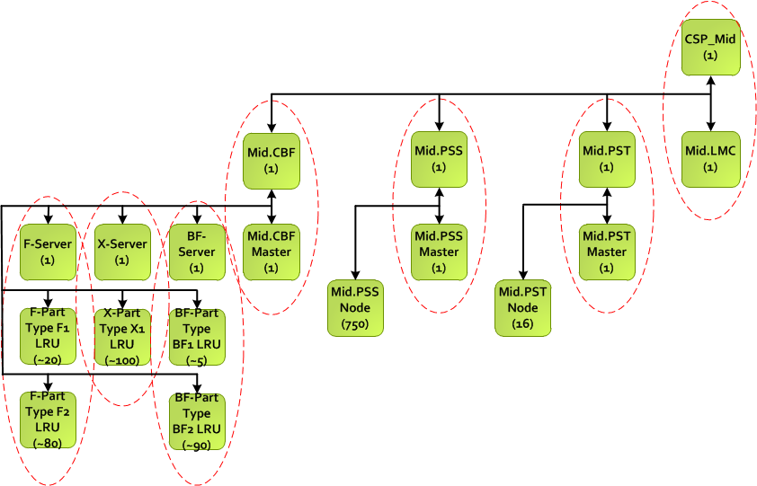
CSP_MID Tango Devices
TANGO Devices implemented by the same software package (i.e. the same s/w package is reporting on behalf of these devices.
Number in the parenthesis indicates the number of instances.

Slide 6
TANGO Facility – best practices - for discussion
Should CSP be implemented as a single Tango Facility?
Or is it more appropriate and practical to implement each CSP sub-element (including LMC) as a distinct Tango facility?
What should we take in consideration when making this decision?
Complexity of the individual devices
Number of devices (types, instances)
Hierarchy. I.e. how deep is the hierarchy (number of levels)
Encapsulation
Organizational considerations:
Each CSP sub-element will be developed independently by a different group, using different technology and code base. Each sub-element will be integrated and tested independently, before integration at the CSP integration and test facility.
For each release, the sub-element acceptance test and sell-off will be performed for each sub-element independently, using test tools (input vector generators, emulators, simulators). CSP AIV group will be responsible for integration of the sub-elements and CSP acceptance test and sell-off to the SKA AIV Group.
Other …

Slide 7
Questions?
Thank you !

