Slide 1
SKA Central Signal Processor Control Context
Sonja Vrcic, NRC-Herzberg
SKA CSP LMC Sub-element Lead
SKA CSP LMC Peer Review
11.April, 2016, Madrid

Slide 2
List of topics to address as a part of this review
CSP Architecture
CSP Control Context
Detail CSP Monitor and Control Architecture
Prototyping - Status
Proposed Design

Slide 3
Overview of this presentation
CSP M&C architecture - considerations, approach
CSP Sub-elements
Interface CSP to TM (EICD)
Interface LMC to CBF, PSS, PST (IICD)

Slide 4
CSP M&C Architecture - consideration
SKA M&C architecture is driven by the requirements and by the organization of the SKA team.
The same applies for CSP.
CSP sub-elements are being designed by different teams, as follows:
LOW.CBF
MID.CBF
LOW.PSS and MID.PSS
LOW.PST and MID.PST
LOW.LMC and MID.LMC

Slide 5
CSP M&C Architecture – considerations (continued)
The principle of encapsulation, adopted for the SKA Telescopes, has been applied to the design of the CSP monitor and control. Justification:
CSP sub-elements being designed by the five different teams.
CSP sub-elements will be independently procured (assumption).
In many cases, the M&C functionality requires deep understanding of the CSP sub-element functionality and design.
Some of the sub-elements (namely PSS and PST) had partly implemented solutions and teams in place at the beginning of the pre-construction.
Integration and testing can be better supported by the M&C designers and developers integrated with the sub-element team.
Schedule may vary across different sub-elements.

Slide 6
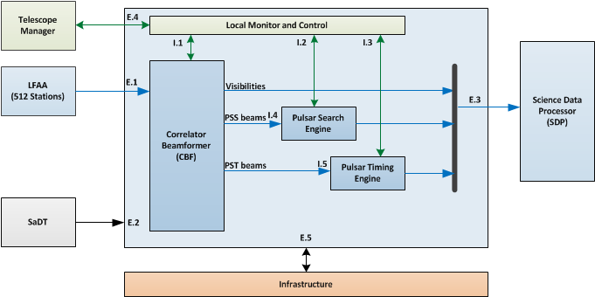
CSP_Low Sub-elements

Slide 7
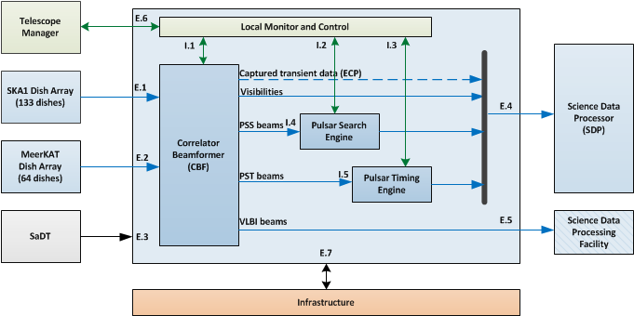
CSP_MID Sub-elements

Slide 8
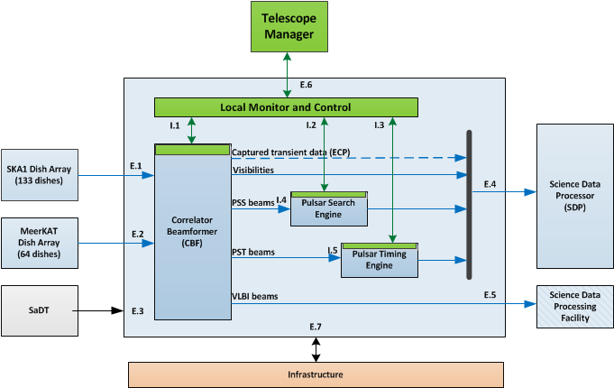
CSP_MID Monitor and Control Hierarchy

Slide 9
CSP Monitor and Control - Responsibilities
The following applies for CSP_Low and CSP_Mid:
Sub-element CSP.LMC is responsible for overall control, co-ordination and monitoring of all CSP sub-elements and for communication with TM (in the same telescope).
Sub-elements CBF, PSS and PST each implement a single interface with CSP.LMC and are responsible for the implementation of monitor and control functionality internal to the sub-element:
Translate commands received from LMC into commands for the components.
Co-ordinate operation of components.
Report overall sub-element status.
Report alarms, monitor points, etc.

Slide 10
CSP.LMC – A thin layer of abstraction
Consequence of the decision to ‘encapsulate’ M&C responsibility and push it to lower layers, and of the overall CSP design:
Most of the monitor and control functionality is implemented by the sub-elements CBF, PSS and PST.
CSP.LMC is a “very thin” layer of abstraction.
Main purpose of the CSP.LMC is to allow TM to configure Pulsar Search and Pulsar Timing observations without being aware of the division of responsibility among CSP sub-elements.
A quick study of the Interface Control Document CSP to TM and “LMC to CBF, PSS and PST” reveals that in many, if not most cases, CSP.LMC forwards messages received from TM unchanged to sub-element (CBF, PSS and/or PST), and vice versa.

Slide 11
CSP_MID Monitor and Control Hierarchy

Slide 12
CSP Sub-elements – Type and Number of LRUs
Sub-element | LOW LRUs | LOW Equipment | MID LRUs | MID Equipment
CBF - Correlator and Beamformer | 88 | FPGA based solution, custom LRUs, switches | 300 | FPGA based solution, custom LRUs, switches
PSS – Pulsar Search Engine | 250+100+2 | COTS compute nodes (GPUs/FPGAs), switches, servers | 750+100+2 | COTS compute nodes (GPUs/FPGAs), switches, servers
PST – Pulsar Timing Engine | 18+2+2 | COTS compute nodes (GPUs), switches, servers | 18+2+2 | COTS compute nodes (GPUs), switches, servers
LMC – Local Monitor and Control | 4 | COTS dual redundant server, redundant switches | 4 | COTS dual redundant server, redundant switches

Slide 13
CSP_MID Monitor and Control Hierarchy

Slide 14
CSP_Mid – Components and Capabilities (an example)

Slide 15
CSP Monitor and Control No coordinated unified approach
CSP has adopted the approach used at the telescope level, CSP.LMC team has no mandate to define a common M&C architecture.
Not easy to initiate work on common architecture and design without clear mandate:
Reluctance to devote effort to work not in SoW
Reluctance to ‘push’ or try to enforce solution chosen by small group of people without clear mandate or support.
However, within CSP Consortium there is more co-operation than among the SKA Elements (see next slide).

Slide 16
CSP.LMC team composition and co-operation with other CSP sub-elements
Members of the CSP.LMC team are involved in the design of other CSP sub-elements:
Sonja Vrcic of NRC, is working on the design of the monitor and control for MID.CBF.
Carlo Baffa and Elisabetta Giani of INAF, are working on the design for the monitor and control of Pulsar Search Engine (Low and Mid)
Andrew Jamison of University of Swinburn, working on the development of Pulsar Timing Engineer (Low and Mid).
Low.CBF team does not have representative in the CSP.LMC group.
It was initially planned that Rajesh Warange of NCRA could take on that role. For now, for practical reasons, Sonja fills that role (keeps the Low.CBF group informed and keeps in mind LOW.CBF requirements and design).

Slide 17
Monitor and Control Interfaces
So far work on interfaces has been the main channel for cooperation and exchange ideas.

Slide 18
CSP.LMC Interfaces
CSP.LMC implements interface with the following entities in the same telescope:
TM
Document 100-000000-021 SKA1—Low Interface CSP to TM
Document 300-000000-021 SKA1—Mid Interface CSP to TM
CBF, PSS and PST sub-elements
Document SKA-TEL-CSP-0000019 CSP ICD LMC to CBF, PSS and PST
In CSP.LMC we often refer to these ICD as:
CSP to TM is external ICD (EICD)\
LMC to CBF, PSS and PST is internal ICD (IICD)
CBF, PSS and PST implement a single interface with CSP.LMC

Slide 19
ICD CSP to TM - Status
Split per telescope (LOW and MID)
Latest version submitted as a part of the Delta PDR package.
These ICDs describe general requirements, very verbose - in the absence of the clear requirements, guidelines and other documents to refer to, concepts are proposed and defined in this ICD.
Much of the content could be used as ‘suggestions’ for the development of the common guidelines.
Need to translate to ‘requirements’ language. But waiting for the progress to be accomplished on the guidelines and standards before investing a significant effort in these documents.
No references to TANGO - underlying protocols and message format TBD.

Slide 20
ICD CSP to TM
This Interface Control Document (ICD) defines the requirements and implementation details of the monitor and control data exchange interfaces:
I.S1M.CSP_TM.001 “SKA1_Mid Central Signal Processing _Telescope Manager Monitor and Control Interface”.
I.S1M.CSP_TM.002 "SKA1_Mid Central Signal Processing _Telescope Manager Scan Real-Time Monitor and Control Interface". This interface is for CSP generated auxiliary data as well as for the real-time updates provided by TM for the on-going scans, as defined in Section 7.8.9 Observing Mode Parameters (e.g. delay models, weights used in beamforming, Jones Matrices). Some of the information transmitted by TM over this interface is provided by SDP.

Slide 21
ICD CSP to TM - Topology

Slide 22
ICD CSP to TM Content: Generic suggestions
Use of SET/GET parameters for all commands.
Command / configuration Activation Time
List of parameters to be implemented by different classes of entities (TANGO Devices):
element, sub-element, LRU
sub-arrays, capabilities
alarms, events
General discussion and definition of states and modes (analysis based on the states and modes proposed in the TM generated “LMC Interface Guidelines”.
Alarms: discussion, definitions, message content, parameters,
Etc.

Slide 23
ICD CSP to TM Content: CSP Specific
Definitions related to: Sub-array, scan, observing modes
1. Create a sub-array
2. Add / remove receptors to/from a sub-array
3. Add / remove resources (PSS, PST, VLBI beams) to/from a sub-array
4. Set Observing Mode for a sub-array & start scan.
5. Stop scan (set Observing Mode = IDLE)
6. Time-Dependent updates for each Observing Mode.
7. Delete sub-array
8. Set engineering parameters for a sub-array.
9. Query parameters and status, including status and setup of Capabilities.

Slide 24
ICD CSP to TM TM Responsibilities (1)
Initiator (client) of control/configuration commands for normal observing, engineering test, and maintenance. TM provided configuration includes destination addresses for the CSP output products.
Acquisition and storage of monitor data, alarms, and events generated by the CSP. Also includes requesting health status of CSP resources (servers, processing nodes, etc.).
Acquisition of internal low-volume data products needed by SDP for its processing such as channel gains, RFI statistics, state counts, phase-cal measurements, etc.
Setting of alarm/notification activity levels, i.e., instructing CSP what level of alarms and monitor data to pass across this interface.

Slide 25
ICD CSP to TM TM Responsibilities (2)
Providing direct access to CSP equipment (components) using messages that do not necessarily comply with this interface (this may require tunnelling). This is required to allow for use of engineering interfaces developed during construction for troubleshooting, testing and maintenance. One possible mechanism is for TM to request a tunnel to an LRU (Line Replaceable Unit) and thereafter allow HMI to talk to the LRU directly using LRU-specific messages.
Provide user authentication and authorization for access to the CSP network via this message passing interface. That is, the TM ensures that no unauthorized traffic/messages pass across this interface.

Slide 26
ICD CSP to TM CSP Responsibilities
Executor (server) of control/configuration commands for normal observing, engineering test, and maintenance. This includes responding within the required time with proper acknowledge/action messages. It is likely the CSP must maintain a queue of commands to execute at specific times.
Collection, filtering, and generation of monitor data, alarms, and events to report to the TM on request, including the status of CSP servers/processing nodes.
Setting of alarm/notification activity levels as specified by the TM.
Providing access to all CSP processing nodes’ information including FMECA, so as to facilitate TM-provided HMIs.

Slide 27
TM Generated Messages / Requests (1)
Request environmental (temperatures, voltages, power usage, fan speeds etc.) status of all or specific CSP LRUs.
Request logical/functional health (e.g., comm. status, processing status) of CSP instantiation or for a specific Component or Capability. CSP makes provision for TM to request either the full report or a very compact indication of the functional health.
Request power on, power off, transition to low-power mode for CSP as a whole and for a specific CSP sub-element or Component. Allows individual LRUs to be power cycled for hard resetting and removal/replacement, as well as power down or low-power mode of the entire sub-element for any purpose. For FPGA-based systems this means de-configuring the bitstream; for GPU and ASIC systems action is TBD.
Update CSP firmware/software.
Set alarm/event/logging activity level. Used to throttle the number of Alarm messages delivered to the TM.

Slide 28
TM Generated Messages / Requests (2)
Define a sub-array, and tag it with a unique logical ID (TBC). Precedes definition of what to do with that sub-array, i.e. how to configure it at any point in the future. Message includes the list of stations and other generic sub-array specific information (TBD).
Add/remove station to/from a sub-array. Message includes sub-array logical ID and the list of stations to be added or removed. Stations can be added and removed to/from an idle sub-array and at scan boundaries (i.e. after one scan ends and before the other scans begins).
Declare station as available or unavailable for use (TBC). This message is used to tell the CSP that a particular station is available or unavailable for use but does not otherwise affect any sub-array composition. This is not a mechanism to add or remove stations from sub-arrays.

Slide 29
TM Generated Messages / Requests (3)
Update/change sub-array parameters such as phase centre.
Observation specific configuration messages for a pre-specified sub-array:
Imaging observation configuration message.
Pulsar Search configuration message.
Pulsar Timing configuration message.
Update time-dependent parameters as applicable to each observing mode:
On-sky calibration residuals sourcing from the SDP via the TM for central beamforming (i.e. station-based delay corrections), as applicable.
Real-time round-trip LO corrections sourcing from the SDP via the TM. These are delay correction messages sent periodically to the CSP.
Jones matrices and weights to be used in creating the tied-array beams.
Bandpass corrections and RFI information from SDP.

Slide 30
TM Generated Messages / Requests (4)
Request direct access to a particular LRU. This may be implemented as tunnelling, so that TM defines LRU-specific tunnel which can be used for exchange of messages that are LRU-specific (not defined by this ICD) without CSP.LMC vetting, filtering, or interaction. This allows engineering interfaces that do not conform to this interface to be used for testing and troubleshooting.
Set a CSP sub-element or portion of a sub-element in test mode. Typically a sub-element or part of a sub-element is put into test mode and generates data; analysis of that data is performed outside the scope of the CSP. Exact requirements TBD. Additional parameters may be defined to be used specifically in test mode.

Slide 31
CSP Generated Messages
CSP responds to TM requests with appropriate action and acknowledgement.
In addition CSP:
Reports detected errors and faults in the form of Alarm messages.
Reports other events of interest in the form of Event messages. Events of interest will be identified in advance and documented in this ICD.
Logs all CSP generated Alarms and Events in the Central CSP logging file. (CSP makes provision for TM to access, copy and search the Central CSP logging file.)
Reports status of monitor points (as configured)
Reports auxiliary data (observing mode dependent).

Slide 32
ICD CSP to TM – Observing Mode Parameters
During detailed review refer to the Section 7.8.9 for the list of parameters for each Observing Mode.

Slide 33
Internal ICD: LMC to CBF, PSS and PST
Document SE-7b describes the following interfaces:
CSP_Low.LMC to CSP_Low.CBF
CSP_Low.LMC to CSP_Low.PSS
CSP_Low.LMC to CSP_Low.PST
CSP_Mid.LMC to CSP_Mid.CBF
CSP_Mid.LMC to CSP_Mid.PSS
CSP_Mid.LMC to CSP_Mid.PST

Slide 34
ICD LMC to CBF, PSS and PST – Status
Single document for both telescopes (LOW and MID)
Latest version submitted as a part of the Delta PDR package.
Describes general requirements.
Uses the same concepts as EICD CSP to TM.
Heavily refers to EICD – in order to void repeating the same content.
Need to translate to ‘requirements’ language.
Waiting for the progress to be accomplished on the guidelines and standards before investing a significant effort in these documents.
No references to TANGO - underlying protocols and message format TBD.

Slide 35
List of topics to address as a part of this review
CSP Architecture
CSP Control Context (end)
Detail CSP Monitor and Control Architecture
Prototyping - Status
Proposed Design

Slide 36
Questions ? Thank you !
Sonja Vrcic
NRC-Herzberg
Dominion Astrophysical Radio Observatory – DRAO
Penticton, BC, Canada

