Slide 1
First Impressions
… an introduction
Nick Rees
4 April 2016

Slide 2
Overview
Personal introduction
Who am I?
Systems that have influenced me
What do I bring?
First Impressions of the SKA
How can I help?
Design Considerations
Ready/set/go architecture

Slide 3
Personal Introduction

Slide 4
Personal History
1984-88: PhD: “The 38 MHz Radio Survey”

Slide 5
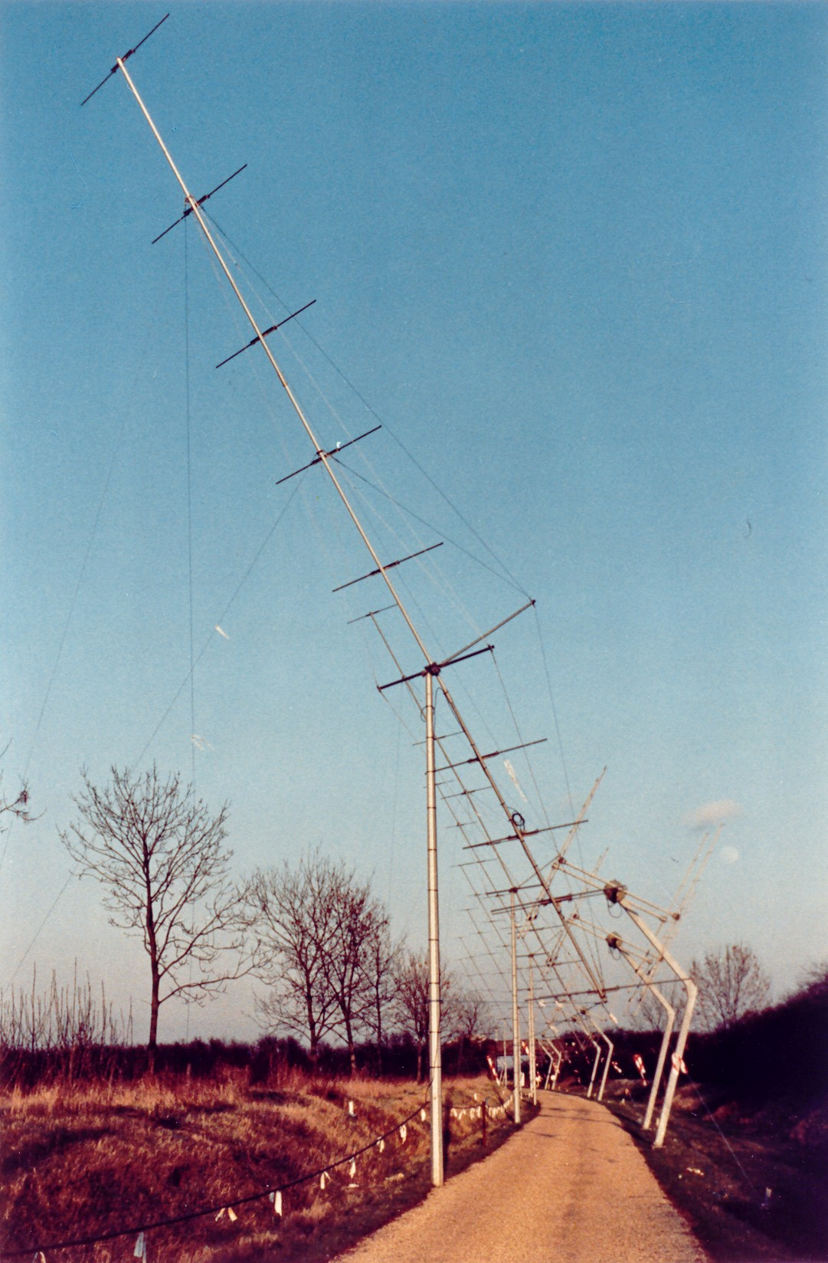
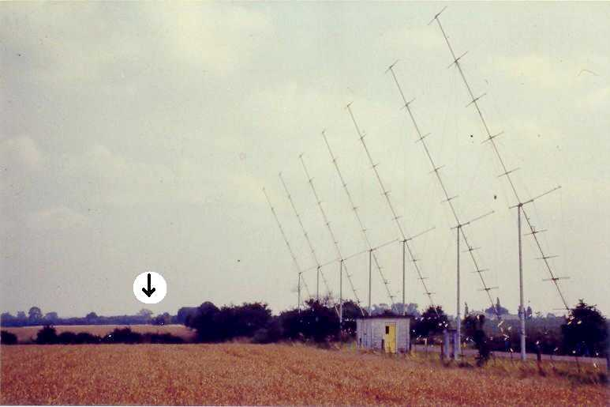
What it looked like

Slide 6
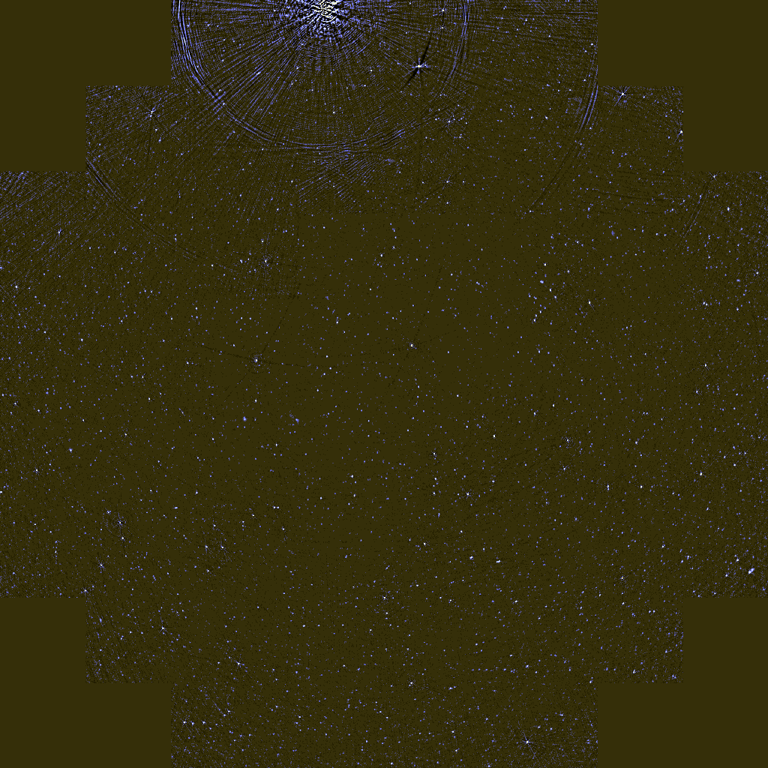
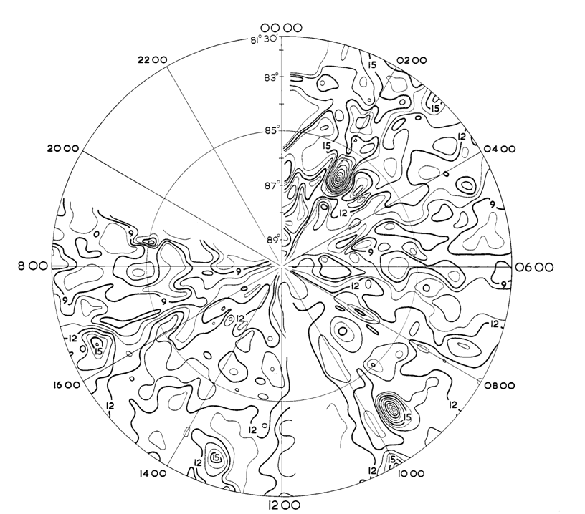
Result

Slide 7
Personal History (continued)
1989-90: Built a dual beam CCD instrument for the WHT
1991: Alan Bridger hired me to support the UKIRT TCS
1991-1996: Software on the UKIRT Upgrades Program
1994: Started using EPICS
1996: Alan left, and I took his job (Head of UKIRT Software)
Oct 1996: Commissioned UKIRT Upgrades
Apr 1997: Raised a project to re-write all UKIRT Observatory Control and Data Reduction Software (ORAC)
1999: Merged JCMT and UKIRT software groups (Head of Software and Computing)
Jan 2000 JCMT Observatory Control System (OCS) put on hold
Apr 2000 JCMT OCS project reformulated
Aug 2000 ORAC released, new JCMT TCS released
Nov 2000 JAC Observation Management Programme (OMP) started
Aug 2002 Release of the OMP

Slide 8
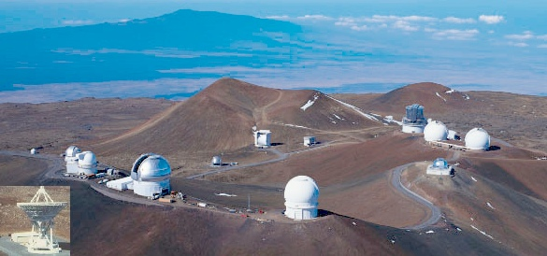
The Mauna Kea telescopes
JCMT
UKIRT

Slide 9
Personal History (continued)
Nov 2004 – Feb 2016
Moved to Diamond Light Source
Large EPICS site with lots of variety
Two roles:
Head of Beamline Controls
Beamlines are effectively ~£10M scientific opto-mechanical x-ray systems, a bit like small telescopes, but there is > 30 of them on one site.
Head of Science Computing
Beamlines generate a significant amount of data and the computer systems have to be able to process the data in real time.
29 Feb 2016 –
Head of Computing and Software at the SKA
Responsible for computing and software domain expertise across the whole SKA
Also responsible for all Enterprise IT.

Slide 10
Systems that have influenced me

Slide 11
EPICS
EPICS has, overall, worked well for me
It scales very well and helped me build robust systems
Astronomy, however, is different, and this explains the reasons for EPICS’s mixed success.
A synchrotron is essentially an horizontal steady-state system whilst astronomy is a vertical, frequently reconfigured system
Astronomy needs a distributed object layer with remote method invocation somewhere.
Similar to synchrotron beamlines.
When adopting a new tool, you have to work with its strengths, and not its weaknesses, and be prepared to change your own paradigms, if required.

Slide 12
NSLS-2 Architecture
MMLT Client
Scripting HLA Client
Control System Studio
Completed
Early Development
Being Extended
PVAccess/CAC
PVAccess/CAC
PVAccess / CAC
Ethernet
PVAccess
PVAccess
PVAccess
PVAccess/CAC
PVAccess/CAC
PVAccess/CAC
Multi-Channel Arrays Svr
Save/Retrieve Server
Magnet, Resp Mtx, etc..
Middle Layer Servers
Model Server
Lattice Server
Channel Finder Svr
Save/Compare Restore Svr
Elegant/Tracy
SQL
SQL
Serves orbit, magnets, any array of channels
SQL
SQL
RDB
RDB
RDB
RDB
PVA
CAS
PVA
CAS
PVA
CAS
PVA
CAS
PVA
CAS
PVA
CAS
Utilities etc..,
Diag & PS
Distributed Front-Ends
Diagnostics
Power Supplies
RF
Vacuum
Physical Device
Physical Device
Physical Device
Physical Device
Physical Device
LS2 Simulation

Slide 13
Tango
I have known the Tango community since attending a training course on Tango in 2005.
I have had regular interactions since then.
It is a distributed object layer with remote method invocation…
So a good fit to Astronomical applications
Quite similar to the DRAMA system we used at the JAC in a similar place in the architecture.
I understand it is quite similar to the KAT control system as well.
I am very happy with the Tango choice, and agree that it should be adopted throughout the SKA and not just inside TM.

Slide 14
Keck Control System - 1
The problem with distributed hierarchical state

Slide 15
JCMT Control System
The problem with centralized top-level control

Slide 16
Diamond
EPICS provides far too wide an interface for instrument control.

Slide 17
JAC Observatory Systems
UKIRT ORAC (OCS + DR)
Problem: Each successive instrument had its own control system and data reduction system.
JCMT OCS
Problem: Spaghetti code of control scripts had too many rendezvous points and hence was inefficient parallel system.
JAC OMP
Problem: Flexible observing required a huge amount of manual coordination,

Slide 18
JAC Observing
Model
Observation Preparation
Schedulable Blocks
Observation Database
Obs. Management
Observation Selection
System Configurations
Observation Translation
Pointing + Focus
Observation Sequencing
Ancillary Control System
Telescope Control System
Instrument Control System
Data Handling
Data Reduction
(Feb 2001)

Slide 19
Observation Management Process
Off-line Functions
Proposal
Proposal Submission
PI
Proposal Reviewer
Accepted Proposal
Coordination
Semester Queue
Operations Designer
Observation Preparation
Project + SB Definition
Observation
Planning
Operations Planner
Project + SB Definition
Schedule
On-line Functions
Observation
Scheduling
TOO Events
SB Scripts
Start SB
Telescope Operator
SB Scripts
Observation
Execution
Telescope M&C
TM Prep
TM Scripts TM M&C Defs
Telescope Manager

Slide 20
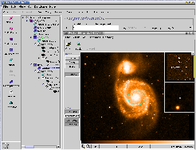
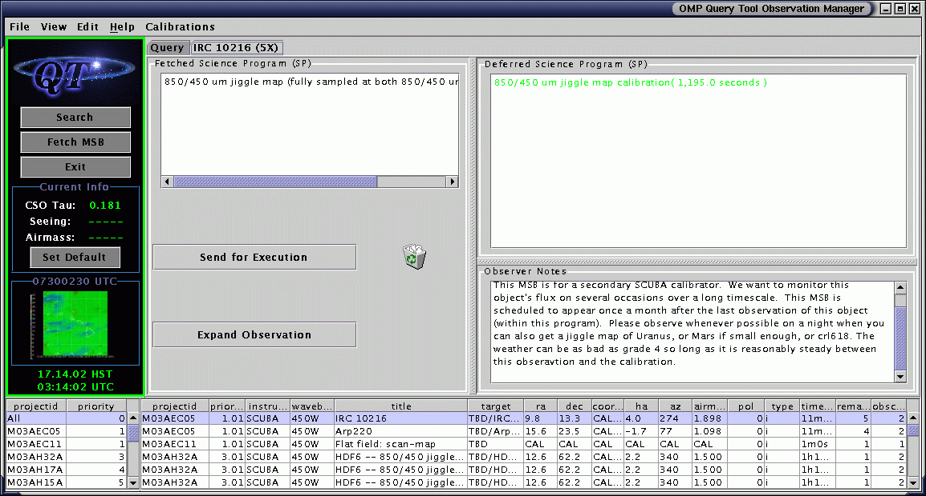
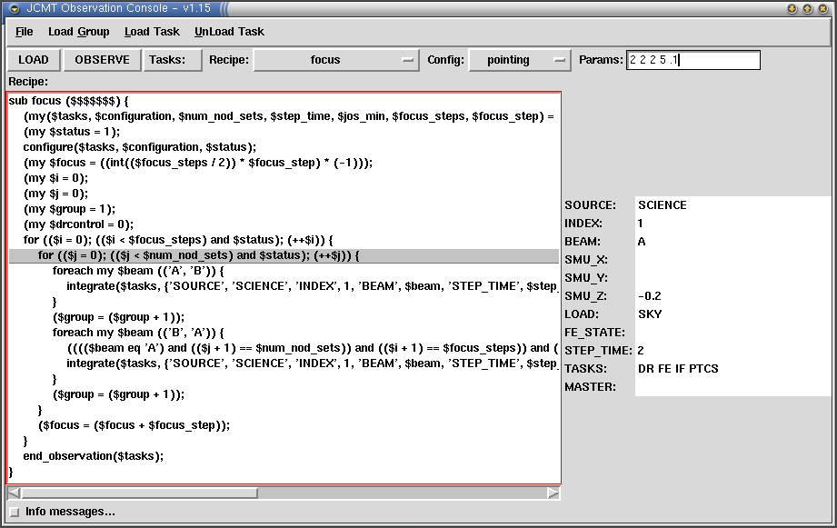
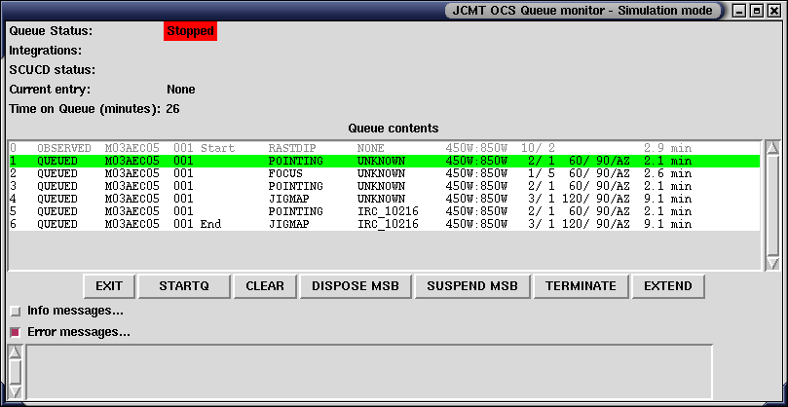
JCMT OCS Block Diagram
Observing Tool
Query Tool
Queue Monitor
Observation Monitor
Science Programs
MSB’s
Observation List
Observation
Instrument Manager
Observation Database
MSB
Observing Queue
Inst. “A” Sequencer
Inst. “B” Sequencer
Observation Translation
Instrument “A” Tasks
Shared Tasks
Instrument “B” Tasks
System Configurations
Configuration Files

Slide 22
New Design
Since observations are fully defined, we changed all sub-system interfaces so they had a common set of simple commands:
CONFIGURE
Send a complete XML observing definition to each sub-system.
SETUP_SEQUENCE
Send just the few parameters which indicate how the next integration differs from the current configuration.
SEQUENCE
Execute the integration sequence - i.e. take data.
On JCMT we have a real-time sequencer that takes over here.
END_OBSERVATION
Needed to close up an observation.
SCAN
SCAN

Slide 23
New Design
All commands are broadcast to all participating systems
An important observing recipe parameter is the “tasklist” - a list of the participating sub-systems).
In general, all tasks on the list receive all the commands.
To first order we don’t care how the sub-systems sequence themselves, we just want them to be ready when data taking starts.
The observing recipes contain no detailed sequencing.
In reality, there are some dependencies, and this is handled by a rendezvous protocol in which a task can wait until a specified task is ready.
We found didn’t need multiple levels of rendezvous.

Slide 24
First Impressions of the SKA

Slide 25
Traps to avoid
Maslow’s Law
“I suppose it is tempting, if the only tool you have is a hammer, to treat everything as if it were a nail”
Your background is your personal hammer.
Conway's Law
“Organizations which design systems ... are constrained to produce designs which are copies of the communication structures of these organizations”
Ego eats brains
e.g.: “My way or the highway”

Slide 26
Avoiding Conway's Law
Must generate a monitoring and control software architecture that is independent of the SKA work packages.
The software will last a lot longer than the work packages.
The architecture will be layered, with tasks at similar layers having similar interfaces.
We need to design these interfaces.
The work package interfaces may lie at different levels in the architecture and so have different interfaces.
Hence, we need to work out where in the architecture each work package interfaces lies.
This variation is acceptable, since there are few work packages.
In contrast, ITER, for example, has ~207 distinct plant systems with ~140 separate Procurement Arrangements, so they need to have much more rigid interface control at the work package level.

Slide 27
Telescope Operations Concept
Operations Concept Document is now available
Contains few surprises, but does write down a lot of information for the first time.
There is also a “Dish Pointing, Motion Behaviour And Control” document that may be more surprising.
Dish control will be more like a single dish system than an interferometer

Slide 28
Telescope model
This is difficult, and may need to be broken up. e.g.:
The telescope state.
A software representation of the real world as a function of time. Possibly represented by the time-stamped Tango Attributes in the system, with the archiver providing persistence.
The telescope status.
A rolled up status of the statuses of the sub-system hierarchy. Possibly represented by an enum attribute in each Tango device server
May also be returned as a result of method invocation.
The atmospheric state
May or may not be a subset of the telescope state.
Telescope simulator or emulator.

Slide 29
Authentication and Authorization
I believe this is an SKAO responsibility
Is required by most work-packages, but must also integrate with the Enterprise system as well.
I propose to define some top level requirements and then contract it out.
The TM A&A requirements document is a good basis for the requirements.
The contract may be to individuals involved in TM, but it will be separate from TM
At the moment work packages should assume that A&A will present a standard Linux interface, and will also be available to web services.

Slide 30
Assembly, Integration & Verification
AIV has been hardware dominated until now.
Possibly because of the lack of software resource at SKAO.
Need to understand how much capability is needed when.
There are also no L1 requirements on:
Software dependency uniformity
Software quality (testing, code coverage, development practice).
Software deployment
Amongst the work there has been some convergence
Git is understandably the favorite code control system.
However, we also need to cover a lot of other areas:
I see your review expresses some ideas, and I would welcome proposals as to what form the requirements should take.

Slide 31
Software domain specialists
The SKA is a software telescope.
It is arguably the worlds biggest scientific software project
SKA-LOW, in particular, is effectively a huge computer system interfaced to a lot of bent wires with some fast ADC’s.
However, SKAO has only had a maximum of one dedicated software domain specialist on staff.
I now have permission in principle to hire two more…
In contrast, Diamond was largely domain specialists, managers, technicians, and administrators
Very few project managers: only ~1 during construction
It has never employed anyone who is a systems engineer in the SKA sense.
However, it was the UK’s largest scientific investment and was delivered on time and on budget.
Lead to a waterfall, rather than agile set of processes

Slide 32
L1 requirements traceability
The is no clear traceability for many of the L1 requirements. For example:
UTC: Only reference to absolute time is via UTC. WTF?
Models. What are they really?:
SKA1-SYS_REQ-2645 Telescope Model
SKA1-SYS_REQ-2302 Single geodetic model (Telescopes).
SKA1-SYS_REQ-2303 Single geometric model.
SKA1-SYS_REQ-2304 Dish pointing model.
SKA1-SYS_REQ-2305 AA element and station beam model.
SKA1-SYS_REQ-2322 Global sky model.
SKA1-SYS_REQ-2646: API for construction of schedule. There shall be an API or APIs for the construction of scheduling blocks from Python and Java.

Slide 33
Monitoring and Control
Control and Monitoring are different:
Control:
Low data rates
A clear hierarchy
Single point of top level control
Commands go down
Aggregated statuses go up
Need a clear understanding of semantics up and down the tree
Not necessarily running all the time
Monitoring
Intermediate data rates
No restriction on who can monitor what
Clients only monitor the subset of monitor points that they need
Don’t want to hide access to any data from any client.
Simple semantics
Always available all the time

Slide 34
Sub-arrays and commensality
These add complexity that is not normally seen in single dish systems.
However, JAC and Gemini telescopes had the concept of running multiple virtual telescopes simultaneously
TELMGR should not place a restriction on the number of sub-arrays – they are just multiple instantiations with different contexts.
Should just query the underlying systems to discover if they are currently capable of running a new context for a given configuration
OBSMGR should understand or be able to model the capacity for planning purposes, but shortcuts could be taken.

Slide 35
Design considerations

Slide 36
Conclusions
I am a month into the job and I am still learning fast.
I am daunted and humbled by what the SKA is planning.
The politics adds complexity, but there are a lot of great people and good relationships, and these are the greatest strength and need to be preserved,
Bring on the challenge!

Slide 37
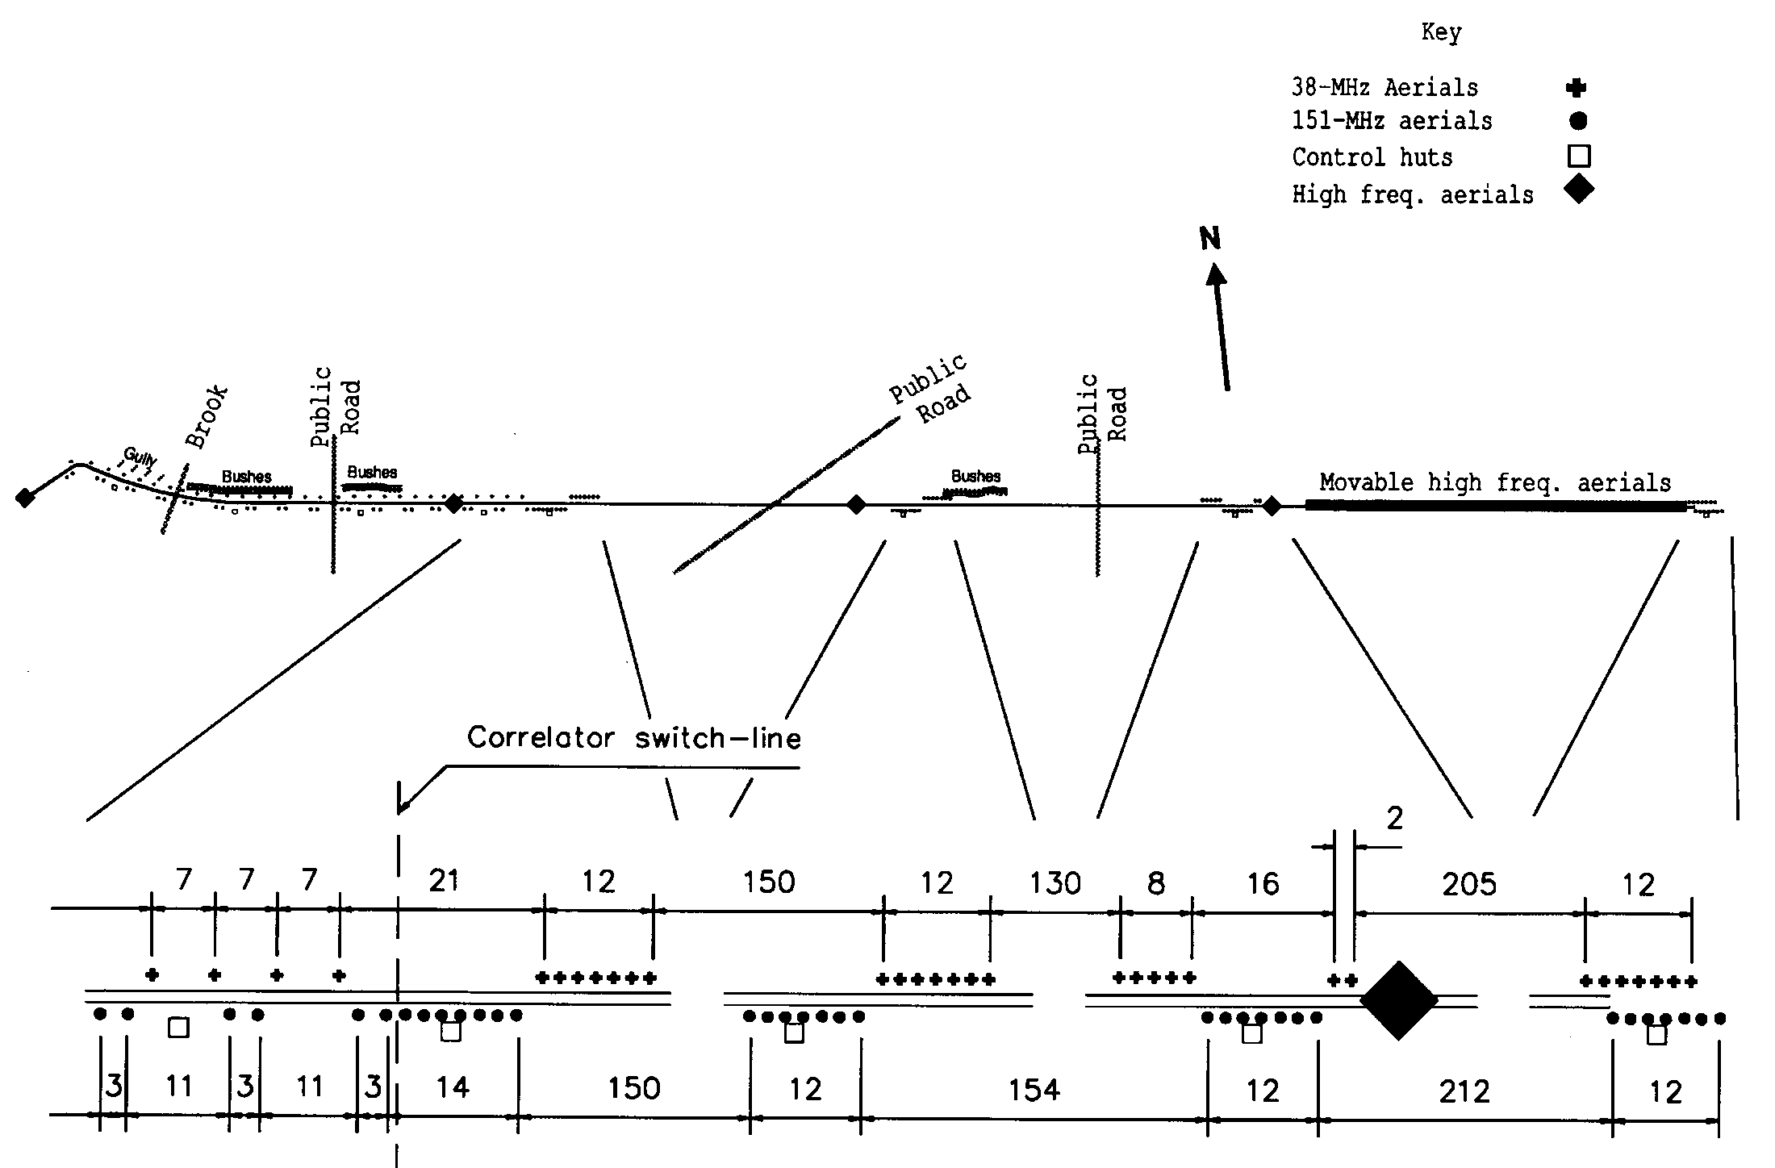
Layout

Slide 38
The 38 MHz Survey
Scientific requirements:
“To provide a survey of the region around the NCP comparable to the 151 MHz 6C survey, but a factor of 4 lower in frequency”
Technical requirements:
Low technology and low risk
Quick - duration of a Ph.D. thesis (and a solar minimum).
Cheap £50,000 (1985)
Fit on the Lord’s Bridge site
Overall:
An order of magnitude better in resolution and sensitivity than previous comparable surveys.

Slide 39
My contribution
Help plan and coordinate the work
Repaired damage and improved design
Ran the observations
Rewrote all the MRAO software to turn the visibilities into a map
Modelling and removal of the ionosphere
Bright source removal
Interactive viewing and processing
Map making
Data processing pipeline
Wrote software to analyze the maps, extract sources, calibrate flux densities and produce paper.
One small sign error ☹

Slide 40
New design of the OCS
Requirement is for a highly automated system, not a manually controlled one
Control is done at a higher level (observation queue).
Commands are optimized for machine control, not human control.
Observing tool allows all subsystems to be given their complete configuration at the same time.
Small variations from the fixed configuration are broadcast before each data taking sequence.
Don’t care about “micro-managing” the control of sub-systems, just focus on synchronizing them so they are all ready when data taking starts.

Slide 41
Commands: CONFIGURE
Takes a single parameter which is an XML file.
File is generated by the translator, and maps onto the XML generated by the OT reasonably well.
File completely determines default instrument state for the observation.
Sub-system moves into default state as a result of configuration, but can return immediately, if desired.
Must set task parameters that are be needed in SETUP_SEQUENCE by other tasks.
Same file could be sent to all sub-systems but, in practice, only subsets will be sent for efficiency.
SCAN

Slide 42
Configuration Files
Use XML, which gives the following advantages
Widely accepted standard
No language bias
Document Type Definition (DTD) and XML Schema documents allow XML to be validated.
Hierarchical structure allows data to be ‘packaged’.
Observation configuration can be viewed as one monolithic file, or a number of small ones which are “included” (XML entities).
OCS DTD is at:
http://www.jach.hawaii.edu/JACdocs/JCMT/OCS/ICD/001/ocs.dtd

Slide 43
Configuration Files
The observation configuration is broken into a number of sections:
HEADER_CONFIG
TCS_CONFIG
INSTRUMENT
RTS_CONFIG
FRONTEND_CONFIG (Heterodyne only)
ACSIS_CONFIG (Heterodyne only)
For example:
http://www.jach.hawaii.edu/JACdocs/JCMT/OCS/ICD/001/ocs.xml

Slide 44
SETUP_SEQUENCE
SCAN
Manages the state transition between sequences.
Small (~10) number of well-defined parameters.
One parameter is the master task which synchronizes the start of observation
This task can return early, but all others must be completely ready to observe before returning.
Tasks can place constraints on the length of the next sequence, if required.

Slide 45
SEQUENCE
SCAN
Actually performs the data-taking
Three parameters
START: Start sequence number - between 1 and 2³²
END: End Sequence number - between START and 2³²
DWELL: The number of RTS transitions (and sequence numbers) between each state transition of the sub-system.
Hands control over to real-time sequencer
CONFIGURE XML file and SETUP_SEQUENCE parameters define the state table to execute.
Rendezvous on first RTS handshake starts observing.
Only one task (the master) can delay the handshake significantly.

Slide 46
END_OBSERVATION
Signals everyone that the current observation is finished.
Data files are closed and systems wait for next commands.
Another observation will require a new CONFIGURE command, so END_OBSERVATION is normally followed by getting the next observation off the queue and another CONFIGURE command.

Slide 47
What do I remember?
Endless arguments about structure of the configuration file.
Actually, these were the control ICD discussions…

