Slide 1

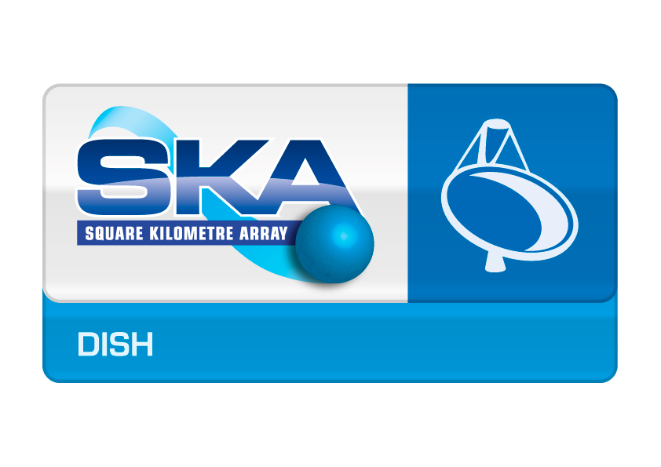
DISH LMC
Corrado Trigilio
LMC Harmonisation Workshop
Madrid 11-13 April 2016

Slide 2
Outline
DSH LMC Team
Dish Overview – SKA-Mid
DSH LMC High level Software architecture
  PBS
  DSH LMC SFW specifications derivation from requirements
  Example for Pointing functions

Slide 3
DSH LMC team
INAF – Italy
Catania, Trieste, Noto
Corrado Trigilio,
Adriano Ingallinera, Alessandro Marassi, Simone Riggi, Francesco Schillirò
Veronica Baldini, Ugo Becciani, Salvo Buttaccio, Igor Coretti, Alessandro Costa, Gaetano Nicotra, Carlo Nocita,
JLRAT – China
Shijiazhuang
Zhang Yifan
Zhang Qiang, Qiao Jianjiang,
Geng Xuguang, Zhang Bing,
Chen Long

Slide 4
SKA1 Mid
Science Drivers
21-cm HI-line: evolution of galaxies, (local, z ~ 0 to Hi z)
All southern sky survey to detect all pulsars at 1400 MHz out to a distance of 10 kpc.
Follow-up observations of detected pulsars at high resolution (<20 mas resolution).
Carrying out a decade long timing campaign to time most detected pulsars and others.
Other Science objectives:
Cosmic magnetism
Star formation history
Cradle of life
Exoplanets
SETI
Transients (GRB, FRB, SN…)
GW with pulsars
AGN, radio jets
…other unknown?...

Slide 5
SKA1-MID After Re-baseline:
After Re-baseline:
SKA Survey in Australia deferred
PAF deferred
Inclusion of high frequency band in the first phase (from both Gal and extraGal science needs)

Slide 6
After Re-baseline:
SKA1 Mid
Location: Karoo in SA

Slide 7
After Re-baseline:
SKA1 Mid
Location: Karoo in SA
Array Configuration:
3 spiral arms,
high density at center
Max Baseline: 150 km

Slide 8
After Re-baseline:
SKA1 Mid
Location: Karoo in SA
Array Configuration:
3 spiral arms,
high density at center
Max Baseline: 150 km
Aperture: 32 664 m²
(3% of 1km²)
197 dishes
  133 SKA 15 m
  64 Meerkat 13.5 m

Slide 9
Dish Structure – Antenna
Design:
Gregorian reflector, offset, unblocked aperture;
Main reflector projected diam : 15m
Feed-arm down;
Feeds at secondary focus
Sub reflector diameter 5m
Projected aperture
Requirement
Notes:
9

Slide 10
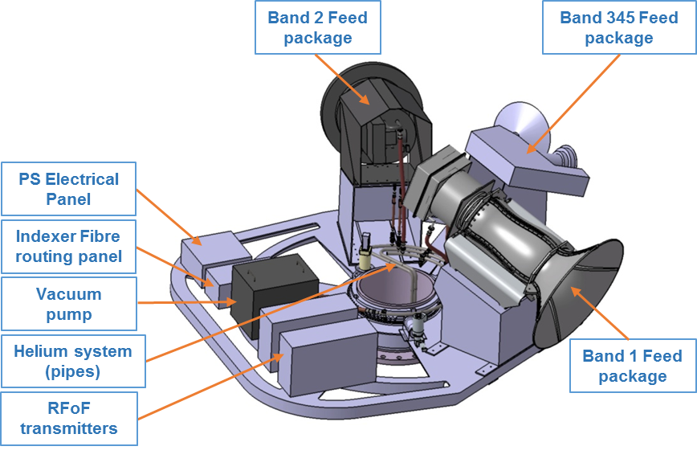
Dish Structure – Antenna
Design:
Gregorian reflector, offset, unblocked aperture;
Main reflector projected diam : 15m
Feed-arm down;
Feeds at secondary focus
Sub reflector diameter 5m
Structural members either consist of mild steel or CFRP.
The panels consist of aluminum.
CFRP: Carbon Fiber-Reinforced Polymer
Sub reflector
Main reflector
Feed indexer
Backup Structure
Pedestal
Notes:
10

Slide 11
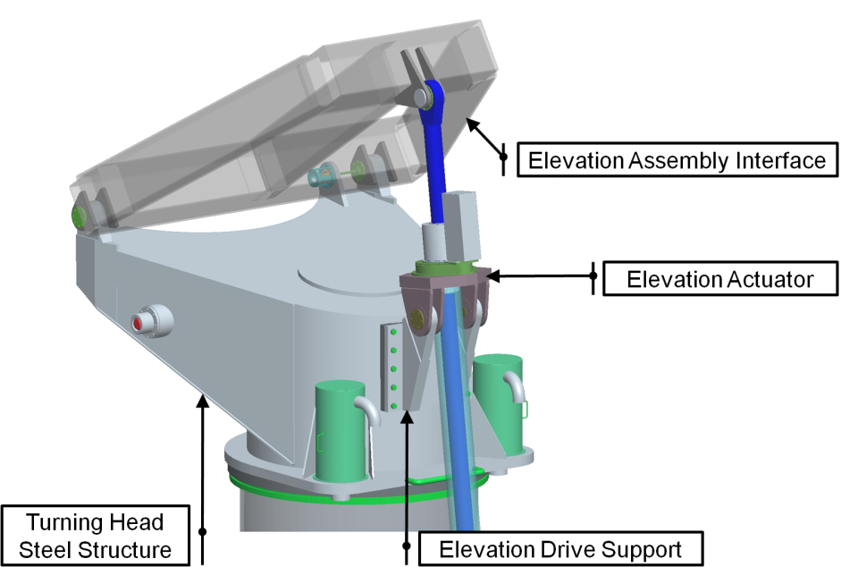
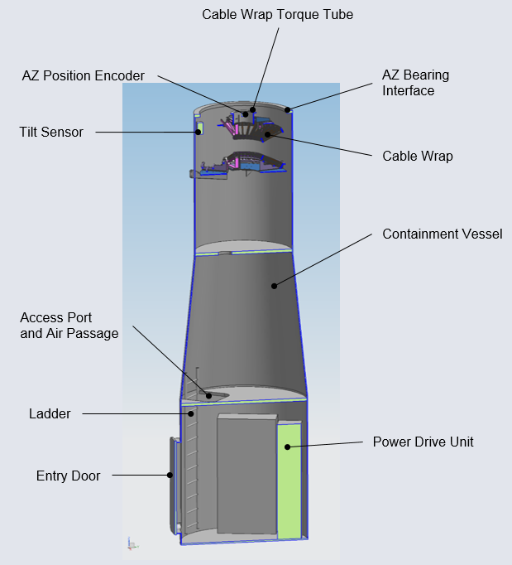
Dish Structure – Pedestal
Shielded compartment (80dB)
Double shielding enclosure inside another enclosure (high risk posed by the high speed digital electronics in the pedestal, and the proximity to the antenna focus).
This reduces the risk of self-induced RFI for the Dish and SaDT equipment located at the Dish.
Cooling: outside ambient air ventilation
-no air conditioning (save $) - TBC
Fans for each controller
^{Turning Head and}
^{Azimuth Bearing}
Operating Conditions
Rack with:
DS Control System
SPF Controller
SPFRx Receiver Pedestal Unit
DI PSC Fibre Routing Panel
LMC Hardware
SaDT equipments
DS Controller will use TANGO?
Notes:
11

Slide 12
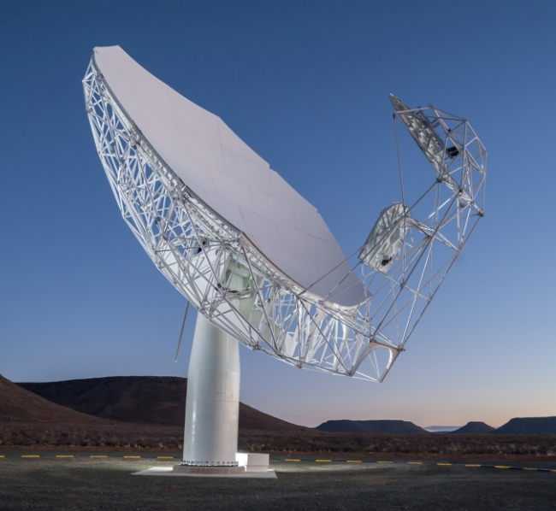
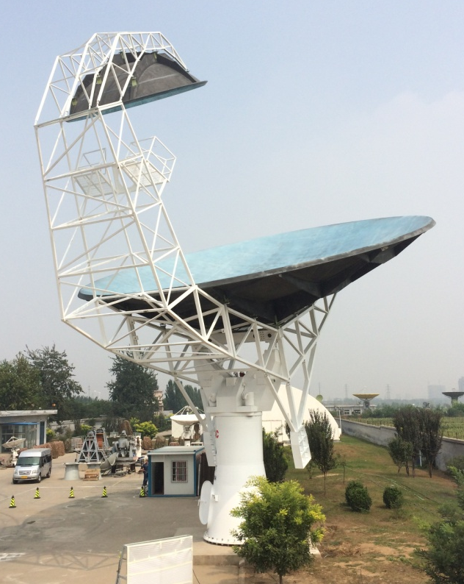
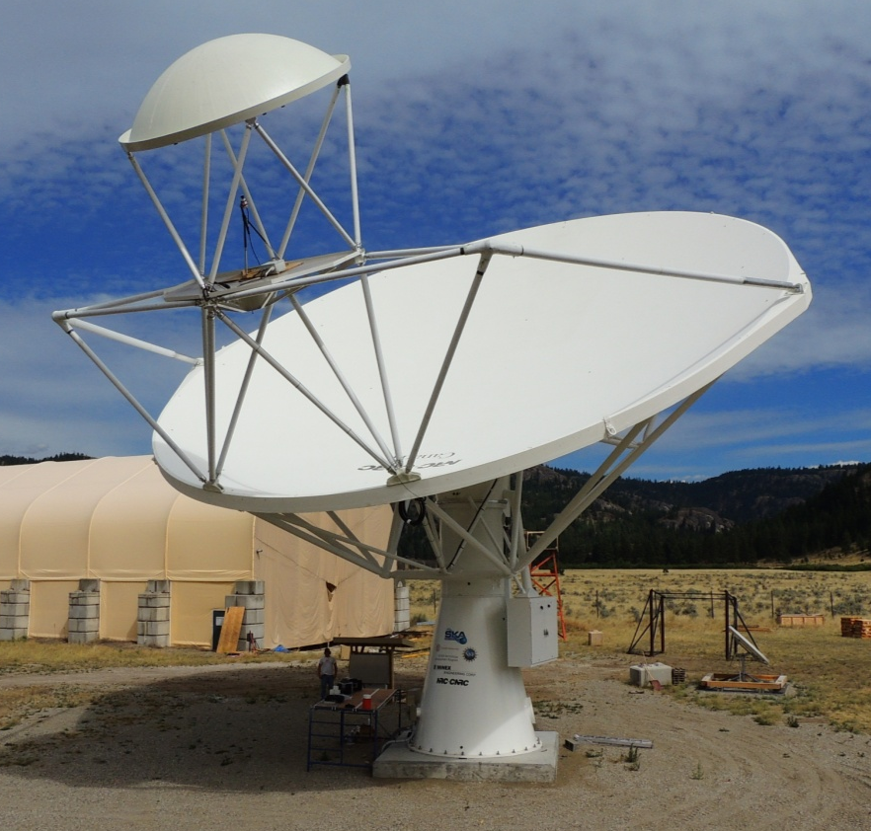
Previous Dish Prototypes
MKT-1:
South Africa
March 2014
DVA-C:
JLRAT China
August 2014
DVA-1:
NRC Canada
July 2014

Slide 13
SKA-Mid: SPFs - Bands
High priority bands for SKA-1 construction
Frequency Coverage for SKA1
SPF Bands
  2: 950-1760 MHz
  5: 4.6-13.8 GHz
  1: 350-1050 MHz
  3: 1.65-3.05 GHz
  4: 2.8-5.2 GHz
Priority
2
5
1
SKA LOW
Log Freq/GHz
Band 5 considered as high priority after scientific meeting in Naxos,
(galactic and extragalactic science)
and re-baseline

Slide 14
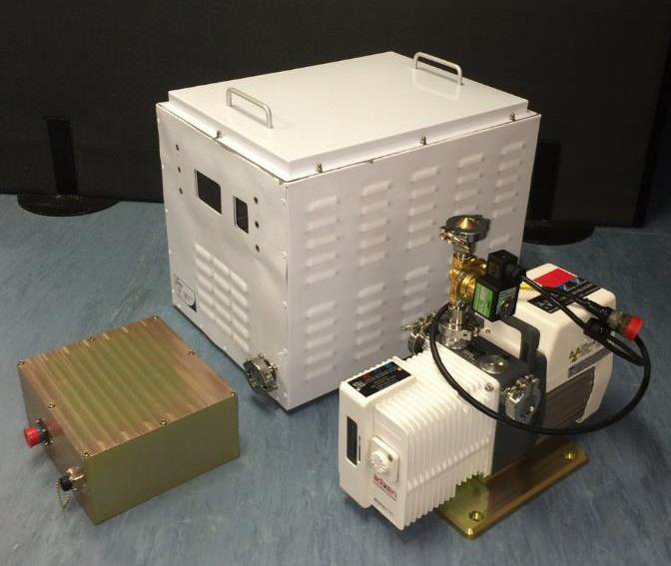
SKA-Mid: SPFs - Bands
Band 2 feed horn design
Cryo system
Band 3,4,5 Common cryostat → Band 5 only for SKA1
Band 1 feed horn prototype
Uncooled Feed and LNA
MeerKAT
vacuum assemblies

Slide 15
SKA-Mid: SPFs - Bands
Band 1 and LNA at room temperature. Two amplification stages, calibration noise.
Band 2 cryostat and LNAs to ~20K. Two amplification stages, calibration noise.
Bands 3, 4 and 5 in one cryostat. For Band 5 the entire system will be cooled.
He System: Common He system; single He compressor and supply at yoke.
Vacuum System: Rotary vane vacuum in indexer; vacuum lines to all SPF.
Controller: in pedestal to C&M all three SPFs, He and vacuum systems, interfaces with the Dish LMC for external control and monitoring, uses Tango
MeerKAT
vacuum assemblies
SPF Band 1
SPF Band 2
SPF Band 3,4,5

Slide 16
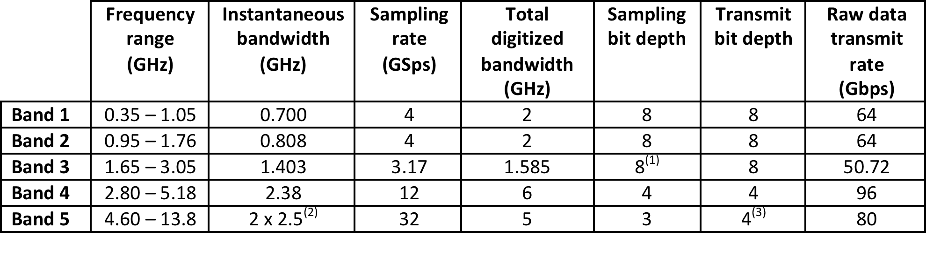
SKA-Mid: Receivers
From SPF to RX (location):
Pedestal with RFoF links from feeds
Master Clock timer :
time and frequency reference (SaDT )
control of the calibration noise source
Digitisers:
RF conditioning (filtering and level control).
Bands 1-3 direct digitised (1 and 2 in the 1° and Band 3 in 2nd Nyquist zone)
Bands 4 & 5 are band selected and direct digitised
Band 5, two individually tuneable sub-bands of 2.5GHz bandwidth, direct digitised
Data packetised and transmitted to CSP
Controller:
in pedestal
Uses Tango

Slide 17
LMC physical overview
Blue: internal sub-elements and connections
Red: external elements and connections
Green: power links
Functional
External: TM
Internal:
    SPF
    Rx
    DS

Slide 18
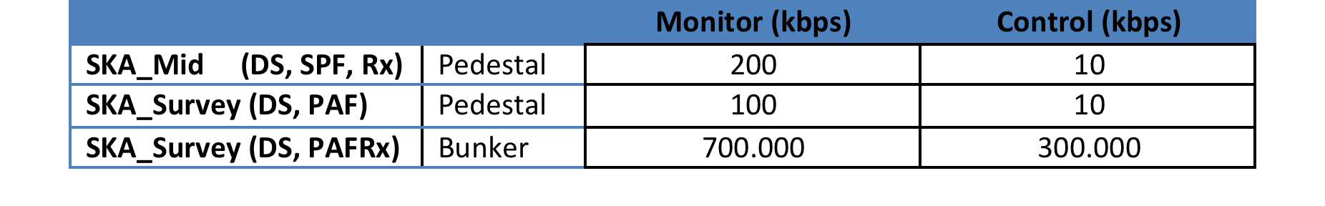
Data rate for SKA_Mid

Slide 19
DSH Product Breakdown Structure

Slide 20
LMC.SFW Product Breakdown Structure
11 software blocks
Different functionalities

Slide 21
Sub-element Monitor & Control Interface Manager
PBS: ISE
implementing communication with the controllers of SE according to the internal ICD
providing commands to control SE systems
receive monitoring data, event and alarms from SE systems
providing a stream of monitoring data/event/alarms towards other LMC packages higher in the functional hierarchy
If all SE use TANGO, the ISE block will be almost transparent
Interface with Dish Structure controller (Antenna ACU, Indexer, sensors…)
Tango??? Hope!
Interface with SPF Receiver (digitaliser, time and freq, noise cal) controller)
Uses TANGO
Interface with Single Pixel Feed controller (Pump, cryo system, LNA…)
Uses TANGO

Slide 22
TM Monitor & Control Interface Manager
PBS: ITM
Implement external interface with TM.TELMGT according to the TM-LMC ICD (non well defined).
It contains components handling and dispatching TM.TELMGT commands to internal LMC components, reporting data, metadata, software and firmware versions from LMC components to TM.TELMGT; services interfacing with Telescope Model.
Manages commands from/to/ TM and sends to LMC components
Manages time scheduled commands (non implemented in Tango)
Utilities as message parser and Self Description Data (SDD)

Slide 23
LMC
Self Monitor and Control
PBS: SMC
Monitor and control of the LMC hardware (i.e. disk status, CPU temperatures, ...) and OS system services (i.e. networking, DBs, daemons, ...), start-up/shutdown of the components
Monitor and control of all LMC software components according to predefined hierarchy levels reporting monitoring information and faults to Monitoring

Slide 24
Configuration
Manager
PBS: CFG
Responsible to set monitoring information reporting (level, drill-down...) requested by TM

Slide 25
Monitoring
Manager
PBS: MON
Collecting and aggregating monitoring data (including self-monitoring data), capabilities from dish sub-elements to be reported to TM.TELMGT
processing alarms, logs and events detected in sub-elements and LMC (filtering according to the Log Level in CFG, corrective actions, ...) before sending them to TM.TELMGT.

Slide 26
Capabilty
Manager
PBS: CAP
To identify capabilities and availability of capabilities, to detect missing components in dish sub-elements, to perform mapping of sub-element operating states and modes from internal (to DSH) to external state model (SCM), to derive global states from sub-system states, configure the capabilities.
SKA Control Model (SCM):
SCM Mapper (external S&M notation)
DSH S&M Mapper (internal S&M notation)
Sub-elements S&M Mapper (internal notation)
Capability Manager:
Configurator
Health manager

Slide 27
Pointing
Manager
PBS: PNT
Responsible for executing pointing of the dish. This includes the acquisition of the telescope model and parameters for static and dynamic pointing corrections, acquisition of the sensor values for dynamical pointing corrections, time stamp Az/El interpolation, computation of static and dynamic corrections, sending pointing coordinates to DS, TM and archive.

Slide 28
SAF, ARC, POW
Safety, Archive, Power
Managers
PBS:
Responsible to take safety actions in presence of critical or emergency scenarios for people or instrumentation, such as power failure or TM communication cuts, strong wind at the station…
STOW manager
Monitor power distribution within the dish and capabilities of emergency power supply (UPS status...), allowing power cycling operations on hardware components.
To store and retrieve data from/to the circular monitoring archive.

Slide 29
User interface, Tests,
Integration, Remote Support
PBS: USR
Utilities to build, test, integrate and maintain the LMC software system.
supplying a build and verification suite for the entire LMC software, to be used during development and pre-integration stage
providing detailed emulators of each sub-element controller, including exposed commands, monitored data, alarms and faults to test the sub-element interface package
providing tools to generate emergency or severe failure scenarios to test system response under such circumstances.
providing the LMC GUI tools to view monitoring data in real-time, browse historical data, send commands to sub-element components supporting remote service operations, such software/firmware update, download of circular monitoring buffer and tunnelling capabilities to access engineering sub-element GUIs.

Slide 30
PBS → Requirements → Functions
Iterative procedure
LMC PDR
PBS L5
PBS L6 (draft)
Requirements L4
Funct alloc PBS L4
Spec L5 (HDW, SFW)
PBS L6 (consolid)
Spec L6
Activity, use case,
sequence diagrams L6
LMC DD
PBS L7
Interfaces LMC-LMC
Spec L7
Activity, use case,
sequence diagrams L7
PBS L8 ?
Req L8 ?
Activity, use case,
sequence diagrams L8

Slide 31
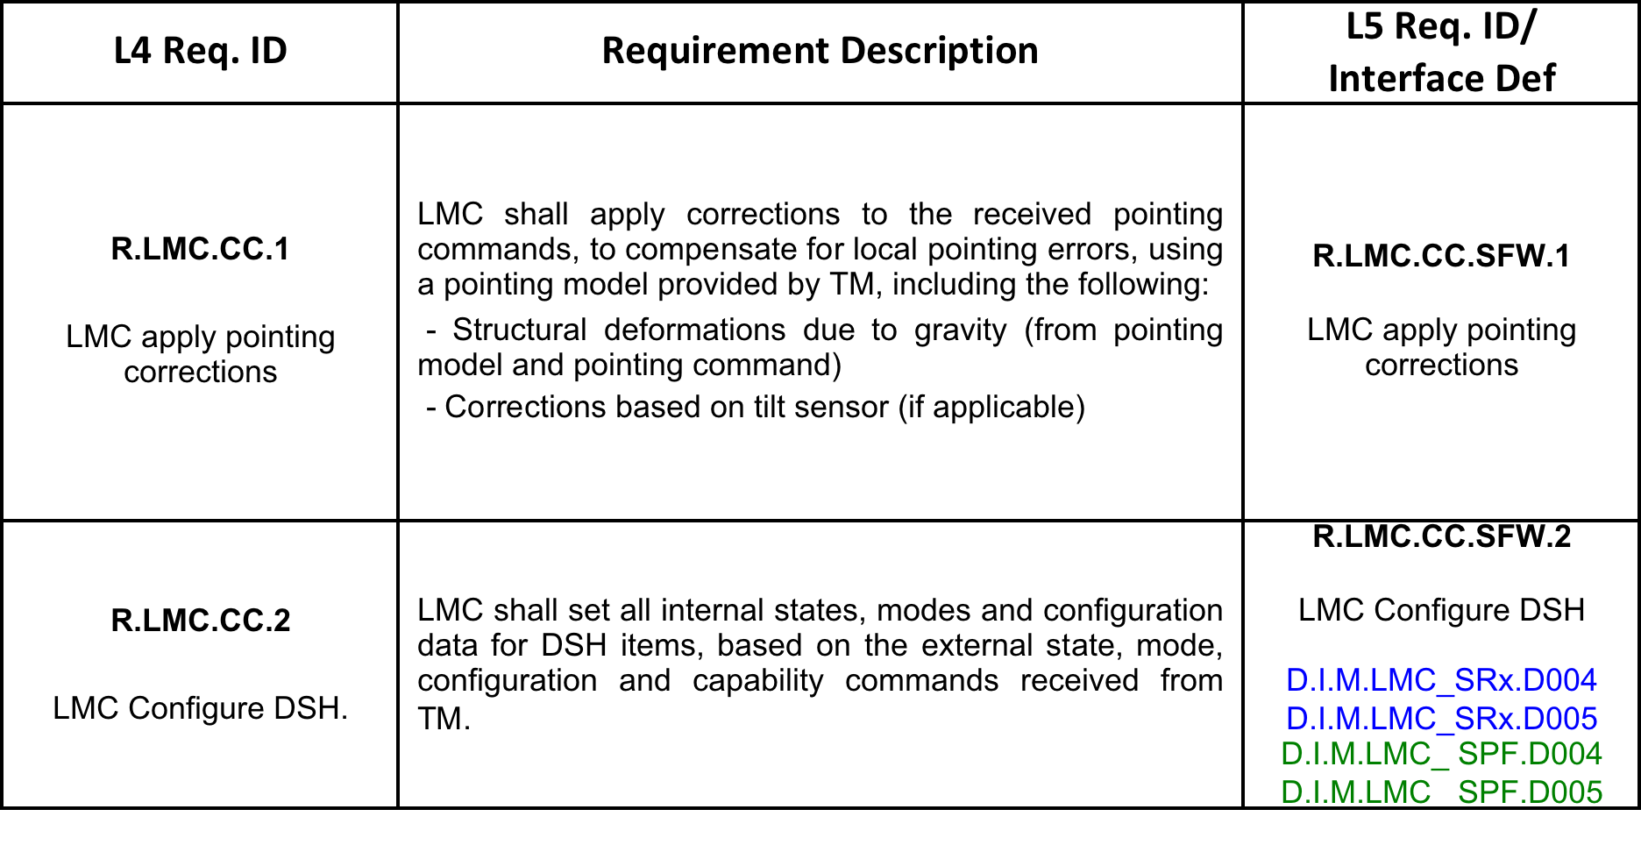

Specifications derivation: L4→L5
From Level 4 Requirements (LMC) to Level 5,6,7 Specifications
Level 5: split specifications for and software…
… and hardware

Slide 32
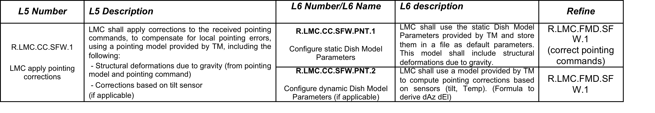
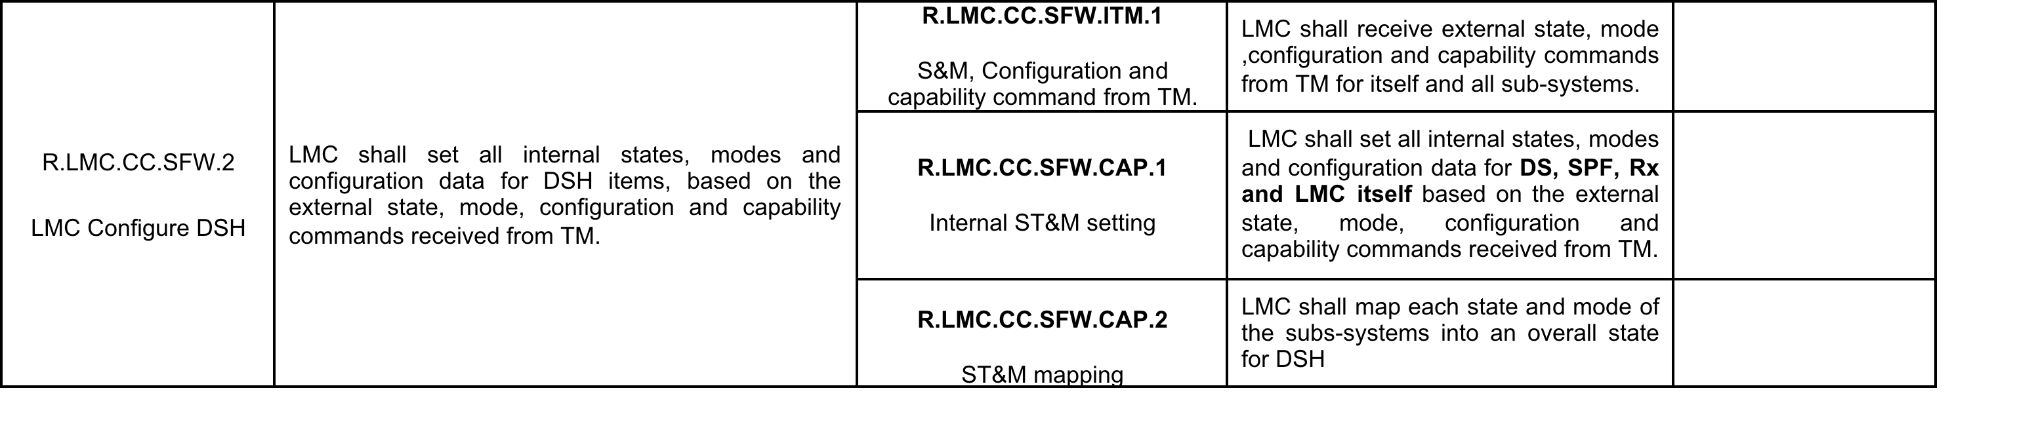
Specifications derivation: L5→L6
From Level 5 specifications (LMC.STW) to Level 6 Specifications
Level 6: definitions for software PBS items

Slide 33
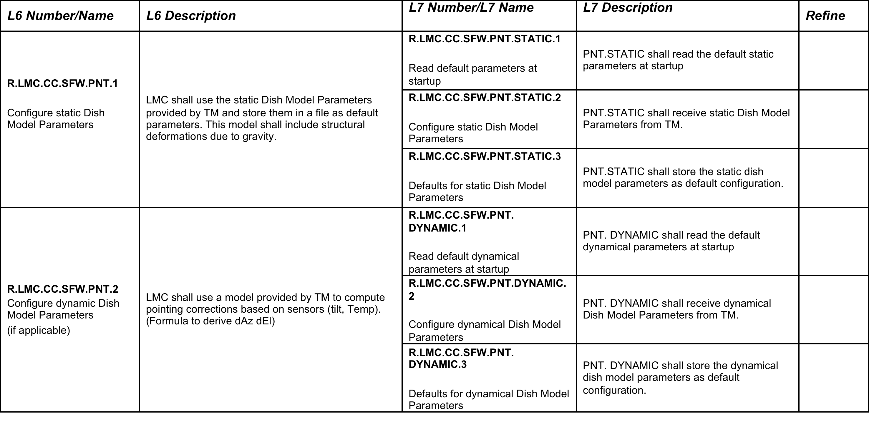
Specifications derivation: L6→L7
From Level 6 specifications (LMC.STW.item) to Level 7 Specifications
Level 7: definitions for components of PBS items (leaf level)

Slide 34
Activity Diagram (example for PNT)

Slide 35

Thanks

