Slide 1

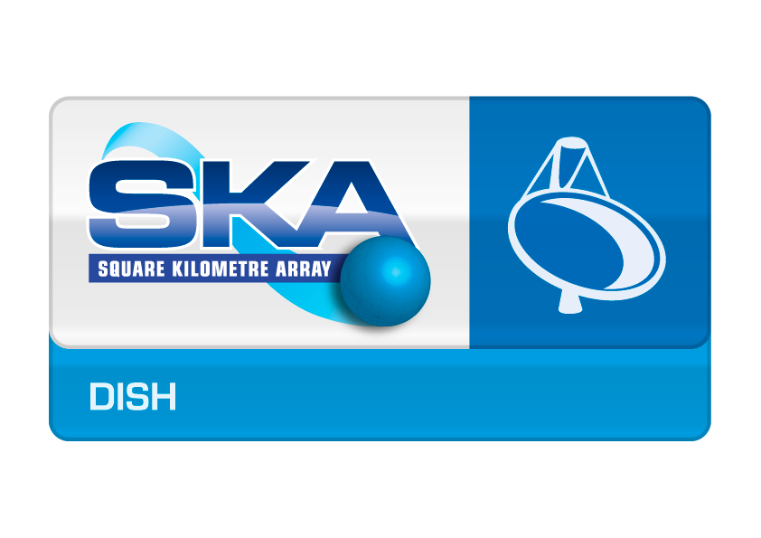
Capability reporting
Francesco Schillirò
INAF- OACT
LMC Harmonisation Workshop
Madrid 11-13 April 2016

Slide 2

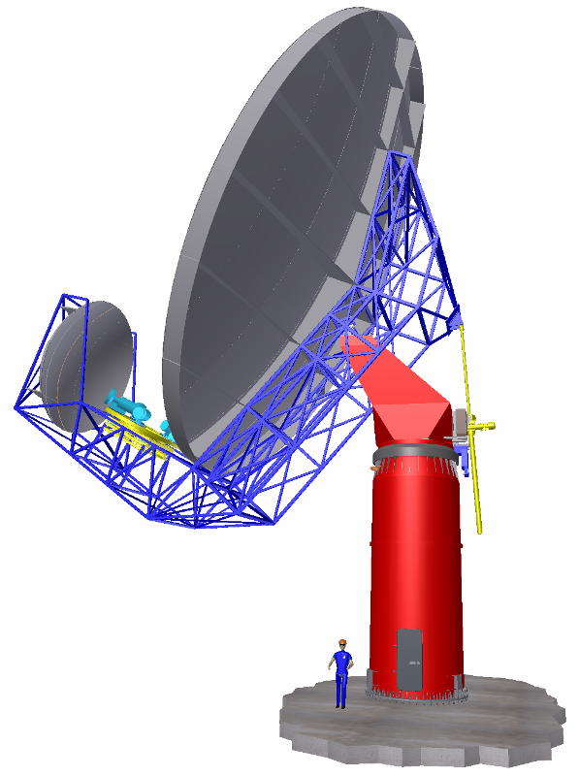
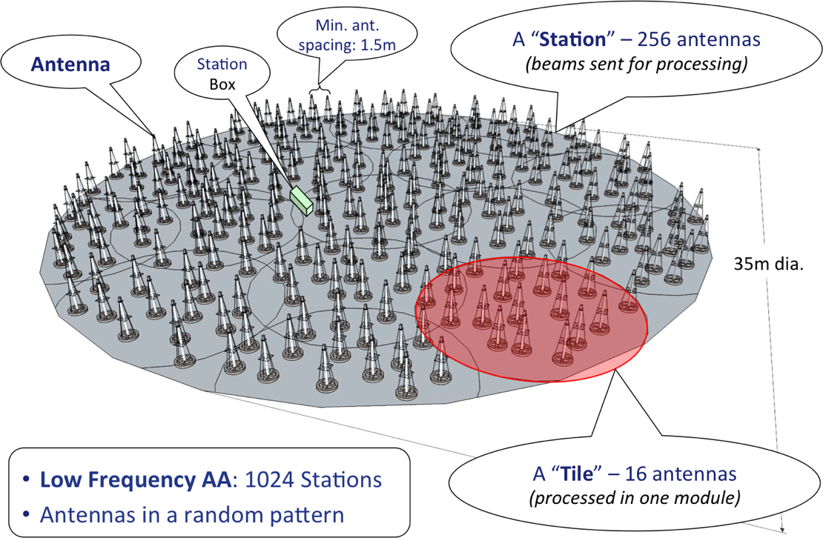
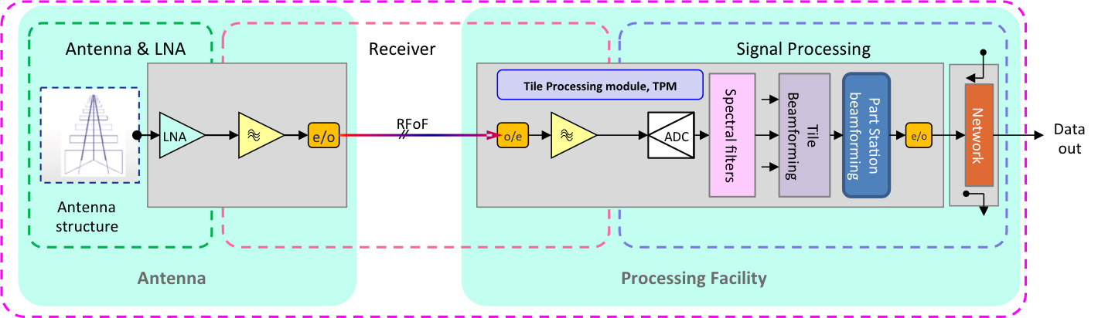
MY EXPERIENCE
Control Software for Noto Radiotelescope
Facilities
DISH-LMC
LMD DISH DESIGN
Digital equipment design
Signal Processing Development
SKA-LOW
DIGITAL PROCESSOR BOARD

Slide 3
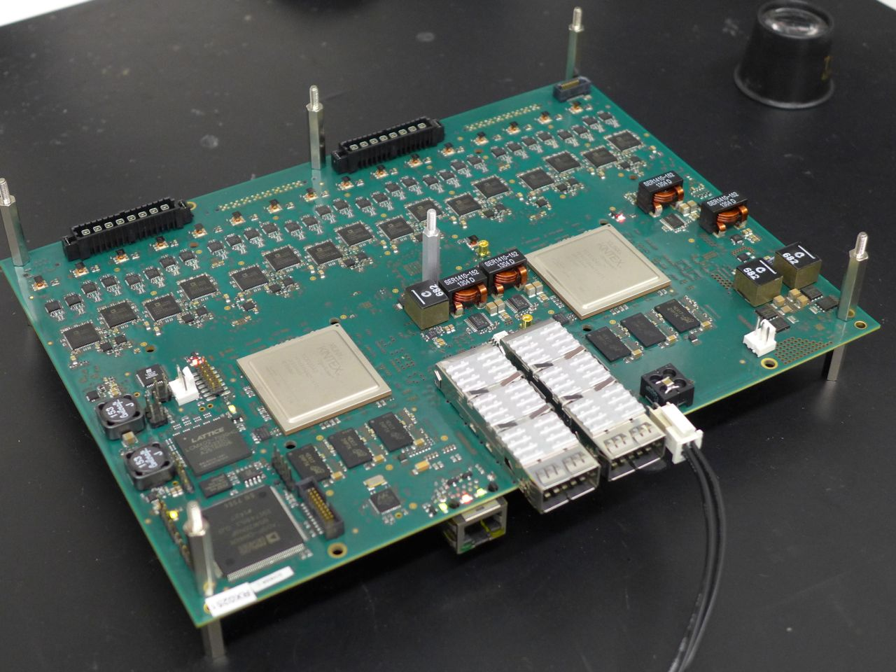












MY EXPERIENCE
ITPM
ITALIAN TILE PROCESSOR MODULE
3 versions designed, produced and qualified (ver. 1.0, 1.1, 1.2)
Version 2.0 engineered for SKA 1
35 ITPM ver.1.2 in production (Italy, Nederland) for AAVS1

Slide 4
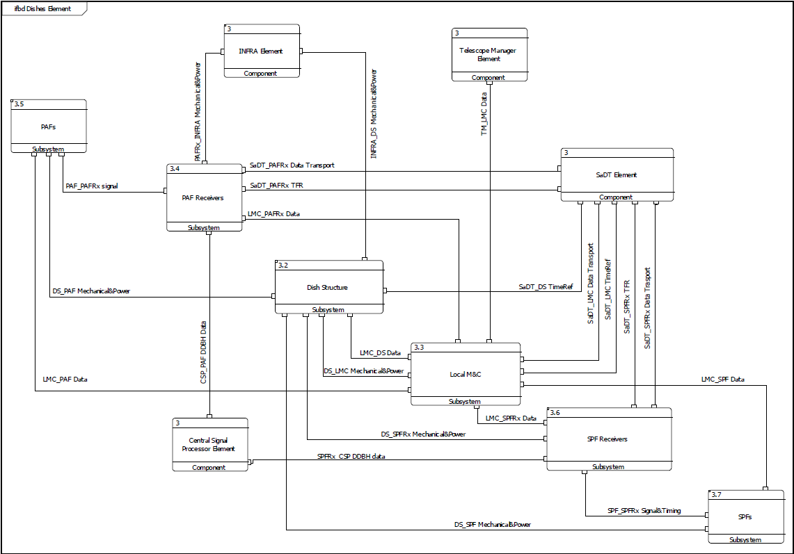
Functional and Fata Flow
MID and Survey
Internal Interface
(sub-elements)
External Interface

Slide 5
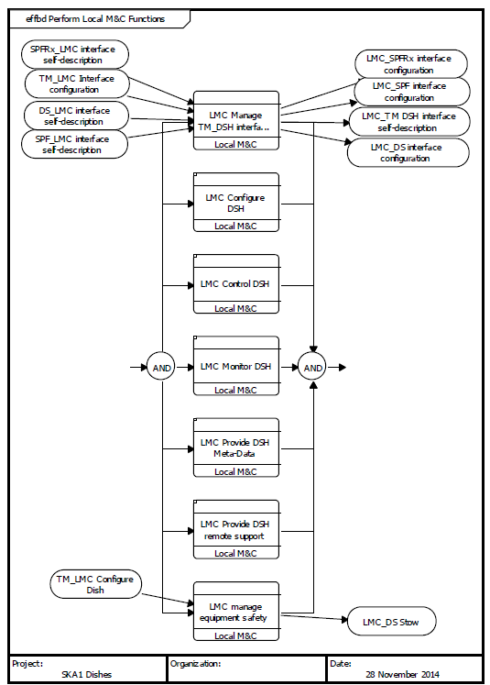
Functional Breakdown
Functional breakdown
The following basic functions shall be implemented by the LMC:
Managing the TM_LMC interface;
Configuring all the components of the Dish in preparation for an observation;
Real-time control of the Dish pointing and Beam forming during an observation;
Monitoring of all Dish components and reporting of this monitoring information to the Telescope Manager;
Sending meta-data to the TM that is required for the processing of signals;
Providing functionality for the remote support of the Dish and all its sub-elements;
Managing equipment safety;

Slide 6
OPERATING STATES
……from LMC interface guidelines document
4.1.4.4 Operating State
…..the actual internal Operating State is detected/derived/assigned by the Element LMC (or entity controller, for entities within the Element).
This actual operating state must be mapped to an abstract operating state as defined by the SCM. Each Element will provide its current operating state to TM.
This will enable TM to generate an aggregated state for the entire SKA telescope.
Each state corresponds to a set of valid commands.
Operating States are used by TM (and users) to determine what commands may be sent to the Element, and to monitor and manage their behaviour.
The Operating State of the Element changes in response to internal events or Commands issued by TM,
it cannot be assigned directly by TM.

Slide 7
OPERATING STATES
INITIALIZING: This is a transient state in which the Element exists when it is starting up its processes,
initializing the components, or configuring the sub-elements in order to get ready for use. Element is not ready to perform its function. Initialization may take different time for each Element. During the Element startup, Element may report this state.
READY: Implies that the Element is available for use or being used in an observation.
ERROR: An Element reports an ‘Error’ state when it detects a problem that affects its ability to accept certain commands or execute certain processes/operations.
This could be a transient internal problem, which the Element is not able to recover immediately, or it can be a persistent problem
SHUTTING-DOWN: This is a transient state in which Element is shutting down its processes, unloading its components, or performing a power off in order to attain a non-operational state. The Element is not available for use in this state.
OFF-DUTY: Special non-operational state in which Entity has been placed to reduce power consumption or improve its resistance to threats and avoid equipment damage. For example, a Dish LMC may report this state when the dish is stowed in the event of high wind/storm.
UNKNOWN: TM is not aware of actual state of Element. This is never reported by the Element, but TM may assign this state when there is no response from the Element. When Element is reporting some state and it stops reporting its state then TM assigns UNKNOWN state to the Element. For example when connectivity is lost.
OFF: This is a Powered off state. This will never be reported by the Element, but TM may assign this state when Element has not reported its state. The Element is not available for use in this state.

Slide 8
OPERATING STATE MACHINE

Slide 9
OPERATING MODES
4.1.4.3 Operating Mode
Operating Mode is an engineering concept handled by TELMGT.
Operating mode of Element can be set by TM (when the Element is under Central control)
or by operator/Engineer remotely using console tools (when the Element is under
Local control). This is used to determine what operations may be performed on the
Element…….
Operating Modes facilitate resource allocation, maintaining integrity of control and
system status assessment.
Operating mode is changed usually on user/operator request. User may request mode change on change of state/status or as per observation need.
Operating Mode is indicative of the operator/engineer intention; it does not reflect the actual status of the equipment.
For example, Equipment may be Normal and still be taken in Maintenance mode.
Not all modes might be applicable to an Element. Hence, it is not mandatory for Elements to implement all modes.

Slide 10
SKA-MID DISH CAPABILITY
A Capability is a functional grouping that is implemented by an Element. For example, receive signal at particular frequency band, beam-forming for sub array, continuum imaging for sub array etc.
Multiple physical and logical internal resources (components e.g. feeds, compute nodes, data buffers, network ports) may be required to deliver a Capability, and the same internal resources may contribute to multiple Capabilities.
An Element may provide one or more capabilities.
An Element may need certain dependencies to be satisfied in order to deliver certain capabilities.

Slide 11
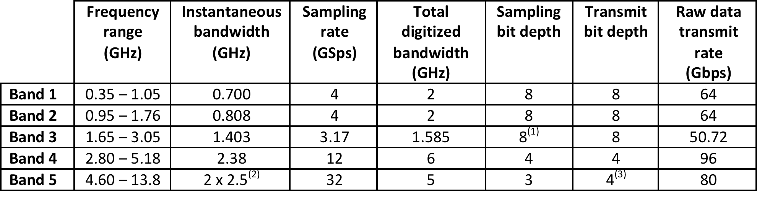
SKA-MID DISH CAPABILITY
SKA MID DISH CAPABILITY:
SKA MID DISH CAPABILITY EXAMPLE:
  BAND5 4.6-13.8 GHz
  Res1 : DS
  Res 1.1 : Indexer
  Res 1.2 : Sensors
  Res 1.3 : Antenna
  Res2 : LMC
  Res3 : BAND 5 SPF
  Res 3.1: Feed
  Res 3.2 :Vacuum Equipment
  Res 3.3 :Crio-Cooling Equipment
  Res4 : BAND 5 Rx (digitizers, processing)
  Res5 : Noise Diode

Slide 12
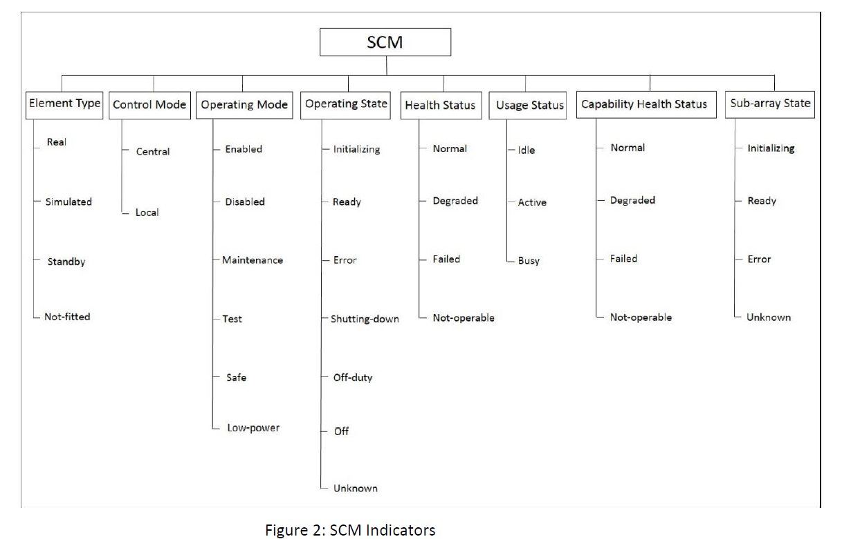
CAPABILITY HEALTH : SCM
R.LMC.FMON.10 LMC Report External State | LMC shall report the DSH element external state to TM as per the SKA Control Model, based on the mapping of sub-element states & modes, according to the LMC interface guideline [SKA-TEL-TM-0000031]. | R.LMC.FMON.SFW.10 LMC Report External State D.I.M.LMC_SRx.D006 D.I.M.LMC_ SPF.D006

Slide 13
DISH CAPABILITY: MAPPING
Each Dish sub-elements produces a SCM according the SCMs of its controlled resources
DS SCM
INDEXER SCM
SENSORS SCM
ANTENNA SCM

Slide 14
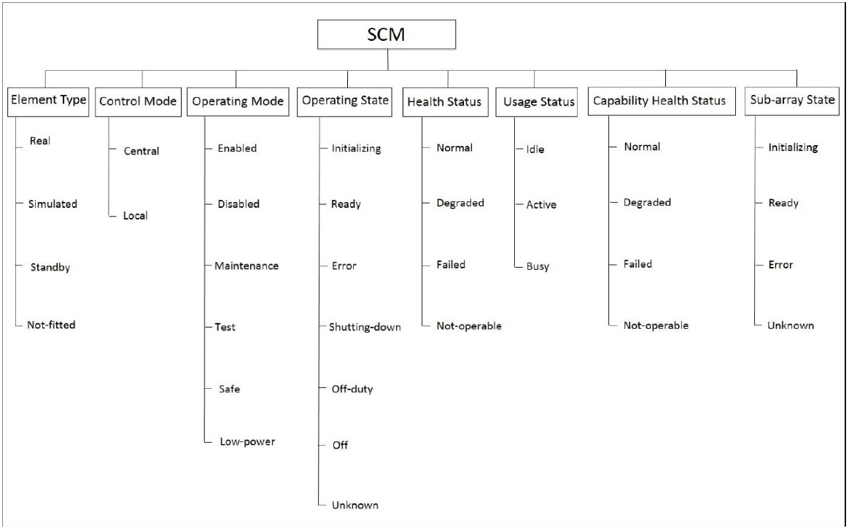
DISH CAPABILITY: MAPPING
RESOURCE 1.SCM
Resource Health Status
Normal
Degraded
Failed
Not-Operable
RESOURCE 2.SCM
CAPABILITY
RESOURCE N.SCM
Capability Health Status
Normal
Degraded
Failed
Not-Operable

Slide 15
DISH CAPABILITY: MAPPING
H
H
H
CAPABILITY HEALTH
RESOURCES1.SCM.HEALTH
RESOURCES2.SCM.HEALTH
RESOURCES3.SCM.HEALTH
RESOURCESN.SCM.HEALTH
H function | NORMAL | DEGRADED | FAILED | NOT-OPERABLE
NORMAL | NORMAL | DEGRADED | FAILED | NOT-OPERABLE
DEGRADED | DEGRADED | DEGRADED | FAILED | DEGRADED
FAILED | FAILED | FAILED | FAILED | FAILED
NOT-OPERABLE | NOT-OPERABLE | DEGRADED | FAILED | NOT-OPERABLE
FAILED 4
3
2
1
LEVEL of HEALTH=h(n)
for nth component
DEGRADED
Capability.Health =max (h(i))
For i=1 to n resources
NOT-OPERABLE
NORMAL

Slide 16
DISH CAPABILITY : STATES
OS
OS
OS
CAPABILITY OP_STATE
RESOURCES1.SCM.OP_STATUS
RESOURCES2.SCM.OP_STATUS
RESOURCES 3.SCM.OP_STATUS
RESOURCES N.SCM.OP_STATUS
OS function | Init | Ready | Error | ShutD | Off-Duty | Off | Unknown
Init | Init | Init | Error | ShutD | Off-Duty | Off | Unknown
Ready | Init | Ready | Error | ShutD | Off-Duty | Off | Unknown
Error | Error | Error | Error | Error | Error | Error | Error
ShutD | ShutD | ShutD | Error | ShutD | ShutD | Off | Unknown
Off-Duty | Off-Duty | Off-Duty | Error | Off-Duty | Off-Duty | Off | Unknown
Off | Off | Off | Error | Off | Off | Off | Unknown
Unknown | Unknown | Unknown | Error | Unknown | Unknown | Off | Unknown
LEVEL of STATE= s
Error 7
Unknown 6
Off 5
Off Duty 4
ShutD 3
Init 2
Ready 1
ORDERE BY DESCENDING
SEVERITY LEVEL
Capability.OpState=max(s(i))

Slide 17
STATES MAPPING
DSH SCM
DS SCM
SPF SCM
RX SCM
LMC SCM
Each Dish sub-elements produces a SCM according the SCMs of its controlled sub-systems, and transmit to upper level.
Overall STATE is calculated by the formula OpState=max(s(i))
Mode is set by TM, and shall be verified only if it is compliant with
STATE and equipment operativity.
INDEXER SCM
SENSORS SCM
ANTENNA SCM

Slide 18
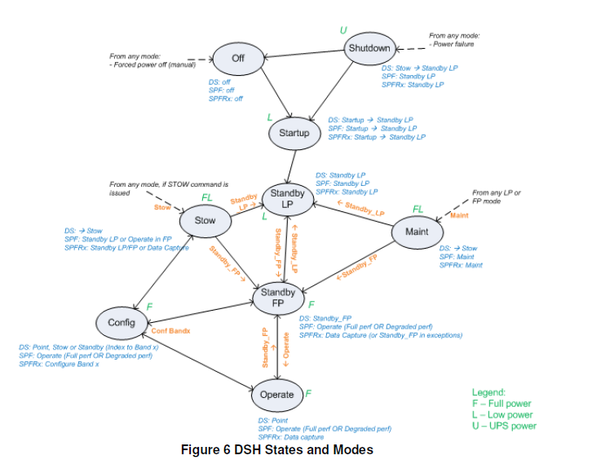
S&M, MAPPING ?

Slide 19
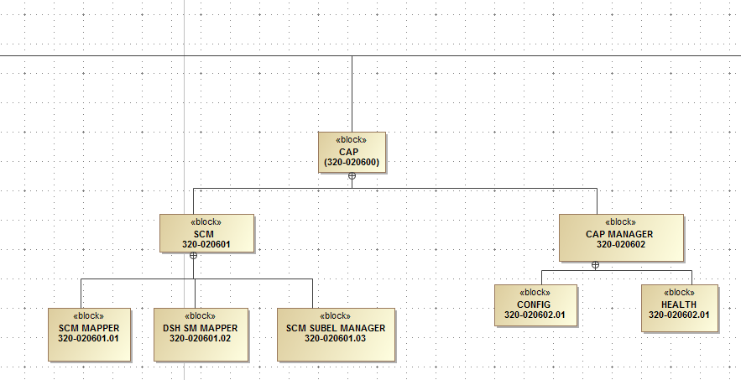
SKA-MID DISH CAPABILITY
SCM functionalities
Capability Status
Functionalities responsible for map the SCM of Sub-el into a SCM for Sub-element and Capability
Functionalities responsible for manager the SCM of Sub-elements
Functionalities responsible for Capability and Element’s health
Functionalities responsible for map the SCM of Sub-el into a DISH State and Mode map
Functionalities responsible for Capability Configuration

Slide 20
THANKS!

