Slide 1
SKA1 Low station configuration workshop
25-26th February 2016
Benjamin Mort,
Fred Dulwich,
Eloy de Lera Acedo
Nima Razavi

Slide 2
Take home messages
Regular arrays should be avoided!
We need to develop a new station configuration with consideration for the electromagnetic effects and geometric limitations → V5 needed!

Slide 3
Overview
Why regular arrays cannot be used (slides from Eloy)
An analysis of current configurations
Answers to workshop questions

Slide 4
The problem with regular arrays

Slide 5
Regular versus irregular antenna positions inside the stations
Mutual coupling in wideband regular arrays can cause in band anomalies in both the impedance and embedded element patterns of the antennas leading to scan blindness for which all power is effectively reflected.
This is the case for the 7:1 SKA-LOW band.

Slide 6
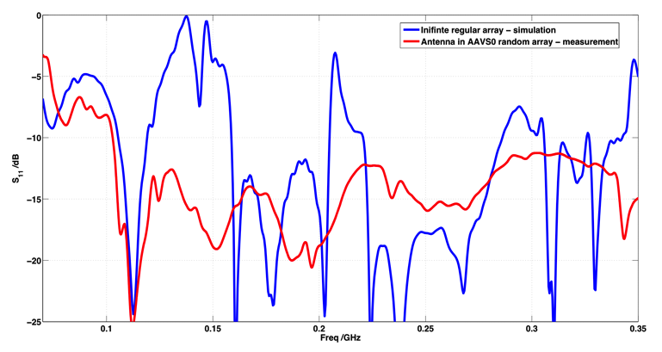
Regular versus irregular antenna positions inside the stations
Regular arrays won’t work!!!
All power reflected
Anywhere below this line for Trec < 35 K
* de Lera et al. Experimental Astronomy 2015

Slide 7
Regular versus irregular antenna positions inside the stations II
An irregular (randomized is the best case) configuration of the antennas in the stations randomizes the effects of mutual coupling. This is beneficial to the performance of the instrument as well as to its calibratability.

Slide 8
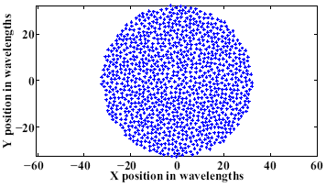
Mutual Coupling in Irregular Arrays
~ 35 dB

Slide 9
An analysis of some current configurations
(Ignoring the problems of regular arrays!)

Slide 10
Introduction
Currently 3 configurations:
  V4A – Pentagonal geometry (sub-stations, stations, super-stations)
  V4D – Circular stations arranged into super-stations
  V4X – Sea of elements super-station
Python scripts:
  https://github.com/OxfordSKA/SKA1-low-layouts

Slide 11
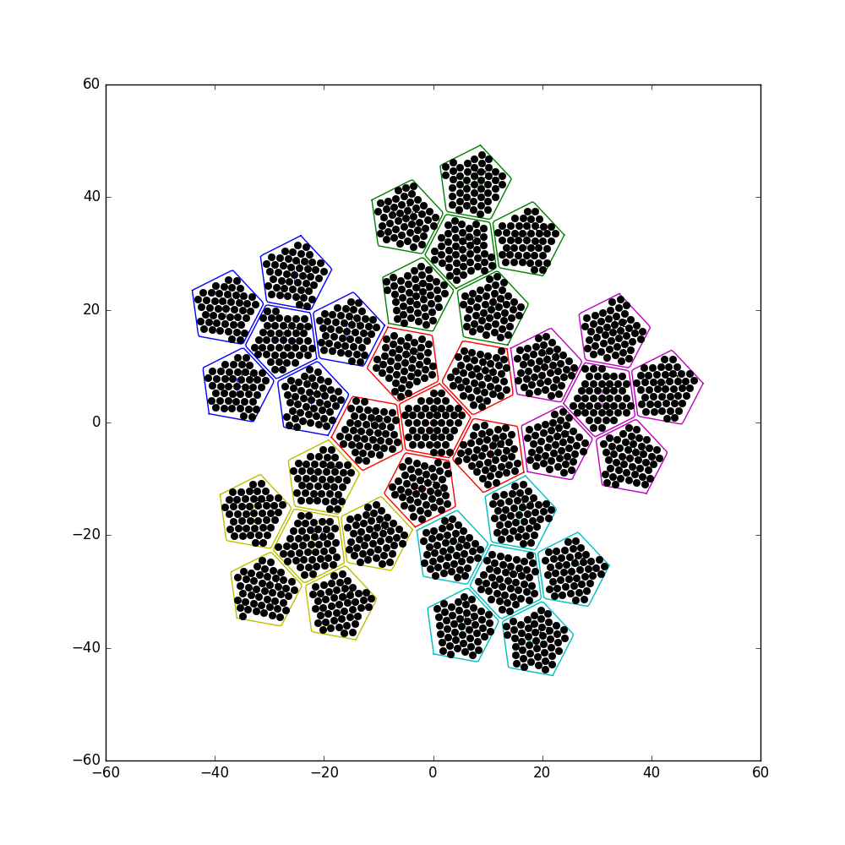
V4A
Stations and super-stations built from a set of pentagonal sub-stations.
Pentagons filled with:
  Randomly rotated hexagonal lattice or
  Random antenna positions
Reference configuration
  48 antennas per sub-station
  Super-station diameter of ~90 m
  94 super-stations
  564 stations
Rotation of super-stations based on ‘v7ska1lowN1v2arev3R.enu.564x4.txt’
Random positions result in fewer antennas per station

Slide 12
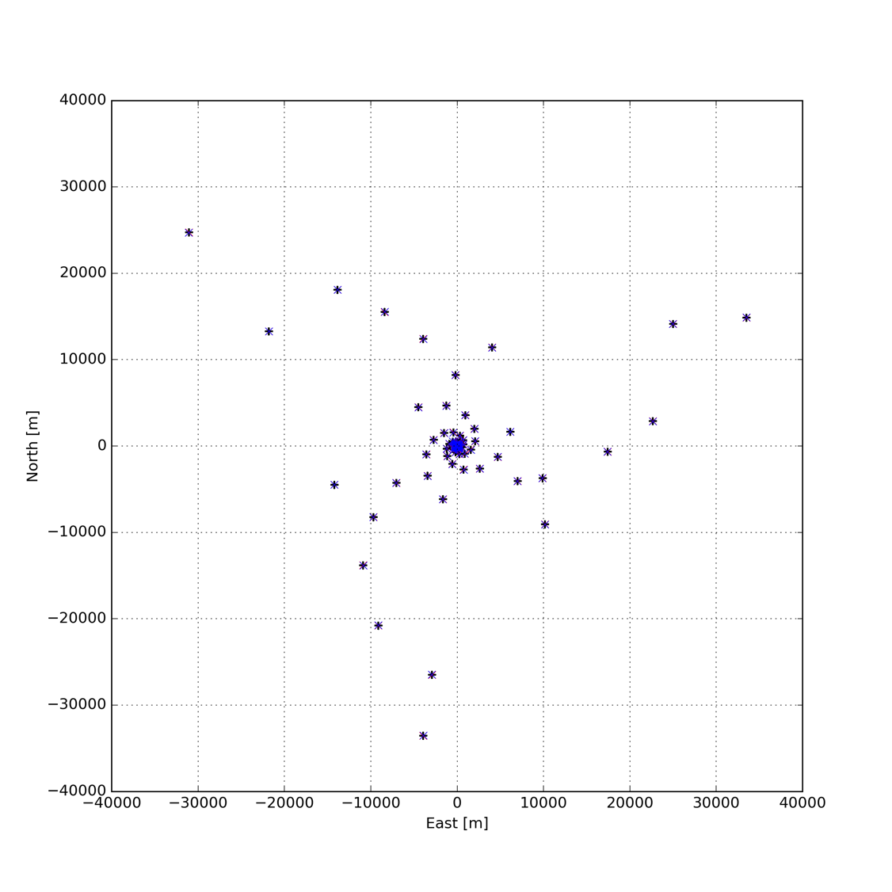
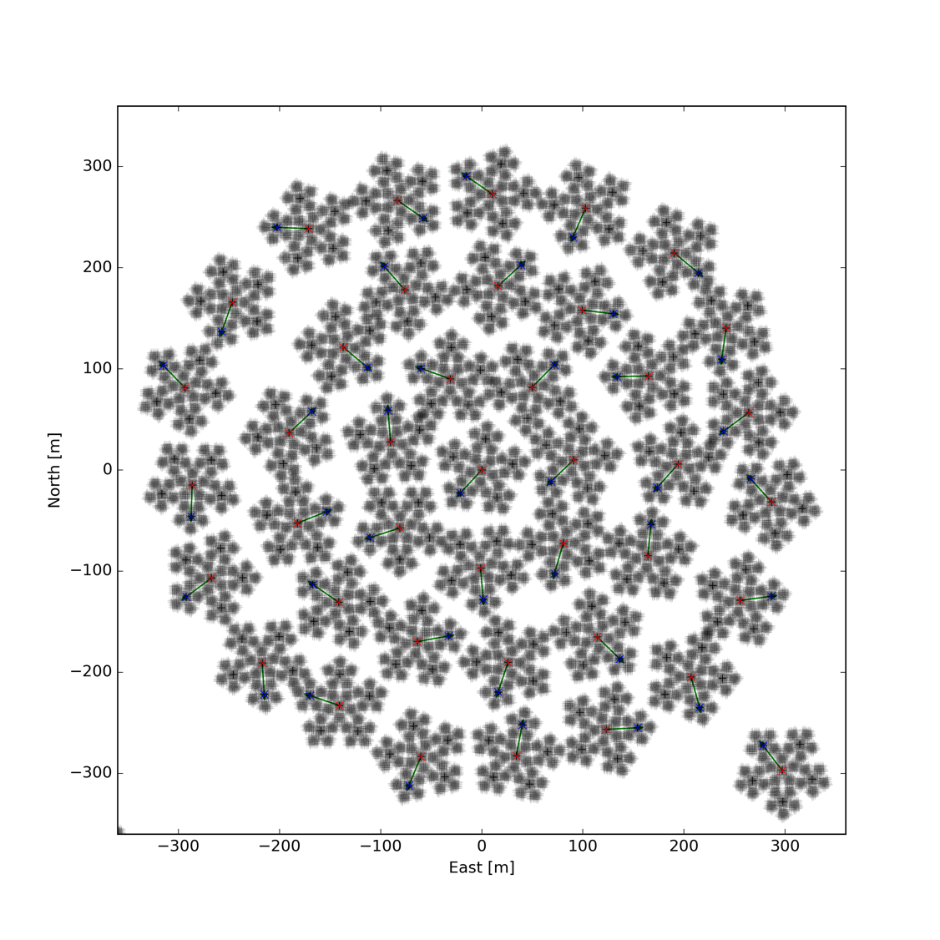
V4A showing full array
Zoom into the central core

Slide 13
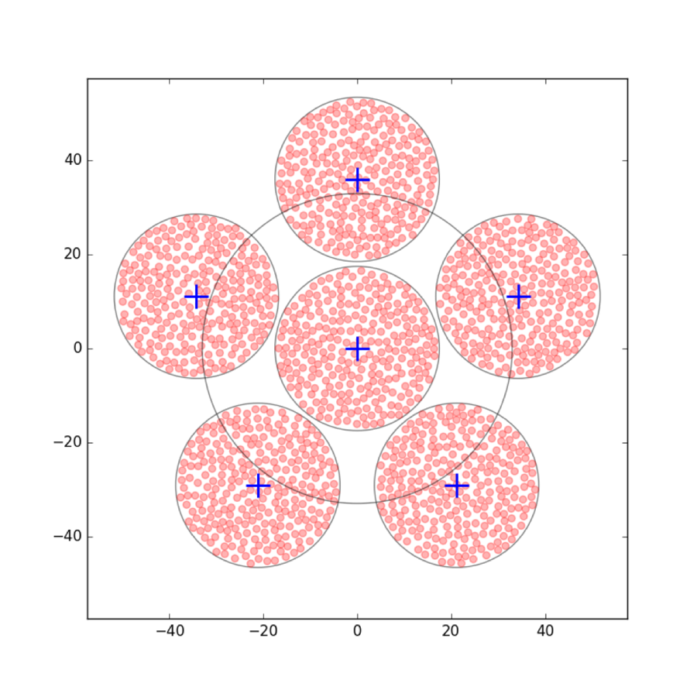
V4D
Pentagonal arrangement of circular stations grouped into super-stations
Random antenna positions within each station.
  Generated using a placement algorithm based on a uniform distribution of trial locations, allowing for the antenna footprint
Reference configuration
  256 antennas per station
  ~90 m (?) diameter super-stations
  85 super-stations
  510 stations
Actual configuration
  180 antennas per station
  Limited by random generation with 2.25 m² antenna footprint
Random rotation of station centres
Possible physical thinning of stations by growing the antenna separation as a function of radius.

Slide 14
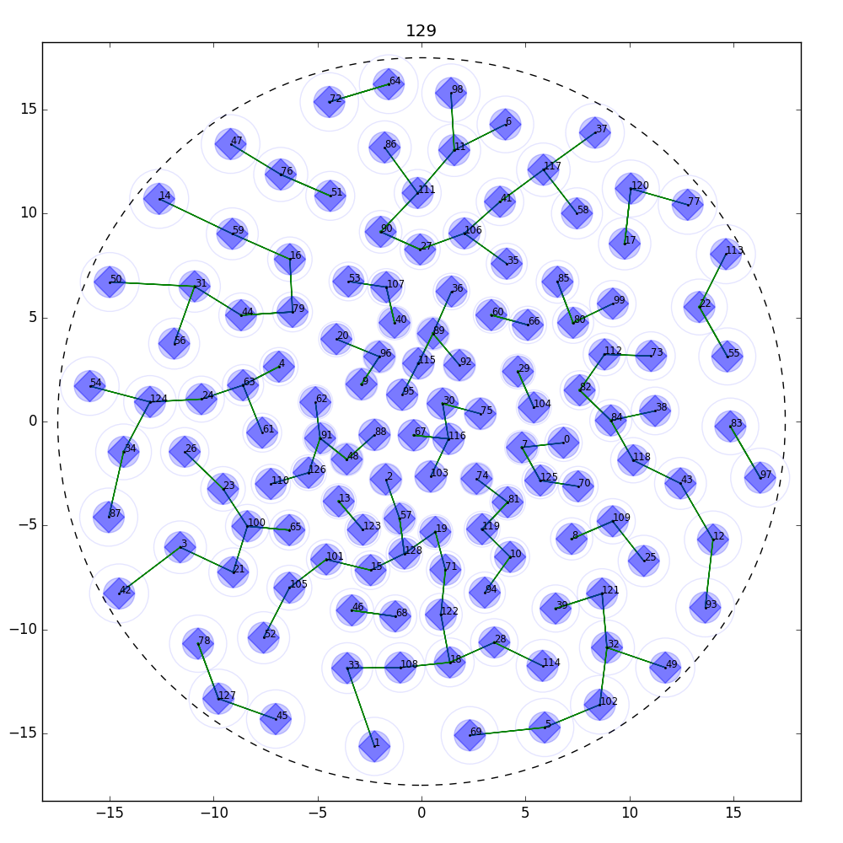
An example thinned random array

Slide 15
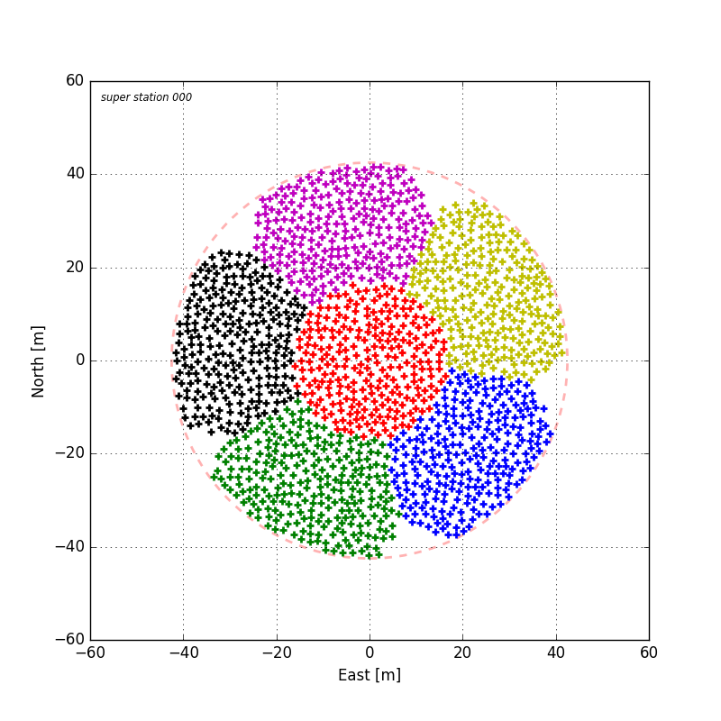
V4X
Super-stations constructed from a ’sea’ of elements
Configuration (based on V4D)
  256 antennas per station (selectable)
  1536 antennas per super-station
  Super-station diameter of 85 m
Random rotation of station centres

Slide 16
A note on the generation of random arrays
Random arrays will have larger average spacing than regular arrays
For this analysis we have chosen to respect the specification of station/ super-station diameters at the expense of fewer antennas per array.

Slide 17
Station beams
Average cross power stokes I station beams where generated by cross correlation of all station pairs
Beams generated for both stations and super-stations
Telescope models
  V4A
    Hexagonal lattice within pentagonal sub-station
    Random antenna positions within pentagonal sub-station
  V4D
    With and without physical thinning
  V4X
Beams generated with and without apodisation using Taylor weighting
Frequencies of 50 MHz and 350 MHz (each end of the SKA1-low band)
Zenith beam pointing (lower scan angles simulated, but not presented here)

Slide 18
Station beams
(this section is mainly for reference)

Slide 19
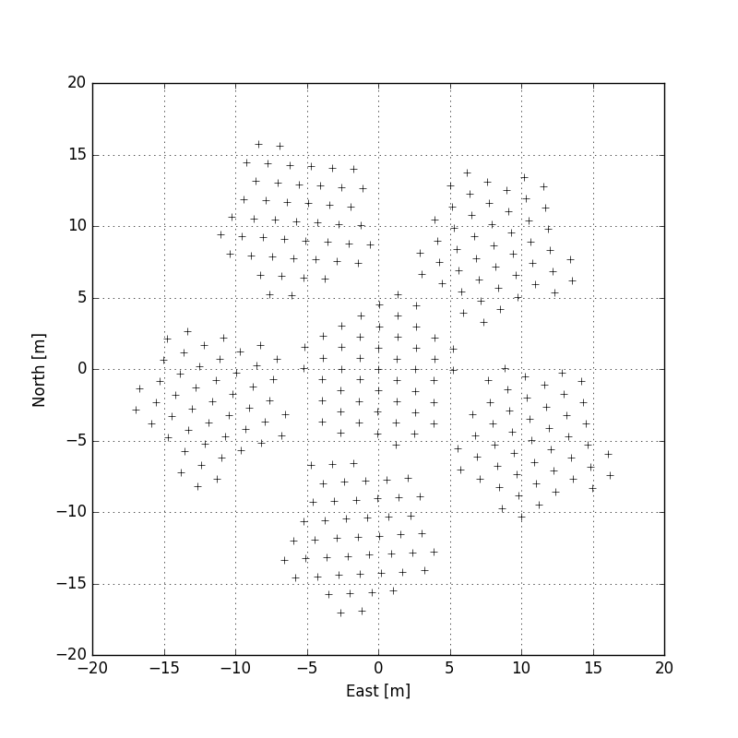
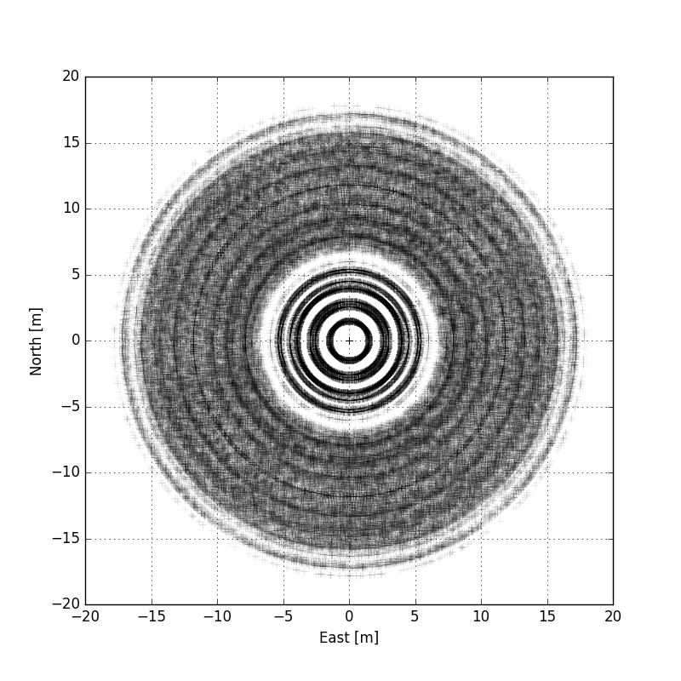
V4A stations: Randomly rotated pentagonal shaped sub-station centred hexagonal lattices
Station orientations defined by coordinates in ‘v7ska1lowN1v2arev3R.enu.564x4.txt’
48 antennas per sub-station, 288 antennas per station, 564 stations, ~35 m diameter
Single station
Superposition of all stations

Slide 20
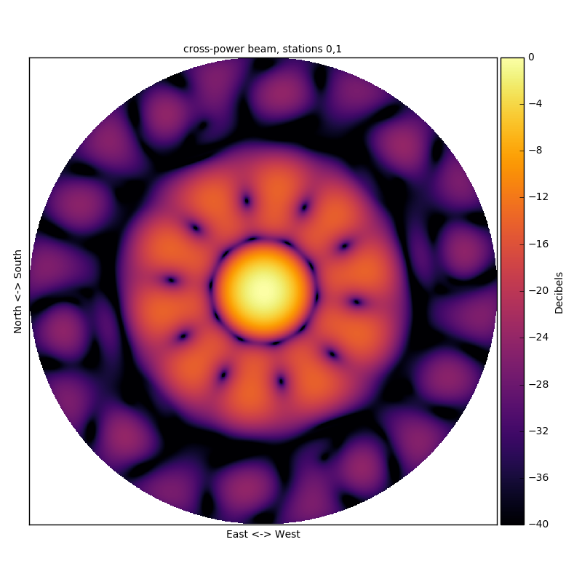
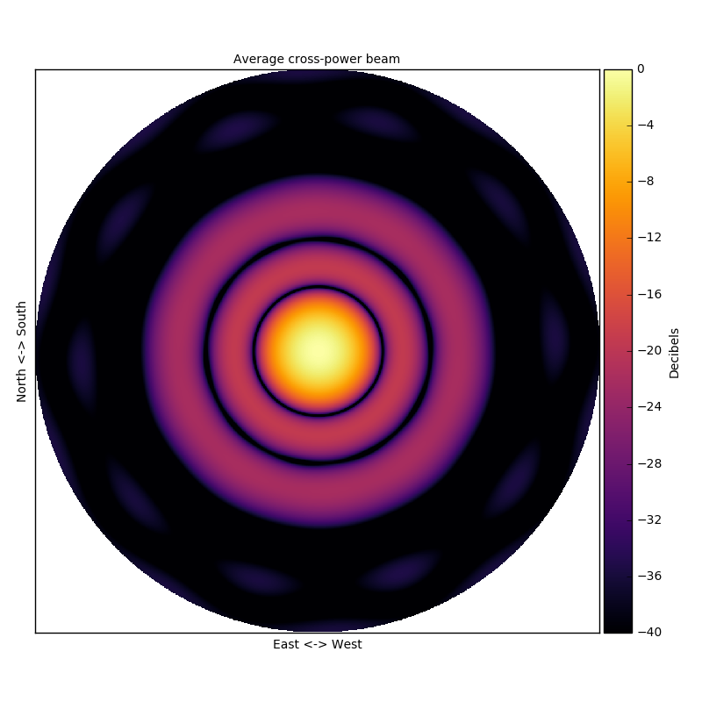
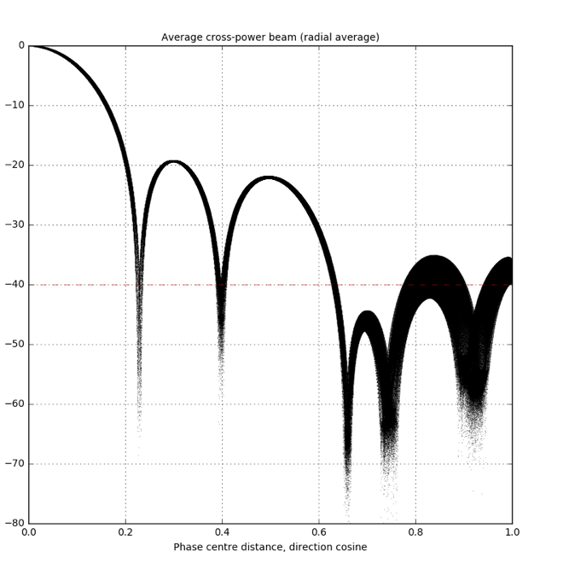
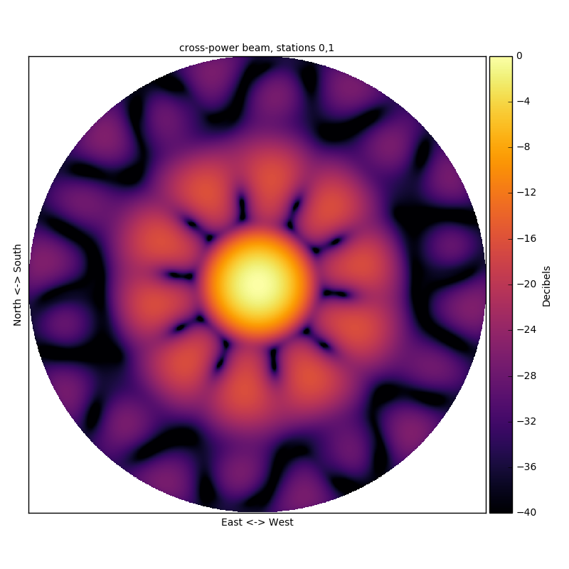
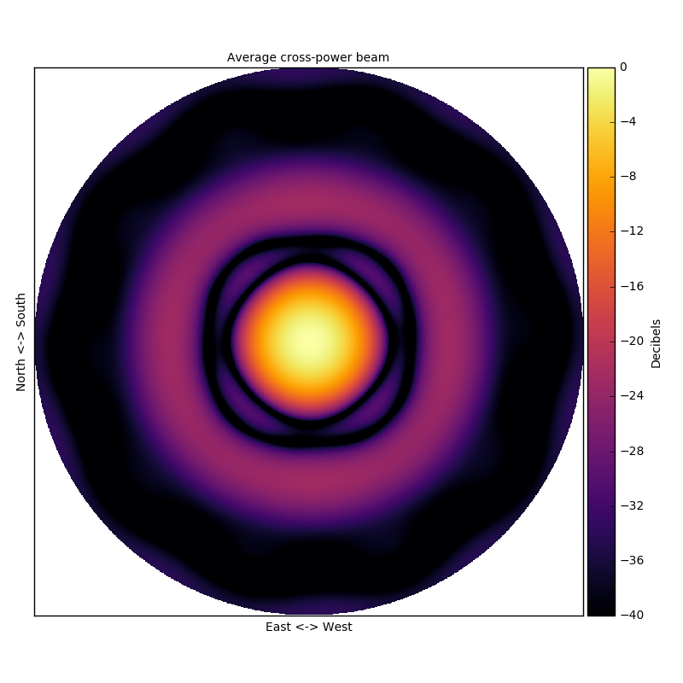
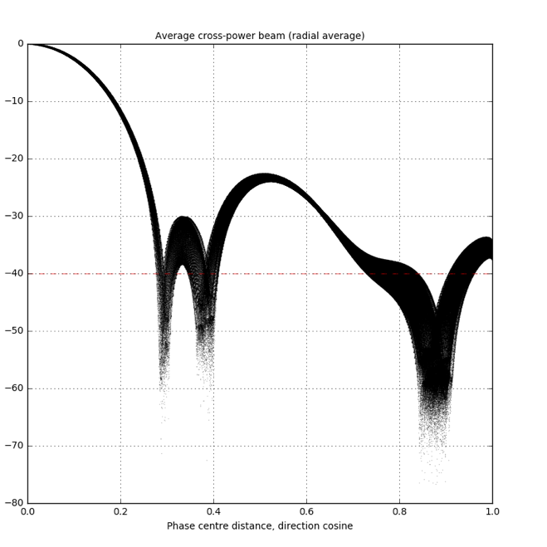
V4A station beams: Randomly rotated sub-station centred hexagonal lattices
Stokes-I cross-power station beams, 50 MHz, zenith pointing
Cross-power beam
Single baseline
Average cross power beam
all baselines
Average cross power beam
Radial profile
No-apodisation
-28 db Taylor weights

Slide 21
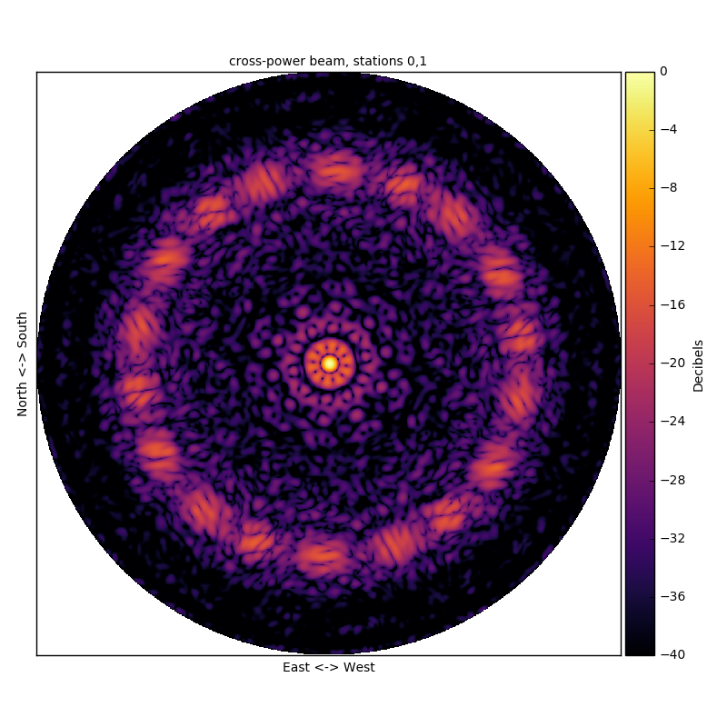
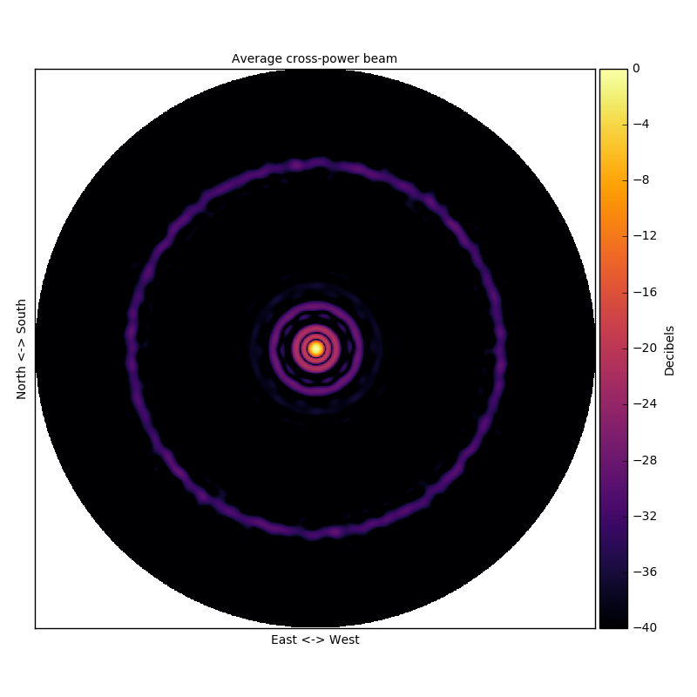
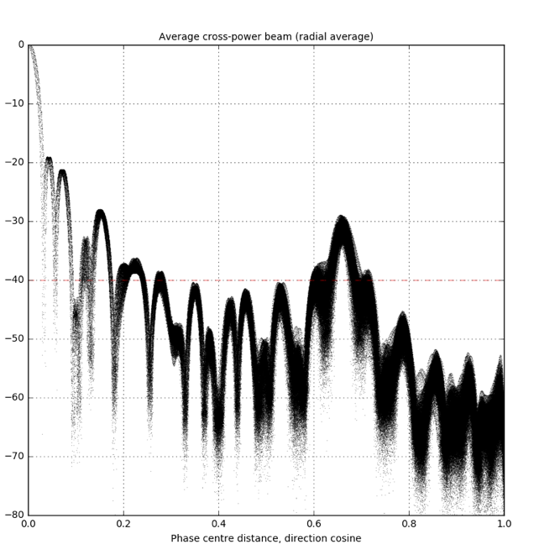
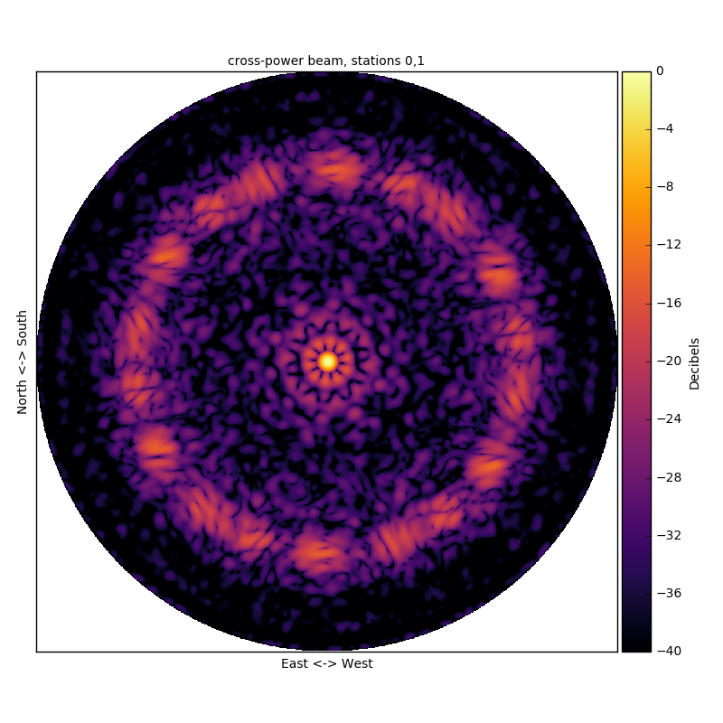
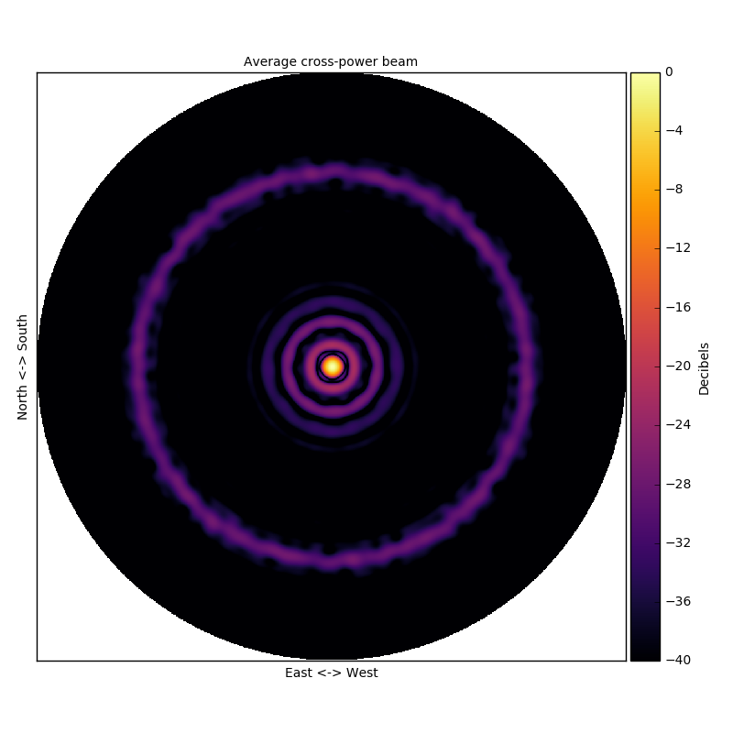
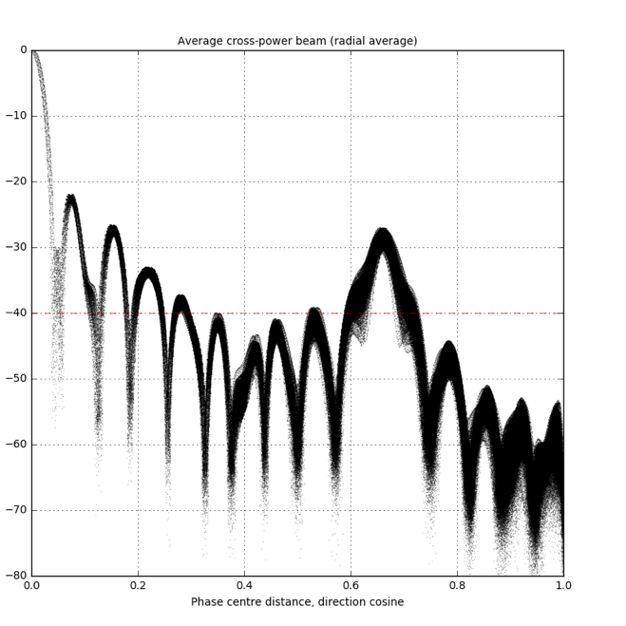
V4A station beams: Randomly rotated sub-station centred hexagonal lattices
Stokes-I cross-power station beams, 350 MHz, zenith pointing
Cross-power beam
Single baseline
Average cross power beam
all baselines
Average cross power beam
Radial profile
No-apodisation
-28 db Taylor weights
Notes:
Note large ring in far side-lobes due to grating lobe from the hexagonal lattice spacing

Slide 22
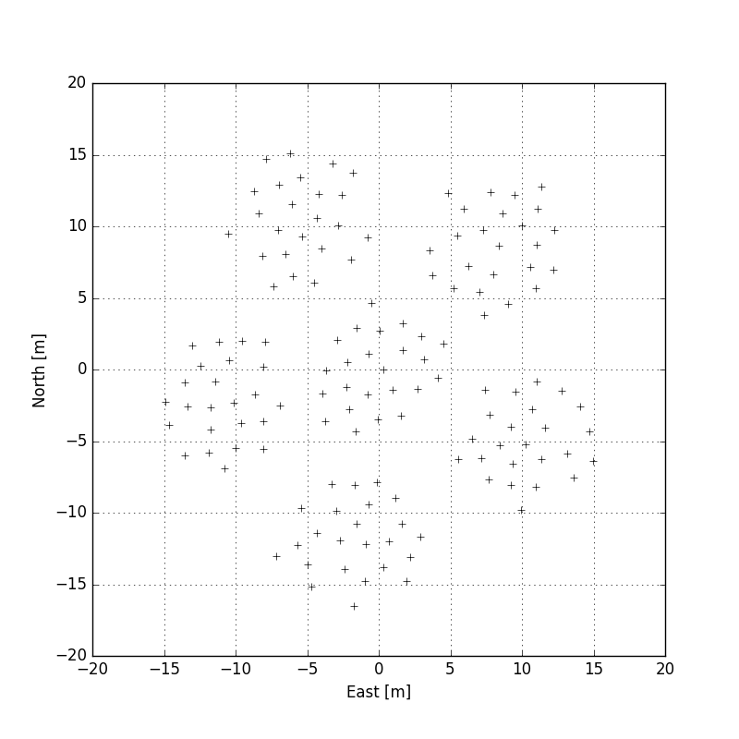
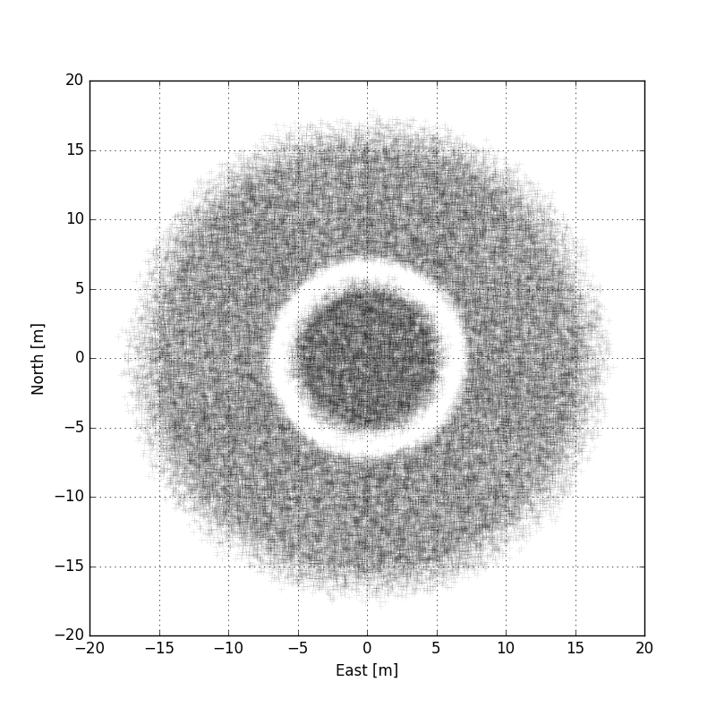
V4A like stations: Randomly generated sub-station antenna positions
Pentagon shaped sub-stations from original V4A layout
Station orientations defined by coordinates in ‘v7ska1lowN1v2arev3R.enu.564x4.txt’
24 antennas per sub-station, 144 antennas per station, 564 stations, ~35 m diameter
Single station
Superposition of all stations

Slide 23
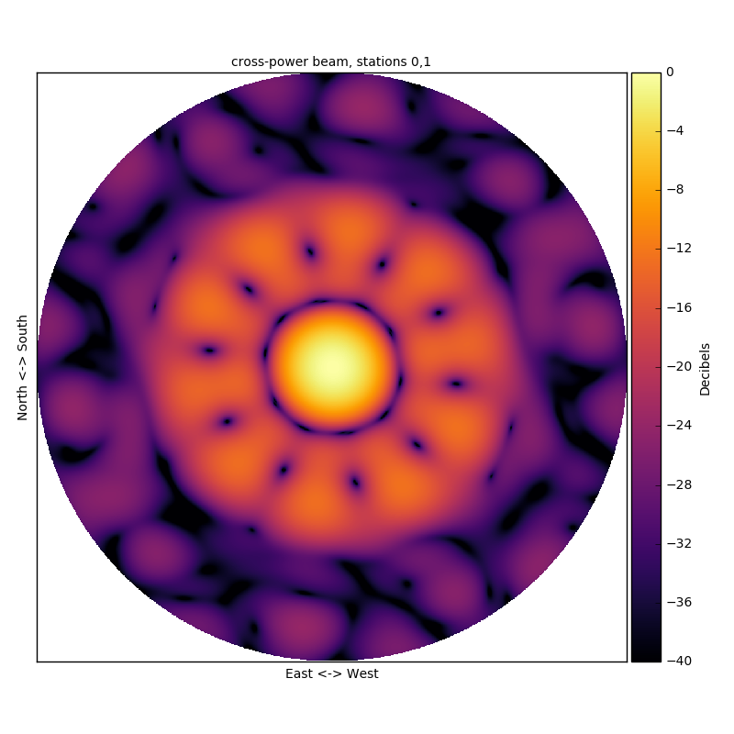
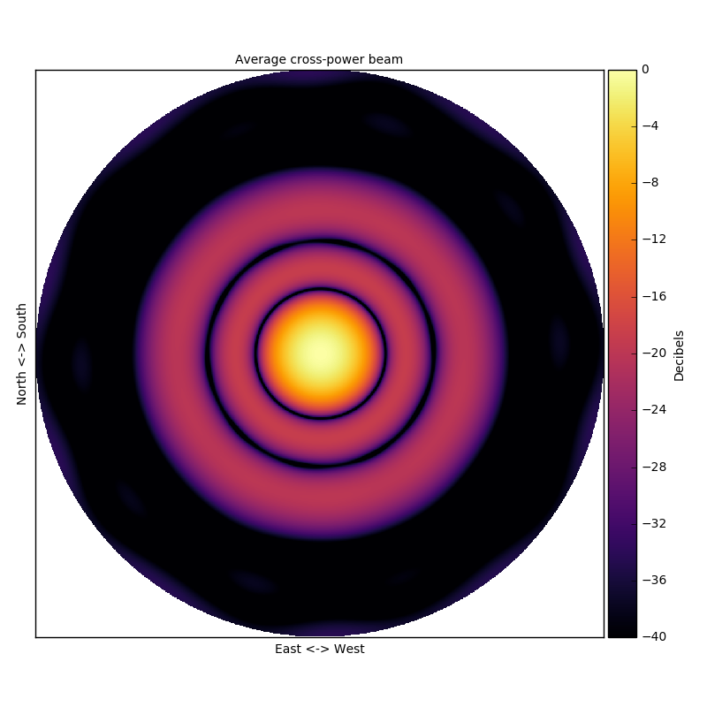
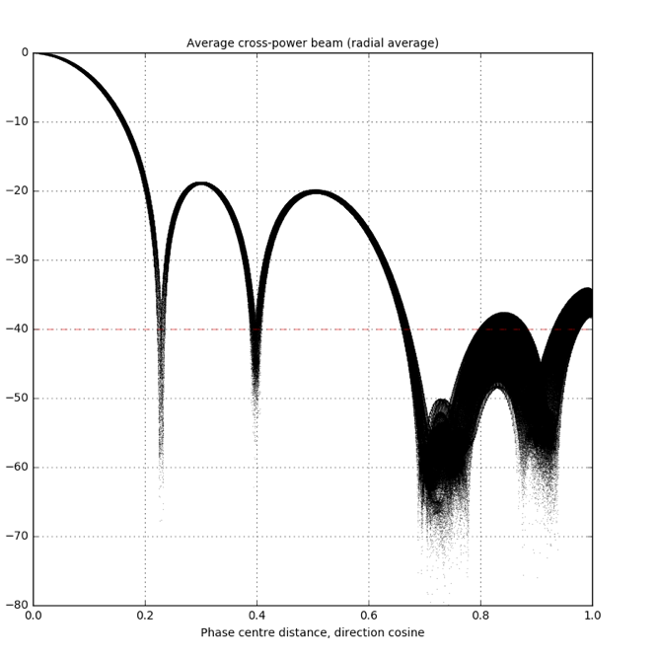
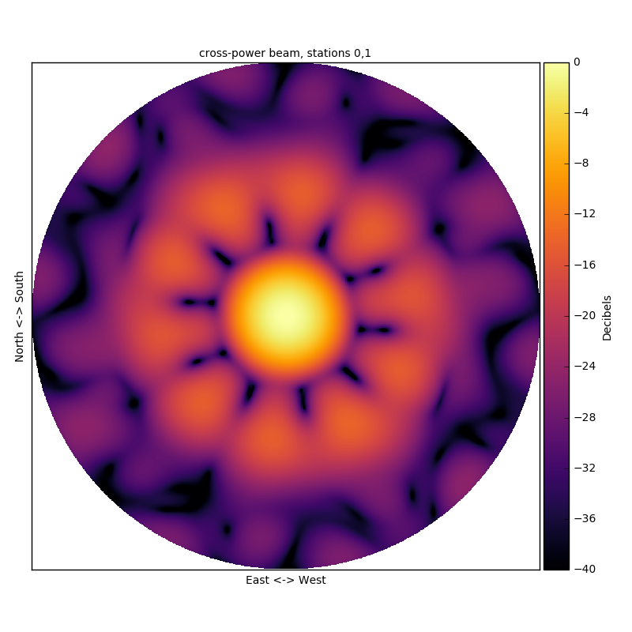
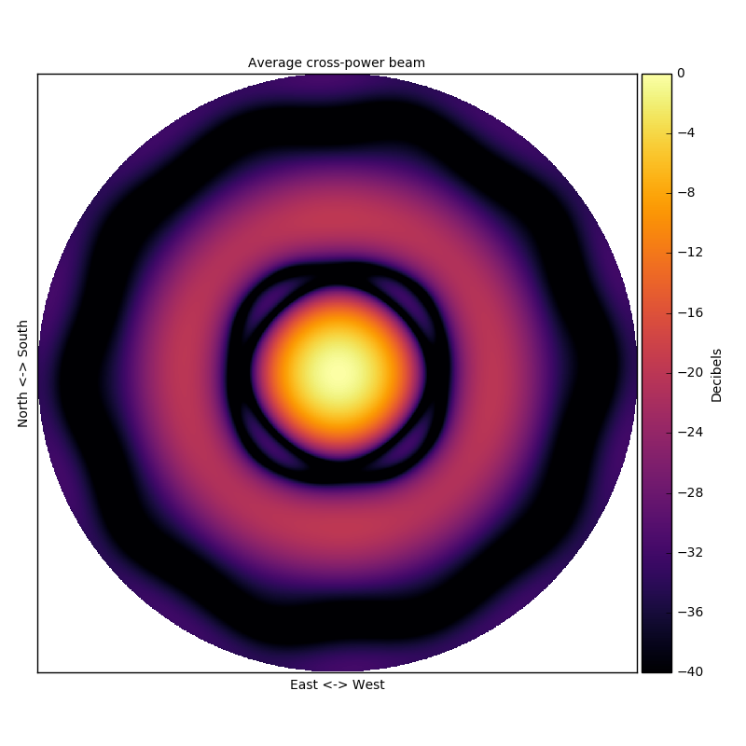
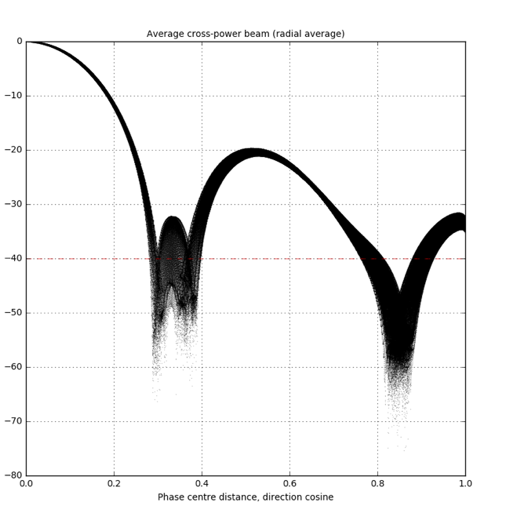
V4A station beams: Randomly generated sub-stations
Stokes-I cross-power station beams, 50 MHz, zenith pointing
Cross-power beam
Single baseline
Average cross power beam
all baselines
Average cross power beam
Radial profile
No-apodisation
-28 db Taylor weights

Slide 24
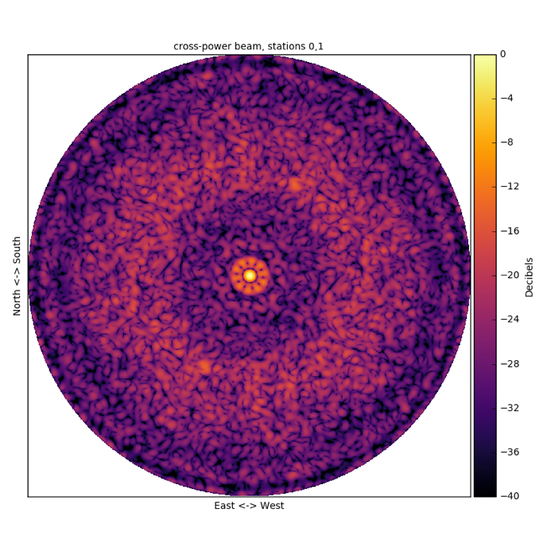
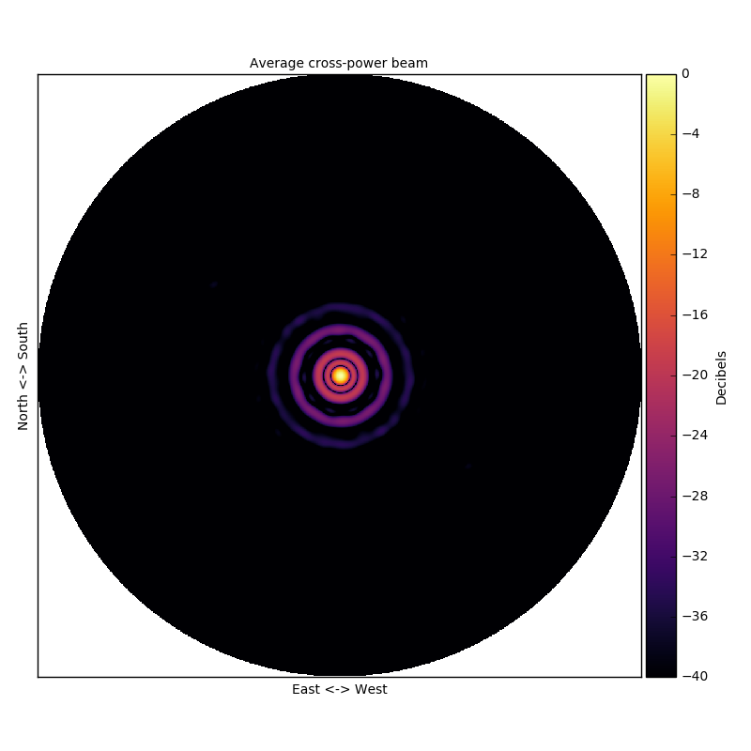
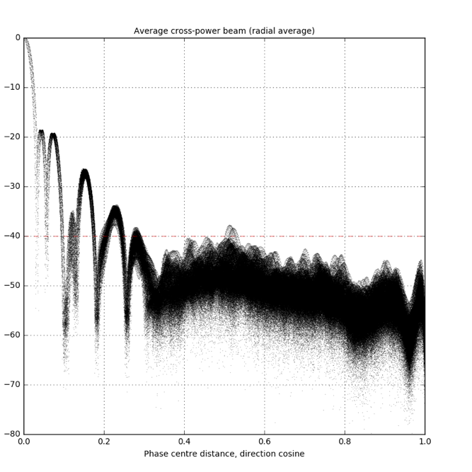
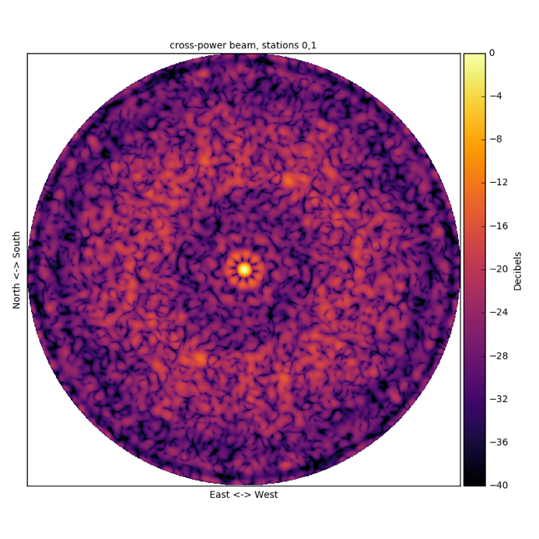
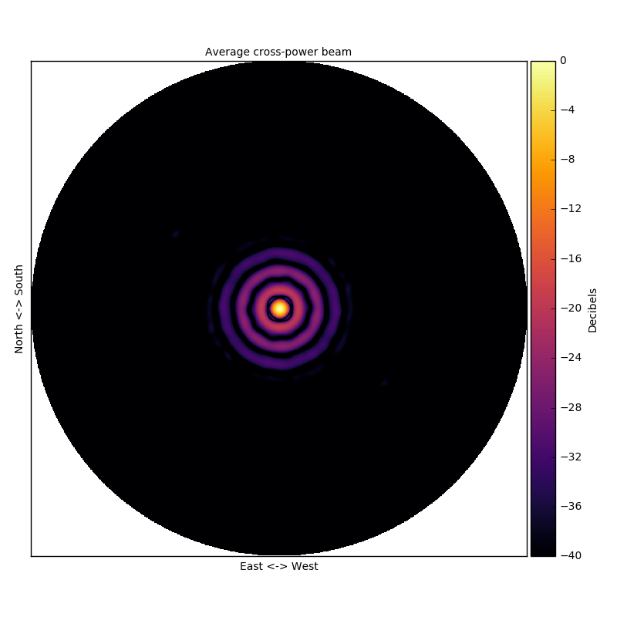
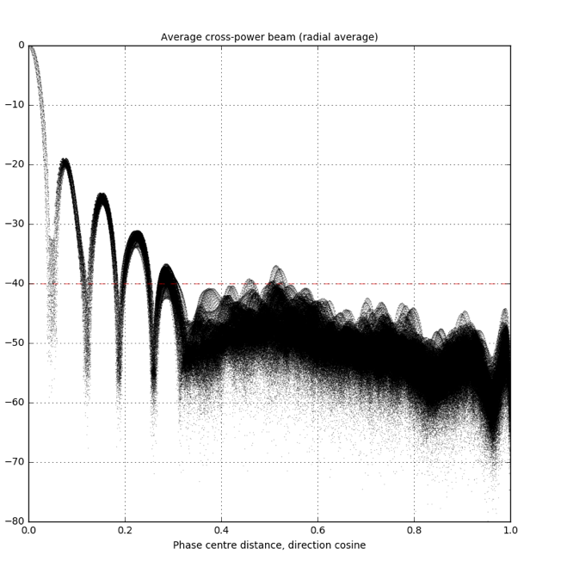
V4A station beams: Randomly generated sub-stations
Stokes-I cross-power station beams, 350 MHz, zenith pointing
Cross-power beam
Single baseline
Average cross power beam
all baselines
Average cross power beam
Radial profile
No-apodisation
-28 db Taylor weights
Notes:
Note: Large area of incoherent sidelobes from random geometry

Slide 25
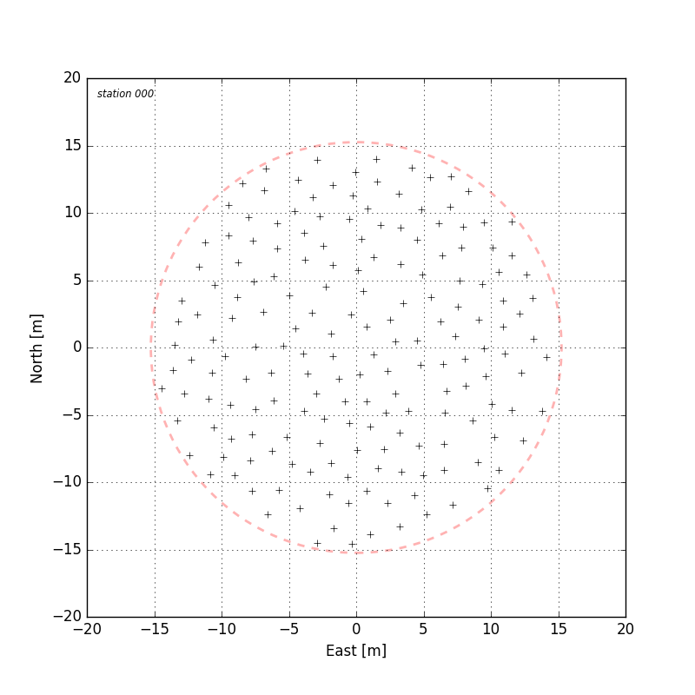
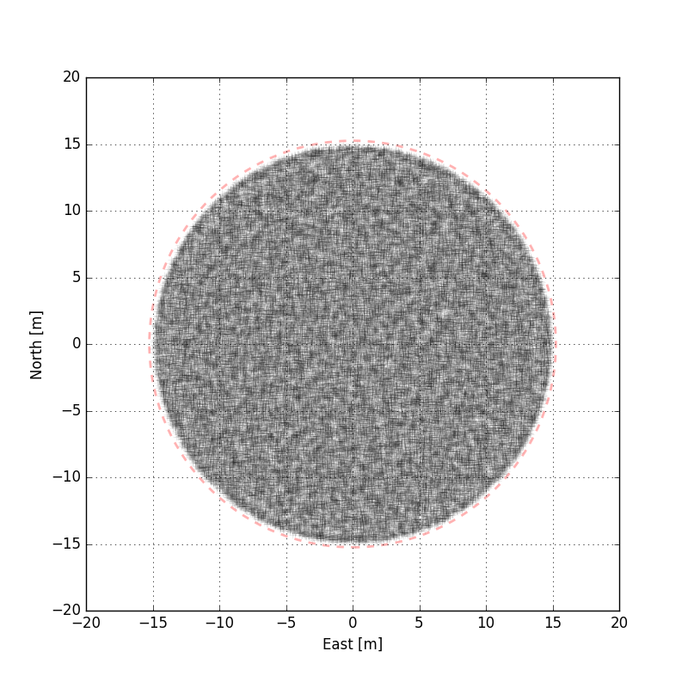
V4D stations: Randomly generated station antenna positions
Randomly generated station orientations
180 antennas per station, 510 stations, 30 m diameter
Single station
Superposition of all stations

Slide 26
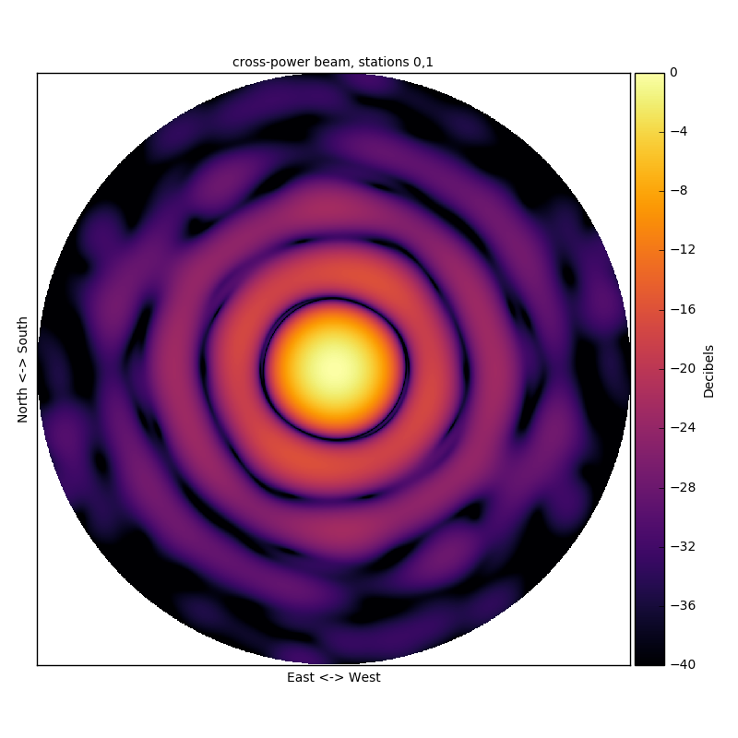

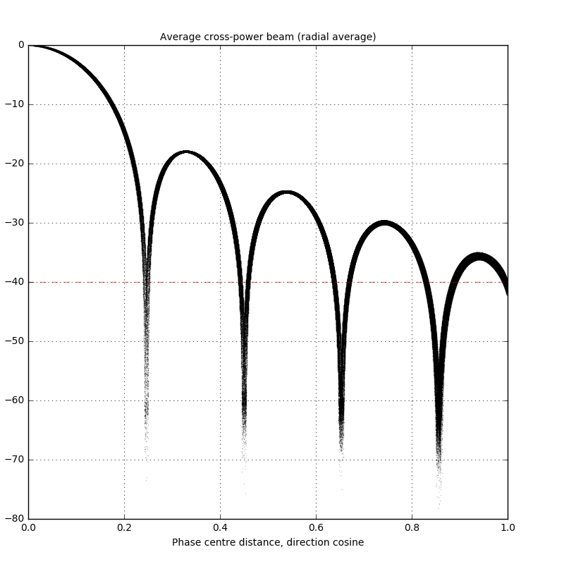
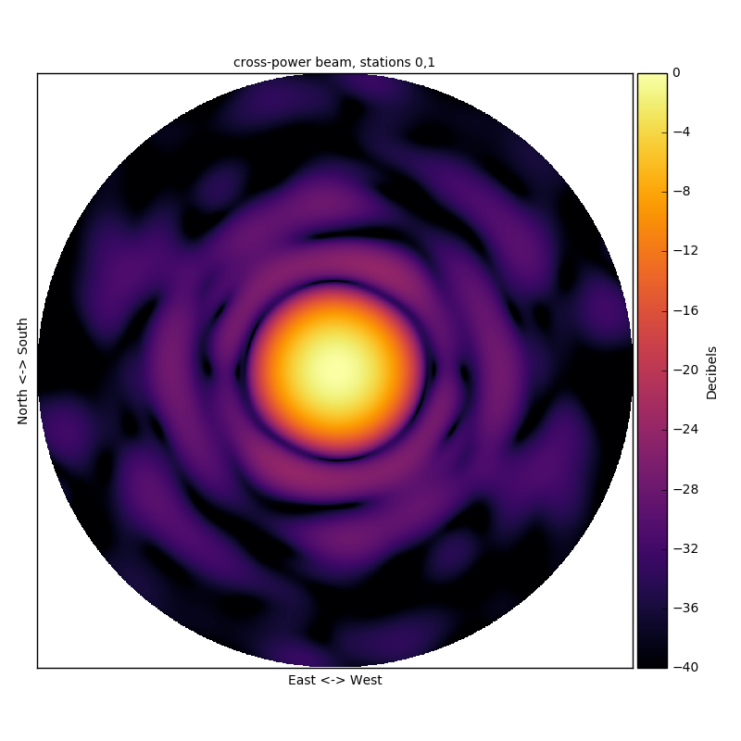
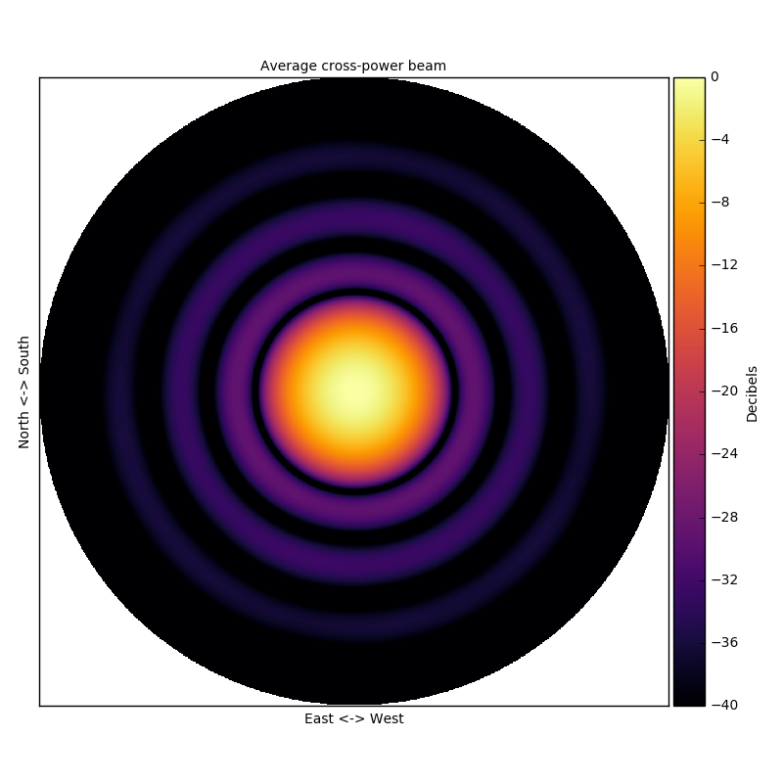
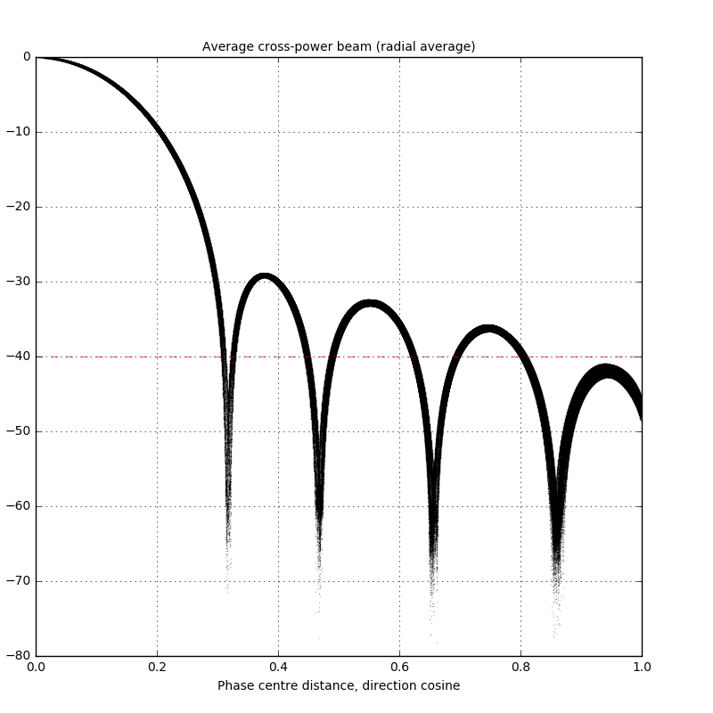
V4D station beams: Randomly generated station antenna positions
Stokes-I cross-power station beams, 50 MHz, zenith pointing
Cross-power beam
Single baseline
Average cross power beam
all baselines
Average cross power beam
Radial profile
No-apodisation
-28 db Taylor weights
Notes:
Apodisation works ’well’ for this uniform random station configuration

Slide 27

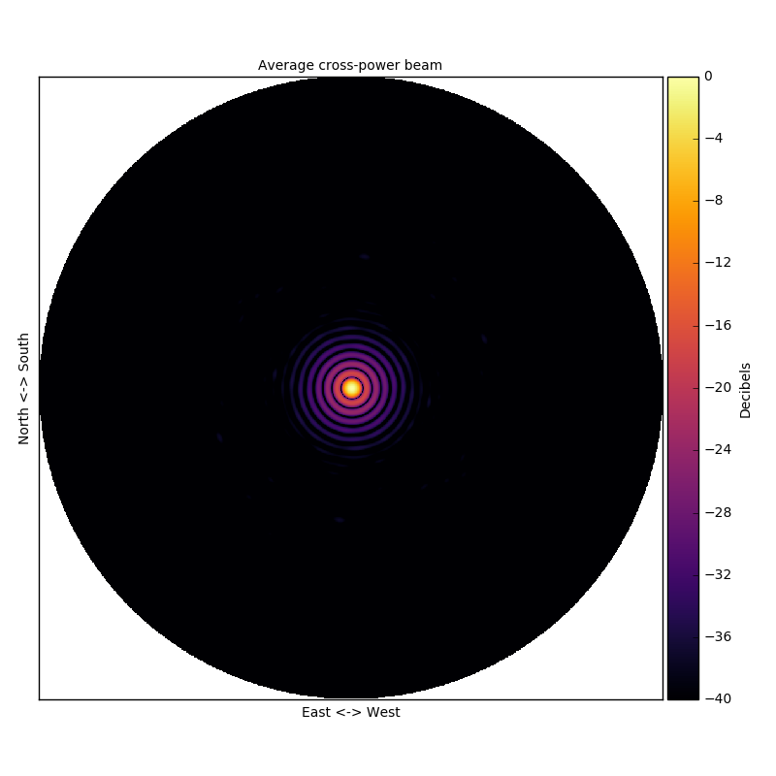
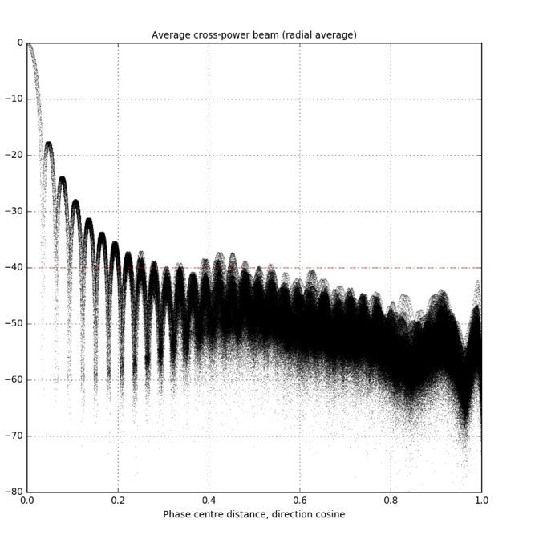
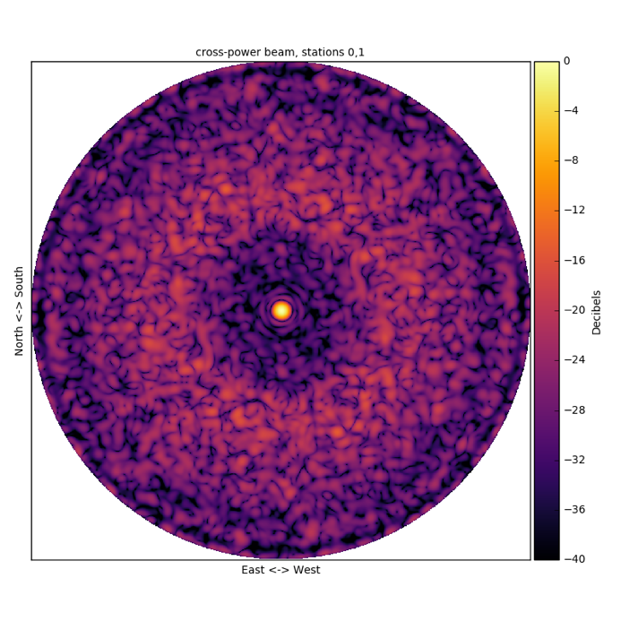
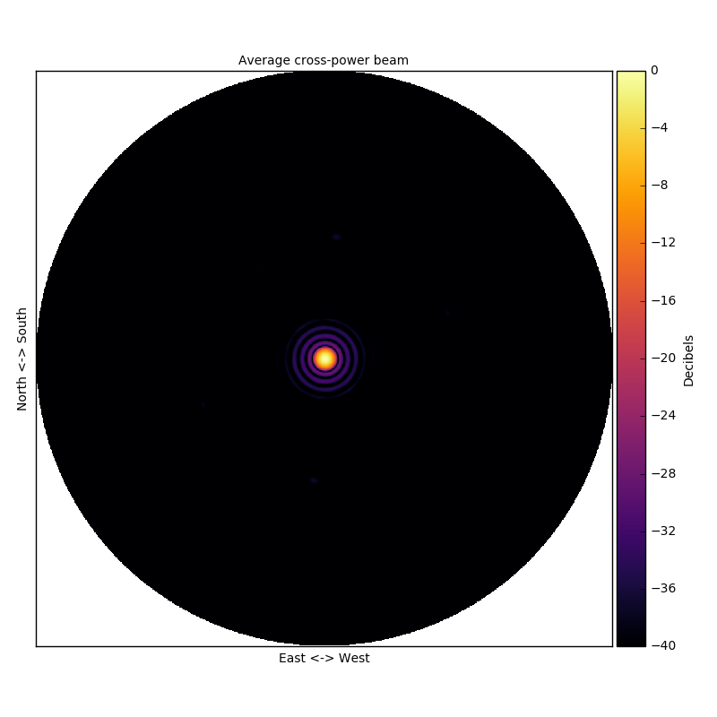
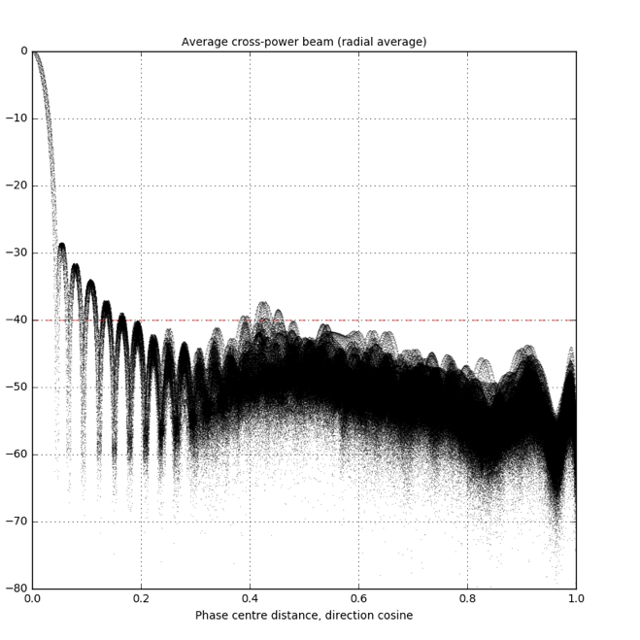
V4D station beams: Randomly generated station antenna positions
Stokes-I cross-power station beams, 350 MHz, zenith pointing
Cross-power beam
Single baseline
Average cross power beam
all baselines
Average cross power beam
Radial profile
No-apodisation
-28 db Taylor weights
Notes:
Apodisation also works well at 350MHz,
Both near in and far out sidelobes better than v4a

Slide 28
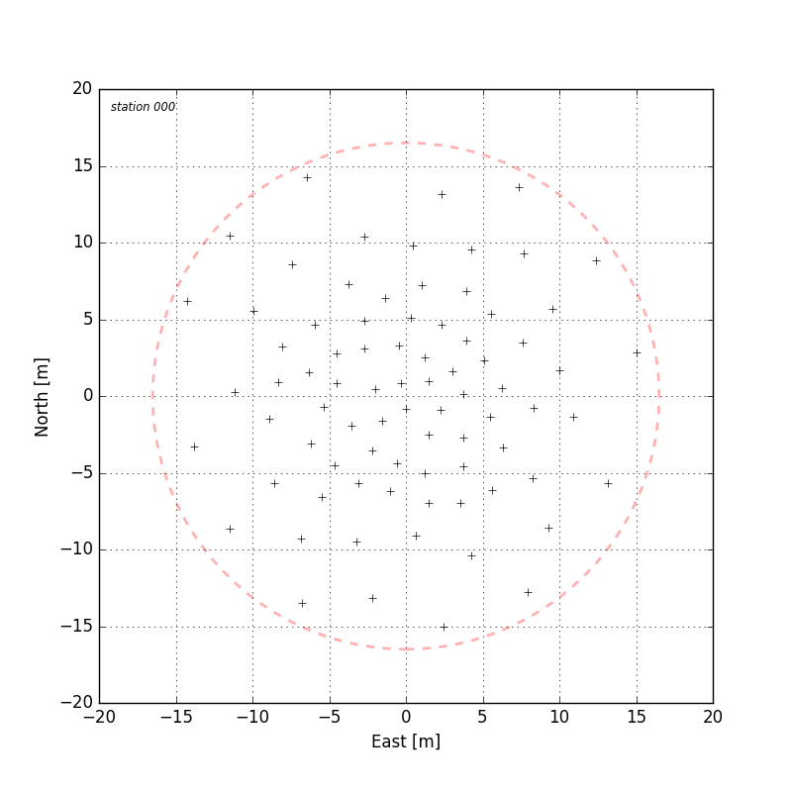
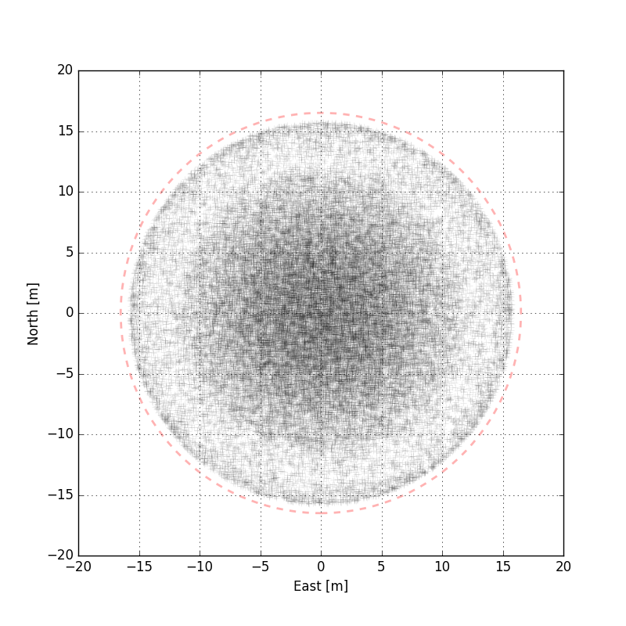
V4D stations: Randomly generated station antenna positions, -28 db Taylor thinning
Randomly generated station orientations
80 antennas per station, 510 stations, 33 m diameter
Single station
Superposition of all stations

Slide 29



V4D station beams: Randomly generated station antenna positions, -28 db Taylor thinning
Stokes-I cross-power station beams, 50 MHz, zenith pointing
Cross-power beam
Single baseline
Average cross power beam
all baselines
Average cross power beam
Radial profile
No-apodisation

Slide 30



V4D station beams: Randomly generated station antenna positions, -28 db Taylor thinning
Stokes-I cross-power station beams, 350 MHz, zenith pointing
Cross-power beam
Single baseline
Average cross power beam
all baselines
Average cross power beam
Radial profile
No-apodisation
Notes:
Thinning suppresses sideblobes but not as well as with weighting

Slide 31


V4X stations: Stations selected from randomly generated super-station ’sea’
Stations selected from super station based on distance from nominal station centres.
Randomly generated station orientations
256 antennas per station, 510 stations, 30-40 m diameter
Single station
Superposition of all stations
Notes:
Note the thinned edge of superposition due to non circular stations
Non circular stations don’t really seem to hurt us too much

Slide 32






V4X station beams: Stations selected from randomly generated super-station ’sea’
Stokes-I cross-power station beams, 50 MHz, zenith pointing
Cross-power beam
Single baseline
Average cross power beam
all baselines
Average cross power beam
Radial profile
No-apodisation
-28 db Taylor weights

Slide 33






V4X station beams: Stations selected from randomly generated super-station ’sea’
Stokes-I cross-power station beams, 350 MHz, zenith pointing
Cross-power beam
Single baseline
Average cross power beam
all baselines
Average cross power beam
Radial profile
No-apodisation
-28 db Taylor weights

Slide 34
Super-station beams
(this section is mainly for reference)

Slide 35


V4A super-stations: Randomly rotated (per sub-station) sub-station centred hexagonal lattice
Pentagon sub-station stencil
Station orientations defined by coordinates in ‘v7ska1lowN1v2arev3R.enu.564x4.txt’
48 antennas per sub-station, 1728 antennas per super-station, 94 super-stations, ~90 m diameter
Single super-station
Superposition of all super-stations

Slide 36






V4A super-station beams: Randomly rotated sub-station centred hexagonal lattices
Stokes-I cross-power station beams, 50 MHz, zenith pointing
Cross-power beam
Single baseline
Average cross power beam
all baselines
Average cross power beam
Radial profile
No-apodisation
-28 db Taylor weights

Slide 37






V4A super-station beams: Randomly rotated sub-station centred hexagonal lattices
Stokes-I cross-power station beams, 350 MHz, zenith pointing
Cross-power beam
Single baseline
Average cross power beam
all baselines
Average cross power beam
Radial profile
No-apodisation
-28 db Taylor weights
Notes:
Hexagonal lattice grating lobe structure seen again

Slide 38


V4A super-stations: Randomly generated sub-station antenna positions
Pentagon sub-station stencil
Station orientations defined by coordinates in ‘v7ska1lowN1v2arev3R.enu.564x4.txt’
24 antennas per sub-station, 868 antennas per super-station, 94 super-stations, ~90 m diameter
Single super-station
Superposition of all super-stations

Slide 39






V4A super-station beams: Randomly generated sub-station antenna positions
Stokes-I cross-power station beams, 50 MHz, zenith pointing
Cross-power beam
Single baseline
Average cross power beam
all baselines
Average cross power beam
Radial profile
No-apodisation
-28 db Taylor weights

Slide 40






V4A super-station beams: Randomly generated sub-station antenna positions
Stokes-I cross-power station beams, 350 MHz, zenith pointing
Cross-power beam
Single baseline
Average cross power beam
all baselines
Average cross power beam
Radial profile
No-apodisation
-28 db Taylor weights

Slide 41


V4D super-stations: Randomly generated station antenna positions
Randomly generated station orientations
180 antennas per station, 1080 antennas per super-station, 85 super-stations, ~90 m diameter
Single super-station
Superposition of all super-stations

Slide 42






V4D super-station beams: Randomly generated station antenna positions
Stokes-I cross-power station beams, 50 MHz, zenith pointing
Cross-power beam
Single baseline
Average cross power beam
all baselines
Average cross power beam
Radial profile
No-apodisation
-28 db Taylor weights

Slide 43






V4D super-station beams: Randomly generated station antenna positions
Stokes-I cross-power station beams, 350 MHz, zenith pointing
Cross-power beam
Single baseline
Average cross power beam
all baselines
Average cross power beam
Radial profile
No-apodisation
-28 db Taylor weights

Slide 44


V4D super-stations: Randomly generated station antenna positions, -28 db Taylor thinning
Randomly generated station orientations
80 antennas per station, 480 antennas per super-station, 85 super-stations, ~90 m diameter
Single super-station
Superposition of all super-stations

Slide 45



V4D super-station beams: Randomly generated station antenna positions, -28 db Taylor thinning
Stokes-I cross-power station beams, 50 MHz, zenith pointing
Cross-power beam
Single baseline
Average cross power beam
all baselines
Average cross power beam
Radial profile
No-apodisation
Notes:
Large near in sidelobes due to azimuthal ring gap at 1 station diameter

Slide 46



V4D super-station beams: Randomly generated station antenna positions, -28 db Taylor thinning
Stokes-I cross-power station beams, 350 MHz, zenith pointing
Cross-power beam
Single baseline
Average cross power beam
all baselines
Average cross power beam
Radial profile
No-apodisation

Slide 47


V4X super-stations: Super-station ’sea’
1536 antennas per super-station, 85 super-stations, ~85m diameter
Single super-station
Superposition of all super-stations

Slide 48






V4X super-station beams: Super-station ’sea’
Stokes-I cross-power station beams, 50 MHz, zenith pointing
Cross-power beam
Single baseline
Average cross power beam
all baselines
Average cross power beam
Radial profile
No-apodisation
-28 db Taylor weights

Slide 49






V4X super-station beams: Super-station ’sea’
Stokes-I cross-power station beams, 350 MHz, zenith pointing
Cross-power beam
Single baseline
Average cross power beam
all baselines
Average cross power beam
Radial profile
No-apodisation
-28 db Taylor weights

Slide 50
Summary of results

Slide 51







V4D vs V4X: Station beams
Discrete stations vs sea of elements?
------------------ 50 MHz ------------------
------------------ 350 MHz ------------------
V4D
V4X
V4D
V4X
Notes:
Natural apodisation of stations at 350MHz V4X due to rotation of non circular stations?

Slide 52








V4D vs V4X: Super-station beams
Discrete stations vs sea of elements?
------------------ 50 MHz ------------------
------------------ 350 MHz ------------------
V4D
V4X
V4D
V4X
Notes:
V4X is far more regular in its beam shape azimuthally. Azimuthal ring in the super-station near radius of the inner station edge causes larger inner sidelobe.

Slide 53
V4D vs V4X: Super-station beams
Discrete stations vs sea of elements?
The increased flexibility in forming stations from the sea of elements (V4X) results in station and super-station beams with lower and more well behaved sidelobe levels.
The ‘gap’ in the superimposed rotated super-station for V4D leads to higher inner sidelobes.

Slide 54







Apodisation vs Thinning: Station beams
------------------ 50 MHz ------------------
------------------ 350 MHz ------------------
Apodised V4D
Thinned V4d
Apodised V4D
Thinned V4X
Notes:
Over-thinning! Otherwise thinning has a similar effect

Slide 55








Apodisation vs Thinning: Super-station beams
------------------ 50 MHz ------------------
------------------ 350 MHz ------------------
Apodised V4D
Thinned V4d
Apodised V4D
Thinned V4X
Notes:
Thinned has large inner sidelobe due to ’gap’ at edge of inner station in the super station

Slide 56
Apodisation vs Thinning: Super-station beams
Thinning and apodisation give qualitatively similar results for zenith pointings
Thinning removes all flexibility for beam optimisations
Thinning results less control over the side-lobes
Super-station beams of the thinned array suffer from the introduction of the ’gap’ in the antenna density near the edge of the inner station, which leads to high inner sidelobes.

Slide 57
Answers to questions

Slide 58
Answers to questions
Q1: Ideal station diameter?
  Answer has to come from science analysis
Q2: Argument for multiple station sizes?
  Answer has to come from science analysis, but building in flexibility unless it greatly impacts cost sounds like a good idea.
Q3: Ratio of area in core to outer stations
  Again, answer has to come from science analysis. Point source removal will require sufficient sensitivity on the longer baselines to not be confusion limited.

Slide 59
Answers to questions
Q4: Must all station configurations be identical?
  For imaging we believe it will be helpful if the station beams, and resulting average cross-power beam are as stable as possible as this will lessen the requirement for direction dependent corrections during imaging. Indeed it may be even desirable to dynamically reshape stations to make this possible which can be achieved using a sea of elements.
  Use of mixed station sizes for calibration would need further analysis.
  While we believe that common station sizes are a good thing, our studies of Far Sidelobe Source Noise (FSSN) (arXiv:1602.01805 [astro-ph.IM]), have shown that the noise picked up by the far-out sidelobes can be dramatically reduced in the interferometric sense if each station’s antenna configuration is different. This is easily achievable since each station can have a different pseudo-random configuration whilst maintaining a given minimum distance criteria.

Slide 60
Answers to questions
Q5: Benefit of different station sizes? What are the ideal sub-station, station and super-station sizes?
  Superstations will reduce the instantaneous field-of-view but provide greater control of station side-lobes.
  If substations are allowed, it is unlikely to be possible to correlate them all (because of the large number).
  For many standard imaging observations which don’t require a large FoV having the option to use large super-stations (leading to lower sidelobe levels) will result in lower contamination from sources in sidelobes (FSSN).
  (Nima to explain) The level of station sidelobes scale as the inverse of the number of antennas, therefore a larger station will result in lower far-out sidelobes. Furthermore, the number of controllable sidelobes (or coherent sidelobes) increases as ~0.3sqrt(N), where N is the number of antennas in a given station. However these will have a width roughly defined as wavelength/2D, where D is the station diameter. Despite this, having “greater control” of sidelobes in a superstation is not really true. It should be noted that some undesirable grating responses will be present in a superstation beam if there is a non-uniform (approx.) distribution of antennas. As such petal-like structures will suffer from such effects.

Slide 61
Answers to questions
Q6: Technical impediments to multiple station diameters
  None / possibly cost
Q7: Technical impediments to building and using substations and super-stations
  None / possibly cost

Slide 62
Answers to questions
Q8: For / against physical tapering
  Weight tapering provides many of the same benefits as spatial or “physical” tapering of antennas. Depending on the approach taken, there can be a loss in sensitivity even in spatial tapering. If the minimum distance requirement which is mostly based on the antenna footprint is maintained, some beamshaping (only over the controllable sidelobes) can be achieved with minimal loss of sensitivity. Note, however, that the region of controllable sidelobes in l-m space decreases the more the array is thinned out, because while the number of antennas may remain the same, the array diameter would surely have to increase. The biggest argument against such an approach is the variable station sizes, which will no longer be feasible if spatial tapering is employed. Weight tapering can also be designed with minimal loss of sensitivity, with the added benefit that variable station sizes can be allowed under such an approach. Reducing the controllable sidelobes by 10+ dB using weight tapering will result in approx. a 15% loss in sensitivity.

Slide 63
Answers to questions
Q9: Ideal antenna density? Dense/ sparse transition frequency?
  Whilst we cannot comment on what is the “optimal” distribution, it is clear that the highest density is limited to the antenna footprint (typically 1.5m). Based on current density requirements in the baseline design, an average antenna spacing of ~1.9m is obtained, as such resulting in a dense/sparse transition region around 80 MHz.
  An important factor which is often ignored in the calculation of antenna density or packing, is that with a pseudo-random configuration which has a minimum distance spacing equal to a desired regular lattice spacing, an approx. packing density of only 2/3 will be achieved in comparison to the regular lattice.
  Images of the average cross power station beam (shown here) as well as our studies of the effects of FSSN suggest that the precise value of the dense sparse transition frequency does not impact the standard imaging performance when using randomised stations.

Slide 64
Answers to questions
Q10: Cost / benefit of a ‘sea of antennas’ approach for a super-station?
  Adopting a sea of elements would allow some optimisation of the station beams over what can be achieved with a more fixed layout (see V4D vs V4X slide).
  Dynamic reshaping of stations is far more practical when using a sea of elements.
  The sea of elements would also permit the formation of different stations effectively randomizing the side lobes and allowing larger integration times (Mort, Dulwich, Razavi, de Lera, Grainge, MNRAS 2016 - submitted).

Slide 65
Take home messages (reprise)
Regular arrays should be avoided!
We need to develop a new station configuration with consideration for the electromagnetic effects and geometric limitations → V5 needed!

