Slide 1
Extragalactic continuum SWG considerations on SKA1-LOW
Rossella Cassano (co-Chair)
INAF-Osservatorio di Radioastronomia (Bologna, Italy) on behalf of the SKA Extragalactic Continuum SWG
Third SKA1-LOW calibration consultation

Slide 2
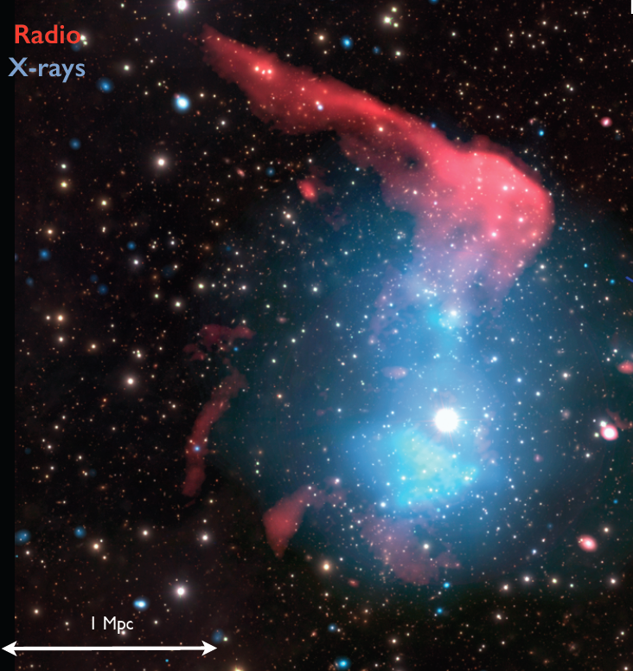
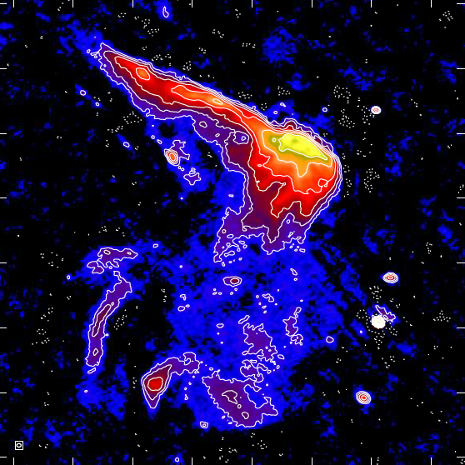
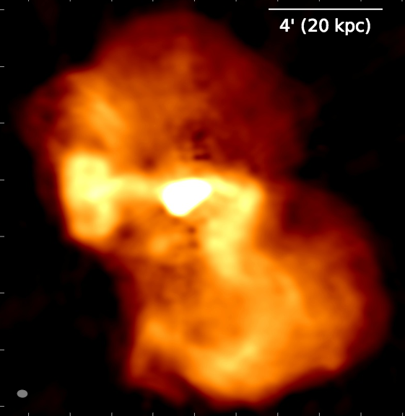
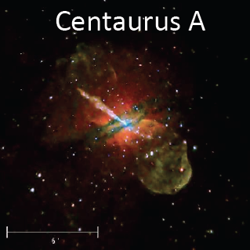
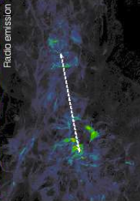
Extragalactic Continuum Science with SKA1-LOW
Diffuse relativistic plasmas in the Universe
Galaxy Clusters: Halos, Relics,… …
Radio Loud AGN (radio galaxies and RL quasars)
LOFAR
M87, LOFAR
van Weeren et al. 16
Cosmic Filaments
de Gasperin et al. 12
Origin of NT-components
Impact of NT-comp. on the ICM microphysics and cluster dynamics
-first detection of shocked WHIM
Life-cycle (birth, life, death) of radio galaxies
Physics of radio emitting regions: jets, lobes..
-high-z AGN, low accretion-rate AGN
-AGN “feedback” and galaxy formation & evolution
Vazza et al. 15
Third SKA1-LOW calibration consultation

Slide 3
Take Home Messages
To make SKA1-LOW an instrument able to perform high level continuum science, and not only EOR/CD and pulsar science, long baselines (now B_{max}~65 km is marginally sufficient, lower than LOFAR B_{max}~90 km, only Dutch stations) and configurations with enough remote stations, at least half of the stations outside of the core (the more outside the core the better for most survey work) are necessary.
Retain long baselines is important not only to avoid to have confusion noise-limited images, but also for a proper direction dependent calibration, that is the only way to obtain deep high resolution (and high dynamic range) low frequency images.
Given this premises, the current SKA1-LOW V4D configuration with 58% of antennas in the core (<1.7 km) is still the preferred solution against the proposed more centrally concentrated configurations (BD-RBS and V4A).
Third SKA1-LOW calibration consultation

Slide 4
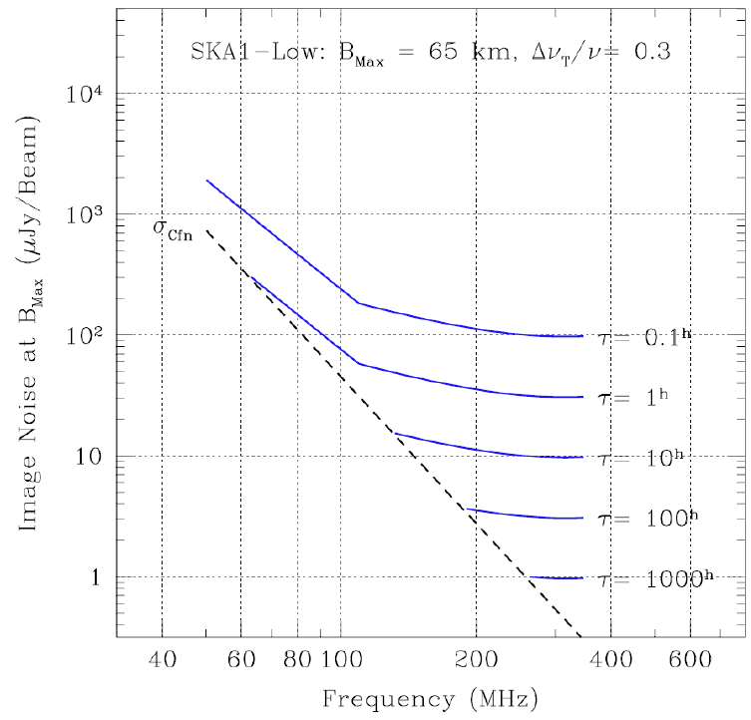
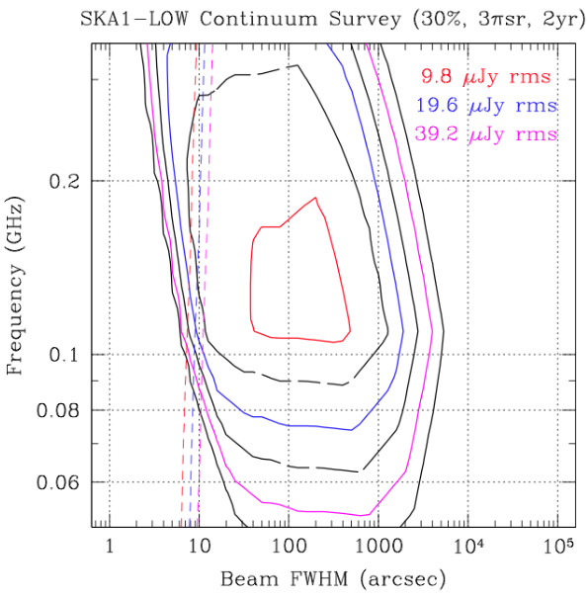
SKA1-LOW continuum surveys
V4D
from Dewdney et al. (in Approach to Agenda…)
LOFAR Tier 1
from SKA1-LOW configuration doc
(30% BW, 3π sr, 2 yr) continuum surveys at 120-150 MHz will reach almost the confusion noise, rms~20 μJy/beam at a resolution of ~10”. To get rid of confusion one needs to move at > 200 MHz, reaching a noise of 10 μJy/beam (which is above the expected confusion level of 3 μJy/b).
deeper imaging with longer integration time, i.e., 100-1000 hours per field is almost prohibitive below ~200-250 MHz, even at the longest baselines.
Third SKA1-LOW calibration consultation

Slide 5
Responses to some questions
(mainly from LOFAR lessons learned for "general surveys type" of work)
Keep the stations sizes reasonable, i.e.> 30m (not smaller) => (Ex.: LOFAR LBA inner configuration: FoV is so large that computers can not really handle it, for large FoV prefer multi-beaming; Collecting area may need to be sacrificed in favor of a well-behaved, predictable station beam response ).
Stations with the same sizes are preferable (i.e, not remote stations that are a factor of two larger than the core).
There could be some advantage in the use of substations for shortest baselines to address missing flux issues of very extended sources faced by all interferometers. Correlating all substations may not be possible - but in sub-array mode it will be possible by keeping number of baselines at manageable level.
The LOFAR instantaneous outer uv-coverage is not good, and there are cases where the self-calibration convergence is poor (dozens of "selfcal" cycles are needed for high-dynamic range). Enough remote stations (i.e., not just 10-20) are needed, at least half of the stations outside of the core (the more outside the core the better for most survey work). The proposed V4D configuration looks good in this aspect.
Third SKA1-LOW calibration consultation

Slide 6
Responses to some questions
(mainly from LOFAR lessons learned for "general surveys type" of work)
“facet calibration” is fundamental to calibrate low-frequency radio data (LOFAR,SKA1-LOW) (see: van Weeren et al. 2016, ApJS in press, arXiv:1601.05422v1). Sufficient S/N in about ~100 directions is needed to obtain phase-only solutions on few second timescales for about 2 MHz bandwidth to calibrate the ionosphere (to prevent decorrelation by TEC, and avoid more complicated wideband calibration schemes which are very (too) slow at the moment) and obtain high dynamic range images.
Having long baselines makes the calibration problem easier (for survey type of work) because (1) you can initially exclude short baselines in the calibration so there is less worry about not modeled diffuse components and (2) with long baselines you get more fringe separation between sources meaning you can take advantage of bandwidth/time smearing to "isolate" your calibration problem in a specific direction. In addition, for very high dynamic range it could be an advantage to build accurate source models at a resolution that is a bit higher (factor of ~2, but this depends on many other things) than the default survey science resolution (so you can more accurately subtract these bright sources).
Having baselines of at least 60-100 km is a must for many continuum science cases. LOFAR HBA did well in this respect (except that more stations should have been build to fill gaps in the uv-plane).
Third SKA1-LOW calibration consultation

Slide 7
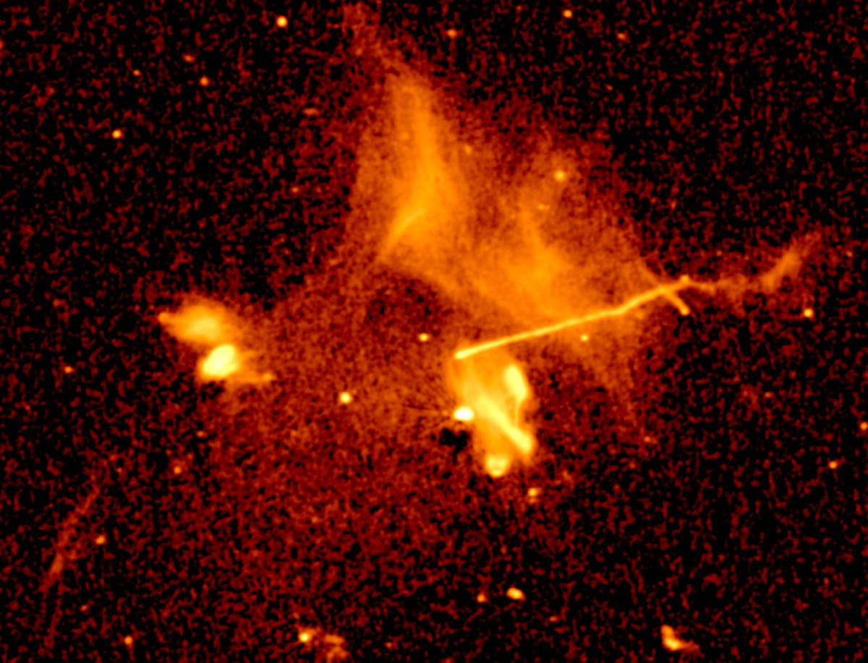
LOFAR Abell 2256
120-180 MHz, 5 arcsec, rms=100 μJy/beam
THANKS!
Image Credits: Reinout van Weeren
Third SKA1-LOW calibration consultation

Slide 8
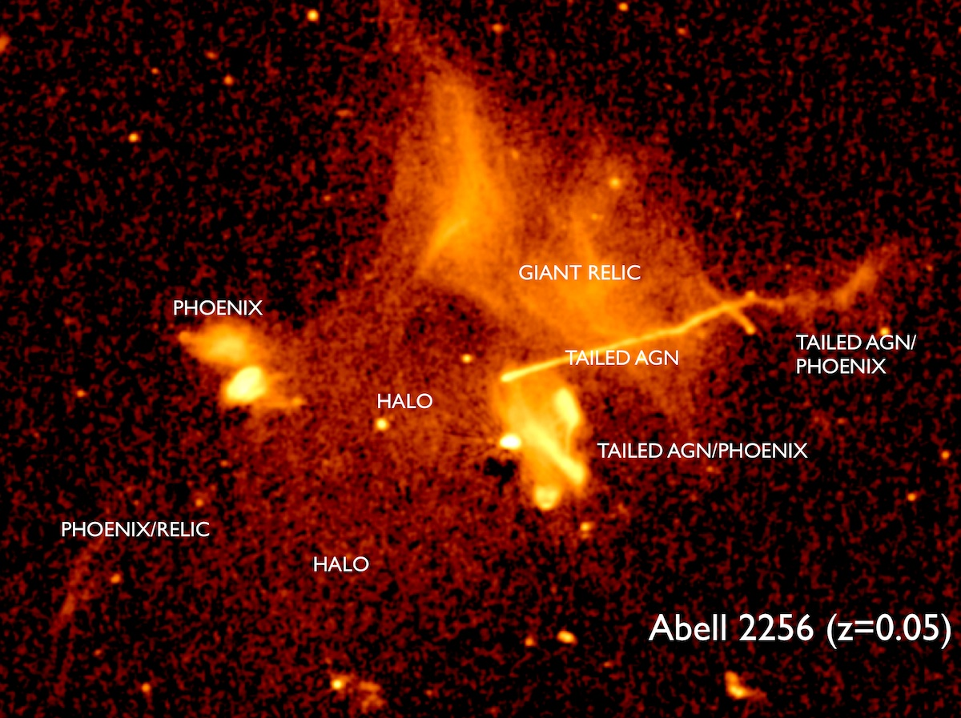
LOFAR Abell 2256
120-180 MHz, 5 arcsec, rms=100 μJy/beam
Image Credits: Reinout van Weeren

