Slide 1
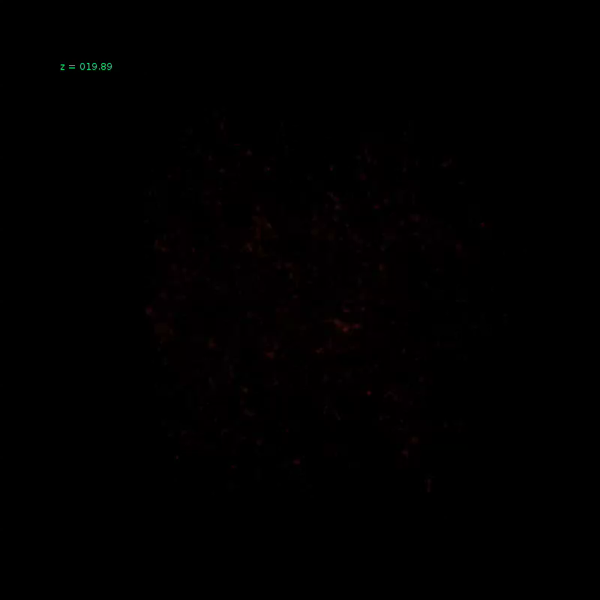



SKA1-low design impact on EoR & Cosmic Dawn science
http://homepage.sns.it/mesinger/EOS.html
Andrei Mesinger
& Brad Greig
for the EoR/CD SWG

Slide 2
What to expect for the Cosmic Signal?
We know almost nothing: expect the unexpected…
2σ
1σ
2σ
Reionization history is weakly constrained
Reionization astrophysics is completely unconstrained
Greig & Mesinger, in prep
see also Mitra+ 2015

Slide 3
We want to find the missing population of first galaxies
Galaxy candidates have been found out to z~10. Are these the sources of reionization?? Estimates suggest they are too few…
Bouwens+(2014)

Slide 4
Tip of the iceberg

Slide 5

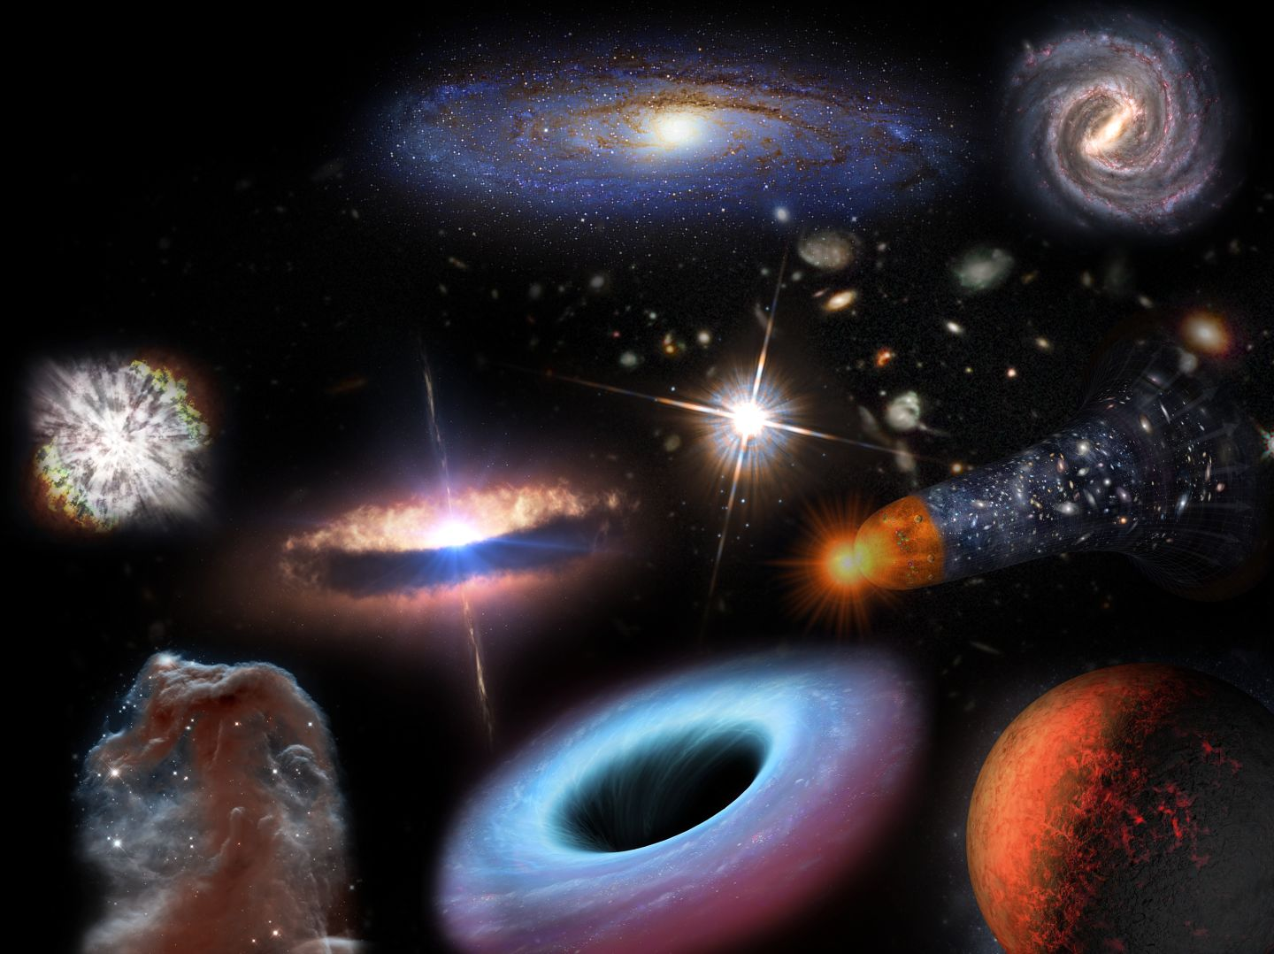
M_{AB}= -22
M_{AB}= -18
Hubble limit
JWST limit
M_{AB}= -14
HERE THERE BE MONSTERS!
hidden population of
abundant ,faint galaxies??
H-cooling threshold
M_{AB}= -10
H₂ cooling
M_{AB}= - 6

Slide 6
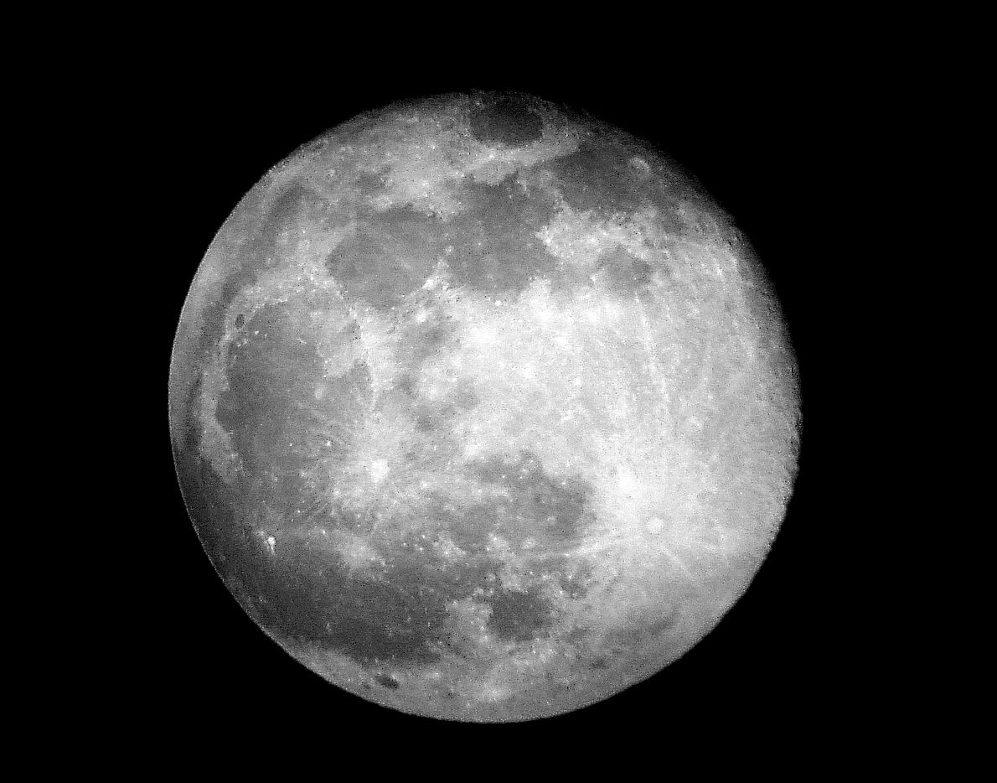
How do we detect the first galaxies?
Galaxy clustering + stellar properties → evolution of large-scale EoR/CD structures
94 Mpc ~
30 arcmin
McQuinn+ 2007
Abundant, faint galaxies
vs
Rare, bright galaxies

Slide 7
Pictures are nice, but we need numbers
Common/simple statistic: power spectrum during EoR
PS at the same mean neutral fraction
Power (mK²)
Greig & Mesinger (2015)

Slide 8
Pictures are nice, but we need numbers
Common/simple statistic: power spectrum during EoR
PS at the same mean neutral fraction
Factor of ~10 variation on large scales between astrophysical models, at a fixed EoR epoch.
Factor of ~2 variation on small scales between astrophysical models, at a fixed EoR epoch.
Power (mK²)
hint: large-scale power is a better discriminant of EoR astrophysics
Greig & Mesinger (2015)

Slide 9
Can we detect this?
Compare four SKA1-Low designs, for a 1000 h observation
Design #4 from Greig+2015: 2014 Baseline Design + packed core, ½ number of antennas per station, 866 x 25m stations in R~1km core
Flower design (V4D):
564 x 30m stations, no substations,
All stations correlated.
Flower design w. 512 substations (V4A_512):
3384 x 10m substations (1440 in core),
N=512 correlations of core substations.
Flower design w. substations (V4A):
3384 x 10m substations (1440 in core),
All substations correlated.

Slide 10
Can we detect this?
PS sensitivity, foreground avoidance (e.g. Pober+2014)
Design #4 from Greig+2015 is best at reducing thermal noise.
V4A with full (N=1400 in core) substation correlation is best at reducing cosmic variance.
V4A with only N=512 correlations is generally the worst in terms of total S/N, though not so bad at EoR parameter recovery…

Slide 11
Bayesian EoR parameter recovery
Use 21CMMC (Greig & Mesinger 2015) to recover astrophysical constraints → better “figure of merit” than S/N
21CMMC (Greig & Mesinger 2015)
https://github.com/BradGreig/21CMMC
(V4D)
V4A)
V4A)
2σ constraints
As seen earlier, EoR parameters are more sensitive to evolution of large-scale power→ favors minimizing cosmic variance.
EoR winners: Design#4 and V4A with full correlations

Slide 12
But there is so much more…
In addition to statistical characterization of EoR, the transformational SKA1-Low science will be (i) EoR tomography (see Cath’s talk) and (ii) Cosmic Dawn

Slide 13
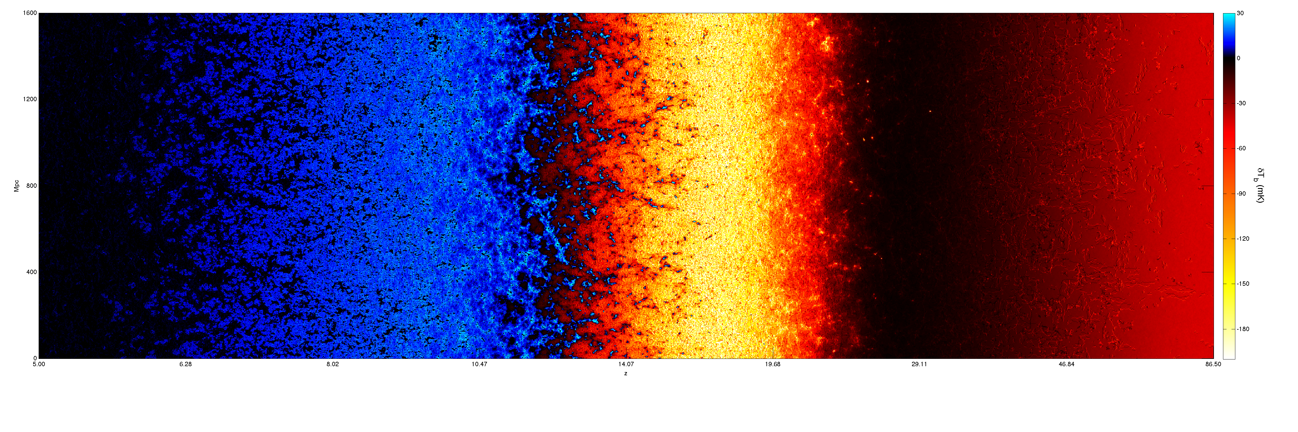
Faint galaxies model
1 Gyr
300 Myr
100 Myr
20 Myr
1.6 Gpc
~9 deg
Reionization
X-ray heating
Lyα coupling
Dark Ages
Evolution of 21cm Structure (EOS) 2016 data release. Mesinger+ (2016)

Slide 14
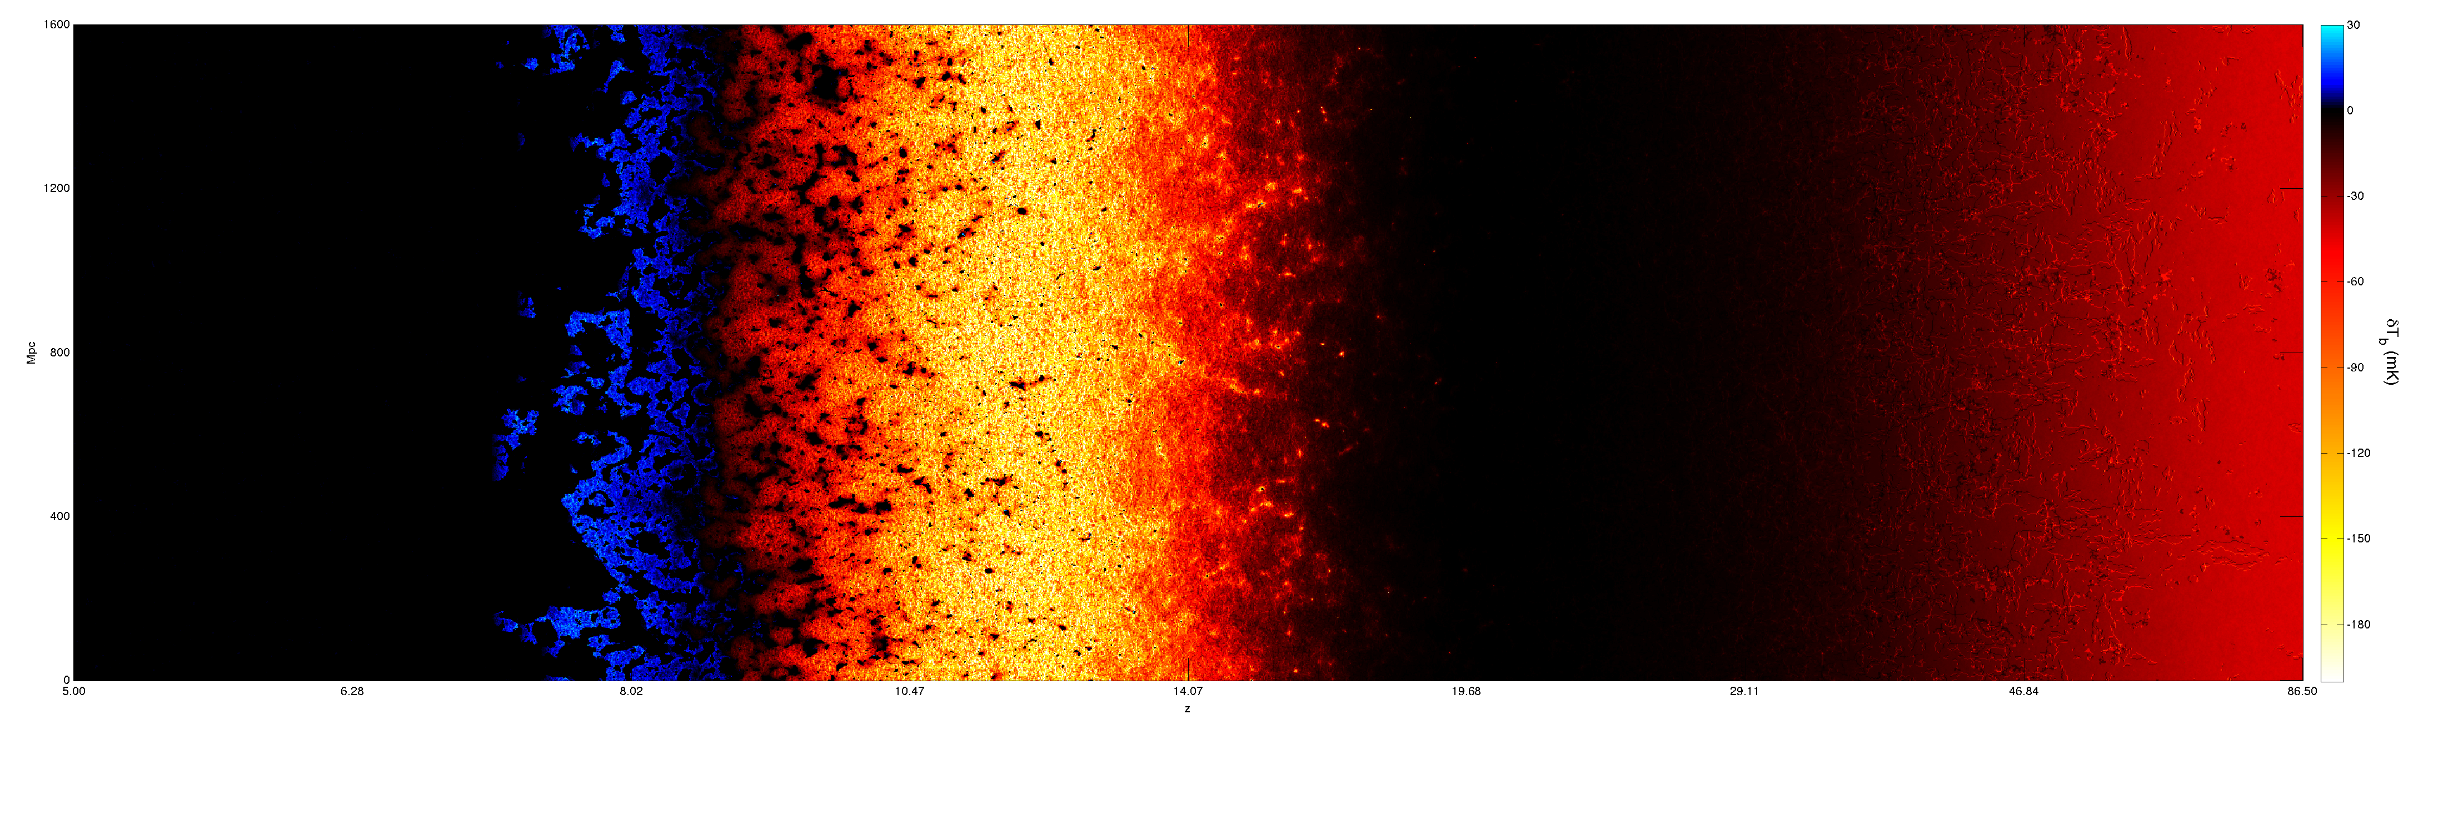
or…. Bright galaxies model
1 Gyr
300 Myr
100 Myr
20 Myr
Reionization
X-ray heating
Lyα coupling
Dark Ages
Evolution of 21cm Structure (EOS) 2016 data release. Mesinger+ (2016)

Slide 15
21cm structures tell the story of unseen galaxies

Slide 16
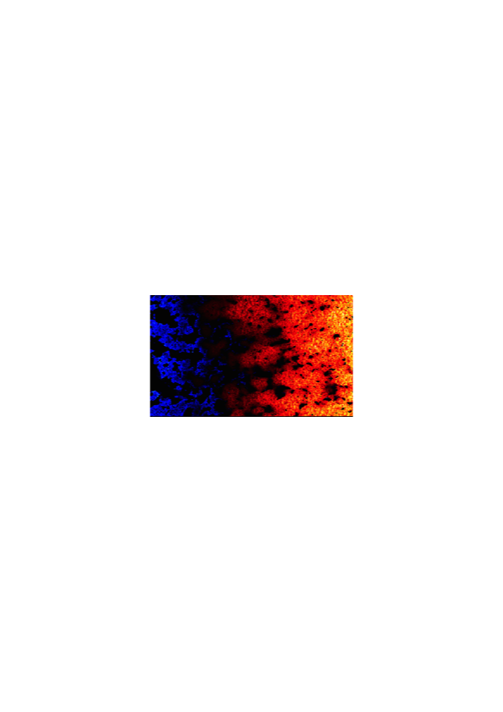
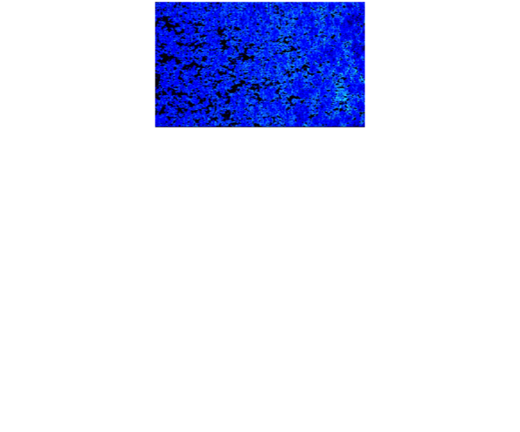
21cm structures tell the story of unseen galaxies

Slide 17
Total S/N evolution
Faint galaxies
Overall S/N winner is: V4A with full substation correlation.
We need to correlate the inner N~1000 substations for V4A to be better than V4D during Cosmic Dawn.
V4A_512 would be a comparable instrument to HERA.
Bright galaxies
High S/N during EoR and X-ray heating should allow imaging!
Mesinger, Greig, Sobacchi (2016)

Slide 18
Conclusions
We don’t know what is out there so we need to be flexible.
EoR parameter constraints prefer packed cores and wide beams minimizing cosmic variance (large modes, k~0.1/Mpc, best descriminate EoR models).
  Substations (V4A) can improve EoR parameter constraints over V4D by up to a factor of 2.
  Improvements scale with number of correlations (up to N~1400 in the core). Note correlator prices decrease with time!
EoR tomography and calibration → see Cath’s talk
Cosmic Dawn detections are more sensitive to thermal noise than the EoR at higher frequencies. Winners are:
  V4A with complete substation correlation;
  V4D (factor of ~2 lower S/N than V4A with complete correlation)
Suggestions:
  Be flexible by building V4A with a packed core, waiting until stations are on the ground to buy the best possible correlator, N~1000.
  Be flexible by having antennaes with a flat frequency response over a wide range (the low frequency range of SKA1-Low will be transformational science).

Slide 19
Sensitivity, foreground subtraction

Slide 20
S/N evolution, foreground subtraction
Faint galaxies
Bright galaxies

