Slide 1

EoR/Cosmic Dawn SWG
Feedback on SKA1-Low Array Configuration
Cath Trott
Brad Greig, Leon Koopmans, Andrei Mesinger, Garrelt Mellema, Jonathan Pritchard
EoR/CD Science Working Group

Slide 2
Outline
SKA1 EoR/Cosmic Dawn program:
Power spectrum z = 5.5 – 27
Tomography (image cubes) z = 5.5 – 20
Proposed configurations:
- “Fixed” station size (BD-RBS)
“Physical” substation/station/superstation (V4A)
“Virtual” substation/ “physical” station/superstation (V4D)
Hybrid arrays:
Benefits of forming baselines between different-sized stations
Suggested array design:
Core: “sea-of-elements” flexibility to form virtual substations
Core: maximal correlator capacity to correlate full core sensitivity
Long baselines: individual stations (80-90% core sensitivity)
Third Calibration Consultation Workshop

Slide 3
Summary and recommendations
Flexibility is key for maximising science
Correlator capacity can be pushed to optimise observational strategy
Different observational setups are optimal for different experiments
Ionospheric analysis + EoR/CD analysis suggests an array with:
maximal core sensitivity (80-90%)
no long-baseline superstations (stations-only adequate for ionosphere)
flexibility for forming custom virtual/physical substations (“sea of elements”*)
V4A/BD hybrid with capacity to correlate full core
* Balance sensitivity loss due to packing problem with flexibility of “sea”
Third Calibration Consultation Workshop

Slide 4
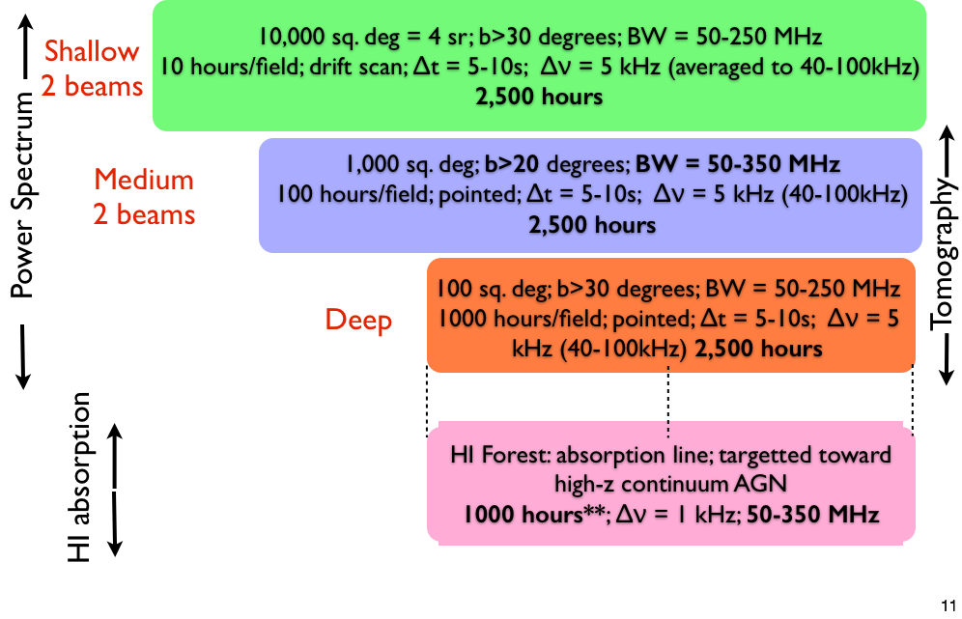
EoR/CD suite of experiments – stations (BD)
Third Calibration Consultation Workshop

Slide 5
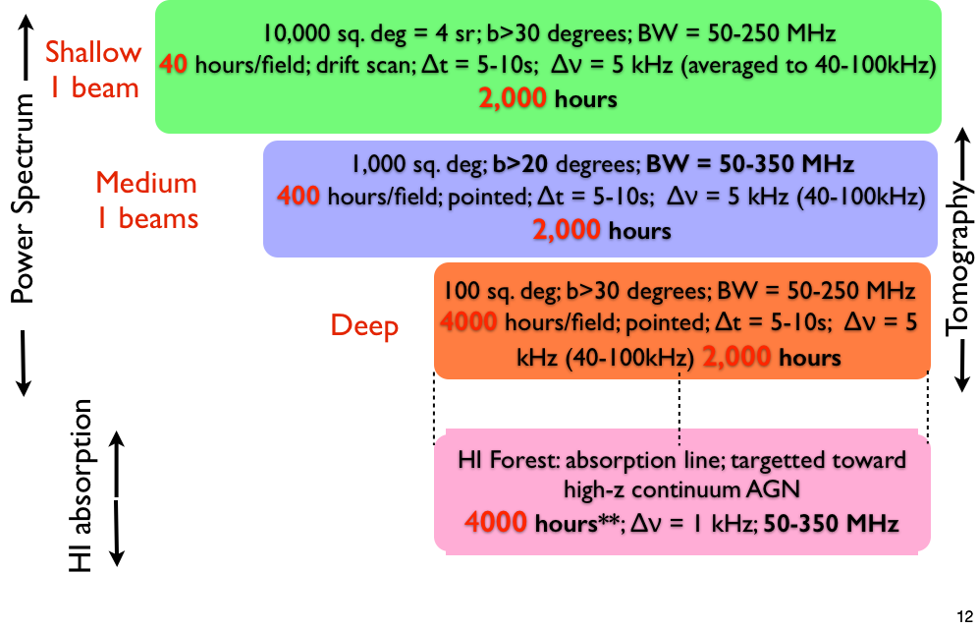
EoR/CD suite of experiments – substations (core: 1764 correlatable entities) – reduce overall observing time
Third Calibration Consultation Workshop

Slide 6
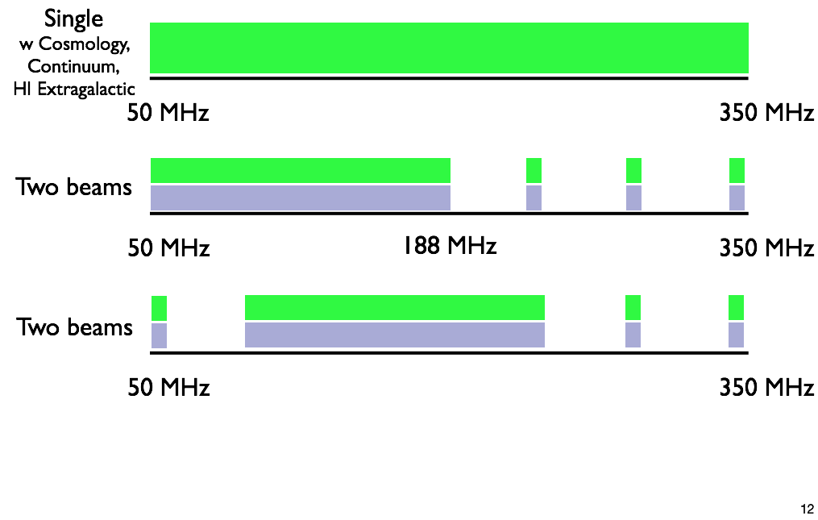
EoR/CD frequency coverage - Stockholm
Flexibility in assigning correlator
Third Calibration Consultation Workshop

Slide 7
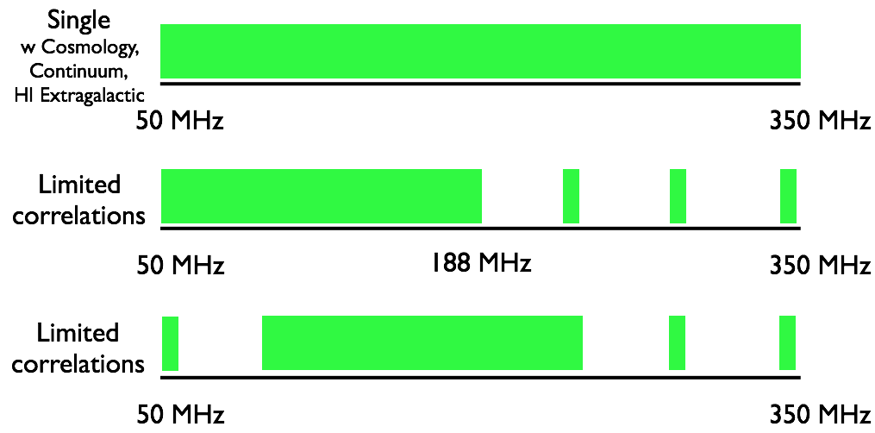
EoR/CD frequency coverage - flexible
Flexibility in assigning correlator
Reducing bandwidth can offset reduction in sensitivity for substations if correlator capacity is limited

Slide 8
Summary of results – power spectrum
See Andrei’s talk for deeper analysis and EoR physics implications
Sample variance significantly reduced with availability of substations (r ≈ 10m) at a large range of redshifts, compared with BD-RBS
Sample variance limited for z ≤ 18 at small k
Thermal noise limited for z ≥ 18 at small k (Cosmic Dawn)
Thermal noise limited at large k for all redshifts
Sample variance unchanged for physical versus virtual substations (V4A/V4D)
Thermal noise worse for virtual substations: packing problem
For Cosmic Dawn, microflowers better than virtual substations (V4A optimal; V4D good; BD-RBS sub-optimal)
ASSUMES CORRELATION OF FULL CORE SUBSTATIONS
Third Calibration Consultation Workshop

Slide 9
Summary of results – tomography
Thermal noise independent of station size, for same collecting area, filling factor and spatial scale
Smaller stations = larger FOV → useful for matching to bubble sizes at low redshift
z > 9, r_{bubble} ≈ 1 Mpc (comoving) ≈ 20 arcsec (30m FOV = 4 deg.)
z ≈ 6, r_{bubble} ≈ 100 Mpc (comoving) ≈ 1 degree (30m FOV = 2.5 deg.)
BD-RBS okay across most redshifts, but too small at z=5-6
V4A optimal for full sensitivity: use stations for z>9, use substations for z<7
V4D okay, but loss of sensitivity (packing problem) impacts noise floor → not likely a problem at low z where sensitivity is good
(V4A optimal; V4D very good; BD-RBS sub-optimal)
ASSUMES CORRELATION OF FULL CORE SUBSTATIONS
Third Calibration Consultation Workshop

Slide 10
Power spectrum – noise considerations
Sample variance determined by number of measurements of a given mode in the observation volume: bigger FOV = less sample variance
Sample variance scales as:
Thermal noise scales as:
  Therefore, for constant collecting area and core size
  Smaller stations are better for sample variance and thermal noise, assuming no loss in sensitivity
Third Calibration Consultation Workshop

Slide 11

Power spectrum – packing problem
V4A allows full sensitivity to be retained for substations. V4D suffers from the “packing problem”: fitting small circles optimally into a larger circle
Third Calibration Consultation Workshop

Slide 12



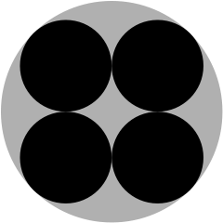
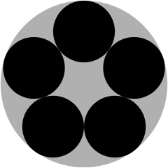
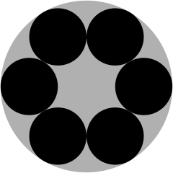
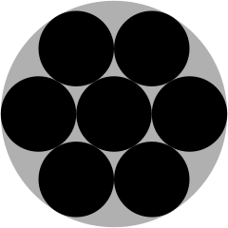
Power spectrum – packing problem
# circles | Radius (cf unity) | Density | Optimal configuration | Δ² (V4A) | Δ² (V4D)
1 | 1 | 1 |  | 1 | 1
2 | 0.5 | 0.5 |  | 0.5 | 2
3 | 0.46 | 0.65 |  | 0.46 | 1.11
4 | 0.41 | 0.69 |  | 0.41 | 0.88
5 | 0.37 | 0.69 |  | 0.37 | 0.79
6 | 0.33 | 0.67 |  | 0.33 | 0.55
7 | 0.33 | 0.78 |  | 0.33 | 0.56
Third Calibration Consultation Workshop

Slide 13
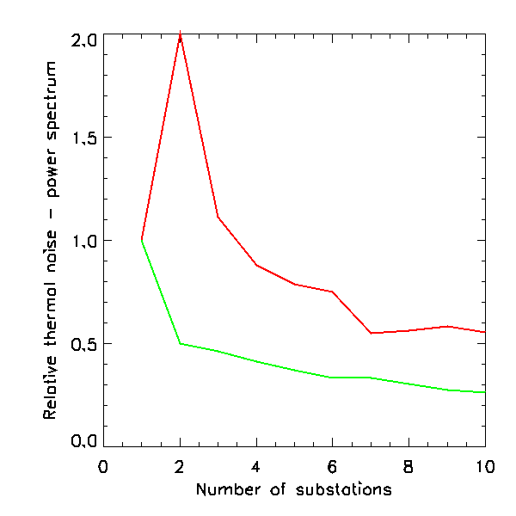
Power spectrum – packing problem
Thermal noise relative to a full station:
V4A
V4D
-> Factor of ~2 worse performance for V4D with full core sensitivity
V4D
V4A
Third Calibration Consultation Workshop

Slide 14
Correlation versus sample variance balance
If we choose to beamform stations with R<27m, how many can we beamform? What are the correlator limitations?
6 substations per station:
Design name | Configuration | Core substations | Sensitivity retained
Flower design (V4D) | 49 core + 36 outer superstations | No substations; 27m stations | 100%
Substations (V4A) | 49 core + 0 outer superstations | 49x6x6 = 1764 | 100%
“Design A” | 14.2 core + 0 outer superstations | 512 | 29%
“Design B” | 8.2 core + 36 outer superstations | 296 | 17%
Third Calibration Consultation Workshop

Slide 15
Power spectrum – sensitivity – “high” z
Sensitivity curves courtesy of Brad Greig
**See Andrei’s talk for deeper analysis**
ASSUMPTIONS: Full correlation of core stations or substations
Sample variance reduced for substations for z < 20
Thermal noise slightly reduced (when full sensitivity retained)
Third Calibration Consultation Workshop

Slide 16
Power spectrum – sensitivity – “high” z
Sensitivity curves courtesy of Brad Greig
**See Andrei’s talk for deeper analysis**
ASSUMPTIONS: Correlation of 512 core substations (reduced sensitivity – DESIGN A)
Correlation of 296 core substations + 36*6 outer (DESIGN B)
Sample variance reduced for substations
Thermal noise reduced
Third Calibration Consultation Workshop

Slide 17
Power spectrum – conclusions
Array | Comment | Ranking
BD - RBS | Physical 30m stations with no substation capability sub-optimal for sample variance reduction | 3/3
V4A | Full sensitivity with substations** | 1/3 - Best
V4D | Reduced sensitivity with substations** | 2/3
** Assumes full correlation of core substations. See Andrei’s talk for breakeven
→ Can recover loss of sensitivity by reducing BW and increasing #correlations
Third Calibration Consultation Workshop

Slide 18
Tomography – noise considerations
Confusion noise not an issue for a spectral line experiment. Purely FOV and thermal noise
Thermal noise (brightness temperature sensitivity) scales as collecting area, filling factor for the same spatial scale
  -> station size not dominant for noise level
FOV determined by station size: smaller stations = larger FOV
  When might we need a larger FOV? Do not want to match FOV to bubble size → primary beams not uniform. Want to be well-sampled within main lobe. Short baselines are relevant.
V4D with substations worse sensitivity than V4A (packing problem)
Third Calibration Consultation Workshop

Slide 19
Tomography – FOV
Frequency | 30m stations FOV | 10m substations FOV | Redshift, z | Bubble size
50 MHz | 11º | 34º | 27.4 | 20”
100 MHz | 5.7º | 17º | 13.2 | 20”
150 MHz | 3.8º | 11º | 8.5 | 30”
200 MHz | 2.9º | 8.6º | 6.1 | 0.5º - 1º
220 MHz | 2.6º | 7.8º | 5.5 | 2º - 3º
Low redshift bubbles potentially constrained by station primary beam for 30m stations
Third Calibration Consultation Workshop

Slide 20
Tomography – conclusions
Array | Comment | Ranking
BD - RBS | Physical 30m stations with no substation capability sub-optimal for low z imaging | 3/3
V4A | Full sensitivity with substations for FOV | 1/3 - Best
V4D | Reduced sensitivity with substations potentially limiting accessible z | 2/3
Third Calibration Consultation Workshop

Slide 21
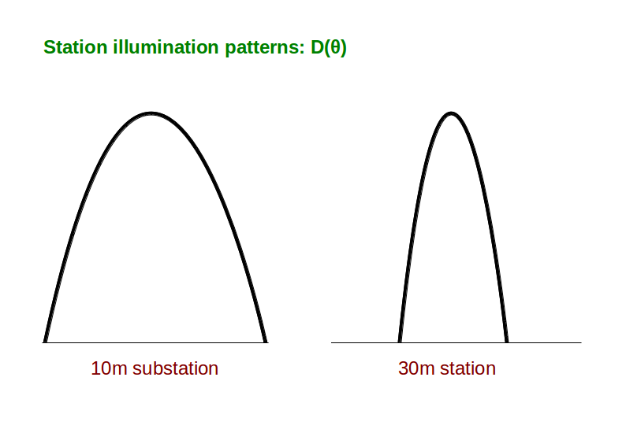
Hybrid station sizes – illumination patterns
Third Calibration Consultation Workshop

Slide 22
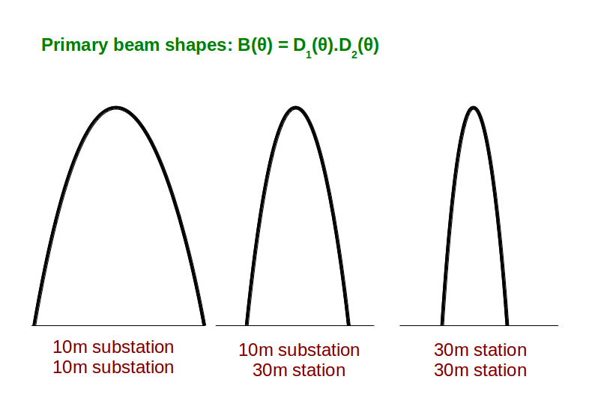
Hybrid station sizes – primary beam
Third Calibration Consultation Workshop

Slide 23
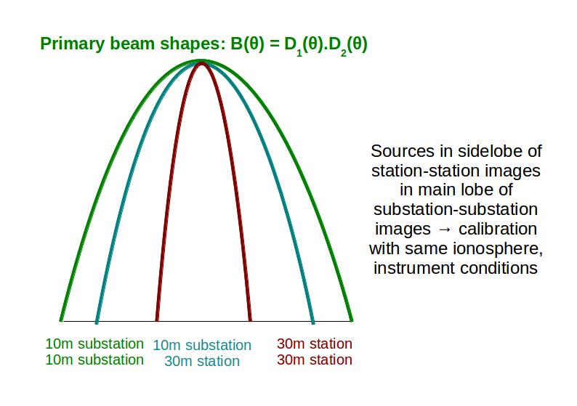
Hybrid station sizes – attenuated sources
Third Calibration Consultation Workshop

Slide 24
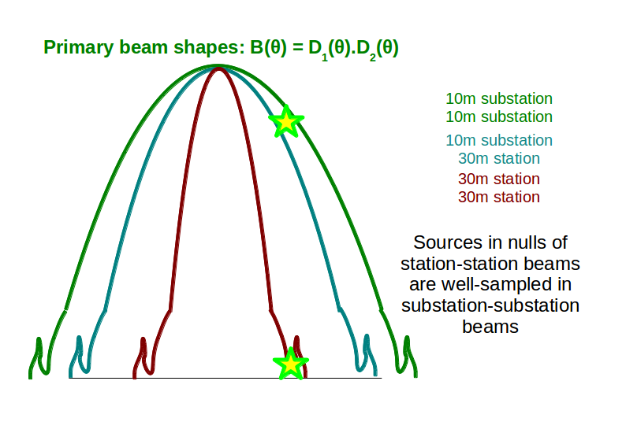
Hybrid station sizes – sources in nulls
Third Calibration Consultation Workshop

Slide 25
Hybrid station sizes – very useful
Availability of multiple station sizes for cross-correlation allows a degree of flexibility that is useful for calibration and science
Calibration: sidelobe sources characterised with same ionosphere, RFI, environmental conditions
EoR/CD science: foreground model measured with large FOV. Science with smaller FOV. Short baselines constrain diffuse structure.
Third Calibration Consultation Workshop

Slide 26
CONCLUSIONS
Availability of multiple station sizes for cross-correlation allows a degree of flexibility that is useful for calibration and science
Calibration: sidelobe sources characterised with same ionosphere, RFI, environmental conditions
Ionosphere: adequate calibration with fewer stations outside core
EoR/CD science: foreground model measured with large FOV. Science with smaller FOV. Short baselines constrain diffuse structure.
OVERALL RECOMMENDATIONS:
Flexibility is key for maximising science
Correlator capacity can be pushed to optimise observational strategy
Different observational setups are optimal for different experiments
Third Calibration Consultation Workshop

Slide 27
Supporting material: power spectra
Sensitivity curves courtesy of Brad Greig
Third Calibration Consultation Workshop

Slide 28
Power spectrum – sensitivity – “high” z
Faint galaxies contribute to Reionisation + “foreground avoidance” strategy
Faint galaxies contribute to Reionisation + “foreground subtraction” strategy
Sensitivity curves courtesy of Brad Greig
Third Calibration Consultation Workshop

Slide 29
Power spectrum – sensitivity – “high” z
Bright galaxies contribute to Reionisation + “foreground avoidance” strategy
Bright galaxies contribute to Reionisation + “foreground subtraction” strategy
Sensitivity curves courtesy of Brad Greig
Third Calibration Consultation Workshop

Slide 30
Power spectrum – sensitivity – “low” z
Sensitivity curves courtesy of Brad Greig
**See Andrei’s talk for deeper analysis**
ASSUMPTIONS: Full correlation of core stations or substations
Sample variance reduced when beamforming substations
Thermal noise slightly reduced (when full sensitivity retained)
Third Calibration Consultation Workshop

Slide 31
Power spectrum – sensitivity – “low” z
Sensitivity curves courtesy of Brad Greig
**See Andrei’s talk for deeper analysis**
ASSUMPTIONS: Correlation of 512 core substations (reduced sensitivity – DESIGN A)
Correlation of 296 core substations + 36*6 outer (DESIGN B)
Sample variance reduced for substations
Thermal noise reduced
Third Calibration Consultation Workshop

