Slide 1
SKA1-Low Error Analysis
Robert Braun, Science Director
25 February 2016

Slide 2
SKA1-Low Configuration
Scientific Constraints:
The highest possible filling factor of both individual stations and the core configuration over the key frequency interval of 100 – 200 MHz.
Instantaneous field-of-view that exceeds about 4 deg² for EoR imaging and 16 deg² for EoR power spectra (both apply to the frequency range 50 – 200 MHz).
Ability to provide excellent quality of ionospheric calibration: enough high sensitivity pierce points.
Ability to provide excellent quality of direction dependent gain calibration: extremely low far sidelobes of station beam.
High sensitivity and good visibility sampling to angular scales of about 10 to 1000 arcsec.
Practical constraints:
Site-specific and maintenance constraints.
Infrastructure Cost.

Slide 3
SKA1-Low Configuration
Desired solution:
Highest possible filling factor of antennas in station tied to a nominal frequency (the λ/2 antenna spacing) of no lower than about 100 MHz.
Tightest practical packing of stations within core consistent with maintenance requirements.
Logarithmic decline of collecting area beyond core: radii of about 350m to 35km.
Smallest total number of extra-core sites plus minimum spanning tree with adequate aperture sampling and instantaneous visibility coverage.
Hierarchical station definition allowing “tuneable” choice of beam-forming scales (discrete or continuous) about 10 – 90 m.
Identical station definition both inside and outside core.

Slide 4
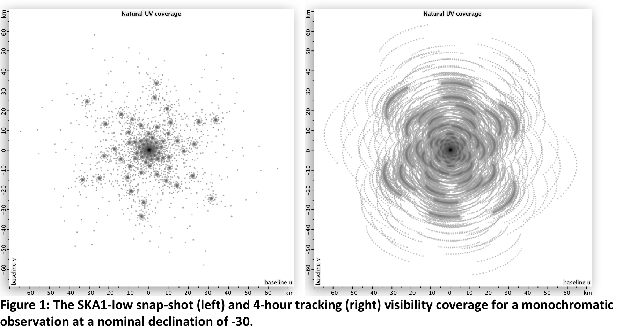
SKA1-Low Configuration

Slide 5
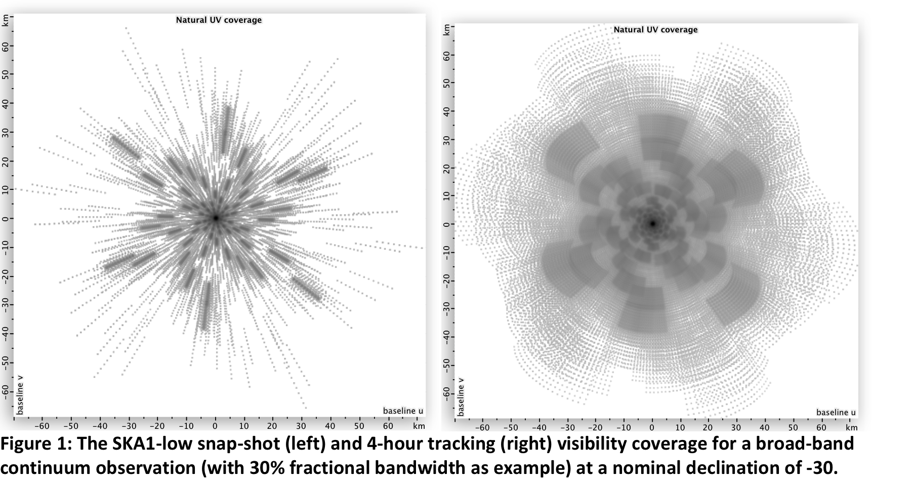
SKA1-Low Configuration

Slide 6
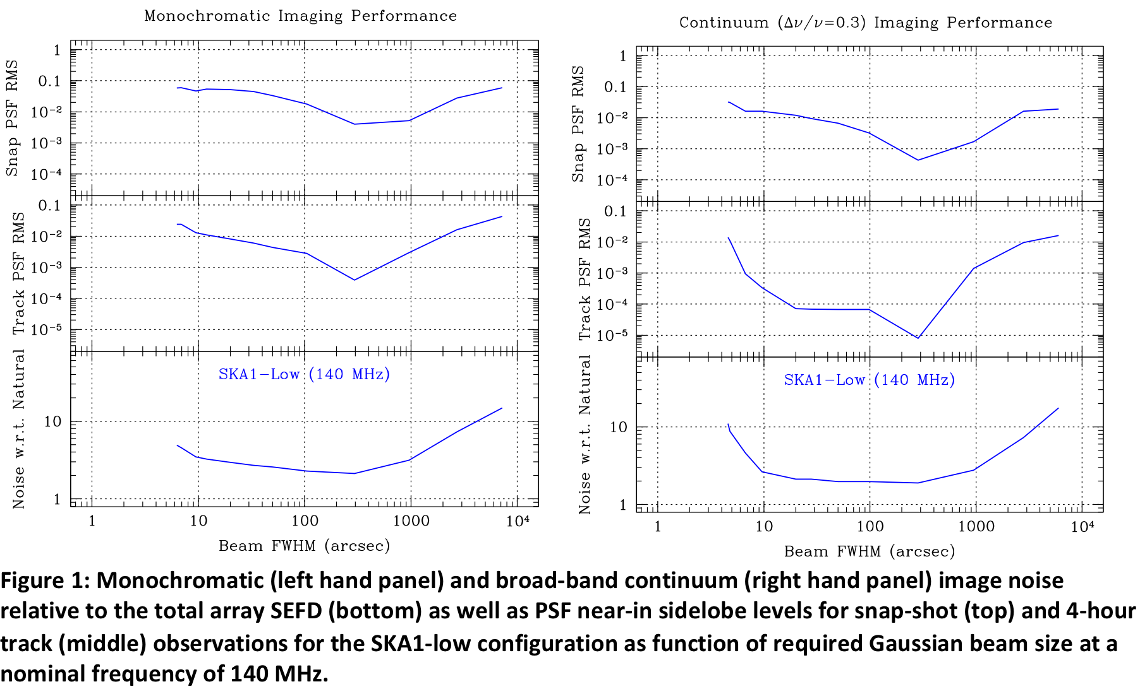
SKA1-Low Configuration

Slide 7
SKA1-Low Instrument/Calibration parms.
Parametric model relating residual calibration errors to effective image noise (Braun, 2013, A&A 551, 91)
Each effect described by both intrinsic magnitude as well as correlation timescale and frequency bandwidth:
σ_{Vis}, τ_{T}, Δν_{F}
Basic unit of observation is an n-hour tracking observation (eg. HA = -4 – +4^{h} or -2 – +2^{h})

Slide 8
SKA1-Low Instrument/Calibration parms.
Distinction between effects due to sources within the image field or outside
  Inside image: standard radiometer equation
  σ_{Map} = σ_{Vis}/[M_{T}M_{F}N(N − 1)/2]^{0.5}
  Outside image: via PSF sidelobes and via self-cal noise propagation
  PSF noise scales as N⁻², self-cal noise as N^{-1.5},
  so self-cal noise dominates for large N (dish/station number)
  σ_{Map} = σ_{Vis} (S_{Max}/S_{Tot}) {N_{C} /[M_{T}M_{F}N²(N − 3)]}^{0.5}
Outcome of multi-track observing campaign depends on nature of each error
  Errors associated with random processes average down as √number tracks
  Errors in source model of sky or description of the stationary instrumental response do not average down

Slide 9
SKA1-Low Instrument/Calibration parms.

Slide 10
SKA1-Low Instrument/Calibration parms.

Slide 11
SKA1-Low Instrument/Calibration parms.

Slide 12
SKA1-Low assumed instrumental parameters

Slide 13
LOFAR-NL Configuration

Slide 14
LOFAR-NL deep integrations
Noise budget for deep integrations

Slide 15
LOFAR-NL deep integrations
A very high modelling precision of ε_{M} =0.002 must be achieved.
  20,0000 – 50,000 source components (mostly main beam and near-in sidelobes) being used for the most demanding apps
  Current models based on wavelets, Gaussians, delta functions
  Must take account of time and bandwidth smearing for data comparison
  Scope for improved source representation
Post-calibration frequency modulation of the main beam gain must be less than ε_{B} = 0.002.
Post-calibration residual main beam azimuthal asymmetries must be less than ε_{Q} = 0.0005.
  SageCal approach uses 100’s of clusters of nearby source components to determine direction dependent gain solutions: combination of ionospheric phase and station beam shape amplitude
  Good station beam model would make this much easier/better

Slide 16
LOFAR-NL deep integrations
Random electronic gain variations (τ ≈ 1^{m}) that induce station “pointing” offsets must be kept below ε’_{P} = 0.006.
The brightest 1.0 dex [= log₁₀(ε_{S}/ε_{S}) = log₁₀(0.01/0.001)] of random sources occurring within the main beam near-in sidelobes must be included in the self-cal model.
  Need to include 2000 – 3000 sources brighter than about 35 mJy
The brightest 0.2 dex [= log₁₀(η_{F}/η_{F}) = log₁₀(0.5/0.3)] of sources occurring over the entire visible sky must be included in the self-cal model and subtracted.
  Need to include all sources brighter than about S_{1.4GHz} ≈ 520 Jy: only Cygnus A and Cas A (and Sun!)
  (Also depends on B_{Med} = 6.6km!)

Slide 17
SKA1-Low Configuration

Slide 18
SKA1-Low deep integrations
512x35m station correlations noise budget

Slide 19
SKA1-Low deep integrations
Extremely high modelling precision of ε_{M} =0.001 must be achieved.
  100,000’s of source components
  Will almost certainly require new source representation methods
  Must take account of time and bandwidth smearing for data comparison
Post-calibration frequency modulation of the main beam gain must be less than ε_{B} = 0.002.
Post-calibration residual main beam azimuthal asymmetries must be less than ε_{Q} = 0.0004.
  Very high quality station beam model probably vital in guiding choice of suitable “clusters” to use in self-cal

Slide 20
SKA1-Low deep integrations
Random electronic gain variations (τ ≈ 1^{m}) that induce station “pointing” offsets must be kept below ε’_{P} = 0.004.
The brightest 1.3 dex [= log₁₀(ε_{S}/ε_{S}) = log₁₀(0.01/0.001)] of random sources occurring within the main beam near-in sidelobes must be included in the self-cal model.
  Need to include 3000 – 4000 sources brighter than about 15 mJy
The brightest 1.0 dex [= log₁₀(η_{F}/η_{F}) = log₁₀(0.5/0.05)] of sources occurring over the entire visible sky must be included in the self-cal model and subtracted.
  Need to include 5 – 10 sources brighter than about S_{1.4GHz} ≈ 85 Jy

Slide 21
SKA1-Low / LOFAR-NL calibration challenge
For most calibration parameters, improvement of 2× relative to LOFAR is enough
Largest increment, 6×, in realm of “all-sky” source modeling at 50 – 100 MHz

Slide 22
SKA1-Low deep integrations
85x86m super-station correlations noise budget
Calibration challenge exacerbated by factor ≈ 4

Slide 23
SKA1-Low deep integrations
3072x14m sub-station correlations noise budget
Calibration challenge relaxed by factor ≈ 4

Slide 24
SKA1-Low implications
Median baseline length of configuration is vital factor in determining magnitude of calibration challenge
  Keep B_{Med} as large as possible: must keep ≥ 50% stations B ≥ 4km
  Only viable method of keeping calibration tractable
  Required precision scales as B_{Med}^{-1.5}
Effective station number has major implications for calibration and HPC requirements (in opposite sense)
  Standard “station”: cal. challenge about 2x LOFAR @ HPC = 1
  “Super-station”: cal. challenge about 8x LOFAR @ HPC = 1/36
  “Sub-station”: cal. challenge about 0.5x LOFAR @ HPC = 36
  Required precision scales as N^{-1,} but HPC scales as N²
Keeping option of all three beam-forming modes (“sub-” and “super-” as well as “station”) could be vital for both science and calibration

