Slide 1
SKA Software Engineering Process
Nick Rees
7 June 2016

Slide 2
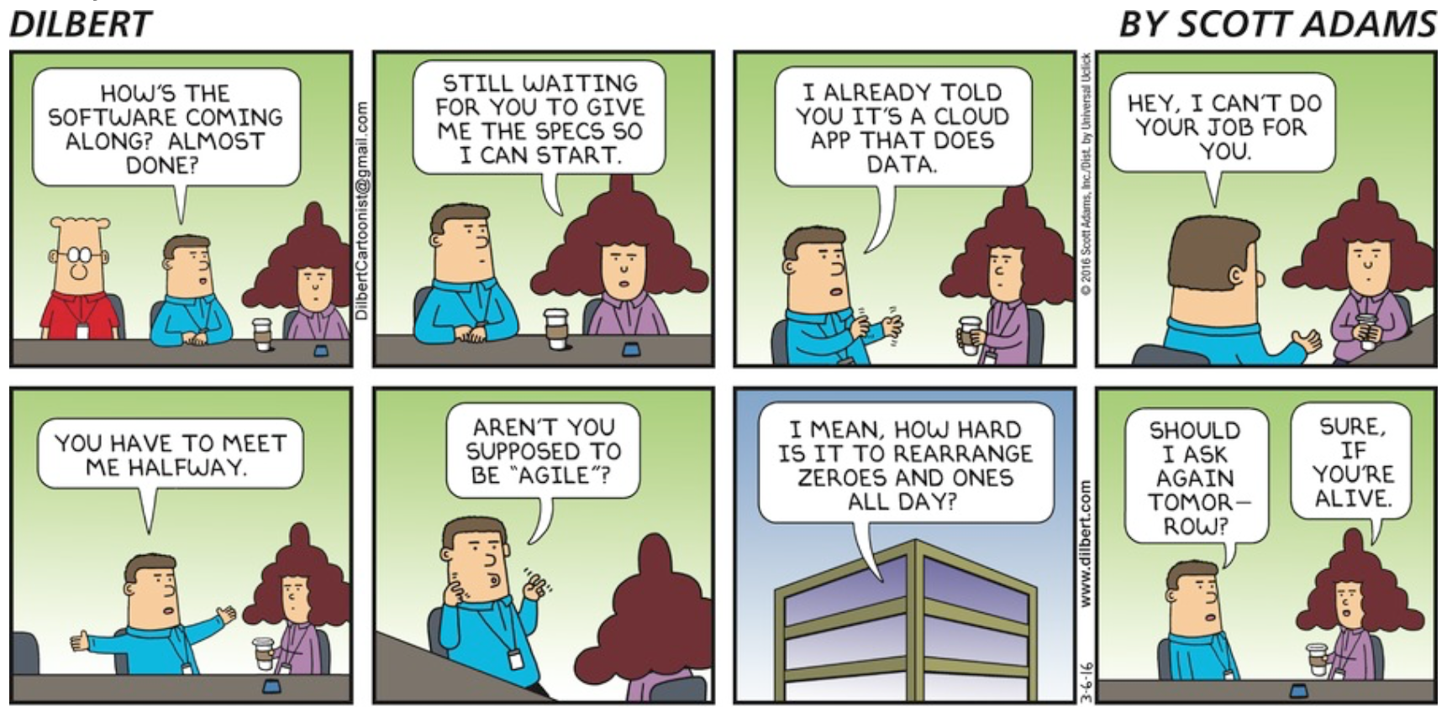

Slide 3
Process for process
Define Goals
  Short list of broadest needs.
  Not necessarily “Shall” statements
Define Scope
  Visual representation of what is in and what is out of scope.
Sticky subjects
  Parking place for difficult problems than need to be resolved
Key concepts
  Enhance communications
  Resolve or clarify sticky subjects.
Process approach
  Generate flowchart of the details of the process.
Key Performance Indicators
  Think about operating the process.
  What do you need to know to validate the process?
  Is this data captured?

Slide 4
Summary
What?
Why?
How?
Who?
When?
Questions?

Slide 5
What?
Develop a documented software engineering process for SKA software development. For example:
  An development process including:
    A defined semi-continuous/iterative process of design, development, testing, delivery, integration and verification.
    A defined long-term roadmap for each element’s development goals.
    Regular reviews scheduled to coincide when each of the periodic goals are delivered where we assess the progress to date and adjust the roadmap for the future.
  A continuous integration system which ensures the software meets basic QA standards, including:
    A central, globally visible, set of repositories so that we can monitor the current state of code development.
    A workflow that ensures a code review of all committed code, and pull requests accepted by authorised individuals.
    Software simulations/stubs/drivers/mocks for all major interfaces to enable sub-system and system level tests.
    Automated build, test and document generation on commit.
    Deployment scripts, which work for bare-metal deployment
  A set of basic software standards
    Defined preferred software license (an open source permissive license: e.g. Apache2), and other permissible compatible licences and ways of
    Defined primary dependencies, for example:
      Languages, O/S, software and GUI frameworks, source code control and deployment systems,
    A process of approving and recording additional, element specific, dependencies.
    Basic coding standards

Slide 6
What?
An development process including:
  A defined semi-continuous/iterative process of design, development, testing, delivery, integration and verification.
  A defined long-term roadmap for each element’s development goals.
  Regular reviews scheduled to coincide when each of the periodic goals are delivered where we assess the progress to date and adjust the roadmap for the future.

Slide 7
What?
A toolset to support the efficient development, including:
  Communication tools for chat, knowledge capture, and design definition.
  A central, globally visible, set of repositories so that we can monitor the current state of code development.
  A work manager with defined workflows
    Ensures work is well defined and monitored.
    A workflow that ensures a code review of all committed code, and pull requests accepted by authorised individuals.
  A continuous integration system which ensures the software meets basic QA standards, including:
    Software simulations/stubs/drivers/mocks for all major interfaces to enable sub-system and system level tests.
    Automated build, test and document generation on commit.
    Deployment scripts, which work for bare-metal deployment
  Support of core tools?
    Openstack, Tango, Casa etc.

Slide 8
What?
Example: LSST Toolchain
  Communication
    Chat: Slack (HipChat deprecated)
    Forum: Discourse
    Wiki: Confluence
    Bugs, issues: Jira, GitHub
    Documentation: DocHub API, reST, Jupyter
  QA and User Services
    AWS (EC2, S3, RDS etc)
    Google Compute Engine
    Openstack
    Fastly / Varnish
    S3 / Swift
    Kubernetes (Swarm? Mesos?)
    Puppet & Ansible
    Elasticsearch / (Logstash|fluentd|Riemann)/ Kibana
    Docker / virtualisation
    Vagrant / packer

Slide 9
What?
A set of basic software standards
  Defined preferred software license (an open source permissive license: e.g. Apache2), and other permissible compatible licences and ways of
  Defined primary dependencies, for example:
    Languages, O/S, software and GUI frameworks, source code control and deployment systems,
  A process of approving and recording additional, element specific, dependencies.
  Basic coding standards

Slide 10
What?
Project Management issues
  Definition of amount of resourcing
    Long and short term resource profile
  Identification of ways to support process.
  Timescales

Slide 11
Why?
SKA will need over €100M of software development.
  Not a task for academic programmers
  Need professional practices for development, testing, integration and deployment.
Hence, we need to be able to:
  Have a virtual “meeting place” for all developers.
  Talk the same language when discussing developments.
  Have easily accessible, scalable, integration and test facilities.
  Have ways of measuring and monitoring quality
  Have confidence that updates won’t break existing systems
  Reduce the diversity of delivered software so maintenance and operations issues are minimized.
  Monitor progress in a consistent way

Slide 12
How?
A harmonization/cross-consortia process based on LMC harmonization and Telescope teams.
  Gather input and get consortia to buy into the process:
    Largely by email and video but some face to face.
  Determine key drivers
    Derive common requirements
  Consider existing standards and officially endorse and adopt de facto standards
  Discuss and develop life cycle model
  Identify resources that could be shared
  Identify areas of divergence and either:
    Work to resolve the differences and generate a harmonized approach
    Acknowledge the fundamental differences leading to them and allow multiple approaches

Slide 13
Who?
Myself (project sponsor)
Alex Alberga (SciSys - project manager/technical specialist)
One or 2 representatives from each affected consortia
Up to 1 representative from each EIT.
Additional expertise from the consortia
  SDP have engaged The Software Engineering Institute from CMU for this sort of role.
  Various countries have direct experience from precursor developments.
Long term resourcing to be defined.

Slide 14
Who?
 | Office | Consortia
Support | Alex Alberga
TM | Nick Rees | Alan Bridger
CSP | Marco Caizzo? | Sonja Vrcic Christopher Williams
SDP | Nick Rees | Peter Braam
LFAA | Mark Waterson | Kris Zarb Adami
DISH | Andrea Cremonini | ??
SADT | David Bolt? | ??
AIV | Peter Heckman? | ??

Slide 15
When?
25 May: Circulation of proposal to SKAO Engineering teams [Done]
27 May: Discussion at EIT Progress Meeting [Done]
6 June: EPM’s to request comments, nomination of individuals and documentation from CPM’s, with response by 20 June. [Done]
20 June: Start of process. Engagement of consultant. Evaluation of responses. [Done]
23 June: Presentation of the LSST Software Engineering Process at SKAO, followed by discussion about how their ideas are relevant to SKA. [Done]
4-6 July: Discussion at LMC Harmonization meeting. [Now]
July-August: Development of the process.
October: Presentation of the draft Software Engineering Process at Stellenbosch
Continuous evolution of process thereafter

Slide 16
Questions?

