Slide 1


Probing the non-Gaussianity in the
EoR 21-cm signal using Bispectrum
Suman Majumdar
Imperial College London

Slide 2
Non-bispectrum presentations on non-Gaussianity
Poster by Sambit Giri --- “Bubble size statistics from 21-cm EoR images”
Talk by Koki Kakichi --- “Recovering the HII region size statistics from 21 cm tomography”

Slide 3

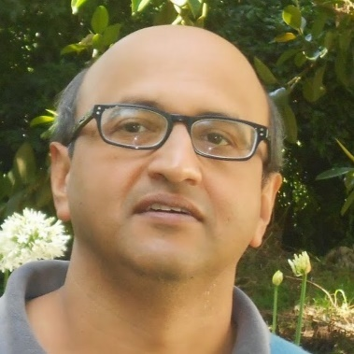
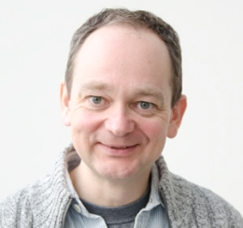
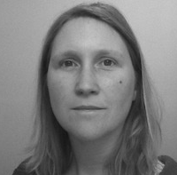

Collaborators
Garrelt Mellema
Stockholm University
Jonathan R. Pritchard
Imperial College London
Catherine A. Watkinson
University College London
Somnath Bharadwaj
IIT Kharagpur
Rajesh Mondal
IIT Kharagpur

Slide 4
Motivation:
The redshifted 21-cm signal from EoR is highly non-Gaussian
Just the power spectrum cannot provide a complete picture
Even the cosmic covariance of the power spectrum gets significantly affected by the non-Guassianity of the signal (essentially by it’s Trispectrum)

Slide 5
Cosmic Variance
Mondal, Bhradwaj, Majumdar et al., 2015, MNRAS Letters, 449, 1
Notes:
Specifications used for SKA1-LOW: Gaussian distribution of Antennas upto 2 km, collecting area of 5x10^5 m^2
But for this analysis we have not done FG subtraction etc..

Slide 6
Cosmic Variance
Mondal, Bhradwaj, Majumdar et al., 2015, MNRAS Letters, 449, 1
Notes:
Specifications used for SKA1-LOW: Gaussian distribution of Antennas upto 2 km, collecting area of 5x10^5 m^2
But for this analysis we have not done FG subtraction etc..

Slide 7
Cosmic Covariance
GRE
SE
Mondal, Bhradwaj, Majumdar, 2016, MNRAS, 456, 2
Notes:
Specifications used for SKA1-LOW: Gaussian distribution of Antennas upto 2 km, collecting area of 5x10^5 m^2
But for this analysis we have not done FG subtraction etc..

Slide 8
x_{HI}=0.98
x_{HI}=0.93
x_{HI}=0.86
x_{HI}=0.15
x_{HI}=0.50
x_{HI}=0.73
Mondal, Bhradwaj, Majumdar, 2016, accepted in MNRAS, arXiv:1606.03874
Notes:
Specifications used for SKA1-LOW: Gaussian distribution of Antennas upto 2 km, collecting area of 5x10^5 m^2
But for this analysis we have not done FG subtraction etc..

Slide 9
Motivation:
The redshifted 21-cm signal from EoR is highly non-Gaussian
Just the power spectrum cannot provide a complete picture
Even the cosmic covariance of the power spectrum gets significantly affected by non-Guassianity of the signal (essentially it’s Trispectrum)
The natural next step after power spectrum estimation is thus bispectrum → Fourier equivalent of the three point correlation function
A non-zero bispectrum detection will also ensure that one has detected the signal
Possibly it will be able to distinguish between different reionization source models, as different sources will give rise to different topologies in the 21 cm map, thus will have a different non-Gaussian signature

Slide 10




Bispectrum
$$k_{3}$$
$$k_{2}$$
$$θ$$
$$k_{1}$$

Slide 11

Bispectrum
$$k_{3}$$
$$k_{2}$$
$$θ$$
$$k_{1}$$
Equations of constraints:
$${\vec{k}}_{1}+{\vec{k}}_{2}+{\vec{k}}_{3}=0$$

Slide 12


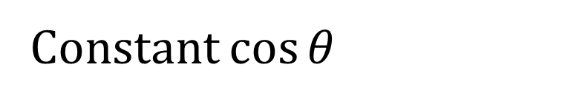
Bispectrum
$$k_{3}$$
$$k_{2}$$
$$θ$$
$$k_{1}$$
Equations of constraints:
$${\vec{k}}_{1}+{\vec{k}}_{2}+{\vec{k}}_{3}=0$$
For N number of grids on one side it would result in reduction of $N^{2}$ steps
$$\left|{\vec{k}}_{2}\right|=m\left|{\vec{k}}_{1}\right|$$
Constant $\cos{θ}$

Slide 13





Testing the algorithm
(on N-body density fields)
$$\left|{\vec{k}}_{2}\right|=\left|{\vec{k}}_{1}\right|$$
$$k_{3}$$
$$k_{2}$$
$$θ$$
$$k_{1}$$
Simulation volume (300 Mpc)³
z= 7
Five independent realizations

Slide 14
Testing the algorithm
(on N-body density fields)
$$\left|{\vec{k}}_{2}\right|=\left|{\vec{k}}_{1}\right|$$
$$k_{3}$$
$$k_{2}$$
$$θ$$
$$k_{1}$$
Simulation volume (300 Mpc)³
z= 7
Five independent realizations
PT estimation:
Sefusatti et al., 2006, PRD,
arXiv:0604505
See also Smith et al., 2008, PRD, arXiv:0712.0017
for similar results from
N-body simulations

Slide 15




Testing the algorithm
(on N-body density fields)
$$\left|{\vec{k}}_{2}\right|=\left|{\vec{k}}_{1}\right|$$
$$k_{2}$$
$$θ$$
$$k_{3}$$
$$k_{1}$$

Slide 16
Testing the algorithm
(on N-body density fields)
$$\left|{\vec{k}}_{2}\right|=\left|{\vec{k}}_{1}\right|$$
$$k_{2}$$
$$θ$$
$$k_{3}$$
$$k_{1}$$
Equilateral triangle

Slide 17
Testing the algorithm
(on N-body density fields)
$$\left|{\vec{k}}_{2}\right|=\left|{\vec{k}}_{1}\right|$$
$$k_{3}$$
$$k_{2}$$
$$θ$$
$$k_{1}$$

Slide 18

Testing the algorithm (on N-body density fields)
$$\left|{\vec{k}}_{2}\right|=\left|{\vec{k}}_{1}\right|$$
Majumdar, Pritchard, Mondal, Watkinson et al. in prep

Slide 19

Testing the algorithm (on N-body density fields)
$$\left|{\vec{k}}_{2}\right|=2\left|{\vec{k}}_{1}\right|$$
Majumdar, Pritchard, Mondal, Watkinson et al. in prep

Slide 20
Bispectrum for the 21-cm signal from EoR
Specifications of the EoR 21-cm simulation:
Same as Mondal et al., 2016, arXiv: 1606.03874
Semi-numerical simulations
Simulation volume (215 Mpc)³
Spatial resolution ~0.56 Mpc
Minimum halo mass ~ 10⁹ M_{ʘ}
Five statistically independent realizations

Slide 21

Bispectrum for the 21-cm signal from EoR
(in real space)
$$\left|{\vec{k}}_{2}\right|=\left|{\vec{k}}_{1}\right|$$
Majumdar, Pritchard, Mondal, Watkinson et al. in prep

Slide 22
Bispectrum for the 21-cm signal from EoR
(in real space)
$$\left|{\vec{k}}_{2}\right|=\left|{\vec{k}}_{1}\right|$$
Majumdar, Pritchard, Mondal, Watkinson et al. in prep

Slide 23
Bispectrum for the 21-cm signal from EoR
(in real space)
$$\left|{\vec{k}}_{2}\right|=2\left|{\vec{k}}_{1}\right|$$
Majumdar, Pritchard, Mondal, Watkinson et al. in prep

Slide 24


Bispectrum for the 21-cm signal from EoR
(in real space)
$$\left|{\vec{k}}_{2}\right|=5\left|{\vec{k}}_{1}\right|$$
$$\left|{\vec{k}}_{2}\right|=10\left|{\vec{k}}_{1}\right|$$
Majumdar, Pritchard, Mondal, Watkinson et al. in prep

Slide 25
Components of the Bispectrum
$$\left|{\vec{k}}_{2}\right|=\left|{\vec{k}}_{1}\right|$$
Majumdar, Pritchard, Mondal, Watkinson et al. in prep

Slide 26
Components of the Bispectrum
$$\left|{\vec{k}}_{2}\right|=\left|{\vec{k}}_{1}\right|$$
Majumdar, Pritchard, Mondal, Watkinson et al. in prep

Slide 27
Components of the Bispectrum
$$\left|{\vec{k}}_{2}\right|=2\left|{\vec{k}}_{1}\right|$$
Majumdar, Pritchard, Mondal, Watkinson et al. in prep

Slide 28
Toy model for HI fluctuations
FT for K>0
Bharadwaj & Pandey, 2005, MNRAS, 358, 3

Slide 29
Toy model for HI fluctuations
R = 10 Mpc

Slide 30
Toy model for HI fluctuations
0.5 Mpc< R <50 Mpc

Slide 31
Toy model for HI fluctuations
$$\left|{\vec{k}}_{2}\right|=\left|{\vec{k}}_{1}\right|$$

Slide 32
Toy model for HI fluctuations
$$\left|{\vec{k}}_{2}\right|=\left|{\vec{k}}_{1}\right|$$
Majumdar, Pritchard, Mondal, Watkinson et al. in prep

Slide 33
Components of the Bispectrum
$$\left|{\vec{k}}_{2}\right|=\left|{\vec{k}}_{1}\right|$$
Majumdar, Pritchard, Mondal, Watkinson et al. in prep

Slide 34

Components of the Bispectrum
$$\left|{\vec{k}}_{2}\right|=5\left|{\vec{k}}_{1}\right|$$
Majumdar, Pritchard, Mondal, Watkinson et al. in prep

Slide 35

Components of the Bispectrum
$$\left|{\vec{k}}_{2}\right|=10\left|{\vec{k}}_{1}\right|$$
Majumdar, Pritchard, Mondal, Watkinson et al. in prep

Slide 36
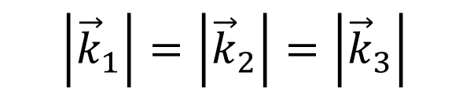

A Fast estimator for Bispectrum
Testing on the N-body density fields
$$\left|{\vec{k}}_{2}\right|=2\left|{\vec{k}}_{1}\right|$$
$$\left|{\vec{k}}_{1}\right|=\left|{\vec{k}}_{2}\right|=\left|{\vec{k}}_{3}\right|$$
One loop through the FFT box and 6 FFT per B(k₁, k₂, k₃)
Watkinson, Majumdar, Pritchard in prep

Slide 37

A Fast estimator for Bispectrum
Toy model of randomly distributed spheres of radius R
$$\left|{\vec{k}}_{2}\right|=2\left|{\vec{k}}_{1}\right|$$
Watkinson, Majumdar, Pritchard in prep

Slide 38
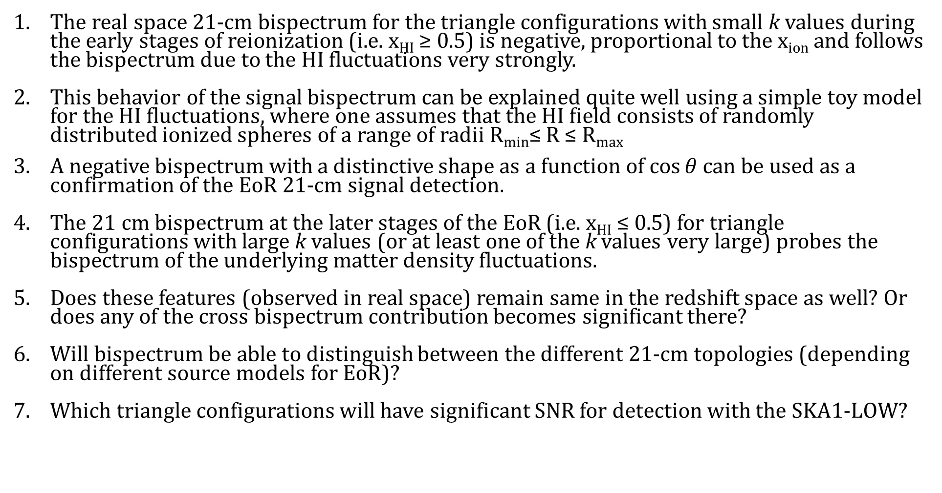
Summary:
The real space 21-cm bispectrum for the triangle configurations with small k values during the early stages of reionization (i.e. x_{HI} ≥ 0.5) is negative, proportional to the x_{ion} and follows the bispectrum due to the HI fluctuations very strongly.
This behavior of the signal bispectrum can be explained quite well using a simple toy model for the HI fluctuations, where one assumes that the HI field consists of randomly distributed ionized spheres of a range of radii R_{min}≤ R ≤ R_{max}
A negative bispectrum with a distinctive shape as a function of $\cos{θ}$ can be used as a confirmation of the EoR 21-cm signal detection.
The 21 cm bispectrum at the later stages of the EoR (i.e. x_{HI} ≤ 0.5) for triangle configurations with large k values (or at least one of the k values very large) probes the bispectrum of the underlying matter density fluctuations.
Does these features (observed in real space) remain same in the redshift space as well? Or does any of the cross bispectrum contribution becomes significant there?
Will bispectrum be able to distinguish between the different 21-cm topologies (depending on different source models for EoR)?
Which triangle configurations will have significant SNR for detection with the SKA1-LOW?

Slide 39
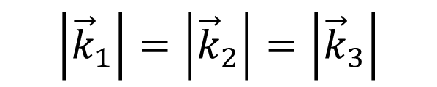
Bispectrum for the 21-cm signal from EoR
(in real space)
$$\left|{\vec{k}}_{1}\right|=\left|{\vec{k}}_{2}\right|=\left|{\vec{k}}_{3}\right|$$

Slide 40
Bispectrum for the 21-cm signal from EoR
(in redshift space)
$$\left|{\vec{k}}_{1}\right|=\left|{\vec{k}}_{2}\right|=\left|{\vec{k}}_{3}\right|$$

Slide 41
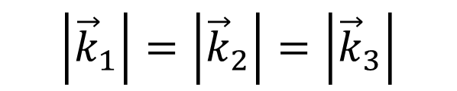
Toy model for HI fluctuations
$$\left|{\vec{k}}_{1}\right|=\left|{\vec{k}}_{2}\right|=\left|{\vec{k}}_{3}\right|$$

