Slide 1
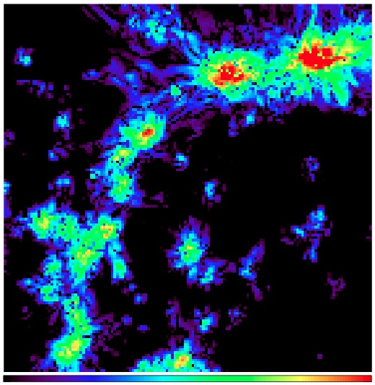
The Cosmic Web A new discovery space in the SKA generation
5 Mpc
D = 100 Mpc
(TA & Ryu, ApJ,
723, 476, 2010)
Contents
Introduction
Extraction of IGMF RM
Are FRBs useful for Magnetism?
Extraction filter development
-2 -1 0 1 2
Log₁₀ |RM| [rad/m²]
Takuya AKAHORI
Kagoshima University, Japan
SKA-Japan Project A/Prof. | SKA-Japan Vice Chair | SKA Cosmic Magnetism SWG

Slide 2
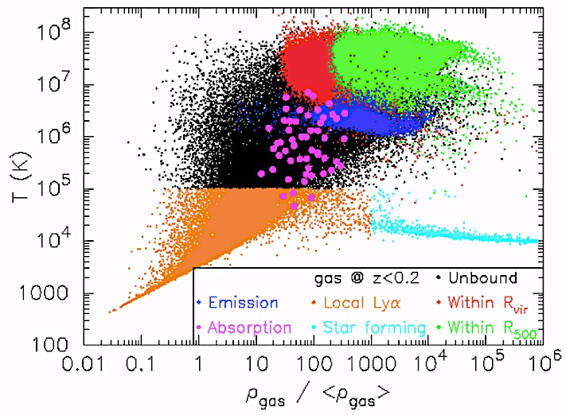
1. Introduction (1/4) The Missing Baryon
BigBang Cosmolgy
Observations
Total baryon content in the Universe
galaxies・clusters・H_{I}・Lyα・O_{VI}
Matter in filaments?
MOND?
Ref: “The cosmic baryon budget” (Fukugita, Hogan, Peebles 1998, ApJ, 503, 518)
clusters
filaments
sheets
galaxies
voids
Visualized by R. Kaehler
http://www.youtube.com/watch?v=8UzVi8MJolo
Piro et al.
(2007)
Warm-Hot Intergalactic Medium (WHIM)
IGM in galaxy filaments, T~10⁵⁻⁷ [K], n~10⁻⁶ –10⁻⁴ [cm⁻³]
The last major yet-unproven piece of the cosmology

Slide 3
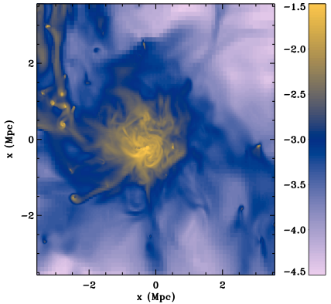
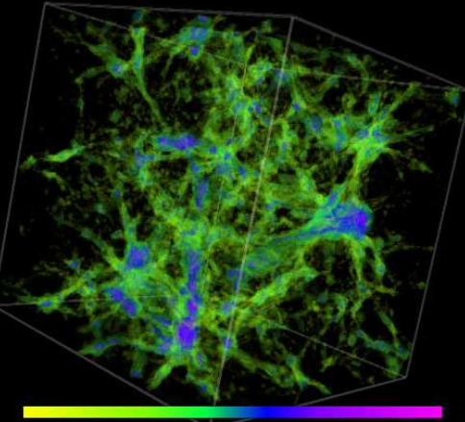
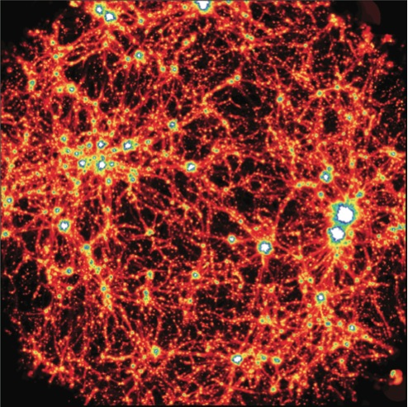
1. Introduction (2/4) The IGMF in the WHIM
Seed
inflation
recombination
reionization
Seed
shock・instability
Seed
shock・instability
Amp.
comp., dynamo
Early Universe
Amplification
compression, dynamo
Leakage
winds, jets, ram pressure
Simulation images by
Dubois & Tessier (2008)
Ryu et al. (2008)
Donnert et al. (2009)
Large-Scale Structure
Galaxies
Ref: “Magnetic Fields in the Large-Scale Structure of the Universe”
(Ryu, Schleicher, Treumann, Tsagas, Widrow, 2012, Space Science Review, 166, 1)
The Inter-Galactic Magnetic Field (IGMF)
If μG in clusters of galaxies → 1-100 nG in filaments
Revolutionize cosmology, plasma physics, galaxy evolution

Slide 4
1. Introduction (3/4) Probes of the WHIM/IGMF
 | λ | var | wide ? | bright ? | deep ? | where ?
Pair halo/echo | γ-ray | EBL B | △ | ◯ | ◯ | void
Thermal emission | X-ray | ne T | △ | ☓ | ☓ | filament
Oxygen lines | X-ray | ne T, Z | △ | △ | ☓ | filament
SZ effect | high radio | ne T | △ | △ | ◯ | filament
Rotation measure | low radio | ne B | ◯ | ◯ | ◯ | filament
Synchrotron radiation | low radio | nc B | ◯ | ◯ | △ | shock
Fast radio burst | low radio | ne (B) | ?? | ?? | ?? | filament & void
personal impression
SKA
(TA, Ryu 2011, ApJ, 738, 134)
Rough Number
~1 rad/m² / filament
~1 filament / 100 Mpc
→ ~10 rad/m² (z>2)

Slide 5
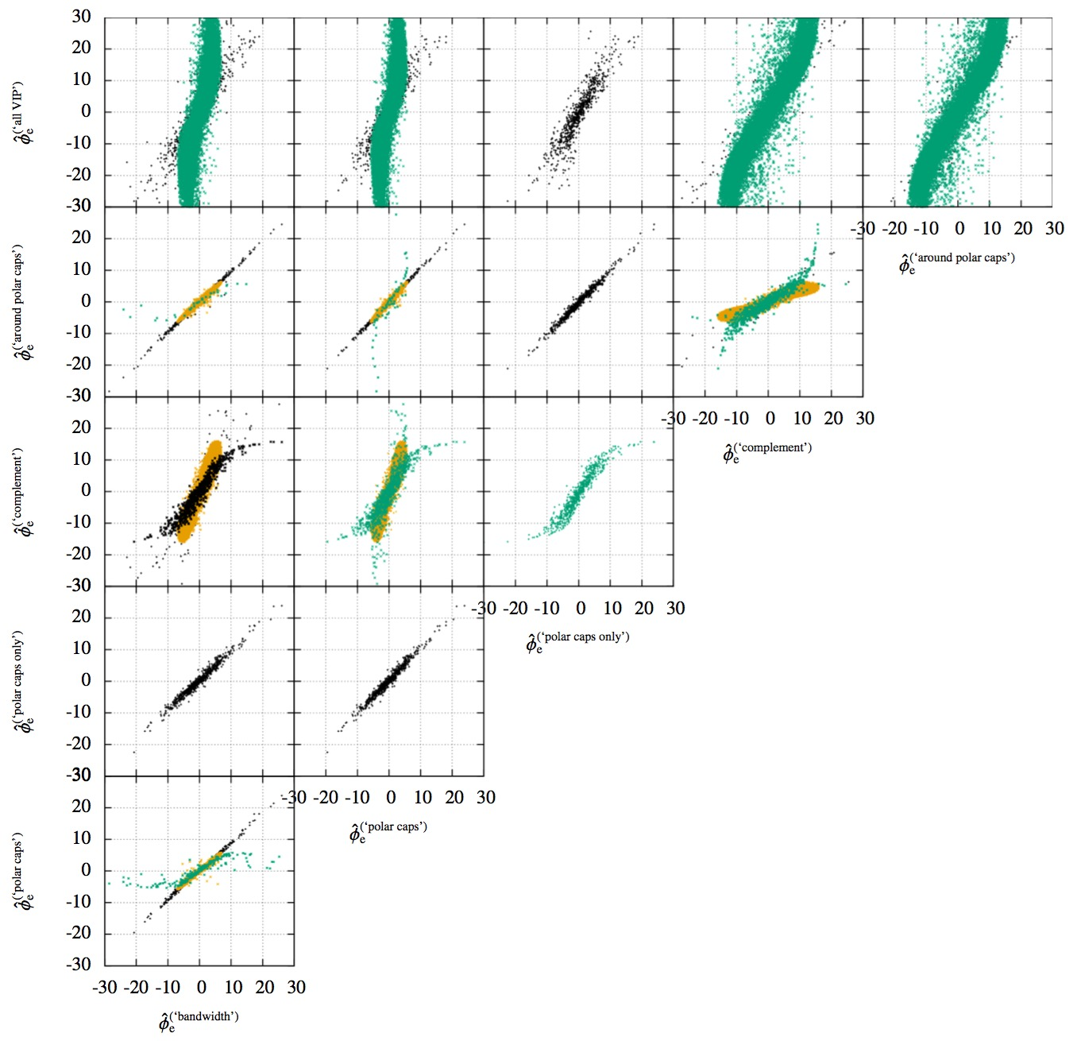
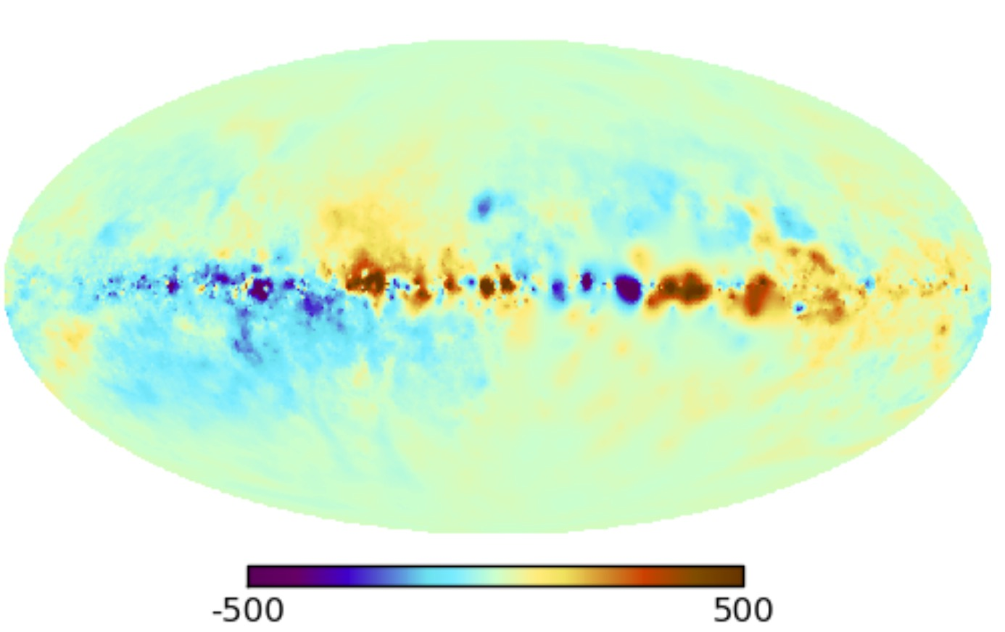
1. Introduction (4/4) Observation of the WHIM/IGMF
○ NVSS
● theirs
Xu & Han (14)
redshift
Oppermann, TA+ (15)
Extraction of RM in filaments is not achieved yet
At least, extragalactic RM < 5-15 rad/m²
Superclusters (Xu+06), cluster radial profiles (e.g., Govoni+10)
RM toward Galactic poles (Mao+10; Stil+11)
All-sky RM grids; latitude dependence (Schnitzeler 10), redshift dependence (Kronberg+08; Hammond+12; Xu & Han14), probabilistic analysis (Oppermann, TA+15)
Relationship with galaxies (MgII/DLA) (Burnet+12; Farnes+14ab;16)
at the observer frame
at ~ GHz band

Slide 6
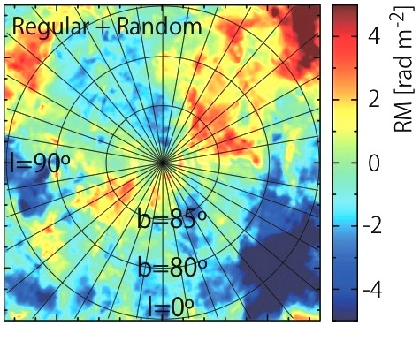
2. Extraction of RM due to the IGMF (1/3) Multiple RMs along a sightline
INT
random
σ_{INT}=σ_{INT,0}/(1+z)²
σ_{INT,0}=10 rad/m²
ALL Map
Subraction filters are under study (like EoR)
COM Map
Refer X-ray brightness map
IGM
map
Akahori, Ryu 2011
IGM filter
Choose high-z sources
INT filter
DIG
random, 50% MgII
DIG filter
Discard depolarized sources
ERR filter
ISM
map
Akahori+ 2013
ISM filter
Choose low-noise sources
ERR
random Gaussian
σ_{ERR}=1 rad/m²
Cut large-scale components
ISM map
RRM map
RRM map
For details, please ask me in Q&A or offline!
(TA, Gaensler, Ryu 2014a, ApJ, 790, 123)

Slide 7
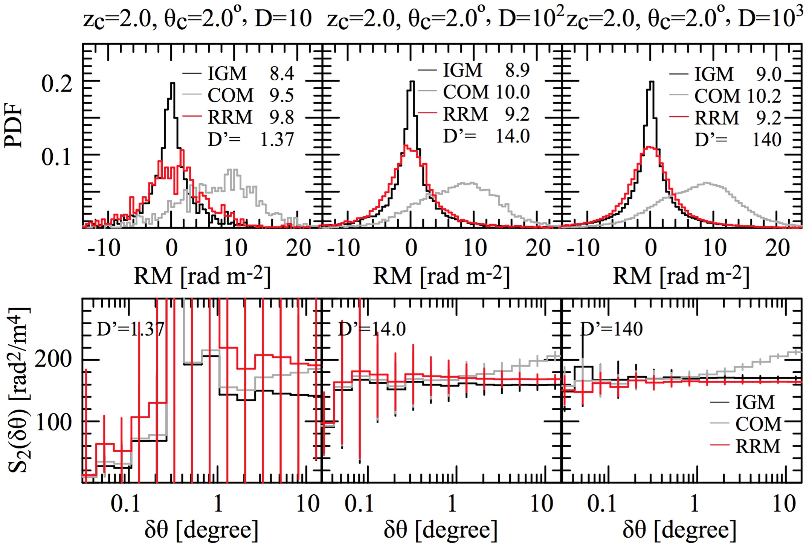
2. Extraction of RM due to the IGMF (2/3) Can we find the IGMF?
900 deg² FOV, South Galactic Pole, z>2, θ=2°
ー IGM ー COM(ALL) ー RRM
Our selection criteria: ~86% of sources were discarded
100 RM/deg² → σ_{RM,WHIM}
1000 RM/deg² → S_{2,RM,WHIM}
Need to select ideal sources from a large polulation → All-sky RM grids
Precursor
10 RM/deg²
~10 μJy level
SKA1
100 RM/deg²
~μJy level
SKA2
1000 RM/deg²
~100 nJy level
(Mpc)
0.1 1.0 10
(TA, Gaensler, Ryu 2014a, ApJ, 790, 123)

Slide 8
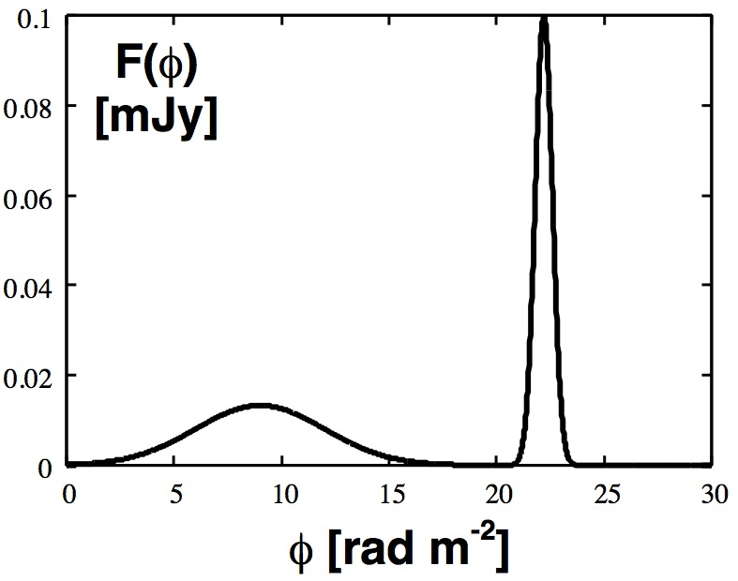
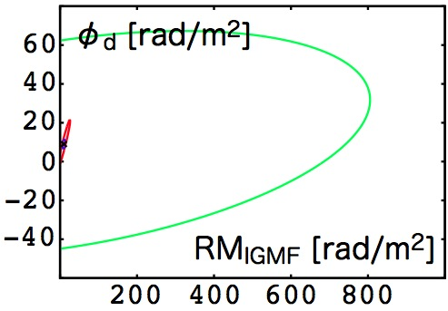
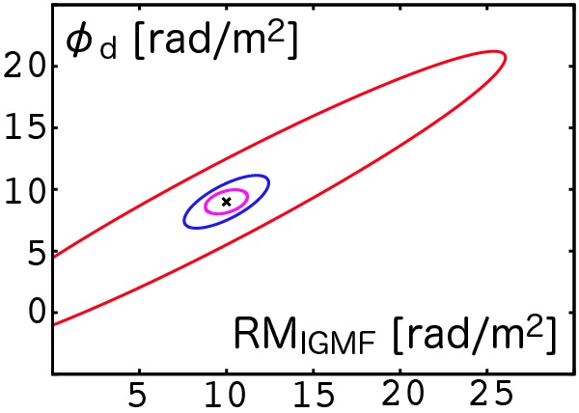
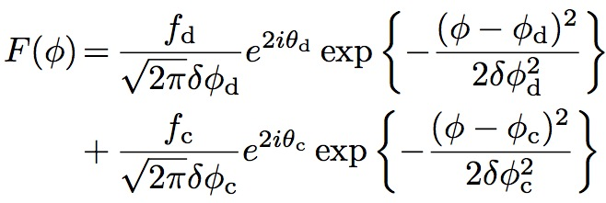
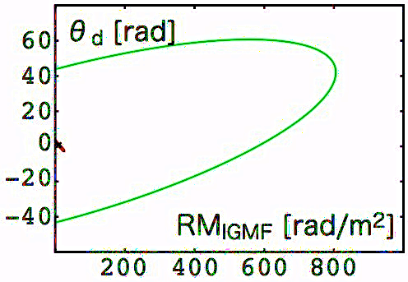
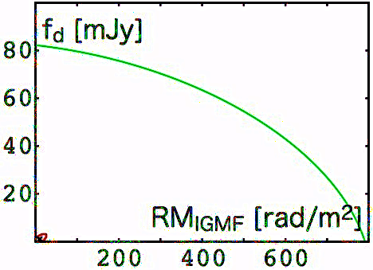
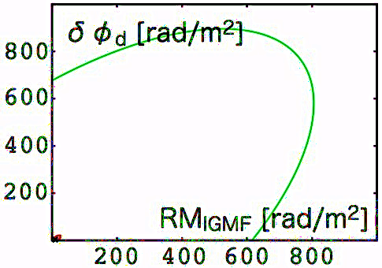
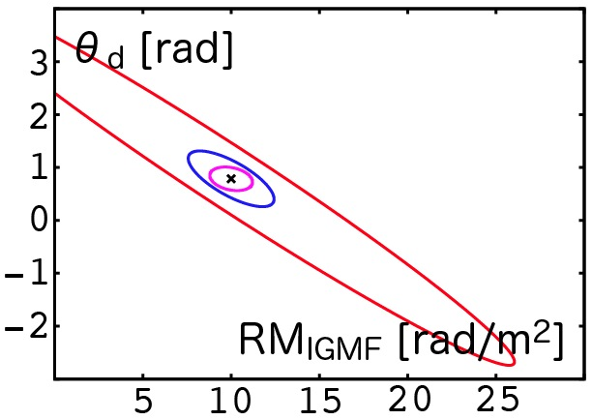
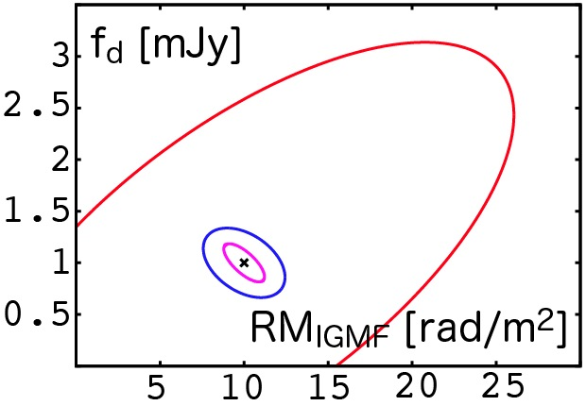
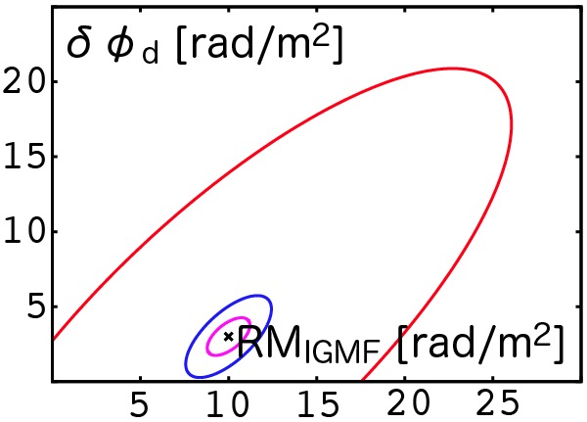
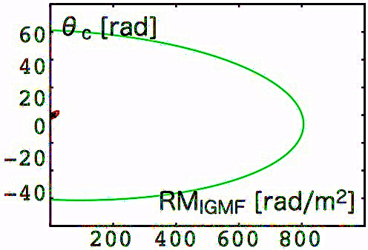
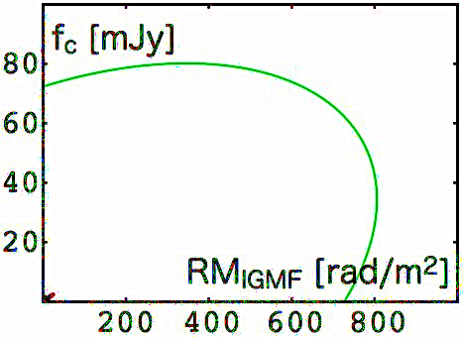
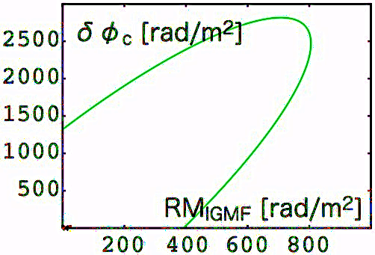
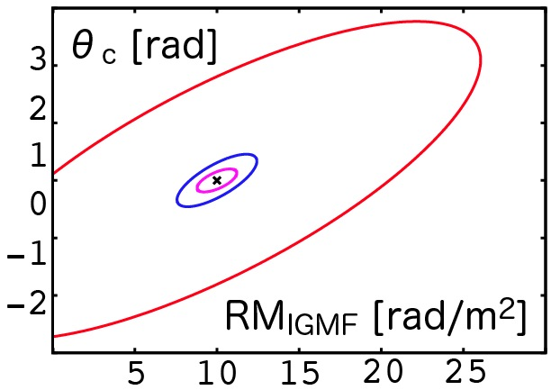
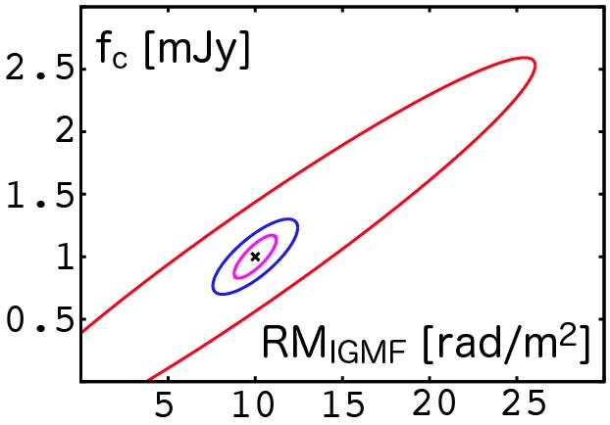
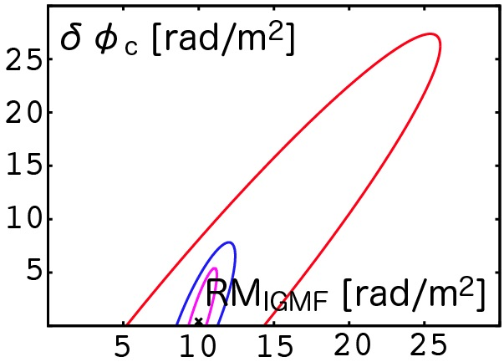
2. Extraction of RM due to the IGMF (3/3) Faraday Tomography
ideal cases
ASKAP-12, 1 hour, 1 mJy source, RM_{IGMF}=10 rad/m²
ー700-1000 MHz ー1150-1450 MHz
ー(700-1000+1150-1450) MHz ー700-1800 MHz
Quasars
1σ
Galactic
or pair
Quarsar
1σ
1σ
1σ
IGMF
↓
1σ
2 Gaussians, 8 params
Null IGMF can be excluded at ~3σ significance
(TA+ 2014b, PASJ, 66, 65; Govoni, TA+ 2014)

Slide 9
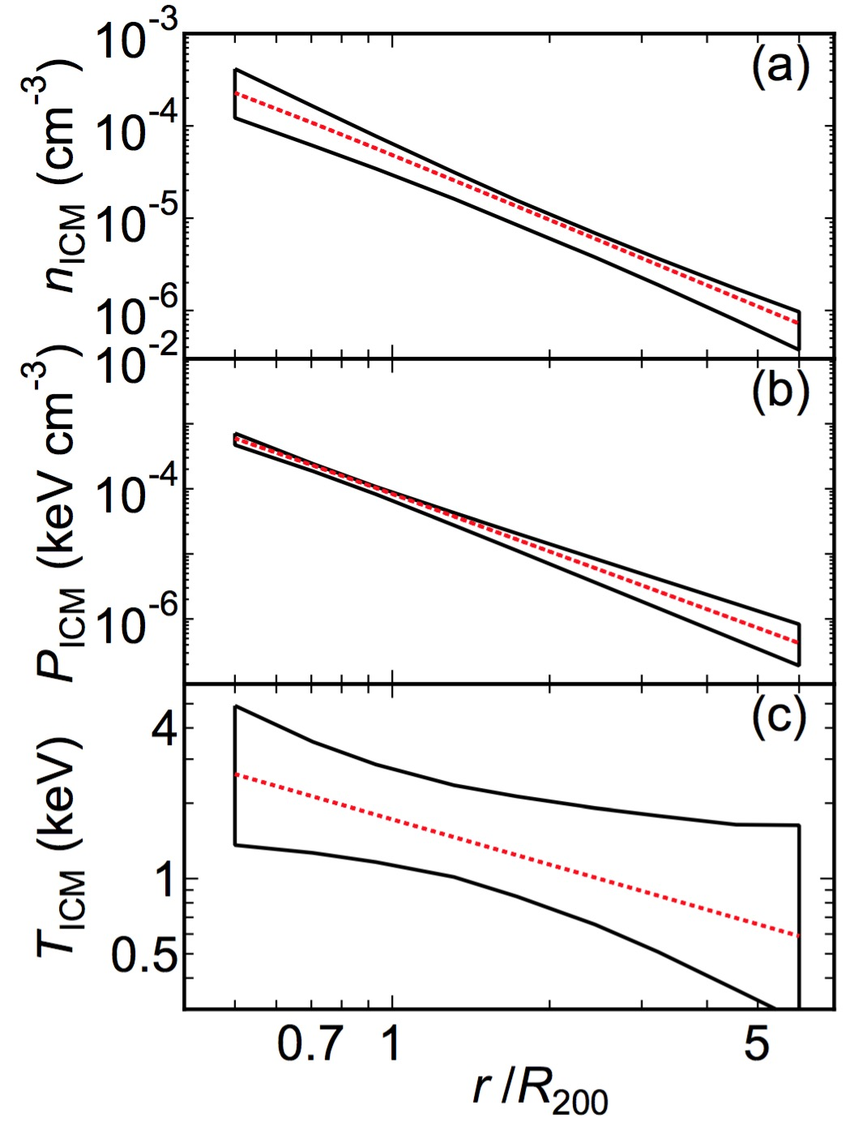
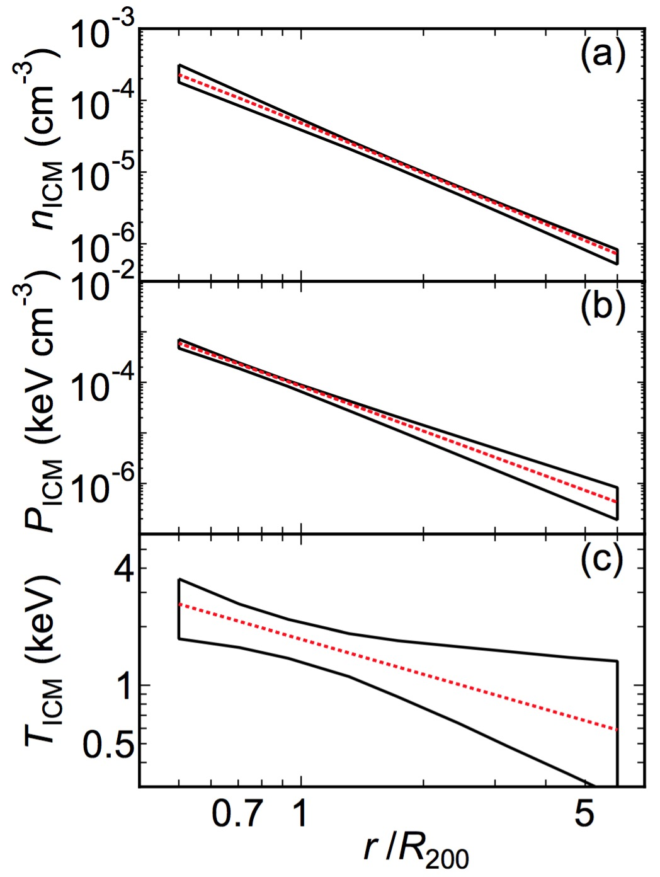
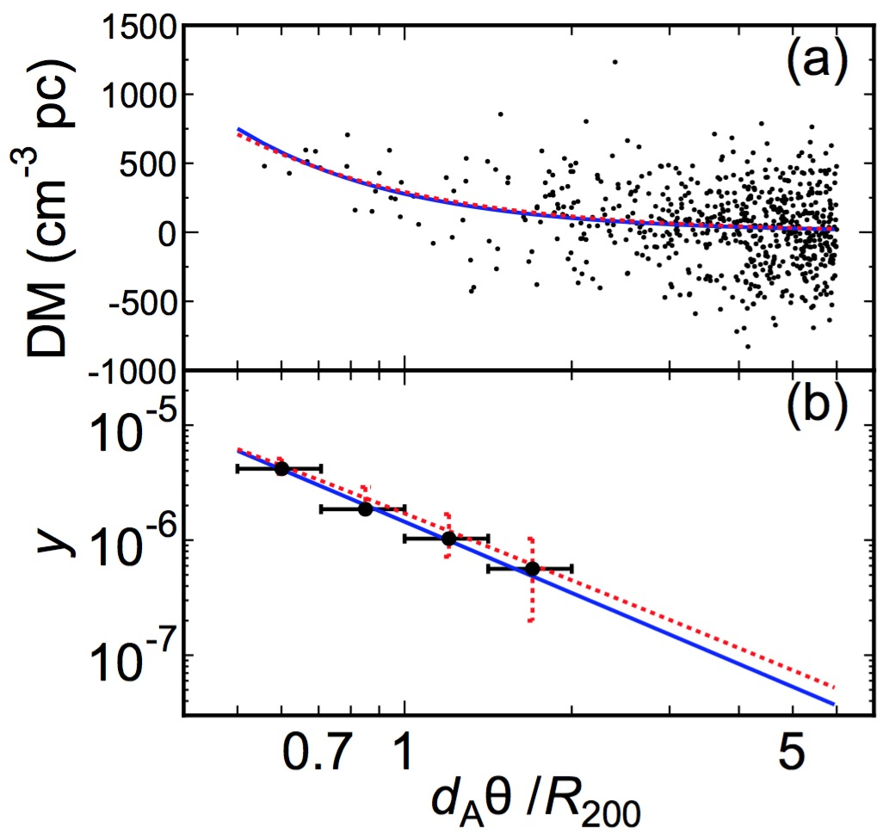
3. Are FRBs useful for Magnetism? (2/3) FRB DM grids?
Probing the WHIM around galaxy clusters
20
5
N_{FRB} = events /deg²
FRB’s DM
SZ
map
ICM
WHIM
(Fujita, TA+ ApJL accepted, arXiv:1609.03566)

Slide 10
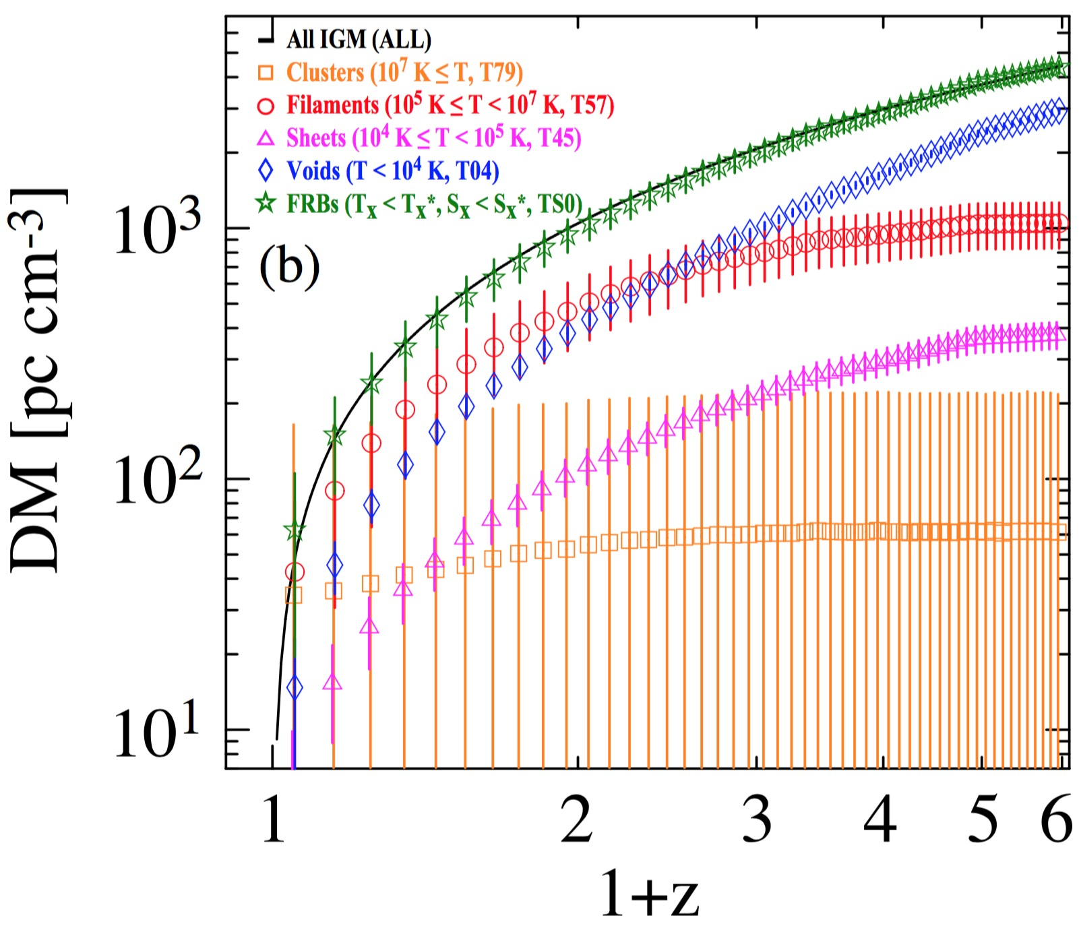
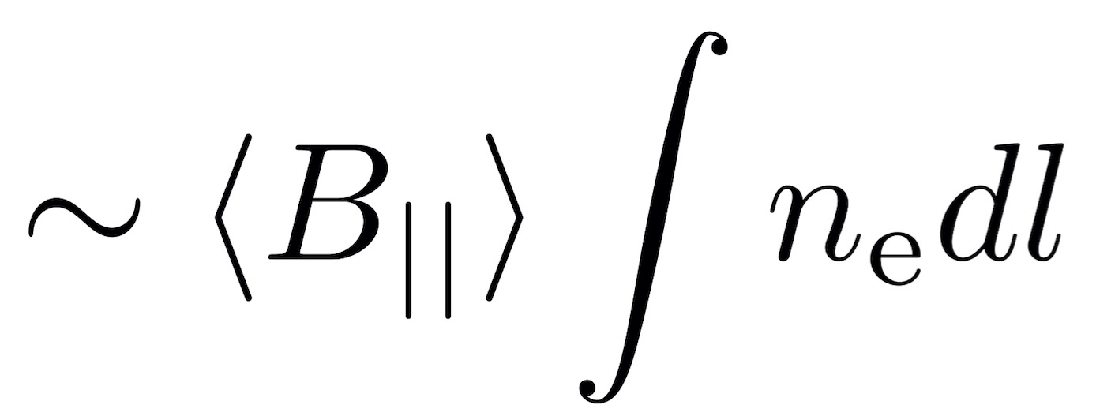
3. Are FRBs useful for Magnetism? (2/3) FRB DM & RM grids?
Use DM & RM of polarized FRB, but B|| ≠ B||† ~ RM/DM
WHIM (z<1) and the void gas (z>1) dominate DM
The traditional method misses the (1+z) factor
Galactic Context
Cosmological Context
(TA, Ryu, Gaensler 2016, ApJ, 824, 105)

Slide 11
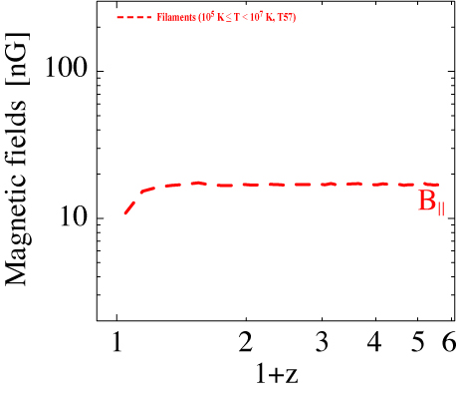
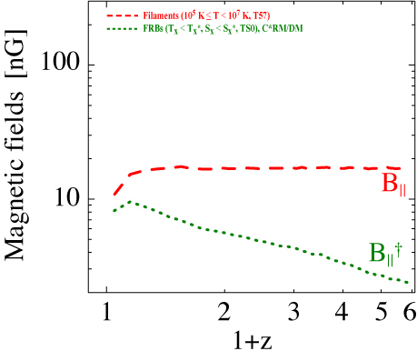
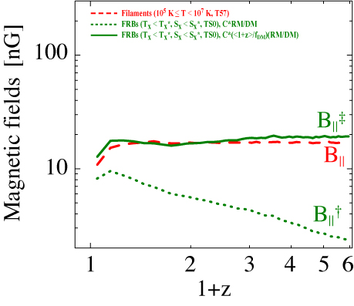
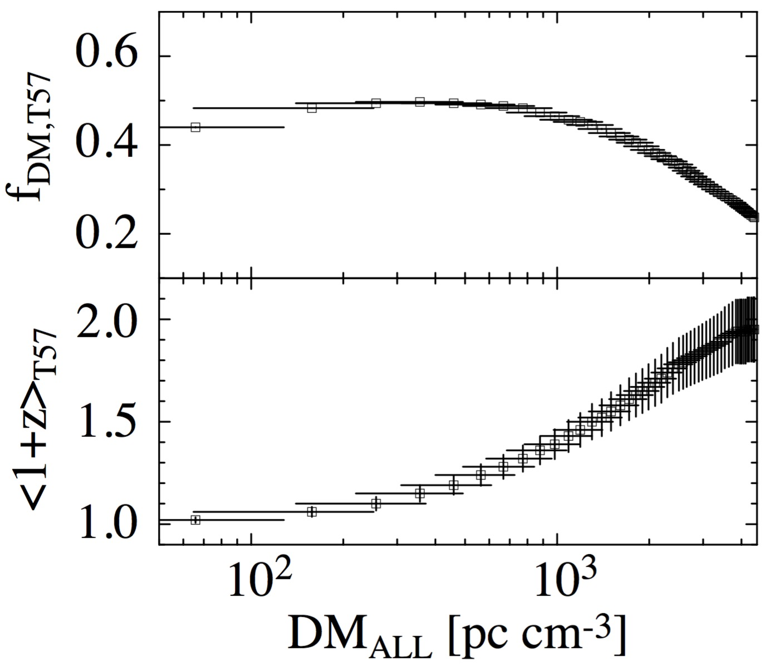
3. Are FRBs useful for Magnetism? (3/3) FRB DM & RM grids?
Use DM & RM of polarized FRB (but B|| ≠ B||† ~ RM/DM)
FRB RM grids ~ O(10-100)/deg²/yr?
Ω_{M0}=0.27, Ω_{Λ0}=0.73, H=70
(TA, Ryu, Gaensler 2016, ApJ, 824, 105)

Slide 12
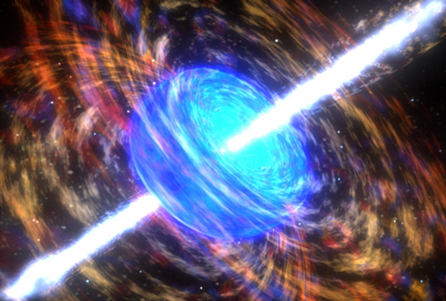
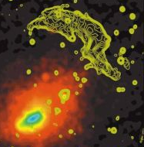
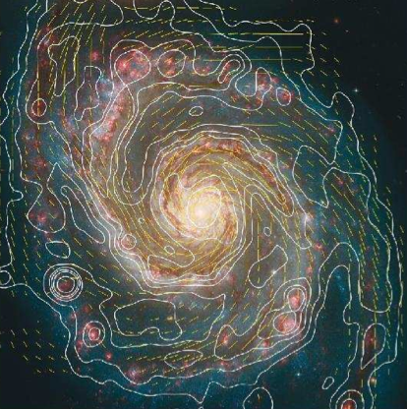
Summary
The WHIM and the IGMF
A candidate of the missing baryon
RM of the IGMF through filaments ~ several rad/m²
Simulation of RM sky
Need to select ideal sources from a large polulation → High-level requirement = all-sky RM grids
RM_{IGMF} → ASKAP, MeerKAT, SKA1 (100 /deg²)
SF_{IGMF} → SKA2 (1000 /deg²)
Faraday Tomography would be a powerful tool, too
Fast Radio Burst?
FRB would be utilized for measuring the WHIM
Linearly-Pol. FRBs can give the IGMF strength
Filter development under study
Band 2 + Band 1 (for depolarization & tomography)
INT
IGM
DIG
ISM

Slide 13
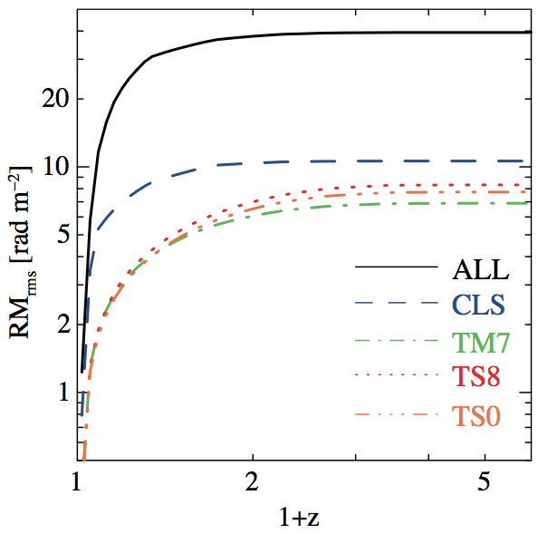
4. Subtraction fileter development (1/4) Modeling and filter for IGM
TM7: T<10⁷ (almost WHIM)
CLS: D >1 Mpc & Tx<2 keV
TS8: Tx*>10⁷ & Sx*>10⁻⁸
TS0: Tx*>10⁷ & Sx*>10⁻¹⁰
T in [K], S in [erg/s/cm²/sr]
Cluster contribution is significant, but it can be substantially subtracted
(TA, Ryu 2011, ApJ, 738, 134)

Slide 14
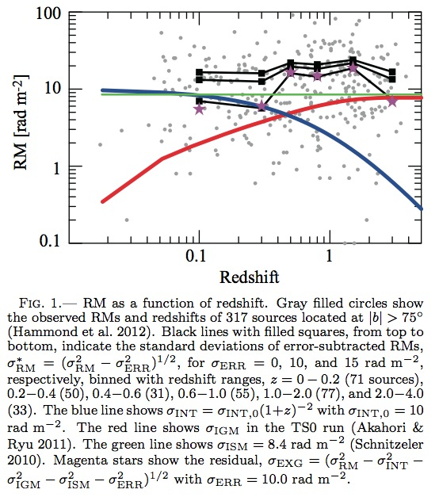
4. Subtraction fileter development (2/4) Modeling and filter for INT
RM of
Ext. Gal.
RM of
Our Gal.
~ 9 rad/m²
RM of
the IGMF
~1-7 rad/m²
RM of
the source
~10 (1+z)⁻²
rad/m²
|RM| or RM_{rms} [rad/m²]
at the observer frame
● 317 NVSS RMs (|b|>75°)
ー average
(Noise level 0, 10, 15 rad/m²)
(TA, Gaensler, Ryu 2014a, ApJ, 790, 123)

Slide 15
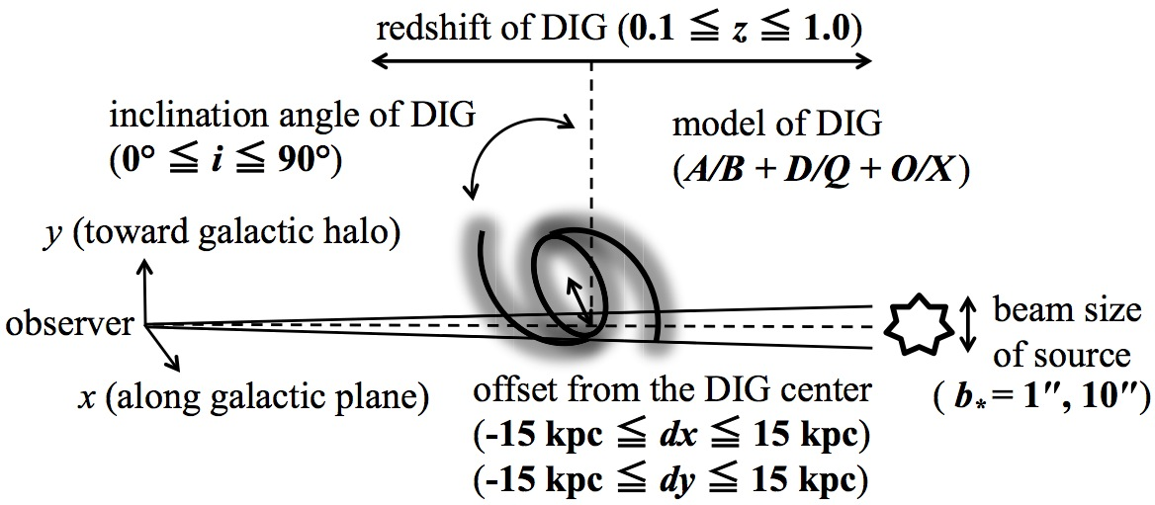
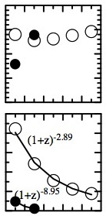
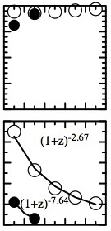
4. Subtraction fileter development (3/4) Modeling and filter for DIG
L(1100-1400 MHz) S(2000-4000 MHz)
○ core-type
● lobe-type
Depolarizing Intervening Galaxies (DIGs) towards:
1″ source (Core-type)
|RM_{DIG}| < 2 rad/m² if z_{DIG} > 1
10″ source (Lobe-type)
|RM_{DIG}| < 2 rad/m²
Depolarization can be used to discard sightlines containing DIG
(TA, Farnes+ in preparation)

Slide 16
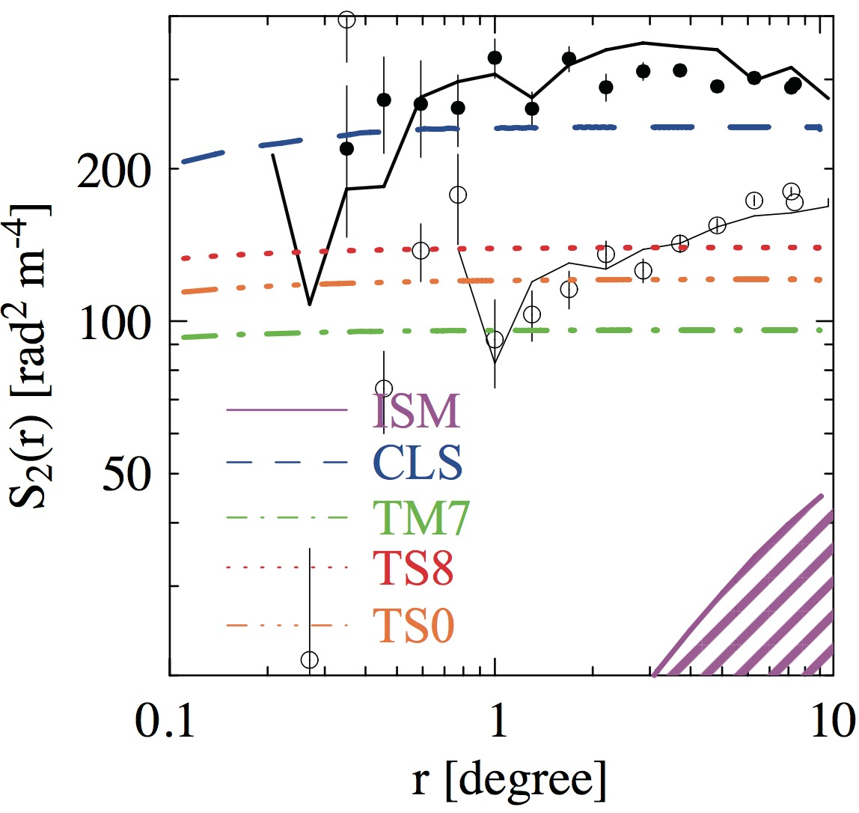
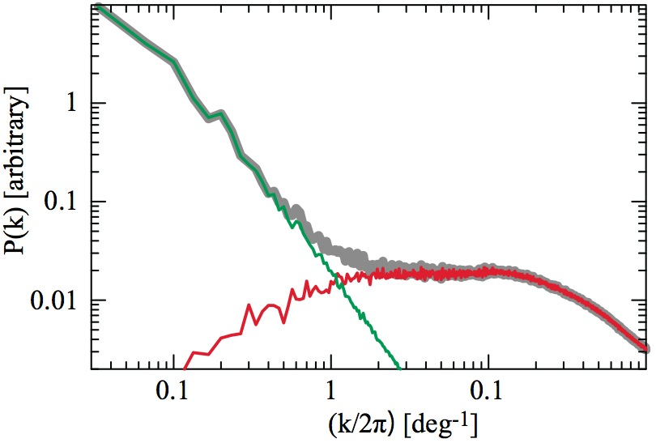
4. Subtraction fileter development (4/4) Modeling and filter for ISM
n-th order
structure function (SF)
←South Galactic Pole
●：Mao+ (2010), ー：Stil+ (2011)
←North Galactic Pole
○：Mao+ (2010), ー：Stil+ (2011)
IGMF
ー：flat S₂ at >0.2° with ~100 [rad²/m⁴]
ISM is small & steep!
ー：steep S₂ with < 50 [rad²/m⁴]
Chop!
Green: ISM
Red: IGM
Spatial filter is successful
(TA, Ryu, Kim, Gaensler 2013, ApJ, 767, 150)

