Slide 1
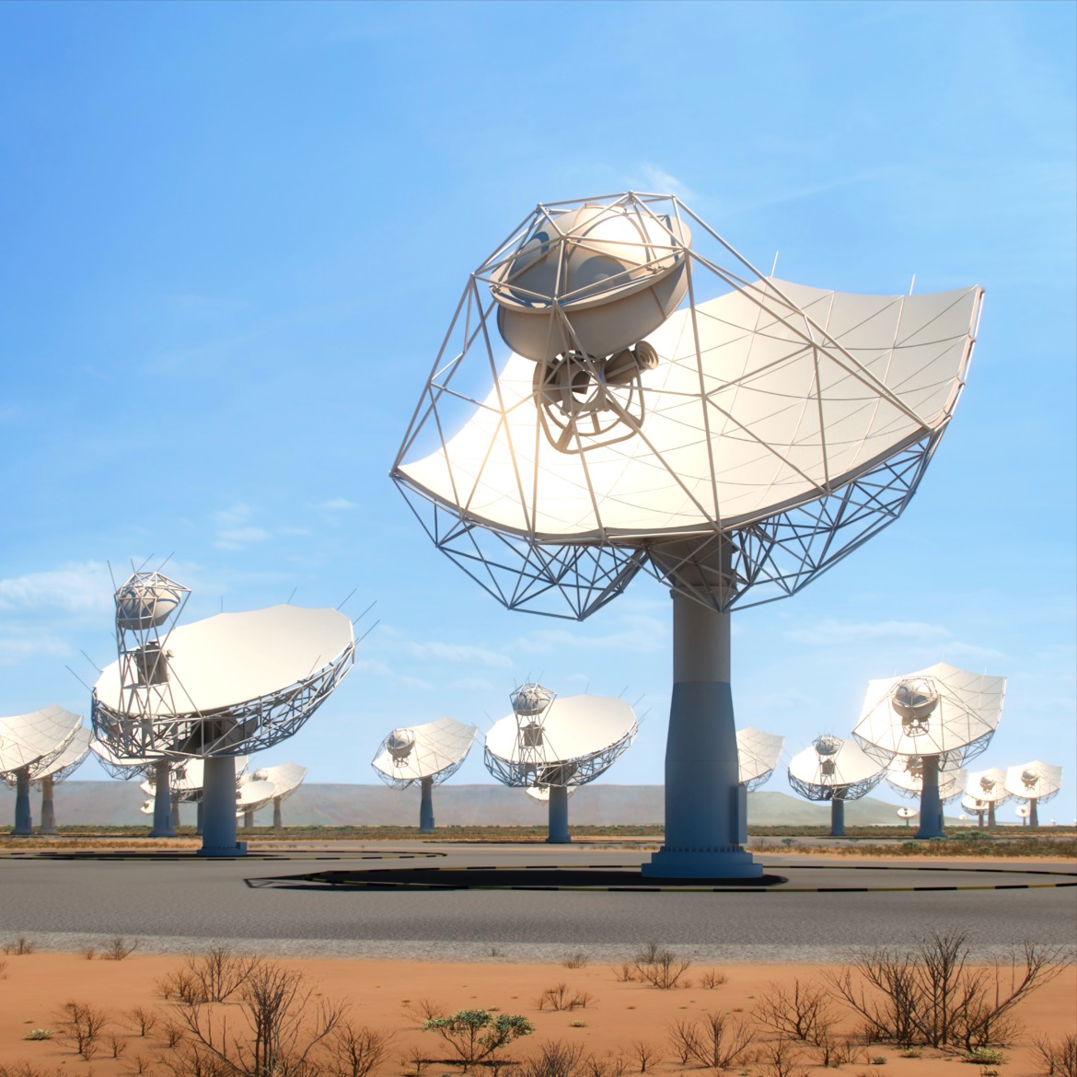
Prototyping Pulsar Search for SKA1
Jayanta Roy
On behalf of the SKA Time Domain Team
led by Ben Steppers and Aris Karastergiou

Slide 2
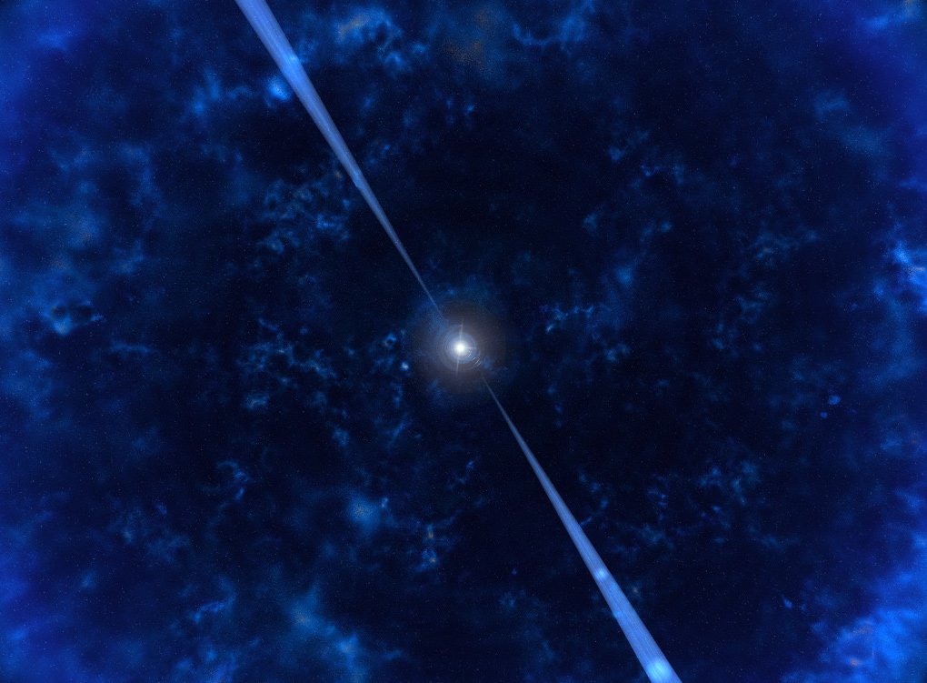
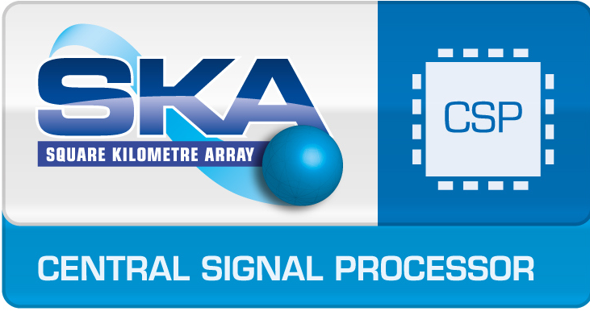
SKA Time Domain Team

Slide 3
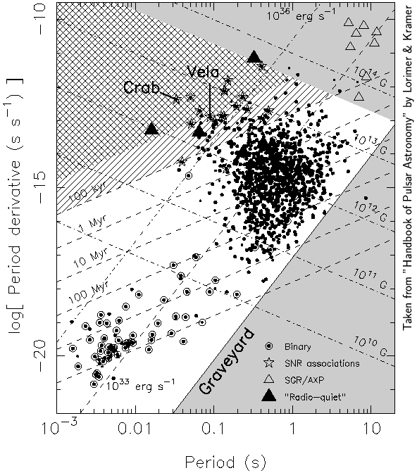
P-Pdot diagram
Young Pulsars
– Energetic, with
significant spin-down noise, glitches, SNRs associations
Magnetars
– High B, Not RP, few in radio
Normal Pulsars
– slower, mostly isolated, bulk of them, good for PSR studies
Double Neutron stars
– spin fast, double pulsars, good for GR tests
Millisecond Pulsars
– Faster, Most in binaries, stable rotators

Slide 4
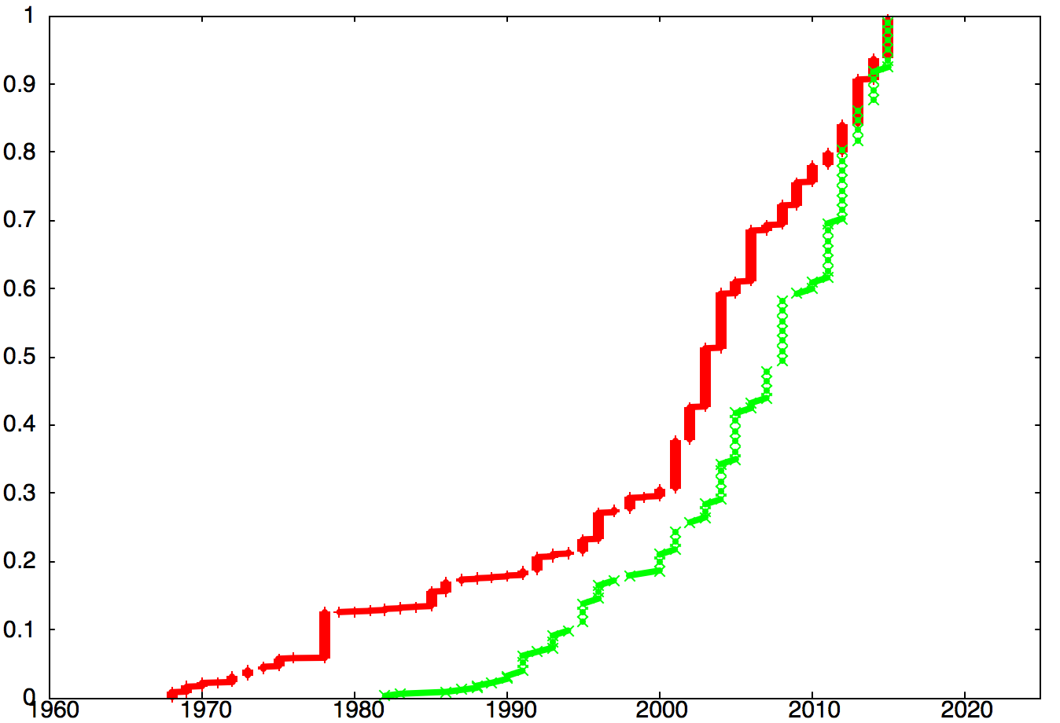
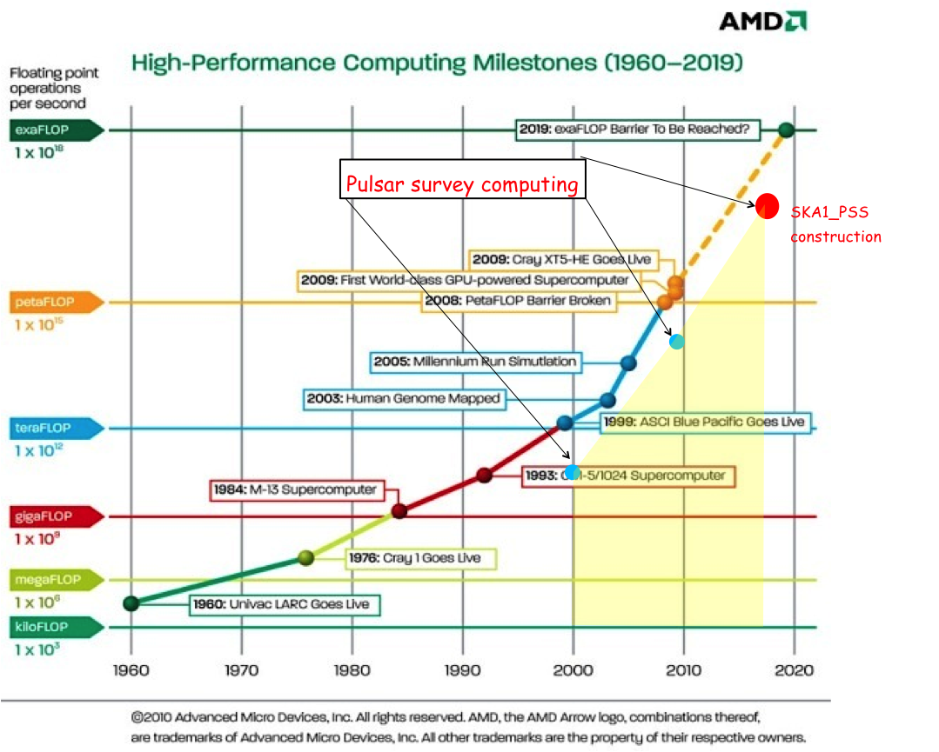
Milestones in discoveries
Extragalactic pulsar
All Pulsars
Pulsar-BH
PMBS
HTRU
MSPs
- 4x in last 10 years
- 2x in last 3 years
Sub-ms MSP
Pulsars in Galactic centre
FERMI-directed
Repeating FRB
FRBs with host galaxy
Triple System
SKA1 construction
Galactic centre Magnetar
J0348+0432
Thornton et al. Bursts
1st Pulsars via AI and Volunteer Computing
100th FERMI Pulsar
SKA1 operation
Cumulative distribution
1st Blind-search radio magnetar
2-M Pulsar
Missing-link pulsar
Sub-100ns timing
“Lorimer Burst”
Intermittent pulsars
RRATs
Fastest MSP!
Double Pulsar
Discovery years
Updated version of Michael Kramer’s presentation in SKA 2014

Slide 5
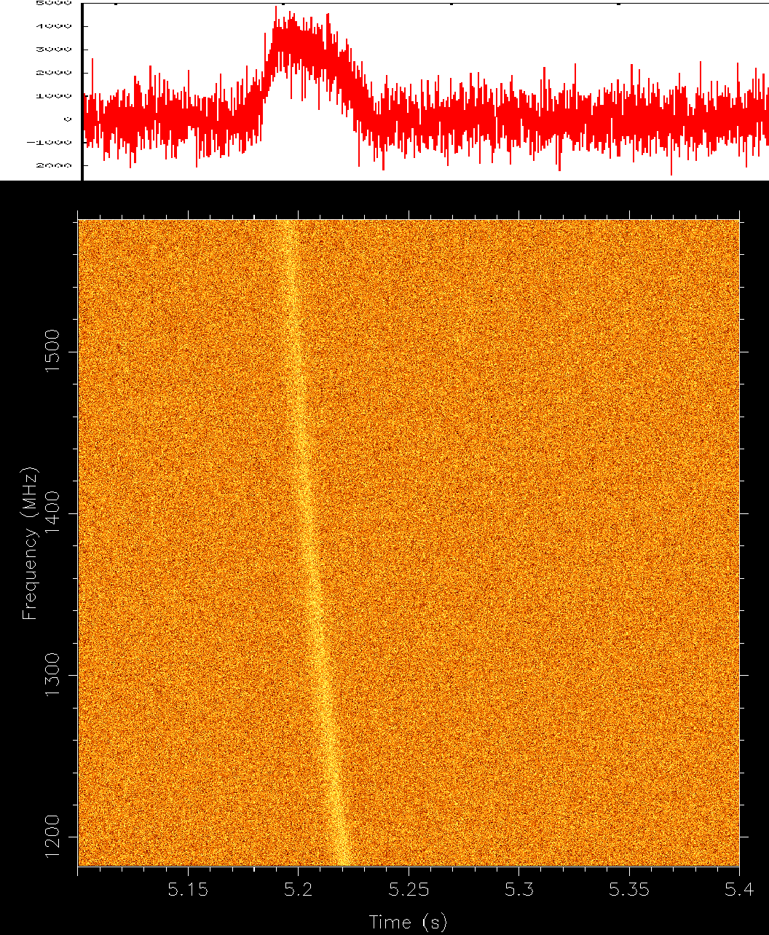
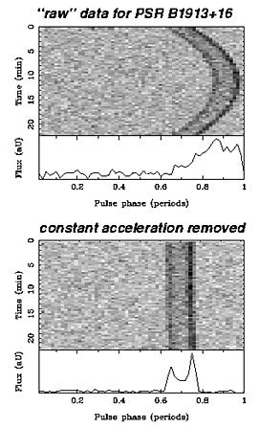
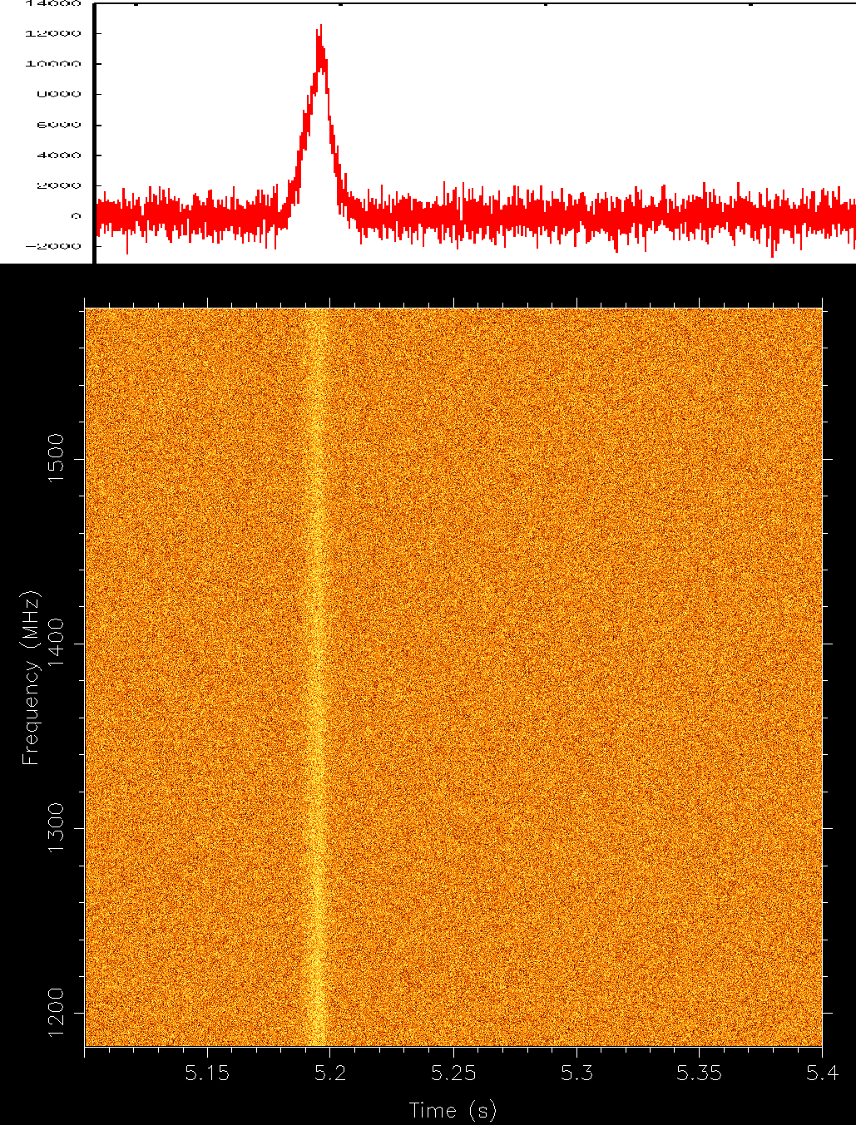
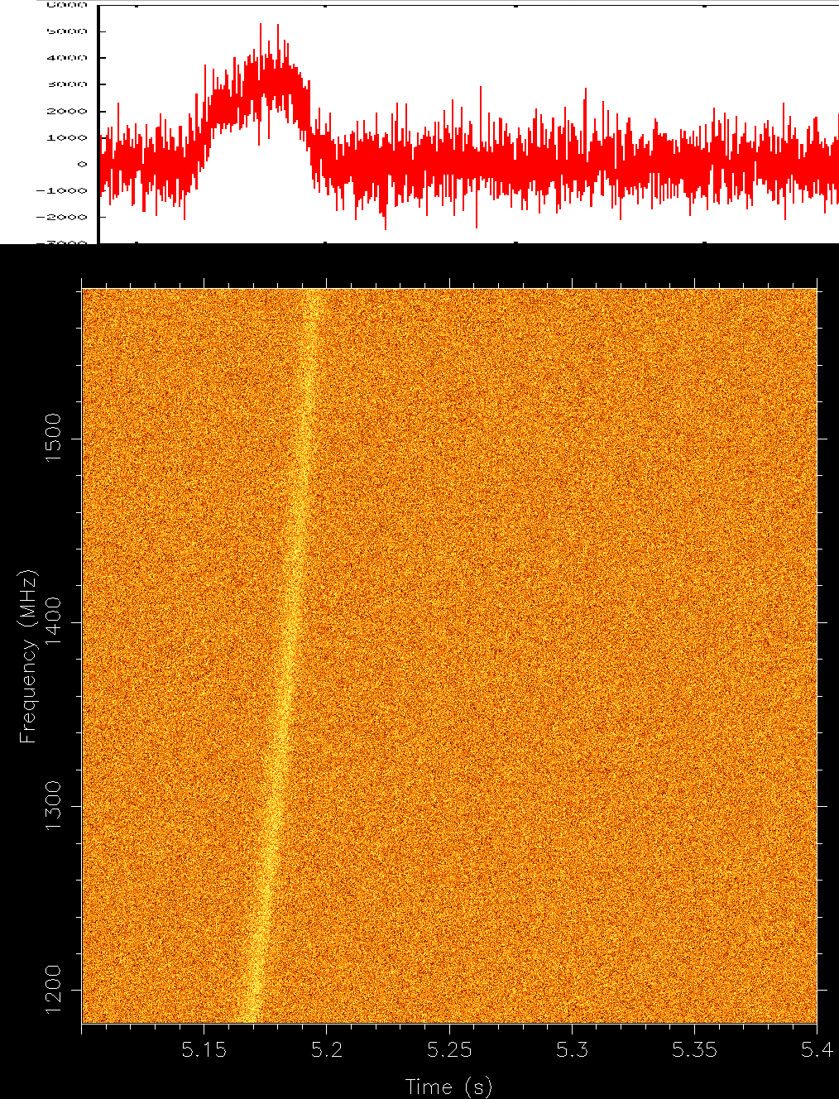
Pulsars with the SKA
only 5% of Galactic population known!
Target to find 20000 new pulsars with 6000 MSPs
Pulsar-BH to test theories of gravity
Fundamental physics (gravitation) with high-precision timers (see Ryan’s talk)
Computational problem
Many frequency dependent
delay sweep: dedispersion trials
Large number of deacceleration
steps to account for binary motion
~ N_{DM} * BW * T_{obs}
~ N_{DM} * N_{acc} * T_{obs}³

Slide 6
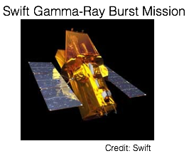
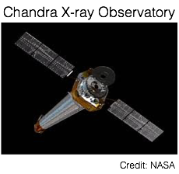
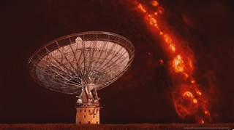
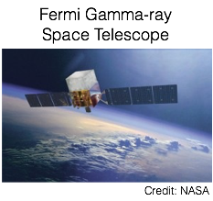
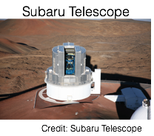
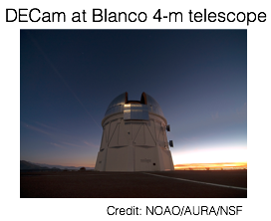
Fast Radio Bursts with the SKA
Millisecond duration radio bursts with likely extragalactic origin
Only ~ 20 discovered so far
Real-time detection with data capturing at full Nyquist domain for rapid follow-up to maximise science returns
Credit: Swinburne Astronomy Productions

Slide 7
Pulsar searches with SKA1 Low + Mid
Low and Mid can probe different pulsar population
SKA1_Low: 50 – 350 MHz
Local population with low DM (dispersion ∞ ν⁻² )
Steep spectra sources (α ∞ ν^{-1.5})
Sensitive away from plane at higher Galactic latitude
Scattering can be of concern (scattering ∞ ν⁻⁴)
Higher survey speed (FOV ∞ ν⁻²) → less beams
SKA1_Mid: 350 MHz – 1.7 GHz (atleast band1 and band2)
Probing population at higher DM
Sources with less steep spectral indices
Less scattering
Sensitive probe for sources close to Galactic plane
More survey beams needed

Slide 8
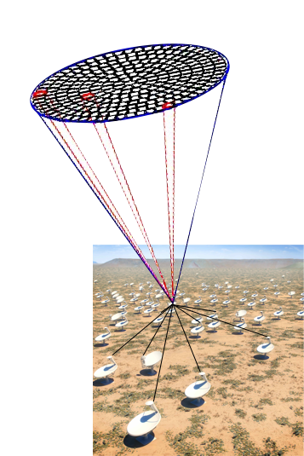
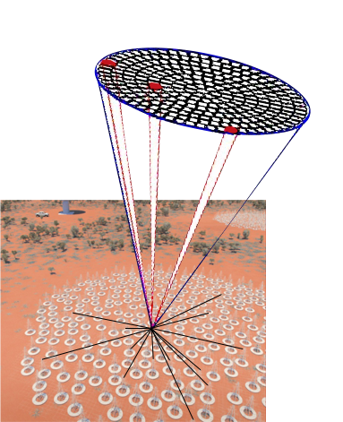
Multi-beam search with the SKA
Increased Field-of-view
Increased data rate to Pulsar Search Sub-element (PSS) of CSP
SKA1 Low
500 beams
@ 100 μs with 15 kHz x 8192 channels
SKA1 Mid
1500 beams
@ 64 μs with
73 kHz x 4096 channels
Credit:
SKAtelescope.org
Credit:
SKAtelescope.org
Data throughput to PSS @ 4% of global internet traffic
From Low_CBF @ 12 PB/day
From Mid_CBF @ 30 PB/day

Slide 9
PSS Processing
Consists of ~ 750 PSS nodes (for Mid) in 48 racks
Each PSS nodes with FPGA+GPU accelerators
Approx. 260 W / beam for processing
→ 25 Gflops/W (6 Gflops/W in Top Green500)
SADT
Central Signal Processing (CSP)
Science Data Processor (SDP)
FRB candidate analysis
Correlator
SADT
Beam-former
Pulsar and FRB search
Pulsar candidate analysis
Pulsar timing
Pulsar timing Data analysis

Slide 10
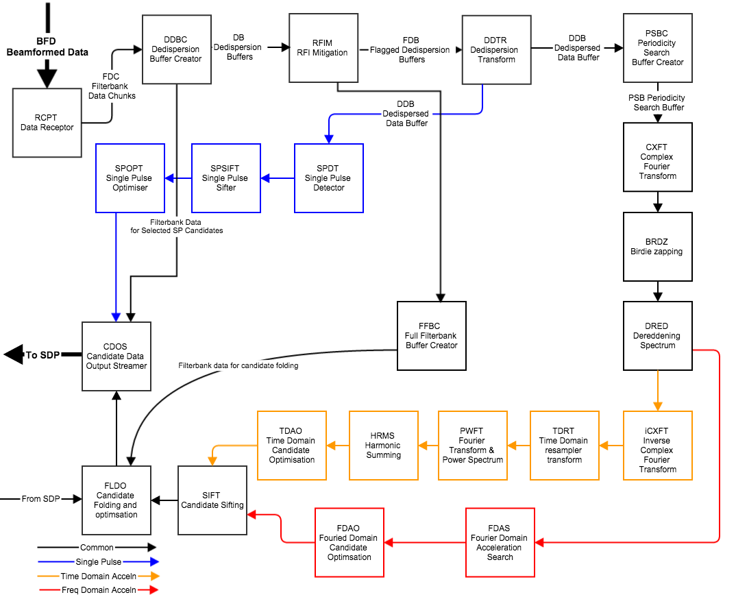
PSS Processing blocks
0.512 Gbps in / beam
Real-time dedispersion, 6000 DM trials
3 Gbps out
3 Gbps in
8Mpt point FFT
10.7 ns per sample
3 Gbps out
1. Receive and dedisperse data
3. Fourier domain conversion and spectral purification
3 Gbps in
6000* 12 * 160 kpt convolutions every 10 seconds
2. search for FRBs
4. Search for accelerated binaries
1000 candidates in
8 Mb/folded candidate
8 Gb/beam/obs out
3 Gbps in
6000 * 85 * 4 Mpt convolutions
harmonic summing

Slide 11
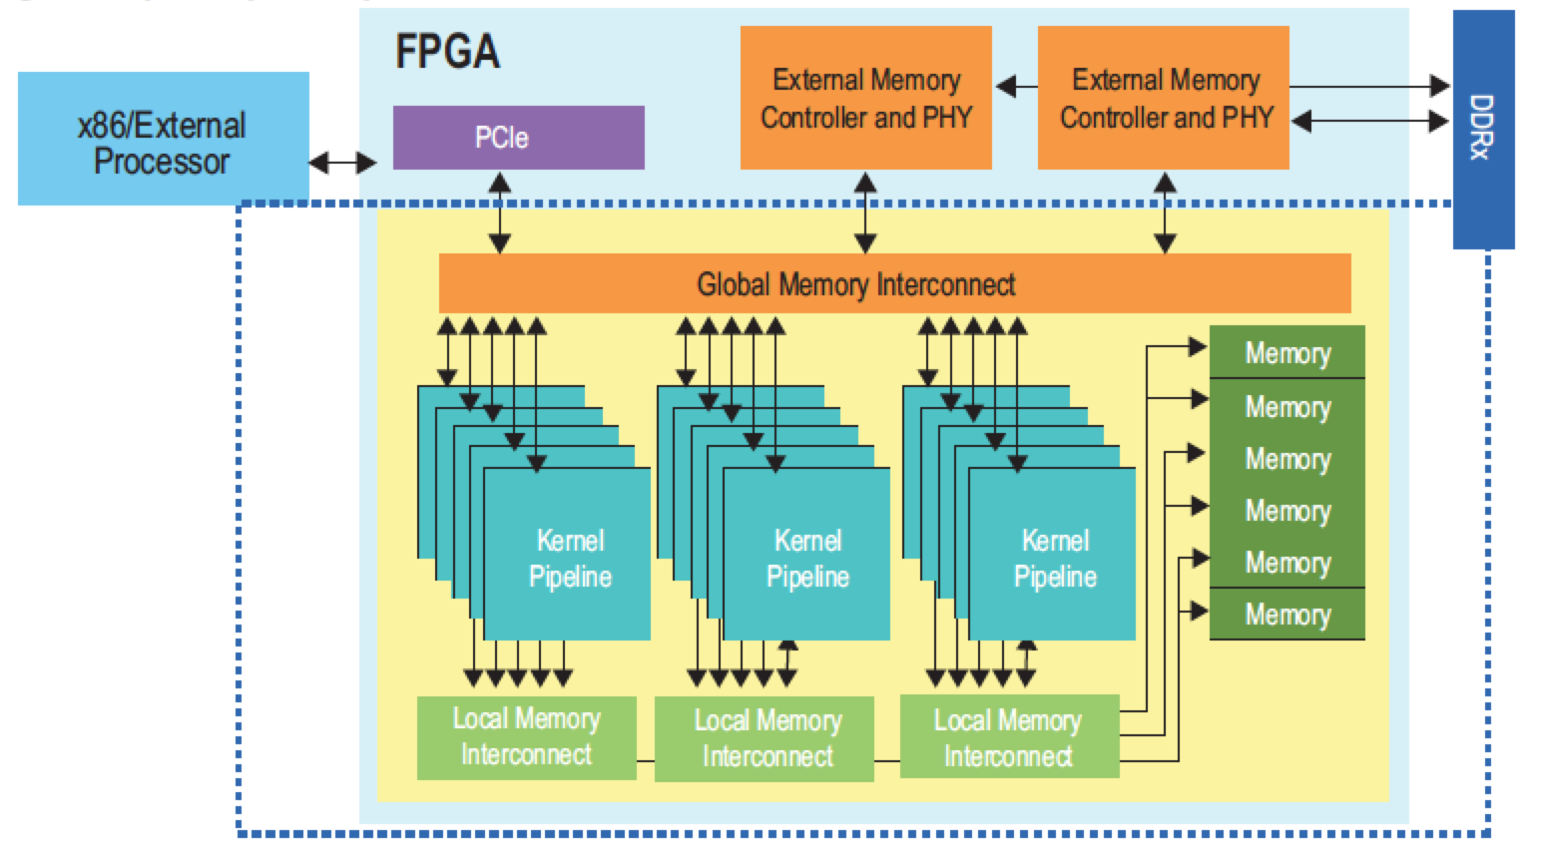
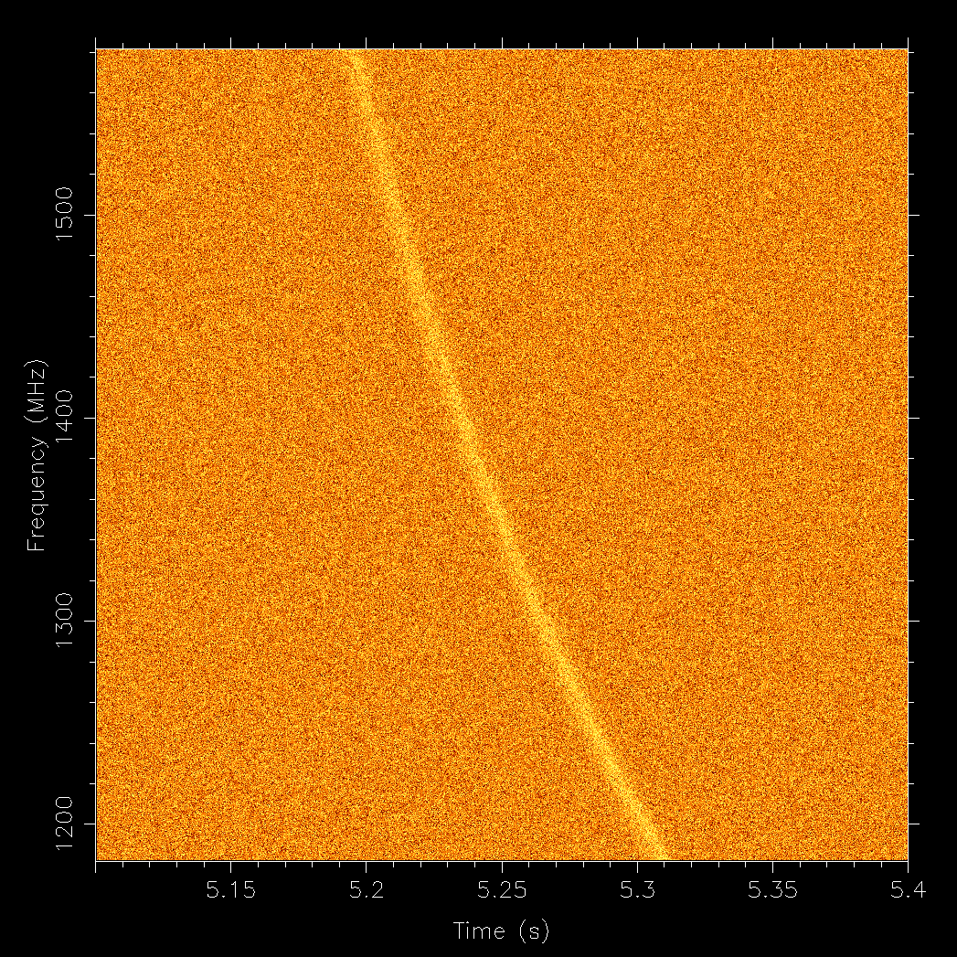
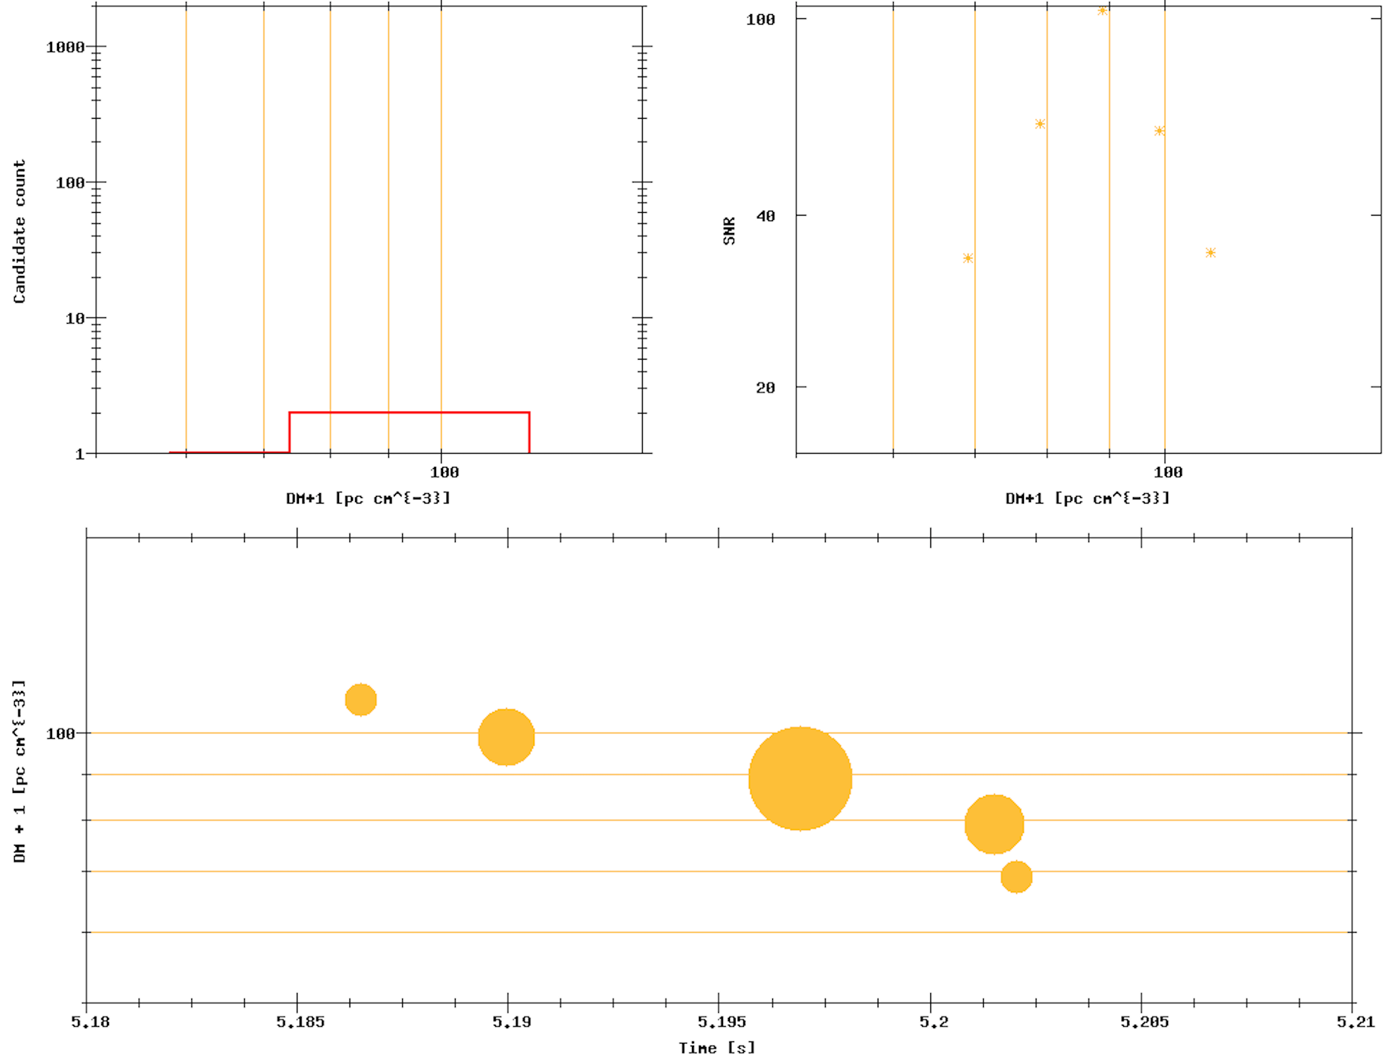
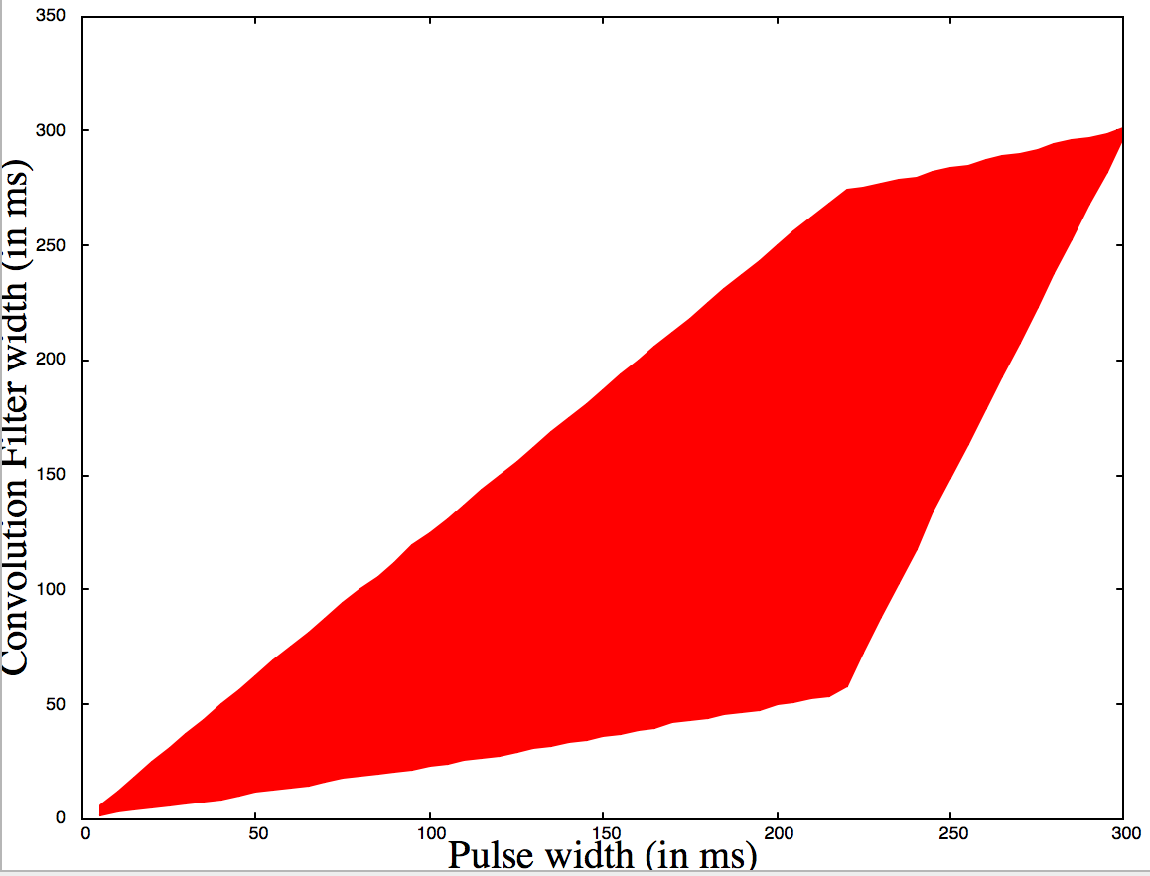
PSS dedispersion and FRB search
Output
Input
Processing
dedispersion
thresholding
convolution
SKA1_Mid beamformer
60 MB/s per beam
Time/Frequency domain convolution
Mean calculator
Variance
calculator
Threshold
detector
Dedispersion
X
√
125 W
Dedispersion
2 Tops/beam
convolution with matched filtering for a pulse-width ranging from 100 μs to 0.5 s ~ 50 Gops/beam
Matched
Filter coeff
40 W (~50 Gflops/W)

Slide 12
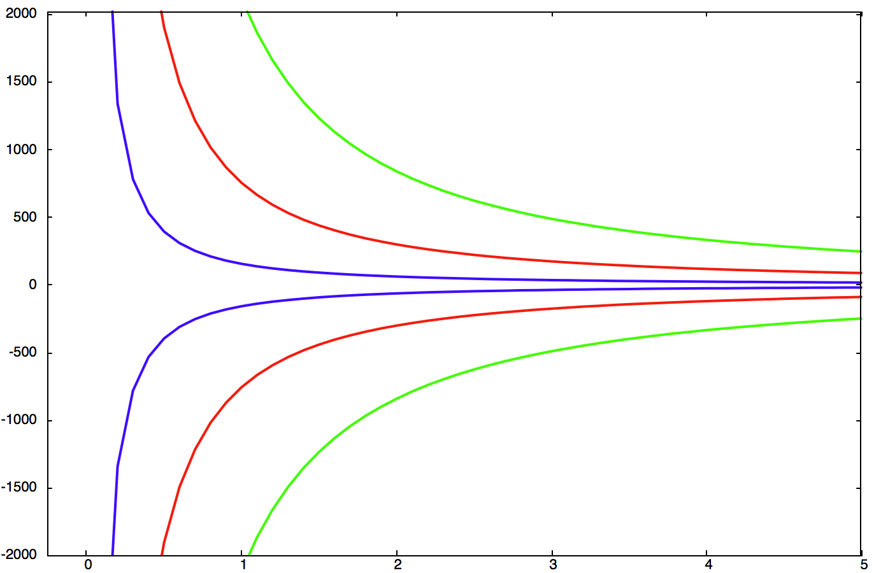
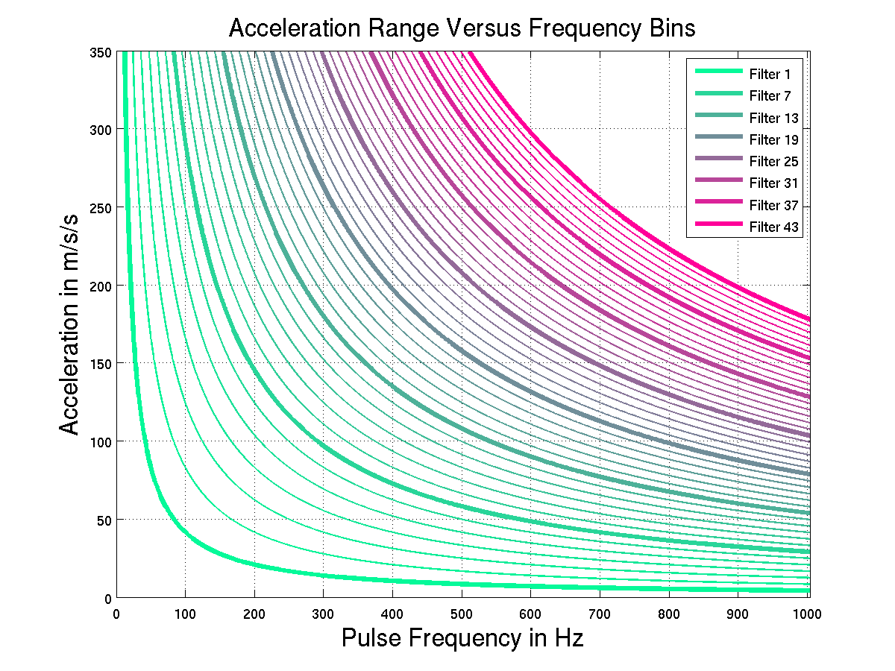
PSS acceleration search
85 acceleration trials over ± 350 m/s^2
Convolve each of 6,000 spectra with 85 templates of varying length
(10 to 400 taps)
Sum up to 8 harmonics
PSS acceleration space for 2 ms pulsar
PSS test/fake pulsars
NS-WD binaries
Circular edge-on orbit
NS-NS binaries
NS-BH binaries
Maximum acceleration (m/s^2)
Orbital period (hour)

Slide 13
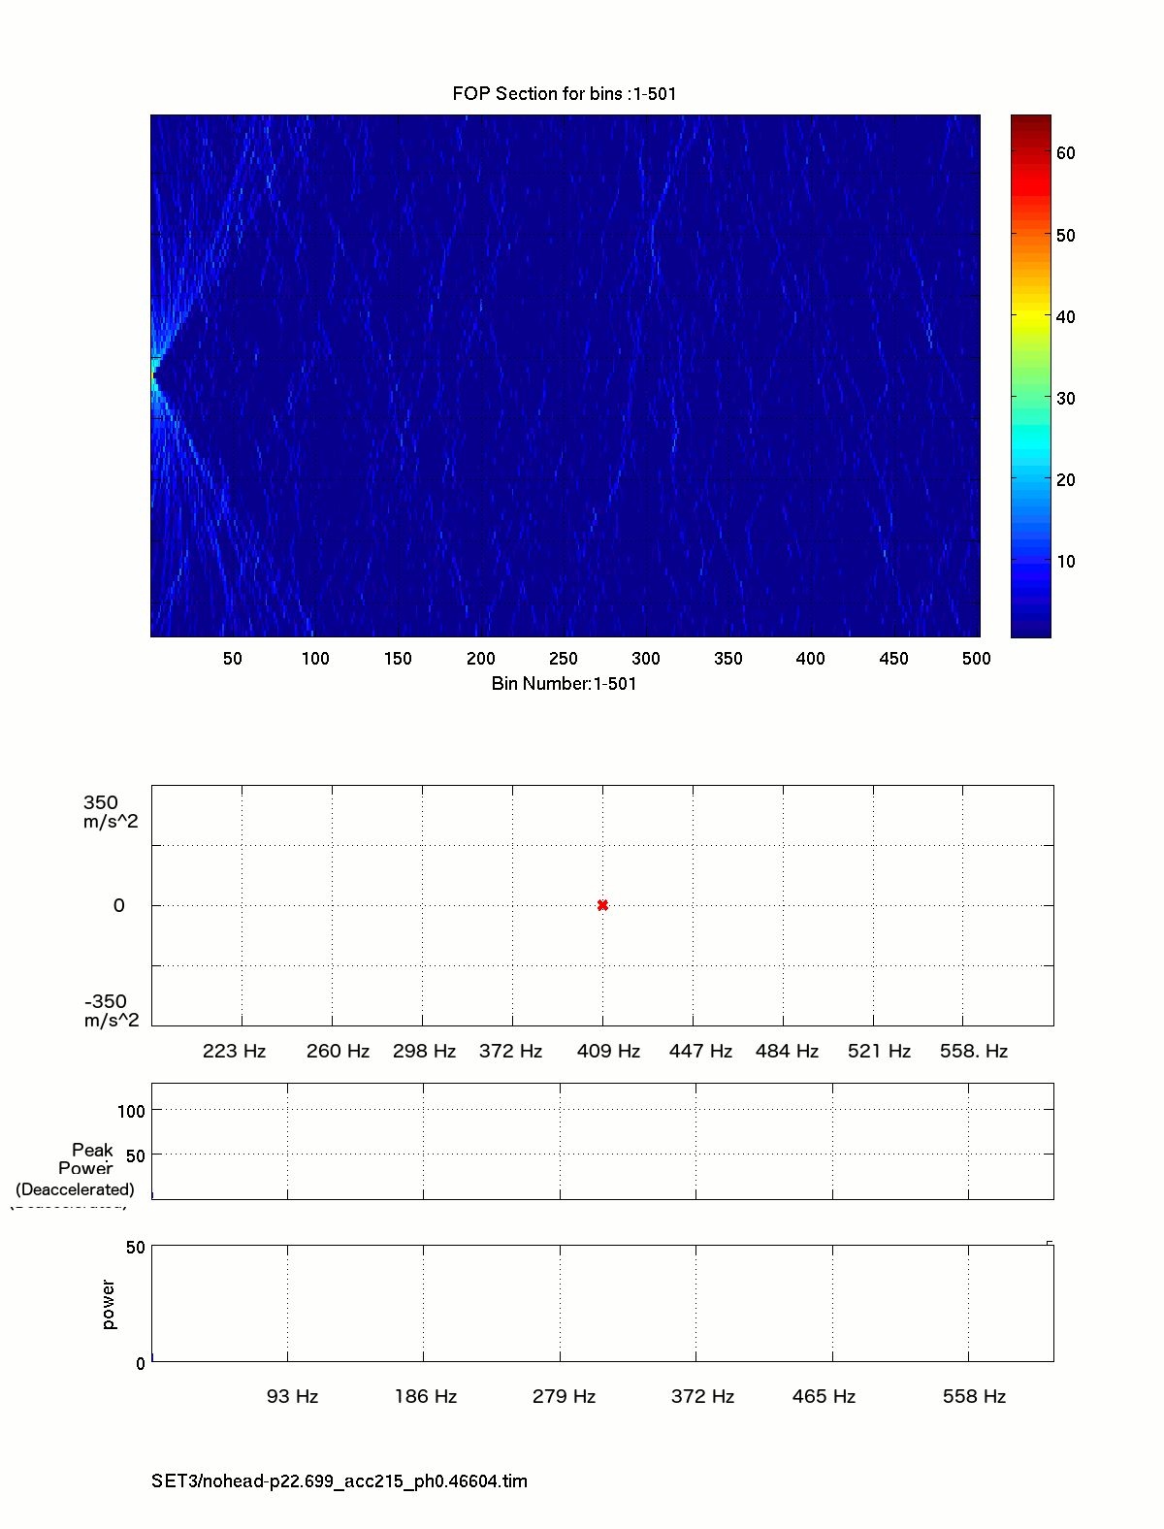
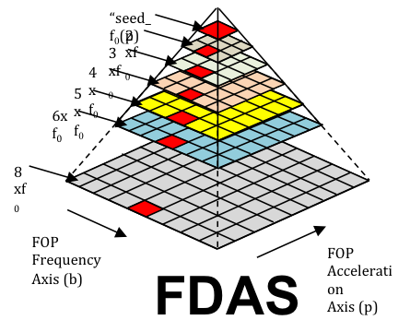
PSS acceleration search
Double pulsar detection in
acceleration-frequency space
FPGA design
20-27 Watts
for 3300 DMs
~15 Tops / beam, Total ~20 Pops

Slide 14
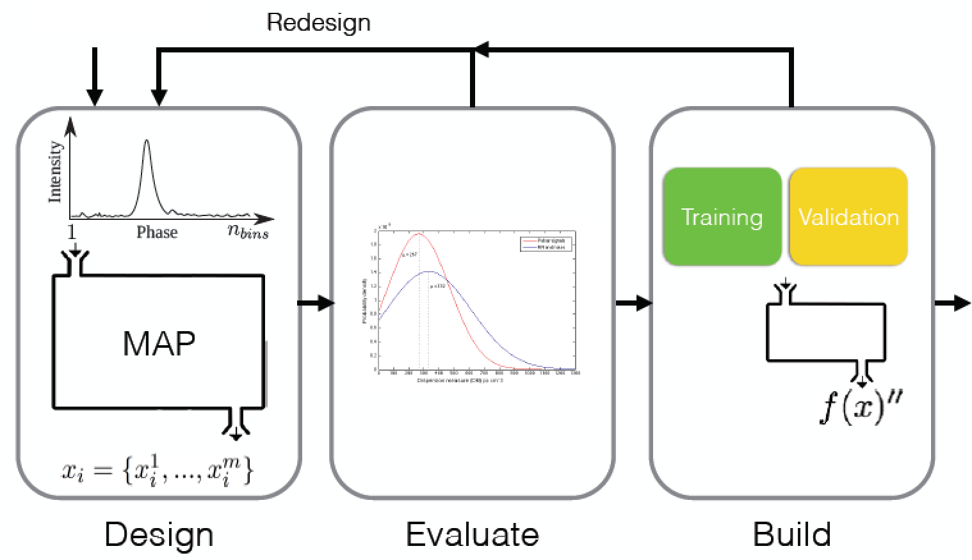
PSS machine learning
~ 20,000 PSRs discovered from ~100 billions candidates from CSP
million candidates per sq deg, 2000-3000 for LOTAAS/HTRU
Making intelligent decisions via mathematical models
Machine learning trade-off
Highest accuracy - more CPU power and memory i.e. Deep neural nets
2.0 Tflops to train quickly, high memory use
Approximate approaches - sub-optimal accuracy, but lower resource requirements (streamed decision tree)
Challenges: feature extraction,
distributed and real-time learning
Incremental stream prototyping

Slide 15
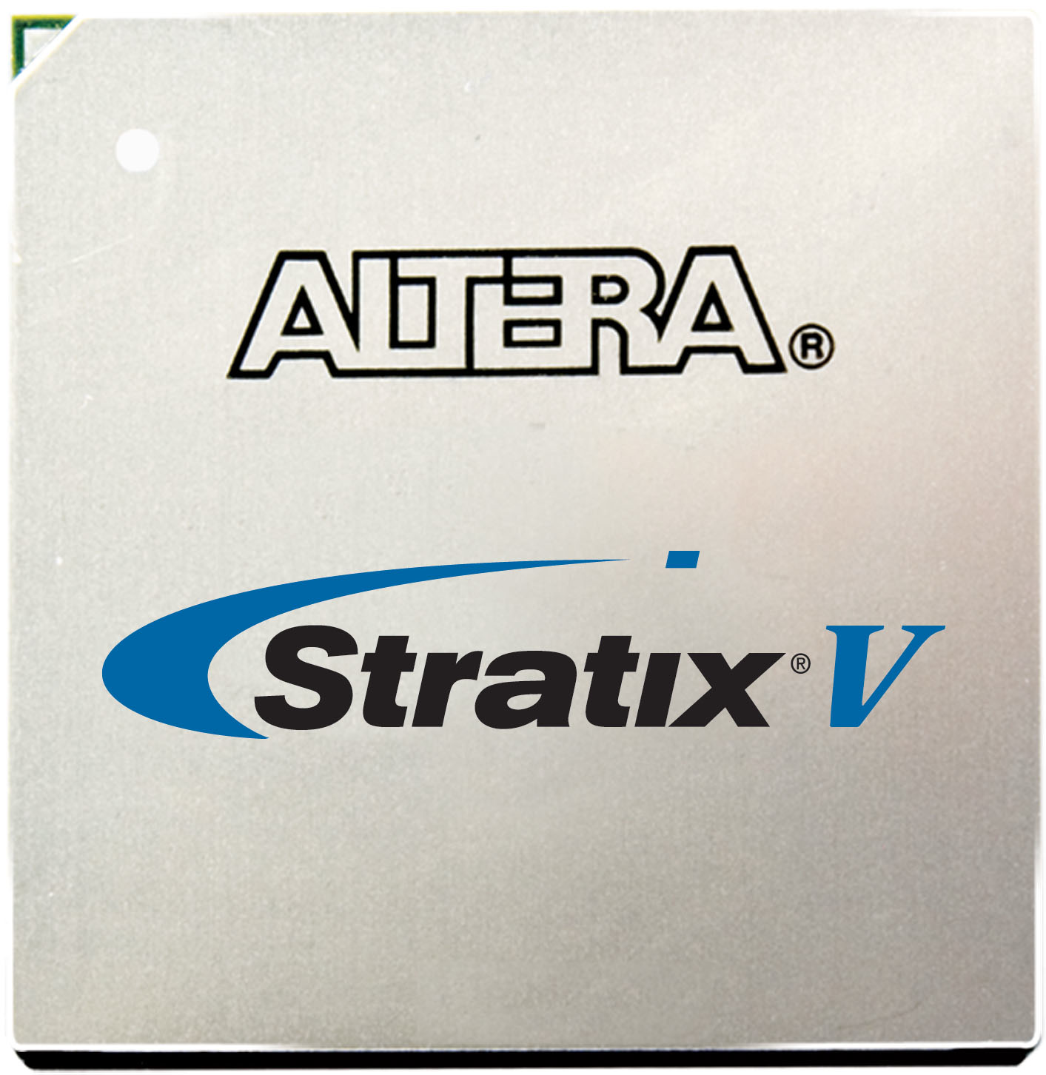
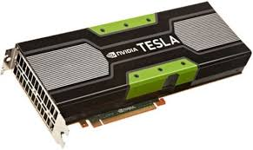
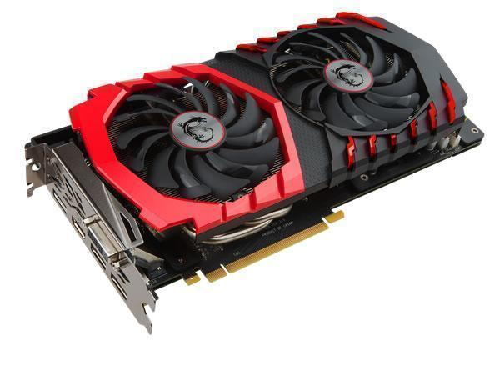
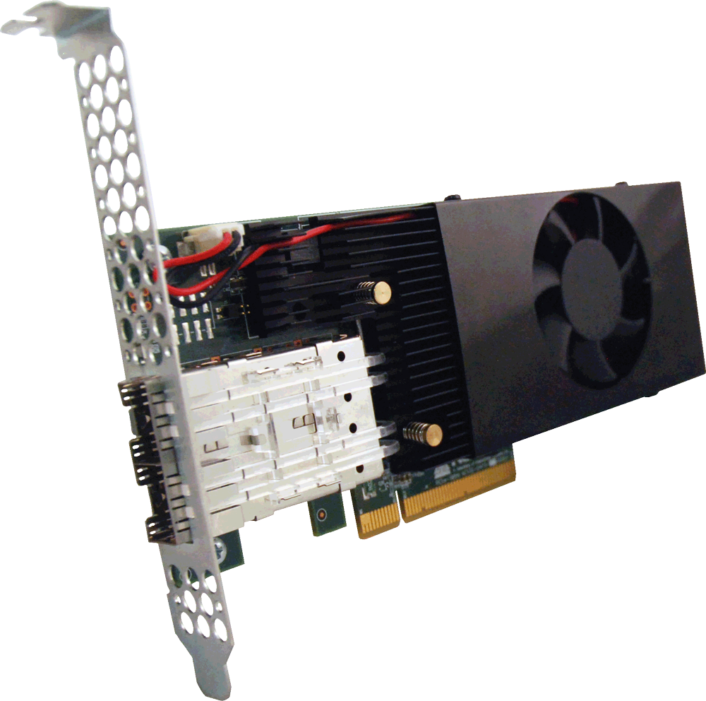
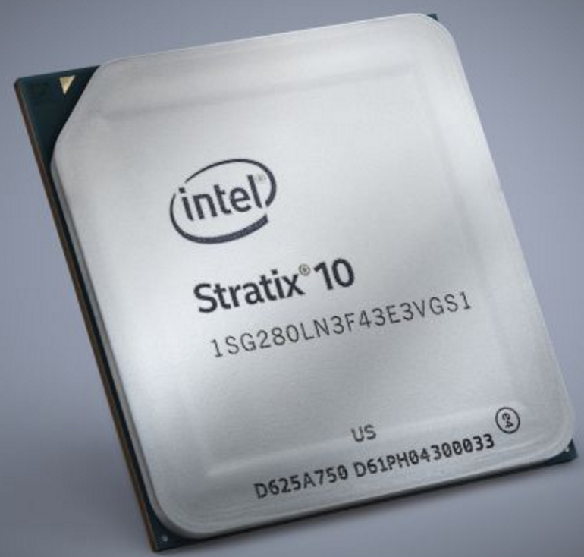
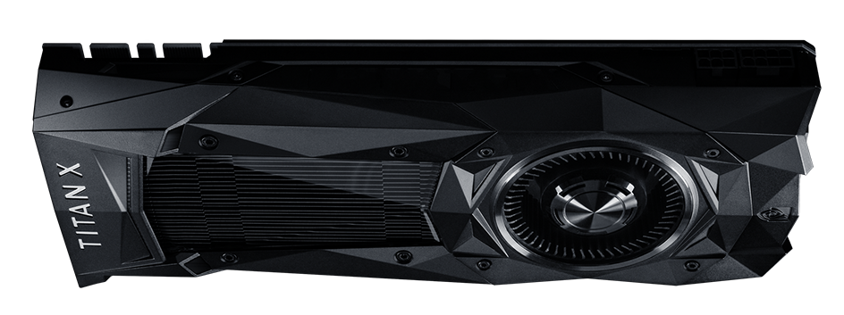
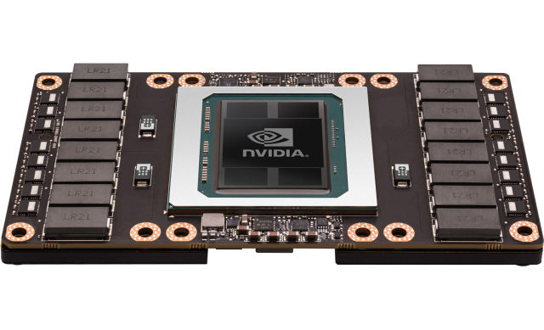
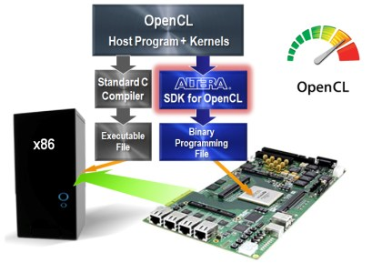
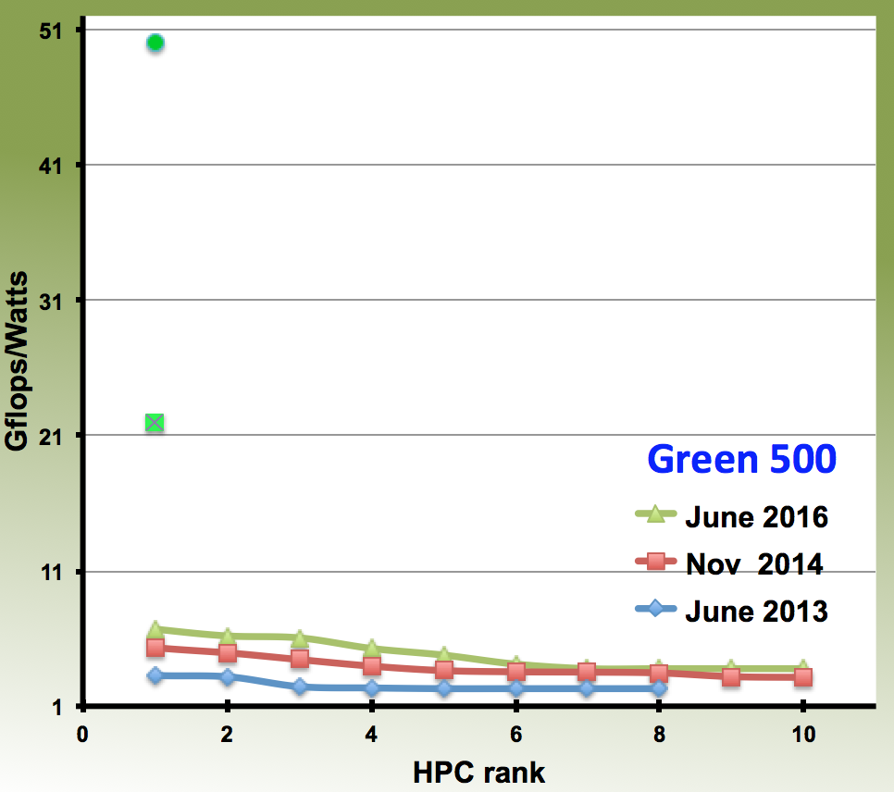
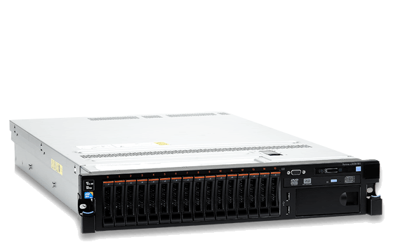
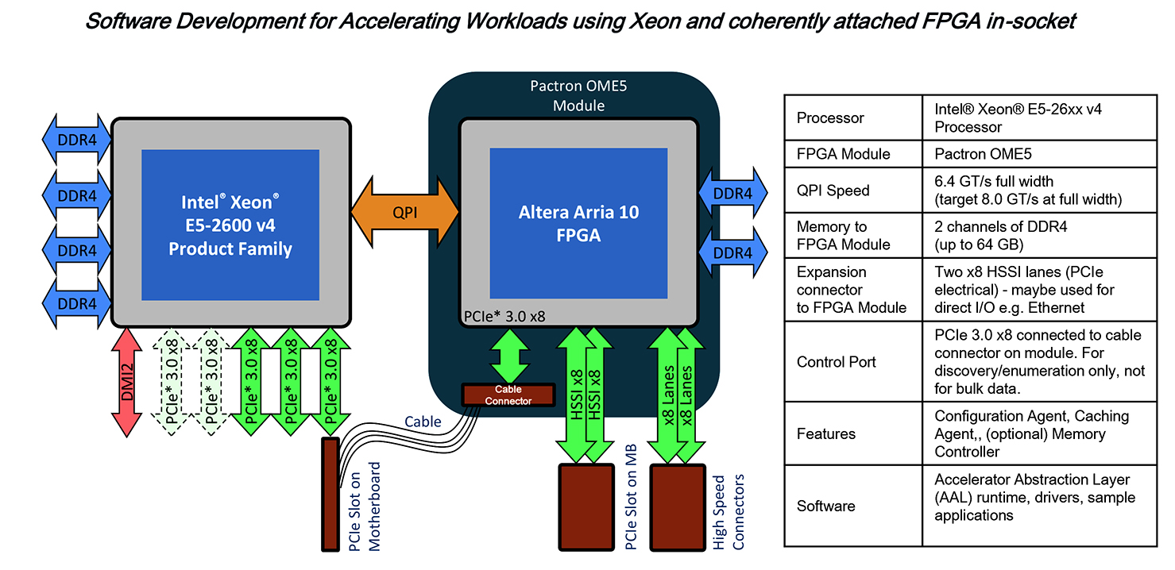
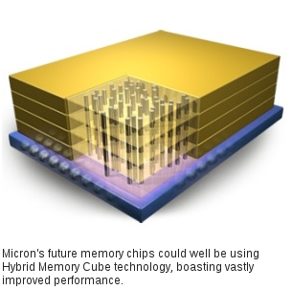
COTS hardware/accelerators
FPGA-OpenCL
GPU-CUDA
28nm
Kepler K40
20nm
+15% performance increase
Maxwell 980
14nm
2x performance increase
100 Gflops/W (exp)
Titan X Pascal
Tesla P100
PSS dedispersion kernel
Energy efficiency
Installed ProtoNIP @ SKA-SA
Energy efficient
14 nm Broadwell CPU
SKA1_PSS
Future
HBM

Slide 16
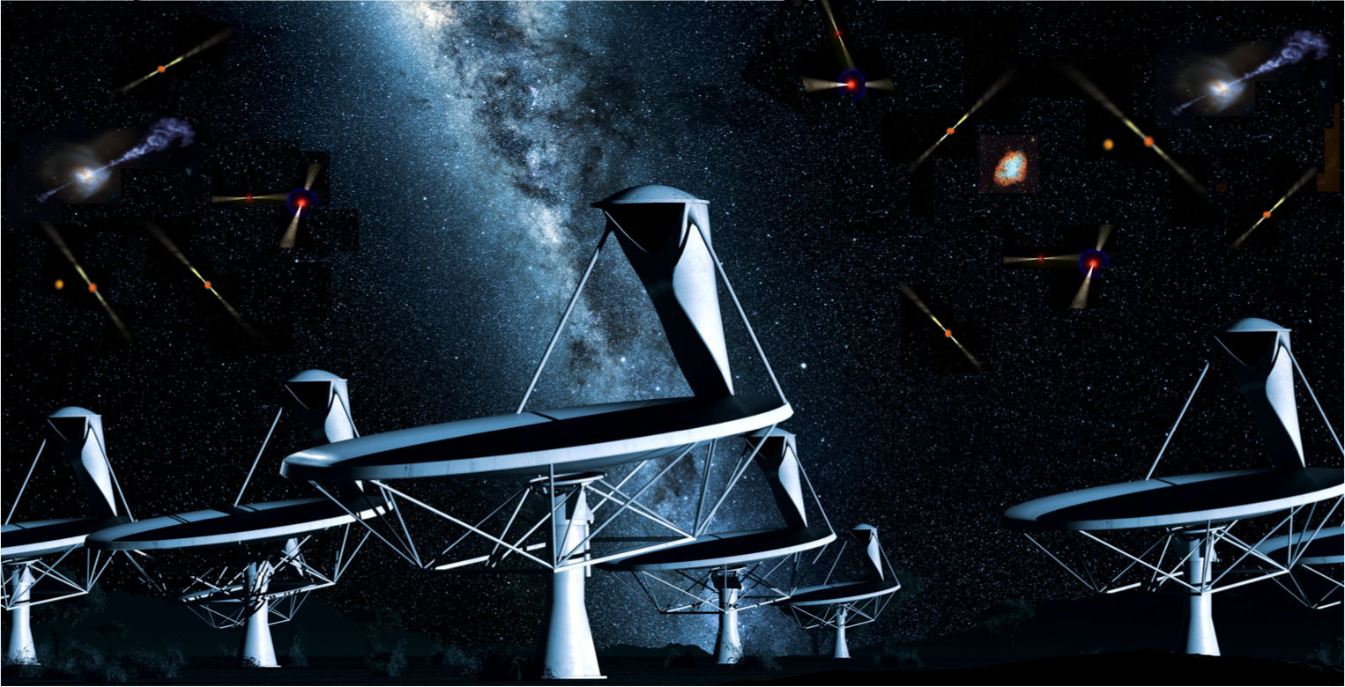
Thank you!

