Slide 1
Bridging the gap between the present and the SKA
The SHAPLEY CONCENTRATION as a pilot science case
Tiziana Venturi
INAF, Istituto di Radioastronomia
tventuri@ira.inaf.it
Background picture – Credits Planck Collaboration
Collaborators:
S. Bardelli, D. Dallacasa, G. Di Gennaro, F. Gastaldello, S. Giacintucci, M. Rossetti
R. Kale & MWA Collaboration
G. Bernardi & MeerKAT Collaboration
SKA 2016 – Science for the SKA Generation – Goa, November 9th 2016

Slide 2
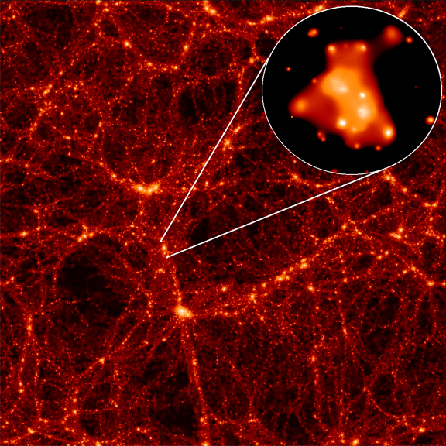
The Shapley Concentration Core in Context
Science case: Galaxy Clusters, AGN evolution & Environment
Hierarchical model and accretion of matter (galaxies and groups) along filaments
Cluster mergers

Slide 3
The Shapley Concentration Core in Context
Science case: Galaxy Clusters, AGN evolution & Environment
Shocks and turbulence injected in the ICM
Hierarchical model and accretion of matter (galaxies and groups) along filaments
Cluster mergers
Impact on relativistic particles and magnetic fields
Impact on the galaxies

Slide 4
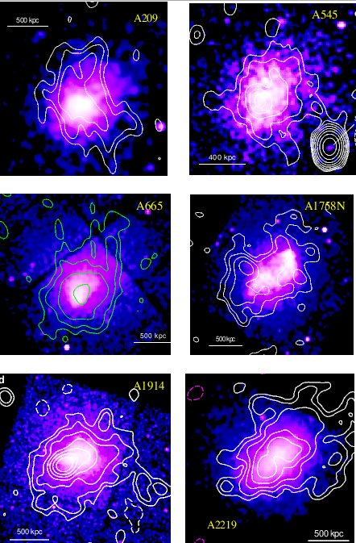
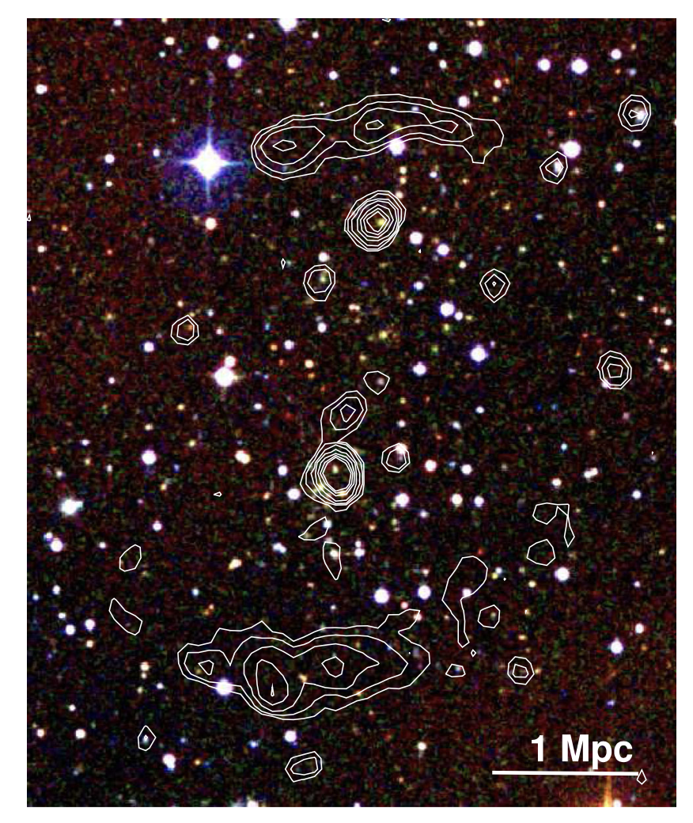
The Shapley Concentration Core in Context
Science case: Galaxy Clusters, AGN evolution & Environment
Shocks and turbulence injected in the ICM
de Gasperin+ 2014
Impact on relativistic particles and magnetic fields
Impact on the galaxies
Giacintucci
Giant radio halos and relics detected in a number of clusters
Angular scales: few to several arcmin
Surface brightness: sub-μJy/arcsec²

Slide 5
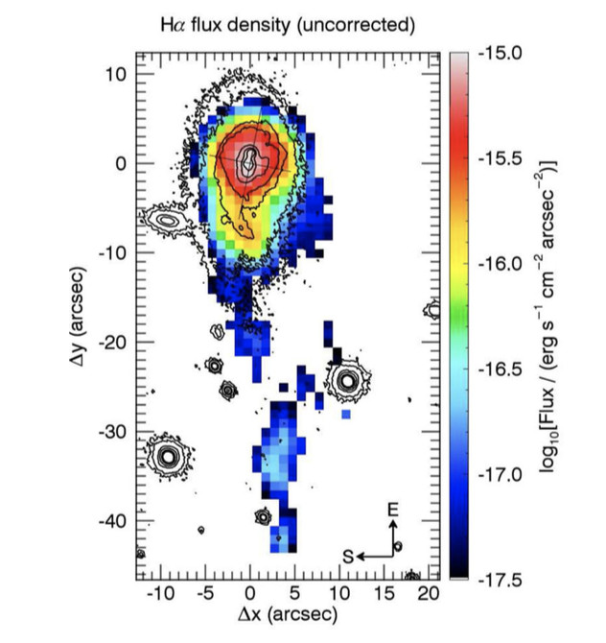
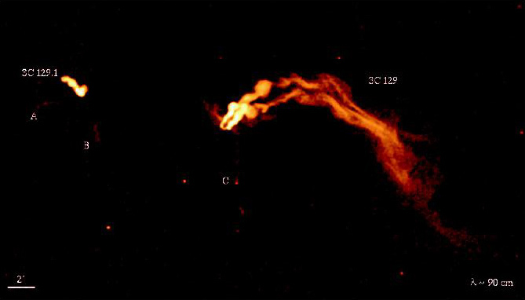
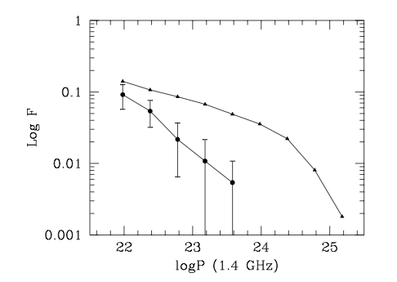
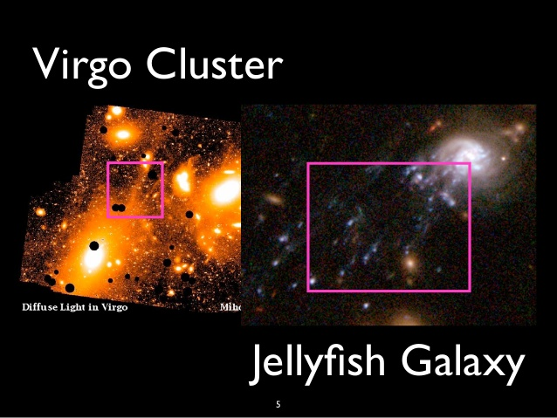
The Shapley Concentration Core in Context
Science case: Galaxy Clusters, AGN evolution & Environment
Merluzzi+ 16
Shocks and turbulence injected in the ICM
Impact on relativistic particles and magnetic fields
Impact on the galaxies
Venturi+ 2000
Synchrotron radio tails, gas stripping, radio AGN & SB activity (Andra’s talk)
Angular scales: sub- to several arcsec

Slide 6
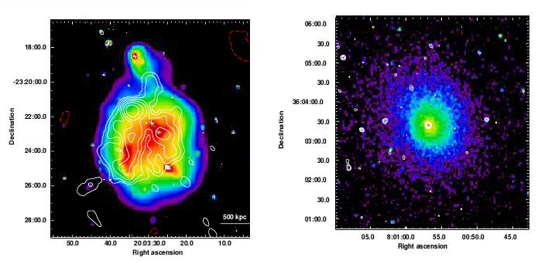
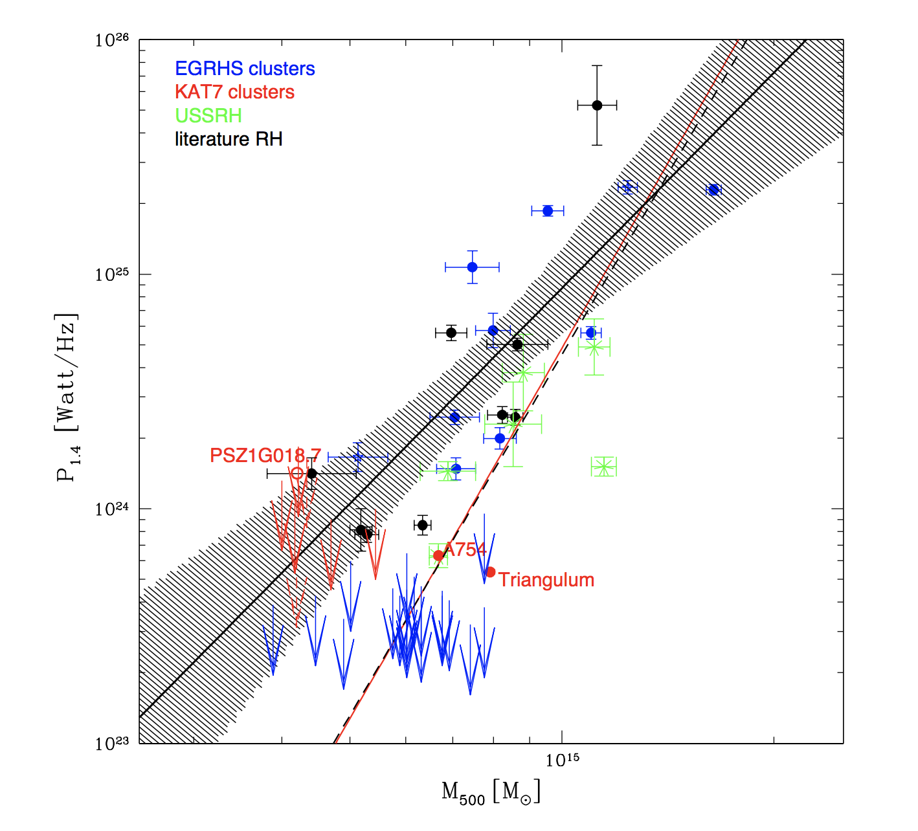
Extended emission in galaxy clusters and scaling laws
Established connection between halos, relics and cluster mergers
Bernardi, TV, Cassano et al. 2016

Slide 7
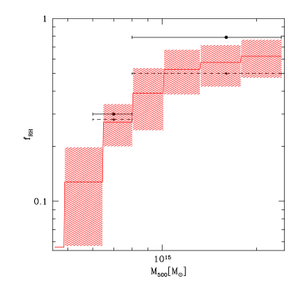
Extended emission in galaxy clusters and scaling laws
Established connection between halos, relics and cluster mergers
Cuciti et al. 2015
Considerable drop of occurrence below 8x10¹⁴M_{Sun}
Bernardi, TV, Cassano et al. 2016

Slide 8
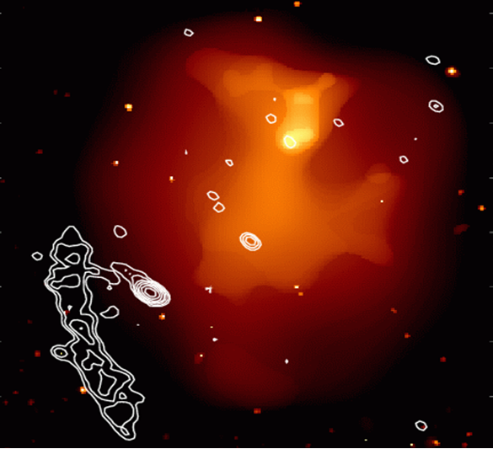
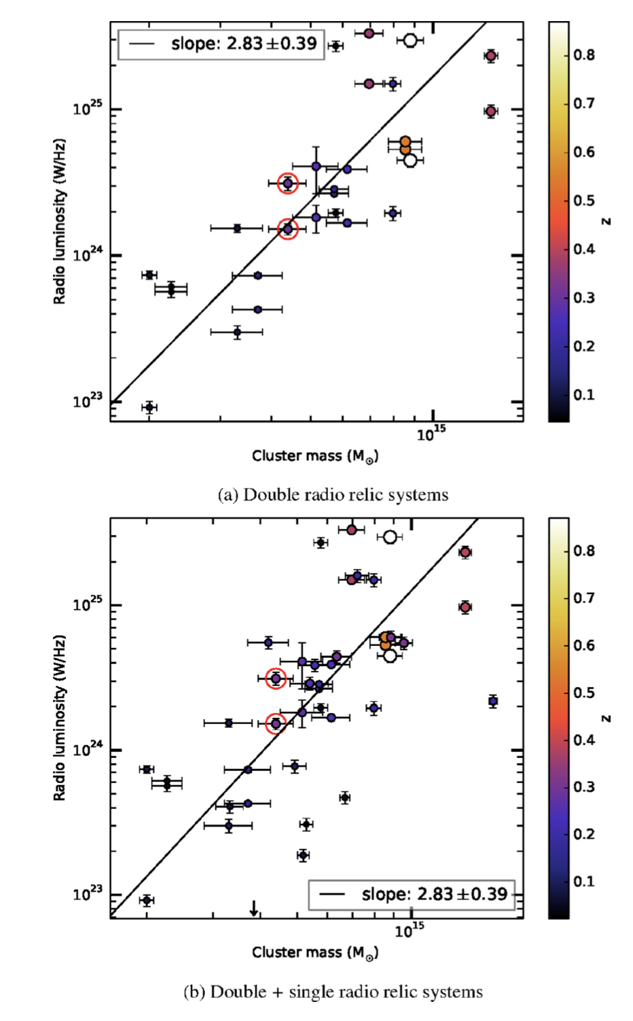
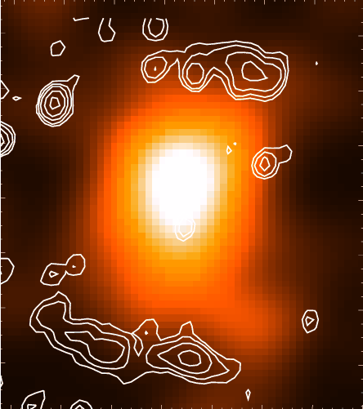
Extended emission in galaxy clusters and scaling laws
A521
de Gasperin et al. 2014
A1240

Slide 9
Extended emission in galaxy clusters and scaling laws
A521
de Gasperin et al. 2014
de Gasperin et al. 2014
A1240

Slide 10
de Gasperin et al. 2014
Bernardi, Venturi et al. 2016
Detection of radio halos and relics in low mass systems challenging so far
Our understanding of low mass accretion and minor mergers still very poor

Slide 11
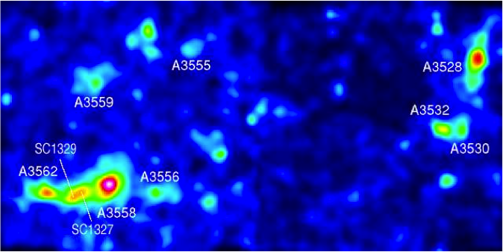
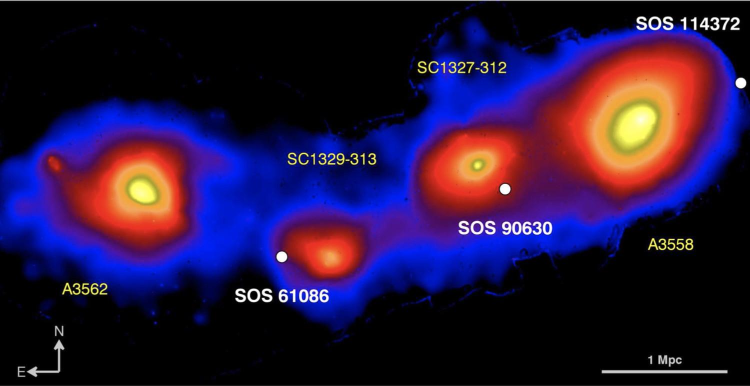
The Shapley Concentration Core in Context
Science case: Galaxy Clusters, AGN evolution & Environment
Largest nearby region (z ≈ 0.039-0.054) in the Southern Sky, where cluster mergers and group accretion are taking place now
Tens of clusters, and 2 main cluster complexes: A3556-A3558-A3562 and A3528-A3530-A3532
Distribution of galaxis
XMM - From Merluzzi+ 2016
Pre-merging and merging groups and clusters, as well as relaxed systems

Slide 12
The Shapley Concentration Core in Context
Science case: Galaxy Clusters, AGN evolution & Environment
T from ≈ 3.2 keV (A3530) to ≈ 5.5 keV (A3558) (De Filippis et al. 2005)
L_{X} from ≈ 1.7x10⁴³ erg s⁻¹ (A3556) to ≈ 6.68x10⁴⁴ erg s⁻¹ (A3558)
M_{opt} ≈ 3.6 (A3528 complex) – 5.4 (A3558 complex) x10¹⁵ h⁻¹ M_{Sun} (Bardelli et al. 2000)
Distribution of galaxis
XMM - From Merluzzi+ 2016
Ideal place to study the effects of the formation of large scale structrures on galaxies, thermal and non-thermal component in the ICM in low & intermediate mass clusters & minor mergers

Slide 13
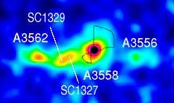
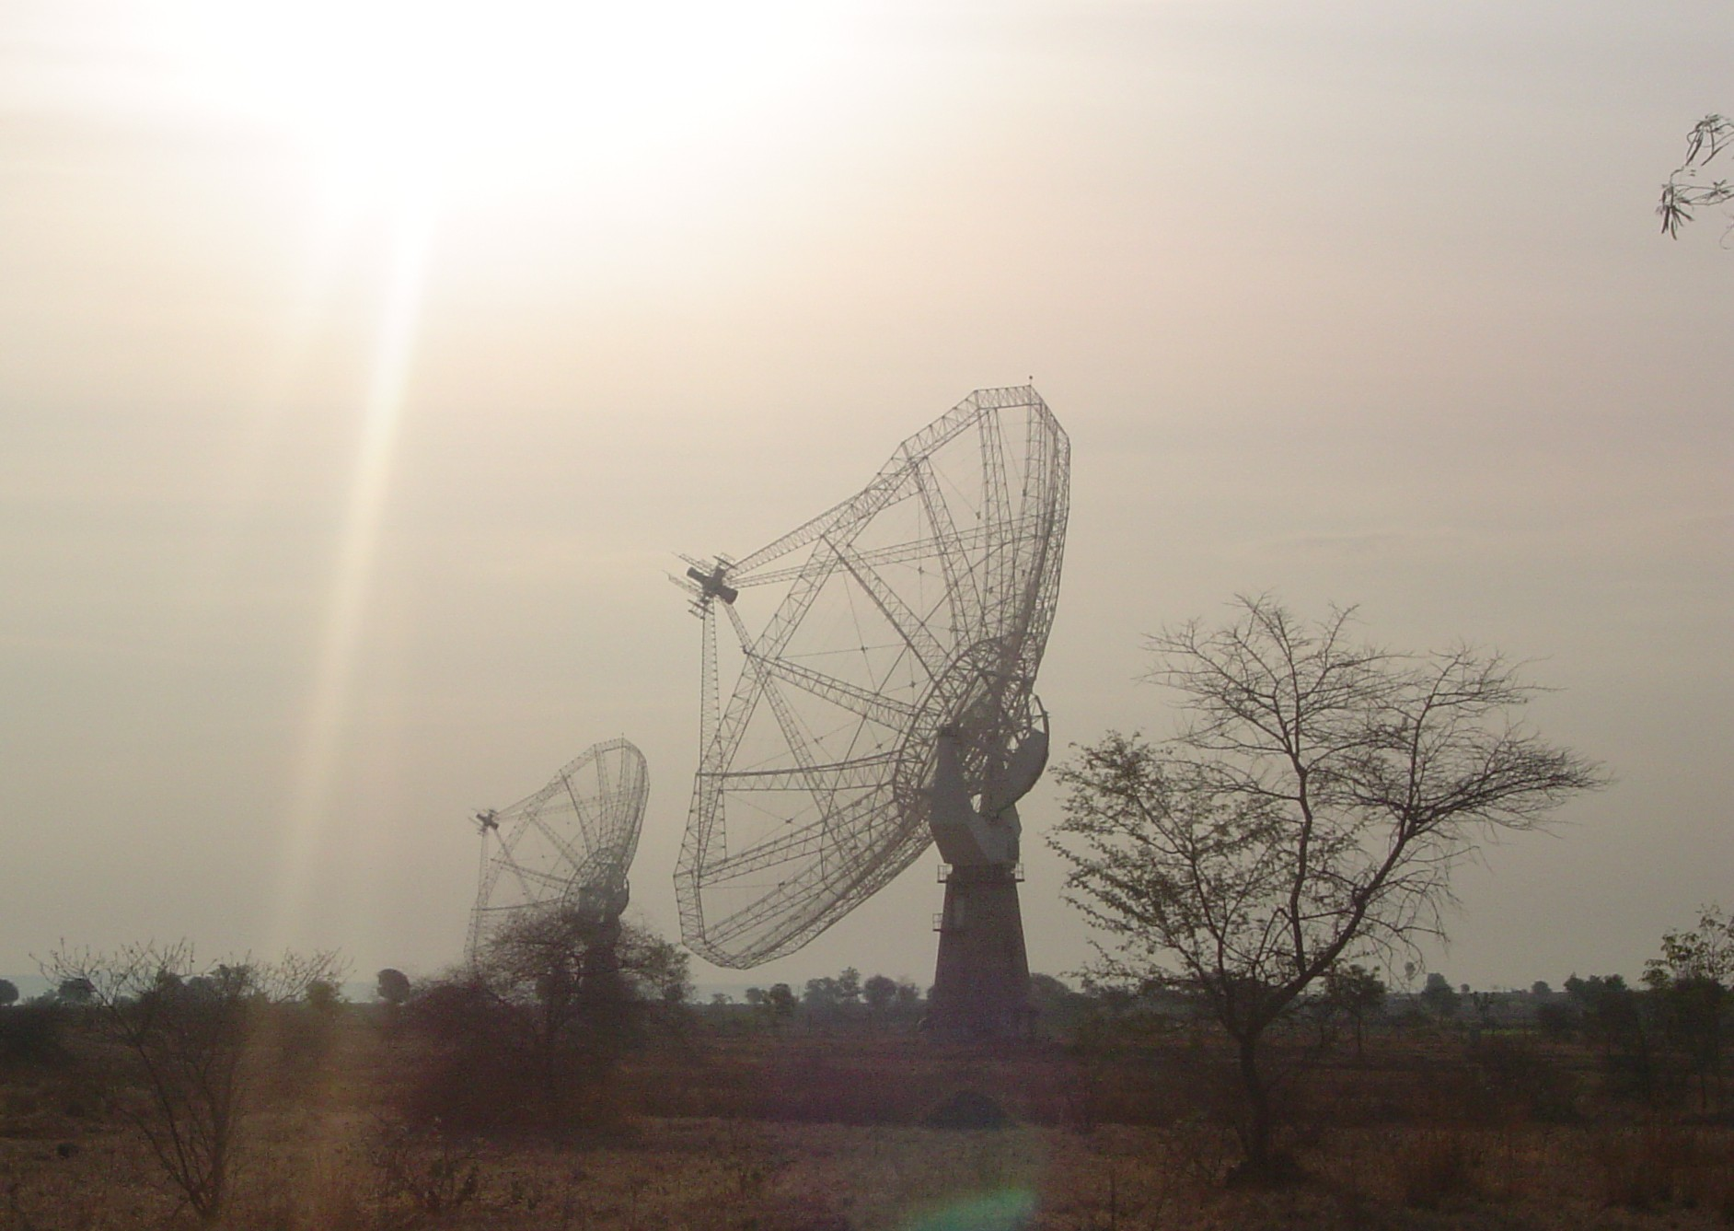
GMRT Survey at 240, 325 and 610 MHz of the A3558 complex, to be combined with previous observations
GMRT study of the extended galaxies to be combined with previous data
FOCUS
Diffuse emission in the SCC (intercluster, intracluster and filaments)
FOCUS
properties of the BCGs in clusters in different dynamical states
ν (MHz) | θ (“x”) | rms (mJy/b) | FoV
235 | ~16”x12” | ~0.6 | ~2.5º
325 | ~13”x10” | ~0.1 | ~1.8º
610 | ~9”x5” | ~0.05 | ~0.8º
Di Gennaro et al. in prep.
~
Venturi et al. in prep.

Slide 14
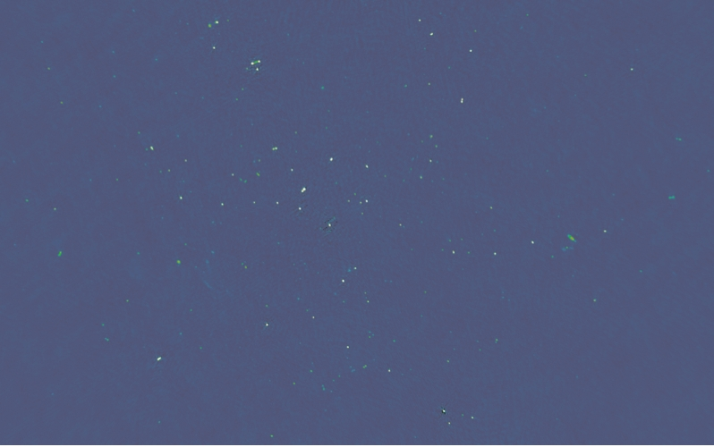
325 MHz – 13”x10” –
rms ≈ 60 – 100 μJy/b
2 deg² centered on A3558

Slide 15
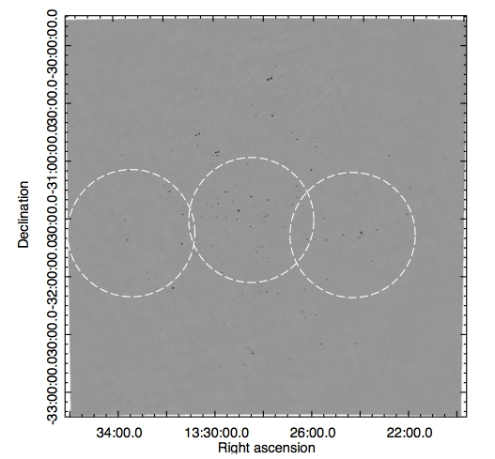
Today
A3559
A3558
A3562
A3556
A3552
SC 1329 & SC 1327
A3560
A3554

Slide 16
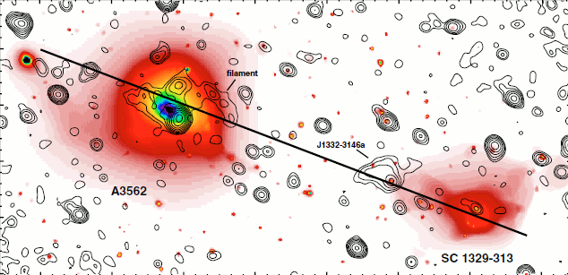
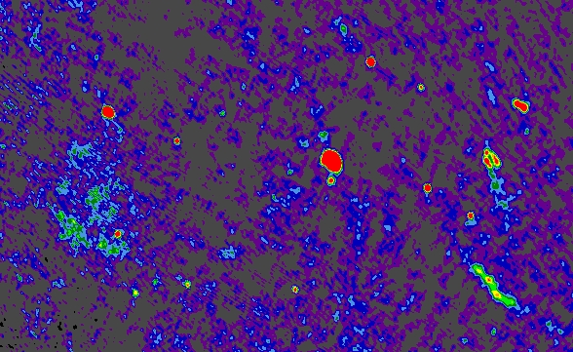
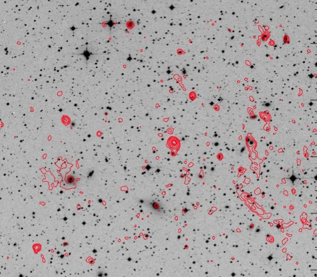
East of A3558
Giacintucci+ 2005 – VLA 1.4 GHz
Serendipitous discovery of a relic… we were actually after an ultrasteep spectrum radio halo in A3558…
“Dead” radio galaxy
S_{325 MHz} = 177 mJy
(P₃₂₅=9.7x10²⁴ W/Hz)
α(325-1400)≈1.9
“Relic”
LAS ≈ 350 kpc
S_{325MHz} = 51 mJy
(P₃₂₅=2.8x10²³ W/HZ)

Slide 17
East of A3558
Giacintucci+ 2005 – VLA 1.4 GHz
de Gasperin+ 14
Chandra image courtesy of P. Mazzotta
“Relic”
LAS ≈ 350 kpc
S_{325MHz} = 51 mJy
(P₃₂₅=2.8x10²³ W/HZ)
“
M~3.5x10¹⁴ M_{Sun}

Slide 18
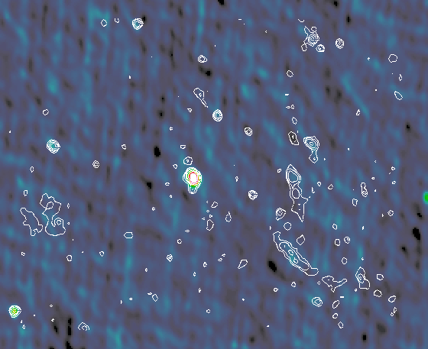
No trace of the relic in any of the public radio surveys (NVSS, SUMSS, TGSS ADR1) and in deep VLA observations at 1.4 GHz
325 MHz over TGSS-rdx
Surface brightness ~ 2 μJy/arcsec²
Only deep pointed observations could detect these features
“Dead” radio galaxy
S_{325 MHz} = 177 mJy
(P₃₂₅=9.7x10²⁴ W/Hz)
α(325-1400)≈1.9
“Relic”
LAS ≈ 350 kpc
S_{325MHz} = 51 mJy
(P₃₂₅=2.8x10²³ W/HZ)

Slide 19
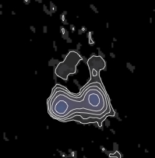
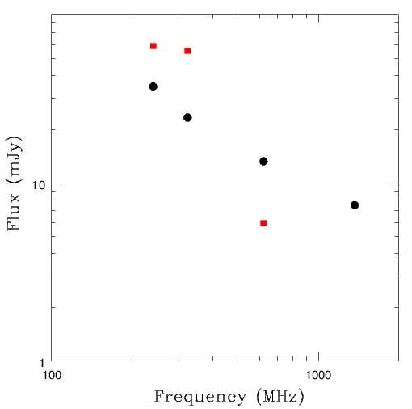
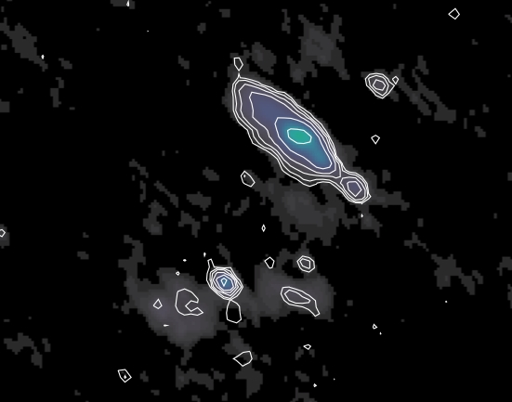
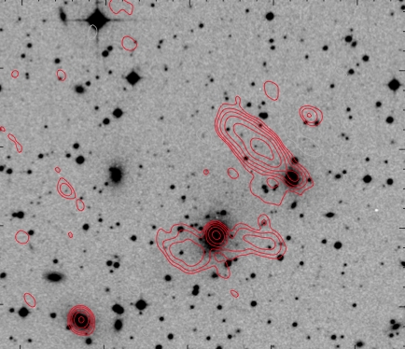
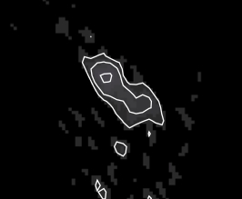
AGN population in the Local Universe:
Evolution and environment
White contours: 610 MHz, 12”x7”
Power law with α≈0.8 in the core - Much steeper spectrum in the lobes
Diffuse steep spectrum lobes and tails detected with deep pointed observations in “previously compact faint AGNs” at various distances form the cluster centres – Lifecycles of radio galaxies, restarted activity, AGN/ICM feedback

Slide 20
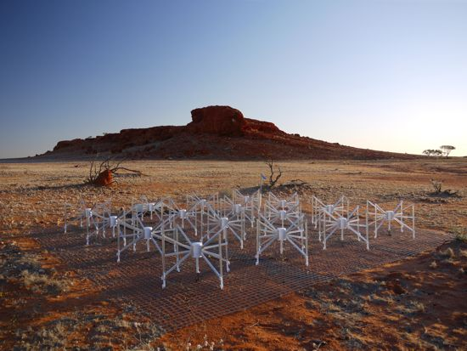
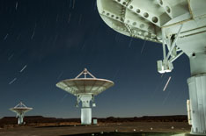
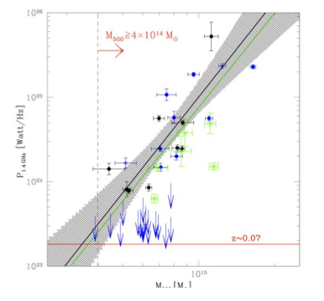
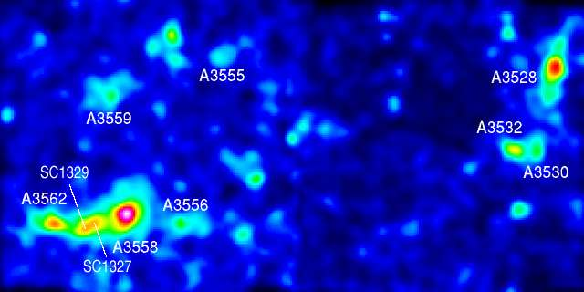
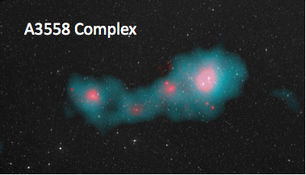
The Shapley Concentration and the SKA precursors
MWA Collaborators:
R. Kale
M. Johnston-Hollit
K.S. Dwarakanath
MeerKAT Collaborators:
G. Bernardi
N. Oozeer et al.
MWA 80 – 300 MHz
95, 155, 215 MHz
θ≈2.5’
KAT-7/MeerKAT 1 – 2 GHz
1250 MHz - 1900 MHz
θ≈2.5’
Diffuse emission on the cluster scale and detection of intercluster filaments
Shapley – Optical isodensities

Slide 21
XMM image
Chandra+Planck
Ideal target to search for radio emission from filaments
Galaxy overdensity

Slide 22
XMM image
Chandra+Planck
Ideal target to search for radio emission from filaments
Galaxy overdensity

Slide 23
ASKAP-EMU Early Science Project 20
Radio Emission in the Shapley Concentration:
from galaxies to cluster and intracluster scale radio emission
SCIENCE GOALS
Detection of the faint radio halo in A3558 -> origin of radio halos in galaxy clusters
Detection of emission from the filaments -> radio emission from WIMPs
Diffuse emission around the BCGs in the Shapley clusters -> evolution of brightest cluster galaxies in different environments
Radio luminosity function down to ≈5x10¹⁸ W/Hz -> radio AGN & starburst galaxy evolution in different environments
TECHNICAL SPECIFICATIONS
Bands 1 & 4
Requested sensitivity 10 μJy/b
Resolution range ~1-2” to ~40”
Largest angular scale ≥ 40’-50’

Slide 24
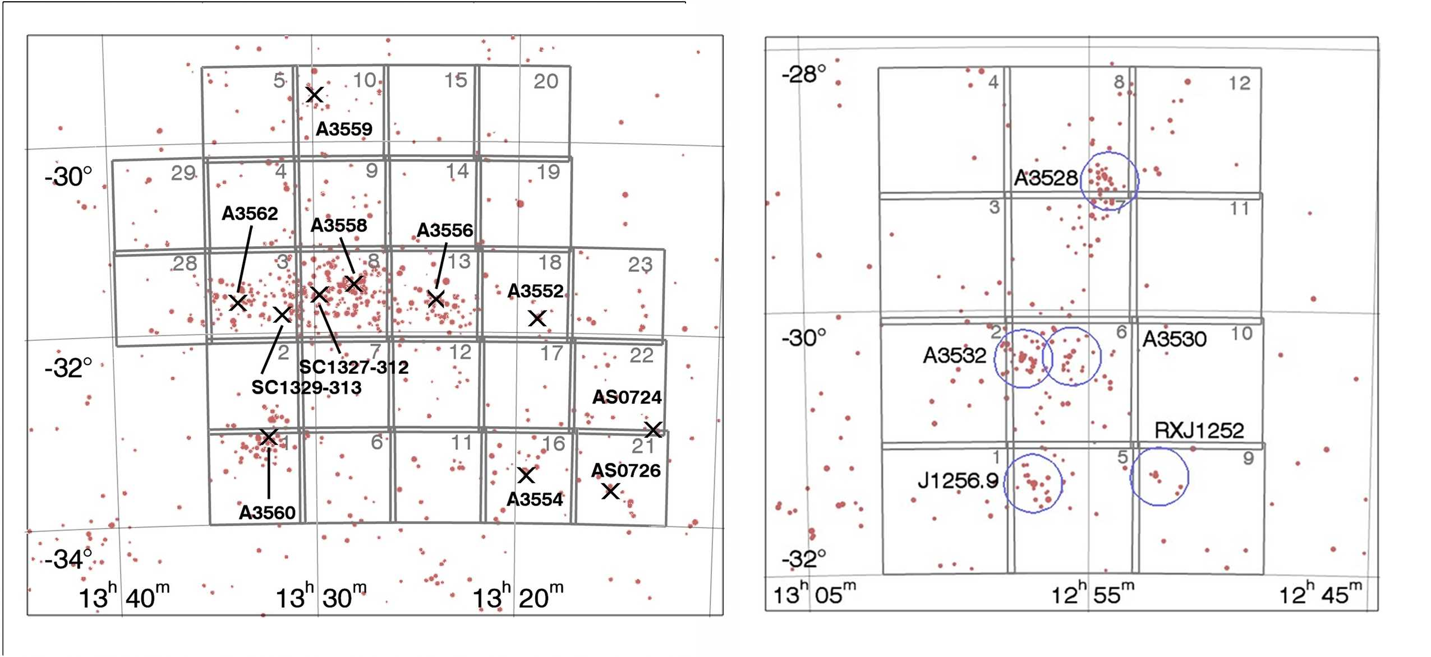
ASKAP-EMU Early Science Project 20
Radio Emission in the Shapley Concentration:
from galaxies to cluster and intracluster scale radio emission
Coverage of the multiband photometry of ShaSS (ESO, VST)
The 25 deg² VST field in the A3558 complex
The 12 deg² VST field in the A3528 complex
Merluzzi et al. 2015

Slide 25
… to conclude …
The Shapley Concentration…
is a Southern Sky Supercluster natural target the SKA and some of its precursors
covers hot areas relevant to the SKA continuum WG, from galaxy evolution to dffuse radio sources in galaxy clusters, to the radio emission from filaments
Includes relaxed, merging and pre-merging systems hence offering a variety of environments to study the role of the environment in the radio properties of the galaxy population (not only continuum…)
covers the parameter space of low mass clusters and minor mergers, which is barely accessible with the present arrays and at the same time is crucial to understand the details and consequences of mass assembly in the Universe

Slide 26
THANK YOU

