Slide 1
Extragalactic Continuum Science with the SKA
Minh Huynh (ICRAR/UWA)
Co-Chair SKA Extragalactic Continuum Science Working Group

Slide 2
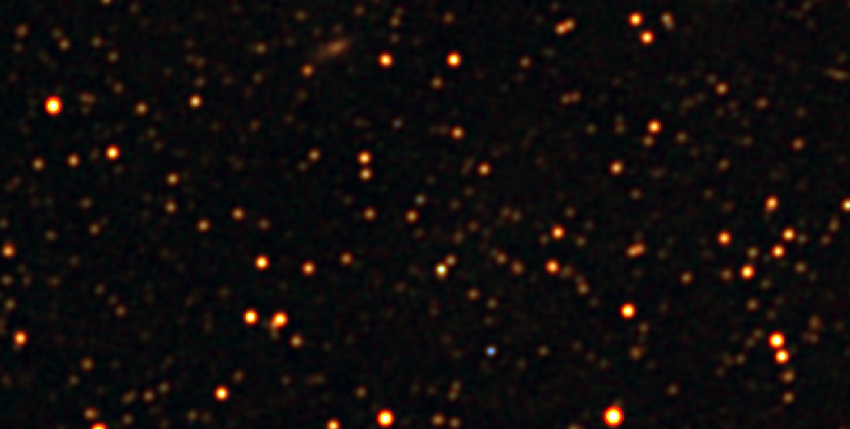
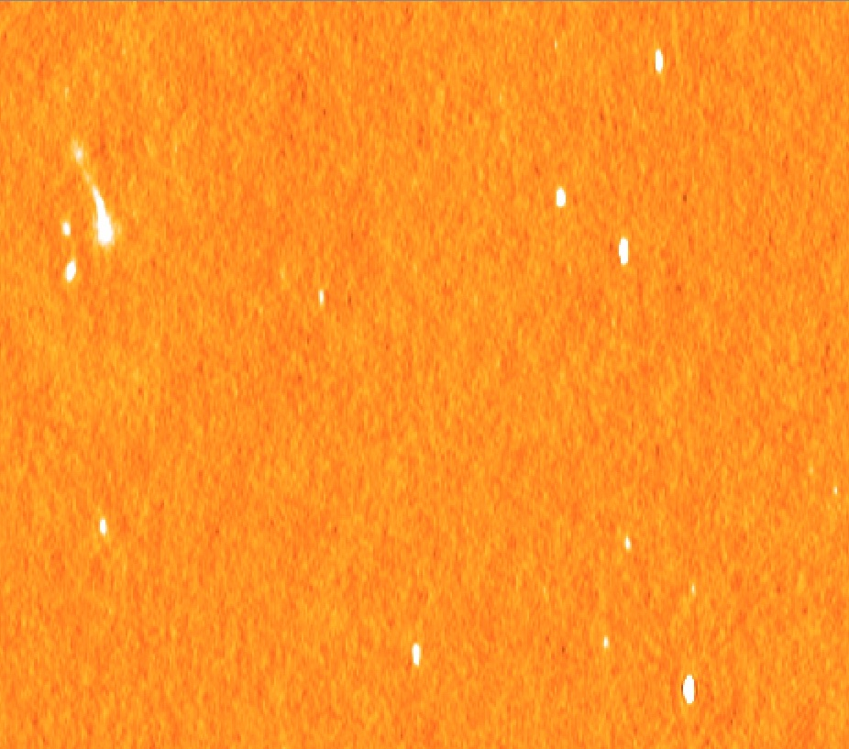
SKA Extragalactic Continuum Science
  Extragalactic Continuum SWG:
  82 members, 16 core and 66 associate, from 19 countries
Diverse Science Drivers:
Star formation history of the Universe
The role of BH in galaxy evolution
Non-Thermal components in galaxy clusters
Detailed astrophysics of star-formation and accretion processes
Dark matter and high-z with strong lensing
Also: legacy, rare sources and serendipity
GLEAM, Hurley-Walkr et al. 2016
Huynh et al. 2015

Slide 3
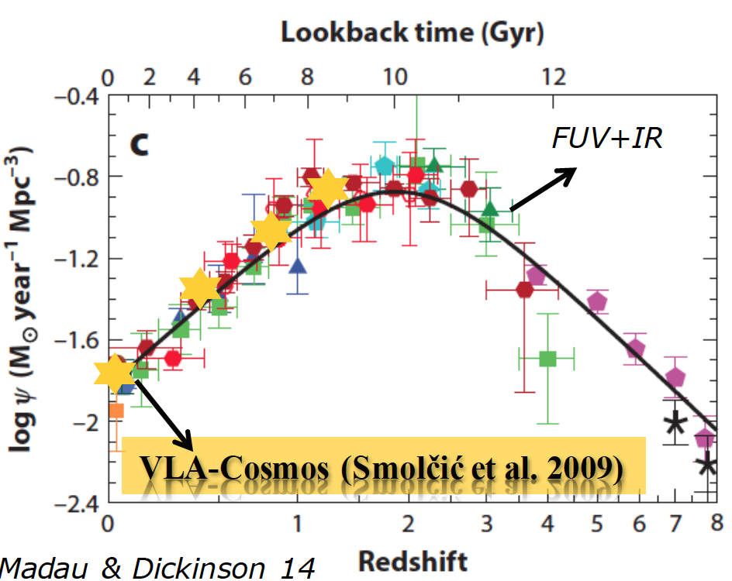
Star Formation History of the Universe
A top SKA1 Priority Science Objective
Star formation (SF) is a key parameter for understanding galaxy formation and evolution
Extragalactic SF science focus is on emission properties of the galaxy population as a whole, empirical scaling laws and parametric prescription
Cosmic Star Formation History (CSFH): steady rise from EoR, peak at 3.5 Gyr after the Big-Bang (z ~ 2), and exponential drop at z < 1.
Some Key questions:
Is there a characteristic cosmic epoch of the
formation of stars in galaxies?
What fraction the luminous baryons observed today were already locked into galaxies at early times (stellar mass density vs z) ?
How does the CSFH compare with the history of mass accretion onto massive black holes ?
How does SF vary with galaxy properties and environment?

Slide 4
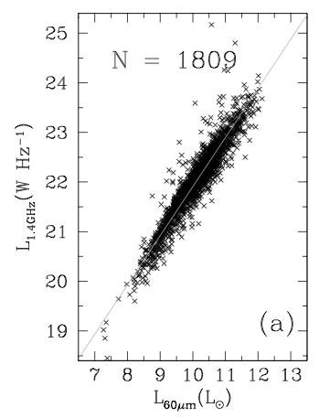
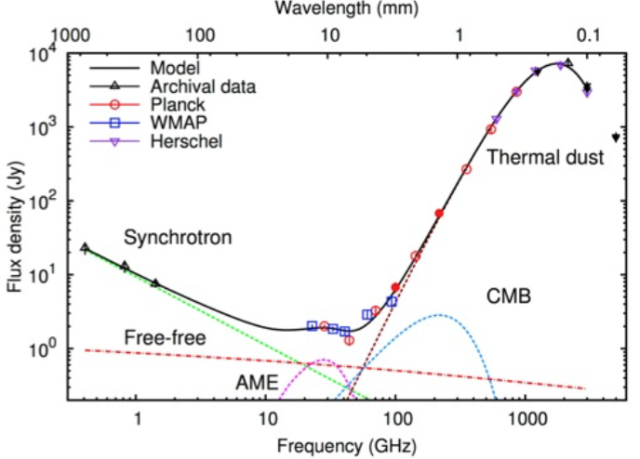
Star Formation History of the Universe
FIR-radio correlation
van der Kruit 71; Helou et al. 85; Condon et
al. 92; Bell 03; Sargent et al. 2010; Mao et al. 2011
Planck Coll. 2015
Yun et al. 2001
What about radio continuum?
SN-accelerated electrons emit steep spectrum non-thermal (synchrotron) radio emission, ν ~ 1 GHz
Flat spectrum thermal (free-free) emission from electrons in HII regions, ν > 10 GHz
Why Radio emission?
Radio emission is unaffected by dust obscuration (unlike UV-optical studies), great value for high-z studies
Tight IR-radio correlation. But not fully understood complex physics (CR acceleration and transport, magnetic field amplification)

Slide 5
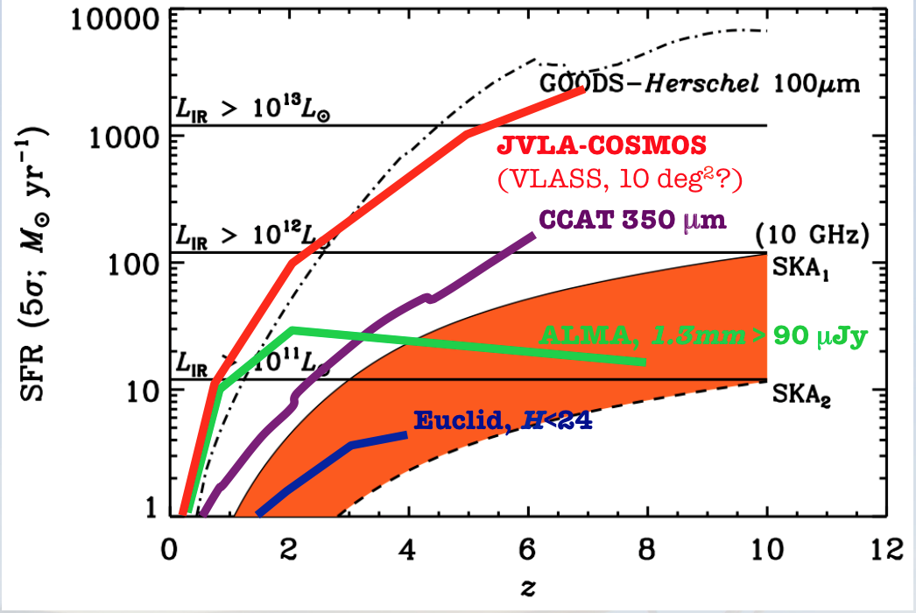
Star Formation History of the Universe
SKA1-mid band 1/2 (~1-2 GHz):
3 Tier strategy to probe non-thermal emission
- Deep and Ultra-Deep (sub-μJy) to get low SFR/low mass galaxies at high-z
- Wide (1000 sq. deg) to sample enough high-mass galaxies at z < 1
- 3 tiers necessary to overcome sample variance by sampling enough volume at each cosmic epoch
SKA1-mid band 5 (~10 GHz):
2 Tier strategy to (Deep and Ultra-Deep) to probe the thermal (free-free) emission (emitted at rest frame >10 GHz,
- Provide accurate measurements of SFR at high-z
see Jarvis, Seymour, Afonso et al. 15; Mancuso et al. 15
see Murphy et al. 2015; Beswick et al. 2015
Competitive with optical/IR studies
Band 5 offers high resolution
Dust unbiased SFR from single consistent tracer over large mass range
Murphy, Sargent, Beswick et al. 2015

Slide 6
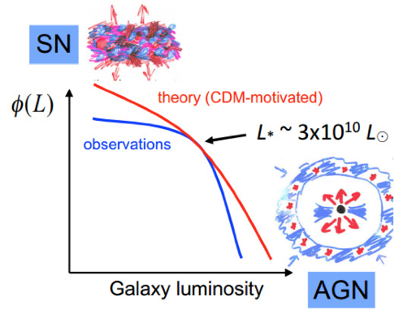
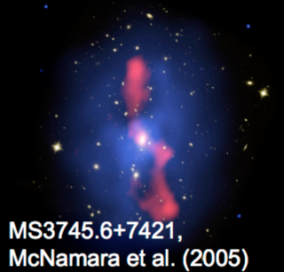
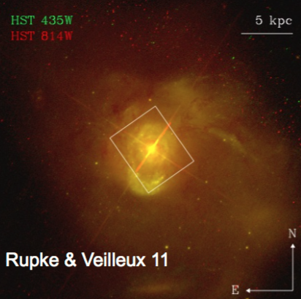
The Role of BHs in Galaxy Evolution
AGN feedback is an essential ingredient of galaxy formation and evolution
Radio/Hot Mode (Low Excitation Radio Galaxies)
Central BH fed by hot gas
Low accretion rates (M_dot < 0.01 Eddington)
Host galaxies have high stellar mass, redder colours
- jet-driven mechanical feedback
QSO/Cold Mode (High Excitation Radio Galaxies)
Central BH fed by cold gas
High accretion rates (M_dot 1 – 10% Eddington)
Bluer hosts with associated ongoing SF
- radiation-driven feedback (winds)
e.g. Best et al. 2005, 2012; Hardcastle et al. 2007

Slide 7
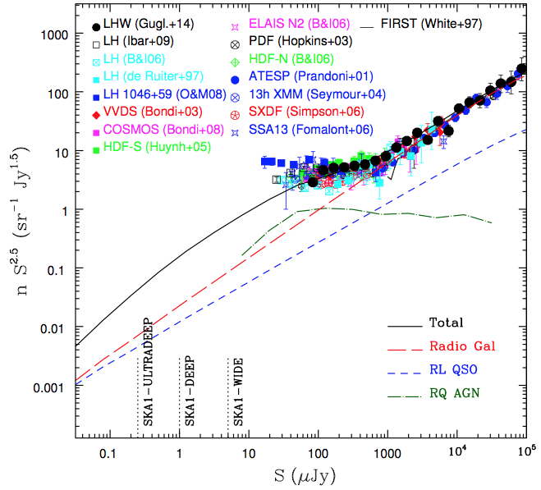
The Role of BHs in Galaxy Evolution
Radio source counts: SFG and radio quiet AGN dominate the source counts below 0.1 mJy.
Deep observations of large areas of
the sky with SKA to:
Complete census of AGN and their evolution
Study physics and life-cycle of radio-loud AGN
Is there a Radio Loud vs Radio Quiet dichotomy? What is the physical cause?
Understand the link between SF and AGN activity in galaxies, esp. in radio-quiet AGN
Mainly use same tiered surveys as SF History case.
+ SKA1-LOW All-sky survey: rms =20 μJy/beam, 8” resolution
Smolcic et al. 2015
Adapted from Bonzini+2013

Slide 8
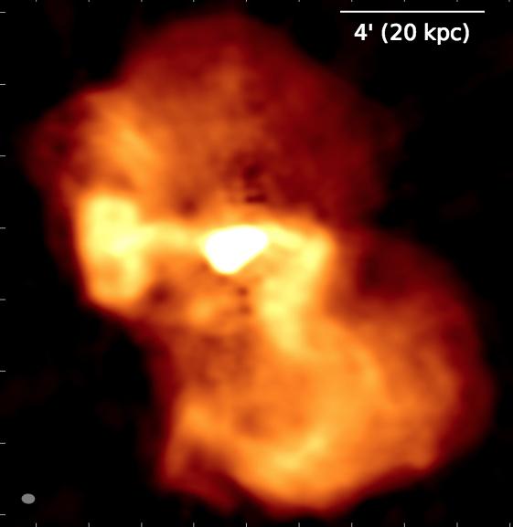
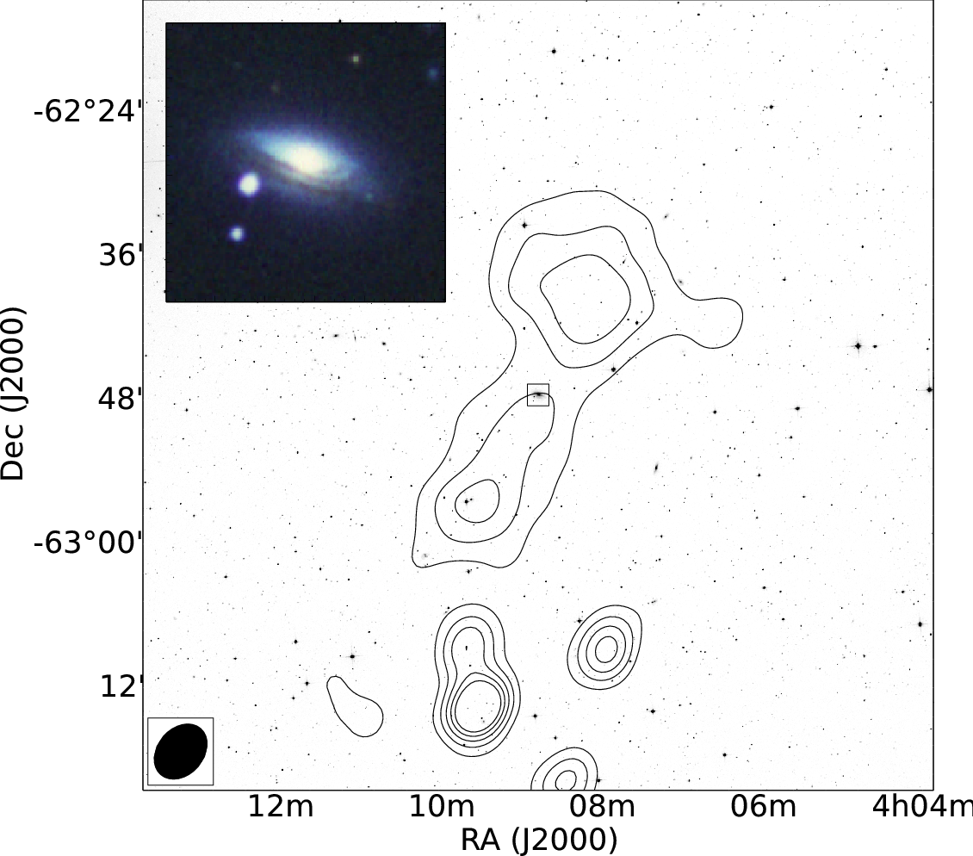
The Role of BHs in Galaxy Evolution
M87, LOFAR
Study of diffuse plasma in radio loud AGN
Life-cycle (birth, life, death) of radio galaxies
Physics of radio emitting regions: jets, lobes…
AGN feedback and galaxy evolution
high-z AGN (ultra-steep spectrum sources), low accretion-rate AGN
SKA1-LOW All-sky survey: rms =20 μJy/beam, 8” resolution
de Gasperin et al. 12
NGC 1534, MWA
Hurley-Walker et al. 2015

Slide 9
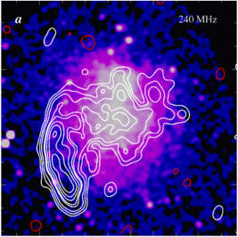
Non-Thermal Emission in Galaxy Clusters
Brunetti et al. 2008
Diffuse Mpc-scale synchrotron radiation from the ICM of merging clusters => GeV relativistic e⁻ and μG magnetic fields on Mpc-scale
halo
Key questions:
- Origin of non-thermal components?
- Impact on the microphysics of the ICM and on the process of formation of the cluster
relic
Main Goals:
- Study the bulk of halos and relics in the Universe (z ~ 1) and to cluster masses of ~ 10¹⁴ Msun
Discovery of ~2500 radio halos, 1000 with ultra-steep spectrum ( ), and ~1000 radio relics
Discovery of “off-state” hadronic halos in “relaxed” clusters
Fraction of clusters with radio halos and relics as a function of cluster mass
Study the radio power - cluster mass correlation (scatter, evol. with z)
test of theoretical models

Slide 10
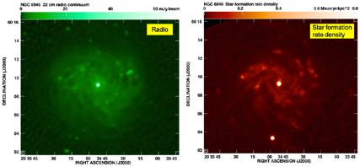
Detailed Astrophysics of Star Formation and BH Accretion
Resolved studies of local galaxies.
From dwarfs to more massive galaxies, including early type galaxies.
Both isolated and merging systems, up to 100 Mpc distance, to probe all environments.
Beswick et al 2015
Key Aims:
Resolved studies of star formation as a function of galaxy type and environment
Calibrate thermal and non-thermal radio tracers of star formation
Understand radio emission from RQ AGN (ADAF or ADIOS, thermal emission from XRay corona, star formation)
Targeted observations of ~100 galaxies using Band 2 (~ 1.4 GHz) and 5 (~10 GHz) with <0.5 arcsec resolution

Slide 11
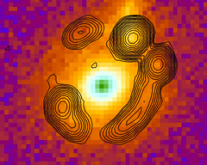
Dark Matter and High-z Universe with Strong Lensing
Strong gravitational lenses provide a way to measure masses in distant universe
Key Aims:
Test predicted dark matter halo profiles and dark matter halo mass function
Study mass properties and mass distribution of high-redshift galaxies
Use the lens to study emission from distant universe – e.g. high redshift CO
McKean et al. 2015
Lenses are intrinsically rare (only 100s known, 10% radio loud)
Cover Euclid field (5000 sq deg) with Band 2 to 6 µJy rms, 0.3-0.5 arcsec resolution, would yield >1500 lenses.
Followup with VLBI for lens sub-structure and Band 5 for high redshift CO (and water masers)

Slide 12
SKA Continuum Reference Surveys
based on Prandoni & Seymour 2015 + Stockholm KSP 2015
Science Drivers | Freq. | Tier | Rms (full BW) | Area | Res. | Science/Commensality
SFHU Non-thermal (gal/AGN co-evol.) | ~1 GHz Band 1/2 | Ultra Deep Deep Wide | 50 nJy 200 nJy 1 uJy | 1 deg2 10-30 deg2 1000 deg2 | ~0.5” ~0.5” ~0.5” | AGN/gal co-evol., Hi AGN/gal co-evol. High-z, Magnetism HI deep field (Band 1) Weak/Strong Lensing
SFHU Thermal (gal/AGN co-evol.) | ~10 GHz Band 5 | Ultra Deep Deep | 40 nJy 300 nJy | 0.008 deg2 1 deg2 | ~0.1” ~0.1” | AGN/gal co-evol., extraga. molecular. spectr. AGN/gal co-evol.
Legacy Strong Lensing (rare populations) | ~1 GHz Band 2 | All-sky (5000 deg2) | 4 uJy | 31000 deg2 (5000 deg2) | ~2” 0.5” | Magnetism + Cosmology Transients + (HI absor.) surveys
Clusters (RL AGNs) | ~150 MHz | All-sky | 20 uJy (confusion) | 31000 deg2 | 8-10” | EoR
Revisited after rebaselining (March 2015)
+ targeted observations of ~100 local galaxies (detailed SF and BH studies)

Slide 13
Breakout Session 1
Update and (Continuum) Lessons Learnt from Pathfinders and Precursors
MeerKAT:
first light image from 16 dish array, AR2 (32 dishes) in early 2017, early science with 32 dishes mid 2017, AR3 (64 dishes) by end 2017
JVLA (deep X band survey):
Large number of spurious sources at 5 sigma, microJy radio sources are small ~ 0.2 arcsec.
ASKAP:
PAF beamforming comes w/ trade-offs: either maximum sensitivity w/ a sub-optimal beam shape or very well-behaved beam with reduced sensitivity
There’s a heavy reliance on global sky model, many calibration steps depend on it
uGMRT:
uGMRT: instantaneous bandwidth to increase from 32 to 400 MHz; continuous coverage from 50-1500 MHz; continuum sensitivity will improve ~3-fold
fully-upgraded uGMRT w/ 30 antennae and 4 bands deployed in late 2017
Notes:
Breakout session 1 was an update and lessons learnt from pathfinders.
So here I give the highlights only, one or two points per pathfinder but there were many more.

Slide 14
Breakout Session 1
Update and (Continuum) Lessons Learnt from Pathfinders and Precursors
MWA/GLEAM:
ionosphere : typical displacement is 10-20 arcsec at 154 MHz
dominated by sideline confusion in GLEAM, huge FoV c.f. SKA_Low, but need to be aware for SKA_Low
LOFAR:
Ionosphere: need to take out instrumental effects, it’s a phase effect (not A and P gains), model as phase screen
-A-projection can only be used if beam model is well known (it is currently not being applied to LOFAR data)
EMERLIN and EVN:
Need high resolution deep surveys to characterise spatial distribution of AGN and SF activity
find sizes of ~1.2 arcsec for SFGs
Notes:
mosaicking w/ closely spaced PAF beams runs into a correlated noise penalty once pointings are moved together too closely - need to find optimum setting

Slide 15
Breakout Session 2
Computing, SDP and data products, and simulations
Computational and imaging challenges
LOFAR (T. Shimwell):
- huge data rates and volume imply fully-automated pipelines are a must
- there are compression algorithms (e.g., Dysco; Offringa+ ’16) capable of reducing - data volume by almost an order of magnitude with only small impact on the sensitivity
- DD-Facet calibration now used for LoTSS, pipeline takes 7 days per field currently
uGMRT (Dwarakanath, K):
- Peeling + ionosphere correction plus subsequent reduction steps takes about 5
x more compute time than classical approach limited to self-cal steps
- Using WSCLEAN, with well-known PB will use A-proj

Slide 16
Breakout Session 2
Computing, SDP and data products, and simulations
Simulations
Need both Sky/Source models and telescope simulators
Action to compile a list of tools to (a) build mock observation and (b) produce simulated skies
Concept of SKAO Regional Centres (Antonio Chrysostomou)
Update from our SDP liaisons (Ishwara-Chandra C.H., with input from Ian Heywood and core team)

Slide 17
Breakout Session 3
Joint discussion with magnetism team
- commensality includes not only field/resolution/sensitivity but also data processing
- key issue for magnetism: Stokes I needs to be calculated in a consistent way with Q & U - current imaging+extraction techniques which continuum group plan on may not necessarily ensure this
- need to make sure that SKAO is aware of these considerations; communicate through official routes, e.g., ECP, formal requirements; don’t contact SDP alone

Slide 18
Breakout Session 3
Science and KSP organisation
- develop the science cases further, start the more detailed work, in preparation for a call for KSP
- form smallish focus teams to develop specific KSP sub-areas; bottom-up approach seems best given that volume/scope of KSPs have yet to be clarified by SKAO
- focus groups will be coordinated by at least one core team member with relevant expertise, all associate members will be encouraged to join sub-groups
- exact work and deliverables TBD by core team, but could include science drivers/case, technical challenges, ancillary data & supporting simulations/mock image generation tools

Slide 19
Breakout Session 3
Science and KSP organisation
KSPs are to be science driven, not technique driven. Too stratified in current SKA SWGs? A KSP could come from multiple SWGs.
Already have polarisation SWG members as associates, appoint formal liaison
Appoint HI SWG liaison
Discuss w/ SKAO scope for synergy teams w/ other major facilities (TMT, Euclid, LSST)

Slide 20
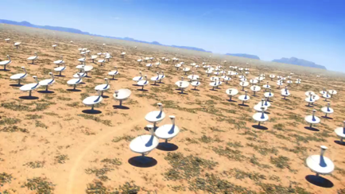
Summary
  Continuum surveys with SKA will provide a valuable dust-free tool to study:
  Galaxy evolution (SFHU and AGN)
  Astrophysics of individual galaxies and galaxy clusters
  SKA sub-µJy sensitivity will make it possible to study high-z SFG and all types of AGN:
  Added value: sub-arcsec resolution and Band 5 (~10 GHz)
  Pathfinders now collecting data – many lessons learnt and to be learnt in coming years
  Extragalactic continuum SWG now forming focus groups in preparation for KSPs.

