Slide 1


Solar, Heliospheric and Ionospheric Science
Divya Oberoi
NCRA-TIFR, Pune
On behalf of the SHI SWG
With contributions from
Mario Bisi (RAL)
Iver Cairns (Sydney)
Piyali Chatterjee (IIA)
Bin Chen (NJIT)
Meagan Crowley (UMass)
Richard Fallows (ILT)
Eduard Kontar (Glasgow)
Kamen Kozarev (CfA)
John Morgan (Curtin)
R. Ramesh (IIA)
Rohit Sharma (NCRA)
Akshay Suresh (IISER-P)

Slide 2
Emerging trends
Solar science
  The huge energetic events
    Detailed theory/simulation and observation comparisons, esp. events of relevance to Space weather
  The smaller events
    Details of flares and particle acceleration physics
  The tiny emission features
    Address coronal (and chromospheric) heating problem
Heliospheric science
  Global IPS network
  Wide field-of-view IPS observations
  Prediction of heliospheric vector magnetic field
Ionospheric science
  Observations of ionospheric scintillation

Slide 3
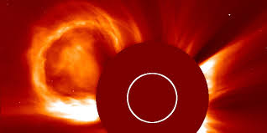
Coronal Mass Ejections

Slide 4
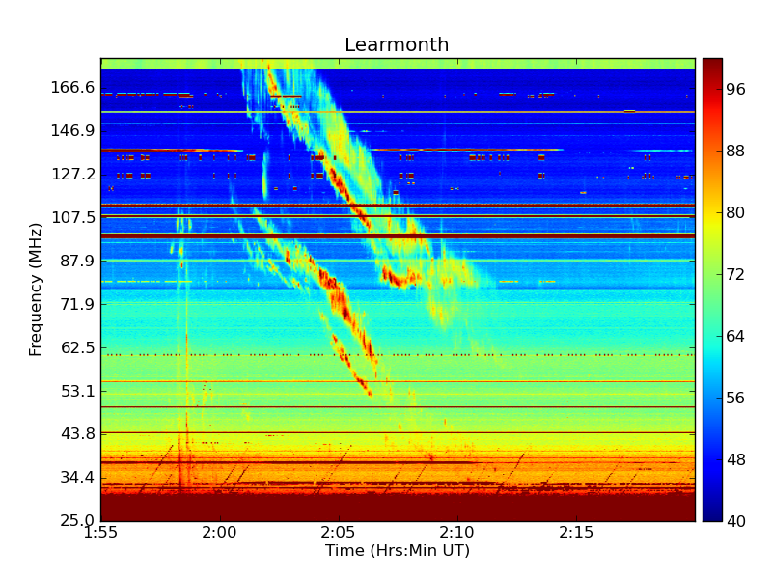
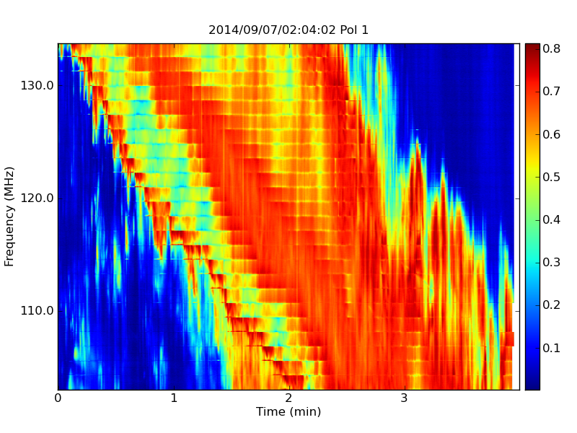
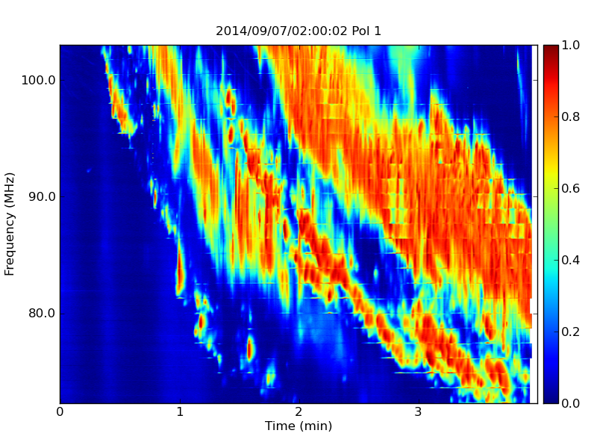
8 min
~61 MHz
Oberoi et al. in preparation

Slide 5
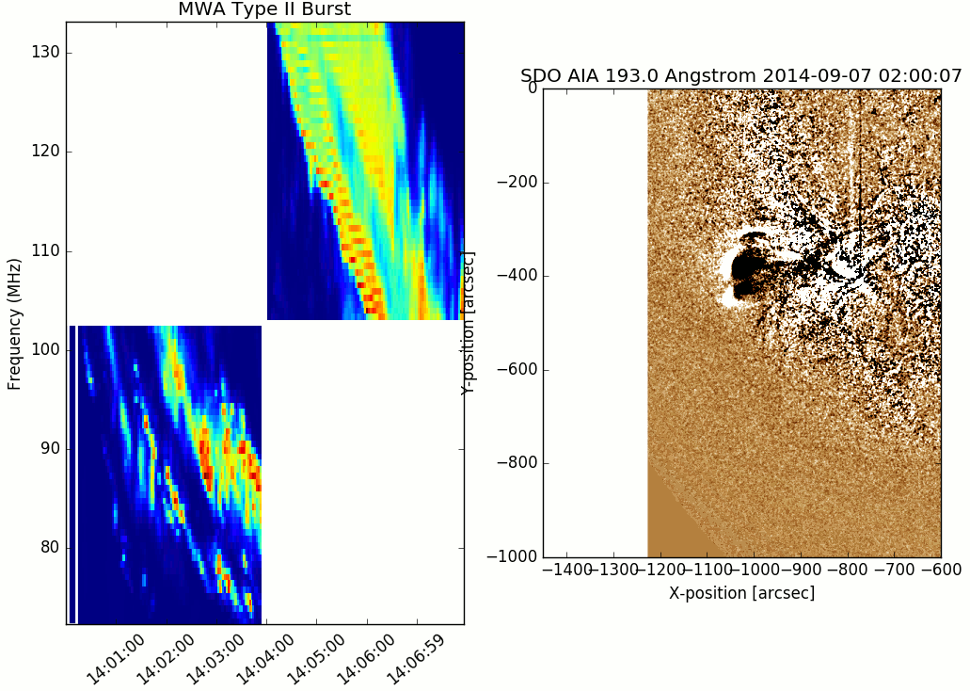
Tracking solar emission in 4D
Oberoi et al. in preparation

Slide 6
Type II Simulation and Theory Approach
(Sydney “bolt-on” theory)
[Iver Cairns &
Joachim Schmidt]
We use the BATS-R-US code (3D MHD + radiation)
  to model realistic corona for the time period.
  simulate CME initiation and propagation.
Kinetic type II theory
  Shock & plasma characteristics from BATS-R-US
  electron energization at shock
  Langmuir waves and radio emission.
Compare theory and observations.
[Roussev et al. 03, 04,
Toth et al., 2012]:
[Schmidt &
Gopalswamy, 2008]
Schmidt & Cairns,
JGR, 2012a,b]
[Schmidt et al., ApJL, 2013; Schmidt & Cairns, JGR, 2014a,b, 2016; Cairns & Schmidt,2015]

Slide 7
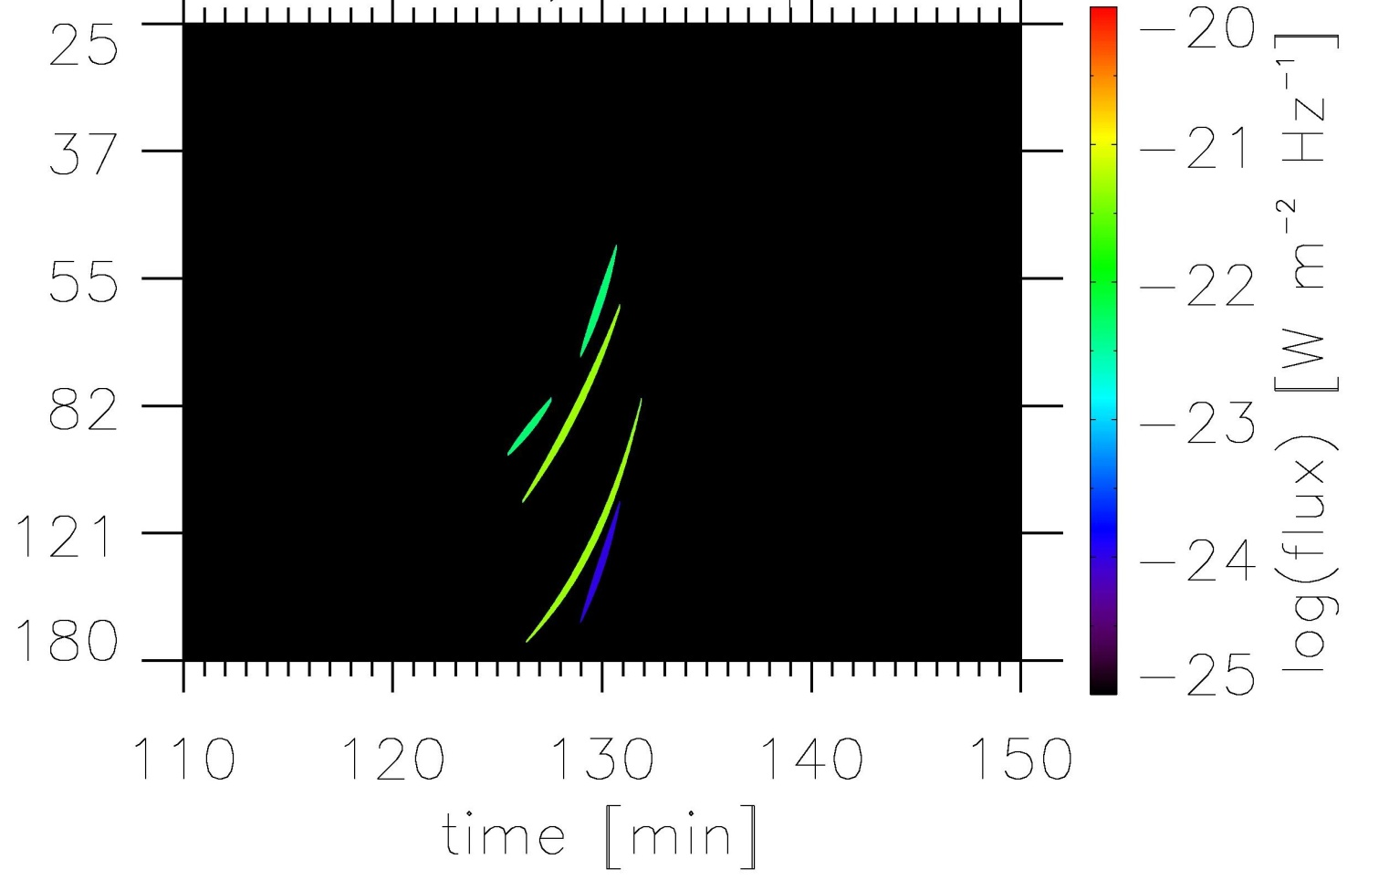
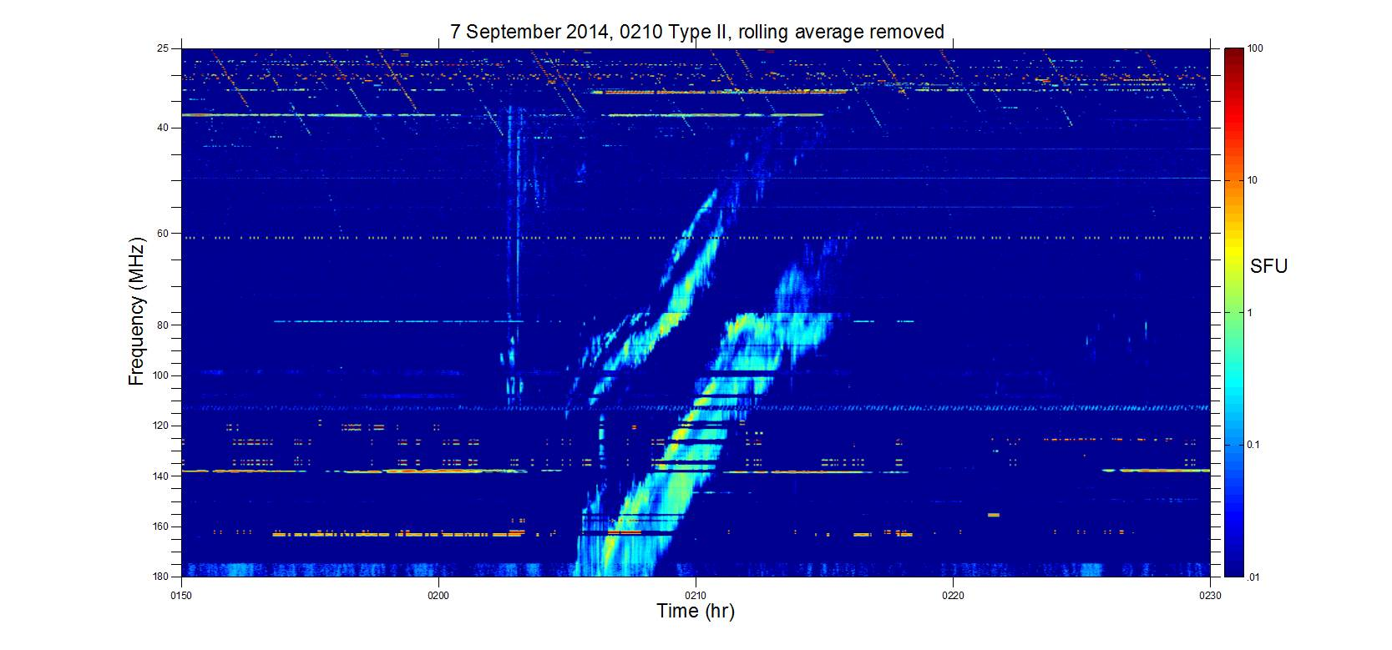
Theory / data
(Learmonth) comparison: same scales
10²
Flux
1
(SFU)
10⁻²
Frequency (MHz)
25
10²
Calibration by
J. Harding in 2014
40
10
60
Flux
(SFU)
7 Sept 2014
Type II Burst
80
1
100
10⁻¹
140
180
10⁻²
0150
0200
0210
0220
0230
[Schmidt, Cairns, Oberoi ,
Harding ... in prep.]
Time (HHMM)

Slide 8
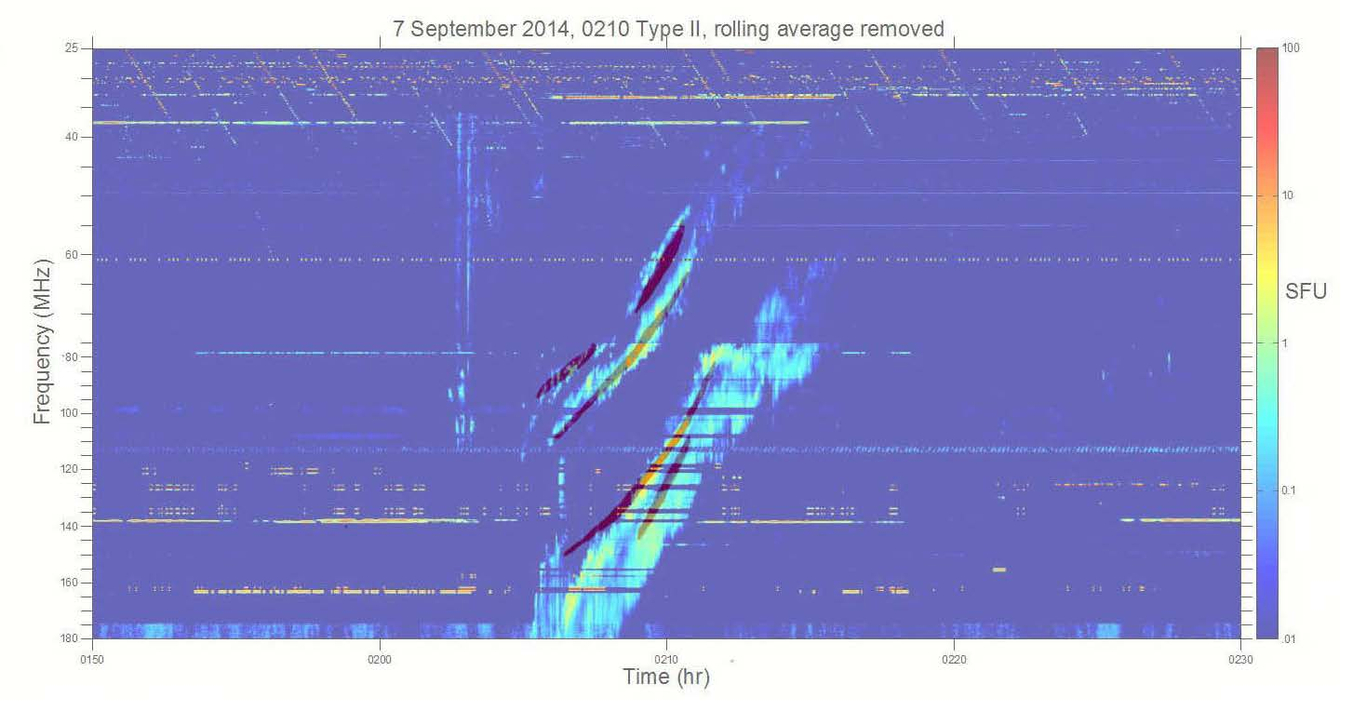
Data – Simulation Comparison: 7 September 2014 Split-band Event
Our simulations agree very well with the observations in frequency, intensity, & time.
Comparing the locations of emission… initial results look promising
[Schmidt, Cairns, Oberoi ... in prep.]

Slide 9
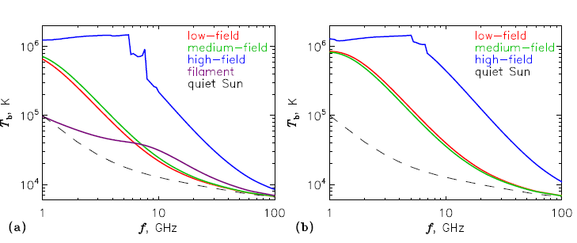
Generating prediction of radio observables from MHD simulations
Type II emission (Univ. of Sydney group)
Gyrosynchrotron emission from the active regions in the photosphere (1-few10s of GHz)
  A key science objective of Frequency Agile Solar Radiotelescope (FASR)
Synchrotron emission from the CME plasma (Razin Tsytovich suppression) (Bastian et al., 2001)
Both of these methods allow one to get a handle on the coronal magnetic field, the only reliable measurements of which are available at the photosphere
20G
100G
1000G
Flux rope center
Flux rope footpoint
Kuznetsov et. al. 2016
Piyali Chatterjee (IIA)

Slide 10
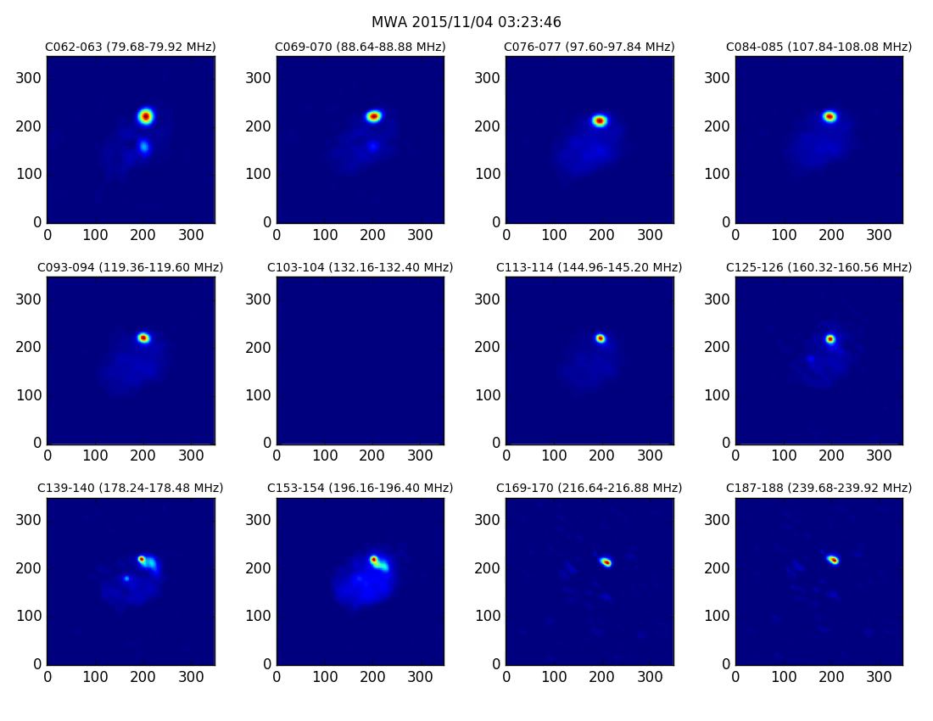
.
Kozarev et al. in preparation

Slide 11
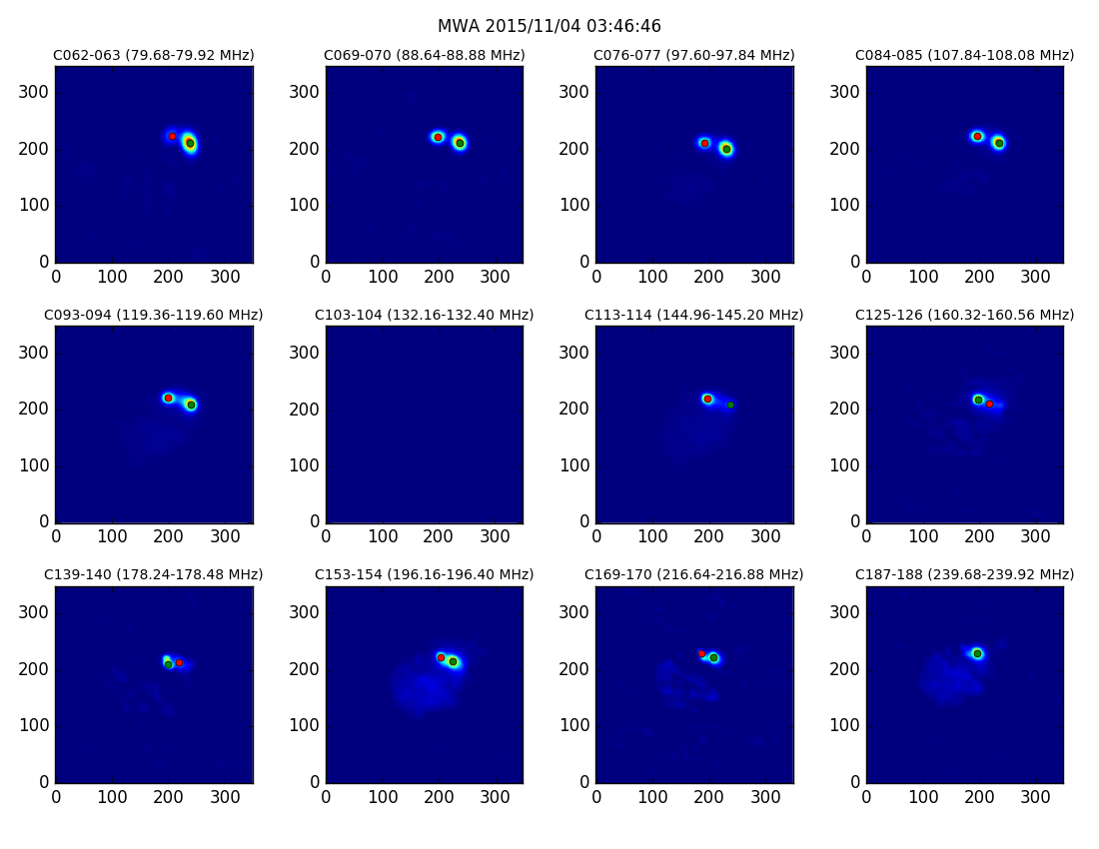
Kozarev et al. in preparation

Slide 12
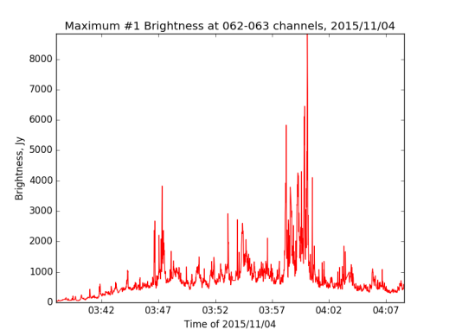
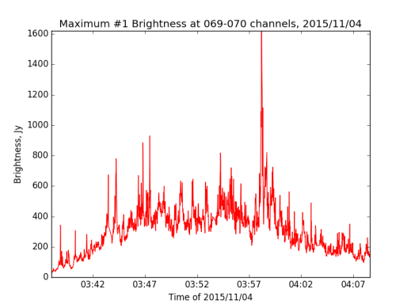
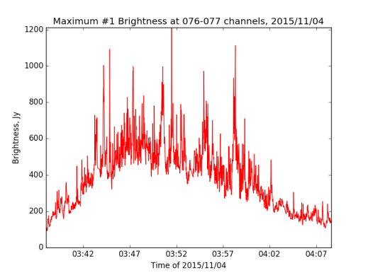
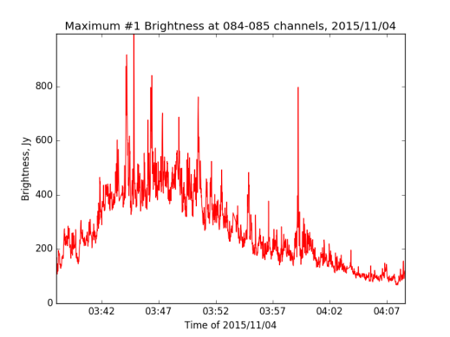
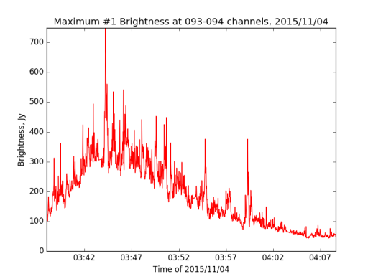
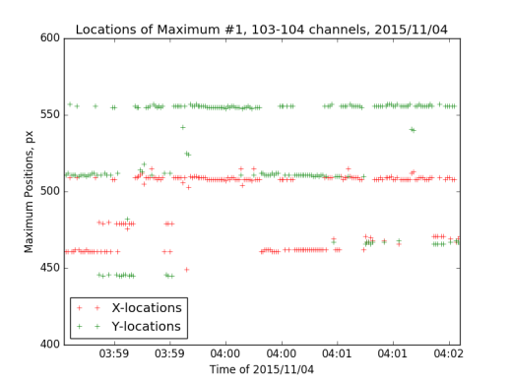
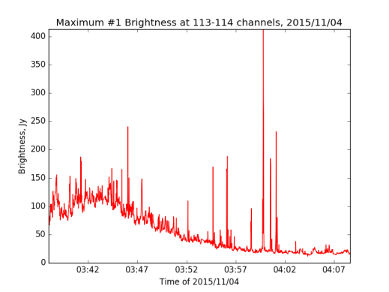
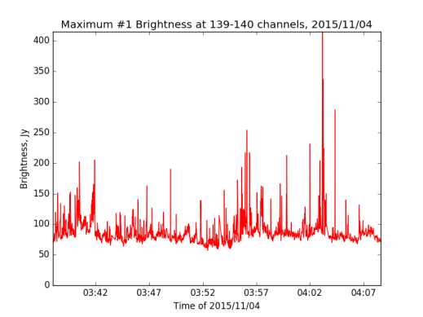
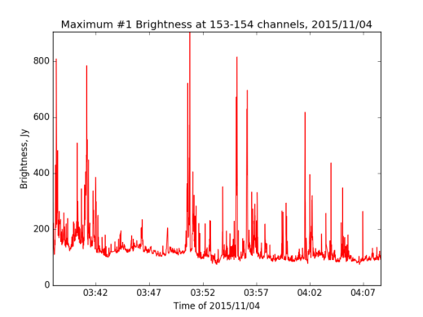
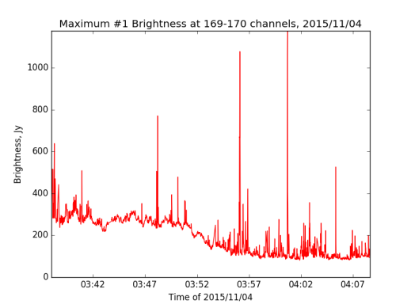
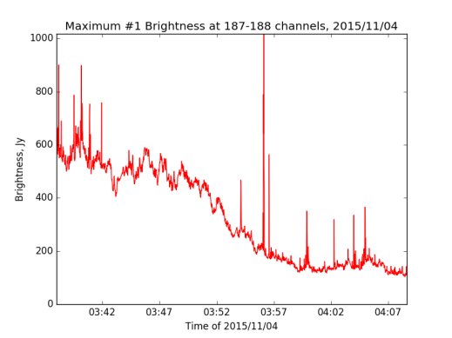
Moving MAX1 Brightness
062-063
069-070
076-077
084-085
093-094
103-104
113-114
125-126
NO DATA
NO DATA
139-140
153-154
169-170
187-188
Kozarev et al. in preparation

Slide 13
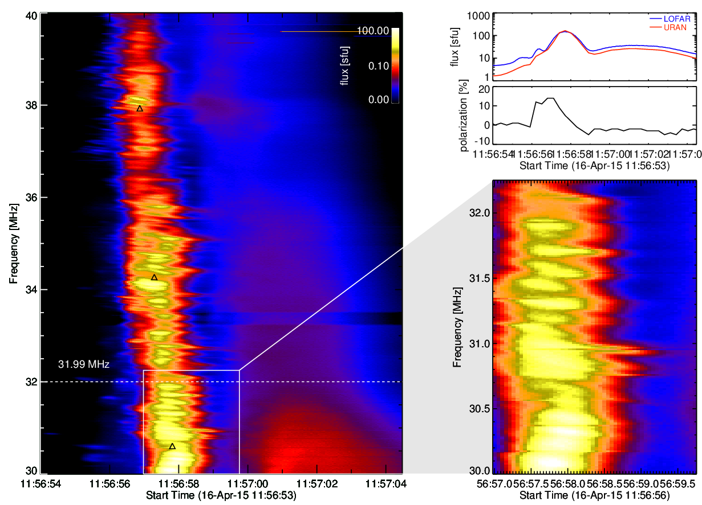
Fine structure in type III bursts
Simulation based approach to try to explain it in terms of fluctuations in the local plasma
Kontar (Glasgow)

Slide 14
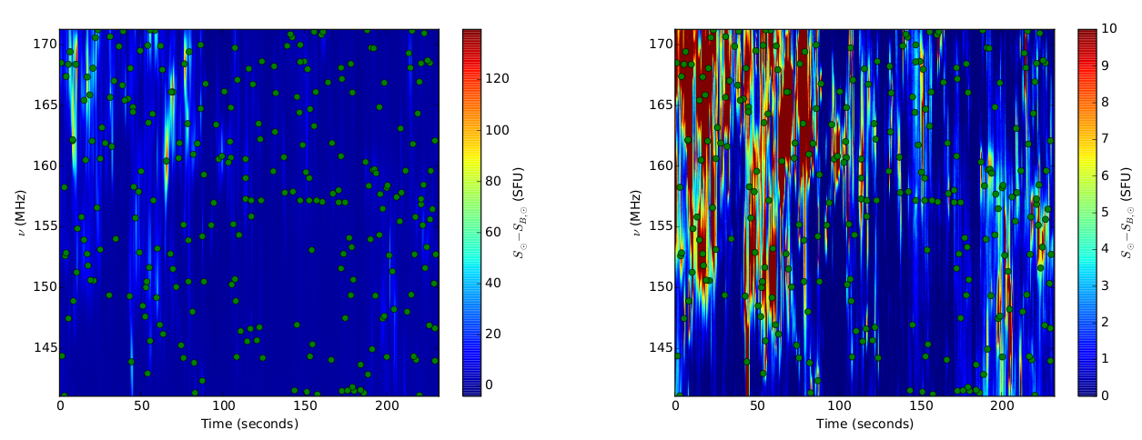
Studying weak solar emission features
Wavelet based feature detection and characterization
Suresh, Sharma, Oberoi et al., 2016
Notes:
This is an independent project which uses a wavelet based feature detection and characterisation for these weak, short-lived and narrow band features. We use a 2D Ricker wavelet. Both the panels show the same dynamic spectrum, the left panel is autoscaled in colour and the right one is scaled to highlight the weak features. The green dots show the features identified by the wavelet algorithm. We found about 14,200 features in about 300 min of observations. An occurrence rate of about 50 features per minute over a bandwidth of 30 MHz.

Slide 15
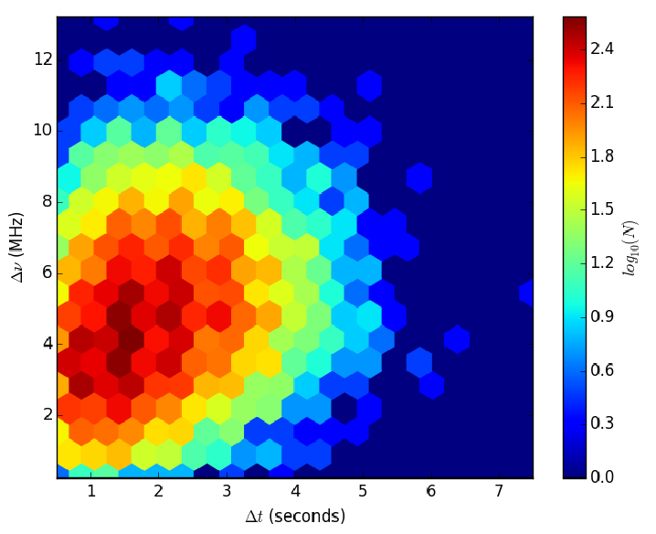
Duration vs bandwidth distribution of weak non-thermal emission features
Suresh, Sharma, Oberoi et al., 2016
Notes:
A 2D histogram of the duration and the spectral span of these features. Note the colours are on a log scale. So the vast majority of these features last for ~1.5 s and ~3-5 MHz.

Slide 16
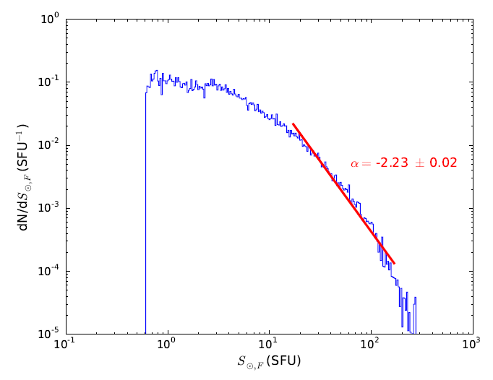
Relation to coronal heating
Suresh, Sharma, Oberoi et al., 2016

Slide 17
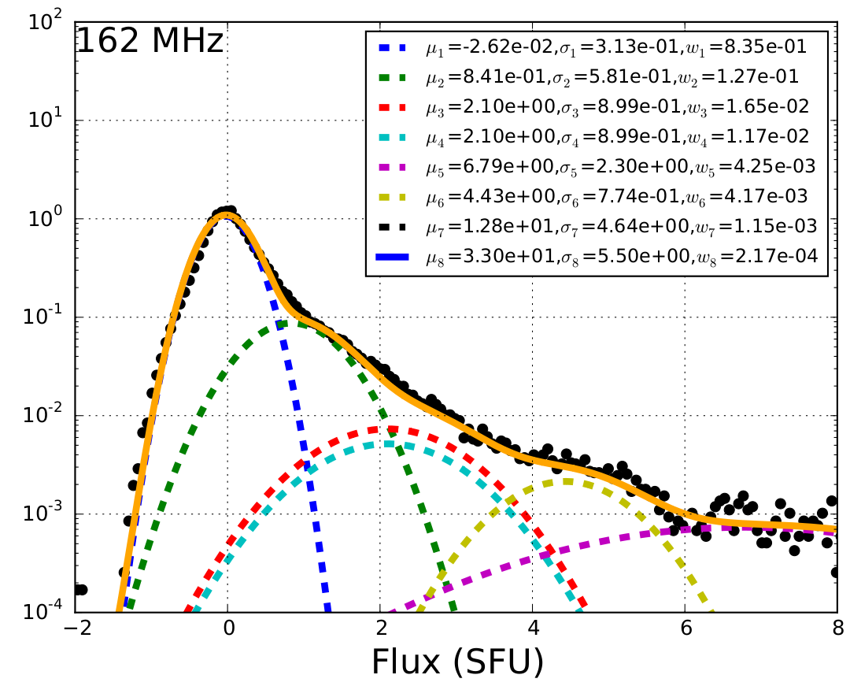
Gaussian mixture decomposition of solar dynamic spectrum
Sharma, Oberoi et al., 2016
Notes:
After flux calibration we plot a histogram of the observed flux densities and fit a Gaussian mixture model. The thermal emission from the million K plasma should lead to a Gaussian distribution (from central-limit theorem and under the assumption that it is stationary, we look at only ~2 MHz and 4 min of data at a time to ensure that). This analysis reveals that only ~83.5% (w_1 in the caption) of the data corresponds to the thermal Gaussian (the one with the lowest mean, \mu) and the rest of it falls outside suggesting the presence of weak non-thermal emission. The peak of the thermal Gaussian sits at zero because a running median filter has been subtracted from the data. There are the weakest non-thermal emission which has been observed to date at these observing frequencies.

Slide 18
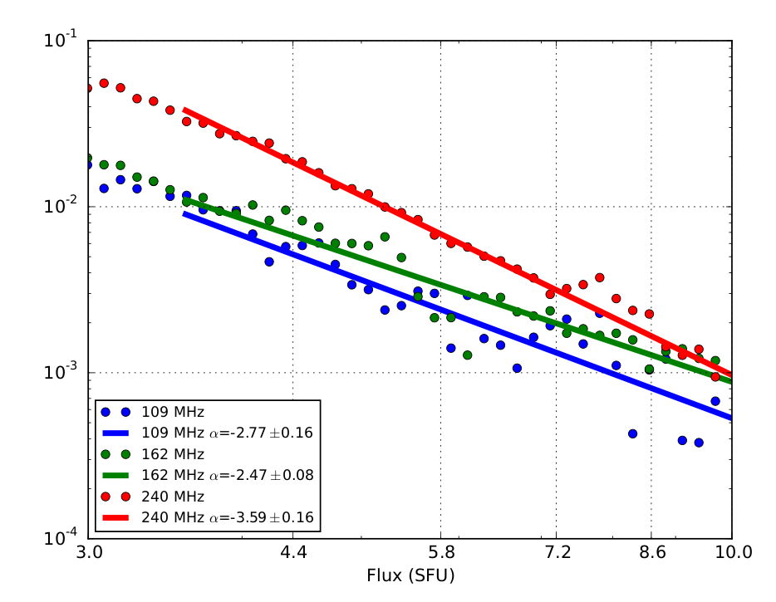
Evidence for very weak non-thermal emission
Sharma, Oberoi et al., 2016
Notes:
One can fit a power-law index to these histograms and we get slopes in the range -2.5 to -3.6. The critical point to make is that for the weak impulsive emissions to make a significant contribution to chromospheric and coronal heating the slope of the power law has to be steeper than -2.0. The power law slopes for many of the known classes of bursts, type Is, are often found to be steeper than -2 (even approaching -4), but these features are about an order of magnitude weaker than what have been characterised before.

Slide 19
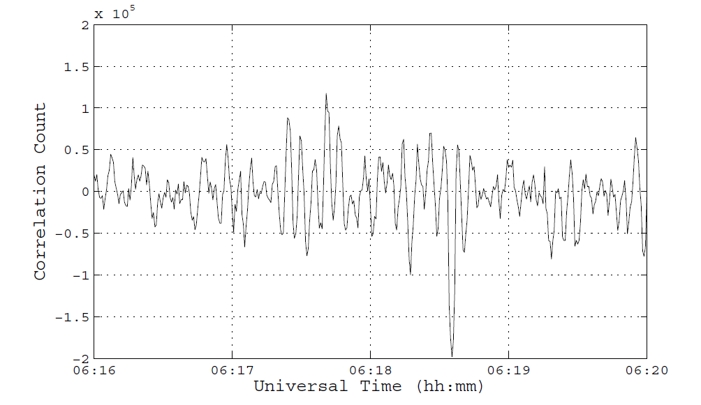
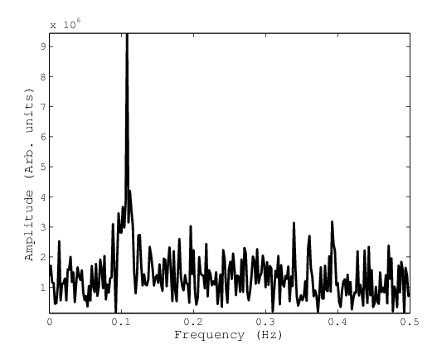
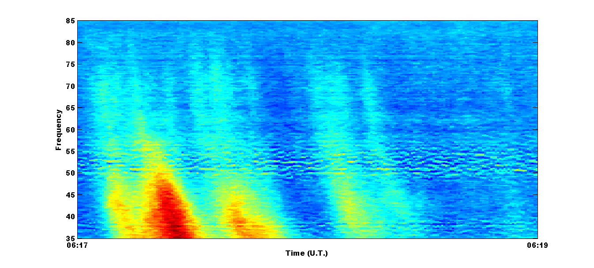
LBI Observations of Type III bursts
~8 km @ 37 MHz
Fringes @ 37 MHz observed during Type III bursts with LBI
Reveals existence of structures <1’ angular size
Peak @ ≈ 0.1 Hz, The expected Fringe Frequency for the baseline
Aug 9, 2015
Gauribidanur Radio Spectrograph observations
from the same epoch
Mugundhan et. al. ,Astrophys. J., 2016, Vol.831, pp154
R. Ramesh (IIA)

Slide 20
Heliospheric Science

Slide 21
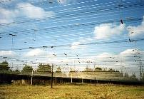
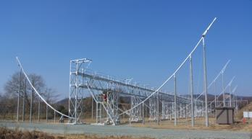
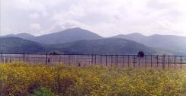

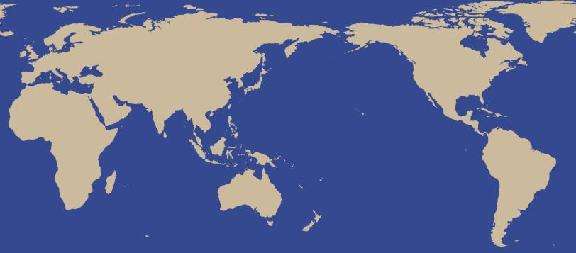
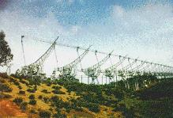

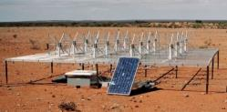
Worldwide IPS Stations
(WIPSS) Network
Pushchino 111 MHz
70,000 ㎡
ISEE Multi-Station 327 MHz
2000 ㎡ × 3, 3500 ㎡
MEXART
140 MHz、10,000 ㎡
Mexico
High-Band Tiles
110 to ~250 MHz.
Low-Band Dipoles
~10 to 90 MHz.
Japan
UK/Europe –
EISCAT/LOFAR
Russia
WIPSS
India
South Korea
Ooty 327 MHz、16,000 ㎡
MWA
80-300 MHz
Mario Bisi (RAL)
(USA-Australia)

Slide 22
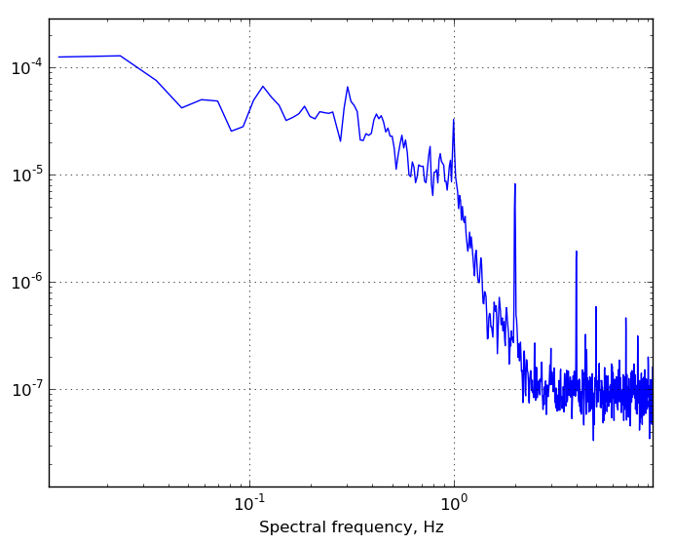
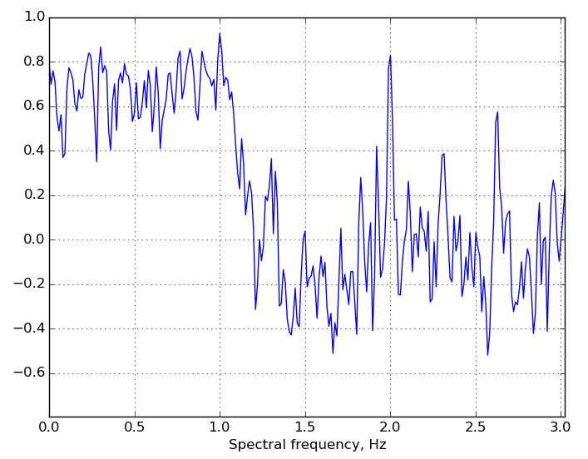
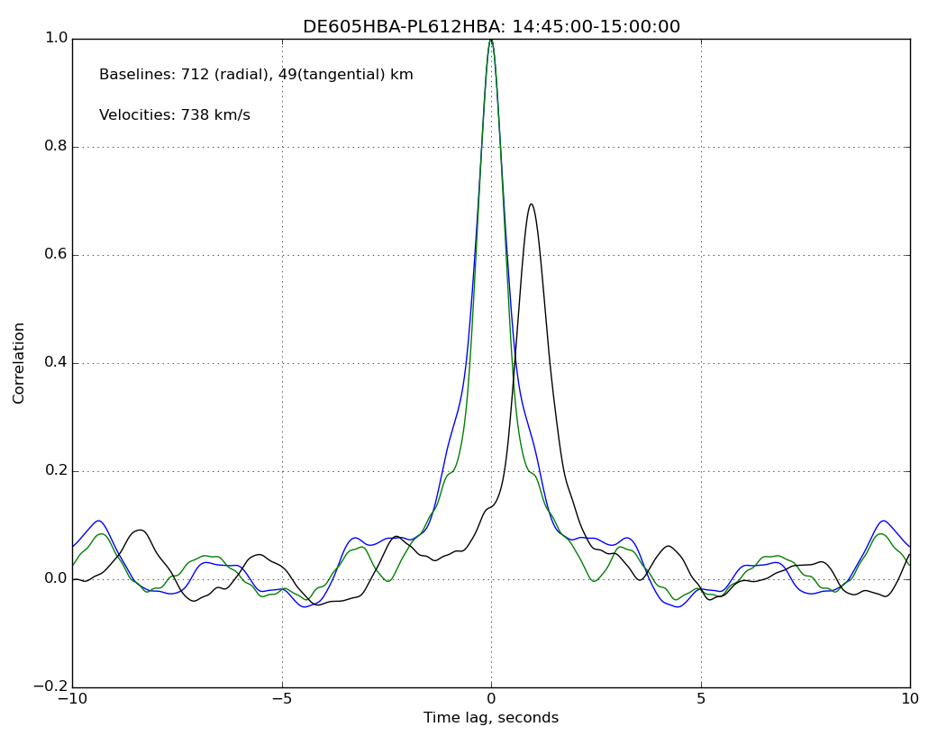
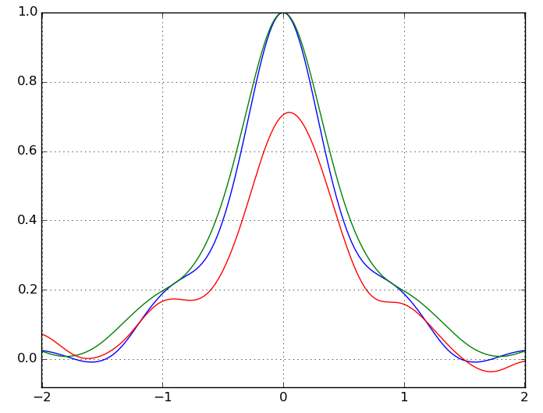
October 2016: The most comprehensive IPS campaign ever undertaken...
Designed as a demonstration of what's possible with new instrumentation and what could be possible with stations dotted all around the world, a major IPS campaign ran through October 2016:
- LOFAR: Wide bandwidth, high time- and frequency- resolution, wide spatial distribution of stations;
- MWA: Wide bandwidth, widefield imaging;
- Dedicated traditional IPS instruments: MEXART (Mexico), ORT (India), ISEE (Japan)
Cross-correlation of time series' from two widely-spaced stations
Cross-correlation of two widely-spaced frequencies from a single site
Power spectrum from single-site time series
Normalised co-spectrum: cross-correlation of two widely-spaced frequencies from a single site
Richard Fallows (ASTRON)

Slide 23
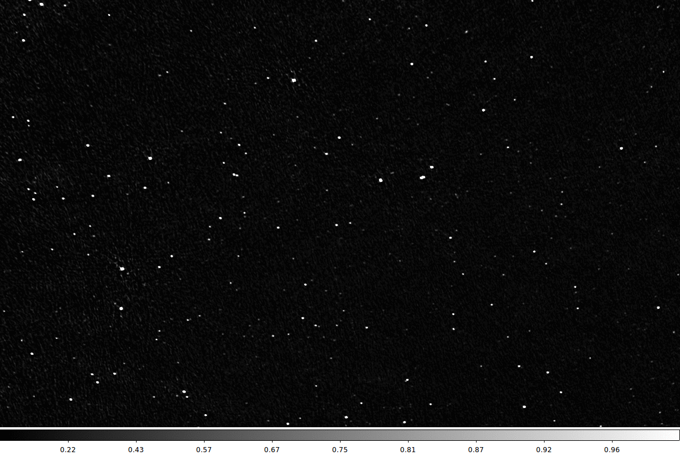
Continuum Image
John Morgan et al. (Curtin)

Slide 24
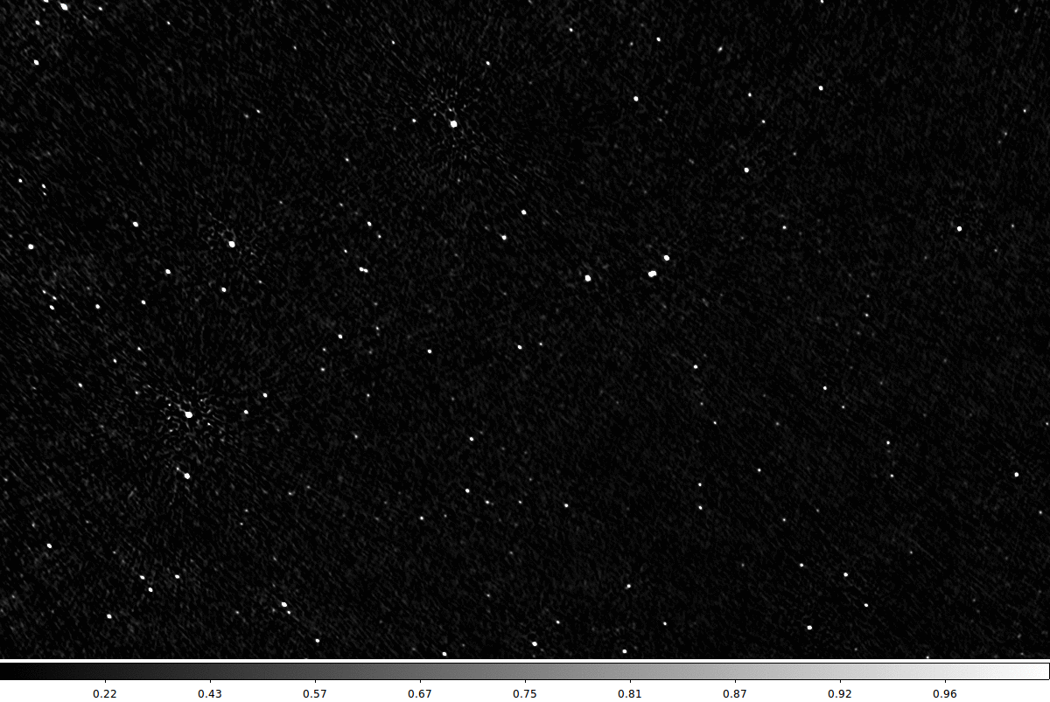
Mean Image vs RMS Image
John Morgan et al. (Curtin)

Slide 25
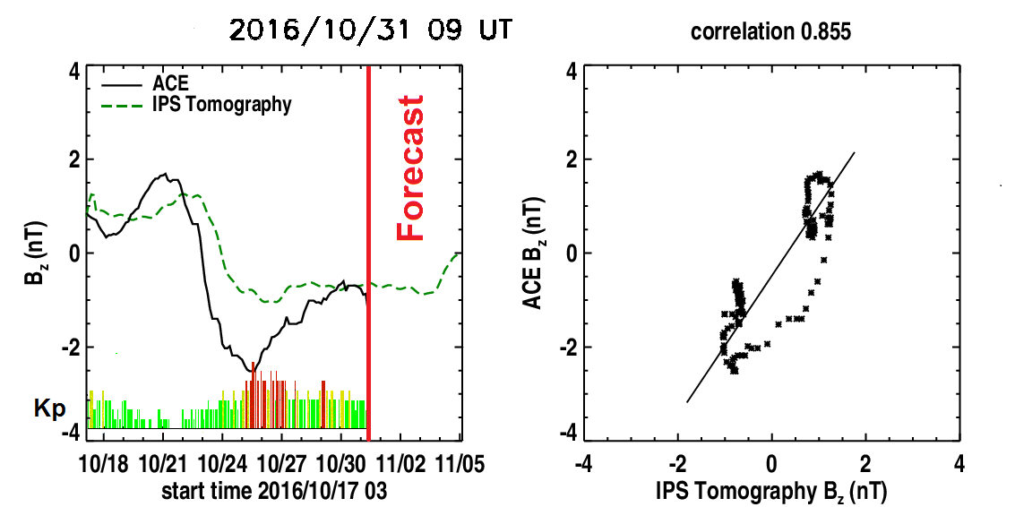
Prediction of heliospheric magnetic field
Bernard Jackson et al. (UCSD)

Slide 26
Ionospheric Science

Slide 27
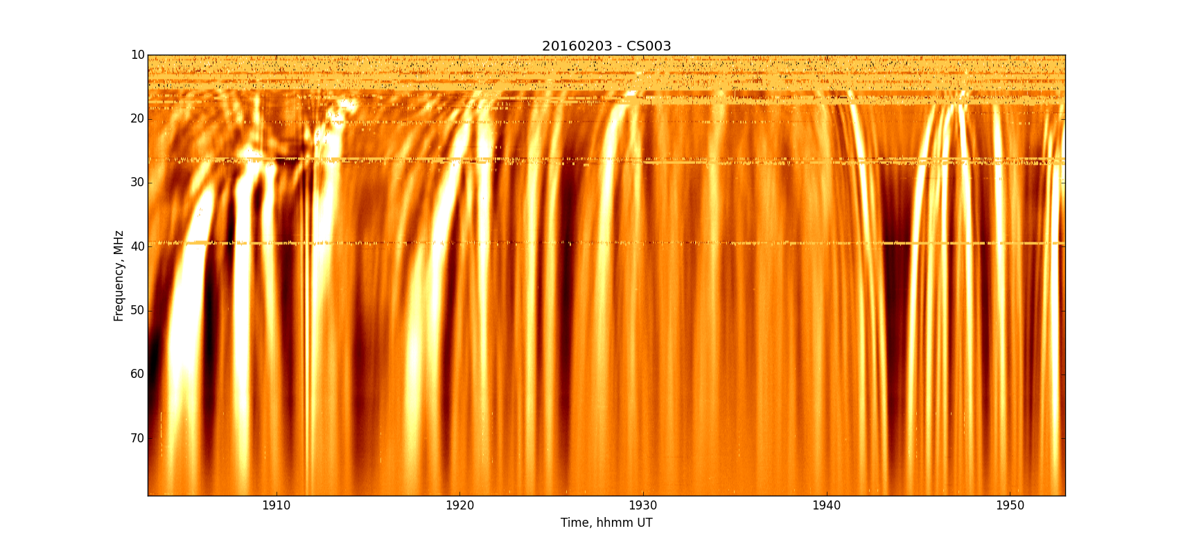
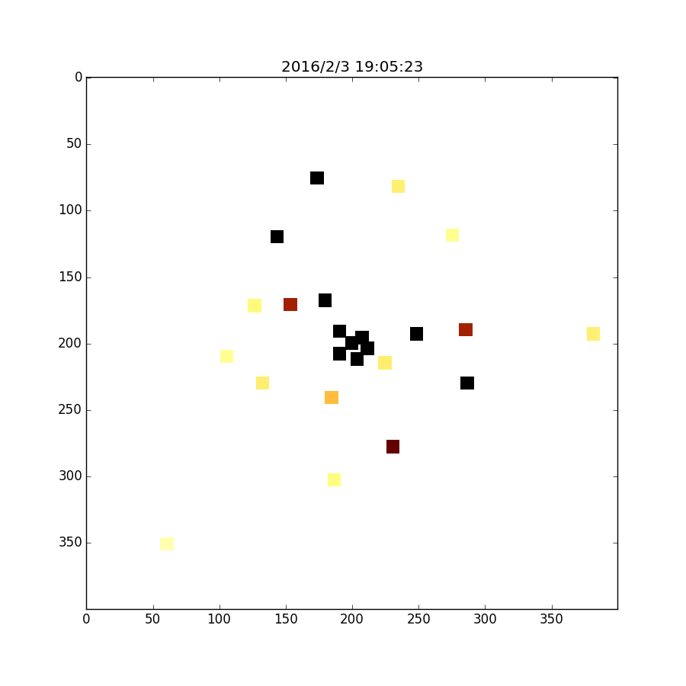
Mapping Ionospheric Scintillation
With many stations, we can record the scintillation at each station and plot the intensities of one sub-band as pixel values on a map of the stations.
Here, we see a map of the LOFAR core stations, with each coloured pixel representing a station and the shade indicating the strength of scintillation (black = strongest).
4000 m
Richard Fallows (ASTRON)

Slide 28
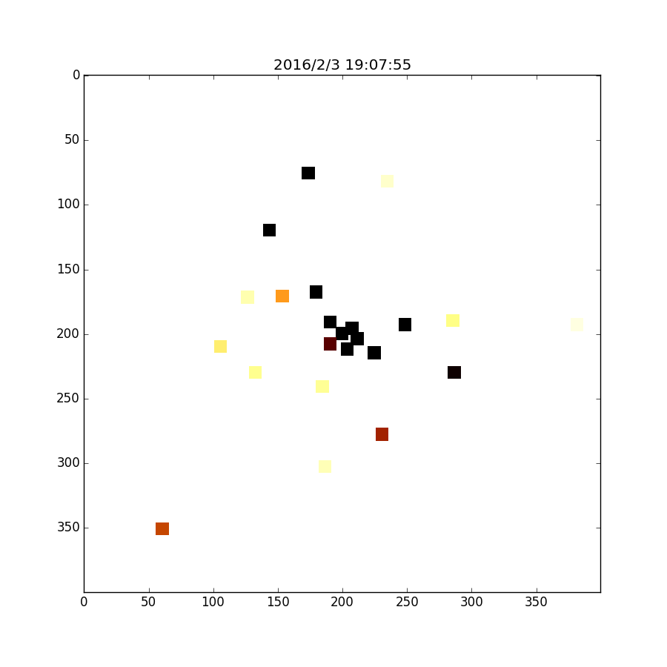
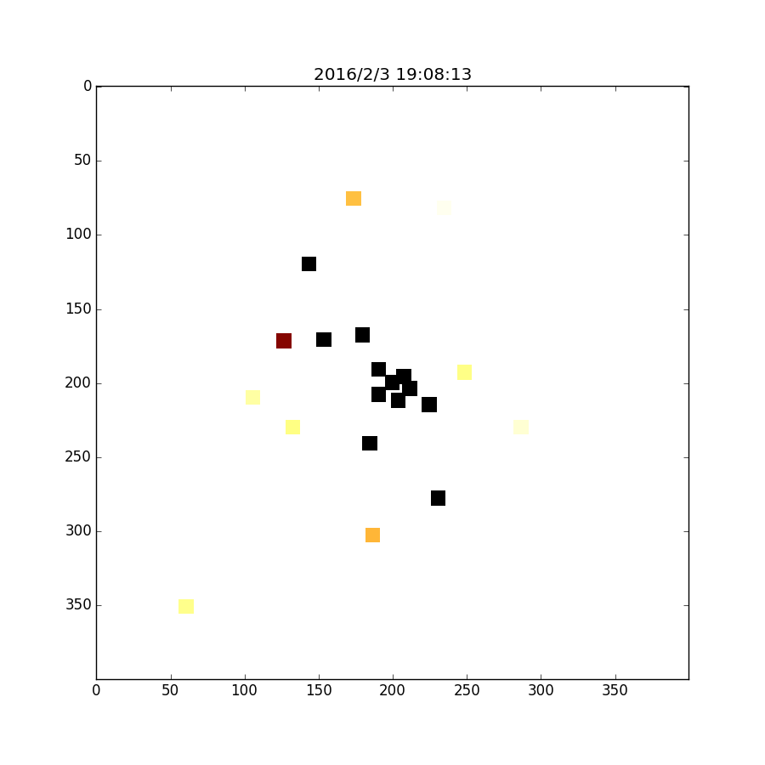
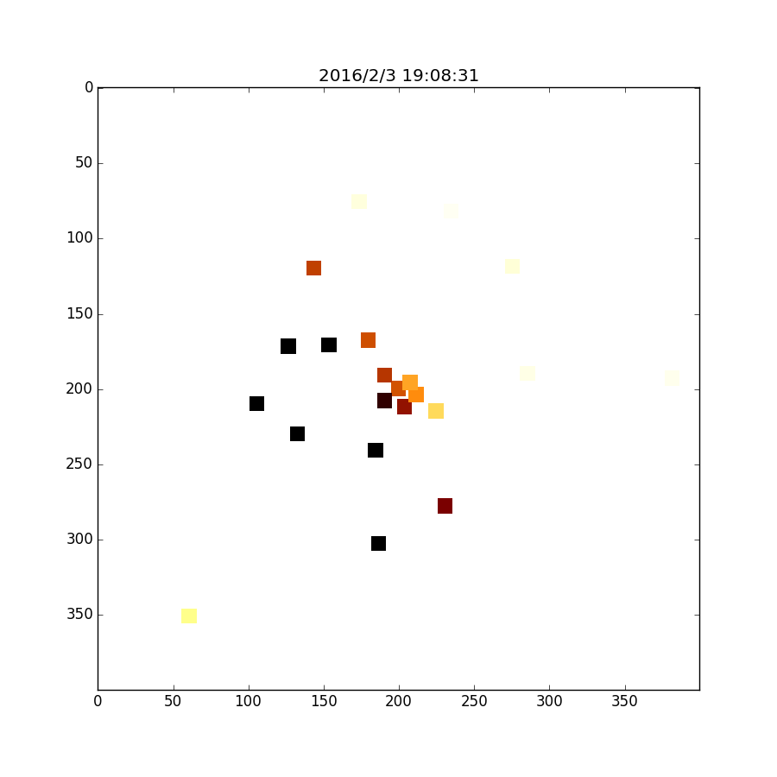
Mapping Ionospheric Scintillation
Series of three images of the intensity scintillation from Cas A received by the core stations on
3rd February 2016. Each image is 18s apart.
This illustrates how variable the scintillation is above LOFAR, even over a relatively small area.
Richard Fallows (ASTRON)

Slide 29
Summary: Emerging trends
Solar science
  The big features
    Detailed theory/simulation and observation comparisons, esp. events of relevance to Space weather
  The smaller features
    Details of flares and particle acceleration physics
  The little features
    Address coronal (and chromospheric) heating
Heliospheric science
  Widefield-of-view IPS observations
  Global IPS array
  Computation and prediction of FR - model + extrapolation
Ionospheric science
  Observations of ionospheric scintillation

Slide 30
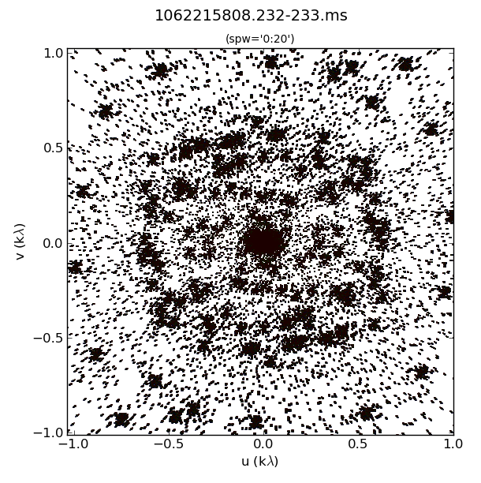


MWA uv sampling
Snapshot uv coverage at 285 MHz

Slide 31

MWA+Soft X-Ray images
Analysis : Kozarev, Crowley and Oberoi
Visualization: McCauley
Notes:
The left panel shows the MWA solar images at 3 different frequencies during the time of a CME lift-off. The right panel shows the same frame with a soft-Xray image from Atmospheric Imaging Assembly (AIA) on SDO as the background image and 2 of the radio images as contours. The intensities across different scales may have arbitrary scaling. The key point to note is that the emission at lower frequencies is seen to come from farther away as compared to that at lower frequencies. This points to a plasma emission mechanism where the frequency of emission is proportional to sqrt(local electron density). There is very good alignment between the place from where the CME lift-off and where radio emission is seen.

Slide 32



Complimentary to coronagraph as on disk events can be studied.
Forward model MHD simulation to obtain Gyro resonance, synchrotron and free-free thermal emission using Fleishman-Kuznetsov GS code: Fleishman & Kuznetsov, 2014
Synthetic images using the above code from simulations in wavelengths 50-400 MHz (SKA1-Low); microwave 1-30 GHz (SKA1-Mid) to be compared with radio heliographs
Study gyro-resonance emission during flux rope formation and gyro synchrotron emission during flaring and CME propagation in the simulation.
Type IV moving (IVM) burst inside core of magnetic cloud: polarization due to magnetic field (Tun & Vourlidas, 2010)
Standard model for emission
sites in a flare
MHD simulation snapshot showing
multi thermal plasma during flaring
gyro-resonance
f-f
f-f
Synthetic radio emission during flux rope formation
(Kuznetsov et. al. 2016)

Slide 33


Long Baseline(≈8kms) Interferometer (LBI) Observations of Solar Noise Storm Bursts @ 37 MHz from Gauribidanur
July 10, 2015
July 10, 2015
T_{int} ≈ 50ms
Power Law Index ≈ -2.5
≈6.4e16 – 1.7e18 ergs (if η = 10⁻⁶)
Weakest Energy Releases Reported to date
Energy
≈6.4e20 – 1.7e22 ergs (if η = 10⁻¹⁰)
Mugundhan et. al. ,Astrophys. J., 2016, Vol.831, pp154

