Slide 1
Software Engineering
Building The SKA Software Products – Quality Assurance & Integration
4th Oct 2016

Slide 2
Development Team
Team Training – some ramp up time required
  Developers
  Reviewers
  Tools and testing facilities (devops)
Interpretation & Tweaking of the Rules
  Who is responsible for verifying?
  Cost of non-compliance?

Slide 3
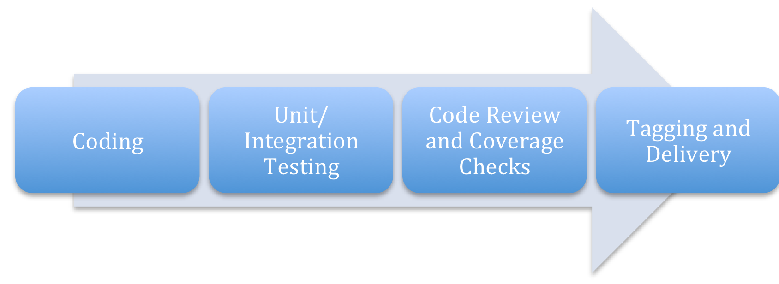
Development Team
Development Team
Integration
Development Team

Slide 4
Integration
  Who reviews Integration work?
  Who owns issues?
    Integration Issues
    Compliance Issues
    Test Feedback
    Acceptance Issues
  Who decides priorities?
Feature branch
compile
tests
☑
☑
Code Review
compile
tests
☑
☑
dev
Production

Slide 5
Integration Process
Better More Timely Feedback = Lower Risk
  More Integration Events
  Official Managed Integration Product Existing Throughout Development “Gold Standard”

Slide 6
Establish A Permanent Integration Team

Slide 7
Additional Integration Team Responsibilities
  Maintain The Integrity of the Integrated Product
    Own Issues and follow them up
  Manage Integration Delivery Planning
    Manage Code Churn
    Prioritise SCRUMs
    Own Integration Process
    Inform progress against Project Plan
  Own QA standards
  Manage the DevOps team
  Write Integration Tests?

