Slide 1
Software Architecture
Nick Rees
4 October 2016

Slide 2
SKA Statement of Work
This includes the following:
… Design reports shall include transport, integration and verification.
Software architecture models and use cases
Software libraries required to demonstrate compliance
Software configuration information (operating system, libraries, compilers etc.) for demonstration of compliance.

Slide 3
Software Architecture
So, I conclude that the CDR should focus on software architecture. What is software architecture?
Definitions :
Software Architecture: The set of structures needed to reason about the system, which comprises software elements, relations among them, and properties of both.
Architectural drivers: The combination of functional, quality-attribute, and business requirements that shape the architecture or the element under consideration.
From: http://www.sei.cmu.edu/architecture/start/glossary/

Slide 4
What quality isn’t
Inflexible
Fragile
Overly complicated
Difficult to diagnose
Coupled failures
Unpredictable
Slow
Unresponsive
Non functional requirements

Slide 5
Problems
With the exception of semi-structured peer review, we have no way of ensuring architectural quality.
Just nominally meeting requirements doesn’t generate quality.
Documentation heavy processes are slow and suffer from large technical debt.
However, good documentation is still critical

Slide 6
Where to start?
I am basing many of my ideas on the Software Engineering Institute’s processes
Why?
SEI is the organization behind the Capability Maturity Model.
World recognized in software process development.
Books and training courses to define what they mean.
Also seems to pass the common sense rule

Slide 7
What is the SEI?
The US Department of Defense (DOD) faced major software setbacks in multi-billion $ projects
In 1984 they founded the Software Engineering Institute (SEI) at Carnegie Mellon University – 500 Staff
Focus:
Software Processes
1988 CERT – computer
emergency response team

Slide 8
Watts Humphrey (1927-2010)
Best biography is at SEI
1959-1986: IBM – oversaw 4,000 engineers across 15 laboratories
1986-2010: Fellow at Software Engineering Institute (SEI), Director of Software Processes
Invented CMM with maturity levels 1-5
Then invented the personal and team software processes (PSP & TSP)
He:
focused on Quality
worked Quantitatively
In 2005 he was awarded a top honor:
National Medal of Technology

Slide 11
SEI architecture development
Quality Attribute Scenarios: Quality attribute requirements are elicited from the system’s stakeholders and are captured as quality attribute scenarios. Those scenarios are used as the driving force for architecture activities.
Attribute Driven Design: An approach for developing an architecture to meet its quality attribute requirements. In architecture design, the defined quality attribute scenarios are used to iteratively decompose the system into an architecture that will fulfill the business goals.
The Views and Beyond: guides the architecture team in producing architecture documentation that is useful to its stakeholders, easy to navigate, and practical to create.
Architecture Tradeoff Analysis Method® Assesses the designed architecture with input from the system’s stakeholders to uncover possible issues in the architecture early, before they create costly problems.
Active Reviews for Intermediate Designs: This review focuses on whether the design is sufficient for the developers who will use it.

Slide 12
Quality Attribute Scenarios - QAS

Slide 13
Quality Attribute Scenario
A QAS is like a use case or requirement but with a quality attribute (QA) e.g.
Availability
Modifiability
Performance
Usability
Reliability
(some 5-8 are considered)
and with a quantitative effect, e.g.:
Recover within 3 seconds
Deliver 100 GB/sec bandwidth
Recording QAS:
Short form – spreadsheet:
Scenario identifier
QA
Summary
Description
Votes
Long form – small table:

Slide 14
QAS table
Scenario Refinement for Scenario N
Scenario(s):
Business Goals:
Relevant Quality Attributes:
Scenario Components | Stimulus:
 | Stimulus Source:
 | Environment:
 | Artifact (If Known):
 | Response:
 | Response Measure:
Questions:
Issues:

Slide 15
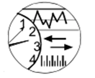
Sample Quality Attribute Scenario
Artifact: Process
Stimulus:
Unanticipated Message
Response: Inform Operator Continue to Operate
Source:
External to system
Environment: Normal
operation
Response Measure:
No Downtime

Slide 16
Quality Attribute Workshop - QAW
The results of a QAW include
a list of architectural drivers
the raw scenarios
the prioritized list of raw scenarios
the refined scenarios
Purpose
Potential Next Steps
Update Architectural Vision
Refine requirements
Create Prototype
Exercise Simulations
Create Architecture
Quality Attribute
Scenarios
Raw
Prioritized
Refined
Useful For
Evaluate
Architecture

Slide 17
QAW - agenda
1.5 day workshop, 5 – 50 people works well
Shorter versions and web conference versions work, but are harder
QAW agenda:
Business Drivers
Quality
Attributes
Scenarios
Architectural Plan
Scenario Refinement
Refined Scenario

Slide 18
Attribute driven design - ADD

Slide 19
Patterns & Tactics
An architectural pattern
has known properties that permit reuse, and
describes a class of architectures, a bundle of decisions
Patterns are found repeatedly in practice, sometime difficult to apply
one does not invent them, one discovers them.
Well known patterns: client-server approach, map-reduce
Less well known patterns: increase software modifiability
Tactics are simpler: address single QAS response.
Enumerated in the ACE process, allow adaptation of patterns
Simple example: “schedule resources to achieve performance”
stimulus
Tactic(s) to control reponse
response

Slide 20
Patterns…

Slide 21
Modifiability design patterns
The ACE has captured numerous tactics and patterns, as a reference catalog
Modifiability
 | Increase Cohesion |  | Reduce Coupling |  |  |  |  | Defer Binding Time
Pattern | Increase Semantic Coherence | Abstract Common Services | Encapsulate | Use a Wrapper | Restrict Comm. Paths | Use an Intermediary | Raise the Abstraction level | Use Runtime Registration | Use Start up-Time Binding | Use Runtime Binding
Layered | X | X | X |  | X | X | X
Pipes and Filters | X |  | X |  | X | X |  |  | X
Blackboard | X | X |  |  | X | X | X | X |  | X
Broker | X | X | X |  | X | X | X | X
Model View Controller | X |  | X |  |  | X |  |  |  | X
……

Slide 22
Architecturally Significant Requirements
Capture the most essential requirements in a utility tree, grouped by quality.
Find tactics and patterns that allow these requirements to be met
(L,M)
Reduce storage latency on customer DB to <200 ms
Data latency
Performance
Transaction throughput
(M,M)
Deliver video in real time
(H,H)
Add CORBA middleware in <20 person-months
New Products
Modifiability
Change Web user inference in <4 person-weeks
(H,L)
Change COTS/W
(H,H)
H/W failure
Power outage at site1 requires traffic to be redirected to be redirected to site 2 in <3 seconds
Availability
COTS S/W failures
Network failure detected and recovered in <1.5 minutes
(H,H)
Importance, Difficulty
L=Low, M=Medium, H=High

Slide 23
Attribute driven design
Systematic approach to decomposition into components
Business Drivers
Architectural Drivers
Decompose according to tactics
Functional Requirements
Quality Attributes
Architectural design concept
Describe decomposition
Architectural description

Slide 24
Documenting Software Architecture – Views and Beyond

Slide 25
Organizing concepts
Views
Each view has diagram,
3 classes of views exist,
Module views
Component & connector views
Allocation views
each class has 5-10 variants
Module views
Uses
Decomposition
Layers
Class
Generalization
…
Component and connector
Client-server
Concurrency
Process
Shared data
…
Allocation
Work assignment
Deployment
Code layout
Implementation
...

Slide 26
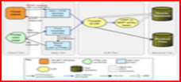
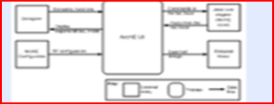
Template for a view
Section 1. Primary Presentation
ACE views go beyond UML
diagrams.
Well structured additional
description is added
Section 2. Element Catalog
Section 2.A. Elements
Section 2.B Relations
Section 2.C Element Interfaces
Section 2.D Element Behavior
Section 3. Context Diagram
Section 4. Variability Guide
Section 5. Rationale

Slide 27
Documentation organization
Select views to match stakeholders needs
Results are called view packets – these become books with chapters
Many views are familiar: module decomposition, sequence diagrams
Others are less usual: source code organization, team allocation

Slide 28
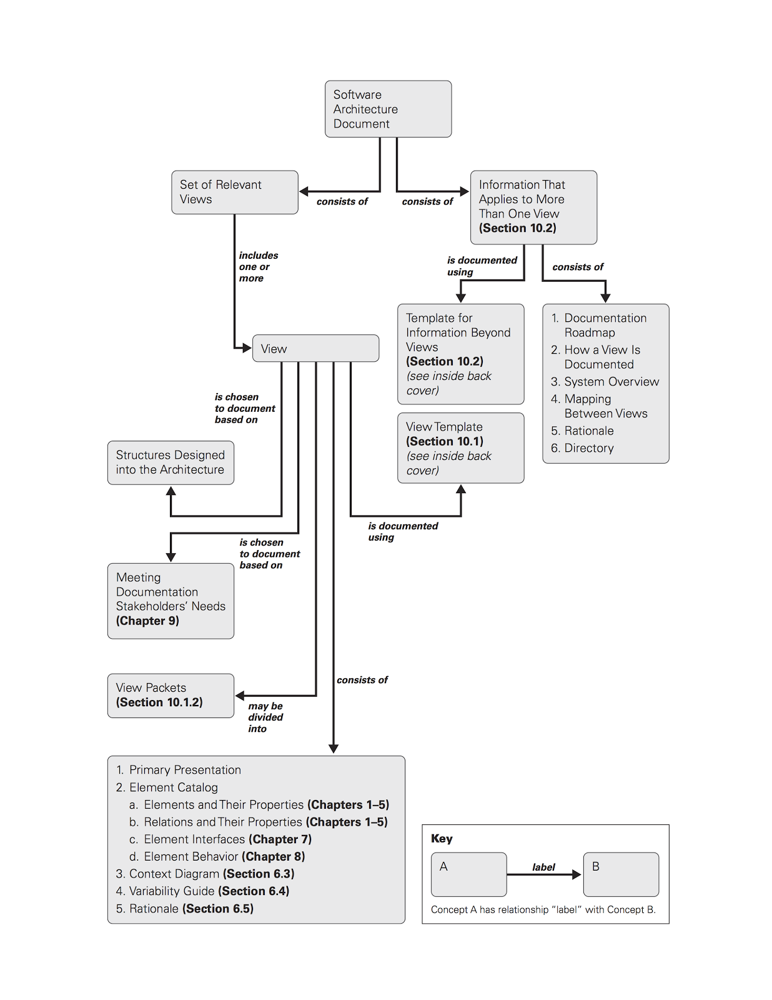

Slide 29
Evaluating software architectures

Slide 30
Measure vs Question evaluation
Using a model, one can measure aspects of an architecture
Performance
Recovery time
Other aspects have to be questioned
Conventional reviews
Active reviews

Slide 31
Architecture Tradeoff Analysis Method - ATAM
evaluates an architecture for
completeness
risks
Meetings are 5 days, involve many stakeholders
There are similarities to QAW, but
ATAM’s are more “serious”
later in the architectural cycle and
must cover all qualities

Slide 32
ATAM overview
The Architectural Tradeoff Analysis Method® (ATAM®) is a method that helps a system’s stakeholder community understand the consequences of architectural decisions with respect to the system’s quality attribute requirements.
Business Drivers
Quality Attributes
Scenarios
Analysis
Software Architecture
Architectural Approaches
Architectural Decisions
Tradeoffs
impacts
Sensitivity Points
distilled into
Non-Risks
Risk Themes
Risks

Slide 33
Active Review for Intermediate Design - ARID
Is the design ready?
Work primarily with designers and developers to evaluate
Is the architecture complete enough for implementation?
One day workshop (with some preparation)
The most novel step is the review step during which participants craft pseudo code for scenarios.
Dates from 1985 Parnass and Weiss “Active design reviews: principles and practices”

Slide 34
Conventional vs Active Reviews
Conventional Design Review Questions | Active Design Review Instructions
Are exceptions defined for every program? | Write down the exceptions that can occur for every program.
Are the right exceptions defined for every program? | Write down the range or set of legal values of each parameter. Write down the sates under which it is illegal to invoke the program.
Are the data types defined? | For each data type, write down an expression for a literal value of that data type. a declaration statement to declare a variable for the type. the greatest and least values in the range of that data type.
Are the programs sufficient? | Write a short pseudo-code program that uses the design to accomplish {some defined task}.
Is the performance of each program adequately specified? | For each program, write down its maximum execution time and list the shared resources that it may consume.
Table : Conventional vs. Active Design Review Question/Instructions

Slide 35
Architecture Exit Criteria
Two categories of architectural task:
Architectural design:
Completes when a quality attribute scenarios is addressed. Done by peer reviews utilizing ATAM techniques and is complete when all uncovered risks are mitigated and there are no open action items. A risk mitigation of “ignore this risk” is acceptable, if the stakeholders agree.
Module specification:
Completes when the description of a module is good enough. This depends on the knowledge and skills of the developers implementing the modules. This can be achieved using the ARID-style peer review, where developers are sketch the solution for one or two use cases, using the provided architecture description. The module specification is completed when all the suggestions from the review are resolved.

Slide 36
Lessons
Separate
Quality attribute requirements – drivers of the architecture
Functional requirements – what it does
Business drivers
Focus on a few (<=5) quality attribute scenarios
Could be called use cases or mission threads.
A small number is sufficient to test most requirements, but is easier to understand.
Focus is on non-functional requirements, as well as the key functional requirements.
Document design with a number of views using different styles.
There is not one view to rule them all!
Well defined diagrams and models, rather than extensive text
Write the documents from the point of the reader.
Need disciplined, trained architects.
Iterate the design
Avoids technical debt buildup
Map to functional requirements identify gaps that the quality attribute scenarios have done their job

Slide 37
Questions?

Slide 38
What quality is (ISO 25010)
Software Quality
Functional Suitability
Usability
Reliability
Performance
Compatibility
Functional completeness
Functional correctness
Functional appropriateness
Time behavior
Resource utilization
Capacity
Co-existence
Interoperability
Appropriateness recognizability
Learnability
Operability
Error protection
Aesthetics
Accessibility
Maturity
Fault tolerance
Recoverability
Security
Confidentiality
Integrity
Non-repudiation
Accountability
Authenticity
Maintainability
Modularity
Reusability
Analysability
Modifiability
Testability
Portability
Adaptability
Installability
Replacability
Availability

Slide 39
What quality is (ISO 25010)
Quality in Use
Effectiveness
Efficiency
Context completeness
Satisfaction
Freedom from risk
Context coverage
Flexibility
Usefulness
Trust
Pleasure
Comfort
Economic risk
Health and Safety risk
Environmental risk

