Slide 1
SKA Town Hall Meeting
Project Overview and Introduction
Alistair McPherson
18th May 2017

Slide 2
Code of Conduct
SKAO is committed to ensuring a meeting environment safe from bullying, intimidation, harassment, violence or discrimination.
https://indico.skatelescope.org/event/402/page/8

Slide 3

Square Kilometre Array
3 sites; 2 telescopes + HQ
1 Observatory
Design Phase: > €170M; 600 scientists+engineers
Phase 1
Construction: 2019 – 2024
Construction cost cap: €674.1M (inflation-adjusted)
Operations cost: under development (see below)
MeerKat integrated
Observatory Development Programme (€20M/year planned)
SKA Regional centres out of scope of centrally-funded SKAO.
Phase 2: start mid-2020s
~2000 dishes across 3500km of Southern Africa
Major expansion of SKA1-Low across Western Australia

Slide 4
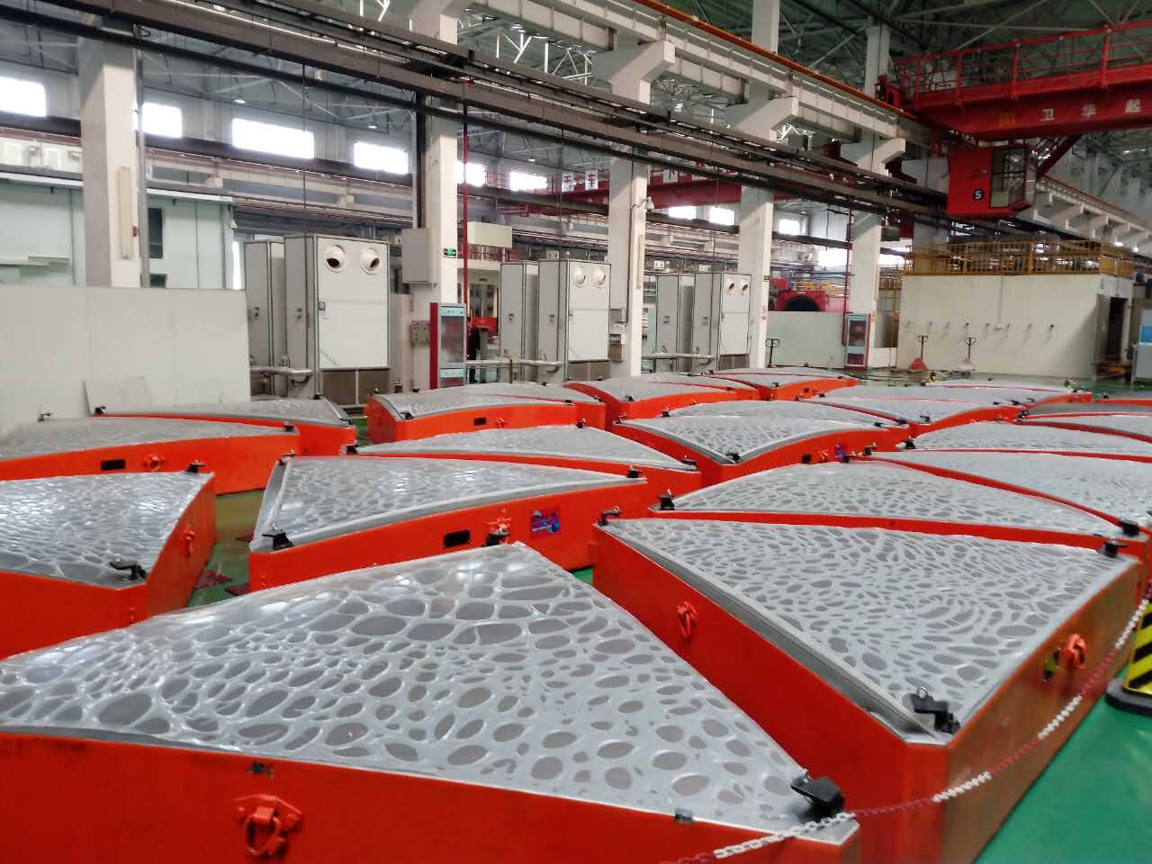
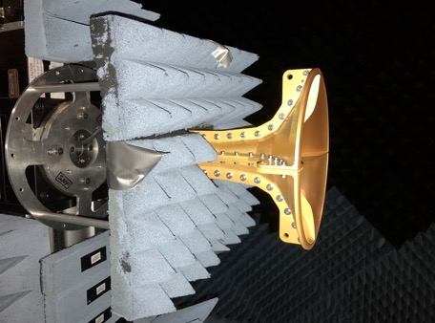
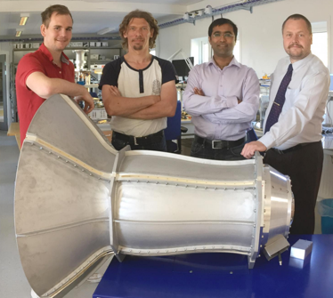
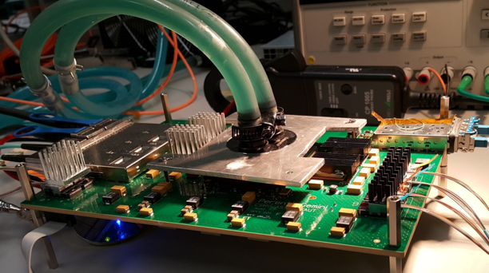
Technical Progress

Slide 5
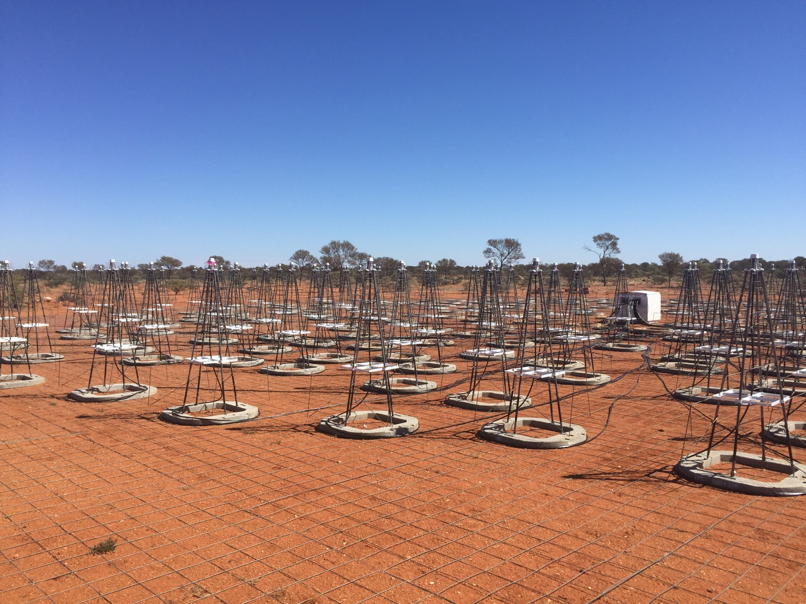
SKA-LOW prototype antenna station deployed

Slide 6

MeerKAT

Slide 7
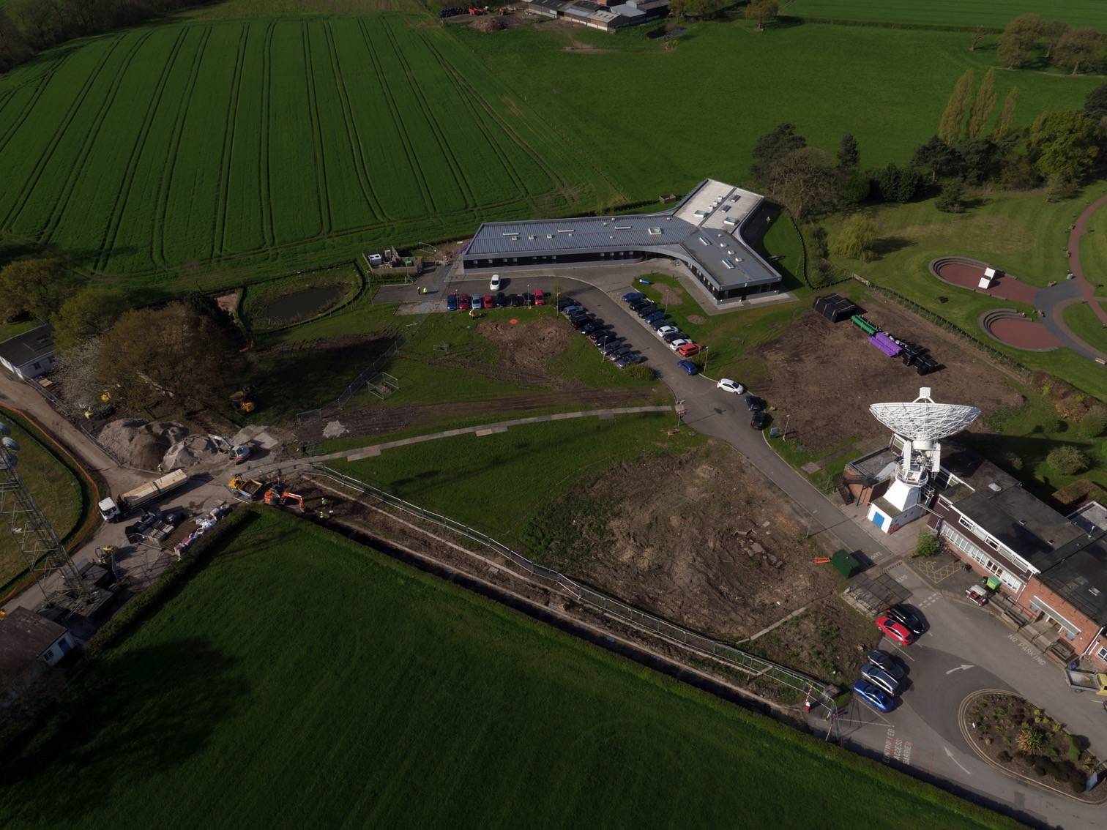

New SKA HQ building: work underway
£16.5M investment
Completion in June 2018

Slide 8


Slide 9
Future Governance

Slide 10
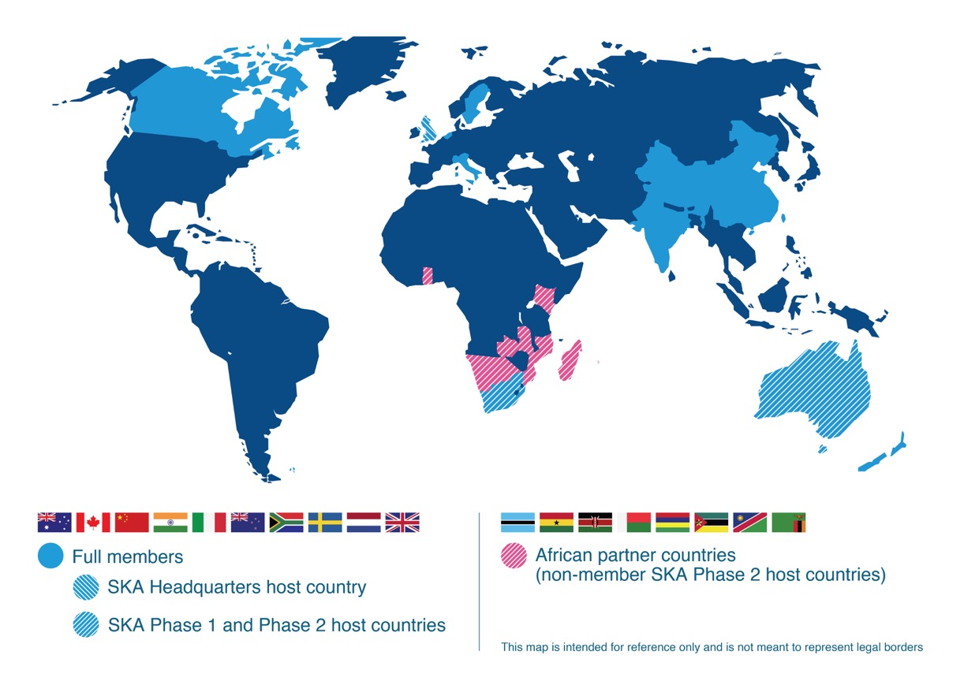
SKA Organisation: 10 countries, more to join
Interested Countries:
France
Germany
Japan
Korea
Malta
Portugal
Spain
Switzerland
USA
Contacts:
Mexico
Brazil
Ireland
Russia
Australia (DoI&S)
Canada (NRC-HIA)
China (MOST)
India (DAE)
Italy (INAF)
Netherlands (NWO)
New Zealand (MED)
South Africa (DST)
Sweden (Chalmers)
UK (STFC)

Slide 11
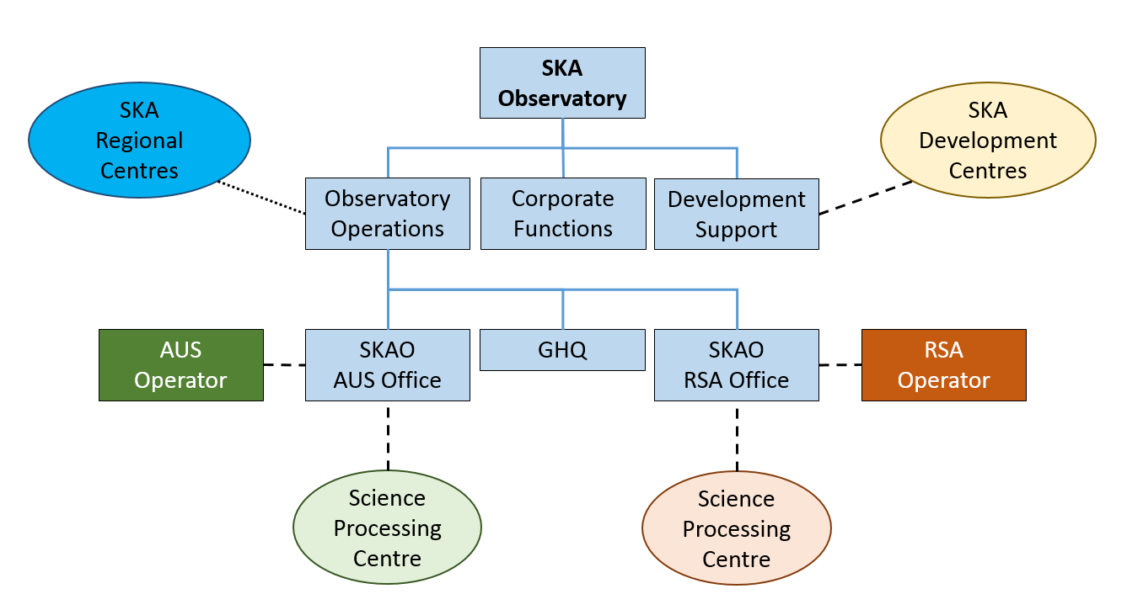
Eventual scope
In Scope
Service Level Agreements
Memorandum of Understanding

Slide 12
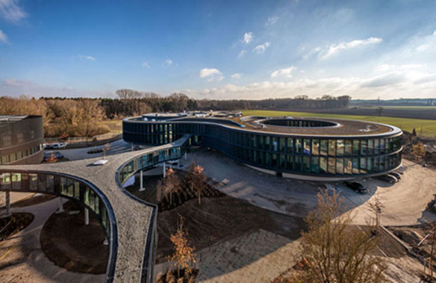
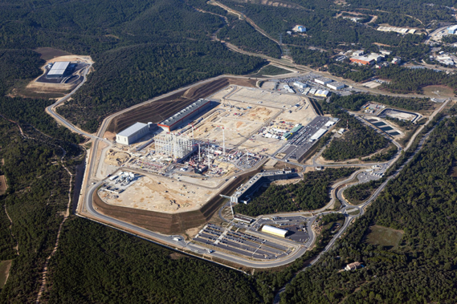


Governance/organisational structure
IGO = ‘Convention’ agreed between governments
  Government commitment: Long-term political stability, funding stability
  A level of independence in structure
  Availability of ‘supporting processes’ through Privileges and Immunities from members: functional support for project
  ‘Freedom to operate’, specifically through procurement process, employment rules and so on

Slide 13
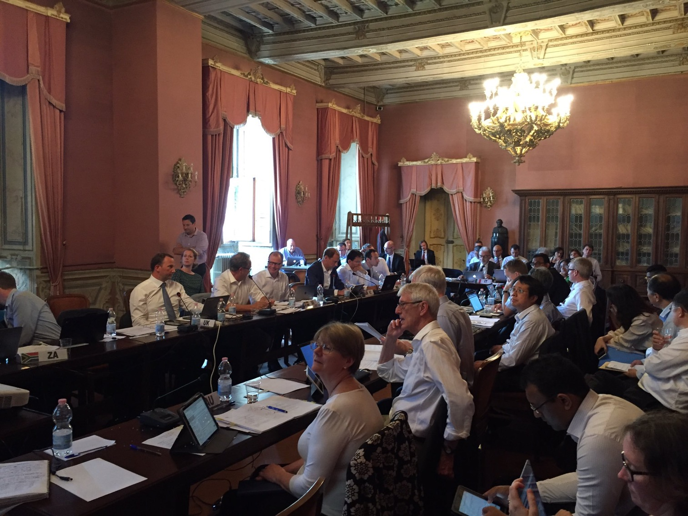

Slide 14
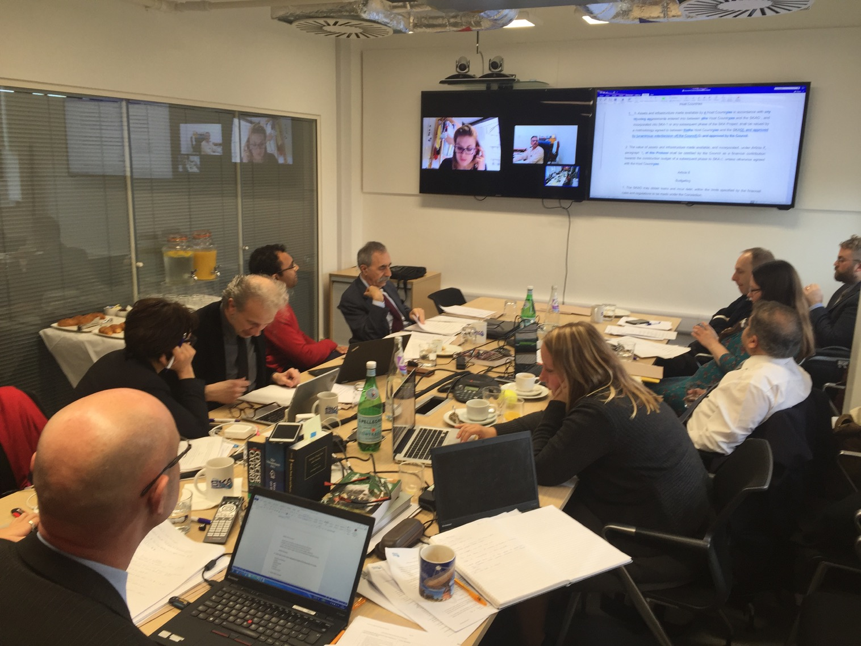
High-level IGO timeline
Now to July:
  Finalising the Convention text and other ‘treaty-level’ documents
  High-level discussions on procurement principles, access etc
  Governments preparing to ‘initial’ the documents
  Discussions about initial phases of funding the IGO (not SKA1 construction…)
~July:
  Documents ‘initialled’ to mark end of negotiation process; governments prepare to sign the Convention
Best guess – September:
  Signing event for negotiating governments – most sign in one go, others when ready
  Ratification of Convention by governments begins
  ‘Proto IGO Council’ starts work preparing for IGO – policies, the transition from the company etc

Slide 15
Cost Control Project

Slide 16
BD-22 Decision
“The Board directs the SKA Office to commence a review of the existing telescope design, guided by a sub-committee of the Board, with a view to reducing construction and operational costs. Such a review will provide revised design options against the cost cap (€674m, 2016 €). In providing the options the SKA Office will:
  Draw on the papers developing alternative options for SKA Mid (provided by RSA) and SKA Low (to be co-ordinated by Australia);
  Optimise the use of pre-cursor and pathfinder technology where it provides cost savings and/or reduces risk;
  Draw on cost reduction options already identified by consortia and the SKA Office;
  As far as possible, preserve the existing schedule and science goals;
  Allow for the expansion of the design as additional funding becomes available.
The SKA Office will present preliminary recommendations at the March Board meeting.”

Slide 17
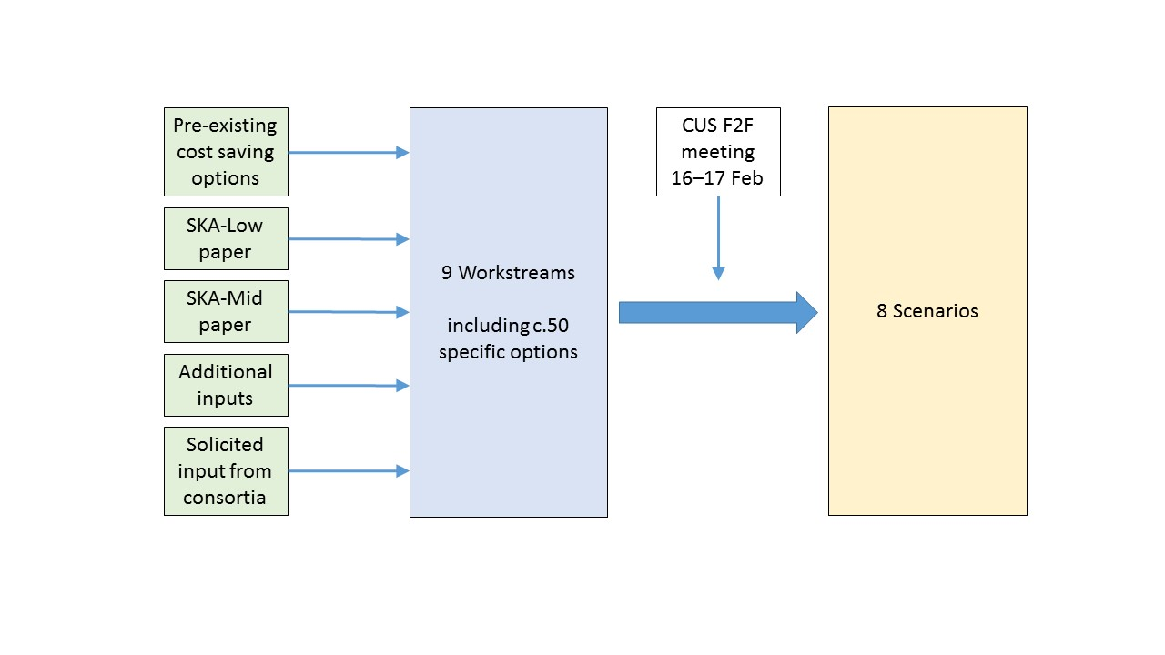
Process

Slide 18
Development of Scenarios
Scenario 1 – Minimum Science Impact
Scenario 2 – Partial Impact on Science
Scenario 3 – Sequential saving to cost cap
Scenario 4 – SA Paper plus minimum science impact on SKA-Low
Scenario 5 – SA Paper plus maximum savings on SKA-Low
Scenario 6 – deleted
Scenario 7 – Minimum impact on current pre- construction schedule
Scenario 8 – SKA-SA Paper and SKA-Low Paper

Slide 19
Recommendation – Further develop Scenarios 3 & 8 design space
Minimum impact on scientific capability
Moderate technical risk with mitigation
Controlled schedule slip
Includes ~16% contingency
Most options can be re-instated if additional funding is available; exploits inherent scalability of interferometers
Minimal changes to the baseline design

Slide 20
Summary of Board discussions
Cost Control Project
Following CUS and SEAC input, and other discussions, the SKA Office will further investigate a ‘design space’ which incorporates both Scenarios 3 and 8; with the aim of bringing to the Board a plan which would allow the Board to issue a resolution on cost reduction options to deliver SKA1 at the cost cap, with opex at or below target.
If additional partners are secured, beyond those currently envisaged as Members of the SKA Observatory, then Council can elect to move back up the scenario, reinstating options and restoring scientific capability to match available funding.
SKA Office, in consultation with CUS, will rapidly develop a plan to conduct the technical and scientific assessments identified. The plan to be approved at the Board Executive Committee on April 24th. ExCo has delegated authority to discharge the CUS, or to provide a revised charge if required.

Slide 21
Phase 2 - Design Space
Scenario:
  A group of options which, if selected, provides a defined design solution
Design Space:
  A group of options which provides a space from which a scenario can be selected. When a scenario is selected, some options will be chosen and some discarded.

Slide 22
CCP Further Work
  SKA-Low Beamforming Resolution Team
  SSKA-Mid CBF review of improved design by CSP
  SKA-Low Antenna – evaluate potential alternatives
  SKA-Mid Frequency Reference and Timing – Review SKA-SA solution
  Data Capture Engine – Review SKA-SA option and compare with baseline solution
  SDP Execution Framework- Review SKA-SA execution framework against SKA-Mid requirements
  Science Assessments:
    • Impact on EoR/CD of changes to SKA1-Low maximum baseline length
    • Required timing accuracy to enable successful precision pulsar timing science
    • Impact of SKA-Low antenna design
  8. Programmatic Assessment

Slide 23
Progress
Board has set overall direction of work.
Cost control options will be implemented at time of procurement, if no additional funding available
Science Assessment Teams investigating specific questions – Robert’s talk – will provide advice
RTs looking at specific engineering choices – will provide advice
SEAC will see outputs, will provide advice
Project (Consortia and/or Office) will generate ECPs as required
Will go through standard change control process for decision by CCB
D-G will be the final decision-maker on technical issues
Board will be kept informed at each Board meeting.
Members (or future Council) will be involved in setting final procurement policy.

Slide 24
Summary
Overall progress is very positive:
  Technical progress moving well, dealing with challenges
  Precursors/pathfinders being delivered; delivering science
  Route to an IGO now appears firm
  HQ construction started
  Real money being spent now by governments, real commitment being made at political level
Route to procurement moving ahead:
  Greater clarity on schedule will emerge soon
  Policy picture converging: working closely with Members on aligning central project thinking with national strategies
SKA only possible through the drive, enthusiasm and support of the science and engineering community.

