Slide 1
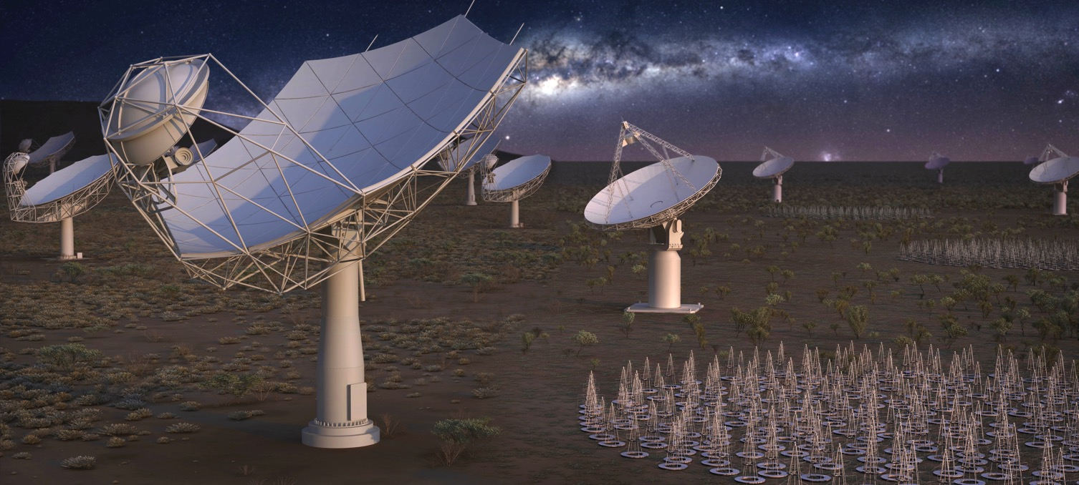
SKA Science Town Hall Meeting
Robert Braun, Science Director
18 May 2017

Slide 2

SKA– Key Science Drivers:
The history of the Universe
Cosmic Dawn
(First Stars and Galaxies)
Testing General Relativity
(Strong Regime, Gravitational Waves)
Galaxy Evolution
(Normal Galaxies z~2-3)
Cradle of Life
(Planets, Molecules, SETI)
Cosmology
(Dark Energy, Large Scale Structure)
Cosmic Magnetism
(Origin, Evolution)
Exploration of the Unknown
Extremely broad range of science!

Slide 3
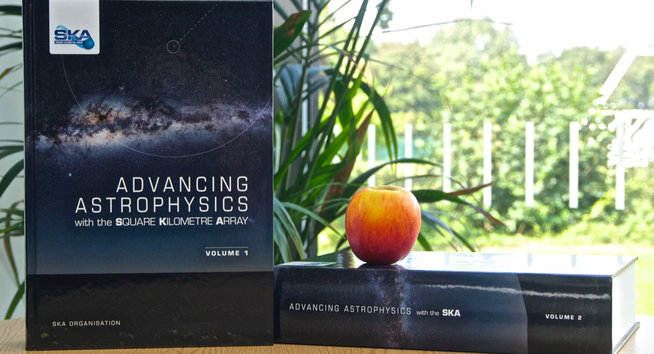
SKA Science Book 2015
135 Chapters, 2000 pages, 8.8 kg
Plus new science directions that continue to emerge!

Slide 4
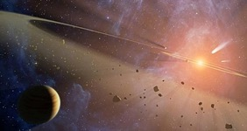

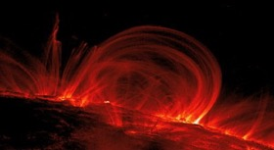
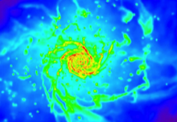
Headline Science with SKA1 and SKA2

Slide 5
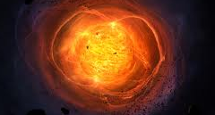

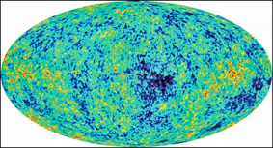

Headline Science with SKA1 and SKA2

Slide 6
Sensitivity Comparison

Slide 7
Survey Speed Comparison

Slide 8
Resolution Comparison

Slide 9
Image Quality Comparison
Single SKA1-Mid snap-shot compared to combination of snap-shots in each of VLA A+B+C+D

Slide 10
Image Quality Comparison
Single SKA1-Low snap-shot compared to LOFAR-INTL snap-shot

Slide 11
SKA Board Meeting, Nov. 2016
In order to ensure the delivery of SKA1 against the defined cost cap of Euros 674M (2016 Euros), the SKA Board directed the SKA Office to undertake a review of the existing design and to explore and capitalise on a range of cost-saving measures. This includes drawing on cost reduction options already identified and further exploiting potential cost-saving and risk-reduction technology developments and solutions provided by SKA precursor and pathfinder facilities. The work will be done under the guidance of a Board Subcommittee comprising all SKA Board Science Directors, with the objectives of preserving the transformational science capabilities of SKA1, minimising impact on the project schedule, and allowing expansion of the telescopes as additional funding becomes available. The SKA Office will present preliminary recommendations to the March 2017 Board meeting of SKA Organisation.

Slide 12
Cost Control Plan
Sequence of reinstatable (via extra funding) measures to achieve construction Cost Cap
Ordering of measures (top to bottom) is attempt to reflect science impact – needs SWG review / update (now underway!)
Some line items represent “competing” options for which a future down-select would occur based on complete technical assessment

Slide 14
Cost Cap is reached at the heavy line

Slide 15
Science Assessment
No significant impact. There are a variety of measures that appear to be genuine savings that have essentially no negative impact on the science capabilities.
Increased observing time. Some measures result in a quantifiable increase in the amount of net observing time required to meet an objective, but do not otherwise impede its achievement.
High risk. Some options modify an essential aspect of the system that puts one or more objectives at high risk of failure. While still possible in principle, there is a significantly reduced confidence in achieving success.
Lost capability. Finally, there are options that make particular objectives essentially impossible to achieve.

Slide 16
How has preliminary order been determined?
Minimise negative science impact, using the “High Priority Science Objectives” as indicative measure
  Wide review and endorsement of the HPSOs
Maximise straightforward re-instatement potential given additional funding
  Recognise the anticipated refresh cycle for High Performance Computing and Pulsar Search hardware of 3 – 5 years
  Recognise that centrally located resources (like the correlator) are more easily upgraded than some distributed resources, particularly with modular design
  Additional feeds (given mature design) are easier to deploy than new dishes
  Major infrastructure re-instatement work is both costly and disruptive

Slide 17
SKA Science Assessment Teams
Impact on EoR/CD of changes to SKA1-Low maximum baseline length
  Emma Chapman (ICL, Chair), Sarod Yatawatta (ASTRON), Gianni Bernardi (SKA-SA), George Heald (CSIRO), Jeff Wagg (SKAO Support)
Required timing accuracy to enable successful precision pulsar timing science
  Andrea Possenti (INAF, Chair), Ingrid Stairs (UBC), Ben Stappers (UMan), Scott Ransom (NRAO), Willem van Straten (AUT), Evan Keane (SKAO Support)
Impact of SKA-Low antenna optimised frequency coverage
  Chiara Ferrari (ObsCoAz, Chair), Leon Koopmans (UGroningen), James Aguirre (UPenn), Annalisa Bonafede (INAF), Jason Hessels (UAmsterdam), Divya Oberoi (NCRA), Philippe Zarka (ObsPM), Francesco de Gasperin (ULeiden), Anna Bonaldi (SKAO Support)

Slide 18
SKA Science Working Groups and Focus Groups
SWGs and FGs | Co-Chairs
Extragalactic (non-HI) Spectral Line | Rob Beswick, Francoise Combes
Our Galaxy | Mark Thompson, Grazia Umana
Solar, Heliospheric & Ionospheric Physics | Eduard Kontar, Divya Oberoi
Epoch of Reionization | Jonathan Pritchard, Garrelt Mellema
Cosmology | Mario Santos, Xuelei Chen
Extragalactic Continuum | Rosella Cassano, Minh Huynh
Cradle of Life | Andrew Siemion, Di Li
HI galaxy science | Erwin de Blok, Martin Meyer
Magnetism | Ann Mao, Russ Taylor
Pulsars | Andrea Possenti, Ingrid Stairs
Transients | Michael Rupen, Jean-Pierre Macquart
VLBI | Zsolt Paragi, Cormac Reynolds
High Energy Cosmic Particles | Justin Bray
Refresh of SWG Co-Chairs every two years, about half reaching term, nominations invited

Slide 19
SKA Science Town Hall Meeting
Preliminary reports from the three Science Assessment Teams
Preliminary Science Assessments from each SWG / FG which:
  Endorse or suggest reordering of items in the cost savings measures list
  Affirm or not the transformational science capability of the cost-capped observatory
Programme for Town Hall
  Reps provided by each SAT, SWG/FG based on availability (challenging given timeline; 8 weeks between 1st announcement and meeting)
  Disappointing lack of balance for both gender and nationality – not representative of SAT, SWG/FG or community more generally!
Q&A opportunities after each talk and in the four Q&A sessions
Wrap-up discussion: areas of consensus and contention
Next steps:
  If contentious issues arise, may ask Science Review Panel to advise
  Science & Engineering Advisory Committee review (23 June)
  Recommendation to SKA Board (19&20 July)

