Slide 1
SKA1-LOW maximum baseline
Progress report on Bmax Science Assessment Panel
George Heald
On behalf of the Bmax Team
18 May 2017
Csiro Astronomy and space science

Slide 2
Team composition
Members Emma Chapman (chair), Gianni Bernardi, George Heald, Bart Pindor, Sarod Yatawatta, Jeff Wagg (SKAO contact)
Contributions from Vibor Jelic, Jack Line, Cath Trott, Daniel Mitchell
Notes:
Here are some polarization results from MWA, highlighting the large field of view and excellent sensitivity to diffuse emission.
All images (and the text) courtesy of Emil Lenc. (I grabbed from one of the presentations that he has online, and used two other images that he recently provided to me for another purpose.)

Slide 3
Context
Reduction of LOW Bmax has been proposed as a possible cost control option (5.30.0, 5.30a)
The three Bmax reduction scenarios have been designated as “High Risk” to EoR science Some options modify an essential aspect of the system that puts one or more objectives at high risk of failure. While still possible in principle, there is a significantly reduced confidence in achieving success.
The purpose of this assessment is to quantify the risk to EoR science
Potentially more than just angular resolution loss in images
Further impacts expected in ionospheric calibration and foreground removal
Can EoR science satisfying the Level 0 requirements be performed with any of the three proposed Bmax scenarios?
Notes:
Here are some polarization results from MWA, highlighting the large field of view and excellent sensitivity to diffuse emission.
All images (and the text) courtesy of Emil Lenc. (I grabbed from one of the presentations that he has online, and used two other images that he recently provided to me for another purpose.)

Slide 4
Questions from SKAO (Terms of Reference)
Establish the range in baseline lengths that are required for accurate EoR/CD foreground modelling and subtraction. While both diffuse and compact foregrounds should be considered, it is of particular importance to quantify the implications of the maximum baseline out to which good visibility sampling is achieved.
Verify (or otherwise) that the current level 0 requirements on brightness dynamic range (SCI_REQ-18) are appropriate and assess how the achieved maximum baseline length would impact meeting this requirement.
Updates: […] document any new insights or experience pertaining to the impact of the maximum achieved baseline length on EoR/CD power spectra analysis and in particular on the prospects for tomographic imaging.
Any other matters […] that the team feel should be addressed, or […] Level 1 requirements that may currently be incomplete or missing.
Notes:
Here are some polarization results from MWA, highlighting the large field of view and excellent sensitivity to diffuse emission.
All images (and the text) courtesy of Emil Lenc. (I grabbed from one of the presentations that he has online, and used two other images that he recently provided to me for another purpose.)

Slide 5
Outline of progress report
State of the field
Ionosphere
Dynamic range
Calibration
Foreground mitigation
Effect of Bmax on calibration
Models for true sky and telescope (configuration)
Visibility generation and calibration
Bonus: extended sources
Effect of Bmax on foreground mitigation
Initial outcomes
Uncertainties
Notes:
Here are some polarization results from MWA, highlighting the large field of view and excellent sensitivity to diffuse emission.
All images (and the text) courtesy of Emil Lenc. (I grabbed from one of the presentations that he has online, and used two other images that he recently provided to me for another purpose.)

Slide 6
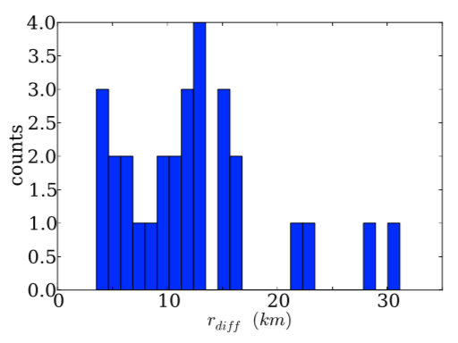
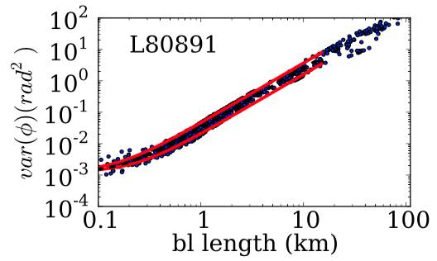
Ionosphere
Two regimes
Central region of core (<=1.5km) or smaller for EoR tomography/power spectrum
Ionospheric behaviour varies, but diffractive scales vary from 5-20 km
Mevius et al (2016)
Notes:
Here are some polarization results from MWA, highlighting the large field of view and excellent sensitivity to diffuse emission.
All images (and the text) courtesy of Emil Lenc. (I grabbed from one of the presentations that he has online, and used two other images that he recently provided to me for another purpose.)

Slide 7
Dynamic range
SCI_REQ-18: SKA1-LOW shall provide 50 dB brightness dynamic range at 300 arcsec spatial and 1 MHz spectral resolution to enable EoR imaging and power spectra generation at 50 – 200 MHz.
Dynamic range limit expected to be dominated by source subtraction errors
Driven by partially resolving sources to be subtracted
Source model errors reduce with the inverse square of the max BL
To first order, expect increase in such errors by 70-164% by decreasing maximum BL from 65 to 50 or 40 km.
Notes:
Here are some polarization results from MWA, highlighting the large field of view and excellent sensitivity to diffuse emission.
All images (and the text) courtesy of Emil Lenc. (I grabbed from one of the presentations that he has online, and used two other images that he recently provided to me for another purpose.)

Slide 8
Calibration
Proper direction dependent calibration required to correct ionospheric errors and subtract bright foreground sources
Two regimes in the current telescopes (long-short baselines)
LOFAR: direction dependent Jones matrix; GMRT: phase screens
SAGECAL (Kazemi et al 2011)
FACTOR (van Weeren etal 2016)
SPAM (Intema)
MWA: all stations have similar LoS through ionosphere
RTS (Mitchell et al 2008): common directional gains
FHD (Sullivan et al 2012)
Notes:
Here are some polarization results from MWA, highlighting the large field of view and excellent sensitivity to diffuse emission.
All images (and the text) courtesy of Emil Lenc. (I grabbed from one of the presentations that he has online, and used two other images that he recently provided to me for another purpose.)

Slide 9
(Diffuse) foreground mitigation
Patil et al (2016) show that incomplete sky model can result in SAGECAL characterising diffuse emission erroneously as compact source radiation: “foreground suppression”
Removal of foregrounds via GMCA or FastICA automatically remove diffuse foregrounds, relying on frequency coherence
If done correctly, provides access to proper statistics on all k-scales
Foreground suppression can affect the accuracy of the diffuse foreground model and thus bias the recovered cosmological signal
Notes:
Here are some polarization results from MWA, highlighting the large field of view and excellent sensitivity to diffuse emission.
All images (and the text) courtesy of Emil Lenc. (I grabbed from one of the presentations that he has online, and used two other images that he recently provided to me for another purpose.)

Slide 10
Effect of Bmax reduction
Calibration
Foreground mitigation

Slide 11
Testing effect of Bmax on calibration
Test planned using a “true” sky model simulated with OSKAR
Telescope model (described on next slide)
Sky populated with various contributions, described subsequently
Compact source model
Diffuse foregrounds
Cosmological signal
Instrumental noise
SAGECAL will be used to calibrate and subtract the compact sources, before further processing
Notes:
Here are some polarization results from MWA, highlighting the large field of view and excellent sensitivity to diffuse emission.
All images (and the text) courtesy of Emil Lenc. (I grabbed from one of the presentations that he has online, and used two other images that he recently provided to me for another purpose.)

Slide 12
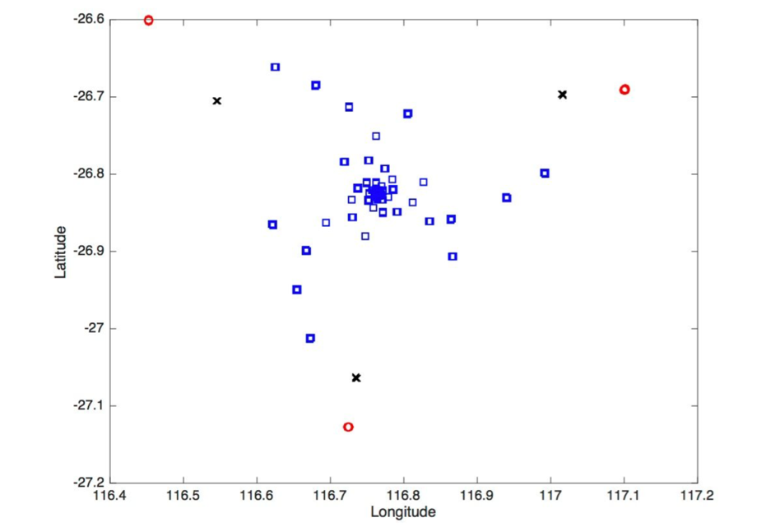
Bmax calibration test: telescope model
S0: current SKA telescope design, stations up to 65 km baseline
S1: Reduce Bmax LOW to 50 km: remove 18 stations (3M Euros)*
S2: Reduce Bmax LOW to 40 km: remove 36 stations (9.6M Euros)
* Not considered: relocation of stations to core
Notes:
Here are some polarization results from MWA, highlighting the large field of view and excellent sensitivity to diffuse emission.
All images (and the text) courtesy of Emil Lenc. (I grabbed from one of the presentations that he has online, and used two other images that he recently provided to me for another purpose.)

Slide 13
Bmax calibration test: compact model
Crucial for the model to contain at least some structure on scales relevant for this test (i.e. on baselines up to 65 km length; ~6” at 150 MHz)
Also important: correct dN/dS over relevant range of flux density
Several methods were suggested, based on combinations of available surveys
GLEAM, NVSS, TGSS, MSSS/LoTSS(DI)
Deep LOFAR imaging? EoR, H-ATLAS, LoTSS(DD), …
Wide area coverage provided by synthesis of FIRST (5”) and VLSSr
Combo achieved with PUMA (Line et al 2017)
To be supplemented with underlying (artificial) faint source population from model by Vibor Jelic
Notes:
Here are some polarization results from MWA, highlighting the large field of view and excellent sensitivity to diffuse emission.
All images (and the text) courtesy of Emil Lenc. (I grabbed from one of the presentations that he has online, and used two other images that he recently provided to me for another purpose.)

Slide 14
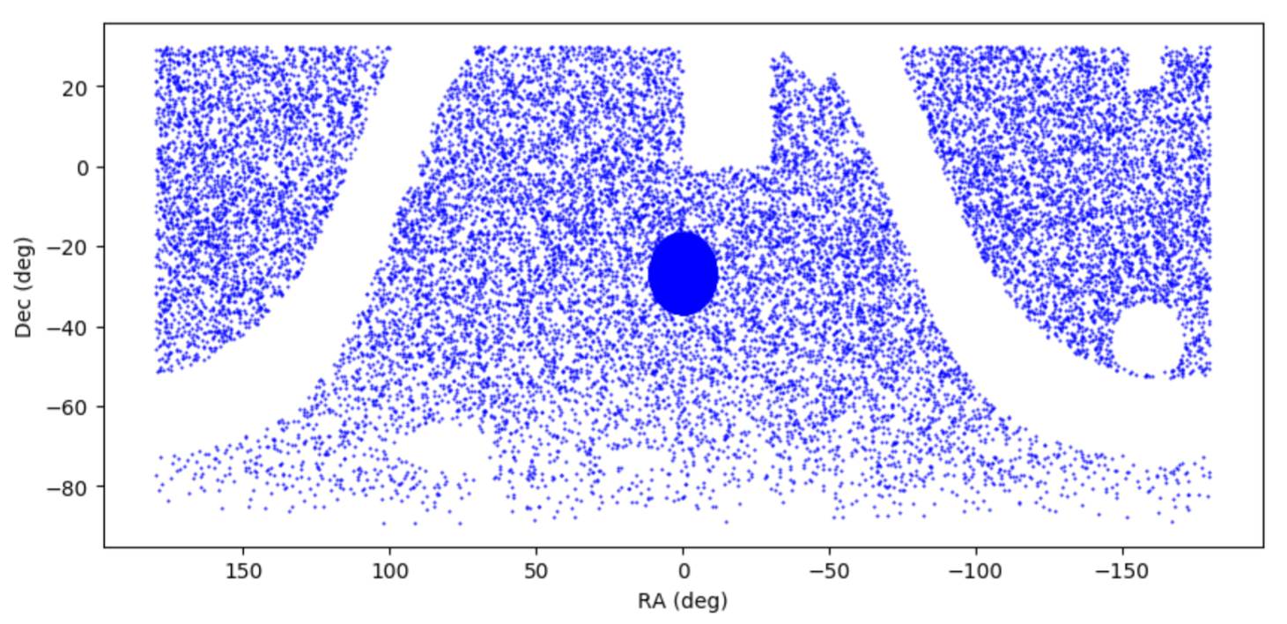
Bmax calibration test: compact model
Notes:
Here are some polarization results from MWA, highlighting the large field of view and excellent sensitivity to diffuse emission.
All images (and the text) courtesy of Emil Lenc. (I grabbed from one of the presentations that he has online, and used two other images that he recently provided to me for another purpose.)

Slide 15
Bmax calibration test: diffuse + cosmology
The compact source model will be supplemented by diffuse foregrounds using the methodology of Jelic et al (2008)
Cosmological signal will be added using 21cmFAST (Mesinger et al 2011)
All of this to be simulated in the context of the telescope models, and supplemented with noise, with OSKAR: http://www.oerc.ox.ac.uk/~ska/oskar2/
Notes:
Here are some polarization results from MWA, highlighting the large field of view and excellent sensitivity to diffuse emission.
All images (and the text) courtesy of Emil Lenc. (I grabbed from one of the presentations that he has online, and used two other images that he recently provided to me for another purpose.)

Slide 16
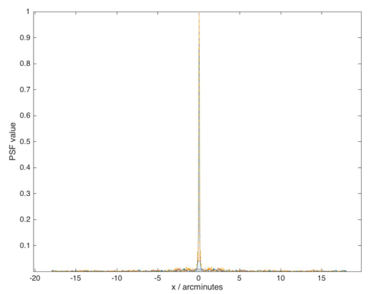
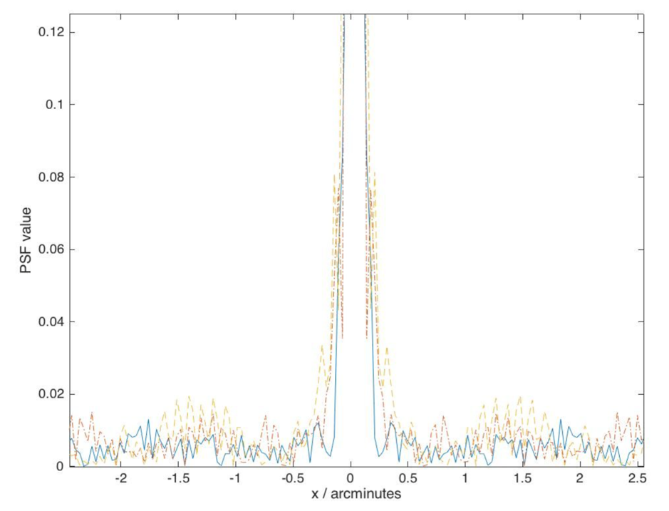
Bmax calibration test: telescope PSFs
OSKAR already used to investigate the PSF for each S0,S1,S2
S0 (blue, solid)
S1 (red, dot-dashed)
S2 (yellow, dash)
Imaging in CASA, uniform weighting
12hr track, 183 kHz bandwidth
Notes:
Here are some polarization results from MWA, highlighting the large field of view and excellent sensitivity to diffuse emission.
All images (and the text) courtesy of Emil Lenc. (I grabbed from one of the presentations that he has online, and used two other images that he recently provided to me for another purpose.)

Slide 17
Bmax calibration test: signal recovery
Given the simulated visibilities (in CASA MS format), the following steps will be followed:
Calibrate and subtract compact sources using SAGECAL
Wide bandwidth and consensus optimisation for smooth solutions
Subtract foregrounds with FastICA, in a blind manner taking advantage of expected smoothness
Assessment:
plot a recovered cosmological signal power spectrum
plot a 2D cylindrical power spectrum in order to assess the impact on foreground avoidance methods which aim to simply avoid k-scales contaminated by foregrounds
assess the effect of reducing maximum baseline on dynamic range
Notes:
Here are some polarization results from MWA, highlighting the large field of view and excellent sensitivity to diffuse emission.
All images (and the text) courtesy of Emil Lenc. (I grabbed from one of the presentations that he has online, and used two other images that he recently provided to me for another purpose.)

Slide 18
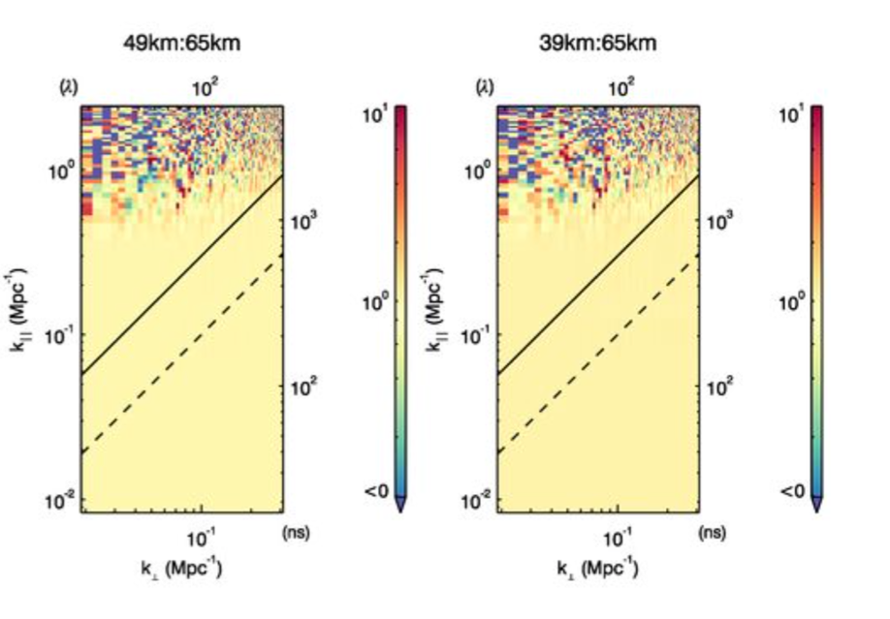
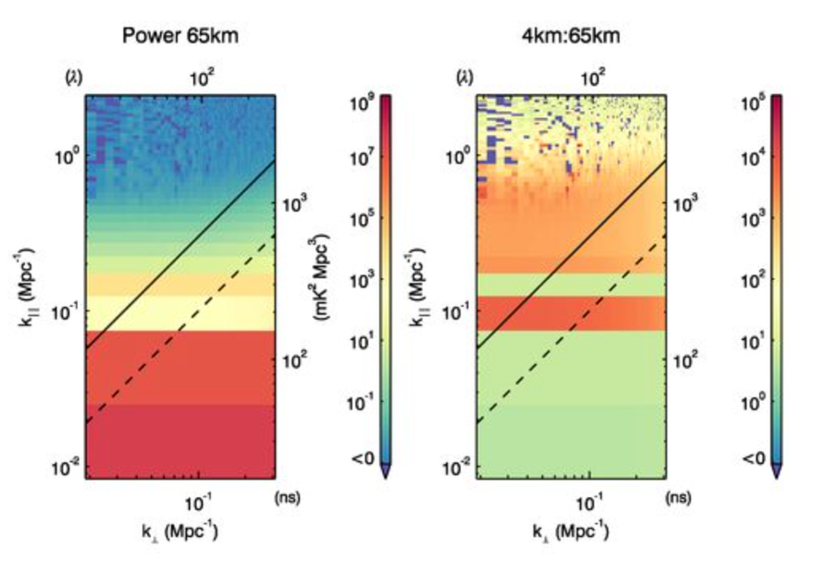
Bmax: analysis of single extended sources
Simulation of complicated extended source (multiscale Gaussian components); sky model also includes extragalactic poplulation
Trott & Wayth, in prep
Notes:
Here are some polarization results from MWA, highlighting the large field of view and excellent sensitivity to diffuse emission.
All images (and the text) courtesy of Emil Lenc. (I grabbed from one of the presentations that he has online, and used two other images that he recently provided to me for another purpose.)

Slide 19
Progress status
Initial conclusions
Uncertainties

Slide 20
Conclusions so far
Over the short baselines that will be used for the power spectrum (and tomographic) analysis, ionospheric effects are not expected to be problematic
On longer baselines, two effects will pose an issue
Quality of compact source model
Ionospheric effects dominating calibration errors and source subtraction
We have drawn together the necessary resources to study and quantify these effects, and provide the data needed to develop a recommendation for Bmax plans in the context of EoR science
Notes:
Here are some polarization results from MWA, highlighting the large field of view and excellent sensitivity to diffuse emission.
All images (and the text) courtesy of Emil Lenc. (I grabbed from one of the presentations that he has online, and used two other images that he recently provided to me for another purpose.)

Slide 21
Uncertainties
Not everything is perfectly clear. Among the questions that remain outstanding at this early stage of our test process
Is the 5” model of “real” compact/extended sources sufficient to provide a stringent test of the errors that may result from losing the outermost stations?
How deep does the model have to go (and over how wide an area) to exclude errors induced by reducing Bmax?
Notes:
Here are some polarization results from MWA, highlighting the large field of view and excellent sensitivity to diffuse emission.
All images (and the text) courtesy of Emil Lenc. (I grabbed from one of the presentations that he has online, and used two other images that he recently provided to me for another purpose.)

Slide 22
Thank you
CSIRO Astronomy & Space Science
George Heald
t +61 8 6436 8758
e george.heald@csiro.au
w www.csiro.au
Astronomy and space science

