Slide 1
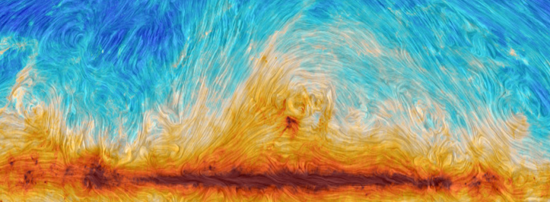
Cosmic Magnetism
Impact of cost control options, and SWG update
George Heald
On behalf of the Cosmic Magnetism Science Working Group (chairs: Ann Mao & Russ Taylor)
19 May 2017
Csiro Astronomy and space science

Slide 2
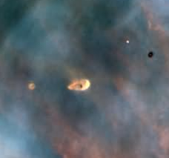
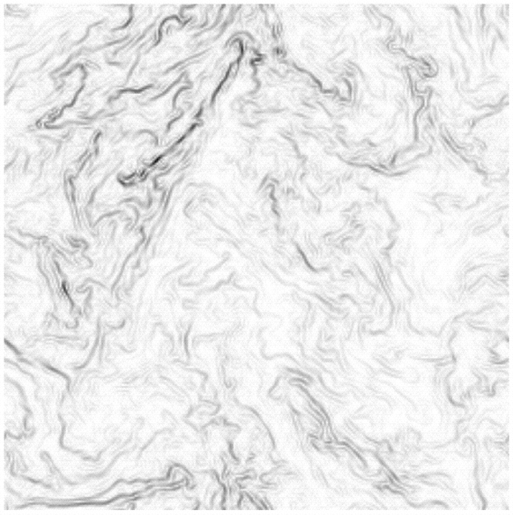
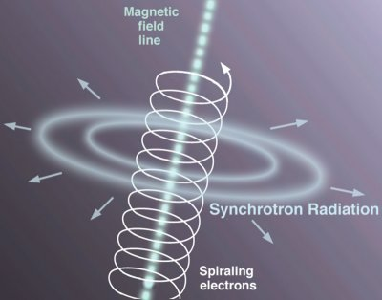
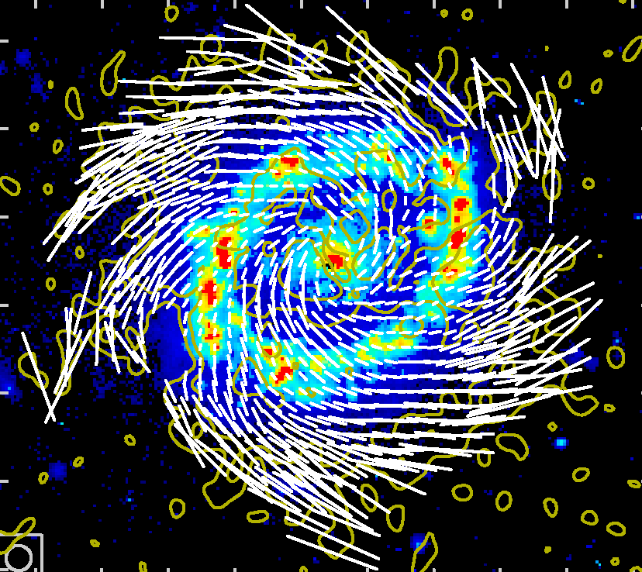
Cosmic Magnetism
Magnetism is central to astrophysics on all scales
  Stellar evolution
    pulsars and collapsed stellar objects
    Jovian planets
    cloud collapse & star formation
    stellar activity & outflows
  Galaxy evolution
    ISM turbulence and energy transport
    stability of galactic disks
    acceleration, propagation & confinement of cosmic rays
  Inter-Galactic phenomena
    energy transport in galaxy cluster media
    AGN and IGM feedback

Slide 3
CM Key Science Projects
Origin and Evolution of Magnetic Fields in Large Scale Structures
(Mpc scales)
  The Magnetic Field in clusters, filaments and their evolution
  Magnetic cosmic web
  Probing the Nature of Dark Matter and Fundamental Physics
2. Origin and Evolution of Magnetic fields in Galaxies
(kpc, <kpc scales)
  Emergence and evolution of magnetic fields in galaxies from absorption and emission experiments
  Broad-band polarimetry as a probe of AGN Physics at all redshifts and luminosities
  Magnetic Fields in Nearby Galaxies
  Multi-scale magnetism in the Milky Way
Magnetic Fields and stellar evolution (stellar scales)
  Role of magnetic fields in star formation, stellar evolution, exoplanets
Notes:
2 KSP, # of subprojects, and they require different KSO
Only listed # of topics,
NOT JUSt produce MAPs, but answering really key questions
Driven by Science Question
Is there a magnetic counterpart to the large-scale structure of the universe, and its evolution as a function of z?
Role of magnetic fielsd in galaxy cluster formation and evolution?
2. How do magnetic fields emerge and grow in galaxies and what is their roles in galaxy formation and evolution
Field amplifcation and feedback processes in galaxies and their evolution in Galactic ecosystem
1.1 How magnetic is the cosmic web and how does it evolve
1.2 how is magnetic field distributed
1.3 how do B fields inform us about dark matter properties
2. Field amplification and feedback processes in galaxies?
Need to know the science driver for each one of these quesitons
----- Meeting Notes (11/10/16 07:19) -----
FARNES:
Filaments - depolarize background sources vs voids
Each project - turning that into a key observation plan.
Science talk about science
Set up page names for contribution short synposis

Slide 4
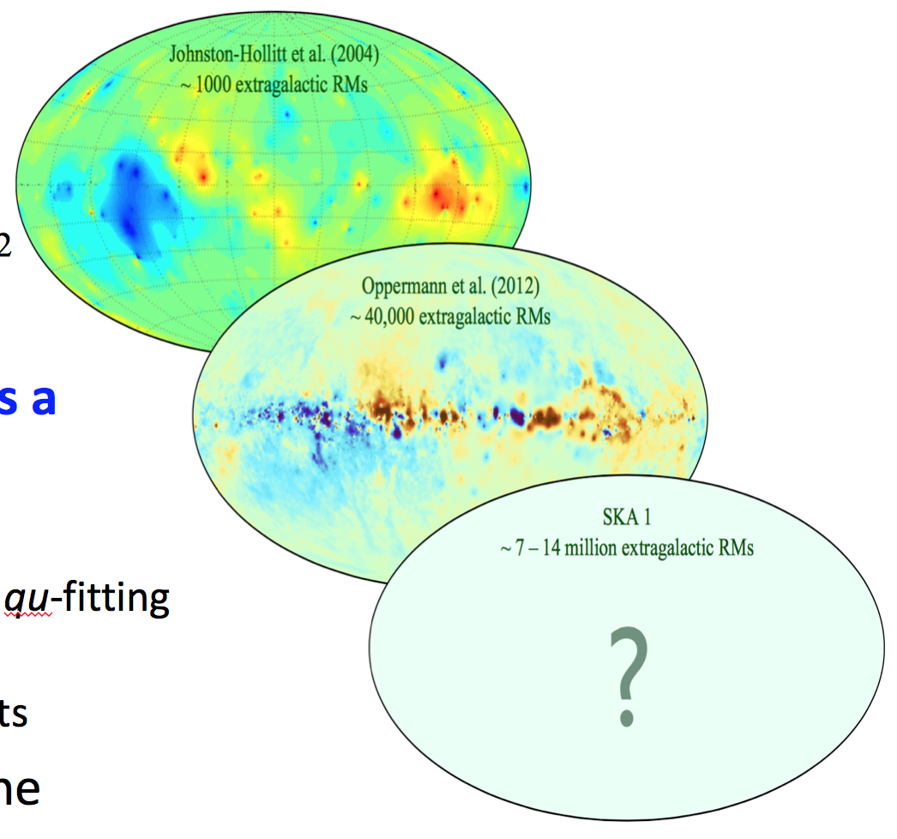
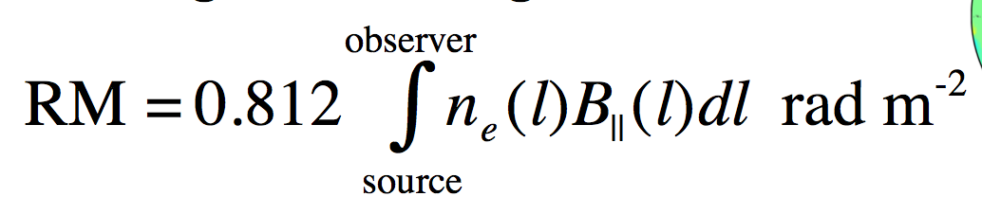
HPSO: SKA1-MID Band 2 RM Grid
Pol. Synchrotron emission
RM Grid: Faraday rotation of
background extragal sources
Broadband radio polarimetry opens a
brand new window:
  Implementation of new algorithms
  Complementary use of RM Synthesis & qu-fitting
  Characterise B fields, density and
  turbulence in a range of different objects
19 magnetism science chapters in the
SKA science book

Slide 5
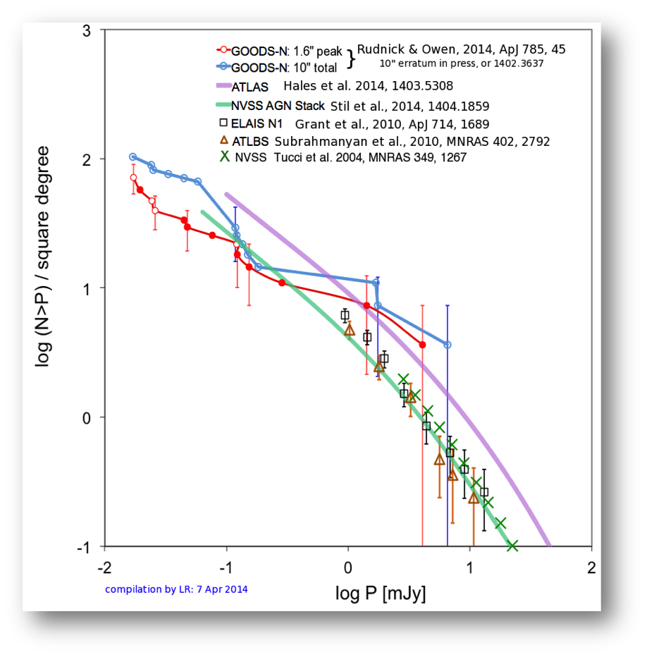
HPSO: SKA1-MID Band 2 RM Grid
Nominal characteristics:
  Band 2, 950-1760 MHz
  rms 4 µJy/beam
  resolution 2”
  goal: 7-14 million RMs
    Either from SDP,
    or post-processing
Courtesy L. Rudnick

Slide 6
Take-home points for magnetism
RM Grid – our HPSO
  Band 2 largely unaffected in current planning, so major impact not anticipated
  But, do cumulative reductions in sensitivity impinge on transformational impact?
  Loss in bandwidth means more than merely sensitivity (RM uncertainties)
LOW
  Both frequency coverage and Bmax important, particularly in combination
MID
  Importance of Band 5 for supplementary science
  NB: impacts on pulsar science are also key for magnetism science capability
  (pulsars are highly effective probes of the ISM)
SDP
  Commensality is key for magnetism observations!

Slide 7
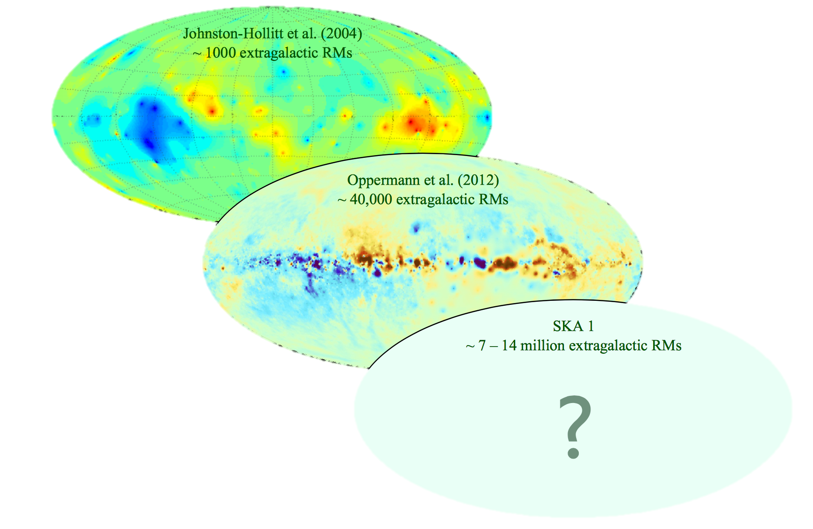
Stockholm KS Observation Matrix
Need science-driven detailed specifications
Complementarity with KSOs for other KSPs

Slide 8
Science project index & overview
 |  | Goal | RMGrid2 | Extras | Time | Area
KSP 1 | 1 | The magnetic field in clusters and filaments | Yes | LOW+1 | 2000 | 30k(+)
 | 2 | Probing the nature of Dark Matter | Yes | Targeted | 3000 | 10
 | 3 | The magnetic cosmic web | Yes | Deep 1,2 | 1000 | 100
KSP 2 | 4 | LoS probes of evolution of cosmic magnetism | Yes | Band 3?
 | 5 | Emergence and evolution of the magnetic fields in galaxy disks (and halos) | No | Deep 2 | 4300 | 10
 | 6 | Broad‐band pol probing AGN/Galaxy physics | Yes | Max λ² | 5000 | 30k
 | 7 | Magnetic fields in AGN at all z and luminosities | Yes | VLBI
 | 8 | Emergence of magnetic fields in the Universe | Yes | LOW+1 | 2-4k | 30k
 | 9 | Magnetic fields in nearby galaxies | Yes | Deep 2,5 | 4-6k | 25-30
 | 10 | Magnetic fields in the heart of the Milky Way | Yes | Deep 1,2,5 | 3000 | 4k
 | 11 | Multi‐scale magnetism in the Milky Way | Yes | Deep 1 |  | 30k
KSP 3 | 12 | Role of magnetic fields in stellar evolution
Notes:
Here are some polarization results from MWA, highlighting the large field of view and excellent sensitivity to diffuse emission.
All images (and the text) courtesy of Emil Lenc. (I grabbed from one of the presentations that he has online, and used two other images that he recently provided to me for another purpose.)

Slide 9
Cost control options: LOW
5.31: Reduce bandwidth 300->200 MHz
Substantial reduction in λ² coverage
Large impact for science projects 1, 8 (clusters, emergence of magnetism)
2: Dipole design (log periodic vs dipole)
primary impact through effect on available/sensitive bandpass
5.30.0: Bmax reduction to 50 or 40 km
Reduced resolution is more critical for LOW than for MID
Impacts particularly cluster/filament science (project 1)
particular impact if combined with reduced bandwidth option
5.30: Remove 54 or 108 stations from core
Lose 20-40% of surface brightness sensitivity
Particular impact for 1 (cluster/filaments), also 8 (emergence)

Slide 10
LOW: bandwidth above 250 MHz
Improved resolution may critically combat beam depolarisation for resolved sources, but this has not been quantified
Lower λ² (higher frequency) may be critical for recovering polarized source population (in cases affected by a frequency-dependent depolarization mechanism)
Expected rise in source count statistics from 250-350 MHz; charting this transition is new and illuminating science!
Particularly bad to restrict to <=250 MHz if outer stations are lost – we would strongly disfavour that combination of options

Slide 11
Cost control options: MID
5.24.1-3: reduction of Bmax from 150 to 120 km
  Nominal resolution reduced by 20%,
  and perhaps more importantly an effective loss of sensitivity
  Resolution directly impacts 6 individual projects targeting single objects
5.13.2/5.35: Band 5 bandwidth reduced to 2.5 or 1.4 GHz
  large reduction in λ² coverage
  impact projects 9,10 (galaxies, Milky Way); huge increase in survey time
5.5.2: Band 5 only in spiral arms, not in core
  Loss of surface brightness sensitivity
  Strong impact on 9,10 (critical question is whether SKA1 remains transformational cf JVLA)
5.24: Remove 11 or 22 dishes from core area
  decrease core sensitivity by 10-20%
  Impacts every project that probes extended emission; esp. MW, MC, CenA, NG
5.5.1,2: remove all band 1 or 5
  Eliminates all science requiring those frequency ranges (clusters/fil., emergence, galaxies)

Slide 12
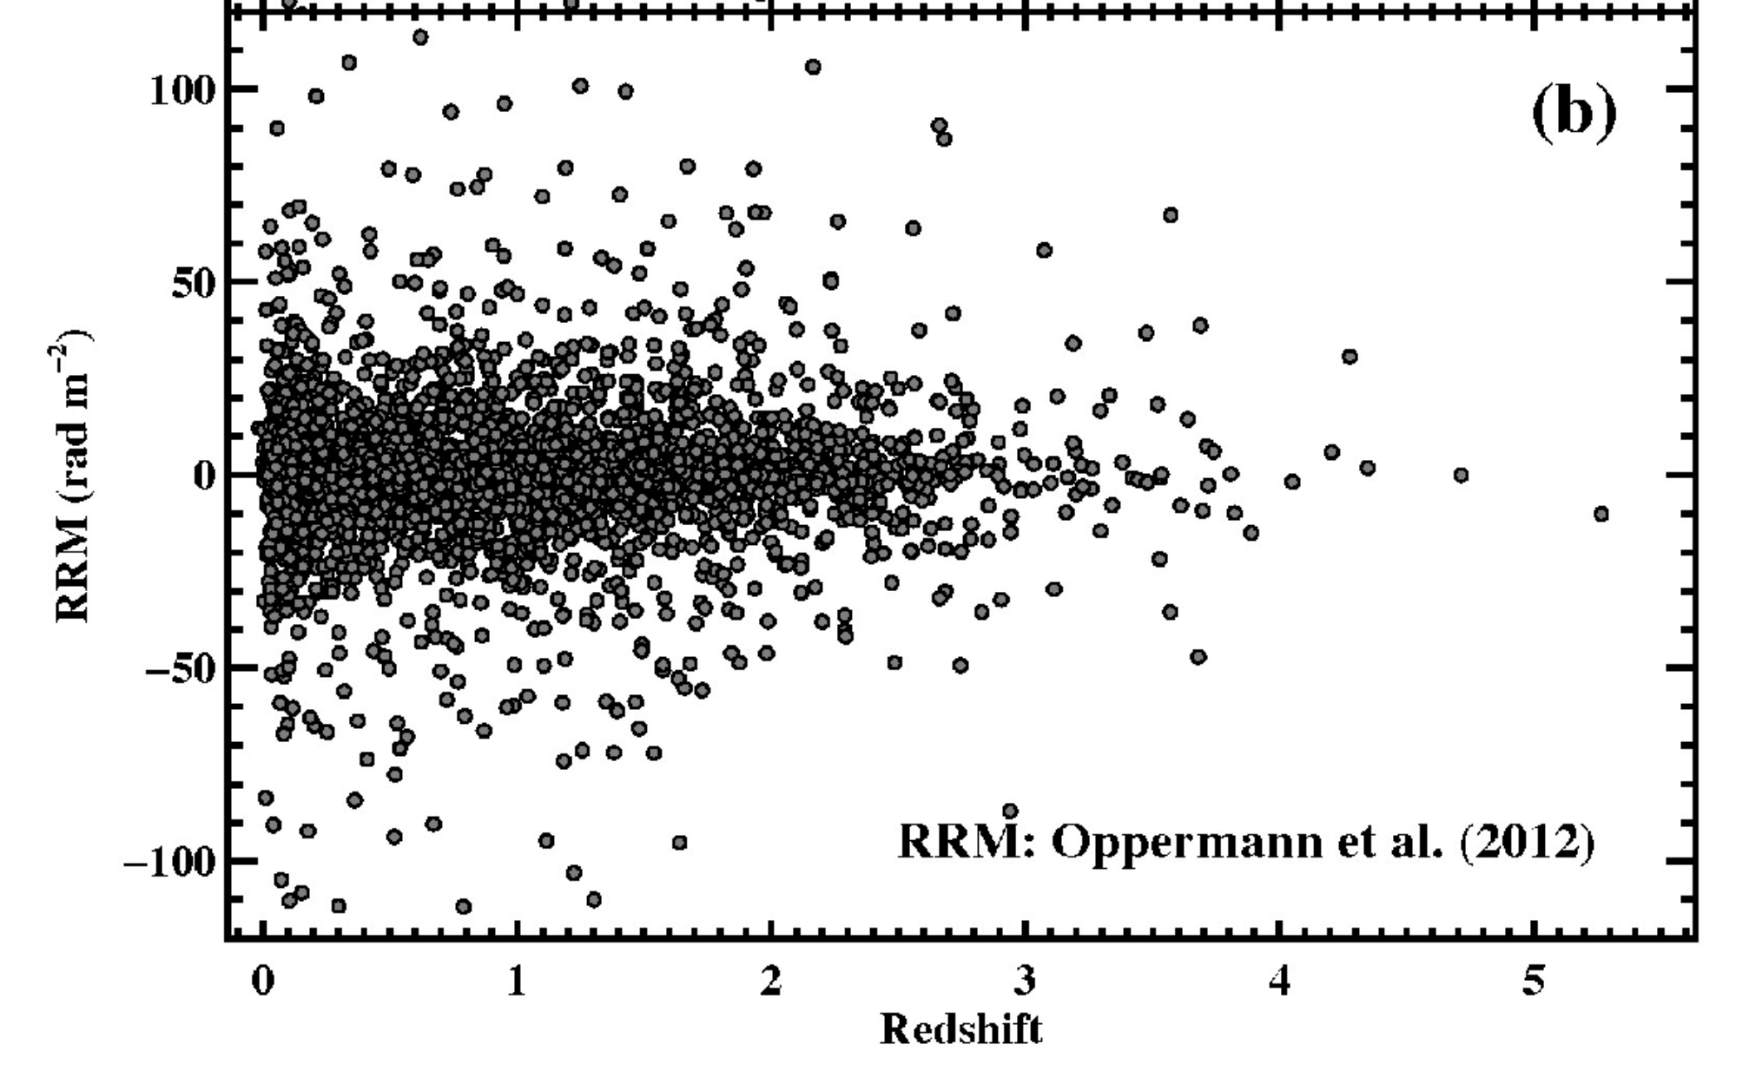
MID: impact of bandpass & reductions
Generally, magnetism calls for large λ² coverage (for improved RM precision)
Shifting to higher portion of Band 2 (by 250 MHz, to combat confusion) results in RM error degrading from 2.8 to 4.9 rad/m²
    Loss of ability to detect and probe weak magnetic fields (e.g. nG for filaments)
    Removal of foreground RMs is also impacted! (twofold impact on RM errors)
    If systematic uncertainties have to be
    compensated by averaging over
    many sources, then we lose RM Grid
    information at small angular separation
    (lose probes of small scale physical
    structure in nearby objects,
    and distant sources)
Hammond+ (2012)

Slide 13
Commensality: SDP and other effects
SDP-HPC capability to enable multi-purpose data processing
  Strong desire to retain ability to accommodate polarisation work on top of “main” purpose
  Anticipate the ability to perform post-processing in regional centres
8: Deploy 200, 150, 100, 50 Pflops
  Worry in the SWG that observations intended to be pursued commensally will be more strongly impacted
Commensality anticipated with HI – e.g. nearby galaxies, as well as continuum surveys, for example.
  Related: how to manage jointly agreed selection of central frequency, in the light of potentially competing interests regarding confusion/localisation (total intensity) vs RM precision (polarization)?

Slide 14
Impact table
= moderate impact
= strong impact
 |  | Goal | LOW BW | LOW Bmax | LOW core | MID Bmax | MID 5BW | MID 5core | MID core | MID B15 | SDP
KSP 1 | 1 | The magnetic field in clusters and filaments
 | 2 | Probing the nature of Dark Matter
 | 3 | The magnetic cosmic web
KSP 2 | 4 | LoS probes of evolution of cosmic magnetism
 | 5 | Emergence and evolution of the magnetic fields in galaxy disks (and halos)
 | 6 | Broad‐band pol probing AGN/Galaxy physics
 | 7 | Magnetic fields in AGN at all z and luminosities
 | 8 | Emergence of magnetic fields in the Universe
 | 9 | Magnetic fields in nearby galaxies
 | 10 | Magnetic fields in the heart of the Milky Way
 | 11 | Multi‐scale magnetism in the Milky Way
KSP 3 | 12 | Role of magnetic fields in stellar evolution
Notes:
Here are some polarization results from MWA, highlighting the large field of view and excellent sensitivity to diffuse emission.
All images (and the text) courtesy of Emil Lenc. (I grabbed from one of the presentations that he has online, and used two other images that he recently provided to me for another purpose.)

Slide 15
Take-home points for magnetism
RM Grid – our HPSO
  Band 2 largely unaffected in current planning, so major impact not anticipated
  But, do cumulative reductions in sensitivity impinge on transformational impact?
  Loss in bandwidth means more than merely sensitivity (RM uncertainties)
LOW
  Both frequency coverage and Bmax important, particularly in combination
MID
  Importance of Band 5 for supplementary science
  NB: impacts on pulsar science are also key for magnetism science capability
  (pulsars are highly effective probes of the ISM)
SDP
  Commensality is key for magnetism observations!

Slide 16

Cosmic Magnetism SWG Workshop
Perth, ARRC building – July 17-21 2017
Attached to SKA Pathfinder Continuum Surveys (SPARCS) meeting
SPARCS VII: The Pathfinders Awaken
http://www.icrar.org/conferences/sparcs7/
Abstract deadline: May 12
Registration deadline: May 30

Slide 17
SWG update
  Progress with
  pathfinder/precursor
  projects

Slide 18
Precursor and Pathfinder Survey Projects
  LOFAR – polarization
  MWA - polarization
  ASKAP – POSSUM
  MeerKAT – MIGHTEE
  JVLA – VLASS
  Technical and Scientific pathfinders to SKA1 CM KSPs
  Calibration and imaging challenges
  data plans, algorithms and processing
  Scientific discovery
SKA-LOW
SKA-MID
Notes:
2 KSP, # of subprojects, and they require different KSO
Only listed # of topics,
NOT JUSt produce MAPs, but answering really key questions
Driven by Science Question
Is there a magnetic counterpart to the large-scale structure of the universe, and its evolution as a function of z?
Role of magnetic fielsd in galaxy cluster formation and evolution?
2. How do magnetic fields emerge and grow in galaxies and what is their roles in galaxy formation and evolution
Field amplifcation and feedback processes in galaxies and their evolution in Galactic ecosystem
1.1 How magnetic is the cosmic web and how does it evolve
1.2 how is magnetic field distributed
1.3 how do B fields inform us about dark matter properties
2. Field amplification and feedback processes in galaxies?
Need to know the science driver for each one of these quesitons
----- Meeting Notes (11/10/16 07:19) -----
FARNES:
Filaments - depolarize background sources vs voids
Each project - turning that into a key observation plan.
Science talk about science
Set up page names for contribution short synposis

Slide 19
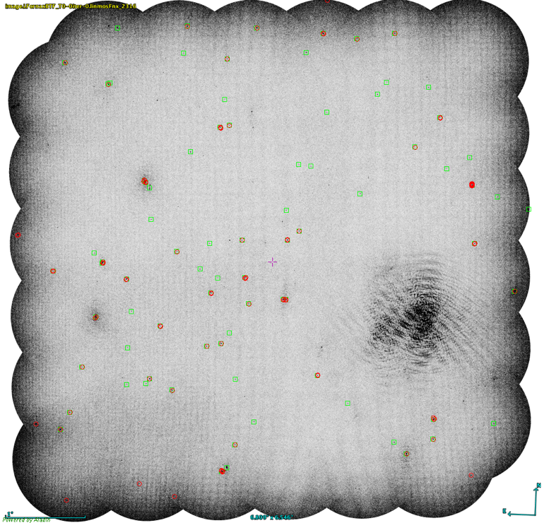
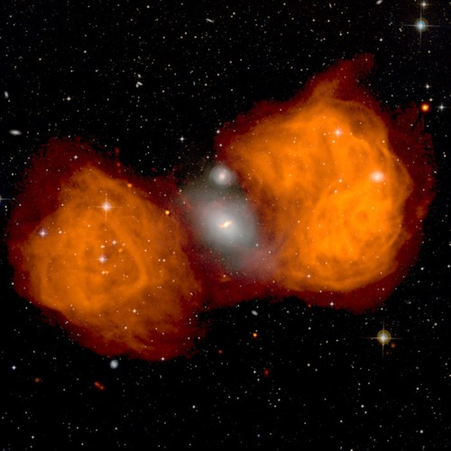
ASKAP: Next step to the “all sky” RM Grid
More-or-less
routine imaging
w/ 36 beams now
Bandwidth
already sufficient
for polarimetry
testing and
early science
Anderson, Raja

Slide 20
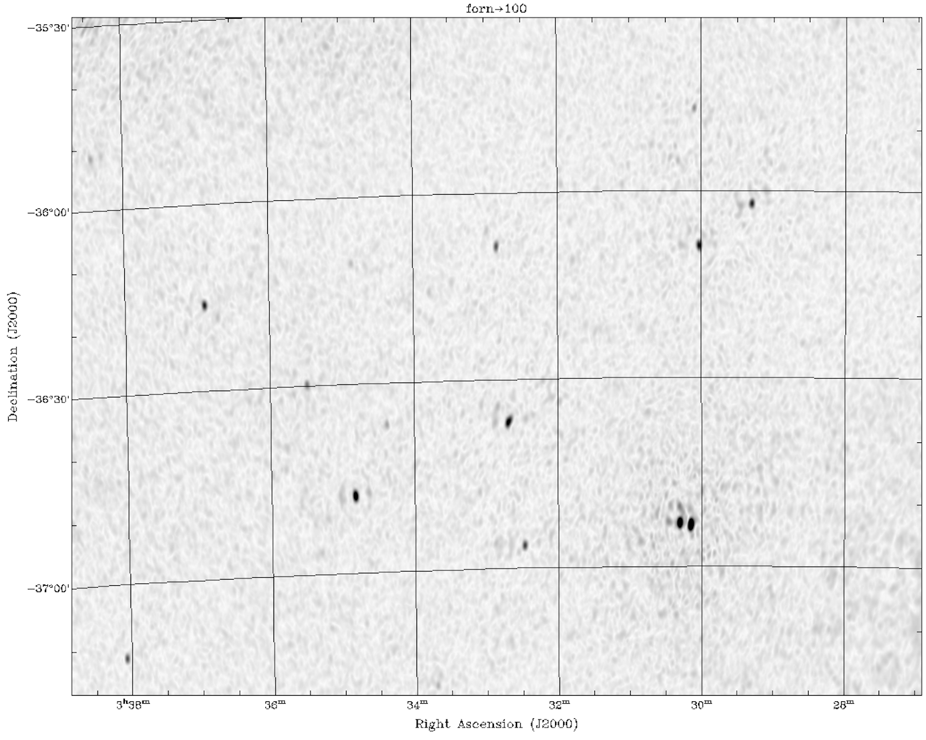
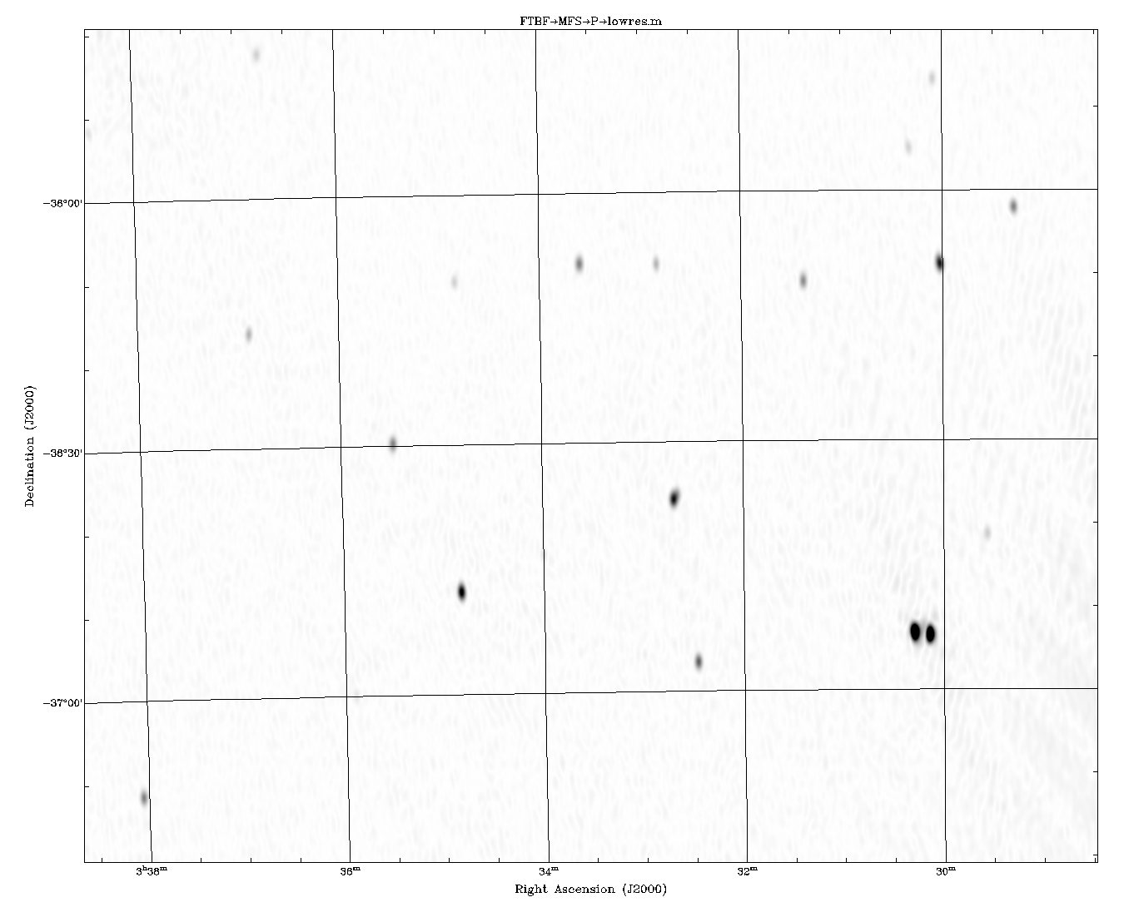
ASKAP: Next step to the “all sky” RM Grid
Central portion of Fornax field:
ATCA (~250 uJy / beam RMS)
ASKAP (~60 uJy / beam RMS)
Anderson, Raja

Slide 21
ASKAP: Polarimetry progress
On-axis polarisation calibration method has been developed. Initial results look promising.
Leakage of Stokes I into V estimated at ~0.3% for bright sources located randomly in the field
High degree of commonality between linearly polarised sources detected with ASKAP, and linearly polarised sources in other catalogues (NVSS RM catalogue, Anderson et al. 2015 ATCA Fornax field)
Detailed source property comparisons are now under way, with the aim of quantifying off-axis effects

Slide 22
Other key forthcoming polarization plans
VLA Sky Survey (VLASS)
  A 21st century version of the NVSS and FIRST, all-sky above declination −40º.
  Resolution: 2.5” (B configuration), covering 2-4 GHz
  RMS: 69 μJy/beam (co-added over 3 epochs)
  Observations: 2017-2024
  Main science programs: polarisation, time-domain science
MIGHTEE (MeerKAT)
  MID L-band (2 uJy, 18 sq deg), S-band (1 uJy, 5 sq deg)
  DEEP L-band & UHF to 0.1 uJy (1 sq deg, commensal with LADUMA)

Slide 23
Thank you
CSIRO Astronomy & Space Science
  George Heald
    t +61 8 6436 8758
    e george.heald@csiro.au
    w www.csiro.au
Astronomy and space science

