Slide 1
SKA Dish Consortium
SW overview
Thomas Küsel
Oct 2017

Slide 2
SKA Dish SW - agenda
Overview of Dish Consortium SW effort (Thomas)
SW approach and implications of SAFe (Simone)

Slide 3
Introduction
In principle, SAFe methodology is great and should be supported on the project where possible.
System integration, operation and upgrades.
For Dish this comes quite late, but let’s see how we can support this...

Slide 4
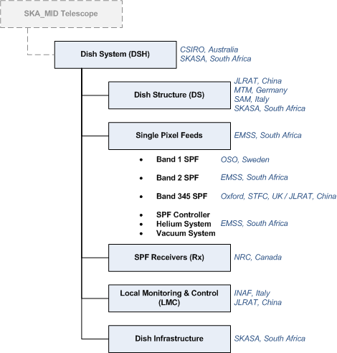
SKA Dish Product / Org Structure
Adaptation of existing SW/FW
SW, FW
Greenfields development
SW, FW
FW
FW
Software/Firmware developed / delivered in these subsystems
FW
SW, FW
SW

Slide 5
Control & monitoring structure
Dish
SPF B1 Feed controller
SPF Controller
SPF B2 Feed controller
TM
LMC
Dish Structure Controller
SPF B345 Feed controller
Receiver Controller

Slide 6
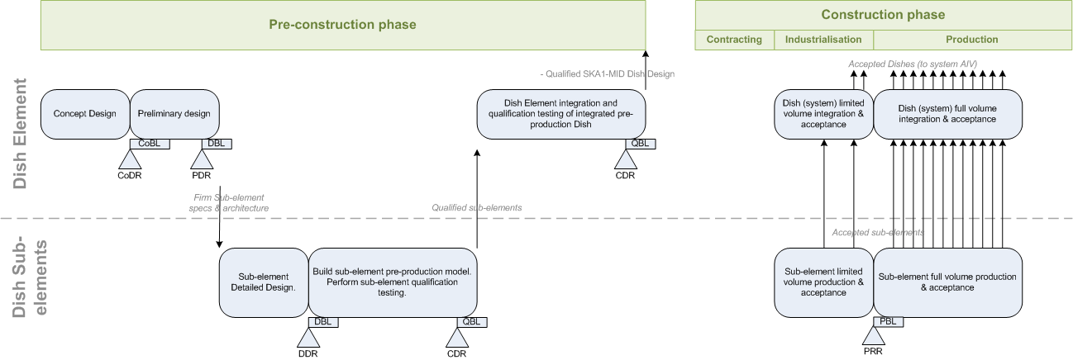
SE Plan overview

Slide 7
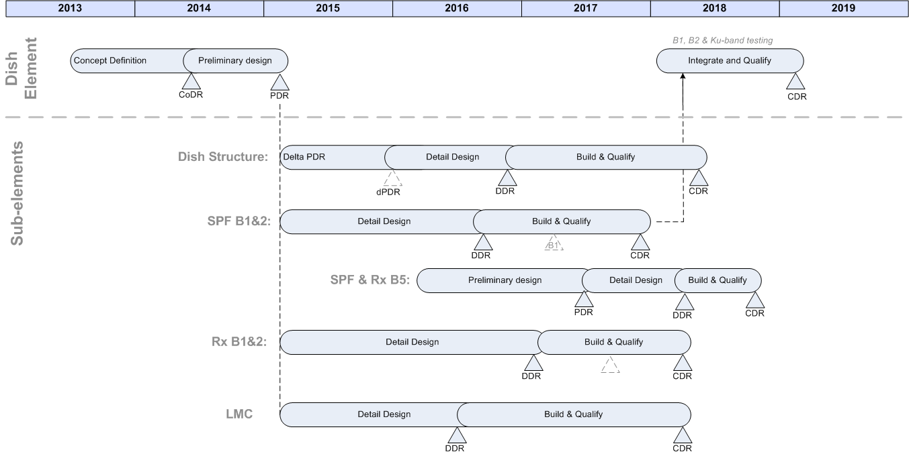
Timeline

Slide 8
Timeline
You are here
SW development
SW integration
SW Dev Testing
SW Qual Testing
SW Maint. & upgrade

Slide 9
Conclusion
Most of the software will be developed during pre-construction.
Only LMC and Rx are new software developments.
Rx:
Pre-construction: probably not resourced for significant changes to the current approach.
Determine to what extent the current approach can support SAFe.
LMC:
Serves as the single point of entry for DSH control and monitoring. Will need most adaptation/upgrade/maintenance during the construction phase
Consider how the DSH LMC can be incorporated into the SAFe approach.
Pre-construction: limited to current resourcing.
Construction: include in the SOW for LMC.

