Slide 1
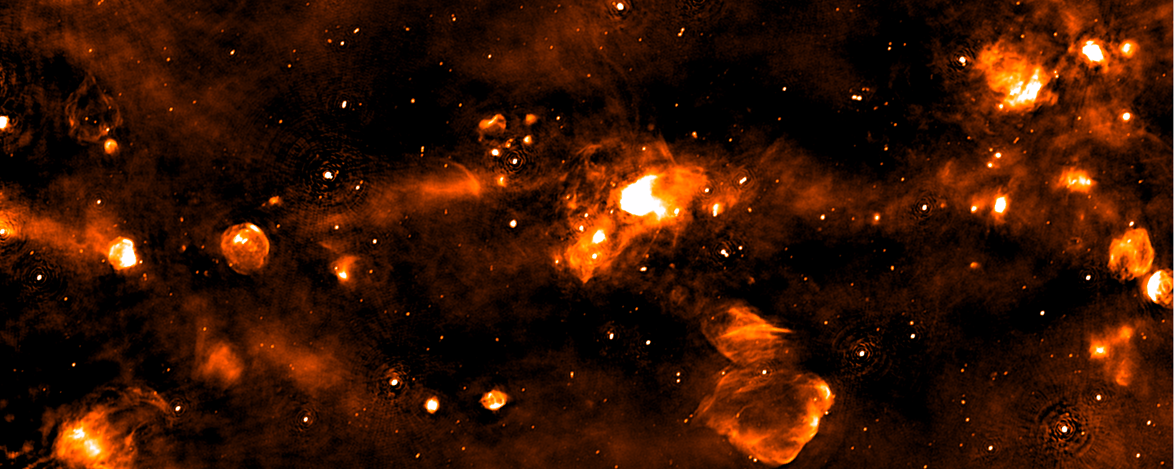
The SCORPIO field ASKAP map
Field center 343.8 -0.2
Dimensions 5.4x1.3 deg²

Slide 2
The SCORPIO field ASKAP map
Field center 343.8 -0.2
Dimensions 5.4x1.3 deg²

Slide 3
The SCORPIO field ASKAP map
Field center 343.8 -0.2
Dimensions 5.4x1.3 deg²

Slide 4
The SCORPIO field ASKAP map
Field center 343.8 -0.2
Dimensions 5.4x1.3 deg²
Green 8μm GLIMPSE
Red 70μm Hi-GAL
Blue ASKAP 912MHz

Slide 5
The SCORPIO field ASKAP map
Field center 343.8 -0.2
Dimensions 5.4x1.3 deg²

Slide 6
The SCORPIO field ASKAP map
Field center 343.8 -0.2
Dimensions 5.4x1.3 deg²

Slide 7
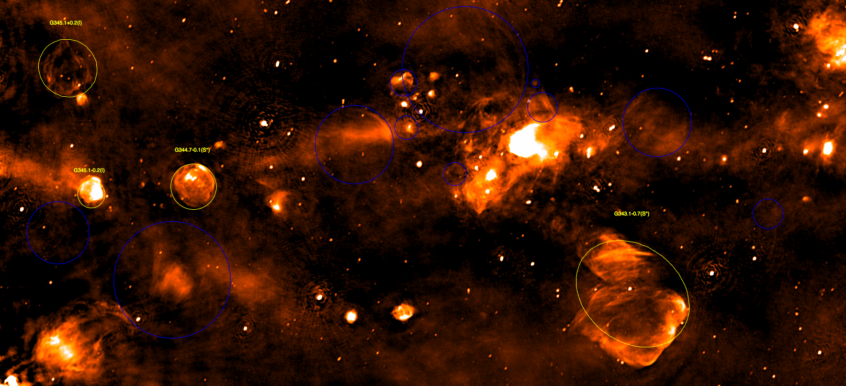
The SCORPIO field ASKAP map
Field center 343.8 -0.2
Dimensions 5.4x1.3 deg²
Jellow – Known SNRs from Green et al. 2014
Blue SNRs candidates (FIR much weaker or absent with respect to HII regions)
Notes:
SCORPIO_SNR

Slide 8
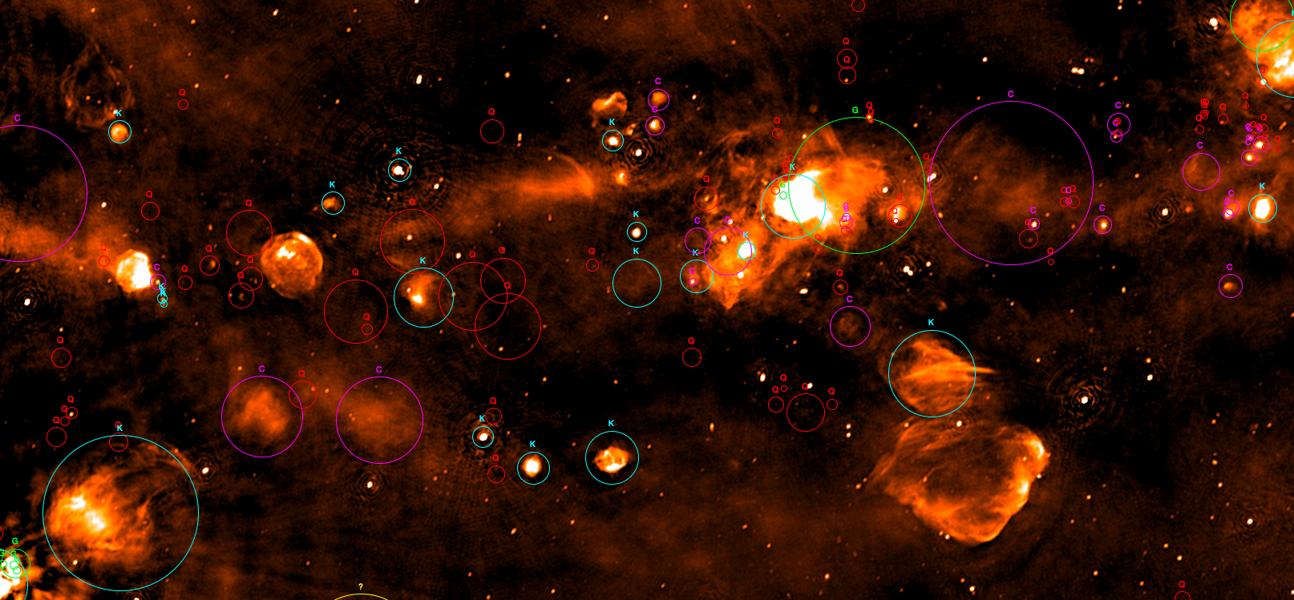
The SCORPIO field ASKAP map
Field center 343.8 -0.2
Dimensions 5.4x1.3 deg²
HII Regions as from the WISE catalog by Anderson et al., 2014
Code:
Light-blue K Known HII
Green G Group
Purple C Candidate
Red Q radio quite
Several Q HII are detected in ASKAP map

Slide 9
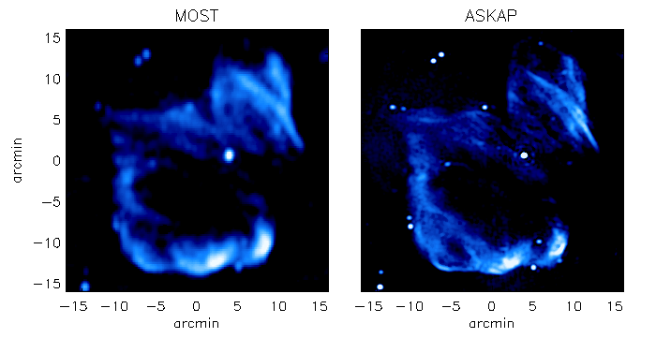
SNR G343.1-0.7
MGPS conducted with the Molongo Observatory Synthesis Telescope
843 MHz
843 MHz
912 MHz
Overall structure of the remnant recovered by the two instruments
The better resolution of ASKAP (20” vs 45”) allow to appreciate finer details

Slide 10
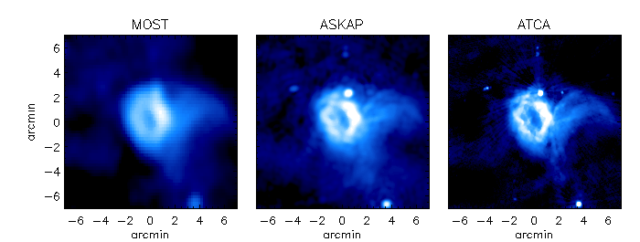
Bubble S17 -Churchell et al., 2006)
ASKAP provide the best compromise between fine details and diffuse emission

Slide 11

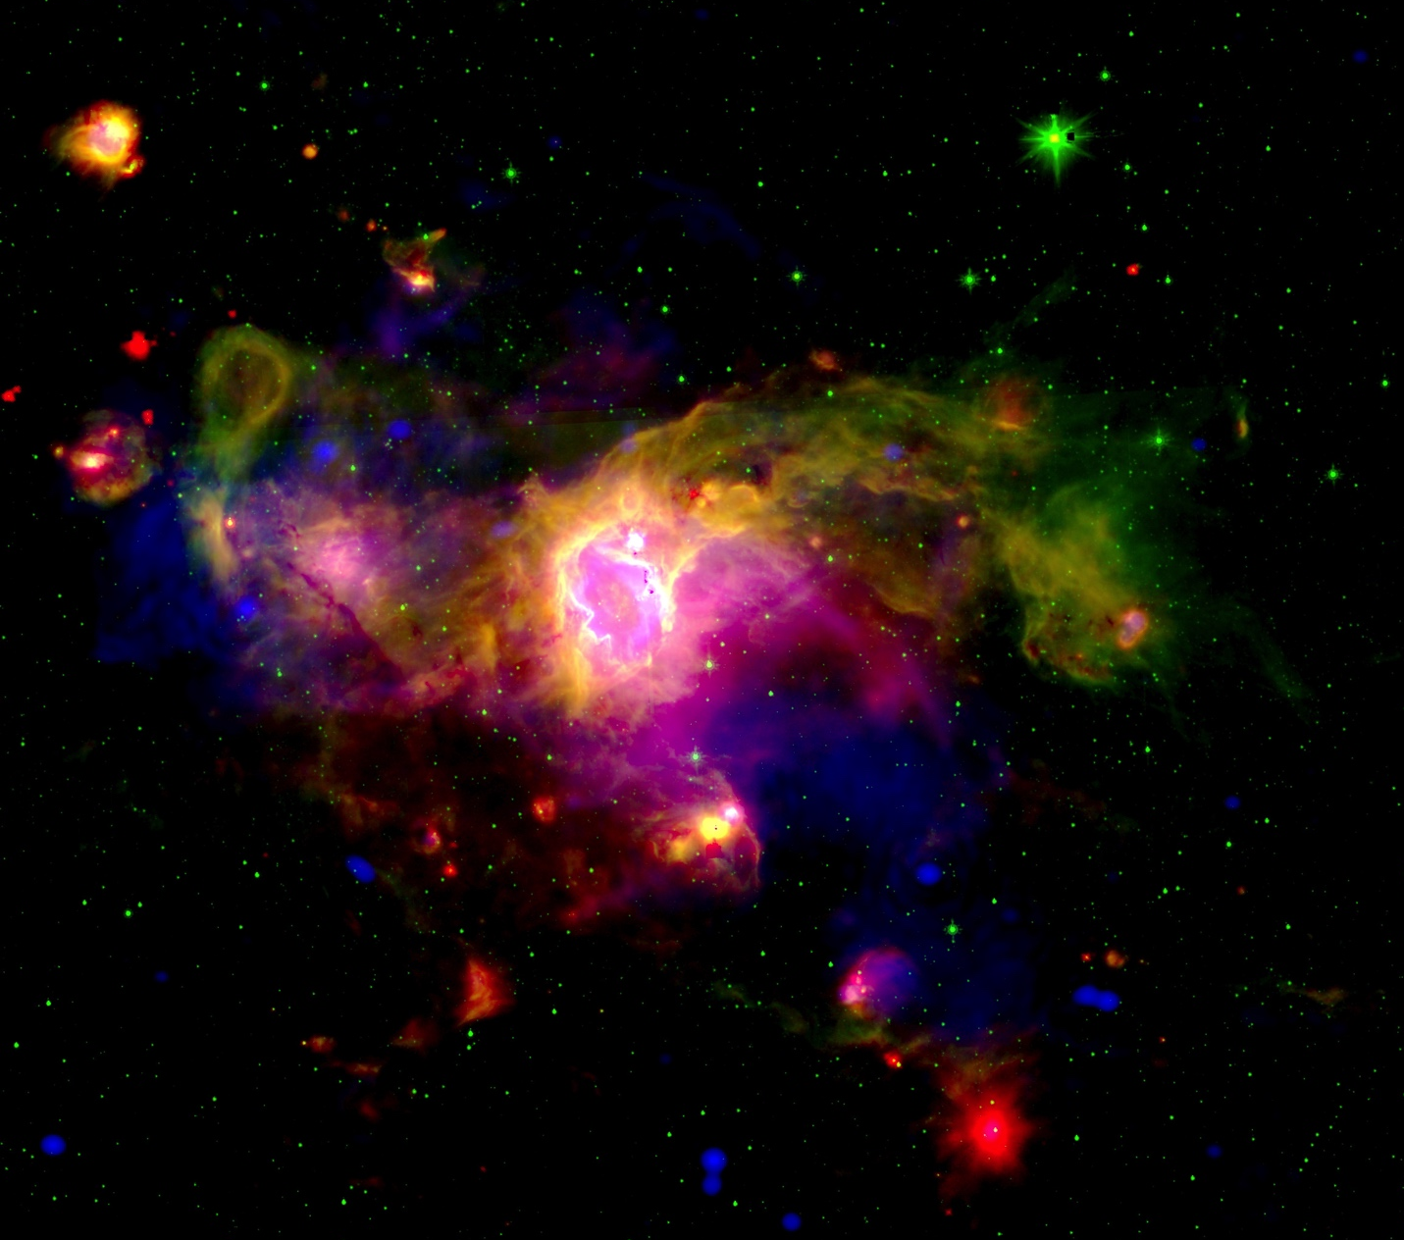

Bubble S17 -Churchell et al., 2006)
Green 8μm GLIMPSE
Red 70μm Hi-GAL
Blue ASKAP 912MHz
The VIALACTEA knowledgebase: a unique tool for source
identification and classification

Slide 12
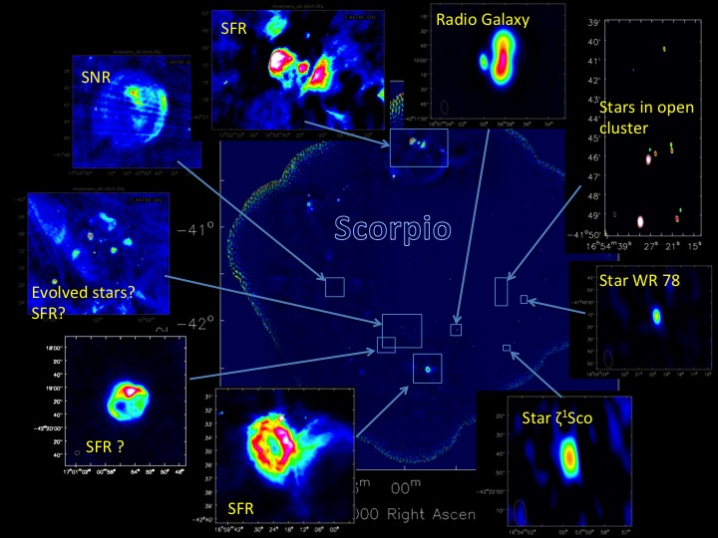
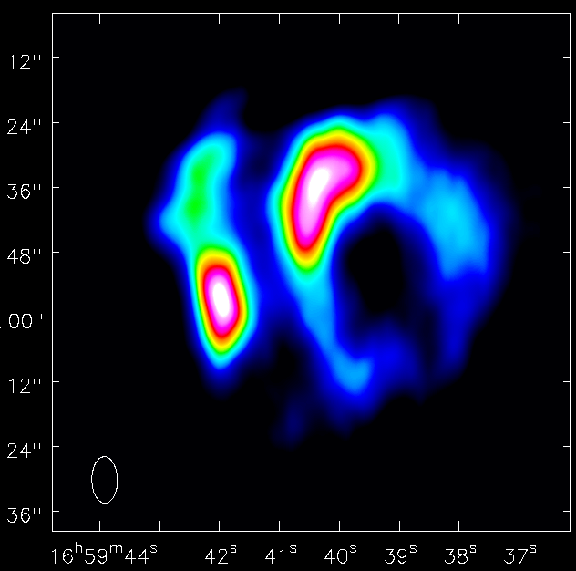
The SCORPIO zoo
Thank you!
SFR or evolved star?
Stay tuned…..ASKAP band 2 (968-1272 MHz) coming soon!

