Slide 1
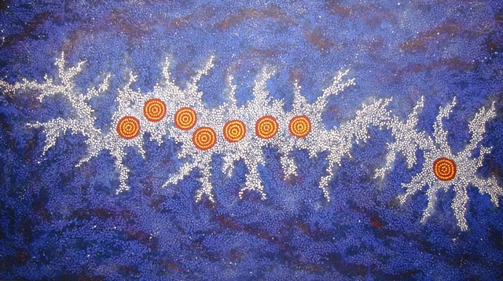
GalactiC Science with the SKA
Our Galaxy SKA SWG
G. Umana & E. Rosolowsky
Seven Sisters Milky Way dreaming
Gabriella Possum Nungurrayi

Slide 2
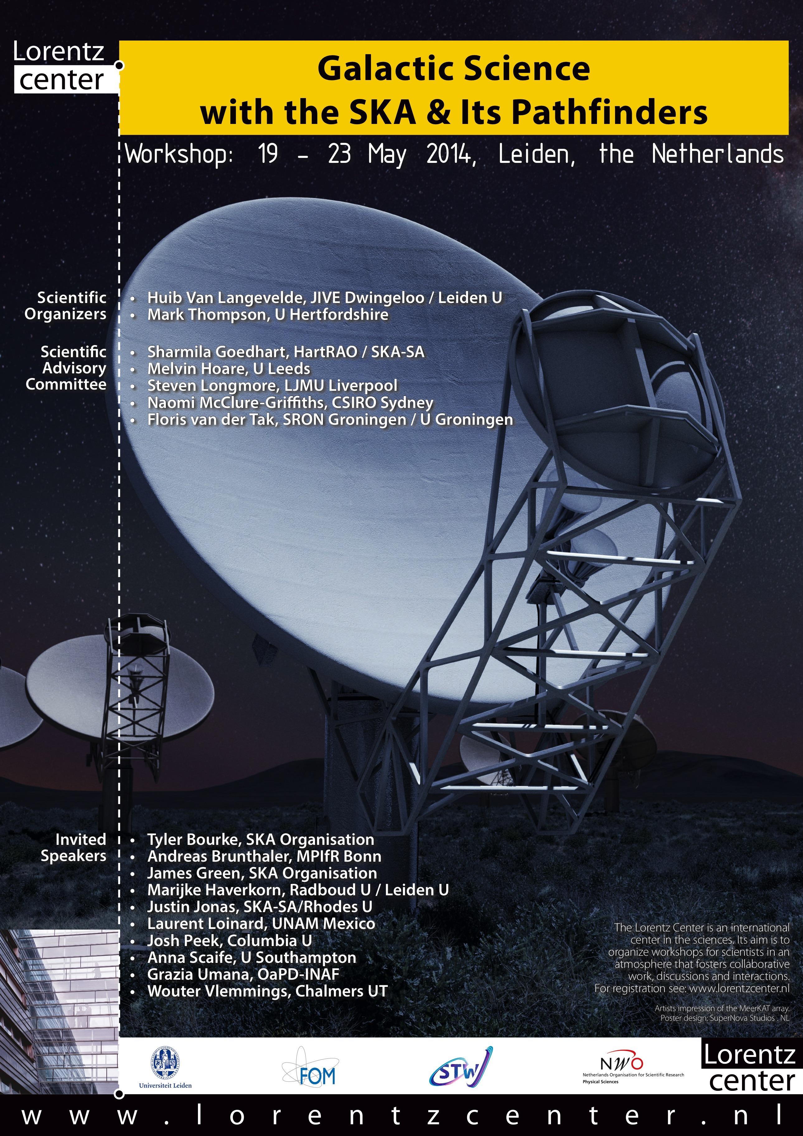
Our Galaxy SKA SWG
First meeting at Leiden, May 2014 ≈ 50 participants
Outcomes:
The potential of SKA to make a tremendous impact on many key areas in the physics of the ISM, the early lives of stellar clusters and stellar evolution.
Strong support to try and form a
Galactic Science Working Group

Slide 3
Our Galaxy SKA SWG
Chairs: Grazia Umana & Erik Rosolowsky 60 members
Antoxon Alberdi
Marc Audard
Miguel Avillez
Adam Avison
Tyler Bourke
Shari Breen
Filomena Bufano
James Dale
Joanne Dawson
John Dickey
Simon Ellingsen
Sandra Etoka
Jan Forbrich
Gary Fuller
Ciriaco Goddi
Adam Ginsburg
Lisa Harvey-Smith
Good coverage in expertise
as well as in Nationality
Many of those people involved
in pathfinder projects
LOFAR, ASKAP and MeerKAT
Seyit Hocuk
Hiroshi Imai
Adriano Ingallinera
Doug Johnstone
Gilles Joncas
Pamela Klaassen
Roland Kothes
Busaba Kramer
Silvia Leurini
Francois Levrier
Bin Liu
Steve Longmore
Laurent Loinard
Uscanga Lucero
Marc-AntoineMiville Deschenes
Naomi McClure-Griffiths
Sergio Molinari
Joseph Mottram
Hiroyuki Nakanishi
Raymond Oonk
Rainer Schoedel
Jill Rathborne
Eric Rosolowsky
Michael Rupen
Kazi Rygl
Alberto Sanna
Gregory Sivakoff
Ian Stevens
Jeroen Stil
Firoza Sutaria
Kengo Tachihara
Corrado Trigilio
James Urquhart
Huib Jan van Langevelde
Serena Viti
Wouter Vlemmings
Andrew Walsh
Albert Zijlstra

Slide 4
The BIG Picture: the cycle of the matter in the Galaxy
Uncovering the ecology of baryons/
understand the cycle of matter in/out and
between Components of our Galaxy:
We want to understand the details of such interplaying.
We want to use Our Galaxy as a resolved template to understand how Galaxies work.

Slide 5
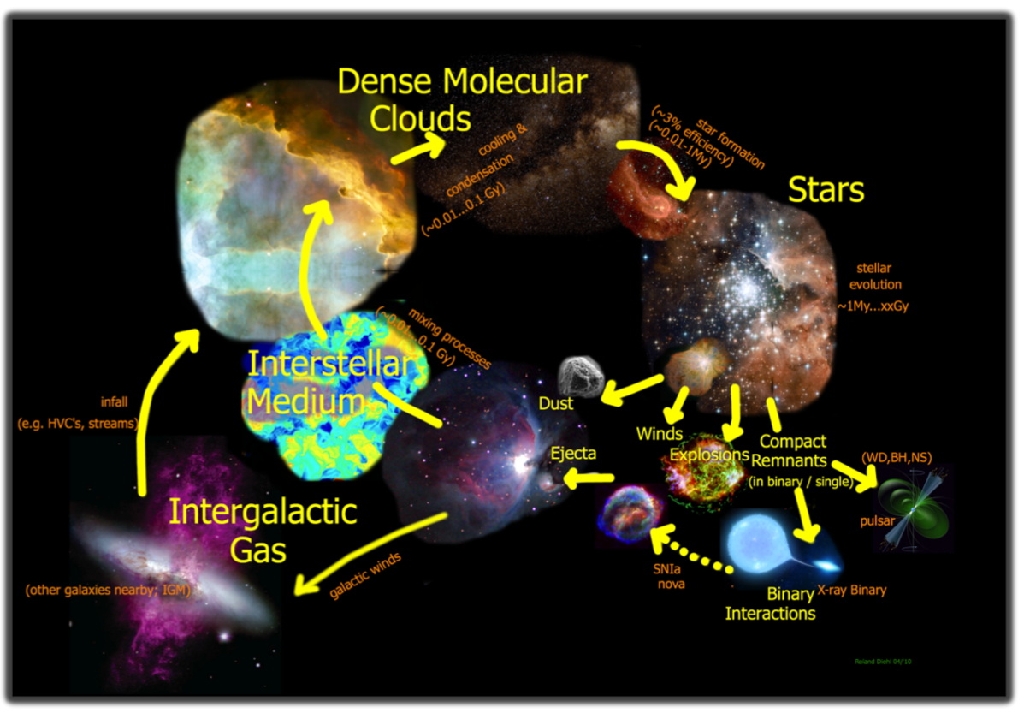
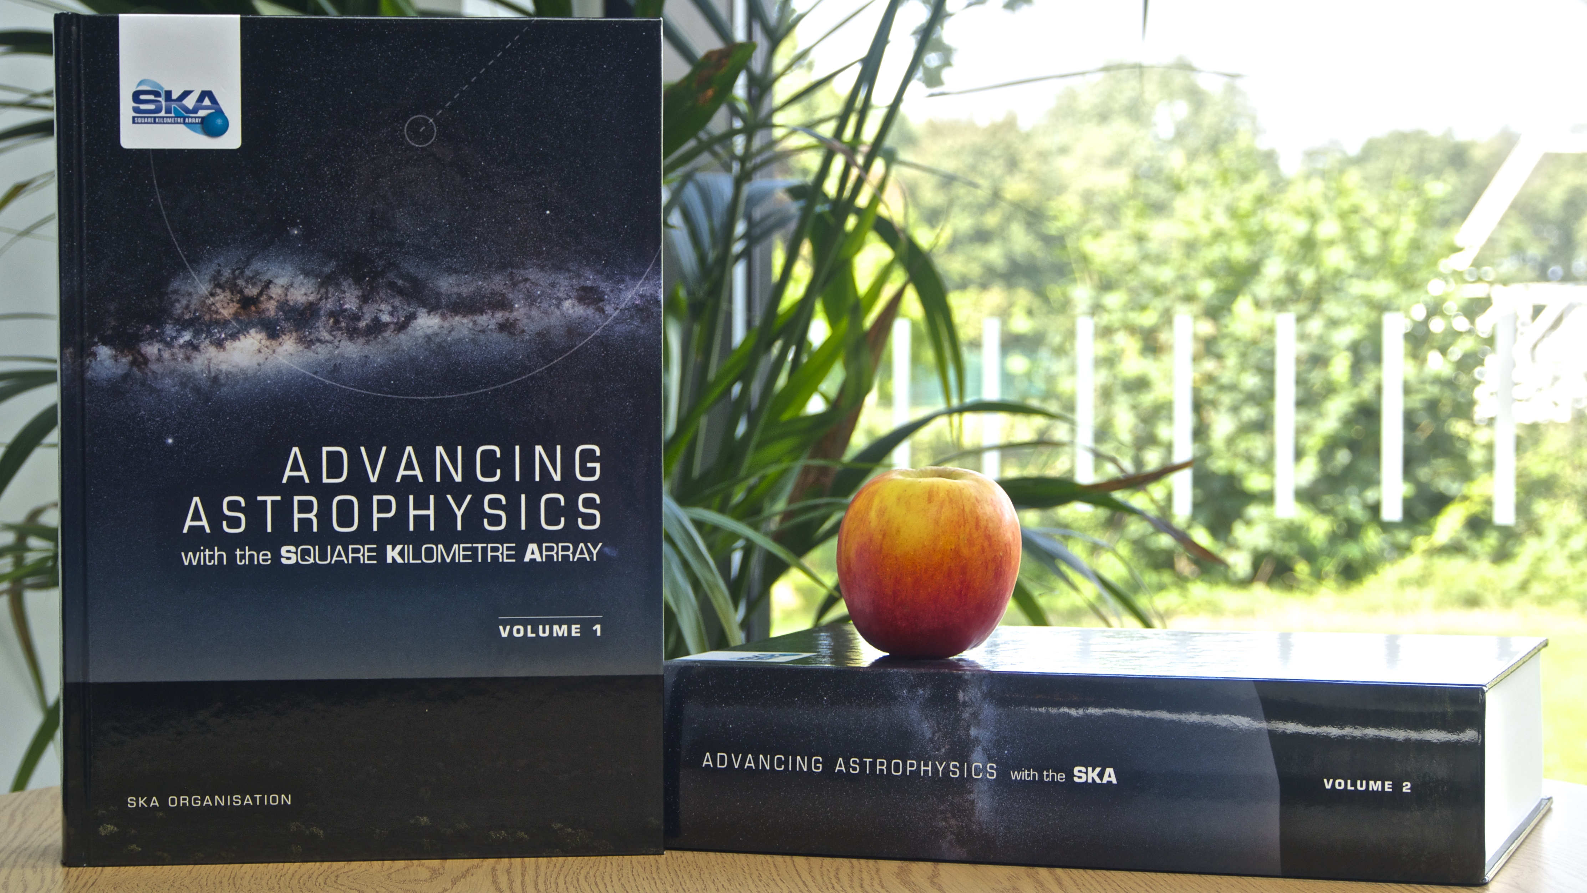
Radio Observations can put all together
Molecular lines: Thompson et al., 2015
Thermal continuum from HII regions: Umana et al., 2015
Radio Recombination Lines:Thompson et al., 2015
Thermal continuum, from jets & winds: Anglada et al., 2015
VLBI Green et al., 2015; Loinard et al., 2015
variability of young cluster: Fuller et al., 2015
Stellar Radio HR diagram: Umana et al., 2015
Maser Lines: Etoka et al., 2015
http://astronomers.skatelescope.org
http://pos.sissa.it/cgi-bin/reader/conf.cgi?confid=215

Slide 6
The concept of Generic Surveys
The best way to go: All-sky, deep Survey
Statistical studies of different populations of radio emitting
Galactic Objects
The place where you look at makes the difference:
most of the Galactic sources localised in/close the GP
Outcome from KSPs 2015 Meeting:
Maximize the return for “priority Science”
Maximize the commensality
Better angular resolution and sensitivity (Continuum & Spectral) than
any ongoing/planned survey of the Galactic Plane

Slide 7
The concept of Generic Surveys
Galactic Studies: try some commensality with other surveys
SKA1_MID-A Generic Survey @ Band 2b (Full BW)
(rms 5μJy/b, 0.8”), ≈8000 hrs, All-sky
SKA1_MID-D Generic Survey @ Band 5 (Full BW)
(rms 6μJy/b, 0.2”), ≈2000 hrs, 480 deg²/GAL

Slide 8
Galactic Plane Radio surveys
SKA1-All-sky will bridge the gap in sensitivity and resolution
between available GP surveys
High angular resolution, limited areas:
CORNISH (Purcell and Hoare, 2010) 6cm, 1-6 arcsec, ≈100 deg², few mJy
MAGPIS (Helfand+ 2006) 20/6cm “ “
Lower angular resolution, wide areas:
CGPS (Taylor+ 2006), 20cm, arcmin, several 100 deg², few mJy
SGPS (McClure-Griffiths+ 2005) “ “
Notes:
The SKA1 all-sky survey will bridge the gap between the exoisting radio GP survey Existing interferometric radio continuum survey of the galactic plane are either at high angular resolution but over a limited survey area, or cover a wide area at low angular resolution.
Moreover, when the SKA1 will be operative results from EMU will be available and they will be very important to cope with all the iusses that are very probbaly arise when working to close to the GP:

Slide 9
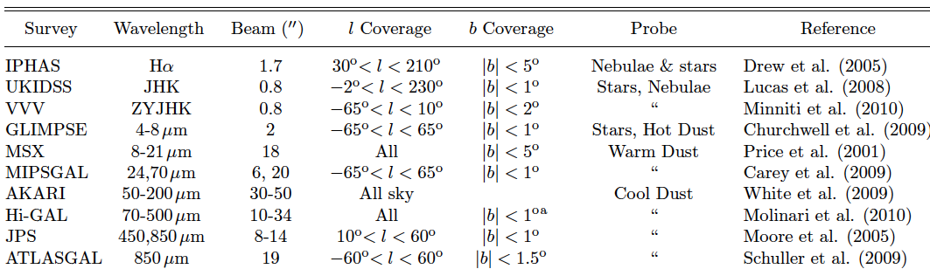
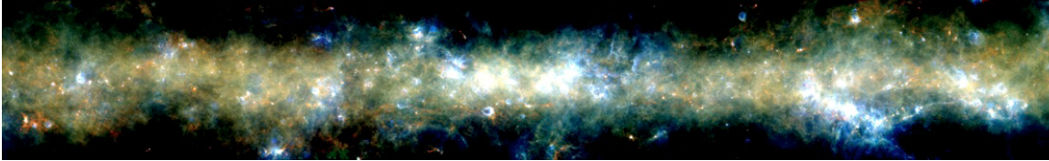
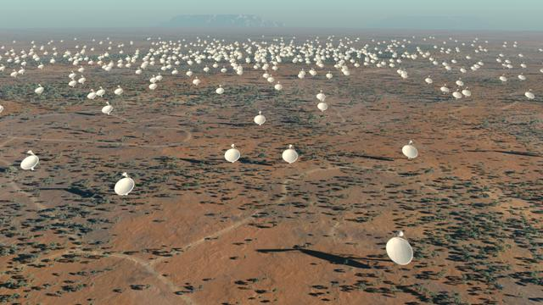
Synergy with multi-frequency Galactic Plane surveys
Adapted from Hoare + 2012
Synergies: tabella da CORNISH
For several classes of Galactic objects robust classification is
possible only by combining radio and IR information
Hi-GAL (Molinari+ 2010) 345d<l<330d
R=350μm; Y=160μm; B=70μm
Notes:
The study of star formation, stellar populations and Galactic structure is currently beeing transformed by a new generation of Galactic plane surveys.
For sevaral classes of Galactic objects robust classification is possible only by combining radio and IR information

Slide 10
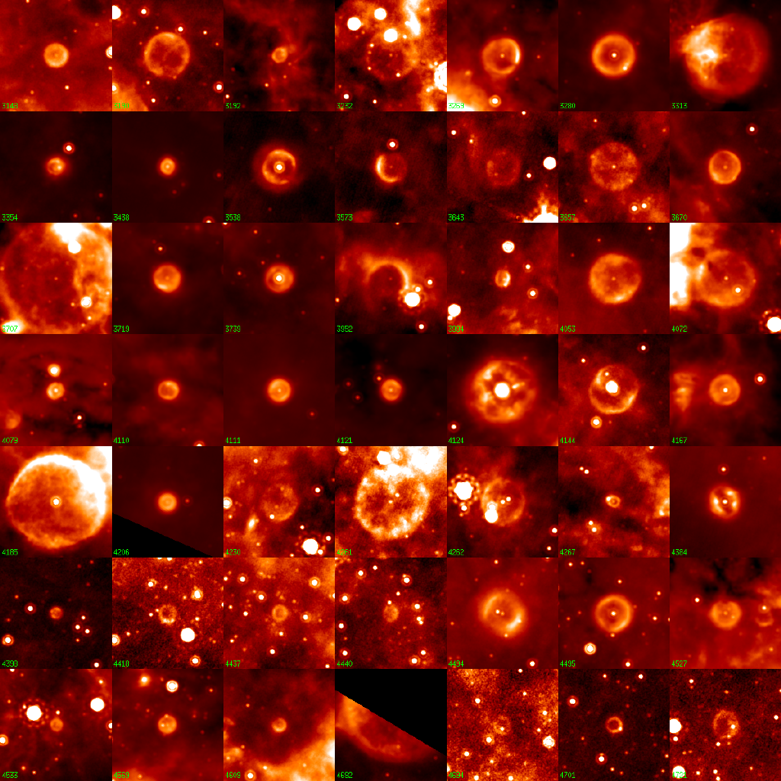
The Bubbling Galactic Plane
About 400 “bubbles” found
in MIPSGAL (24 μm)
Carey et al., 2009, Mizuno et al 2010
Possibly related to late stages
of Stellar evolution
less than 10% have been identified
Radio observations/IR
morphological information
to classify the object
HII vs PN, WR
and HII vs SNR
24 μm
Credit: Spitzer MIPSGAL Legacy Team
Ingallinera et al., 2014; 2016
Bufano et al., 2018
Notes:
This is just an example on how the sinergies between IR and radio can help in classifing galactic object.

Slide 11
Galactic Plane Radio surveys
Preparatory work (Spectral and continuum surveys)
KuGARS (PI Thompson) Pilot JVLA, 4°x 2° deg, 12-18 GHz, 110 μJy (5σ), sub-arcsec
pathfinder to MeerGAL (PIs- Thompson and Goedhart ): Currently in stand-by
MeerKAT, 140 deg², GP, 14 GHz, 30μJy (5σ), 0.8 arcsec, multi-epoch
THORS (Bihr et al., 2015)- JVLA, 100deg2 GP, 1-2 GHz, 10-20”, 0.3-1mJy/b (1σ)
SCORPIO (PI Umana ) ATCA, 1.4 GHz, 30-40 μJy (1σ), 10 arcsec, 4 deg²
pathfinder to EMU (PI R. Norris), ASKAP, All-sky 1.4 GHz, 50μJy (5σ), 10 arcsec
Currently in Early Science phase
Galactic EMU 2 KSP- Galactic Plane (PI: Kotes )- Different classes of Galactic
Objects in. SNRS
Radio Stars (PI: Umana) more focused on “normal
stars”
Notes:
The SKA1 all-sky survey will bridge the gap between the exoisting radio GP survey Existing interferometric radio continuum survey of the galactic plane are either at high angular resolution but over a limited survey area, or cover a wide area at low angular resolution.
Moreover, when the SKA1 will be operative results from EMU will be available and they will be very important to cope with all the iusses that are very probbaly arise when working to close to the GP:

Slide 12
Galactic Plane Radio surveys
Lessons learnt so far:
Pathfinder surveys essential to design the better strategy for Galactic Plane SKA surveys;
To face issues due to complex structures in the GP, to the variable sources and diffuse emission
Need for automated source extraction (both compact and extended) and classification methods
Need for baseline zero data; need for better methods to combine single-dish and interferometric data
See tomorrow talks on SCORPIO
Notes:
The SKA1 all-sky survey will bridge the gap between the exoisting radio GP survey Existing interferometric radio continuum survey of the galactic plane are either at high angular resolution but over a limited survey area, or cover a wide area at low angular resolution.
Moreover, when the SKA1 will be operative results from EMU will be available and they will be very important to cope with all the iusses that are very probbaly arise when working to close to the GP:

Slide 13
The impact of SKA on Galactic Science
A SKA-survey results will address several science topics:
(list not exhaustive!)
Massive stars formation
A census of the early stage of massive stars formation in the GP
Giant HII and interaction with their environments: triggered star formation
Evolved stars
Detection of SNRs
Detection of PNs
Radio Stars
Serendipitous discoveries
To derive accurate space density and rate formation
Radio needed for robust identification
Providing the most complete catalog of Galactic Sources to date
Notes:
SKA will give the opportunity to create a sensitiv atlas of discrete radio sources and to address sevaral science topics
LIST IS NOT EXHAUSTIVE

Slide 14

The BIG Picture: Proposed Observations
Galactic Plane narrow spectral
5-10 GHz & 10-15 GHz followup
0.1 K rms in 0.1 km/s (line)
~0.4 µJy rms continuum
-70 < l < +60 |b|<1
Main science driver spectral line:
RRLs kinematics of ionised gas
H₂CO Molecular gas volume density
Galactic Plane wide continuum
5-10 GHz, 3 µJy rms (continuum)
-170 < l < +60 with |b|<1
Galactic Bulge |b|< 10?
Main science driver continuum:
Stellar evolution
from Cradle (YSO) to Grave (PNs etc)

Slide 15
The BIG Picture: Proposed Observations
Galactic Plane narrow spectral
5-10 GHz & 10-15 GHz followup*
0.1 K rms in 0.1 km/s (line)
~0.4 µJy rms continuum
-70 < l < +60 |b|<1
Main science driver spectral line:
RRLs kinematics of ionised gas
H₂CO Molecular gas volume density
Galactic Plane wide continuum
5-10 GHz, 3 µJy rms (continuum)
-170 < l < +60 with |b|<5
Galactic Bulge |b|< 10?
Combined with data from SKA1-A will provide:
-spectral index infos- to disentangle between thermal and non-therm
-Full Stokes infos- B and gyrosynchrotron flaring stars (strong V)

Slide 16
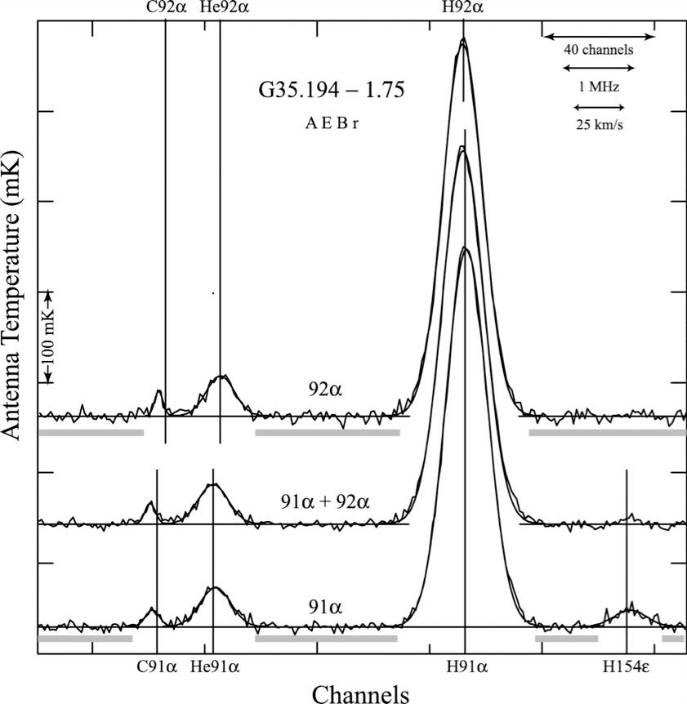
Tier 1-The ionized medium with RRLs
SKA will be a recombination line
mapping machine
Thompson et al., 2015
Can simultaneously map 50 Hα (+ Heα + Cα RRLs) in Band 2 and 25 in Band 5
Band 2 RRL mapping speed of SKA1-mid comparable to VLA continuum mapping speed
Broad frequency coverage traces different electron densities
Multiple lines from multiple atoms allows metallicity, abundance, radiation field to be measured
See Mark’s talk
Quireza et al., 2007
Notes:
RRl are powerful extinction free diagnostic of the ionized gas in young star-forming regions
-single measurement: kinematic of the system, electroin temperature

Slide 17
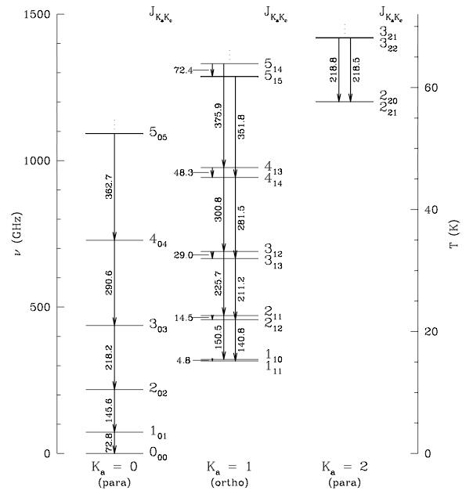
Tier 1- Spectral Survey H₂CO -
Thompson et al., 2015
First detection of the molecule
with VLA at 4.8 GHz (Evans et al., 1987)
Shows up in absorption against CMB
when Tex < T_{CMB}
  Excellent and unique tracer of gas density
  line ratio between 4.8 GHz & 14.4 GHz
  fixes gas density to ~0.2 dex with good
  dynamic range: 10³ - 10⁶ cm⁻³
  (Ginsburg et al 2011)
  See Mark’s talk
SKA band 5/5+
(traces nH2)

Slide 18
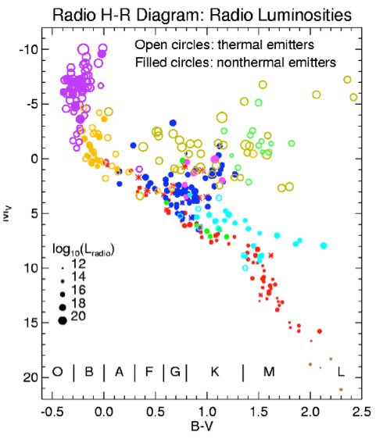
Tier 2- Stellar Evolution: from the cradle to grave
Radio Stars
Currently few hundreds detected in radio
Radio probes astrophysical phenomena
not detectable by other means:
B field & topology in flare stars,RS CVn
HII region in dust enshrouded sources
Wind-wind interactions
Stellar magnetospheres
Planetary nebulae shaping by jets?
SKA will address current problems of limited sensitivity & selection bias
Gudel, 2002
See SCORPIO talk

Slide 19
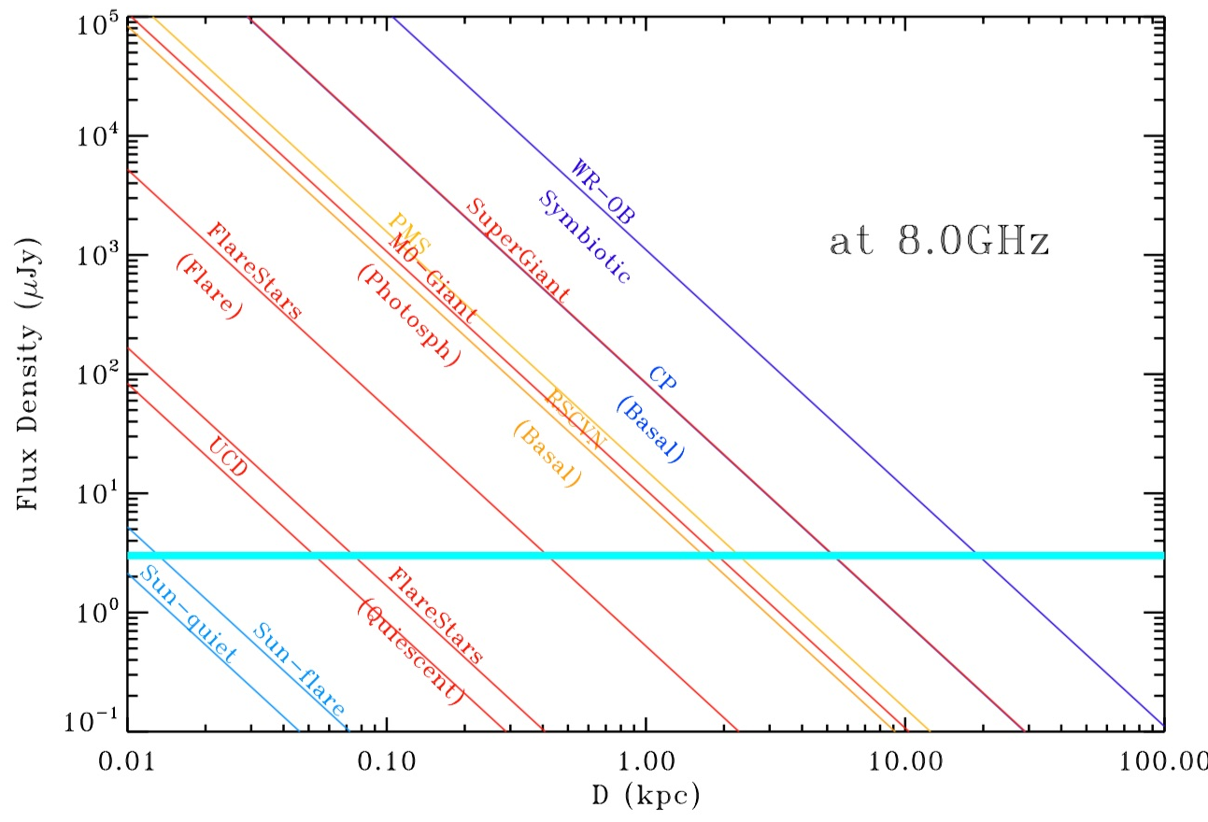
Tier 2- Stellar Evolution: from the cradle to grave.
Umana et al., 2015
Radio Stars detection forecast
Flaring Sun @ 10pc OB-WRs @GC

Slide 20
Possible Key Science Projects
To reach our main goal –the BIG PICTURE-
Several KSPs and Focus follow-up cases carried out by a team (TBD) consisting of people coming from different SWGs
-define clear commensal objectives
-”contact points” between SWG
Via:
Synergies/discussions/meeting with Cradle of Life
Magnetism
HI
(non) HI spectral line
Continuum
Transients
KSPs : some already defined
some in preparation
others just in the “brain storming mode”
See following talks

Slide 21
Design Baseline/ Deployment Baseline
Outcome of July 2017 SKA Board meeting
Reduced resolution
Reduced sensitivity
Deployment Baseline scoped for cost-capped Construction budget
The final Deployment Baseline of SKA1 to be defined in the Construction
Proposal
Re-instatement of ALL omitted capabilities is planned, during of after construction
Phase, depending on available funding

Slide 22
SKA1 Frequency range
A chart showing the major areas of observations and investigation for SKA1 in order of frequency range
from Dewdney, 2016
Most of Galactic
Science in Band 5

Slide 23
Design Baseline/ Deployment Baseline
WARNING for Galactic Science
Hoare et al, 2015, Testi et al., 2015,
Codella et al., 2015, Umana et al., 2015,
Thompson et al., 2015……
Reduction in number of elements means:
Reduced sensitivity
Reduced angular resolution
Not optimized UV coverage for imaging fidelity-question on how distributed
a reduced initial Band-5 feeds
A wide community consultation should be undertaken to ensure that
any partial deployment of Band-5 feeds takes accout of all
Science constraints

Slide 24
Summary
SKA covers important Milky Way physics in breadth and depth
Radio provides us with unique extinction-free diagnostics for better comprehension of:
-Star formation
-Stellar evolution
-Energy and matter return to ISM
Particularly important to reach the goals high frequency, high angular resolution with optimal UV coverage,
http://astronomers.skatelescope.org/science-working-groups/milky-way/

