Slide 1
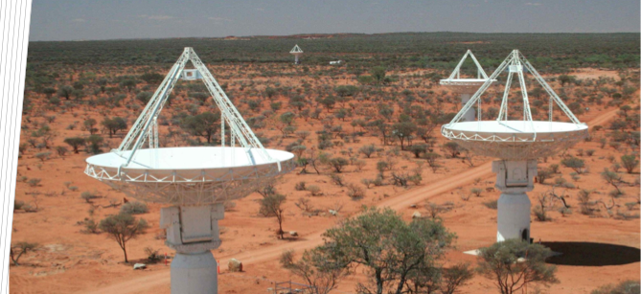

ASKAP & EMU: Update
Ray Norris, Western Sydney University &
CSIRO Astronomy & Space Science,

Slide 2
Australian SKA Pathfinder (ASKAP)
36*12m antennas with Phased Array Feed (PAF)
Tsys ~ 55K
30 sq deg FOV
Frequency 0.7-1.8GHz
Instantaneous bandwidth 300 MHz
Max basline 6kmn
Located at Murchison Radio Observatory
(MRO) in a “Radio quiet Zone”

Slide 3
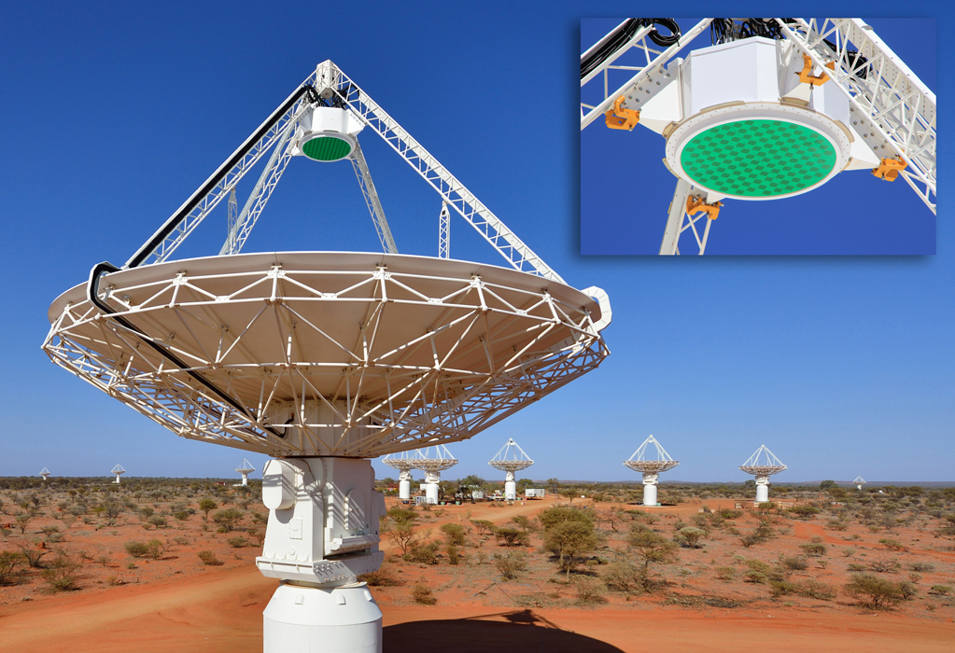
Total bandwidth = 2.1THz per antenna
Processed data volume = 70 PB/year

Slide 4
ASKAP Status in a nutshell
Phased Array Feeds (PAF) give 30 sq deg FOV and an amazing survey speed
Fully funded
All 36 antennas & infrastructure completed
All 36 PAFS complete and installed
Currently debugging and commissioning backend and processing pipeline

Slide 6
ASKAP Timeline
2009 | Project initiated
2014-2016 | BETA operational (6 antennas)
2017-mid 2018 | Early Science Phase 1 (12-14 antennas) plus commissioning and debugging
mid-late 2018 | Early Science Phase 2 (18 antennas) plus commissioning and debugging
Jan 2019 | Commissioning of final survey array 36 antennas, 36 beams, 300 MHz bandwidth Pilot survey porojects
Mid 2019? | Full surveys start (for ~ 5 years)

Slide 8
Slide courtesy Dave McConnell

Slide 9
Recent observation of 1934-638 by Wasim Raja
16 antennas
288 MHz BW
Robust. = -0.5
Rms = 37 uJy/bm
DR = 250k

Slide 10
S=13.6 Jy
rms=37 uJy/bm

Slide 11
ASKAP Current Status: Technical
Wins:
All 36 antennas now equipped with PAFs
Backends complete for most of them
Can currently observe with up to 16 antennas at 288 MHz BW
Phase rotator upgrade now taking place
On-dish calibration (ODC) installed and being characterised
Hybrid power station handed over
Band 3 commissioning (1.5-1.8 GHz) completed
Need more work:
Significant processing limitation because of limited throughput and disk space on galaxy at the Pawsey Centre
RFI flagging not yet optimum
Beam-forming and calibration not yet optimum

Slide 12
ASKAP Current Status: Early science
ASKAP Early Science period 1 has ended
All EMU projects that said they were ready to process data have now got data at 864.5 MHz:
SPT deep field
Abell S1136
GAMA 23
SCORPIO
CDFS
Cosmology Field
Still awaiting:
SCORPIO and GAMA23 at 1320.5 MHz
Remaining Cosmology fields
Early Science phase 2 (18 antennas) to start in June?
Remaining EMU early science projects, (plus others?)

Slide 13
Slide courtesy John Reynolds

Slide 14
Features available in early science period 2
(June-December 2018)
Slide courtesy Aidan Hotan
Some support available for installing askapsoft on other machines

Slide 15
Slide courtesy Aidan Hotan

Slide 16
Data Validation script, courtesy Jordan Collier
(run at the end of the processing pipeline)
Source counts plots are generated automatically in the validation stage of the pipeline

Slide 17
Slide courtesy Aidan Hotan

Slide 18
Leahy, D, et al (MNRAS, submitted) Radio Sources and Optical-IR Counterparts in the GAMA 23 Field (2018)

Slide 19

EMU: the ASKAP continuum survey
Deep radio image of 75% of the sky (to declination +30°)
Frequency range: 1100-1400 MHz
40 x deeper than NVSS (the largest existing radio survey)
      Target is 10 μJy rms across the sky
5 x better resolution than NVSS (10 arcsec)
      Better sensitivity to extended structures than NVSS
Expect to detect and image ~70 million galaxies at 20cm
      c.f. 2.5 million detected over the entire history of radio-astronomy so far
All data to be processed in real-time pipeline
Images, catalogues, cross-IDs, to be placed in public domain
The EMU team has over 300 members in 21 countries

Slide 20
EMU will generate the deepest, highest resolution atlas yet
of the Galactic Plane. Already we have discovered several new SNR, planetary nebulae, and radio stars
5 deg
EMU Early Science image of the SCORPIO region of the Galactic Plane, courtesy Francesco Cavallero

Slide 21
ASKAP Early Science Cosmology Field
2000 square degree region
68 pointings (18 observed so far)
200 minutes per pointing
(image courtesy of David Parkinson)

Slide 22
Part of an EMU Early Science image of the
Small Magellanic Cloud, courtesy of Miroslav Filipovic

Slide 23
Galactic Studies with ASKAP
Main surveys for the Galaxy are:
EMU – continuum
POSSUM - polarisation
GASKAP – spectral line
All three will observe small projects in Early Science Period 2 (August-December 2018)
All three will propose “pilot” projects with the full array in first half of 2019

Slide 24
We acknowledge the Wajarri Yamaji people as the traditional owners of the ASKAP site

