Slide 1
Accessing the data from the ASKAP-EMU Pilot Survey
Ray Norris, Western Sydney University &
CSIRO Astronomy & Space Science,
Notes:
Abstract: It has been said that there is nothing at useless as a radio source. Certainly, the science is greatly magnified if the radio sources can be cross-identified with other multi-messenger catalogues such as CTA, and redshifts measured or estimated. But it is non-trivial to do so for the catalogues of tens of millions of sources that will be generated by next-generation radio continuum surveys, especially since many of those sources are extended or contain multiple components, none of which may correspond to the optical host galaxy. In this talk I review recent developments, mainly using machine learning techniques, for radio source cross-identification, classification, and redshift estimation, and outline the science, including the unexpected, that we may expect to result from them.

Slide 2
Access this zoomable image on emu-survey.org
The EMU Pilot Survey

Slide 3
Four ways of accessing EMU data:
Recommended
Zoomable web image
Download FITS files from CASDA
Use VOTools from TopCat, Aladin, etc (not yet fully tested)
Access files from emushare (requires a Pawsey account)

Slide 4
1) The zoomable image on http: emu-survey.org
Disadvantages:
not full resolution or sensitivity.
- We hope to fix this in a later version
Cannot easily get quantitative information Advantages:
good way of doing a quick look or finding an object
shows tile names and beam names
NB: Click on icon at top left to remove boundaries and markers if they are in the way

Slide 5
2 Access data via CASDA This information is also on http://askap.pbworks.com/PilotDataAccess
Make sure you have a current OPAL account ( https://opal.atnf.csiro.au/ )
Go to https://data.csiro.au/collections/#domain/casdaObservation/search/PRAS101 - ASKAP Pilot Survey for EMU/
Refine your search criteria or just click the 'Search' button at the bottom of the page for all EMU pilot data products.
Source catalogues
Images

Slide 6
To download FITS files
Click on the “Image Cubes” tab
That will give you a list of ~216 files with confusing names:

Slide 7
Stokes V
(you probably want I)
You probably DO want “restored”
Block number (see zoomable image or table on wiki)
Continuum
Taylor 0 = total power
Taylor 1 gives you spectral index (in theory!)
Alt=tapered to 30 arcsec
You probably don’t want this

Slide 8
Problems with the public domain release (Hopefully all will be fixed in the proprietary EMU data release)
Don’t trust spectral indices
averaged over component
we are measuring them at the peak pixel instead
Duplicate sources where tiles overlap
We will generate a merged FITS file and re-do source extraction
Source catalogue only contains compact sources
We want to do diffuse source extraction too
As far as we know, everything else is OK

Slide 9
Lots of weird things in the EMU Pilot
EMU

Slide 10
“Smoking-gun” remnant galaxies (and Giant Radio Galaxies)
EMU

Slide 11
Wisps and filaments
MWA
EMU
First seen in the ASKAP Early Science image of Abell S1136
Appears as a diffuse blob in MWA data
Now seen in several clusters in the Pilot Survey.
Similar to, but different morphology from, previously seen “relics”
Relics? Shock-excited electrons?
EMU

Slide 12
Ring–shaped object
EMU
No corresponding optical diffuse emission. Faint red object at centre is probably a galaxy
Probably not an artefact, SNR, planetary nebula, starburst ring, gravitational lens, bent-tail galaxy, pulsar wind nebula, end-on BL Lac, Einstein ring, cluster halo, etc
So WTF? Consistent with edge-brightened sphere. Spherical shock from something that went bang?
Now finding other examples in the EMU pilot data
Not seen before in radio surveys because (a) rare, (b) low-surface brightness
Several other examples have now been found in the pilot survey
A new phenomenon – shock from an explosion?
DES
DES

Slide 13
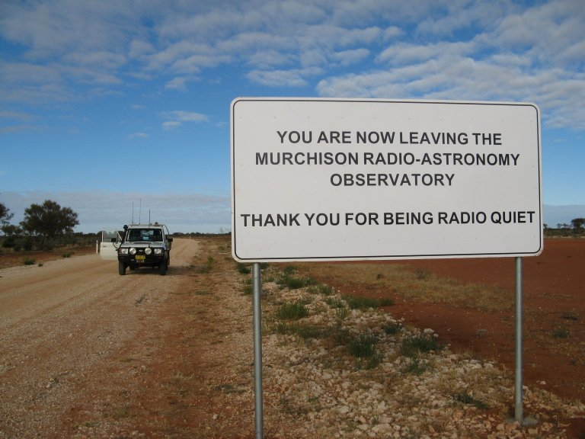
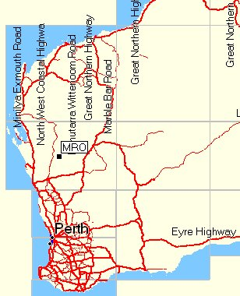
Western Australia
We acknowledge the Wajarri Yamaji people as the traditional owners of the ASKAP site

