Slide 1
Radio Galaxies: a) Are we having fun? b) A new schema for external medium interactions
Lawrence Rudnick,
Minnesota institute for astrophysics
EMU Int’l meeting, OCT 2019
With support from U.S. Nat’l Science Found., AST 17-14205

Slide 2
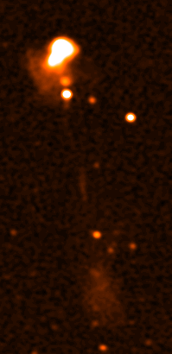
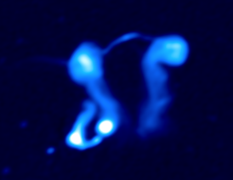
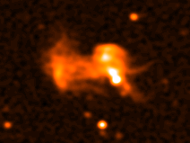
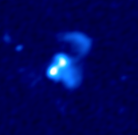
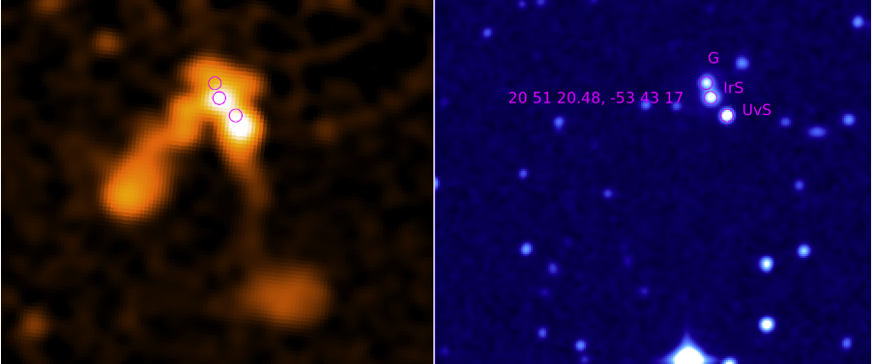
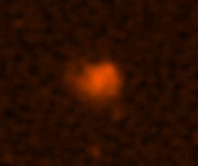
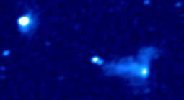
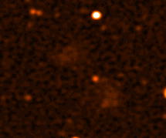
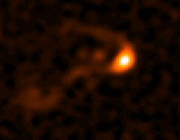
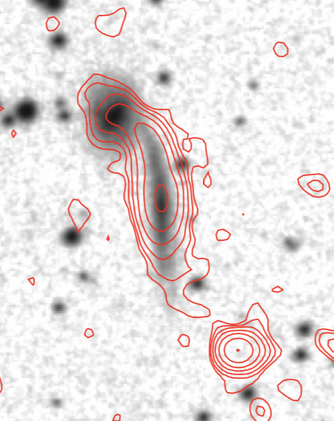
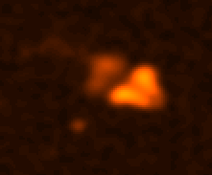
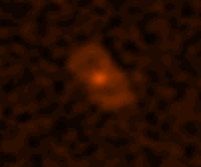
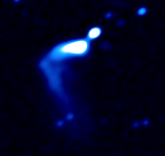
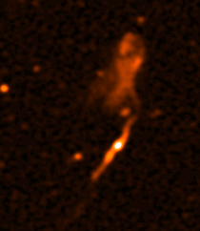
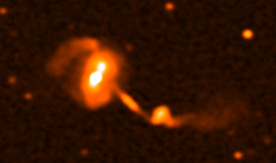
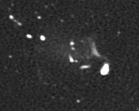
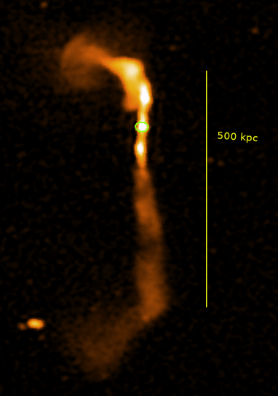
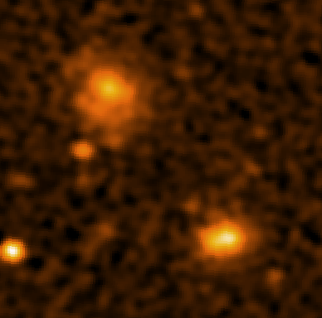
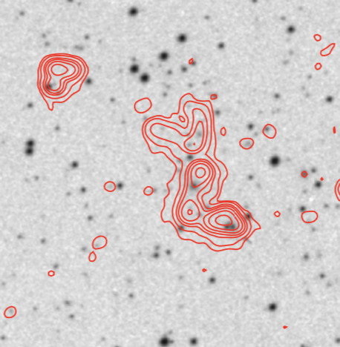
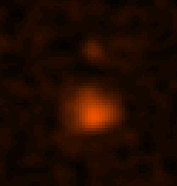
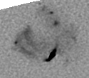
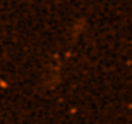
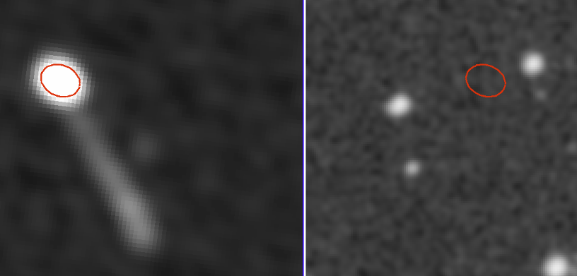

Slide 3
FUN I
FUN II
FUN III

Slide 4
FUN I: Unusual Sources
FUN II: Unusual Sources→ New physics

Slide 5
FUN I: Unusual Sources
SPT S-Z Cluster
Halo and Relic
FUN II: Unusual Sources→ New physics
Unique gradient in spectral index
Steepening away from relic

Slide 6
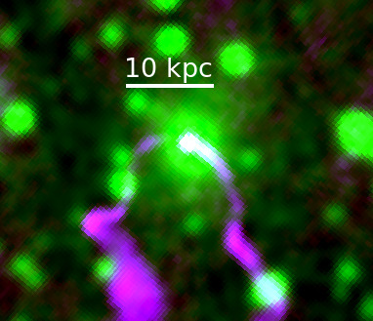
FUN I: Unusual Sources
VLASS Quick Look
500 kpc
FUN II: Unusual Sources→ New physics
How do you protect jet from bending
over 100s of kpc?

Slide 7
Radio Galaxies: b) A new schema for external medium interactions

Slide 8
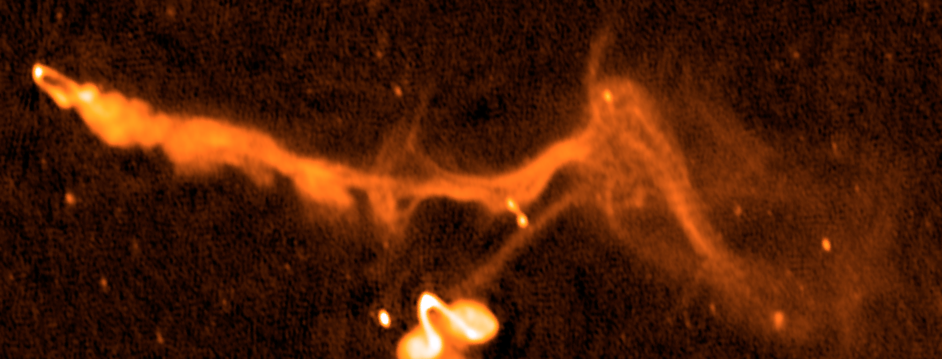
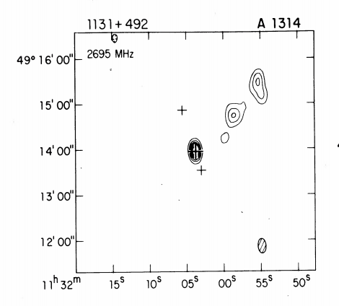
On the path to a richer view… E. Blanton, M. Bruggen, Gf. Brunetti,T. Clarke, J. Eilek, G. diGennaro,, S. Giancintucci, A. Garon, T. Jones, M. Lame'e, N. Miller, T. Mroczkowski, K. Nyland, R. Pizzo, S. Randall, H. Rottgering, L. Rudnick, C. Sarazin, R. vanWeeren
So after 40 years, it’s time to
move our brains…
Courtesy R. van Weeren

Slide 9
How do RADIO GALAXIES interact with the ICM?
Quasi-static pressure balance, uniform* ICM
Evolution in non-uniform, but static ICM
Interactions with a dynamic ICM
Interactions with ICM magnetic structures
Perturbations of the ICM by RGs
uniform* over scale of radio source

Slide 10
Quasi-static pressure balance in UNIFORM ICM
RELAXED RADIO STRUCTRES
Are there always X-ray cavities, not all visible?
What is the internal pressure budget of lobes?
Hercules A: Perley, Cotton, O’Dea & Baum → NASA

Slide 11
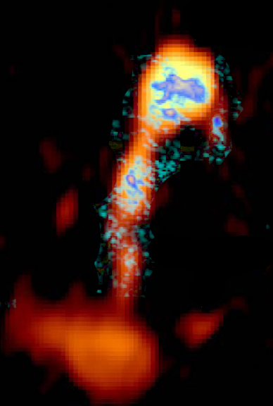
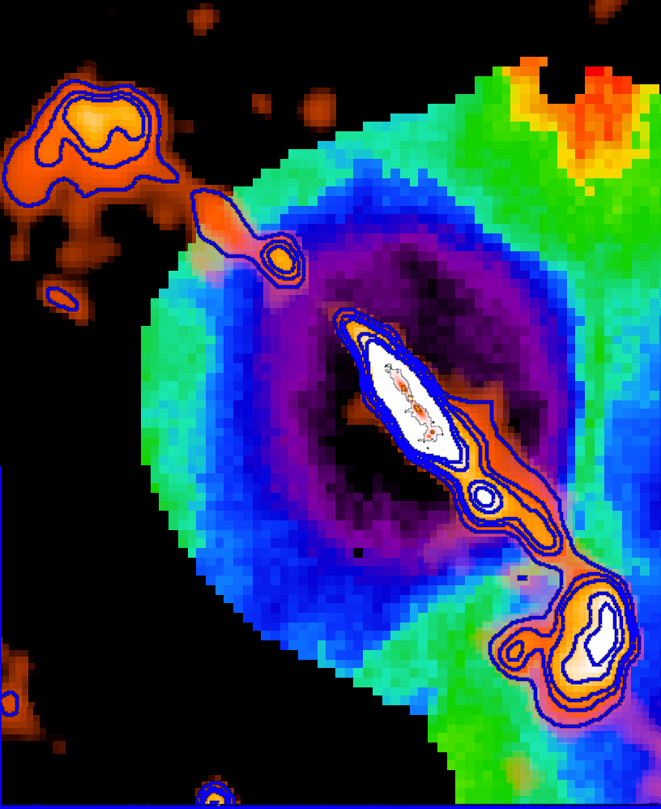
RG dynamics in Non-UNIFORM ICM
BUOYANCY DRIVEN FLOWs
Timescales for flow?
Stability?
Initial jet flow?
JET ENCOUNTER with CONTACT DISCONTINUITY
Special conditions?
Non-disruptive?
Abell 133, Randall+2010
X-ray temperature + radio TGSS
N7626, Randall+2013

Slide 12
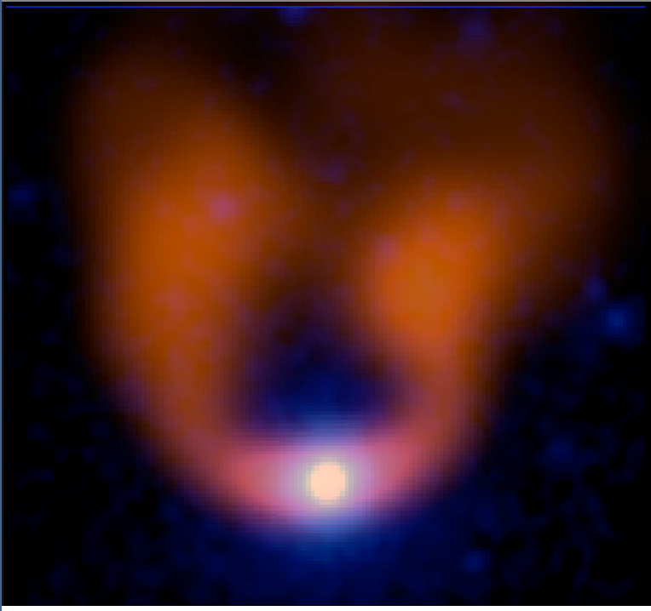
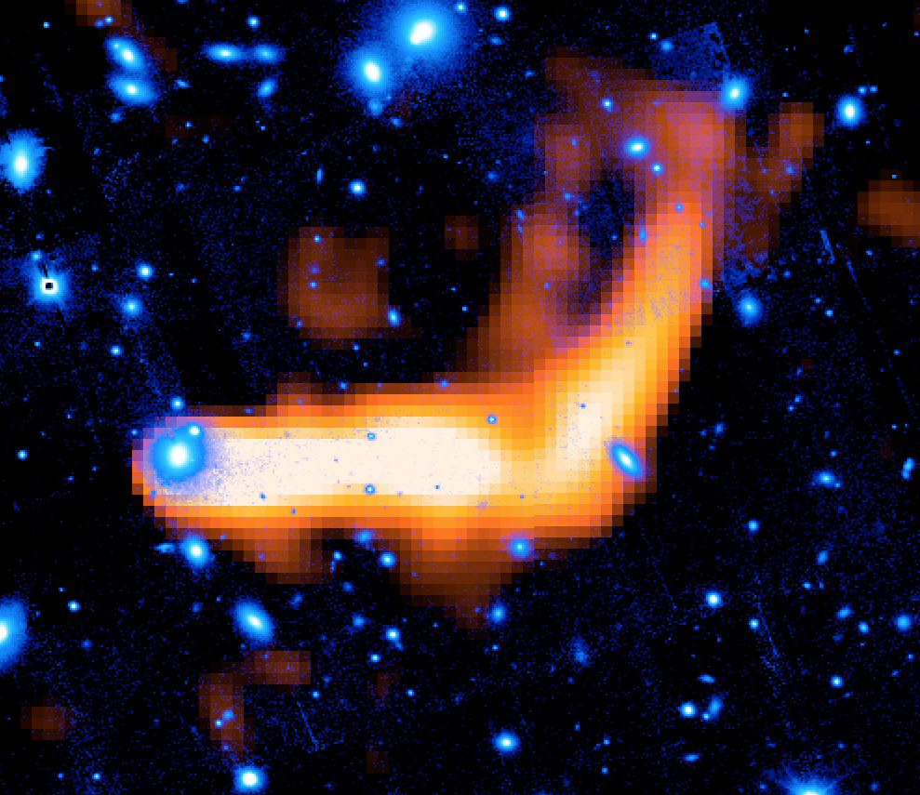
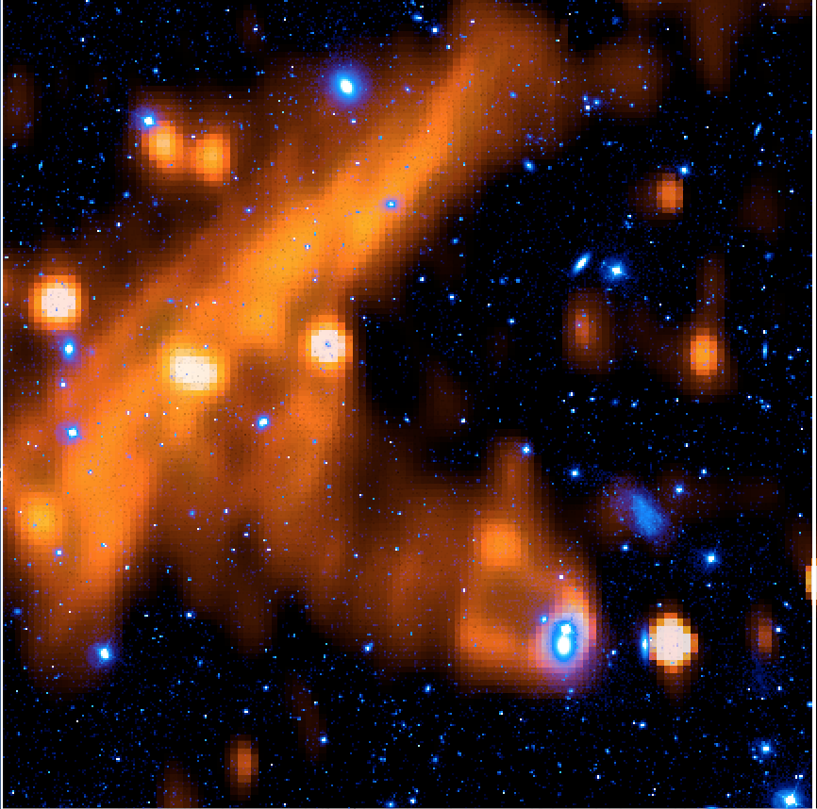
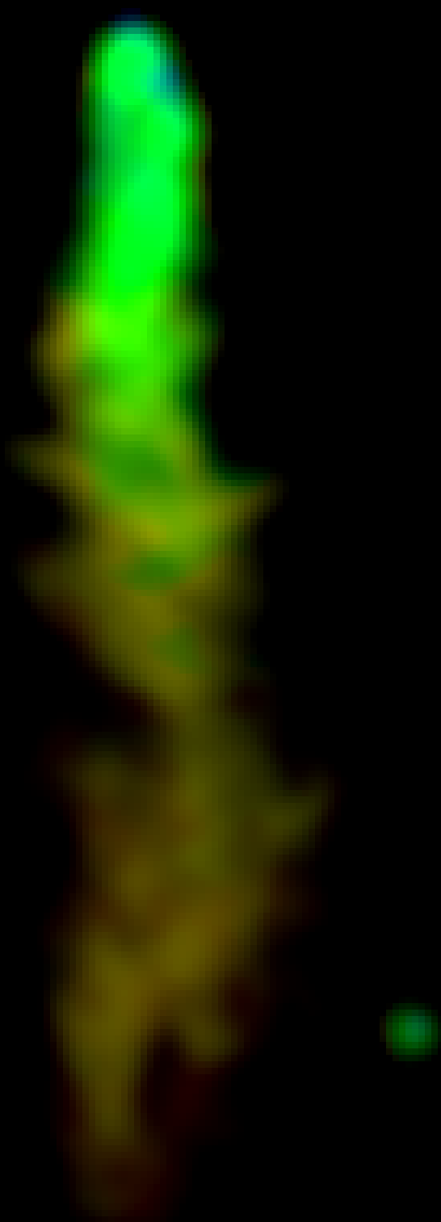
Interactions with a DYNAMIC ICM
SWEPT-BACK FLOW
A2256, Tail B; Owen+14
SHARP BENDS
Shear or turbulence
scales > length
NGC4869 Coma, TGSS +PanSTARRS
TRANSVERSE TERMINATIONs
Shock encounter
With tail?
NGC4789 Coma Brown & Rudnick 2011, PanSTARRSr
SMALL-SCALE RIPPLES
(width < Turbulence <length)
NGC4869 Coma, Neal Miller

Slide 13
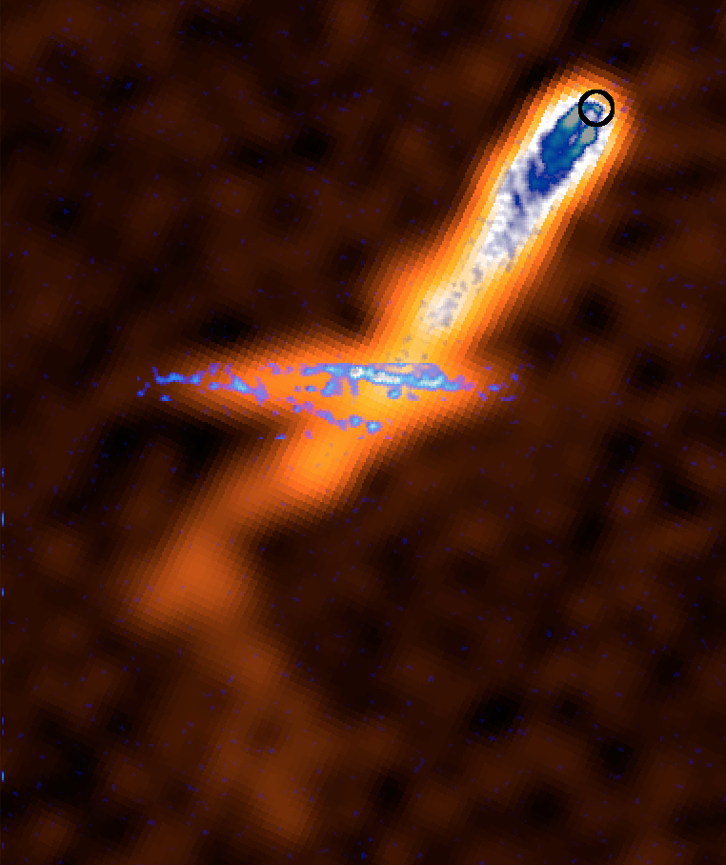
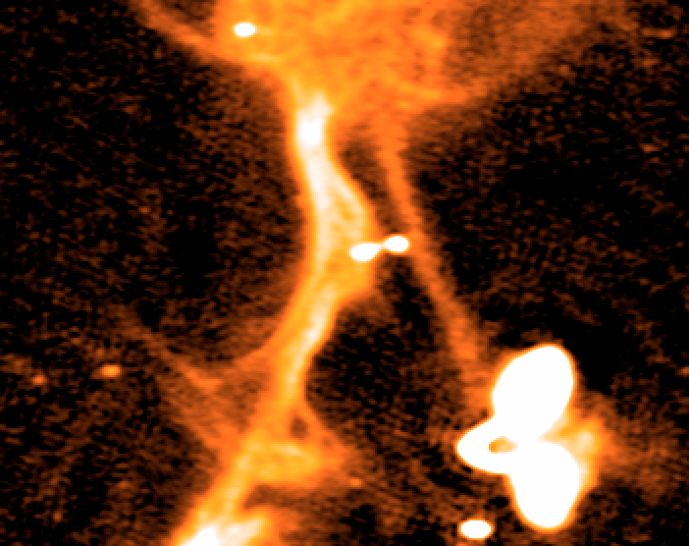
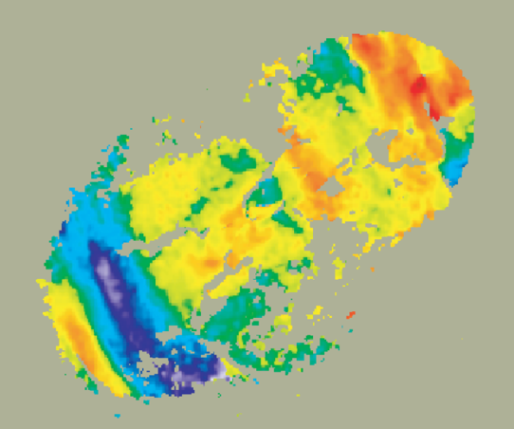
Interactions with ICM MAGNETIC STRUCTURES
SWEPT-BACK FIELDS
(RM structure)
0206+35, RM structure, Guidetti+2011
FILAMENTS gone WILD…
Magnetic filaments dragged, entrained in flow, ???
N. end of IC711, Abell 1314, Wilber+2019, courtesy RvW
CROSSING-BARS
ICM Magnetic filaments intersecting tail?
Tail B, Abell 2443, Clarke+2013

Slide 14
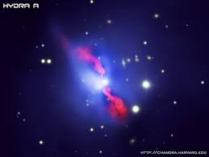
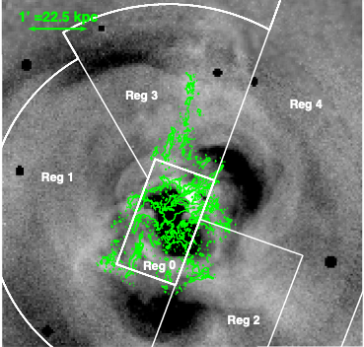
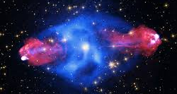
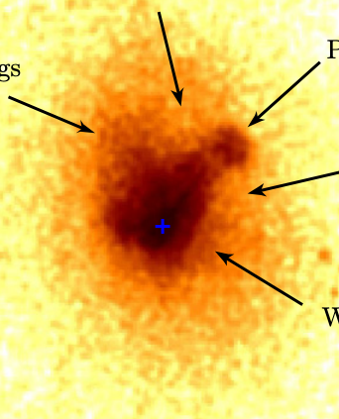
Perturbations of the ICM by RGs
RINGS and jets and hot spots in the ICM
Where to start?
Cygnus A. X-ray: NASA/CXC/SAO; Optical: NASA/STScI; Radio: NSF/NRAO/AUI/VLA
CAVITIES from RAM+ PRESSURE
Hydra A
BUOYANCY DRIVEN CAVITIES and LIFTING of COOL, METAL RICH
A133, Randall+2010; Perseus, Gendron-Marsolais+2018
X-ray: NASA/CXC/U.Waterloo/C.Kirkpatrick et al.;
Radio: NSF/NRAO/VLA;
Optical: Canada-France-Hawaii-Telescope/DSS

Slide 15
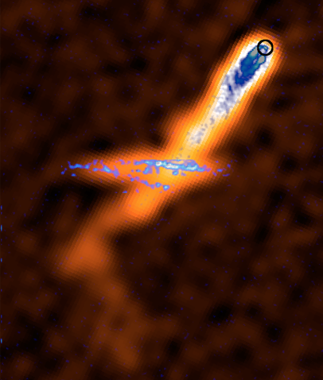
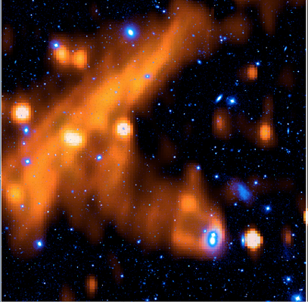
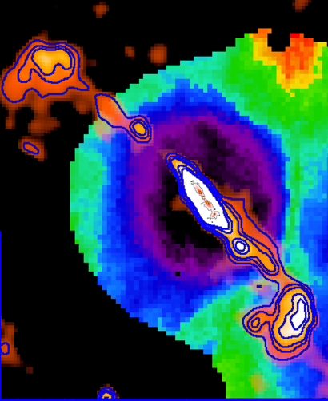
A CLOSER LOOK…

Slide 16
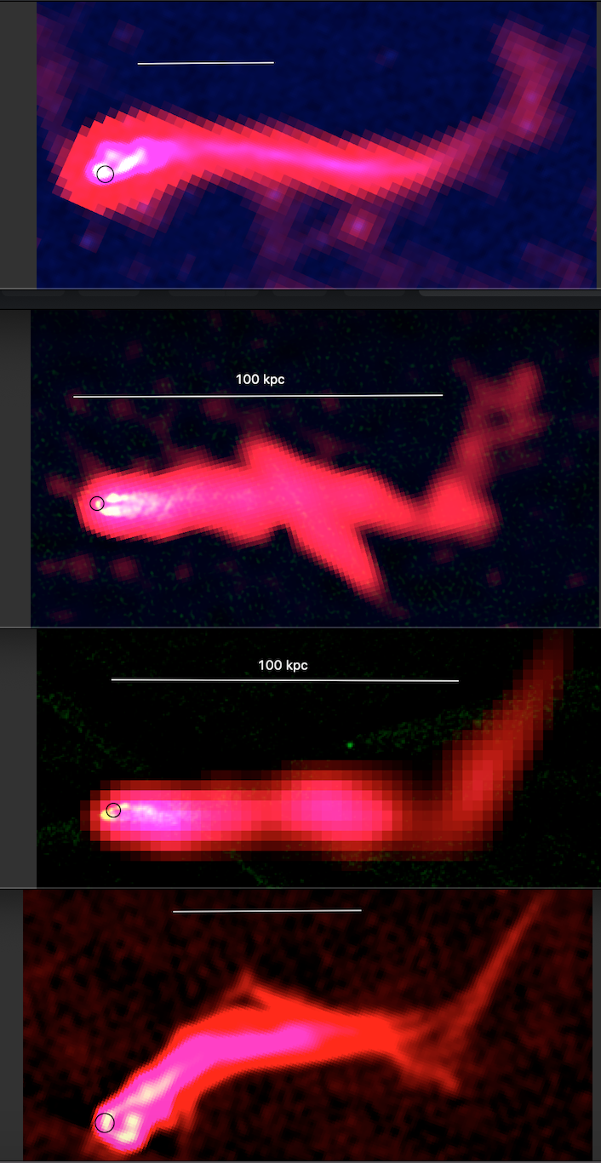
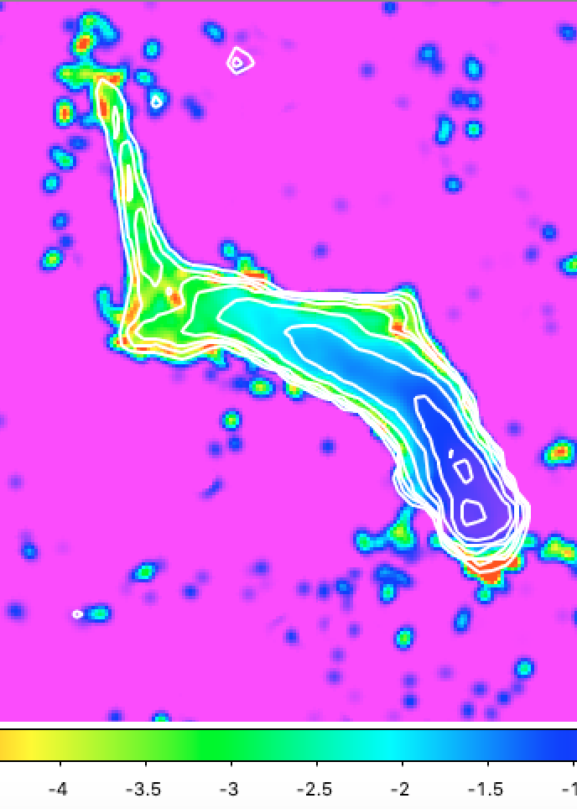
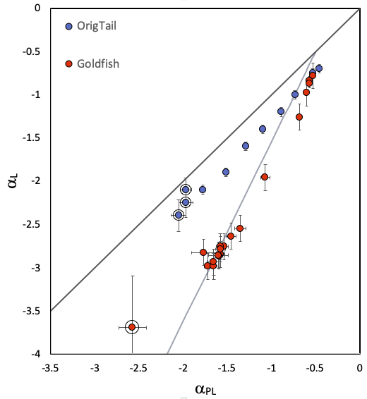
Sudden Bends

Slide 17
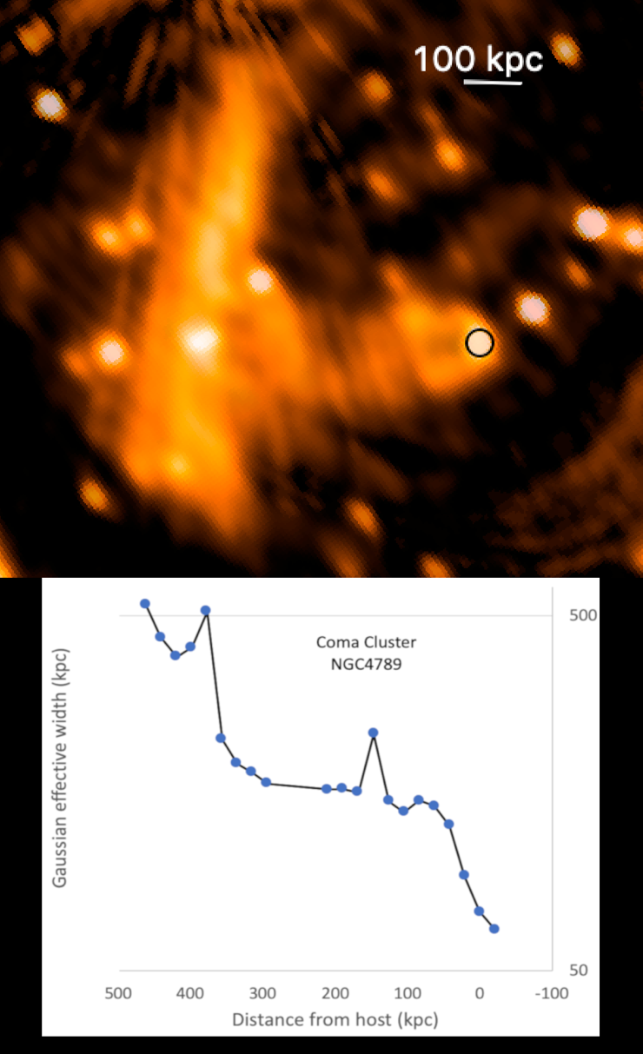
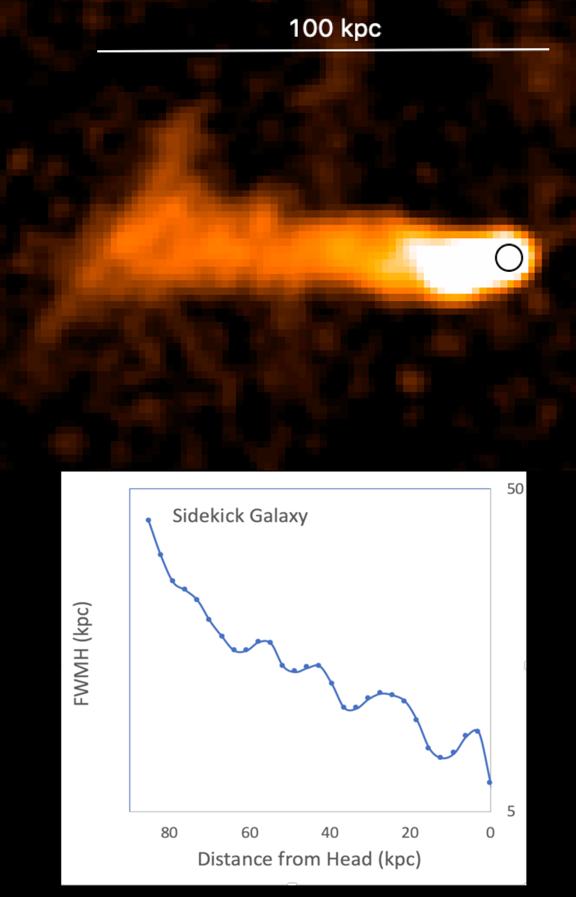
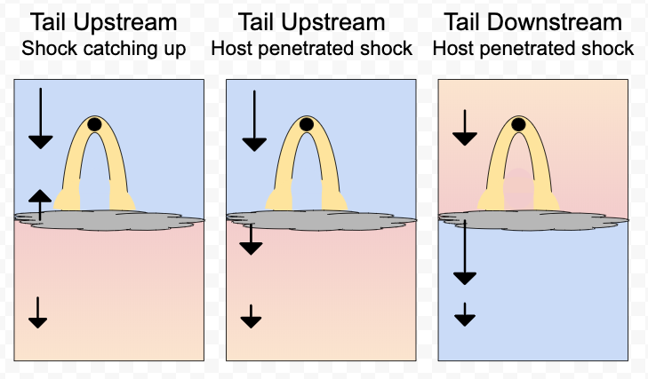
Shocks
Physics of the interaction?
Shocks? Or ?
Courtesy G. diGennaro, R. van Weeren

Slide 18
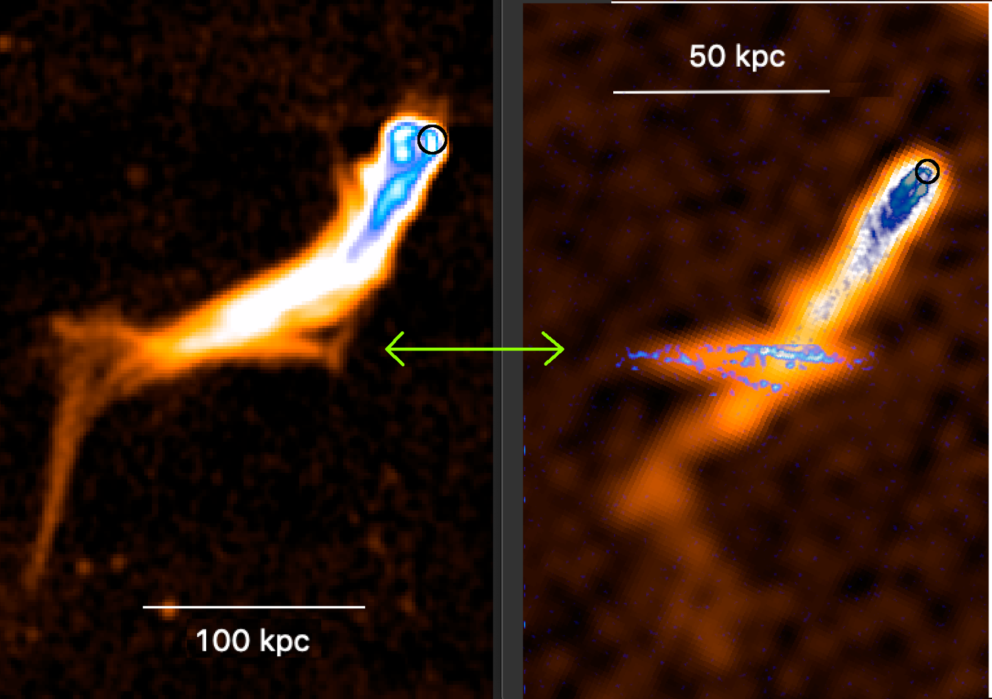
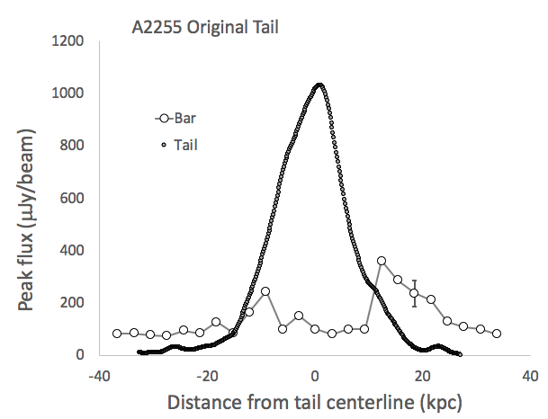
Magnetic Filaments, I
Tail doesn’t care about bar
Bar is brighter OUTSIDE of tail
Similar electron populations in bar and tail

Slide 19
Magnetic Filaments, II
Courtesy R. van Weeren

Slide 20
It’s a RICH NEW WORLD! Lots to learn! About RGs & ICM

